Slide 1
Talking about activities and events
Montag
Freitag
Dienstag
Samstag
Mittwoch
Sonntag
Donnerstag
rot
Follow ups 1-5
Term 3 Week 1
Notes:
Artwork by Steve Clarke. Pronoun pictures from NCELP (www.ncelp.org). All additional pictures selected from Pixabay and are available under a Creative Commons license, no attribution required.
Phonics: [v] vier [200] vergessen [584] Vater [232] positiv [516] viel [56]
Vocabulary: Montag [1044] Dienstag [1356] Mittwoch [1187] Donnerstag [1244] Freitag [981] Samstag [1112] Sonntag [804] Tag [111] Woche [219] heute [116] morgen [752]
Revisit 1: gewinnen [372] hören [146] machen [58] zu Hause [n/a]
Revisit 2: Frau [99] Herr [154] Lehrer, Lehrerin [695] Mann [121] sehr [81]
Jones, R.L & Tschirner, E. (2019). A frequency dictionary of German: Core vocabulary for learners. London: Routledge.
The frequency rankings for words that occur in this PowerPoint which have been previously introduced in these resources are given in the SOW and in the resources that first
introduced and formally re-visited those words.
For any other words that occur incidentally in this PowerPoint, frequency rankings will be provided in the notes field wherever possible.

Slide 2
aussprechen
[v]
…
The German [v] sounds very like the English [f] sound.
vier
Notes:
Timing: 1 minute
Aim: to introduce the SSC [v].
Procedure:
Introduce the SSC and present the source word ‘vier’ (with gesture, if using).
Click to bring on the picture and get pupils to repeat the word ‘vier’ (with gesture, if using).
Note:
a gesture for ‘vier’ might be to hold 4 fingers up.
2

Slide 3
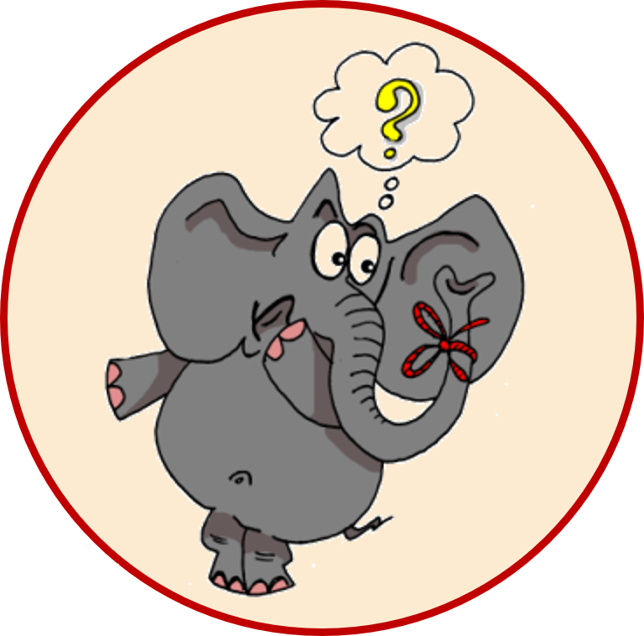
aussprechen
[v]
…
vergessen
Vater
vier
4
[to forget]
positiv
viel
[a lot, much]
Notes:
Timing: 1 minute
Aim: to consolidate the SSC [v].
Procedure:
Re-present the SSC and the source word ‘vier’ (with gesture, if using).
Click to bring on the picture and get pupils to repeat the word ‘vier’ (with gesture, if using).
Present the cluster words in the same way, bringing on the picture and getting pupils to pronounce the words.
Frequency:
vier [200] vergessen [584] Vater [232] positiv [516] viel [56]
Jones, R.L & Tschirner, E. (2019). A frequency dictionary of German: Core vocabulary for learners. London: Routledge.

Slide 4
aussprechen
[w]
Remember: A German [w] sounds like an English [v].
…
Wasser
Antwort
Welt
wahr
gewinnen
Notes:
Timing: 1 minute
Aim: to revise the SSC [W] before contrasting it with the new SSC [V]
Procedure:
Re-present the SSC and the source word ‘Welt’ (with gesture, if using).
Click to bring on the picture and get pupils to repeat the word ‘Welt’ (with gesture, if using).
Present the cluster words in the same way, bringing on the picture and getting pupils to pronounce the words.
Vocabulary: Antwort [522] gewinnen [372] wahr [737] Wasser [245] Welt [164]
Jones, R.L & Tschirner, E. (2019). A frequency dictionary of German: Core vocabulary for learners. London: Routledge.

Slide 5
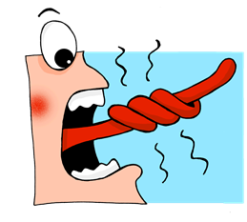
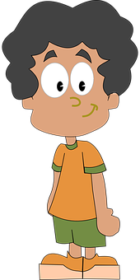
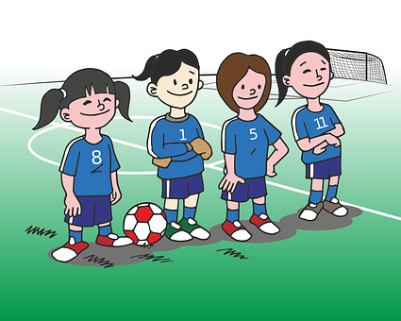
Follow up 1
Can you separate the words in the sentences, spot the [v] sounds and say the tongue-twisters?
lesen
Felix findet viele Finger am Freitag.
1
FelixfindetvieleFingeramFreitag.
Felix finds lots of fingers on Friday.
Vier feine Vögel machen Fotos von fünf feinen Fischen.
2
VierfeineVögelmachenFotosvonfünffeinenFischen.
Four fine birds take photos of five fine fish.
Ferdinand und Freunde vergessen vier volle Fußball Flaschen.
3
FerdinandundFreundevergessenviervolleFußballFlaschen.
Ferdinand and friends forget four full football bottles .
Notes:
Timing: 5 minutes
Aim: to practise written recognition of the [v] sound and to practise decoding at sentence level; to use cognates and known words to infer meaning of sentences.
Procedure:
Pupils work as pairs and then as a whole class to work out where one word ends and another starts.
Pupils then focus on the [v] sound and find the examples in the sentences.
Click to bring on sentences one by one with the [v] sounds highlighted and the words separated.
Discuss meanings of tongue-twister sentences (using picture prompts to help) and then show English translations.
Click to listen to the tongue twisters said by a native speaker at three different speeds: slow, medium, fast. Draw their attention to the fact that [f] and [v] sound the same here.
Give pupils time to practise saying them at whatever speed they can manage! Important to maintain clear pronunciation.
Word frequency:
finden [103] Finger [1019] am [616] fein [1676] Vogel [1701] von [9] Fisch [1959] vergessen [584] voll [388]

Slide 6
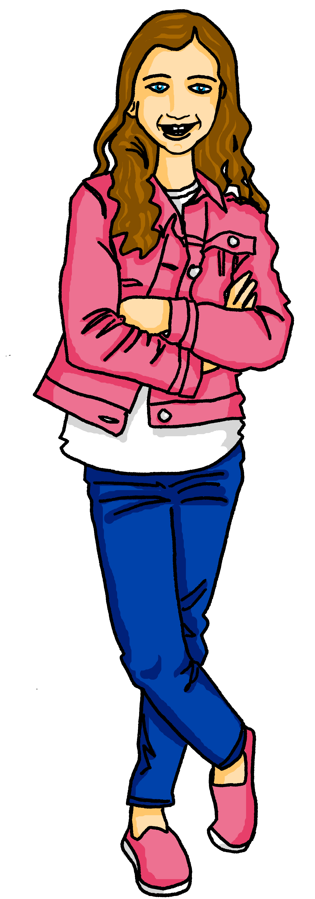
Follow up 2
Hör zu!
Moritz is practising his English. Johanna is describing her weekly activities in German.
Help Moritz to identify what day of the week it is in English.
Listen again and help Moritz note down the activity Johanna is doing each day.
1
2
3
4
5
6
7
Make a picture
Monday
Learn in school
Friday
Make a present
4
3
6
Take photos
Win a match
Tuesday
Saturday
7
Play
tennis
Here Johanna said: ‘morgen ist Sonntag’= tomorrow is Sunday.
Play
football
Sing at home
5
Wednesday
Sunday
2
Play music
1
Thursday
Listen to music
Notes:
Timing:10 minutes
Aim: to practise aural recognition of the days of the week and new vocab (morgen, heute) and to revise some key verbs and vocabulary from previous weeks.
Procedure:
Explain the scenario. Moritz is practising his English. Johanna is saying the day of the week in German, and he must find the correct day in English and circle it. She then says an activity she does on that day, and Moritz has to translate it into English.
Pupils write down numbers 1-7,
Play audio 1-7 and ask pupils to write down the day of the week in English for each item.
Click to show the answers on the board. Item 7 is tricky as pupils need to recognise the word ‘morgen’.
Play items 1-7 again, and this time ask pupils to jot down the activity in English.
Click to bring up Moritz’ answers. Has he translated everything correctly or do the pupils disagree?
Click again to bring up the 3 answers Moritz got partially wrong (in green).
Transcript:
Es ist Donnerstag. Ich höre Musik.
Heute ist Sonntag. Ich singe zu Hause.
Es ist Freitag. Ich mache ein Bild.
Heute ist Montag. Ich lerne in der Schule.
Es ist Mittwoch. Ich spiele Fußball.
Heute is Dienstag. Ich mache Fotos.
Morgen ist Sonntag! Heute gewinne ich ein Spiel.

Slide 7
Follow up 3
Schreib auf Deutsch und auf Englisch.
A Write the missing days of the week.
lesen
C Translate the sentences into English.
 | heute | morgen
1 |  | Mittwoch
2 | Sonntag
3 |  | Freitag
4 | Freitag
5 |  | Sonntag
1. | Heute ist Donnerstag.
2. | Morgen ist Samstag.
3. | Mein Lieblingstag ist Sonntag.
4. | Ist heute Dienstag oder Mittwoch?
Dienstag
Today is Thursday.
Montag
Tomorrow is Saturday.
Donnerstag
Samstag
My favourite day is Sunday.
Samstag
Is today Tuesday or Wednesday?
B
Write the days of the week in order.
Mittwoch
Donnerstag
Sonntag
Montag
Dienstag
Samstag
Freitag
Notes:
Timing: 5-10 minutes
Handout (optional) at end of presentation.
Aim: to consolidate written recognition and recall of the days of the week and other new vocab this week.
Procedure:
Recap meanings of heute (today) and morgen (tomorrow) and then ask pupils to fill in the missing days of the week in table A.
Click to bring up the answers.
Ask pupils to write the days of the week in order on the caterpillar. Pupils could turn away from the board to practise spelling from memory.
Click to bring up answers.
Ask pupils to translate the 4 sentences in C into English. Click to bring up translations.
Additional task suggestions: 1. Pupils could begin to write their own sentences in German using the days of the week and the example sentences here e.g. Mein Lieblingstag ist…/ Heute ist…
More able pupils could also add an activity they do e.g. Heute ist Mittwoch. Ich höre Musik or someone else does e.g. Heute ist Donnerstag. Ellis spielt Tennis.

Slide 8
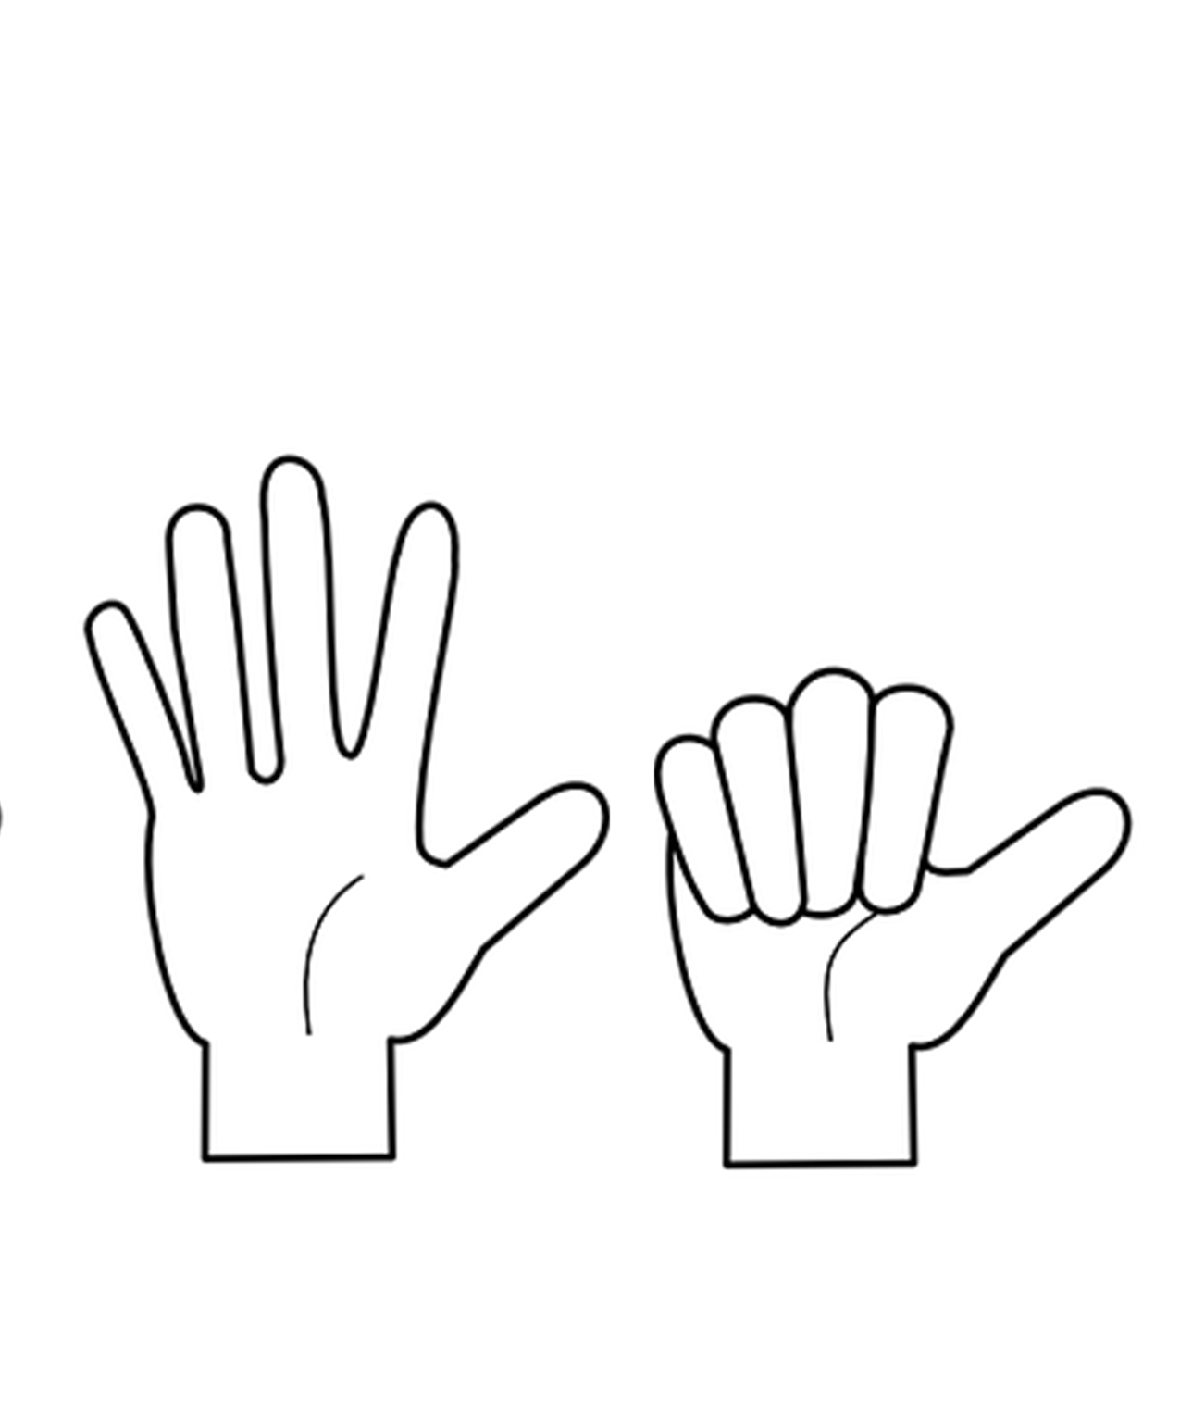
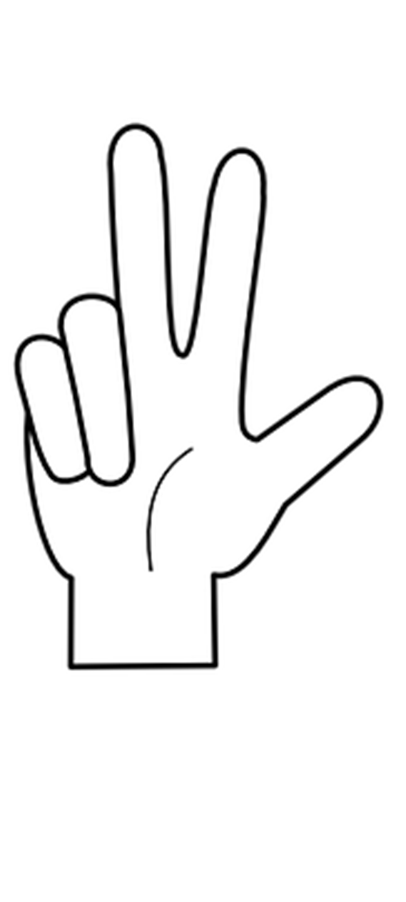
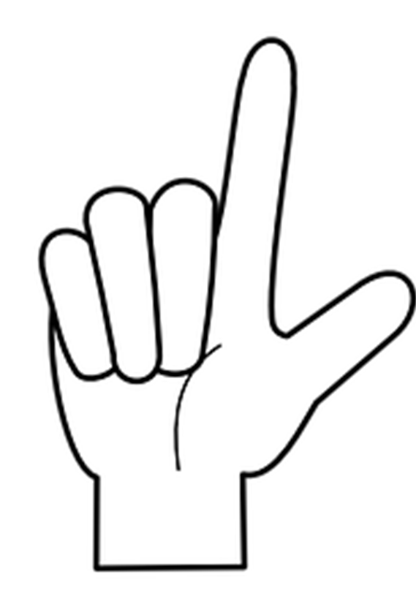
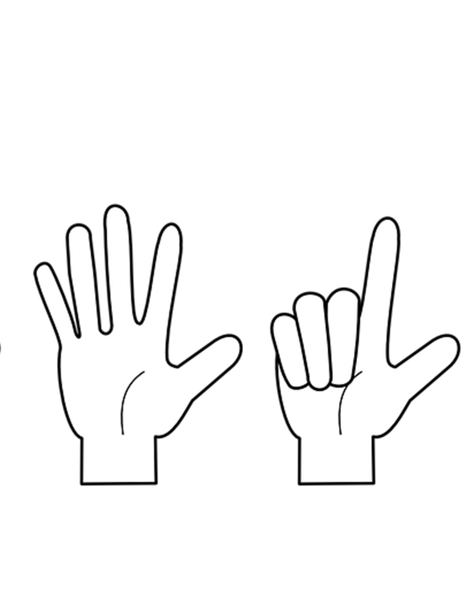
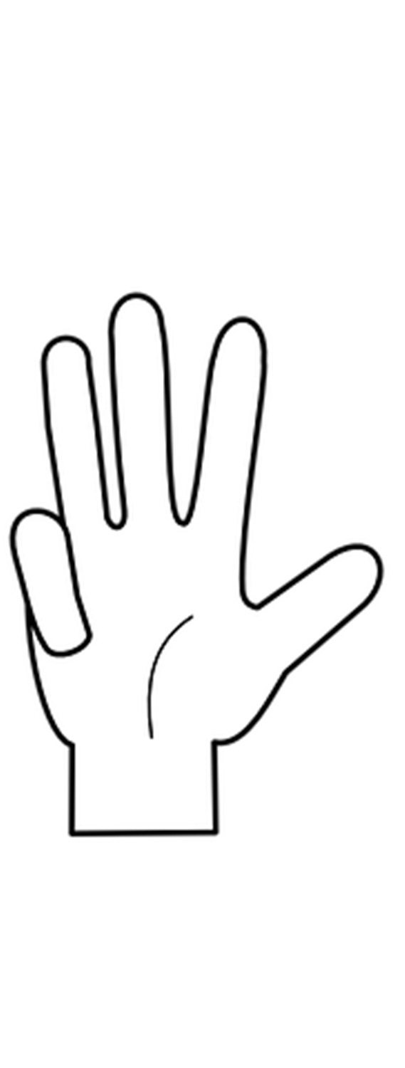
Follow up 4a Read the days aloud in the correct order.
…
Sag die Tage!
sprechen
60
Mittwoch
Samstag
Dienstag
S
Freitag
Montag
0
Sonntag
Donnerstag
START
Notes:
Timing: 2 minutes
Aim: to consolidate days of the week (in combination with hand gestures to embed meaning).
Procedure:
Read the instruction.
In pairs, ask pupils to read the days of the week in the correct order.
Click “Start” to trigger 30-second timer.
Go to next slide for answers.

Slide 9
Follow up 4a
…
Sag die Tage.
Dienstag
Freitag
sprechen
Samstag
Donnerstag
60
Montag
Mittwoch
Sonntag
S
Montag
Dienstag
Mittwoch
Donnerstag
0
Freitag
Samstag
START
Sonntag
Notes:
ANSWERS Procedure:
Click to make the days disappear in the correct order and click again to bring up the correct answer with image.
Click again to make all of the answers disappear and bring back the jumbled days.
Click “Start” to trigger 30-second timer. Pupils practise one more time saying all of the days in the correct order.

Slide 10
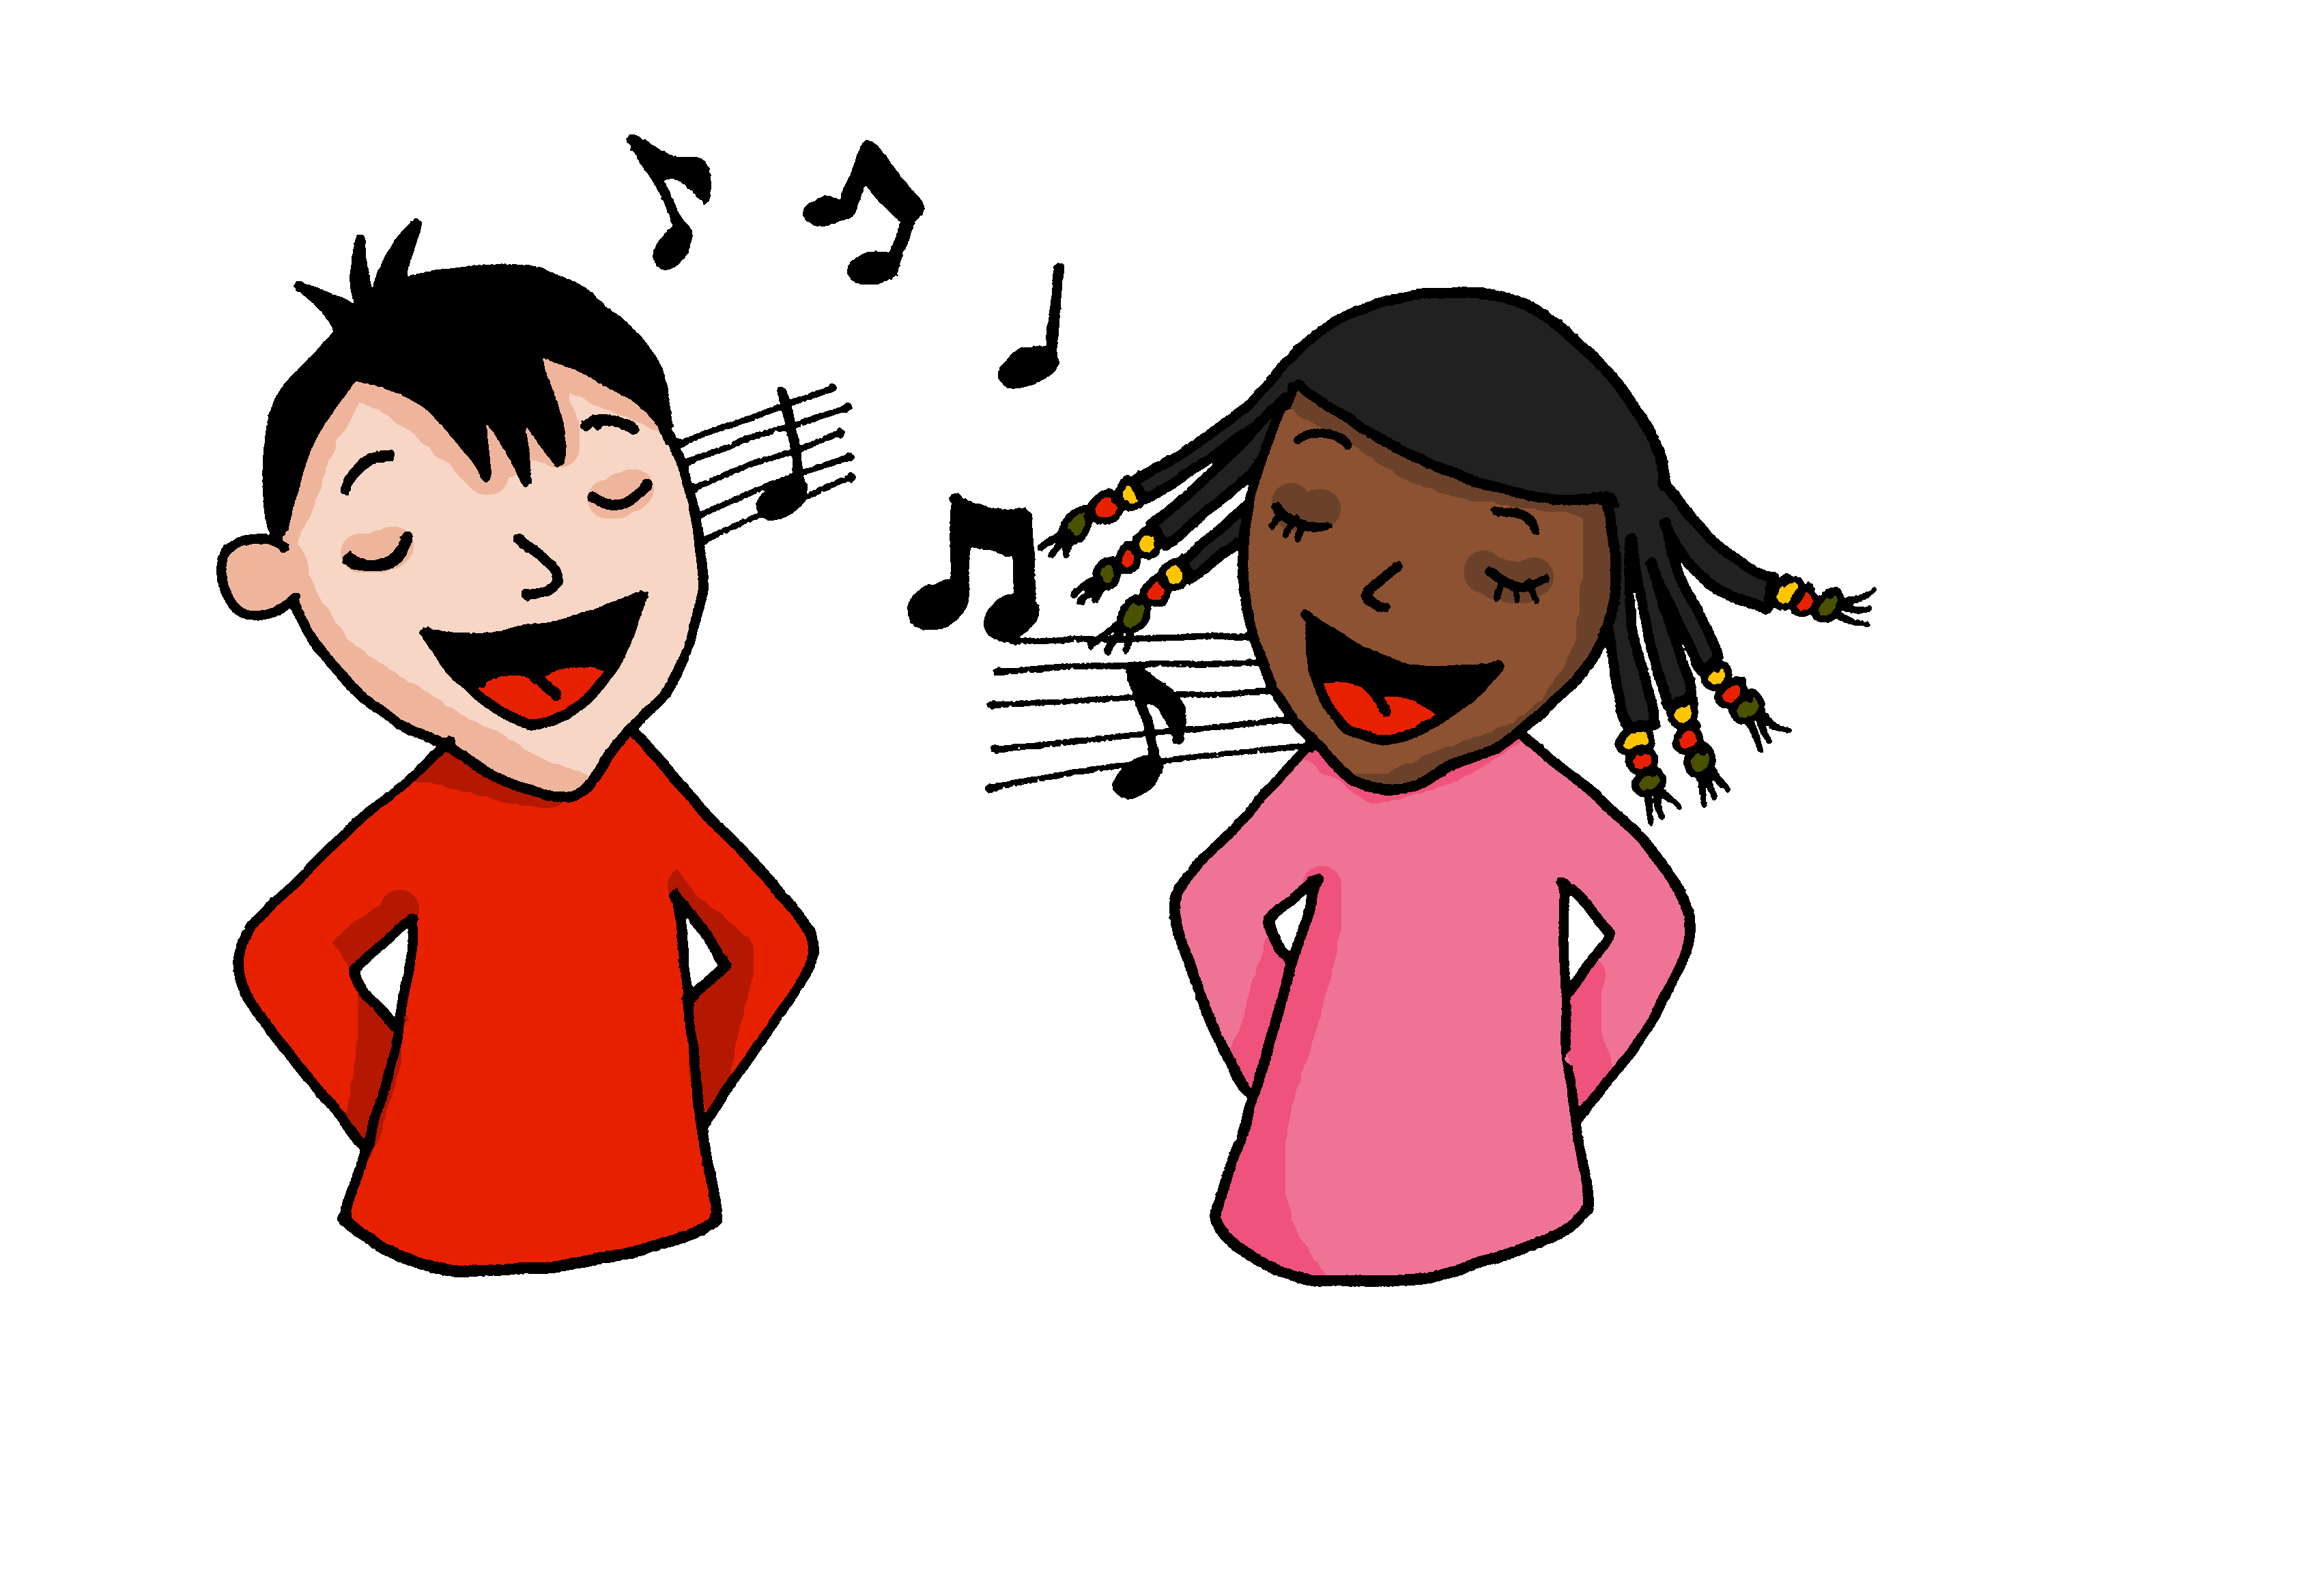
Die Wochentage!
singen
Sing mit!
Notes:
OPTIONAL
Timing: 5 minutes
Aim: to practise oral production of the days of the week (in a song that constrains the time and helps to speed up production).
Procedure:
Click to play the song.
Encourage pupils to join in when they can.
Link to song:
https://www.youtube.com/watch?v=RjlfcpVBBNw
Notes: i) the song is just the days (repeated over and over) but the tune is catchy after a while and the harmonies make it not unpleasant to listen to, despite the minion-type voices!
ii) we recommend opening the link in a separate window just prior to the start of the lesson and playing through the adverts, leaving the song paused at the start ready to go, when needed.

Slide 11
Follow up 5:

Schreib auf Englisch.
Can you get at least 15 points?
Wörter
 | sehr | der Lehrer | die Lehrerin
 | Herr | der Mann | die Frau
 | gewinnen | die Woche | hören
 | der Tag | zu Hause | machen
 | Montag | Donnerstag | Sonntag
 | morgen | Mittwoch | Freitag
 | Dienstag | Samstag | heute
very
(the) [male] teacher
(the) [female] teacher
Vokabeln
x3
Mr
(the) man
(the) woman, Mrs, Ms.
to win, winning
(the) week
to listen, listening
x2
(the) day
at home
to do, make
Monday
Thursday
Sunday
tomorrow
Wednesday
Friday
x1
Tuesday
Saturday
today
Notes:
Timing: 5 minutes
Aim: to practise written comprehension of vocabulary from this and revisited weeks.
Procedure: 1. Give pupils a blank grid. They fill in the English meanings of any of the words they know, trying to reach 15 points in total.
Note: The most recently learnt and practised words are pink, words from the previous week are green and those from earlier weeks are blue, thus more points are awarded for them, to recognise that memories fade and more effort (heavy lifting!) is needed to retrieve them.

Slide 12
Follow up 5:

Schreib auf Deutsch.
Can you get at least 15 points?
Wörter
 | (the) [female] teacher | (the) Mann | very
 | (the) woman, Mrs, Ms | Mr | (the) [male] teacher
 | to listen, listening | to do, make | at home
 | to win, winning | (the) day | (the) week
 | Sunday | today | tomorrow
 | Thursday | Friday | Saturday
 | Monday | Tuesday | Wednesday
die Lehrerin
der Mann
sehr
Vokabeln
x3
die Frau
Herr
der Lehrer
hören
machen
zu Hause
x2
gewinnen
der Tag
die Woche
Sonntag
heute
morgen
Donnerstag
Freitag
Samstag
x1
Montag
Dienstag
Mittwoch
Notes:
Timing: 5 minutes
Aim: to practise written production of vocabulary from this and revisited weeks.
Procedure: 1. Give pupils a blank grid. They fill in the German meanings of any of the words they know, trying to reach 15 points in total.
Note: The most recently learnt and practised words are pink, words from the previous week are green and those from further back are blue, thus more points are awarded for them, to recognise that memories fade and more effort (heavy lifting!) is needed to retrieve them.

Slide 13
Tschüss!
rot
Notes:
13

Slide 14
Follow up 3
Schreib auf Deutsch und auf Englisch.
A Write the missing days of the week.
C Translate the sentences into English.
 | heute | morgen
1 |  | Mittwoch
2 | Sonntag
3 |  | Freitag
4 | Freitag
5 |  | Sonntag
1. | Heute ist Donnerstag.
2. | Morgen ist Samstag.
3. | Mein Lieblingstag ist Sonntag.
4. | Ist heute Dienstag oder Mittwoch?
B
Write the days of the week in order.
Montag
Notes:
HANDOUT

Slide 15
Follow up 5:

Schreib auf Englisch.
Can you get at least 15 points?
Wörter
 | sehr | der Lehrer | die Lehrerin
 | Herr | der Mann | die Frau
 | gewinnen | die Woche | hören
 | der Tag | zu Hause | machen
 | Montag | Donnerstag | Sonntag
 | morgen | Mittwoch | Freitag
 | Dienstag | Samstag | heute
Vokabeln
x3
x2
x1
Notes:
HANDOUT

Slide 16
Follow up 5:

Schreib auf Deutsch.
Can you get at least 15 points?
Wörter
 | (the) [female] teacher | (the) Mann | very
 | (the) woman, Mrs, Ms | Mr | (the) [male] teacher
 | to listen, listening | to do, make | at home
 | to win, winning | (the) day | (the) week
 | Sunday | today | tomorrow
 | Thursday | Friday | Saturday
 | Monday | Tuesday | Wednesday
Vokabeln
x3
x2
x1
Notes:
HANDOUT

