Slide 1
Talking about activities and events
Montag
Freitag
Dienstag
Samstag
Mittwoch
Sonntag
Donnerstag
rot
Days of the week
SSC [v]
Term 3 Week 1
Notes:
Artwork by Steve Clarke. Pronoun pictures from NCELP (www.ncelp.org). All additional pictures selected from Pixabay and are available under a Creative Commons license, no attribution required.
Phonics: [v] vier [200] vergessen [584] Vater [232] positiv [516] viel [56]
Vocabulary: Montag [1044] Dienstag [1356] Mittwoch [1187] Donnerstag [1244] Freitag [981] Samstag [1112] Sonntag [804] Tag [111] Woche [219] heute [116] morgen [752]
Revisit 1: gewinnen [372] hören [146] machen [58] zu Hause [n/a]
Revisit 2: Frau [99] Herr [154] Lehrer, Lehrerin [695] Mann [121] sehr [81]
Jones, R.L & Tschirner, E. (2019). A frequency dictionary of German: Core vocabulary for learners. London: Routledge.
The frequency rankings for words that occur in this PowerPoint which have been previously introduced in these resources are given in the SOW and in the resources that first
introduced and formally re-visited those words.
For any other words that occur incidentally in this PowerPoint, frequency rankings will be provided in the notes field wherever possible.
Note that the first three lessons of the year teach language that can be continuously recycled as lesson routine every lesson in Y3/4.
The idea would be that the class teacher (whether or not s/he teaches the class German can re-use the language as part of the daily routine with the class.
1

Slide 2
Guten Tag, die Klasse!
hören
sprechen
lesen
schreiben
Notes:
Timing: 1 minute
Aim: to revise four infinitive verbs as part of essential classroom language.
Procedure:
Say Guten Tag, die Klasse and prompt pupils to say the infintives and their English meaning.
Elicit pronunciation and word knowledge orally by prompting in English. (e.g. ‘Lesen’ – ‘to read, reading’. ‘Gut. Sprechen?...).

Slide 3
aussprechen
[v]
…
The German [v] sounds very like the English [f] sound.
vier
Notes:
Timing: 1 minute
Aim: to introduce the SSC [v].
Procedure:
Introduce the SSC and present the source word ‘vier’ (with gesture, if using).
Click to bring on the picture and get pupils to repeat the word ‘vier’ (with gesture, if using).
Note:
a gesture for ‘vier’ might be to hold 4 fingers up.
3

Slide 4
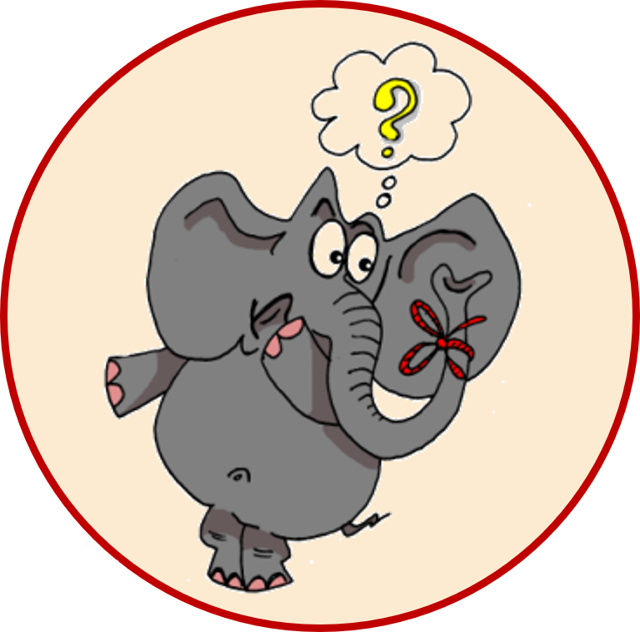
aussprechen
[v]
…
vergessen
Vater
vier
4
[to forget]
positiv
viel
[a lot, much]
Notes:
Timing: 1 minute
Aim: to consolidate the SSC [v].
Procedure:
Re-present the SSC and the source word ‘vier’ (with gesture, if using).
Click to bring on the picture and get pupils to repeat the word ‘vier’ (with gesture, if using).
Present the cluster words in the same way, bringing on the picture and getting pupils to pronounce the words.
Frequency:
vier [200] vergessen [584] Vater [232] positiv [516] viel [56]
Jones, R.L & Tschirner, E. (2019). A frequency dictionary of German: Core vocabulary for learners. London: Routledge.

Slide 5
aussprechen
[w]
Remember: A German [w] sounds like an English [v].
…
Wasser
Antwort
Welt
wahr
gewinnen
Notes:
Timing: 1 minute
Aim: to revise the SSC [W] before contrasting it with the new SSC [V]
Procedure:
Re-present the SSC and the source word ‘Welt’ (with gesture, if using).
Click to bring on the picture and get pupils to repeat the word ‘Welt’ (with gesture, if using).
Present the cluster words in the same way, bringing on the picture and getting pupils to pronounce the words.
Vocabulary: Antwort [522] gewinnen [372] wahr [737] Wasser [245] Welt [164]
Jones, R.L & Tschirner, E. (2019). A frequency dictionary of German: Core vocabulary for learners. London: Routledge.

Slide 6
[v]
Comparing [v] and [w]
Hör zu. Ist das [v] oder [w]?
Write numbers 1-8. Listen and note down the missing sound in each word.
 | [v] oder [w]? | English?
1 | W e t t e r | [weather]
2 | V e t t e r | [cousin]
3 | V i e h | [cattle]
4 | w i e | [how]
5 | w a r m | [warm]
6 | V o g e l | [bird]
7 | n e g a t i v | [negative]
8 | V o l k s w a g e n | [‘people’s car’]
?
?
?
?
Notice that some words look very like the English but sound quite different!
?
?
?
?
?
Notes:
Timing: 5 minutes
Aim: to consolidate aural recognition of the SSC [V] by contrasting it with the SSC [W].
Procedure:
1. Pupils write down numbers 1-8 and will write [v] or [w] or both for each item.
2. Play the audio by pressing the buttons 1-8.
3. Elicit answers and click to reveal missing letter(s).
4. Discuss meanings of 8 words and click to reveal English definitions one by one. Draw attention to the fact some words look like the English e.g. warm, Wetter, negativ but sound different. Encourage pupils to pronounce all of the words.
NOTE: Pupils may already have some idea how to pronounce Volkswagen, but encourage them to have a go with their new knowledge about pronunciation of [v] and [w].
Transcript:
Wetter
Vetter
Vieh
wie
warm
Vogel
negativ
Volkswagen
Word frequency:
Wetter [1881] Vetter [N/A ] Vieh [N/A ] wie [25] warm [1281] Vogel [1701] negativ [817] Volkswagen [N/A]
Jones, R.L & Tschirner, E. (2019). A frequency dictionary of German: Core vocabulary for learners. London: Routledge.

Slide 7
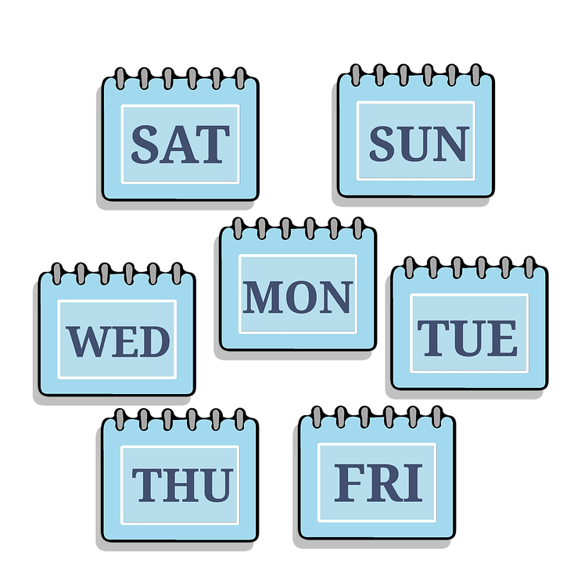
Vokabeln
Vokabeln lernen
Wörter
Sag die Wörter.
der Tag
heute
[day]
[today]
die Woche
morgen
[week]
Notes:
Timing: 2 minutes
Aim: to present and practise 4 new items of vocabulary for this week.
Procedure:
Click for each new word to appear, then again for the supporting picture and English to appear. Explain that today pupils will be learning days of the week, and they will see the words ‘Tag’ and ‘Woche’ appear in them.
Practise repeating the words as a whole class.
7

Slide 8
Vokabeln
Vokabeln lernen
Wörter
Was ist das auf Englisch? Und auf Deutsch?
der T_ _
day
_ eu _ _
_ _d _ y
der Tag
d _ _
heute
today
die W_ _ _e
die Woche
_ ee _
week
m_ _ _e_
tomorrow
morgen
t _ _ o _ _ o _
Notes:
Timing: 2 minutes
Aim: to consolidate understanding of 4 new items of vocabulary for this week.
Procedure:
Pupils try to recall the English orally (chorally), looking at the German and the gapped English.
Click to reveal the full English words one by one.
Next click to make the full German words disappear and the gapped versions to appear.
Pupils try to recall the German, looking at the English and the gapped German.
8

Slide 9
Vokabeln
Vokabeln lernen
Wörter
Sag die Wochentage.*
Montag
[Monday]
Both of these words end with the word ‘Tag’. Can you remember what that means?
This day is a little different. Can you work out the literal translation?
Dienstag
[Tuesday]
Mittwoch
Mitte= middle
Woche= week
*der Tag=day
die Woche=week
Wochentage=days of the week
[Wednesday]
Notes:
Timing: 2 minutes
Aim: to introduce the days of the week.
Procedure:
Click for each new day to appear, with its English translation.
Practise repeating the words as a whole class.
Click to bring up the call-outs relating to the words ‘Tag’ and ‘Woche’, and finally ‘Wochentage’.
9

Slide 10
Was ist das?
Das ist…
lesen
Montag.
Montag
Dienstag.
Mittwoch.
Notes:
Timing: 2 minutes (3 slides)
Aim: to practise written comprehension and read aloud of the new vocabulary so far.
Procedure:
Teacher initiates the phrase: Das ist…
Pupils respond orally with the correct word, using the partially obscured day as their clue.
Teacher clicks to confirm the answer, and elicits English meaning.
Repeat for the next slides.
10

Slide 11
Was ist das?
Das ist…
lesen
Montag.
Mittwoch
Dienstag.
Mittwoch.
Notes:
2/3
11

Slide 12
Was ist das?
Das ist…
lesen
Montag.
Dienstag
Dienstag.
Mittwoch.
Notes:
3/3
12

Slide 13
Vokabeln
Vokabeln lernen
Wörter
Sag die Wochentage.
Donnerstag
[Thursday]
Days of the week always have capital letters because they are nouns.
Freitag
All of these words end in the word ‘Tag’ too.
[Friday]
Samstag
[Saturday]
Sonntag
[Sunday]
Notes:
Timing: 2 minutes
Aim: to introduce the remaining days of the week.
Procedure:
Click for each new day to appear, with its English translation.
Practise repeating the words as a whole class.
Click to bring up the call-outs relating to the word ‘Tag’ and capital letters.
13

Slide 14
Vokabeln
Vokabeln lernen
Wörter
Sag die Wörter.
Dienstag
Freitag
[Tuesday]
[Friday]
Think carefully about how to pronounce these two days of the week.
This is the ie sound, as in the words Liebe, sie and Brief.
This is the ei sound, as in the words ein, sein and klein.
Notes:
Timing: 1 minute
Aim: to recap the SSC [ie] and [ei] in context of days of the week.
Procedure:
Click to bring up the callouts relating to pronunciation.
Practise repeating the words as a whole class.
14

Slide 15
Was ist das?
Das ist…
lesen
Mittwoch.
Donnerstag
Donnerstag.
Freitag.
Notes:
Timing: 2 minutes (3 slides)
Aim: to practise written comprehension and read aloud of the new vocabulary so far.
Procedure:
Teacher initiates the phrase: Das ist…
Pupils respond orally with the correct word, using the partially obscured day as their clue.
Teacher clicks to confirm the answer, and elicits English meaning.
Repeat for the next slides.
15

Slide 16
Was ist das?
Das ist…
lesen
Dienstag.
Sonntag
Freitag.
Sonntag.
Notes:
Slide 2/3
16

Slide 17
Was ist das?
Das ist…
lesen
Donnerstag.
Freitag
Freitag.
Samstag.
Notes:
Slide 3/3
17

Slide 18
Wochentage
Was ist das auf Englisch?
Can you match the German days of the week to their literal meaning in English, and their translation?
lesen
Montag
Sun day
Wednesday
Donnerstag
Thunder day
Saturday
Mid-week
Thursday
Sonntag
Moon day
Tuesday
Freitag
Dienstag
Day of service
Sunday
Monday
Samstag
Free day
Friday
Mittwoch
Sabbath
Notes:
Timing: 5 minutes
Aim: to encourage pupils to notice similarities and make links between languages and to consolidate their understanding of the days of the week.
Procedure:
Read the English instructions. Pupils are going to link the German, the literal meaning and the English translation.
Allow pupils time in pairs or individually to work out the literal meanings. They can work out the less obvious ones by process of elimination.
Click for answers to be highlighted one by one.
Differentiation:
For an easier task, pupils could simply write down the German days of the week in order and match to the corresponding English.

Slide 19
Wochentage
Hör zu. Was hörst du?
hören
B
today | tomorrow
Monday | Wednesday | Friday
1
today | tomorrow
Tuesday | Thursday | Saturday
2
today | tomorrow
Monday | Tuesday | Friday
3
today | tomorrow
Wednesday | Sunday | Friday
4
today | tomorrow
Thursday | Wednesday | Sunday
5
today | tomorrow
Monday | Thursday | Friday
6
today | tomorrow
Tuesday | Wednesday | Friday
Notes:
Timing: 5 minutes
Aim: to practise aural comprehension days of the week, today and tomorrow.
Procedure:
Explain that pupils need to decide which words they hear out of the options given.
Play the example (B) and discuss as a class which 2 options to circle. Click to reveal answers.
Pupils write down numbers 1-6.
Play items 1-6 and pupils write down their 2 word choices for each item. Click to display answers.
Transcript:
[B] Heute ist Mittwoch.
[1] Morgen ist Samstag.
[2] Morgen ist Montag.
[3] Heute ist Sonntag.
[4] Heute ist Donnerstag.
[5] Morgen ist Freitag. Mein Lieblingstag!
[6] Heute ist Dienstag.

Slide 20
Mach Sätze!
sprechen
Heute ist…
Morgen ist…
Montag
Dienstag
Mittwoch
Donnerstag
Freitag
Samstag
Sonntag
Mein Lieblingstag ist…
Notes:
Timing: 3 minutes
Aim: to use days of the week and the other new vocab from this week orally in full sentences.
Procedure:
Click to bring up the first sentence-starter: Heute ist…
Pupils complete the sentences orally with whatever day it is today!
Repeat for the next two sentence starters (tomorrow and favourite day of the week).
Repeat with pupils working in pairs to tell each other the day today, tomorrow and their own favourite day.
20

Slide 21
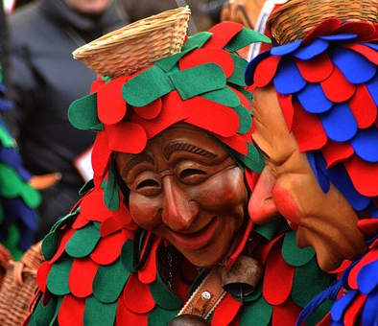
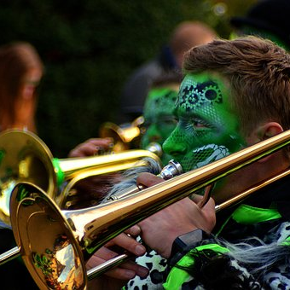
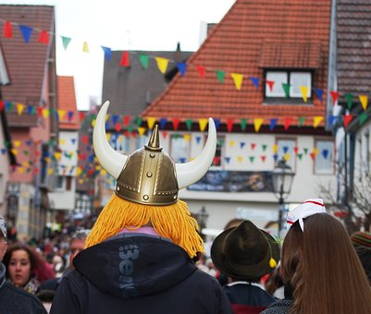
Rosenmontag
In many parts of Germany, Karneval celebrations are a highlight of the year. Karneval is an opportunity to celebrate together before Lent.
Rosenmontag (Rose Monday) is the Monday before Aschermittwoch (Ash Wednesday) in February, and it is the high point of the Karneval celebrations.
Schools and offices in many parts of Germany close all day and people take part in colourful parades and festivities.
People often wear elaborate costumes and masks to take part in the parades and dance in the streets. Sweets are often thrown into the crowds of people lining the streets.
Notes:
Timing: 3 minutes
Aim: to familiarise pupils with the celebrations of Rosenmontag and Karneval.
Procedure:
1. Discuss the title- which day of the week can they see? What could it mean?
2. Click for information to appear paragraph by paragraph. Pupils might like to share their own experience or make contrasts with celebrations in other countries.

Slide 22
Montag
Notes:
Timing: 4 minutes (seven slides)
Aim: to practise reading aloud the days of the week once again, cuing pupils with hand gestures to represent the number of each day.
Procedure:
Use hand gesture and (1-7 for days of the week) in combination with oral production of day of the week & get pupils to repeat.

Slide 23
Dienstag
Notes:
[2/7]

Slide 24
Mittwoch
Notes:
[3/7]

Slide 25
Donnerstag
Notes:
[4/7]

Slide 26
Freitag
Notes:
[5/7]

Slide 27
Samstag
Notes:
[6/7]

Slide 28
Sonntag
Notes:
[7/7]

Slide 29
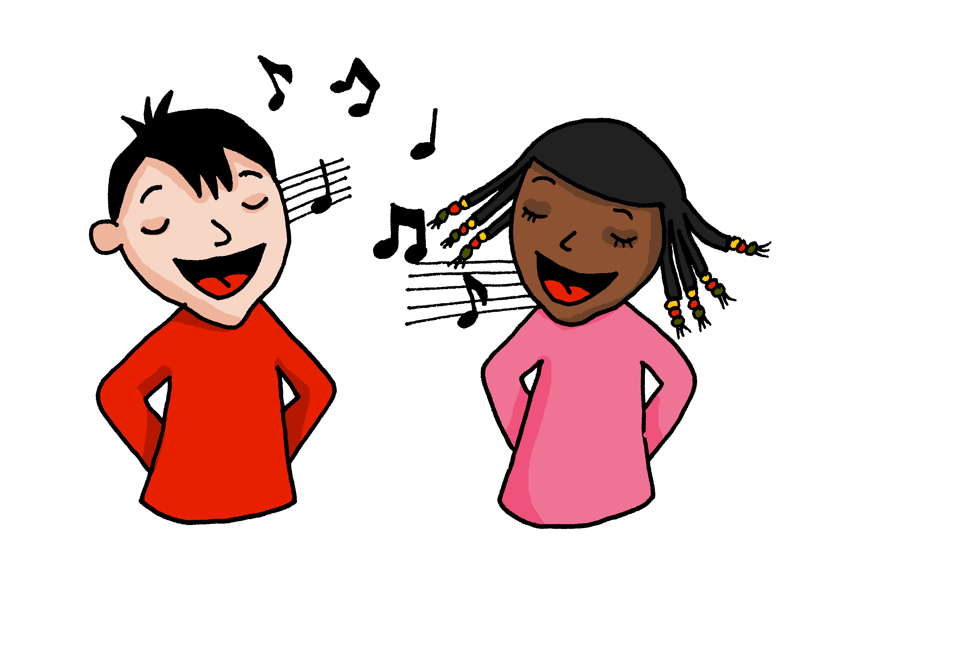
Die Wochentage!
singen
Sing mit!
Notes:
OPTIONAL
Timing: 5 minutes
Aim: to practise oral production of the days of the week (in a song that constrains the time and helps to speed up production).
Procedure:
Click to play the song.
Encourage pupils to join in when they can.
Link to song:
https://www.youtube.com/watch?v=RjlfcpVBBNw
Notes: i) the song is just the days (repeated over and over) but the tune is catchy after a while and the harmonies make it not unpleasant to listen to, despite the minion-type voices!
ii) we recommend opening the link in a separate window just prior to the start of the lesson and playing through the adverts, leaving the song paused at the start ready to go, when needed.

Slide 30
Auf Wiedersehen!
hören
sprechen
lesen
schreiben
Notes:
Timing: 1 minute
Aim: to recap four infinitive verbs as part of essential classroom language.
Procedure:
Remind pupils of the meanings and pronunciations of these four verbs.
Repeat them with the class.
Ask them to tell you which of these activities they have done this lesson.
Say Auf Wiedersehen, die Klasse! and explain the meaning of the words/phrase. Encourage pupils to respond and say ‘Auf Wiedersehen’ in response, perhaps with a ‘farewell wave’ gesture.

Slide 31
Tschüss!
rot
Notes:
31

