Slide 1
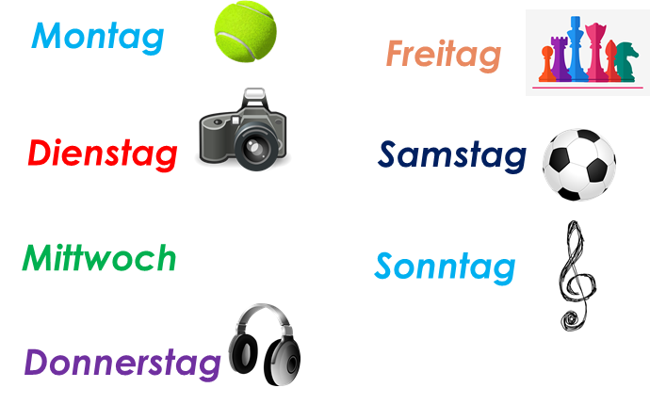
Talking about activities and events
rot
Follow ups 1-5
Term 3 Week 2
Notes:
Artwork by Steve Clarke. Pronoun pictures from NCELP (www.ncelp.org). All additional pictures selected from Pixabay and are available under a Creative Commons license, no attribution required.
Phonics:
consonantal [r] rot [477] drei [106] rechts [829] Frage [157] warum? [192]
vocalic [r] Ort [341] Uhr [348] Tier [614] lernen [288] Farbe [1079]
Vocabulary: sitzen [231] wiederholen [988] Antwort [522] Frage [157] Satz [432] neben [266]
Revisit 1: Nummer [806] null [1680] eins [774] zwei [70] drei [106] vier [200] fünf [274] sechs [428] sieben [611] acht [645] neun [1053] zehn [333] elf [1507] zwölf [1080] es gibt [n/a]
Revisit 2: Wer? [149] haben, ich habe, er, sie, es hat [6] Blume [2463] Geschenk [2595] Spiel [328] Kuchen [4381]
The frequency rankings for words that occur in this PowerPoint which have been previously introduced in these resources are given in the SOW and in the resources that first
introduced and formally re-visited those words.
For any other words that occur incidentally in this PowerPoint, frequency rankings will be provided in the notes field wherever possible.

Slide 2
aussprechen
[r]
…
[r] before a vowel is a roll from the back of your throat. Open your mouth, tongue flat, lips still and growl ‘rrrr’.
Touch your throat and feel the vibration!
rot
Notes:
Timing: 1 minute
Aim: to introduce the SSC [r] before a vowel.
Procedure:
Introduce the SSC and present the source word ‘rot’ (with gesture, if using).
Click to bring on the picture and get pupils to repeat the word ‘rot’ (with gesture, if using).
Note:
a gesture for ‘rot’ might be to hold up some red classroom items e.g. a pen/book/flag/clothing.
2

Slide 3
aussprechen
[r]
…
3
Why?
warum?
drei
rot
?
Frage
rechts
[question]
Notes:
Timing: 1 minute
Aim: to consolidate the SSC [r] before a vowel.
Procedure:
Re-present the SSC and the source word ‘rot’ (with gesture, if using).
Click to bring on the picture and get pupils to repeat the word ‘rot’ (with gesture, if using).
Present the cluster words in the same way, bringing on the picture and getting pupils to pronounce the words.
Word frequency: rot [477] drei [106] rechts [829] Frage [157] warum? [192]
Jones, R.L & Tschirner, E. (2019). A frequency dictionary of German: Core vocabulary for learners. London: Routledge.
3

Slide 4
aussprechen
…
[r]
[r] after a vowel sounds like ‘uh’!
Ort
[place]
Notes:
Timing: 1 minute
Aim: to consolidate the SSC [r] after a vowel
Procedure:
Re-present the SSC and the source word ‘Ort’ (with gesture, if using).
Click to bring on the picture and get pupils to repeat the word ‘Ort’ (with gesture, if using).
Note:
a gesture for ‘Ort’ might be to point to a particular place on a map.

Slide 5
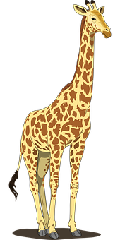
aussprechen
…
[r]
Farbe
lernen
Ort
[place]
When ‘h’ follows a vowel, it makes a long vowel sound.
Uhr
Tier
[clock, watch, o’clock]
Notes:
Timing: 1 minute
Aim: to consolidate the SSC [r] after a vowel
Procedure:
Re-present the SSC and the source word ‘Ort’ (with gesture, if using).
Click to bring on the picture and get pupils to repeat the word ‘Ort’ (with gesture, if using).
Present the cluster words in the same way, bringing on the picture and getting pupils to pronounce the words.
Note: ‘Uhr’ is a slight exception as the ‘r’ does not directly follow the vowel. However, ‘h’ following a vowel makes a long vowel sound, so the ‘r’ sound here is the same as after a vowel.
Word frequency: Ort [341] Uhr [348] Tier [614] lernen [288] Farbe [1079]
Jones, R.L & Tschirner, E. (2019). A frequency dictionary of German: Core vocabulary for learners. London: Routledge.

Slide 6
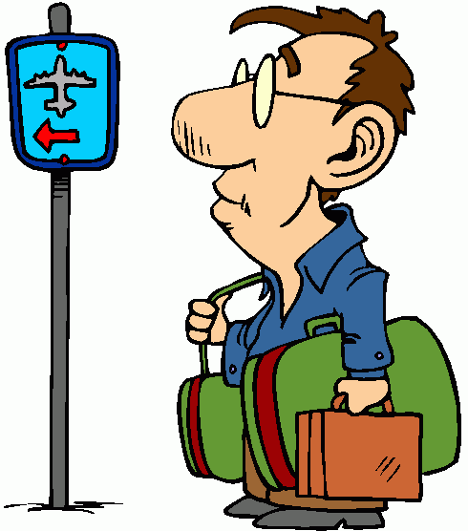
Follow up 1 [r] like ‘rot’ or [r] like ‘Ort’? Which word is the odd one out in each row?
aussprechen
1
1 | Freund | Wort | richtig
2 | klar | wahr | rennen
3 | wer | reiten | warum
4 | morgen | drei | Antwort
5 | wieder | rechts | aber
6 | fragen | Reise | Fenster
60
2
3
Why?
S
4
5
[again]
6
[journey]
0
START
Notes:
Timing: 5 minutes
Aim: to practise applying knowledge of [r] before and after a vowel.
Procedure: 1. Remind pupils about the two ways of pronouncing [r]: before and after a vowel.
2. Ask pupils to work in pairs to find the Odd One Out in each row, based on the pronunciation of the [r].
3. Click to bring up answers and discuss as a class. 4. Ask pupils to try and pronounce all 18 words against the 60 second timer.
5. Check pronunciation by pressing the blue numbers (optional).
Word frequency:
rennen [2068] reiten [3470] wieder [74] warum [192] aber [31] fragen [153] Reise [734]
Jones, R.L & Tschirner, E. (2019). A frequency dictionary of German: Core vocabulary for learners. London: Routledge.

Slide 7
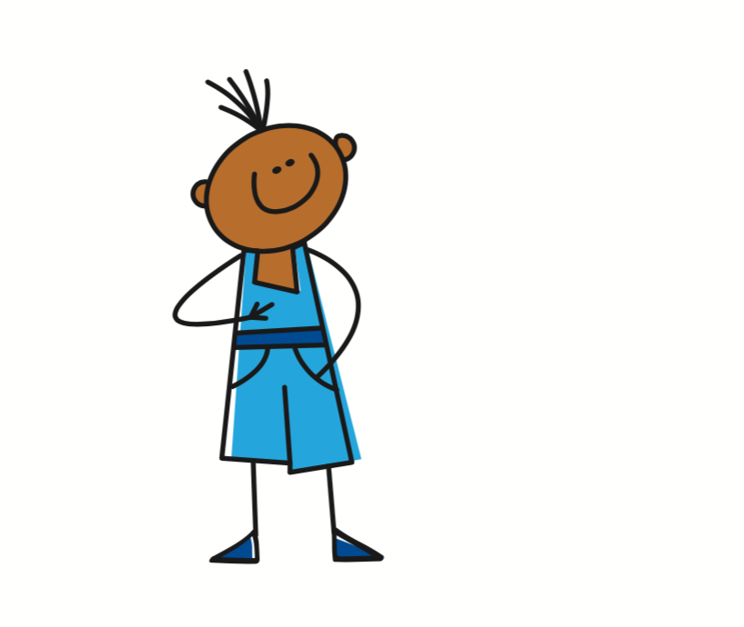
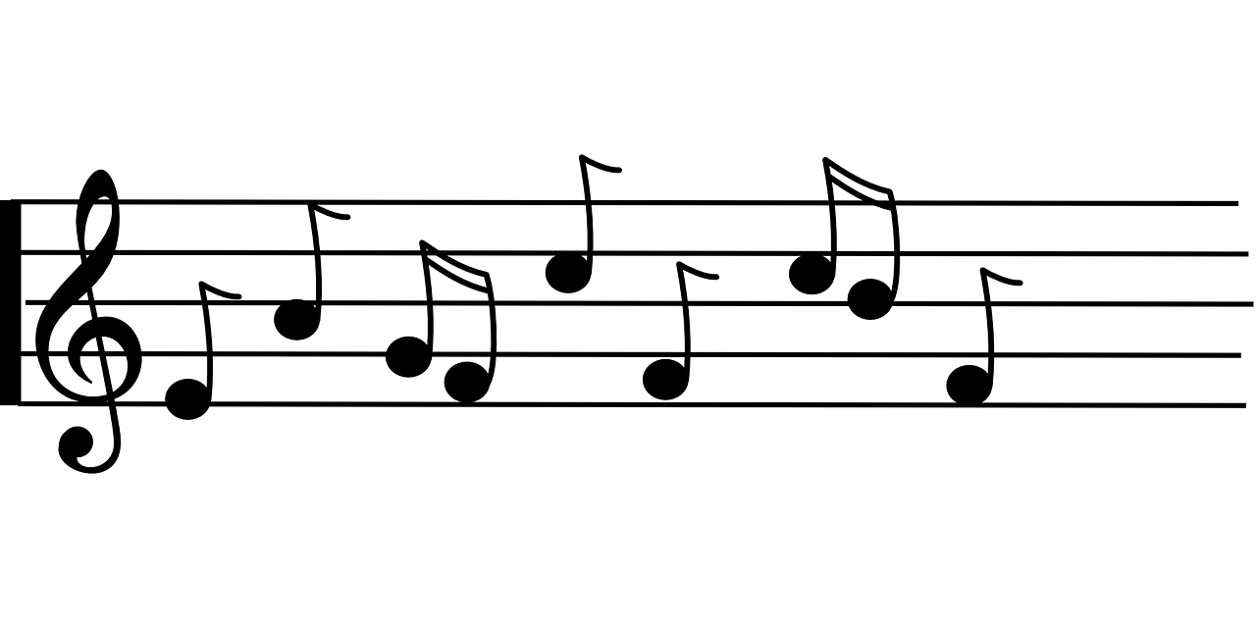
Time adverbs
Compare the word order:
Ich lerne freitags Deutsch.
I learn German on Fridays.
In German the time adverb often comes straight after the verb.
Du hörst montags Musik.
You listen to music on Mondays.
In English the time adverb often comes at the end of the sentence.
Notes:
Timing: 2 minutes
Aim: to demonstrate the different relative positions of time adverbs in German and English.
Procedure:
Click through the animations to present the information.
Elicit English translation for the German examples provided.
7

Slide 8
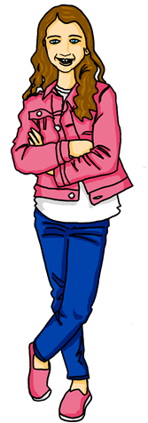
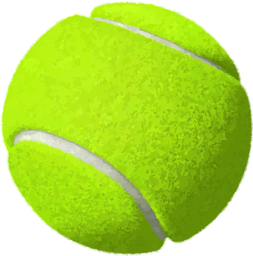
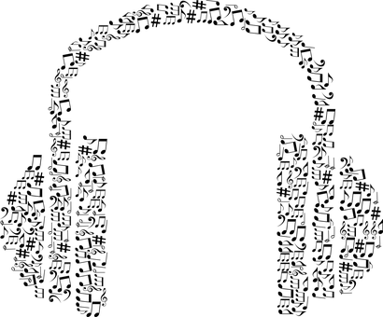
Follow up 2
Hör zu. Was macht Johanna?
Can you work out what these abbreviations mean?
Johanna is describing her after-school and weekend activities. Can you listen and fill in her weekly planner?
1
Johannas Woche
MO. | DI. | MI. | DO. | FR. | SA. | SO.
Schule | Schule | Schule | Schule | Schule
2
3
4
5
Ich
wiederhole das Lied
Ich sitze zu Hause und ich gewinne Spiele!
6
Ich singe ein Lied
Ich spiele Tennis
Ich lerne
Englisch
Ich mache Fotos
Ich höre Musik
7
Notes:
Optional handout at end of presentation
Timing: 5-10 minutes
Aim: to practise aural comprehension of a range of 1st person present tense verbs and time adverbs.
Procedure:
Draw attention to the abbreviated days of the week across the top of the timetable.
Pupils are going to listen and try to fill in Johanna’s activity planner, but the activities will not be given in order. They need to pay attention to the day of the week adverbs to identify when she does each activity.
Play audio number 1. On first listening, pupils should identify the day and draw a quick sketch or make a quick note of the activity in English in the correct box.
On second listening, pupils should try to transcribe the German.
Repeat for all 7 items.
NOTE: If no handout is used, pupils could either quickly copy down the days of the week and fill in their own version, or write numbers 1-7 and note down the day of the week each time as well as the activity.
Additional Activities:
1. Pupils could write sentences about Johanna in the 3rd person, using the information they have found out e.g. Sie lernt mittwochs Englisch.
Transcript:
Ich spiele dienstags Tennis.
Ich lerne mittwochs Englisch.
Ich höre freitags Musik. Freitag ist mein Lieblingstag!
Ich singe montags ein Lied.
Ich wiederhole samstags das Lied.
Ich mache donnerstags Fotos.
Ich sitze sonntags zu Hause und ich gewinne Spiele! Heute ist Sonntag!

Slide 9
Follow up 3
B Translate the
sentences into German.
I sing on Sundays.
2) I am playing tennis today.
3) You have the answer!
4) She is winning the game today.
5) He is sitting next to Moritz today.
Schreib auf Deutsch.
A Unjumble the German sentences.
I sit next to Lukas on Mondays.
sitze neben montags Lukas ich
2) You are repeating the question today.
wiederholst du heute Frage die
3) He listens to music on Saturdays.
Musik er hört samstags
4) I am playing football today.
Fußball ich heute spiele
Remember: I am playing is the same as I play in German. Don’t try to translate the ‘am’!
Remember: the time adverb needs to be placed straight after the verb, so the word order will be different to the English.
schreiben
Ich sitze montags neben Lukas.
Ich singe sonntags.
lesen
Ich spiele heute Tennis.
Du wiederholst heute die Frage.
Du hast die Antwort.
Er hört samstags Musik.
Sie gewinnt heute das Spiel.
Ich spiele heute Fußball.
Er sitzt heute neben Moritz.
Notes:
Timing: 5-10 minutes
Aim: to practise forming sentences in the first, second and 3rd person singular present tense using time adverbs.
Procedure:
Explain Section A- pupils are given the English sentences and a jumbled up German sentence. They must rewrite the German correctly. Click to bring up the call-out to remind about position of the time adverb.
Discuss number 1 as a class and click for answer. Give pupils time independently to do numbers 2-4. Click to reveal answers.
Move on to full translation in Section B. Emphasise to pupils that the verb endings for ich/du/er/sie and the time adverbs are the most important considerations here (correct spellings of other words is a bonus).
Click to bring up answers one by one. Emphasise as you do so that despite the English simple present and present continuous looking and sounding quite different, German just has the one present tense. Most common mistake here would be for pupils to try and translate ‘am’ and ‘is’ in present continuous, which we want to try and eradicate now!
Note: In Years 5/6, pupils will learn that you can start sentences with the time adverbs and invert the verb and subject (Word Order 2), but for now we are sticking to straightforward word order. If you have native pupils (or someone who has learnt a lot of German) they may find it more natural to write e.g. ‘Montags sitze ich neben Lukas’. Additional task suggestions: 1. Pupils make their own sentences about what they do/are doing and their friends do/are doing on different days.

Slide 10
Follow up 4:
Find your partner’s weekly activities to sink their ships!
Beispiel
MO. | DI. | MI. | DO. | FR. | SA. | SO. | Heute
A: Singst du mittwochs?
B:Nein. Das ist falsch.
Draw your pictures on any day of the week in the top table. This is just an example. Keep your drawings hidden from your partner!
MO. | DI. | MI. | DO. | FR. | SA. | SO. | Heute
Sing x
B: Spielst du samstags Fußball?
A: Ja, richtig! Ich spiele samstags Fußball. ☹
A: Hörst du donnerstags Musik?
B: Ja, richtig. Ich höre donnerstags Musik.
Notes:
Handout at end of presentation
Timing: 10 minutes
Aim: to practise oral production of second and first person weak verbs with time adverbs in the context of weekly activities.
Procedure:
Give pupils a copy of the handout and explain that the top table is for them to draw/note down an activity for each day, and the bottom table is for them to keep track of their partner’s activities/ships. It is important that pupils use the verbs/activities on the board, not their own, as otherwise their partner has no chance of guessing, and may not have the German to do so.
Click through the animations on this slide to show pupils a) to draw their pictures (if this takes too long they can just write one word e.g. photos, tennis) b) how to conduct the conversation, reminding them of ‘du’ forms of the verb for questions and c) how to keep track of what they have asked their partner. If they ‘sink’ their partner’s ship by guessing the correct activity on the correct day, they can tick/cross/draw a ship in that box.
NOTE: 1) This game has the potential to last a long time, so it could be the first to sink X number of ships! 2) Infinitive German verbs are given on the handout to help pupils, but they still need to conjugate them.
Additional Activities:
Pupils could make sentences in the 3rd person to tell another pair what they have found out about their partner. E.g. Sammy spielt mittwochs Tennis.
Alternatively, pupils might like to have real conversations now about themselves using these and other verbs/activities of their choice. This could be done as a survey around the class: ‘Spielst du sonntags Spiele?’

Slide 11
Follow up 5:

Schreib auf Englisch.
Can you get at least 15 points?
Wörter
 | das Spiel | er, sie, es hat | wer?
 | haben | ich habe | das Geschenk
 | die Nummer | es gibt | null
 | sieben | drei | elf
 | eins | fünf | neun
 | neben | wiederholen | die Frage
 | die Antwort | sitzen | der Satz
(the) game
he, she, it has
who?
Vokabeln
x3
to have, having
I have
(the) present
(the) number
there is, there are
zero
x2
seven
three
eleven
one
five
nine
next to, beside
to repeat, repeating
(the) question
x1
(the) answer
to sit, sitting
(the) sentence
Notes:
Timing: 5 minutes
Aim: to practise written production of vocabulary from this and revisited weeks.
Procedure: 1. Give pupils a blank grid. They fill in the English meanings of any of the words they know, trying to reach 15 points in total.
Note: The most recently learnt and practised words are pink, words from the previous week are green and those from week 1 are blue, thus more points are awarded for them, to recognise that memories fade and more effort (heavy lifting!) is needed to retrieve them.

Slide 12
Follow up 5:

Schreib auf Deutsch.
Can you get at least 15 points?
Wörter
 | he, she, it has | (the) present | (the) game
 | who? | to have, having | I have
 | ten | twelve | there is, there are
 | four | six | eight
 | (the) number | zero | two
 | (the) question | (the) sentence | next to, beside
 | to sit, sitting | to repeat, repeating | (the) answer
er, sie, es hat
das Geschenk
das Spiel
Vokabeln
x3
wer?
haben
ich habe
zehn
zwölf
es gibt
x2
vier
sechs
acht
die Nummer
null
zwei
die Frage
der Satz
neben
x1
sitzen
wiederholen
die Antwort
Notes:
Timing: 5 minutes
Aim: to practise written production of vocabulary from this and revisited weeks.
Procedure: 1. Give pupils a blank grid. They fill in the German meanings of any of the words they know, trying to reach 15 points in total.
Note: The most recently learnt and practised words are pink, words from the previous week are green and those from week 1 are blue, thus more points are awarded for them, to recognise that memories fade and more effort (heavy lifting!) is needed to retrieve them.

Slide 13
Tschüss!
rot
Notes:
13

Slide 14
Follow up 2
Johanna is describing her after-school and weekend activities. Can you fill in her weekly planner?
Johannas Woche
MO. | DI. | MI. | DO. | FR. | SA. | SO.
Schule | Schule | Schule | Schule | Schule
Notes:
HANDOUT

Slide 15
Follow up 4:
Draw your activities in the first table.
Use the second table to keep track of which of your partner’s
ships you have sunk and what you have already asked.
MO. | DI. | MI. | DO. | FR. | SA. | SO. | Heute
spielen- to play
machen-to do/make
gewinnen-to win
singen-to sing
hören- to listen
sitzen- to sit
denken- to think
MO. | DI. | MI. | DO. | FR. | SA. | SO. | Heute
Notes:
HANDOUT

Slide 16
Follow up 5:

Schreib auf Englisch.
Can you get at least 15 points?
Wörter
 | das Spiel | er, sie, es hat | wer?
 | haben | ich habe | das Geschenk
 | die Nummer | es gibt | null
 | sieben | drei | elf
 | eins | fünf | neun
 | neben | wiederholen | die Frage
 | die Antwort | sitzen | der Satz
Vokabeln
x3
x2
x1
Notes:
HANDOUT

Slide 17
Follow up 5:

Schreib auf Deutsch.
Can you get at least 15 points?
Wörter
 | he, she, it has | (the) present | (the) game
 | who? | to have, having | I have
 | ten | twelve | there is, there are
 | four | six | eight
 | (the) number | zero | two
 | (the) question | (the) sentence | next to, beside
 | to sit, sitting | to repeat, repeating | (the) answer
Vokabeln
x3
x2
x1
Notes:
HANDOUT

