Slide 1
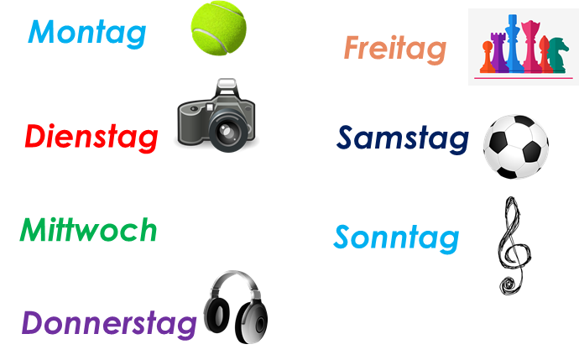
Talking about activities and events
rot
Present tense – I do and I am doing
SSC [r]
Term 3 Week 2
Notes:
Artwork by Steve Clarke. Pronoun pictures from NCELP (www.ncelp.org). All additional pictures selected from Pixabay and are available under a Creative Commons license, no
attribution required.
Phonics:
consonantal [r] rot [477] drei [106] rechts [829] Frage [157] warum? [192]
vocalic [r] Ort [341] Uhr [348] Tier [614] lernen [288] Farbe [1079]
Vocabulary: sitzen [231] wiederholen [988] Antwort [522] Frage [157] Satz [432] neben [266]
Revisit 1: Nummer [806] null [1680] eins [774] zwei [70] drei [106] vier [200] fünf [274] sechs [428] sieben [611] acht [645] neun [1053] zehn [333] elf [1507] zwölf [1080] es gibt [n/a]
Revisit 2: Wer? [149] haben, ich habe, er, sie, es hat [6] Blume [2463] Geschenk [2595] Spiel [328] Kuchen [4381]
Jones, R.L & Tschirner, E. (2019). A frequency dictionary of German: Core vocabulary for learners. London: Routledge.
The frequency rankings for words that occur in this PowerPoint which have been previously introduced in these resources are given in the SOW and in the resources that first
introduced and formally re-visited those words.
For any other words that occur incidentally in this PowerPoint, frequency rankings will be provided in the notes field wherever possible.
Note that the first three lessons of the year teach language that can be continuously recycled as lesson routine every lesson in Y3/4.
The idea would be that the class teacher (whether or not s/he teaches the class German can re-use the language as part of the daily routine with the class.
1

Slide 2
aussprechen
[r]
…
[r] before a vowel is a roll from the back of your throat. Open your mouth, tongue flat, lips still and growl ‘rrrr’.
Touch your throat and feel the vibration!
rot
Notes:
Timing: 1 minute
Aim: to introduce the SSC [r] before a vowel.
Procedure:
Introduce the SSC and present the source word ‘rot’ (with gesture, if using).
Click to bring on the picture and get pupils to repeat the word ‘rot’ (with gesture, if using).
Note:
a gesture for ‘rot’ might be to hold up some red classroom items e.g. a pen/book/flag/clothing.
2

Slide 3
aussprechen
[r]
…
3
Why?
warum?
drei
rot
?
Frage
rechts
[question]
Notes:
Timing: 1 minute
Aim: to consolidate the SSC [r] before a vowel.
Procedure:
Re-present the SSC and the source word ‘rot’ (with gesture, if using).
Click to bring on the picture and get pupils to repeat the word ‘rot’ (with gesture, if using).
Present the cluster words in the same way, bringing on the picture and getting pupils to pronounce the words.
Word frequency: rot [477] drei [106] rechts [829] Frage [157] warum? [192]
Jones, R.L & Tschirner, E. (2019). A frequency dictionary of German: Core vocabulary for learners. London: Routledge.
3

Slide 4
aussprechen
[r]
…
[r] after a vowel sounds like ‘uh’!
Ort
[place]
Notes:
Timing: 1 minute
Aim: to consolidate the SSC [r] after a vowel
Procedure:
Re-present the SSC and the source word ‘Ort’ (with gesture, if using).
Click to bring on the picture and get pupils to repeat the word ‘Ort’ (with gesture, if using).
Note:
a gesture for ‘Ort’ might be to point to a particular place on a map.

Slide 5
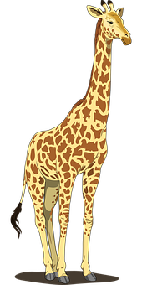
aussprechen
[r]
…
Farbe
lernen
Ort
[place]
When ‘h’ follows a vowel, it makes a long vowel sound.
Uhr
Tier
[clock, watch, o’clock]
Notes:
Timing: 1 minute
Aim: to consolidate the SSC [r] after a vowel
Procedure:
Re-present the SSC and the source word ‘Ort’ (with gesture, if using).
Click to bring on the picture and get pupils to repeat the word ‘Ort’ (with gesture, if using).
Present the cluster words in the same way, bringing on the picture and getting pupils to pronounce the words.
Note: ‘Uhr’ is a slight exception as the ‘r’ does not directly follow the vowel. However, ‘h’ following a vowel makes a long vowel sound, so the ‘r’ sound here is the same as after a vowel.
Word frequency: Ort [341] Uhr [348] Tier [614] lernen [288] Farbe [1079]
Jones, R.L & Tschirner, E. (2019). A frequency dictionary of German: Core vocabulary for learners. London: Routledge.

Slide 6
[r]
Listen to the 8 words. Can you hear [r] before a vowel (like ‘rot’) or [r] after a vowel (like ‘Ort’)?
Hör zu. Schreib A oder B.
hören
 | A (rot) | B (Ort)
1 |  |  | richtig
2 |  |  | morgen
3 |  |  | klar
4 |  |  | Frau
5 |  |  | Freitag
6 |  |  | Form
7 |  |  | nicht wahr?
8 |  |  | trinken
Remember: when ‘h’ follows a vowel, it makes a long vowel sound.
Notes:
Timing: 5 minutes
Aim: to consolidate the SSC [r] by identifying words with [r] before or after a vowel with previously taught and some unknown words.
Procedure:
1. Pupils write down numbers 1-8. They will write down ‘A’ (r before a vowel) or ‘B’ (r after a vowel) for each answer. As an extra task they could try to transcribe the word they hear.
2. Click audio button 1 and discuss whether it is like ‘rot’ or like ‘Ort’. Click to reveal answer. Click again to reveal correct spelling of the word.
3. Repeat for items 2-8.
Transcript:
richtig
morgen
klar
Frau
Freitag
Form
nicht wahr
trinken
Word frequency of unknown words:
morgen [752] trinken [634]
Jones, R.L & Tschirner, E. (2019). A frequency dictionary of German: Core vocabulary for learners. London: Routledge.

Slide 7
Vokabeln
Vokabeln lernen
Wörter
Sag die Wörter.
sitzen
wiederholen
repeat
The cat sat on the mat.
[question]
[answer]
[sentence]
[next to]
die Frage
die Antwort
der Satz
neben
Notes:
Timing: 5 minutes [1/2]
Aim: to present and practise new vocabulary for this week.
Procedure:
Click for each word to appear, and click again for picture/English to appear. As this is useful classroom language, you may want to use gestures or demonstrate the actions yourself too and continue to use these in future. Start with pupils standing up so they can sit down for sitzen!
Practise pronunciation of each word as it appears.
Once all 6 pieces of vocabulary are on the board practise repeating again, varying volume and voice.
If you have chosen to use actions, now practise first giving the German words (in random order) one by one and pupils doing the actions. Then you do the actions and pupils say the correct German word chorally.
Possible actions: sit down; rotate arms in a circular motion (like Wind The Bobbin Up!); draw a question mark in the air; put hand up keenly; write a sentence in the air; pretend you have someone next to you and point rapidly between them and yourself (or use two pupils next to each other).
7

Slide 8
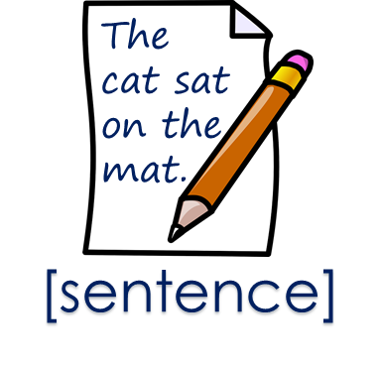
Vokabeln lernen
sitzen
neben
die Frage
der Satz
wiederholen
die Antwort
1
2
5
6
3
4
Notes:
[2/2]
Timing: 5 minutes (including previous slide) Aim: to provide production (speaking) practice with the new vocabulary.
Procedure: 1. Pupils match the German words to the pictures in their heads.
2. The teacher gives the pupils a number and the pupils must say the correct word in German. The number prompts are the trigger (i.e. wait for the hand and then click on the number) for the lines to connect the correct word to the picture.
3. Click to make each German word disappear in turn. Encourage pupils to use the actions you used if relevant as each word disappears, and then to recall the German word.

Slide 9
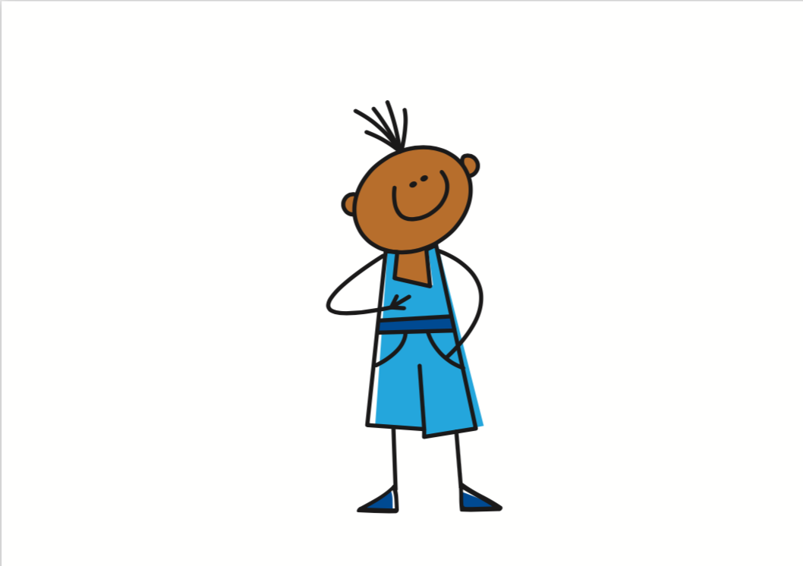
Present tense
Remember! German has one present tense, but English has two:
Ich wiederhole die Frage.
I repeat the question.
I’m repeating the question.
The time adverb suggests which English present tense to use:
Ich sitze montags neben Lukas.
I sit next to Lukas on Mondays.
Montag = Monday montags = on Mondays
Use simple present for repeated actions.
Du sitzt heute neben Moritz.
You are sitting next to Moritz today.
Note! No ‘s’ here because the verb stem ends in –z.
Use continuous present for ongoing actions happening now.
Notes:
Timing: 2 minutes
Aim: to recap the 2 possible English translations of German present tense and to introduce the use of time adverbs to determine these.
Procedure:
Click through the animations to present the information.
Elicit English translation for the German examples provided.
9

Slide 10
lesen
Moritz is finding his English homework tricky.
Can you help him to translate the German sentences correctly?
Was ist richtig? Schreib A oder B.
Ich singe oft ein Lied.
Ich wiederhole heute den Satz.
Er lernt donnerstags Deutsch.
Sitzt du montags neben Jana?
Sie spielt heute Fußball.
Ich gewinne heute das Spiel!
Du hörst samstags Musik.
Denkt er oft?
Hausaufgaben
 | A | B
1 | I sing a song. | I am singing a song.
2 | I repeat the sentence. | I am repeating the sentence.
3 | He learns German. | He is learning German.
4 | Do you sit next to Jana? | Are you sitting next to Jana?
5 | She plays football. | She is playing football.
6 | I win the game. | I am winning the game!
7 | You listen to music. | You are listening to music.
8 | Does he think? | Is he thinking?
Notes:
Timing: 8 minutes
Aim: to practise recognising time adverbs to help determine whether to use the simple present or the present continuous when translating into English.
Procedure:
Explain that Moritz is finding his English difficult, because he has the choice of two translations for each German verb. Pupils must help decide which translation is correct by using the time adverbs.
Pupils write down 1-8 and either A or B to choose the translation they think is correct. They should also note down the time adverb that helped them to decide on their answer.
Click for answer to number 1 to appear circling the correct English translation, then click again for the time adverb to be circled in the German. It’s important that pupils can identify the adverb so they can justify their answer.
Repeat for items 2-8.
Additional Activities:
Pupils could translate the German sentences in full ( i.e. by translating the time adverb too)
Pupils could write their own contrasting sentences with 2 different time adverbs and the same verb, with the translations in English. E.g. Du sitzt heute neben Alex/ Du sitzt dienstags neben Isla. They can now form sentences in the 1st, 2nd or 3rd person singular and can write statements or questions.
10

Slide 11
hören
Frau Tahler is talking to Moritz about what is happening in class. Is she
talking to Moritz or about Lukas? How would you translate each of her sentences?
Hör zu. Wer ist das? Was ist das auf Englisch?
 | du | er | English
 |  |  | You are learning a sentence today.
 |  |  | You make a picture on Mondays.
 |  |  | He is listening to a song today.
 |  |  | He is repeating the word today.
 |  |  | You sing on Fridays.
 |  |  | He has the answer!
 |  |  | You/he sit(s) next to Hamza on Wednesdays.
B
There is no ‘s’ in the du form of sitzen, so this could be du or er.
1
We wouldn’t say ‘He is having’ here, even if it is happening right now.
2
3
4
5
6
Notes:
Timing: 5 minutes
Aim: to practise aural comprehension of 2nd and 3rd person weak verbs, time adverbs and activities in the simple present and present continuous.
Procedure:
1. Explain the scenario: pupils must listen to the verb to identify who the teacher is talking to/about.
2. Play the blue audio button for example (B). On first listening pupils identify whether the sentence is in the ‘du’ form or the ‘er’ form. Click for answer.
3. Play the audio again. This time pupils focus on the time adverb they hear and write the English verb, deciding whether simple present or present continuous. Optional extra would be to translate the full sentence. Click for English answer to appear.
4. Repeat for items 1-6, listening twice (or more) for the two different parts of the activity.
5. Use the call-outs to explain why numbers 5 and 6 are a little different.
6. Optional- click again for the 2nd set of audio buttons. Click on the yellow buttons to hear the full sentence versions.
Transcript
B: [Du] lernst heute einen Satz.
[Du] machst montags ein Bild.
[Er] hört heute ein Lied.
[Er] wiedeholt heute das Wort.
[Du] singst freitags.
[Er] hat die Antwort!
[Du/Er] sitzt mittwochs neben Hamza.
11

Slide 12
Tschüss!
rot
Notes:
12

