Slide 1

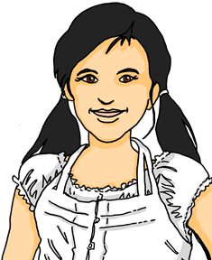

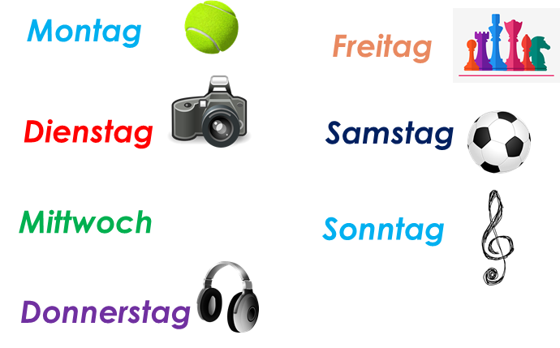



Talking about activities and events
rot
Follow ups 1-5
Term 3 Week 3
Notes:
Artwork by Steve Clarke. Pronoun pictures from NCELP (www.ncelp.org). All additional pictures selected from Pixabay and are available under a Creative Commons license, no attribution required.
Phonics:
[er-] er [15] Konzert [2350] Person [357] schwer [256] wer? [173]
[-er] wieder [74] aber [31] oder [35] Oktober [1223] wunderbar [1603]
Vocabulary: schwimmen [1863] tanzen [1497]
Revisit 1: language from Term 2
Revisit 2: (du) hast [7]
Jones, R.L & Tschirner, E. (2019). A frequency dictionary of German: Core vocabulary for learners. London: Routledge.
The frequency rankings for words that occur in this PowerPoint which have been previously introduced in these resources are given in the SOW and in the resources that first
introduced and formally re-visited those words.
For any other words that occur incidentally in this PowerPoint, frequency rankings will be provided in the notes field wherever possible.

Slide 2

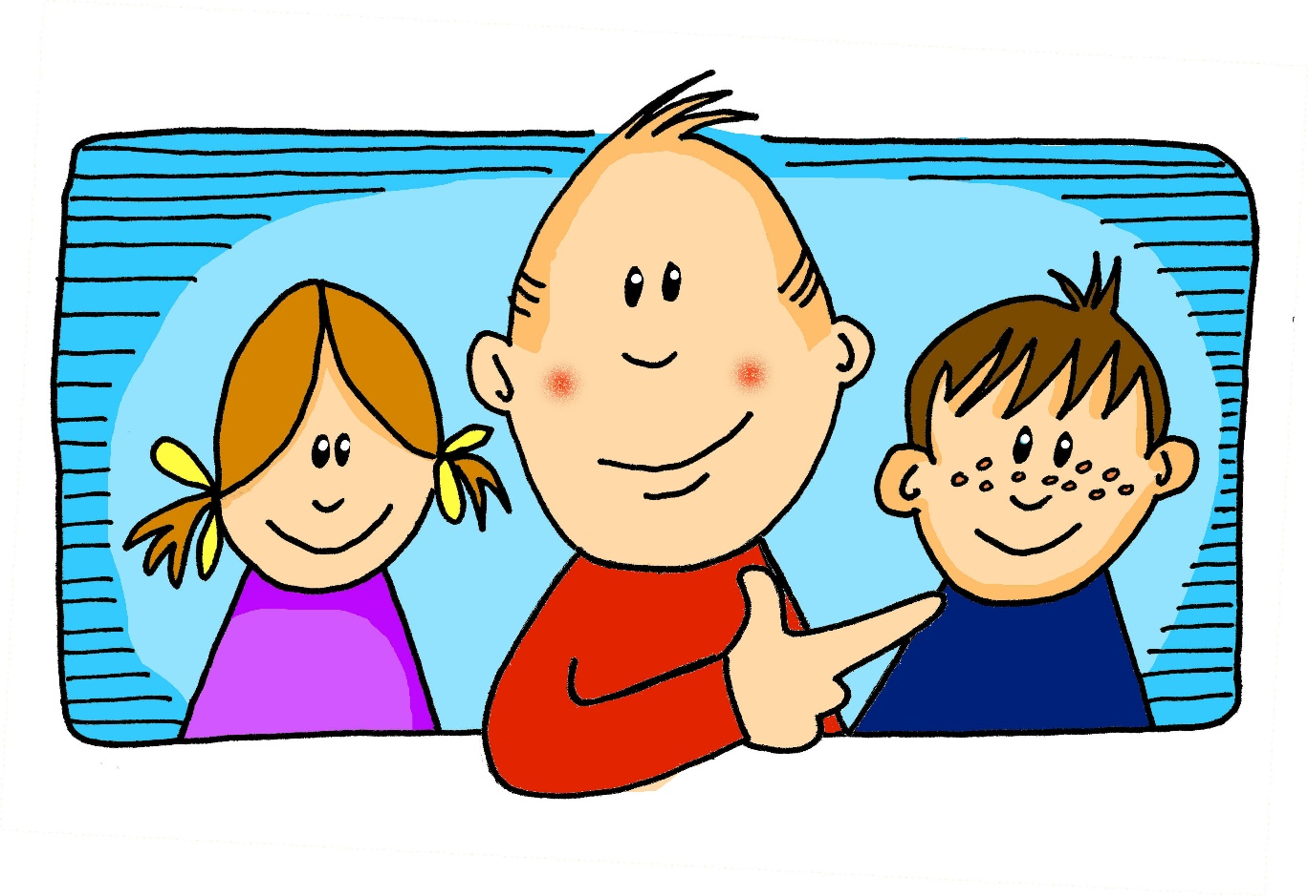
aussprechen
[er]
…
er
When the [er] is the stressed syllable, it usually sounds like two short syllables: e-uh
Remember, words are made up of different parts called syllables. A stressed syllable means the part of the word that is most emphasised when you say it aloud.
Notes:
Timing: 1 minute
Aim: to introduce/consolidate SSC [er]
Procedure:
1. Present the letter(s) and say the [er] sound first, on its own. Pupils repeat it with you.
2. Bring up the word ”er” on its own, say it, pupils repeat it, so that they have the opportunity to focus all of their attention on the connection between the written word and its sound.
3. A possible gesture for this would be to point to an imaginary ‘he’, using your index finger, thumb point upwards (to make the gesture more exaggerated), as per the image.
4. Roll back the animations and work through 1-3 again, but this time, dropping your voice completely to listen carefully to the pupils saying the [er] sound, pronouncing ”er” and, if using, doing the gesture.
Word frequency (1 is the most frequent word in German):
er [15]
Source: Jones, R.L. & Tschirner, E. (2006). A frequency dictionary of German: core vocabulary for learners. Routledge
2

Slide 3
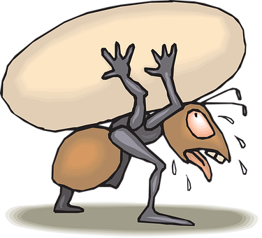





aussprechen
[er]
In all of these words, the [er] is part of the stressed syllable. This means it is emphasised or stronger than the other part of the word.
…
schwer
fertig
[heavy, difficult]
er
Konzert
wer?
Notes:
Timing: 2 minutes
Aim: to introduce/consolidate SSC [er]
Procedure:
Introduce and elicit the pronunciation of the individual SSC [er] and then the source word again ‘er’ (with gesture, if using).
Then present and elicit the pronunciation of the five cluster words.
The cluster words have been chosen for their high-frequency, from a range of word classes, with the SSC (where possible) positioned within a variety of syllables within the words (e.g. initial, 2nd, final etc.). Additionally, we have tried to use words that build cumulatively on previously taught SSCs (see the Phonics Teaching Sequence document) and do not include new SSCs. Where new SSCs are used, they are often consonants which have a similar symbol-sound correspondence in English.
Word frequency (1 is the most frequent word in German):
er [15] fertig [n/a] Konzert [2350] schwer [256] wer? [173]
Source: Jones, R.L. & Tschirner, E. (2006). A frequency dictionary of German: core vocabulary for learners. Routledge

Slide 4

aussprechen
[er]
…
As you know [er] can also sound like ‘uh’. This is when the syllable is unstressed, most often at the end of the word.
wieder
[again]
Notes:
Timing: 1 minute
Aim: To introduce/consolidate SSC [er]
Procedure:
1. Present the letter(s) and say the [er] sound first, on its own. Pupils repeat it with you.
2. Bring up the word ”wieder” on its own, say it, pupils repeat it, so that they have the opportunity to focus all of their attention on the connection between the written word and its sound.
3. A possible gesture for this would be to roll your hands over in the air, clockwise. Your hands are in front of your body.
4. Roll back the animations and work through 1-3 again, but this time, dropping your voice completely to listen carefully to the pupils saying the [er] sound, pronouncing ”wieder” and, if using, doing the gesture.
Word frequency (1 is the most frequent word in German):
wieder [74]
Source: Jones, R.L. & Tschirner, E. (2006). A frequency dictionary of German: core vocabulary for learners. Routledge
4

Slide 5





aussprechen
[er]
In all of these words, a different part of the word is the stressed syllable, not the [er] sound.
…
aber
Oktober
[but]
wieder
?
Wonderful!
[again]
oder
wunderbar
[or]
Notes:
Timing: 2 minutes
Aim: To introduce/consolidate SSC [er]
Procedure:
Introduce and elicit the pronunciation of the individual SSC [er] and then the source word again ‘wieder’ (with gesture, if using).
Then present and elicit the pronunciation of the four cluster words.
Word frequency (1 is the most frequent word in German):
wieder [74] aber [31] oder [35] Oktober [1223] wunderbar [1603]
Source: Jones, R.L. & Tschirner, E. (2006). A frequency dictionary of German: core vocabulary for learners. Routledge

Slide 6





Follow up 1
Sag die Sätze und hör zu.
aussprechen
1. Sie lernt Klavier aber es ist nicht schwer.
She learns/is learning piano but it is not difficult.
2. Wer ist auf dem Konzert? Ist Vater da? Das ist wunderbar!
Who is at the concert? Is father there? That is wonderful!
3. Wo ist der Lehrer? Ist er im Klassenzimmer?
Where is the teacher? Is he in the classroom?
4. Die erste Nummer ist hundert.
The first number is a hundred.
5. Er hat Geburtstag im September oder Oktober.
His birthday is in September or October. (He has birthday in…)
Notes:
Handout at end of presentation
Timing: 5 minutes
Aim: to practise applying knowledge of [er] in stressed and unstressed syllables.
Procedure:
1. Each pupil will need a copy of the handout at the end of the presentation to annotate.
2. Click to bring up the first sentence. As a class, identify and underline the stressed [er] syllables and circle the unstressed [er] syllables in the sentence. Listen to the sentence to check, then click to bring up the answers.
3. Click to bring up items 2-5. Ask pupils to read the sentences aloud in pairs and 1) underline the stressed [er] syllable and 2) circle the unstressed [er] in each sentence. You could encourage them to clap the syllables in the [er] words if you did this in the main lesson.
3. Listen to sentences 2-5 to allow pupils to check their answers. It is ok for them to change their mind now they have listened!
4. Click to bring up answers.
5. Discuss meanings and click to bring up English translations.
6. Encourage pupils to read aloud again now that they have the answers, clapping if appropriate.
Word frequency:
Klavier [4340] auf [16] Konzert [2350] Vater [232] Klassenzimmer [N/A] hundert [1107] Geburtstag [1779] Oktober [1223]

Slide 7










lesen
Follow up 2
Is Lias saying ‘not’ or don’t/doesn’t in each sentence?
Lies die Sätze.
 |  | don’t/ doesn’t | not
 | Das ist nicht gelb.
 | Ich bin nicht Ronja!
 | Ich spiele nicht.
 | Er versteht das Lied nicht.
 | Das ist nicht mein Hund!
 | Heute ist nicht Montag.
 | Ich weiß es nicht.
 | Ich gewinne das Spiel nicht.
1
That is not yellow.
2
I am not Ronja!
3
I don’t play.
4
He doesn’t understand the song.
5
That is not my dog.
6
MON.
Today is not Monday.
7
I don’t know (it).
8
I don’t win the game.
Notes:
Timing: 5 minutes
Aim: to practise nicht (meaning both ‘don’t’ and ‘not’) and previously taught words in short sentences.
Procedure:
Pupils read the sentence and decide whether nicht would be translated as ‘don’t/doesn’t’ or ‘not’.
Click to bring up answer ticks.
Elicit full translations of sentences to recap both uses of nicht and vocabulary. Click to bring up answers in English.
NOTE: Pupils met ‘Ich weiß es nicht’ as an item of vocabulary in Term 2, but now can understand the translation of nicht as ‘don’t’.
Additional tasks:
1. Ask pupils to change one element of each sentence to make them their own. They could e.g. change one piece of vocabulary or they could change the person of the verb, or they could remove the nicht to make the sentence positive.
7

Slide 8











Follow up 3a
Hör zu.
Was macht Lias (nicht)? Was macht Moritz (nicht)?
Er
hören
Ich
M
L
1
8
M + L
2
7
3
6
5
4
Notes:
Timing: 10 minutes [Slide 1/2]
Aim: to practise aural recognition of affirmative and negative sentences in the 1st and 3rd person.
Procedure:
Explain that Moritz is talking about himself (ich) and his cousin Lias (er). Pupils must listen and decide which of the activities 1-8 just Moritz does, just Lias does, and which both do.
Pupils jot down numbers 1-8 and will write down M, L or M+ L for each activity.
Play each audio item.
Click for each picture to move to the correct part of the venn diagram to show answers.
Move on to the next slide to practise transcription of the same sentences.
Transcript:
Ich sitze neben Ronja nicht. Er sitzt neben Ronja.
Er macht das Geschenk nicht. Ich mache das Geschenk.
Ich gewinne das Spiel nicht. Er gewinnt das Spiel!
Ich verstehe den Film und er versteht den Film!
Ich höre das Lied nicht. Er hört das Lied.
Ich singe das Lied. Er wiederholt das Lied.
Er tanzt nicht aber ich tanze!
Er spielt zu Hause nicht. Ich spiele zu Hause.

Slide 9
Follow up 3b
Hör zu und schreib auf Deutsch.
hören
 | I…..s………n……R……n….. | E….s……n……R…….
 | I….m……d……G………. | E…m……d….G………n……
 | I……g……..d…….S……n…… | E…..g………d…..S…….
 | I…..v…………d….F…..u….. | e…..v………..d…..F…..!
 | I…..h……..d…..L…..n…… | E…h………d….L……
 | I…..s……..d…..L…… | E….w……………d…..L…….
 | ….i……t………! | E….t………n……a…..
 | I….s……..z…H…….. | E….s………z…H…..n…….
1
Ich sitze neben Ronja nicht.
Er sitzt neben Ronja.
2
Ich mache das Geschenk.
Er macht das Geschenk nicht.
3
Ich gewinne das Spiel nicht.
Er gewinnt das Spiel.
4
Ich verstehe den Film und…
…er versteht den Film!
5
Ich höre das Lied nicht.
Er hört das Lied.
6
Ich singe das Lied.
Er wiederholt das Lied.
7
…ich tanze!
Er tanzt nicht aber…
8
Ich spiele zu Hause.
Er spielt zu Hause nicht.
Notes:
Timing: 10 minutes [Slide 2/2]
Aim: to practise aural recognition and transcription of affirmative and negative sentences in the 1st and 3rd person.
Procedure:
Explain that pupils will hear the same 8 items again.
Pupils jot down numbers 1-8 and will try to transcribe the German they hear. For a more challenging task, pupils should not face the board.
Play each audio item as many times as necessary.
Click for answers to appear. Draw attention to the position of nicht in each negative sentence.
Transcript
Ich sitze neben Ronja nicht. Er sitzt neben Ronja.
Er macht das Geschenk nicht. Ich mache das Geschenk.
Ich gewinne das Spiel nicht. Er gewinnt das Spiel!
Ich verstehe den Film und er versteht den Film!
Ich höre das Lied nicht. Er hört das Lied.
Ich singe das Lied. Er wiederholt das Lied.
Er tanzt nicht aber ich tanze!
Er spielt zu Hause nicht. Ich spiele zu Hause.

Slide 10





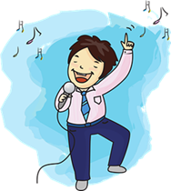







Follow up 4:
Find your partner’s weekly activities to sink their ships!
Beispiel
MO. | DI. | MI. | DO. | FR. | SA. | SO. | Heute
A: Schwimmst du mittwochs?
B: Nein. Ich schwimme mittwochs nicht.
Draw your pictures on any day of the week in the top table. This is just an example. Keep your drawings hidden from your partner!
MO. | DI. | MI. | DO. | FR. | SA. | SO. | Heute
A: Ja, richtig! Ich spiele samstags zu Hause. ☹
Swim x
B: Spielst du samstags zu Hause?
A: Tanzt du donnerstags?
B: Ja, richtig. Ich tanze donnerstags.
Notes:
Handout at end of presentation
Timing: 10 minutes
Aim: to practise oral production of second and first person weak verbs in affirmative and negative sentences with nicht, in the context of weekly activities.
NOTE: This is a repeat of last week’s activity, but this time pupils are expected to use sentences with ‘nicht’ when they don’t do something on a given day. There are also a few new activities to reflect this week’s vocabulary and the negation of whole noun phrases.
Procedure:
Give pupils a copy of the handout and explain that the top table is for them to draw/note down an activity for each day, and the bottom table is for them to keep track of their partner’s activities/ships. It is important that pupils use the verbs/activities on the board, not their own, as otherwise their partner has no chance of guessing, and may not have the German to do so.
Click through the animations on this slide to show pupils a) to draw their pictures (if this takes too long they can just write words e.g. swim; listen song) b) how to conduct the conversation, reminding them of ‘du’ forms of the verb for questions and c) how to keep track of what they have asked their partner. If they ‘sink’ their partner’s ship by guessing the correct activity on the correct day, they can tick/cross/draw a ship in that box.
NOTE: 1) This game has the potential to last a long time, so it could be the first to sink X number of ships! 2) Infinitive German verbs are given on the handout to help pupils, but they still need to conjugate them.
Additional Activities:
Pupils could make positive and negative sentences in the 3rd person to tell another pair what they have found out about their partner. E.g. Sammy spielt mittwochs zu Hause; er tanzt nicht.
Alternatively, pupils might like to have real conversations now about themselves using these and other verbs/activities of their choice. This could be done as a survey around the class: ‘Spielst du sonntags zu Hause?’ ‘Ja/Nein…’.

Slide 11



Follow up 5:

Schreib auf Englisch.
Can you get at least 15 points?
Wörter
 | du hast | kein, keine,kein | Ich weiß es nicht
 | Wie sagt man? | haben | viel
 | der Film | der Hund | das Lied
 | das Wort | die Blume | die Musik
 | hören | spielen | neben
 | schwimmen | tanzen | nicht
Vokabeln
you have
not a, no
I don’t know
x3
How do you say?
to have, having
a lot, much
(the) film
(the) dog
(the) song
x2
(the) word
(the) flower
(the) music
to listen, listening
to play, playing
next to, beside
x1
to swim,
swimming
to dance,
dancing
not, don’t
Notes:
Timing: 5 minutes
Aim: to practise written comprehension of vocabulary from this and revisited weeks.
Procedure:
1. Give pupils a blank grid. They fill in the English meanings of any of the words they know, trying to reach 15 points in total.
Note:
The most recently learnt and practised words are pink, words from the previous week are green and those from week 1 are blue, thus more points are awarded for them, to recognise that memories fade and more effort (heavy lifting!) is needed to retrieve them.

Slide 12
Follow up 5:

Schreib auf Deutsch.
Can you get at least 15 points?
Wörter
 | to have, having | you have | a lot, much
 | not a, no | How do you say? | I don’t know
 | (the) music | (the) flower | next to, beside
 | (the) film | (the) dog | to listen, listening
 | (the) word | (the) song | to play, playing
 | to dance, dancing | not, don’t | to swim, swimming
Vokabeln
haben
du hast
viel
x3
kein, keine, kein
Wie sagt man?
Ich weiß es nicht
die Musik
die Blume
neben
x2
der Film
der Hund
hören
das Wort
das Lied
spielen
x1
tanzen
nicht
schwimmen
Notes:
Timing: 5 minutes
Aim: to practise written comprehension of vocabulary from this and revisited weeks.
Procedure:
1. Give pupils a blank grid. They fill in the German translations of any of the words they know, trying to reach 15 points in total.
Note:
The most recently learnt and practised words are pink, words from the previous week are green and those from week 1 are blue, thus more points are awarded for them, to recognise that memories fade and more effort (heavy lifting!) is needed to retrieve them.

Slide 13
Tschüss!
rot
Notes:
13

Slide 14

Follow up 1
Follow up 1
Read each sentence aloud. Underline the stressed
[er] syllables and circle the unstressed [er] syllables.
Read each sentence aloud. Underline the stressed
[er] syllables and circle the unstressed [er] syllables.
1. Sie lernt Klavier aber es ist nicht schwer.
1. Sie lernt Klavier aber es ist nicht schwer.
2. Wer ist auf dem Konzert? Ist Vater da?
Das ist wunderbar!
2. Wer ist auf dem Konzert? Ist Vater da?
Das ist wunderbar!
3. Wo ist der Lehrer? Ist er im Klassenzimmer?
3. Wo ist der Lehrer? Ist er im Klassenzimmer?
4. Die erste Nummer ist hundert.
4. Die erste Nummer ist hundert.
5. Er hat Geburtstag im September oder Oktober.
5. Er hat Geburtstag im September oder Oktober.
Notes:
HANDOUT
There are 2 copies of the exercise per handout

Slide 15
Follow up 4:
Draw your activities in the first table.
Use the second table to keep track of which of your partner’s
ships you have sunk and what you have already asked.
MO. | DI. | MI. | DO. | FR. | SA. | SO. | Heute
schwimmen- to swim
tanzen-to dance
singen-to sing
das Fußballspiel gewinnen-to win the football match
das Lied hören- to listen to the song
neben Ronja sitzen- to sit next to Ronja
den Film verstehen- to understand the film
zu Hause spielen- to play at home
MO. | DI. | MI. | DO. | FR. | SA. | SO. | Heute
Notes:
HANDOUT

Slide 16
Follow up 5:

Schreib auf Englisch.
Can you get at least 15 points?
Wörter
 | du hast | kein, keine | Ich weiß es nicht
 | Wie sagt man? | haben | viel
 | der Film | der Hund | das Lied
 | das Wort | die Blume | die Musik
 | hören | spielen | neben
 | schwimmen | tanzen | nicht
Vokabeln
x3
x2
x1
Notes:
HANDOUT

Slide 17
Follow up 5:

Schreib auf Deutsch.
Can you get at least 15 points?
Wörter
 | to have, having | you have | a lot, much
 | not a, no | How do you say? | I don’t know
 | (the) music | (the) flower | next to, beside
 | (the) film | (the) dog | to listen, listening
 | (the) word | (the) song | to play, playing
 | to dance, dancing | not, don’t | to swim, swimming
Vokabeln
x3
x2
x1
Notes:
Handout

