Slide 1
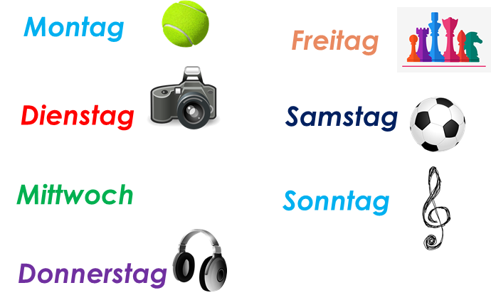
Talking about activities and events
rot
Negation after verbs, with nicht
SSC [er-] [-er]
Term 3 Week 3
Notes:
Artwork by Steve Clarke. Pronoun pictures from NCELP (www.ncelp.org). All additional pictures selected from Pixabay and are available under a Creative Commons license, no
attribution required.
Phonics:
[er-] er [15] Konzert [2350] Person [357] schwer [256] wer? [173]
[-er] wieder [74] aber [31] oder [35] Oktober [1223] wunderbar [1603]
Vocabulary: schwimmen [1863] tanzen [1497]
Revisit 1: language from Term 2
Revisit 2: (du) hast [7]
Jones, R.L & Tschirner, E. (2019). A frequency dictionary of German: Core vocabulary for learners. London: Routledge.
The frequency rankings for words that occur in this PowerPoint which have been previously introduced in these resources are given in the SOW and in the resources that first
introduced and formally re-visited those words.
For any other words that occur incidentally in this PowerPoint, frequency rankings will be provided in the notes field wherever possible.
Note that the first three lessons of the year teach language that can be continuously recycled as lesson routine every lesson in Y3/4.
The idea would be that the class teacher (whether or not s/he teaches the class German can re-use the language as part of the daily routine with the class.
1

Slide 2
aussprechen
[er]
…
er
When the [er] is the stressed syllable, it usually sounds like two short syllables: e-uh
Remember, words are made up of different parts called syllables. A stressed syllable means the part of the word that is most emphasised when you say it aloud.
Notes:
Timing: 1 minute
Aim: to introduce/consolidate SSC [er]
Procedure: 1. Present the letter(s) and say the [er] sound first, on its own. Pupils repeat it with you. 2. Bring up the word ”er” on its own, say it, pupils repeat it, so that they have the opportunity to focus all of their attention on the connection between the written word and its sound.
3. A possible gesture for this would be to point to an imaginary ‘he’, using your index finger, thumb point upwards (to make the gesture more exaggerated), as per the image.
4. Roll back the animations and work through 1-3 again, but this time, dropping your voice completely to listen carefully to the pupils saying the [er] sound, pronouncing ”er” and, if using, doing the gesture. Word frequency (1 is the most frequent word in German): er [15] Source: Jones, R.L. & Tschirner, E. (2006). A frequency dictionary of German: core vocabulary for learners. Routledge
2

Slide 3
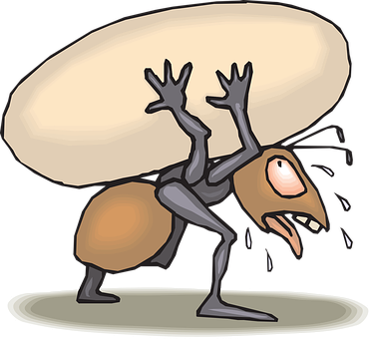
aussprechen
[er]
In all of these words, the [er] is part of the stressed syllable. This means it is emphasised or stronger than the other part of the word.
…
schwer
fertig
[heavy, difficult]
er
Konzert
wer?
Notes:
Timing: 2 minutes
Aim: to introduce/consolidate SSC [er]
Procedure:
Introduce and elicit the pronunciation of the individual SSC [er] and then the source word again ‘er’ (with gesture, if using).
Then present and elicit the pronunciation of the five cluster words.
The cluster words have been chosen for their high-frequency, from a range of word classes, with the SSC (where possible) positioned within a variety of syllables within the words (e.g. initial, 2nd, final etc.). Additionally, we have tried to use words that build cumulatively on previously taught SSCs (see the Phonics Teaching Sequence document) and do not include new SSCs. Where new SSCs are used, they are often consonants which have a similar symbol-sound correspondence in English.
Word frequency (1 is the most frequent word in German): er [15] fertig [n/a] Konzert [2350] schwer [256] wer? [173]
Source: Jones, R.L. & Tschirner, E. (2006). A frequency dictionary of German: core vocabulary for learners. Routledge

Slide 4
aussprechen
[er]
…
As you know [er] can also sound like ‘uh’. This is when the syllable is unstressed, most often at the end of the word.
wieder
[again]
Notes:
Timing: 1 minute
Aim: To introduce/consolidate SSC [er]
Procedure: 1. Present the letter(s) and say the [er] sound first, on its own. Pupils repeat it with you. 2. Bring up the word ”wieder” on its own, say it, pupils repeat it, so that they have the opportunity to focus all of their attention on the connection between the written word and its sound.
3. A possible gesture for this would be to roll your hands over in the air, clockwise. Your hands are in front of your body.
4. Roll back the animations and work through 1-3 again, but this time, dropping your voice completely to listen carefully to the pupils saying the [er] sound, pronouncing ”wieder” and, if using, doing the gesture. Word frequency (1 is the most frequent word in German): wieder [74] Source: Jones, R.L. & Tschirner, E. (2006). A frequency dictionary of German: core vocabulary for learners. Routledge
4

Slide 5
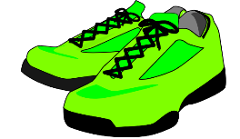
aussprechen
[er]
In all of these words, a different part of the word is the stressed syllable, not the [er] sound.
…
aber
Oktober
[but]
wieder
?
Wonderful!
[again]
oder
wunderbar
[or]
Notes:
Timing: 2 minutes
Aim: To introduce/consolidate SSC [er]
Procedure:
Introduce and elicit the pronunciation of the individual SSC [er] and then the source word again ‘wieder’ (with gesture, if using).
Then present and elicit the pronunciation of the four cluster words.
Word frequency (1 is the most frequent word in German): wieder [74] aber [31] oder [35] Oktober [1223] wunderbar [1603] Source: Jones, R.L. & Tschirner, E. (2006). A frequency dictionary of German: core vocabulary for learners. Routledge

Slide 6
[er]
Listen to and read the 8 words. Can you find the stressed syllable?
Is the [er] stressed or unstressed?
Hör zu.
 |  | stressed [er] | unstressed [er]
1 | September
2 | lernen
3 | Wasser
4 | November
5 | erst
6 | Herz
7 | Nummer
8 | der
Can you clap the syllables in each word, clapping louder for the stressed syllables?
Notes:
Timing: 5 minutes
Aim: to consolidate the SSC [er] by identifying the stressed and unstressed syllables in known and unknown words.
Procedure:
1. Explain that pupils are going to hear words with [er]. On first listening they need to highlight/circle/jot down the syllable of the word they hear that is stressed/emphasised.
2. Play number one and click to show the syllable they should have highlighted. Then discuss as a class whether it is a stressed or unstressed [er].
3. Repeat for items 2-8.
4. Click to bring up the call-out and try clapping through the words together as a class, clapping louder for the stressed syllable in each word.
Transcript:
September
lernen
Wasser
November
Erst
Herz
Nummer
der
Word frequency:
September [1035] November [1273] erst [132] Herz [532]

Slide 7
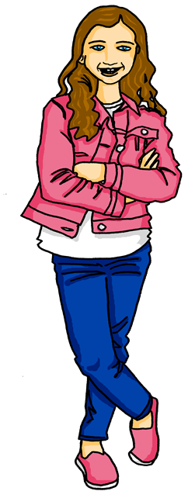
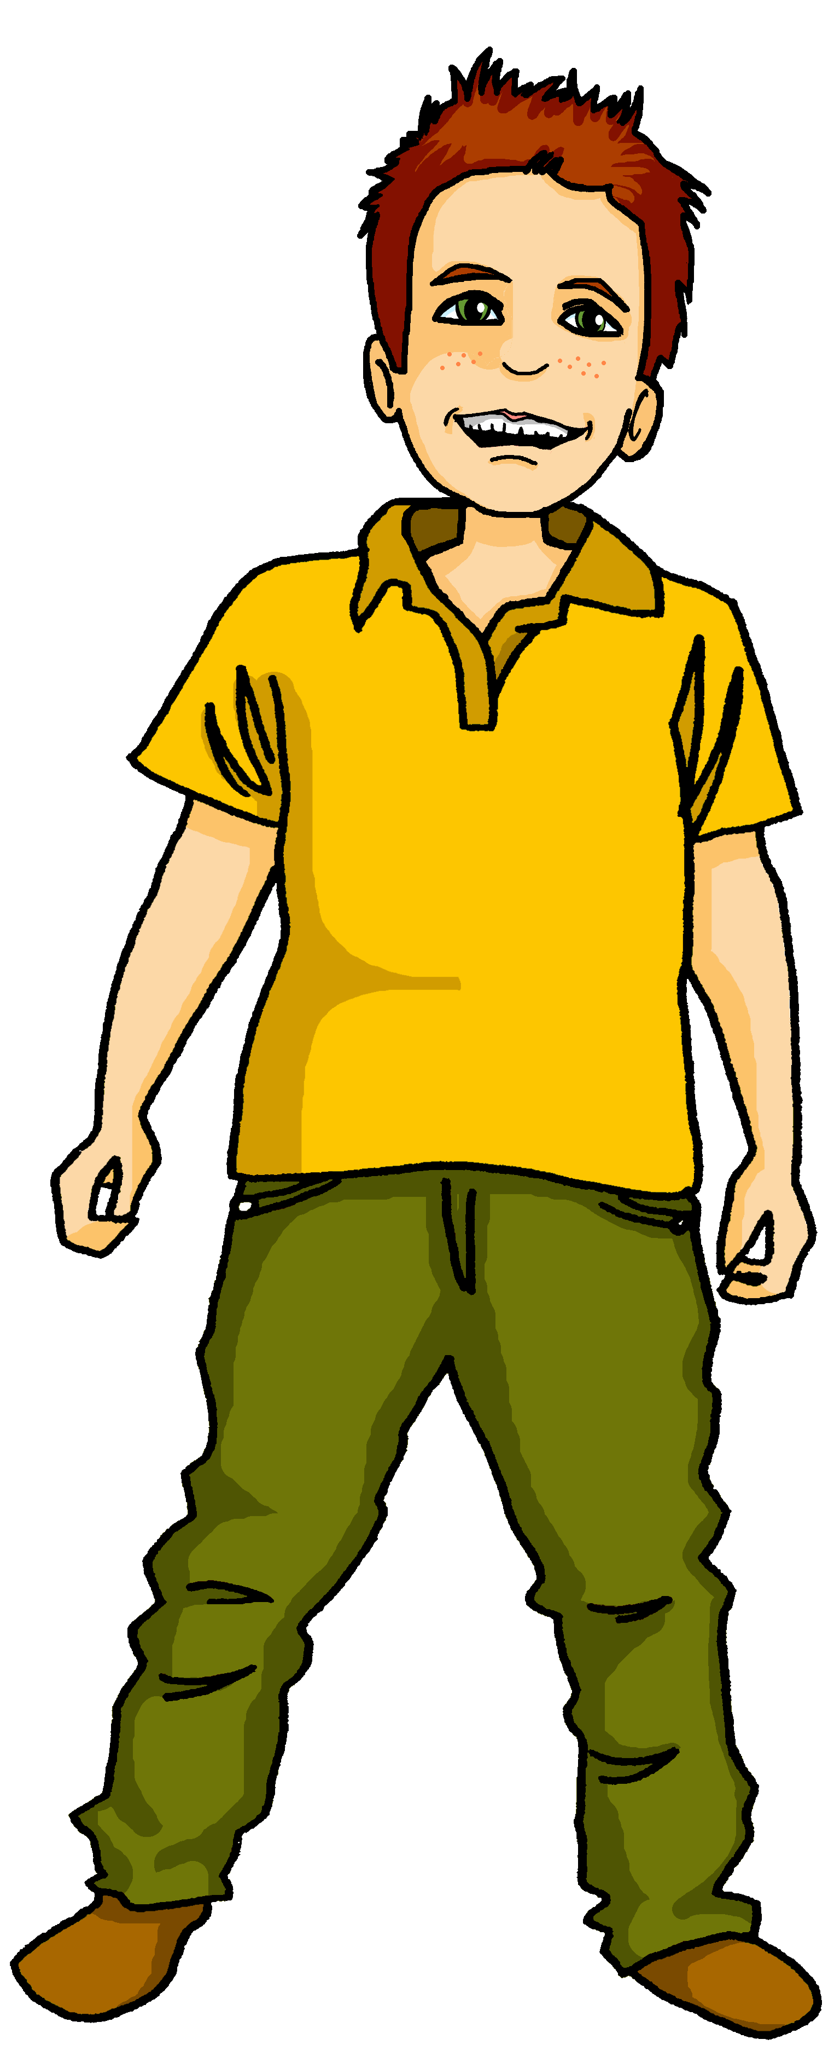
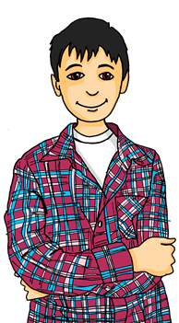
Johanna hat Cousins in der Schweiz.*
Mein Lieblingshobby ist Eishockey. Ich spiele samstags.
Sie ist Ronja.
Hallo! Ich bin Ronja.
Er ist Lias.
Mein Lieblingshobby ist Singen! Ich singe mittwochs.
Ich bin Lias!
Let’s find out what our Swiss cousins like to do in their free time!
*die Schweiz-Switzerland
Notes:
Timing: 2 minutes
Aim: to introduce two new characters, Johanna’s cousins in Switzerland, and to revise ‘Lieblings-’ and verbs with time adverbs.
Procedure:
1. Read the slide together as a class to meet the two new characters. Click to bring up Ronja then Lias.
2. Click to bring up Moritz (Johanna’s brother) who wants to introduce their favourite activities too.
2. Click to bring up Ronja’s then Lias’ favourite hobbies. Ask pupils what ‘Lieblings’ means and what each of the cousins likes doing and when they do it.

Slide 8
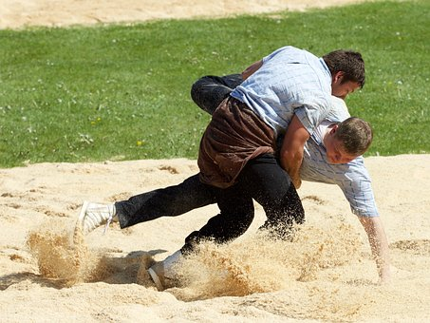
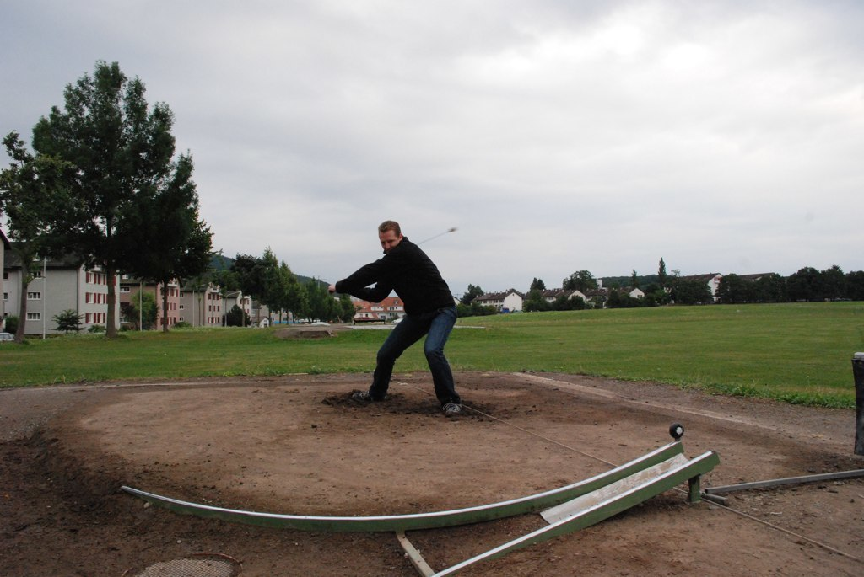
Kultur
Lieblingssportarten* in der Schweiz
Sag die Wörter. Was ist das?
Fußball
Skilaufen
Eishockey
Tennis
Schwingen
Hornussen
Hornussen is another traditional Alpine sport. It is a combination of golf and baseball. When hit, the ‘Hornuss’ (rubber puck, called ‘hornet’) can whizz through the air at up to 300 km/h and creates a buzzing sound!
Schwingen is an Alpine wrestling sport. It is a duel between two competitors, who wrestle in a circle of sawdust. The first one to get the other’s back on the ground wins!
*Sportarten= (types of) sports
Notes:
Timing: 5 minutes
Aim: to practise pronunciation of and to gain cultural knowledge of most popular sports in Switzerland.
Procedure:
1. Click to bring up the top 6 sports one by one. Pupils should use their knowledge of phonics to try to pronounce them accurately.
2. Click for the audio buttons to appear and click to check pronunciation if needed.
3. Ask pupils to discuss which sports they think they are (should be able to work out 1-4!) then explain that 5 and 6 are traditional Swiss sports which don’t happen much outside of Switzerland.
4. Click to bring up Lias and his explanations of the two sports.
Source: Most Popular Sports in Switzerland: https://studyinginswitzerland.com/sports-in-switzerland/
Picture source: David Haberthür, CC BY 2.0 via Wikimedia Commons
Video clip (English introduction, then English translation of interview with Swiss Hornussen champion): https://digg.com/video/hornussen-video The video shows how the Hornuss (puck, called Hornet) is hit and how the opposing team tries to stop it from hitting the ground with their wooden paddles.
8

Slide 9
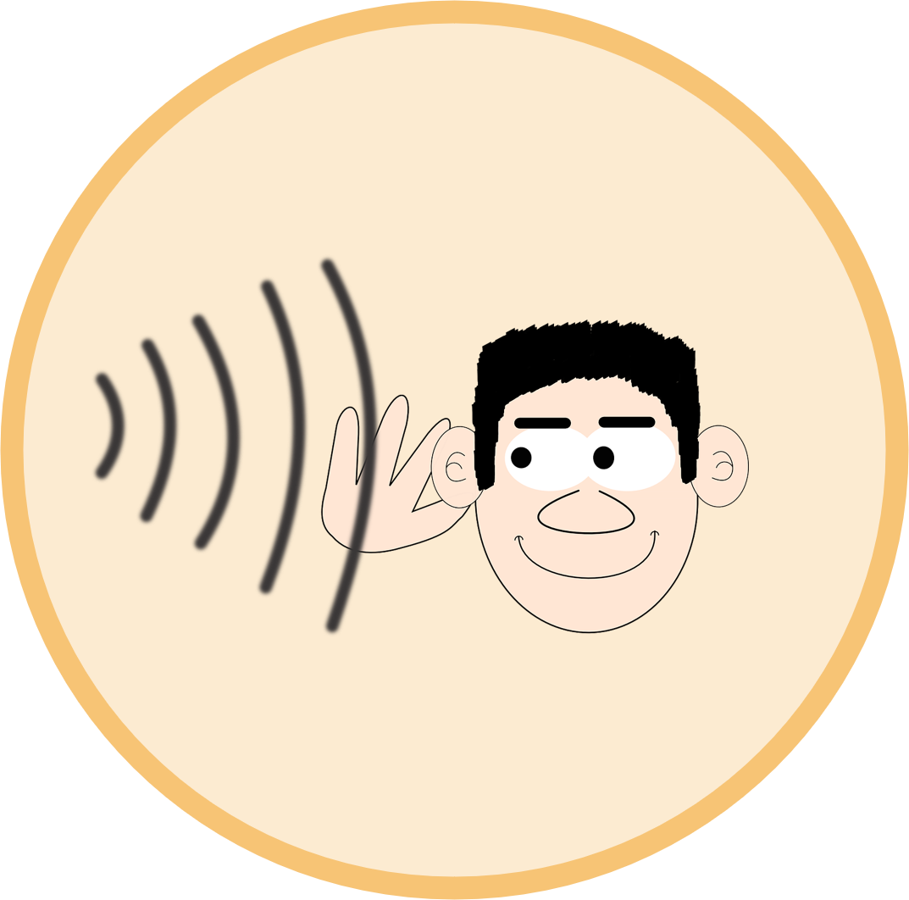
Vokabeln
Vokabeln lernen
Wörter
Hör zu und wiederhole.
schwimmen
tanzen
spielen
singen
lernen
hören
Notes:
Timing: 5 minutes
Aim: to present and practise 2 new items of vocabulary for this week and to recap 4 other key verbs.
Procedure:
Click to bring up the verb ‘schwimmen’ then the picture and repeat as a class. Click again to bring up ‘tanzen’ and picture and repeat.
Click to bring up the next four with pictures first. Can pupils remember the German infinitives? Click to bring each up in turn.
Repeat all 6 verbs as a class.
Click for all pictures to disappear. Ask pupils in pairs to recall the English for all 6. Click again for all pictures to return.
Click for all 6 words to disappear. Ask pupils in pairs to recall the German. Click again for all words to return.
9

Slide 10
Nicht (not)
You already know how to use nicht (not):
Use nicht before an adjective or adverb to mean not:
Ich bin hier.
Ich bin nicht hier.
I am here.
I am not here.
Use nicht before ‘der, die, das’ and a noun to mean not the:
Das ist das Geschenk.
Das ist nicht das Geschenk.
That is the present.
That is not the present.
Use nicht before proper nouns to mean not:
Das ist Lias.
Das ist nicht Lias.
That is Lias.
That is not Lias.
Notes:
Timing: 2 minutes (two slides)
Aim: to revise the already known uses of nicht.
Procedure:
Click through the animations to recap uses of nicht information.
Elicit English translation for the German examples provided.
10

Slide 11
Nicht (not)
We also use nicht to mean not before ‘my’ and ‘your’:
Das ist mein Lieblingshobby.
Das ist nicht mein Lieblingshobby!
That is my favourite hobby.
That is not my favourite hobby!
Das ist deine Lehrerin.
Das ist nicht deine Lehrerin.
That is your teacher.
That is not your teacher.
Notes:
2/2
11

Slide 12
Nicht + Verb (don’t)
Note the word order difference between English and German!
We also use nicht after a verb to say what we don’t do:
Ich schwimme nicht.
I don’t swim.
Du tanzt aber er tanzt nicht.
You dance but he
doesn’t dance.
Remember! No ‘s’ here because the verb stem ends in –z. The ‘du’ and ‘er, sie, es’ forms are the same.
Notes:
Timing: 2 minutes
Aim: to introduce the use of ‘nicht’ with verbs to negate them.
Procedure:
Click through the animations to present the new information.
Elicit English translation for the German examples provided.
12

Slide 13
hören
Do they or don’t they?
Lias is talking about what he does/doesn’t do and what his sister Ronja does/doesn’t do.
Hör zu.
 |  | I | she
1
I don’t swim
Remember that the word order in English is different for the negative sentences.
2
She listens to music
3
She doesn’t dance
4
I sing a song
5
She learns ice hockey
6
I play football
7
I don’t win
8
She doesn’t sing
Notes:
Timing: 5 minutes
Aim: to practise aural comprehension of negative sentences with ‘nicht’ in the first and third person singular.
Procedure:
1. Explain that pupils are listening to Lias talking about himself and Ronja; what they do and what they don’t do.
2. Play audio 1. Pupils must tick if the sentence they hear is affirmative and cross if negative.
3. Repeat for items 2-8. Click for answers.
4. Now pupils are going to listen again and translate each sentence, identifying whether the sentence is in the ‘I’ or ‘She’ form. Use the call-out to remind about word order for the negative sentences.
5. Repeat for items 2-8. Click for answers.
Transcript:
Ich schwimme nicht.
Sie hört Musik.
Sie tanzt nicht.
Ich singe ein Lied.
Sie lernt Eishockey.
Ich spiele Fußball.
Ich gewinne nicht.
Sie singt nicht.
13

Slide 14
Nicht + Verb (don’t)
We know that we use nicht after a verb to mean ‘don’t’:
Ich singe nicht.
I don’t sing.
However, when nicht negates a whole noun phrase, it goes to the end of the phrase:
Ich singe das Lied nicht.
I don’t sing the song.
Note again the word order difference between English and German!
Notes:
Timing: 2 minutes
Aim: to introduce the use of ‘nicht’ with noun phrases to negate them.
Procedure:
Click through the animations to present the new information.
Elicit English translation for the German examples provided.
14

Slide 15
Ronja is saying what people don’t do. Is each sentence general (A) or specific (B)? Is there a noun hiding behind each ?
Schreib A oder B.
A | B
I don’t win. | I don’t win the game.
You don’t play. | You don’t play at home.
I don’t sing. | I don’t sing the song.
She doesn’t hear. | She doesn’t hear the question.
I don’t understand. | I don’t understand the word.
He doesn’t learn. | He doesn’t learn the answer.
You don’t repeat. | You don’t repeat the song.
1) Ich gewinne das Spiel nicht.
2) Du spielst nicht .
3) Ich singe nicht .
4) Sie hört die Frage nicht.
5) Ich verstehe das Wort nicht.
6) Er lernt nicht .
7) Du wiederholst das Lied nicht.
1
2
3
4
5
6
7
Notes:
Timing: 5 minutes
Aim: to practise written comprehension of nicht with a verb to mean ‘don’t’ with individual verbs and with whole noun phrases.
Procedure:
Explain that all of Ronja’s sentences are negative, but some are general e.g. I don’t play, whilst some are specific e.g. I don’t play the game. Based on the position of nicht, pupils need to decide whether or not a noun is behind the red blobs.
Click to bring up the table with possible English translations.
Pupils write down 1-7 and A or B for each sentence.
Where they have chosen B, they could also try to translate the missing nouns into German.
Click to circle the correct answer A or B.
Elicit suggestions for the missing German nouns from pupils, then click to reveal if anything/what is behind the blobs.
Additional Tasks:
1. Pupils could rewrite numbers 2, 3 and 6, adding a noun with a definite article and therefore moving nicht to the end of the sentence. E.g. du spielst das Spiel nicht; Ich singe das Lied nicht; Er lernt das Wort nicht.
2. Pupils could alter the person (not) doing each verb e.g. 1) Er gewinnt das Spiel nicht, taking care to change their verb endings.

Slide 16
Tschüss!
rot
Notes:
16

