Slide 1
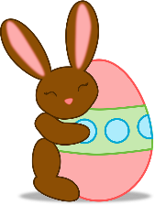
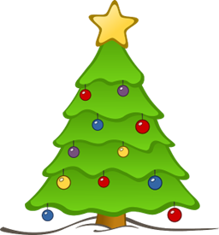
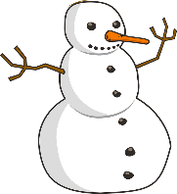
Talking about activities and events
rot
Follow ups 1-5
Term 3 Week 4
Notes:
Artwork by Steve Clarke. Pronoun pictures from NCELP (www.ncelp.org). All additional pictures selected from Pixabay and are available under a Creative Commons license, no attribution required.
Phonics:
[-ig] richtig [177] dreißig [2046] fertig [n/a] ruhig [911] wichtig [144]
Vocabulary: Januar [1052] Februar [1093] März [987] April [1004] Mai [1048] Juni [1148] Juli [1544] August [1929] September [1035] Oktober [1223] November [1273] Dezember [1527] Geburtstag [1779] Monat [316] wann [657]
Revisit 1: Montag [1044] Dienstag [1356] Mittwoch [1187] Donnerstag [1244] Freitag [981] Samstag [1112] Sonntag [804] Tag [111] Woche [219] heute [116] morgen [752]
Revisit 2: Film [505] Lieblings- [n/a] Lied [1733] Musik [509]
Jones, R.L & Tschirner, E. (2019). A frequency dictionary of German: Core vocabulary for learners. London: Routledge.
The frequency rankings for words that occur in this PowerPoint which have been previously introduced in these resources are given in the SOW and in the resources that first introduced and formally re-visited those words.
For any other words that occur incidentally in this PowerPoint, frequency rankings will be provided in the notes field wherever possible.

Slide 2
aussprechen
[-ig]
…
The [-ig] sound is mostly found at the end of words.
richtig
Notes:
Timing: 1 minute
Aim: To introduce/consolidate SSC [-ig]
Procedure: 1. Present the letter(s) and say the [-ig] sound first, on its own. Pupils repeat it with you. 2. Bring up the word ”richtig” on its own, say it, pupils repeat it, so that they have the opportunity to focus all of their attention on the connection between the written word and its sound.
3. A possible gesture for this would be to mime ‘correct’ by tracing a tick in the air with the index finger on your right hand.
4. Roll back the animations and work through 1-3 again, but this time, dropping your voice completely to listen carefully to the pupils saying the [-ig] sound, pronouncing ”richtig” and, if using, doing the gesture. Word frequency (1 is the most frequent word in German): richtig [177]
Source: Jones, R.L. & Tschirner, E. (2019). A frequency dictionary of German: core vocabulary for learners. Routledge
2

Slide 3
aussprechen
[-ig]
…
30
fertig
dreißig
richtig
[ready, finished]
ruhig
wichtig
[quiet, calm]
[important]
Notes:
Timing: 2 minutes
Aim: To introduce/consolidate SSC [-ig]
Procedure:
Introduce and elicit the pronunciation of the individual SSC [-ig] and then the source word again ‘richtig’ (with gesture, if using).
Then present and elicit the pronunciation of the four cluster words.
The cluster words have been chosen for their high-frequency, from a range of word classes, with the SSC (where possible) positioned within a variety of syllables within the words (e.g. initial, 2nd, final etc.). Additionally, we have tried to use words that build cumulatively on previously taught SSCs (see the Phonics Teaching Sequence document) and do not include new SSCs. Where new SSCs are used, they are often consonants which have a similar symbol-sound correspondence in English.
Word frequency (1 is the most frequent word in German): richtig [177] dreißig [2046] fertig [n/a] ruhig [911] wichtig [144] Source: Jones, R.L. & Tschirner, E. (2019). A frequency dictionary of German: core vocabulary for learners. Routledge

Slide 4
Sag die Wörter. Was ist das auf Englisch?
Follow up 1
…
What do you think these words could mean? Remember they are all adjectives ending in –y in English!
The German [-ig] is the equivalent of the English [-y] at the end of adjectives.
Can you pronounce these [-ig] words like Moritz, and then like Lias?
aussprechen
[ik]
60
[ich]
fettig
heilig
windig
[fatty]
[holy]
hungrig
frostig
[windy]
grasig
sonnig
[frosty]
[hungry]
[sunny]
[grassy]
salzig
schläfrig
schokoladig
[salty]
[sleepy]
[chocolatey]
schleimig
fluffig
0
milchig
[slimy]
[fluffy]
START
[milky]
Notes:
Timing: 5 minutes
Aim: to practise pronouncing unknown words with the SSC [-ig] and to make the link between German [-ig] and English [-y] in adjectives.
Procedure:
Explain that all of these words end in –ig, and can be translated by English adjectives endings in –y.
Pupils work in pairs and each try to pronounce all of the words within the 60 second time limit. They should have one go pronouncing the –ig the Northern German way [-ich], like Moritz, and then another go pronouncing it [-ik], like Lias from Switzerland. Click Start to start the timer.
If needed, click on the yellow audio buttons to check the [-ich] pronunciation and the white audio buttons to check the [-ik] pronunciation.
Click to bring up the text box asking pupils to think about meanings and give them 1 minute to discuss.
Click for English translations to appear. Give pupils time to notice the many cognates and the –y replacing the –ig.
Word frequency:
windig [N/A] sonnig [N/A] schokoladig [N/A] schleimig [N/A] fettig [N/A] hungrig [N/A] salzig [N/A] milchig [N/A] heilig [2124] frostig [N/A] grasig [N/A] schläfrig [N/A] fluffig [N/A] Source: Jones, R.L. & Tschirner, E. (2019). A frequency dictionary of German: core vocabulary for learners. Routledge

Slide 5
Follow up 2
A Hör zu. Was hörst du?
B Schreib auf Englisch.
B
May | August | March
B
1
2
3
4
5
6
1
I have | You have | She has
His birthday is in March.
Your birthday is in November.
2
Who | When | What
Who has a birthday in May?
3
month | day | week
My favourite day is Saturday.
4
November | October | September
My birthday is in October.
My favourite month is January.
5
June | January | July
When is your birthday?
6
birthday | Monday | Tuesday
Notes:
Timing: 5 minutes
Aim: to practise aural comprehension of this week’s new vocabulary (months) and revisited vocabulary.
Procedure:
(Part A) Click to listen to each audio item B-6. Pupils write down the word they hear mentioned (selecting from the 3 given) in each sentence.
Click to circle the correct answers.
(Part B) Pupils listen again to B-6 and try to translate the sentences they hear into English, in full this time. They might find it easier to make notes in German then think about English word order afterwards. E.g. er hat, März→He has birthday in March→ His birthday is in March.
Elicit possible translations then click to bring up English translations.
Transcript
Beispiel: Er hat im März Geburtstag.
1. Du hast im November Geburtstag.
2. Wer hat im Mai Geburtstag?
3. Mein Lieblingstag ist Samstag.
4. Ich habe im Oktober Geburtstag.
5. Mein Lieblingsmonat ist Januar.
6. Wann hast du Geburtstag?

Slide 6
Follow up 3
Schreib auf Deutsch.
A
März
1. Januar Februar April
B
Oktober
Er hat
2. September November Dezember
Du hast
Ich habe
Sie hat
Juli
3. Mai Juni August
im März
im Dezember
im Mai
im Juli
Mai
Juni
4. April Juli
Geburtstag.
Januar
5. Februar März
April
Beispiel:
Er hat im Juli Geburtstag= his birthday is in July.
Notes:
Timing: 5 minutes
Aim: to practise written production of the months of the year and full sentences with haben.
Procedure:
For activity A, pupils write down the missing month(s) in each sequence.
Click to display answers.
Click to bring up activity B. Here pupils must write their own sentences using one of each colour components in the circle, and translate into English. E.g. Er hat im Mai Geburtstag= his birthday is in May. Click again to bring up the example (Beispiel).
Additional tasks:
1. Pupils could continue to write their own sentences e.g. Ich habe im Oktober Geburtstag. Susie hat im April Geburtstag.

Slide 7
Follow up 4
Wer hat Geburtstag wann?
Januar | Februar | März | April
Mai | Juni | Juli | August
September | Oktober | November | Dezember
sprechen
James
Wann hast du Geburtstag?
Mia
Ich habe
im Mai Geburtstag.
Kieran
Is it someone’s birthday this month? If so, wish them a happy birthday in German:
Alles Gute zum Geburtstag!
Notes:
Timing: 5 minutes
Aim: to provide oral practice of asking and answering about birthdays.
Procedure:
Using the balloons, remind pupils how to ask ‘When is your birthday?’ and ‘My birthday is in…’. Take a few volunteers from around the class to ask and answer, ensuring pupils know to substitute their own month.
Explain that, like Ronja did with her family, the pupils are going to do a class birthday calendar and need to fill in names above each month.
Demonstrate how pupils should move around the classroom, asking and answering in GERMAN and jotting down names as they go. Click to bring up the 3 different names filled in on the calendar to show that they should note down names of classmates.
If time allows, ask for feedback using the questions: Wer hat im Mai Geburtstag? and Wann hat Kieran Geburtstag? Pupils should try to answer in full sentences: Mia hat im Mai Geburtstag!
Finally, bring up the callout to teach how to say ‘Happy Birthday’ in German. Repeat together as a class. See if pupils can remember it in German each time there is a classmate’s birthday.
Additional Tasks:
Pupils could write up their findings about others in their class using full sentences. E.g. Mia hat im Mai Geburtstag.
The class could make a large birthday calendar in German with everybody’s birthday to display on the wall of the classroom.
Pupils could have conversations in pairs about who has birthdays when, using the two question types above.

Slide 8
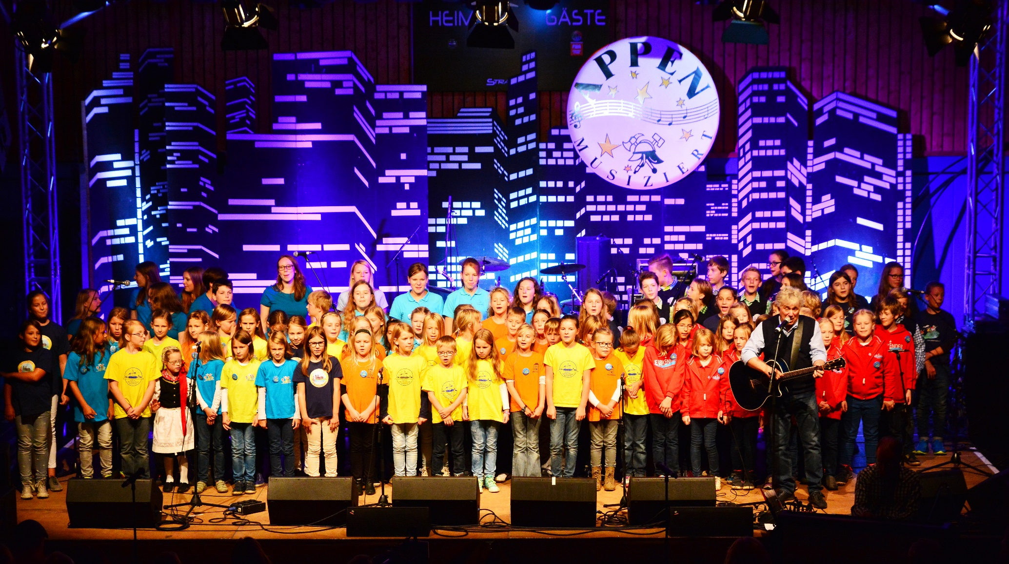
Hör zu und sing mit!
Rolf Zuckowski is a German musician. German children grow up knowing his catchy songs!
See if you can join in with the months of the year in this song!
Jahr- year
Uhr- clock, watch
Notes:
Timing: Optional 5 mins (also features in main lesson)
Aim: to practise oral production of the months of the year in a memorable way.
Procedure: 1. Play the video and invite pupils to sing along. It is repetitive and catchy. 2. Point out Rolf Zuckowski and explain that German children would grow up knowing him and his songs.
Note:
The ideas in the compound noun ‘Jahresuhr’ may be understood from the two separate words, but finding an English equivalent can be tricky (yearly clock, calendar year; year’s clock?)
Word frequency of unknown words (1 is the most frequent word in German): Jahr [53] stehen 85] niemals [1402] still [1301] wecken [2578] uns [75] Lebenslust [N/A] anfangen [497] ganz [69] von [9] vorne [N/A] Source: Jones, R.L. & Tschirner, E. (2019). A frequency dictionary of German: core vocabulary for learners. Routledge
Photo attribution: Frank Schwichtenberg, CC BY-SA 3.0 <https://creativecommons.org/licenses/by-sa/3.0>, via Wikimedia Commons
Video link: https://www.youtube.com/watch?v=WJ0uJo5kJ04

Slide 9
Follow up 5:

Schreib auf Englisch.
Can you get at least 15 points?
Wörter
 | der Film | das Lied | heute
 | Lieblings | die Musik | die Woche
 | Samstag | der Tag | morgen
 | Dienstag | Mittwoch | Donnerstag
 | der Geburtstag | der Monat | Wann?
 | August | Oktober | Dezember
 | Februar | April | Juni
(the) film
(the) song
today
Vokabeln
x3
favourite
(the) music
(the) week
Saturday
(the) day
tomorrow
x2
Tuesday
Wednesday
Thursday
(the) birthday
(the) month
When?
August
October
December
x1
February
April
June
Notes:
Timing: 5 minutes
Aim: to practise written comprehension of vocabulary from this and revisited weeks.
Procedure: 1. Give pupils a blank grid. They fill in the English meanings of any of the words they know, trying to reach 15 points in total.
Note: The most recently learnt and practised words are pink, words from the previous week are green and those from week 1 are blue, thus more points are awarded for them, to recognise that memories fade and more effort (heavy lifting!) is needed to retrieve them.

Slide 10
Follow up 5:

Schreib auf Deutsch.
Can you get at least 15 points?
Wörter
 | (the) music | (the) day | tomorrow
 | (the) film | favourite | (the) song
 | Sunday | today | (the) week
 | Monday | Wednesday | Friday
 | (the) birthday | (the) month | When?
 | July | September | November
 | January | March | May
die Musik
der Tag
morgen
Vokabeln
x3
der Film
Lieblings
das Lied
Sonntag
heute
die Woche
x2
Montag
Mittwoch
Freitag
der Geburtstag
der Monat
Wann?
x1
Juli
September
November
Januar
März
Mai
Notes:
Timing: 5 minutes
Aim: to practise written production of vocabulary from this and revisited weeks.
Procedure: 1. Give pupils a blank grid. They fill in the German meanings of any of the words they know, trying to reach 15 points in total.
Note: The most recently learnt and practised words are pink, words from the previous week are green and those from week 1 are blue, thus more points are awarded for them, to recognise that memories fade and more effort (heavy lifting!) is needed to retrieve them.

Slide 11
Tschüss!
rot
Notes:
11

Slide 12
Follow up 4
Wer hat Geburtstag wann?
Januar | Februar | März | April
Mai | Juni | Juli | August
September | Oktober | November | Dezember
sprechen
Wann hast du Geburtstag?
Ich habe
im Mai Geburtstag.
Notes:
HANDOUT
(Pupils write in classmates’ names above the month of their birthday.)

Slide 13
Follow up 5:

Schreib auf Englisch.
Can you get at least 15 points?
Wörter
 | der Film | das Lied | heute
 | Lieblings | die Musik | die Woche
 | Samstag | der Tag | morgen
 | Dienstag | Mittwoch | Donnerstag
 | der Geburtstag | der Monat | Wann?
 | August | Oktober | Dezember
 | Februar | April | Juni
Vokabeln
x3
x2
x1
Notes:
HANDOUT

Slide 14
Follow up 5:

Schreib auf Deutsch.
Can you get at least 15 points?
Wörter
 | (the) music | (the) day | tomorrow
 | (the) film | favourite | (the) song
 | Sunday | today | (the) week
 | Monday | Wednesday | Friday
 | (the) birthday | (the) month | When?
 | July | September | November
 | January | March | May
Vokabeln
x3
x2
x1
Notes:
HANDOUT

