Slide 1
Experiences at home and away
blau
Follow ups 1-5
Term 3 Week 1
Notes:
Artwork by Steve Clarke. Pronoun pictures from NCELP (www.ncelp.org). All additional pictures selected from Pixabay and are available under a Creative Commons license, no
attribution required.
Phonics: [v] vier [200] vergessen [584] Vater [232] positiv [516] viel [56]
Vocabulary: Angst (vor) [392] Durst [n/a] Hunger [2097] Spaß [1045] froh [1424] müde [2000] bitte [471] danke [877]
Revisit 1: gehen [66] sein [3] Bibliothek [2366] Dom [4916] Garten [1158] Haus [147] Kino [2020] Stadt [204] Wohin? [1811]
Revisit 2: bekommen [212] bleiben [113] lesen [305] machen [58] schreiben [184] sein [3] spielen [205] Abend [342] Essen [323] Film [505] Geschichte [262] Hausaufgabe(n) [n/a] Morgen [621] Nachmittag [1464] Schule [359] heute [116]
manchmal [382] oft [223] nie [196] jeden Tag [n/a]
Jones, R.L & Tschirner, E. (2019). A frequency dictionary of German: Core vocabulary for learners. London: Routledge.
The frequency rankings for words that occur in this PowerPoint which have been previously introduced in these resources are given in the SOW and in the resources that first
introduced and formally re-visited those words.
For any other words that occur incidentally in this PowerPoint, frequency rankings will be provided in the notes field wherever possible.
Remember that at the start of the course (first three lessons of Rot/Gelb) pupils learnt language (for greetings and register taking) that can still be part of the lesson routines in upper KS2 (Blau/Grün). They are not re-taught, as we anticipate that teachers have built these in from early in lower KS2.

Slide 2
aussprechen
[v]
…
vier
Notes:
Timing: 1 minute
Aim: to introduce the SSC [v].
Procedure:
Introduce the SSC and present the source word ‘vier’ (with gesture, if using).
Click to bring on the picture and get pupils to repeat the word ‘vier’ (with gesture, if using).
Note:
a gesture for ‘vier’ might be to hold 4 fingers up.
2

Slide 3
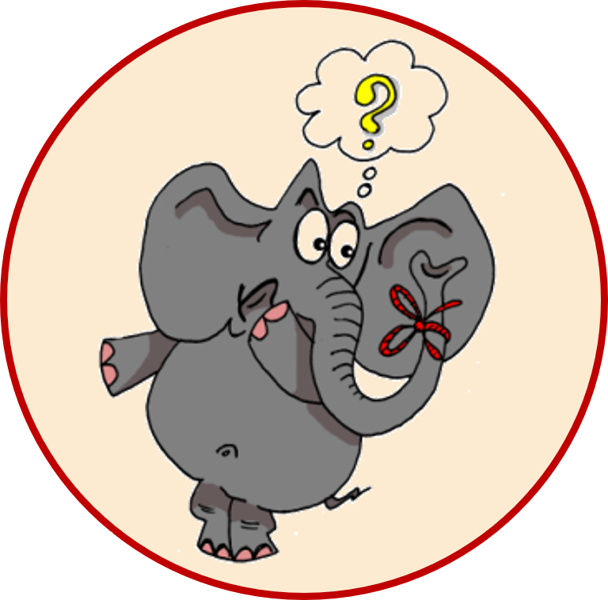
aussprechen
[v]
…
vergessen
Vater
vier
4
[to forget]
positiv
viel
[a lot, much]
Notes:
Timing: 1 minute
Aim: to consolidate the SSC [v].
Procedure:
Re-present the SSC and the source word ‘vier’ (with gesture, if using).
Click to bring on the picture and get pupils to repeat the word ‘vier’ (with gesture, if using).
Present the cluster words in the same way, bringing on the picture and getting pupils to pronounce the words.
Frequency:
vier [200] vergessen [584] Vater [232] positiv [516] viel [56]
Jones, R.L & Tschirner, E. (2019). A frequency dictionary of German: Core vocabulary for learners. London: Routledge.

Slide 4
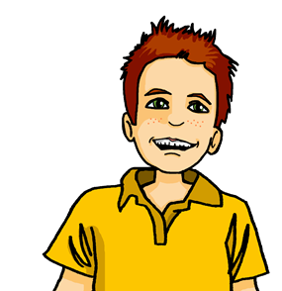
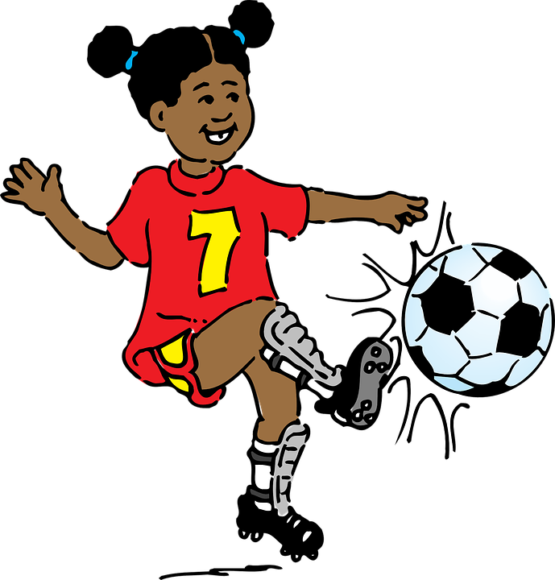
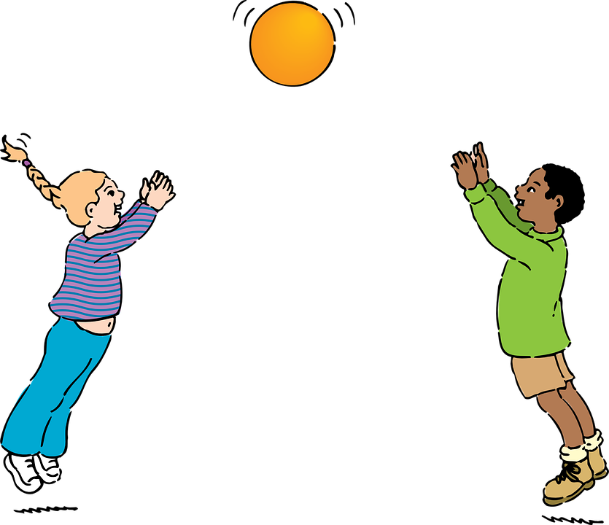
Follow up 1
Was ist das?.
Ich sehe was*…
Was ist das?
rot
blau
gelb
groß [big]
klein [small]
Anfang?
Das ist rot…
werfen?
Falsch!
Richtig!
was – what?, something
Bewegung
Anfang
Vorlesung
Zwiebel
aktiv
Luft
]
verlassen
Fuß
werfen
Wal
Notes:
Timing: 5 minutes
Aim: to practise distinguishing between [v]/[f] (where [v] usually sounds like [f]), and [w] (pronounced like English [v]).
Procedure: 1. Point out that the words are all red, blue, yellow, big or small, and that there is a key to help them with the German for these words. They are going to play a speaking game like eye spy with the words. Explain that Ich sehe means ‘I see’ or here, ‘I spy’. 2. Click to bring up the example conversation between the teacher and Moritz. Explain that the pupils will take on Moritz’ role first of all, and you will be the teacher. 3. Play the game as a class, with you saying the teacher role and the pupils guessing the word, based on whether you say rot/gelb/blau/groß/klein. Check that pupils are applying the pronunciation rules for [v[/[f] and [w] in each word. Repeat a few times with different words.
4. Pupils can then play in pairs, with one pupil taking on the teacher role and choosing a word and the other guessing the word.
Word frequency (1 is the most frequent word in German): aktiv [790] Anfang (beginning) [427] Bewegung (movement, exercise) [709] Fuß 573] Luft (air) [487] verlassen (to leave) [450] Vorlesung (talk, presentation) [703] Wal [>5009] werfen (throw) [718] Zwiebel (onion) [>5009]
Source: Jones, R.L. & Tschirner, E. (2019). A frequency dictionary of German: core vocabulary for learners. Routledge

Slide 5
Follow up 2:

Schreib auf Englisch.
Can you get at least 15 points?
Wörter
 | heute | der Nachmittag | die Hausaufgabe(n)
 | nie | manchmal | der Abend
 | die Stadt | der Dom | die Bibliothek
 | das Kino | wohin? | gehen
 | froh | (die) Angst (vor) | (der) Durst
 | sie sind | (der) Spaß | ihr seid
 | müde | du hast | (der) Hunger
today
(the) afternoon
(the) homework
Vokabeln
x3
never
sometimes
(the) evening
(the) town
(the) cathedral
(the) library
x2
(the) cinema
where…to?
to go, going
glad, happy
(the) fear (of)
(the) thirst
they are
(the) fun
you (pl., inf.) are
x1
tired
you have
(the) hunger
Notes:
Timing: 5 minutes
Aim: to practise written comprehension of vocabulary from this and revisited weeks.
Procedure: 1. Give pupils a blank grid. They fill in the English meanings of any of the words they know, trying to reach 15 points in total.
Note: The most recently learnt and practised words are pink, words from the previous week are green and those from week 1 are blue, thus more points are awarded for them, to recognise that memories fade and more effort (heavy lifting!) is needed to retrieve them.

Slide 6
Follow up 2:

Schreib auf Deutsch.
Can you get at least 15 points?
Wörter
 | sometimes | today | never
 | (the) evening | (the) homework | (the) afternoon
 | (the) cinema | (the) town | where…to?
 | to go, going | (the) library | (the) cathedral
 | you have | you (pl, inf.) are | they are
 | (the) fun | glad, happy | tired
 | fear (of) | (the) thirst | (the) hunger
manchmal
heute
nie
Vokabeln
x3
der Abend
die Hausaufgabe(n)
der Nachmittag
das Kino
die Stadt
wohin?
x2
gehen
die Bibliothek
der Dom
du hast
ihr seid
sie sind
(der) Spaß
froh
müde
x1
(die) Angst (vor)
(der) Durst
(der) Hunger
Notes:
Timing: 5 minutes
Aim: to practise written production of vocabulary from this and revisited weeks.
Procedure: 1. Give pupils a blank grid. They fill in the German meanings of any of the words they know, trying to reach 15 points in total.
Note: The most recently learnt and practised words are pink, words from the previous week are green and those from week 1 are blue, thus more points are awarded for them, to recognise that memories fade and more effort (heavy lifting!) is needed to retrieve them.

Slide 7
Follow up 3

Schreib die Wörter auf Deutsch und auf Englisch.
Heute ______ ___ viel Hunger.
Und ___, ____ ___ heute viel Durst?
___ ____ heute Nachmittag im Park.
Frau Bahlsen und Herr Winter, ____ ____ auch im Park.
Herr Winter, _______ ___ Angst vor ________?
Nein, die Schüler und die Lehrer, ___ ______ _____ ______ vor Fußball!
_______ we are very ________.
And you, you are all very _______, ?
We are in the park ___ __________.
Frau Bahlsen and Herr Winter, they are _____ __ ____ _____.
Herr Winter, are you _______ ___ football?
No, the students and the_________, they are not scared __ ________ !
haben wir
Today
hungry
schreiben
ihr habt ihr
thirsty
Wir sind
this afternoon
sie sind
also in the park
haben Sie
scared of
Fußball
teachers
sie haben keine Angst
of football
Notes:
Timing: 5-10 minutes
Aim: to practise written production of this week’s two verb forms, new vocabulary and written comprehension of other new and revisited vocabulary.
This is a jigsaw translation task.
Procedure:
Students write the missing words in both German and English to complete the sentences.
Teacher clicks to provide the written answers.
Differentiation: 1. For a different challenge (i.e. to practise spelling rather than full written recall of the missing German words), the task could be completed as a transcription task initially, by listening to the full sentences and writing the words.
2. Then pupils could complete the English part of the jigsaw.

Slide 8
Yes / no questions
You know to swap verb and subject to make a yes/no question:
Statement
Du singst das Lied.
= You sing the song.
Question
Singst du das Lied?
= Do you sing the song?
Remember! German has no word for ‘do’ in questions.
Note that when you hear questions, you get an extra clue from the intonation, and when you read, you see the question mark.
Notes:
Timing: 3 minutes Aim: to revisit knowledge that pupils were taught in 1.1.7 on the formation of closed questions.
Procedure: 1. Click to animate the explanation.
2. Highlight that German does not have a word for do/does, or the continuous equivalent are/is, and that inversion must be used to translate these.
3. Ensure pupils’ understanding at each stage.
8

Slide 9
Follow up 4
Johanna und Aisha üben* Deutsch mit der Klasse mit Zoom.
‘?’ oder ‘.’ ?
Hör zu. Frage (?) oder Satz (.) ?
hören
 | ? oder . | Englisch?
 |  | You (all) are hungry.
 |  | Are we scared?
 |  | They are happy.
 |  | Are you thirsty, Frau Bahlsen?
 |  | You (all) are tired.
 |  | We are here in the school.
.
1
?
2
.
3
?
4
.
5
.
6
üben = to practise
Notes:
Timing: 3 minutes
Aim: to identify questions/statements based on word order (following on from the previous slide), and to translate plural forms of haben/sein.
Procedure:
Explain the context: Johanna and Aisha giving the English class some practice before they arrive (over Zoom). They will say something in German, and the English pupils need to work out whether what they say is a question or a statement.
Play the audio button for item 1. Pupils decide whether this is a question or a statement, based on word order alone. Elicit the answer.
Click to bring up the answer.
Continue for items 2-6.
Now click on the audio buttons again for a second round of listening. Pupils listen out for the meaning.
Elicit the translation and click to bring up the answers.
Transcript:
Ihr habt Hunger.
Haben wir Angst?
Sie sind froh.
Haben Sie Durst, Frau Bahlsen?
Ihr seid müde.
Wir sind hier in der Schule.
Frequency of unknown words and cognates:
üben [1928]
Source: Jones, R.L. & Tschirner, E. (2019). A frequency dictionary of German: core vocabulary for learners. Routledge

Slide 10
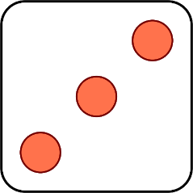
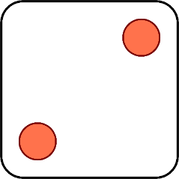
Follow up 5:
Wer hat oder ist was?
Habe ich Hunger?
sprechen
Er ist froh.
Du bist hier.
Ist sie müde?
Hast du Angst?
Hat sie Durst?
1 | I am
2 | You are
3 | He is
4 | Am I?
5 | Are you?
6 | Is she?
1 | hungry
2 | glad, happy
3 | tired
4 | scared
5 | thirsty
6 | here
Notes:
Timing: 5 minutes
Aim: to practise oral production of singular person forms of haben and sein in statements and questions.
Procedure: 1. Remind pupils how verbs change their ending depending who is ‘doing’ the verb and how the syntax changes for a question.
2. Click to ‘roll’ the 2 dice.
3. Pupils translate the pronouns and verbs into German according to the numbers on the 2 dice.
4. Click to reveal the correct verb phrase/question.
5. Repeat until all six dice combinations have been used.
Additional task suggestions:
If pupils have their own dice, they could continue in pairs, rolling the dice and making sentences. If they don’t have dice, their partner could give them two numbers and they have to make a sentence.

Slide 11
Tschüss!
blau
Notes:
11

Slide 12
Follow up 2:

Schreib auf Englisch.
Can you get at least 15 points?
Wörter
 | heute | der Nachmittag | die Hausaufgabe(n)
 | nie | manchmal | der Abend
 | die Stadt | der Dom | die Bibliothek
 | das Kino | wohin? | gehen
 | froh | (die) Angst (vor) | (der) Durst
 | sie sind | (der) Spaß | ihr seid
 | müde | du hast | (der) Hunger
Vokabeln
x3
x2
x1
Notes:
HANDOUT

Slide 13
Follow up 2:

Schreib auf Deutsch.
Can you get at least 15 points?
Wörter
 | sometimes | today | never
 | (the) evening | (the) homework | (the) afternoon
 | (the) cinema | (the) town | where…to?
 | to go, going | (the) library | (the) cathedral
 | you have | you (pl, inf.) are | they are
 | (the) fun | glad, happy | tired
 | fear (of) | (the) thirst | (the) hunger
Vokabeln
x3
x2
x1
Notes:
HANDOUT

