Slide 1
Experiences at home and away
blau
Haben with meaning ‘be’
SSC [v] vs [w] [f]
Term 3 Week 1
Notes:
Artwork by Steve Clarke. Pronoun pictures from NCELP (www.ncelp.org). All additional pictures selected from Pixabay and are available under a Creative Commons license, no
attribution required.
Phonics: [v] vier [200] vergessen [584] Vater [232] positiv [516] viel [56]
Vocabulary: Angst (vor) [392] Durst [n/a] Hunger [2097] Spaß [1045] froh [1424] müde [2000] bitte [471] danke [877]
Revisit 1: gehen [66] sein [3] Bibliothek [2366] Dom [4916] Garten [1158] Haus [147] Kino [2020] Stadt [204] Wohin? [1811]
Revisit 2: bekommen [212] bleiben [113] lesen [305] machen [58] schreiben [184] sein [3] spielen [205] Abend [342] Essen [323] Film [505] Geschichte [262] Hausaufgabe(n) [n/a] Morgen [621] Nachmittag [1464] Schule [359] heute [116] manchmal [382] oft [223] nie [196] jeden Tag [n/a]
Jones, R.L & Tschirner, E. (2019). A frequency dictionary of German: Core vocabulary for learners. London: Routledge.
The frequency rankings for words that occur in this PowerPoint which have been previously introduced in these resources are given in the SOW and in the resources that first
introduced and formally re-visited those words.
For any other words that occur incidentally in this PowerPoint, frequency rankings will be provided in the notes field wherever possible.
Remember that at the start of the course (first three lessons of Rot/Gelb) pupils learnt language (for greetings and register taking) that can still be part of the lesson routines in upper KS2 (Blau/Grün). They are not re-taught, as we anticipate that teachers have built these in from early in lower KS2.
1

Slide 2
aussprechen
[v]
…
vier
Notes:
Timing: 1 minute
Aim: to introduce the SSC [v].
Procedure:
Introduce the SSC and present the source word ‘vier’ (with gesture, if using).
Click to bring on the picture and get pupils to repeat the word ‘vier’ (with gesture, if using).
Note:
a gesture for ‘vier’ might be to hold 4 fingers up.
2

Slide 3
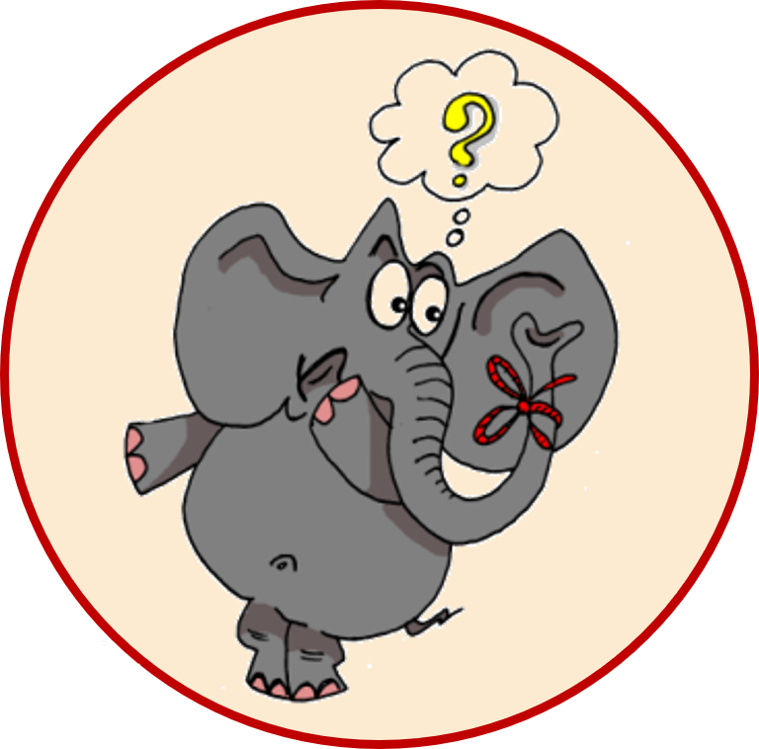
aussprechen
[v]
…
vergessen
Vater
vier
4
[to forget]
positiv
viel
[a lot, much]
Notes:
Timing: 1 minute
Aim: to consolidate the SSC [v].
Procedure:
Re-present the SSC and the source word ‘vier’ (with gesture, if using).
Click to bring on the picture and get pupils to repeat the word ‘vier’ (with gesture, if using).
Present the cluster words in the same way, bringing on the picture and getting pupils to pronounce the words.
Frequency:
vier [200] vergessen [584] Vater [232] positiv [516] viel [56]
Jones, R.L & Tschirner, E. (2019). A frequency dictionary of German: Core vocabulary for learners. London: Routledge.

Slide 4
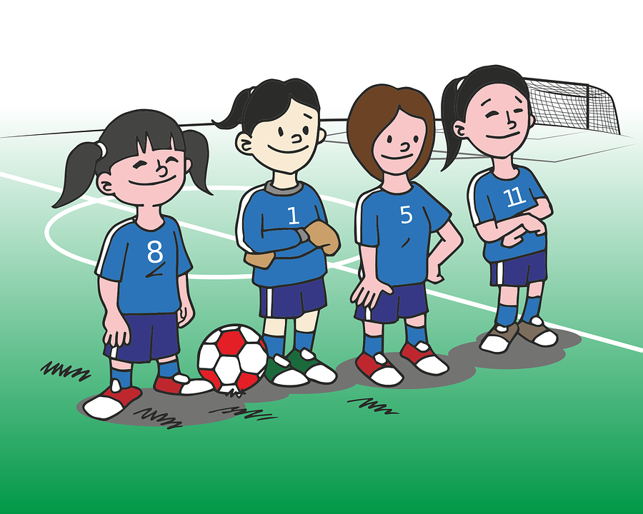
hören
[v]
[v] oder [w]?
Hör zu und schreib das Wort.
Write numbers 1-6. Turn away from the board, listen and write down the word that you hear. It will have either [v] or [w] in it!
 | Wort | English
1 | wichtig | important
2 | die Welt | (the) world
3 | voll | full
4 | warum | why
5 | der Verein | club
6 | bevor | before
8 | weit | far
Notes:
Timing: 5 minutes
Aim: to consolidate aural recognition of the SSC [V] by contrasting it with the SSC [W]; to practise transcription of individual unknown words.
Procedure:
Pupils turn away form the board.
Click to bring up the written version of the words and the symbols.
Pupils write down numbers 1-8.
Play the audio by clicking the buttons 1-8.
Pupils try to transcribe the word they hear, paying particular attention to [v] or [w].
Pupils turn back round again and check their answers.
Reveal the English meanings (remembering that these are unknown words) - click to reveal each translation in turn.
Transcript:
wichtig
die Welt
voll
warum
der Verein
bevor
weit
Word frequency:
bevor [537] Verein voll [388] warum [192] weit [230] Welt [164] wichtig [144]
4

Slide 5
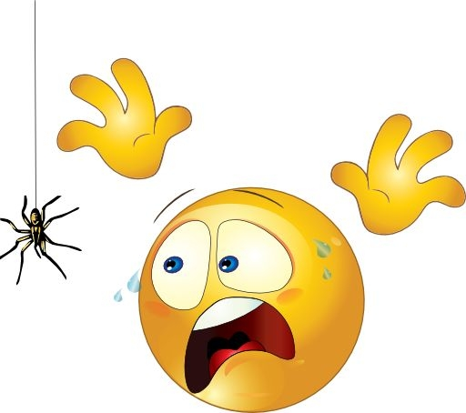
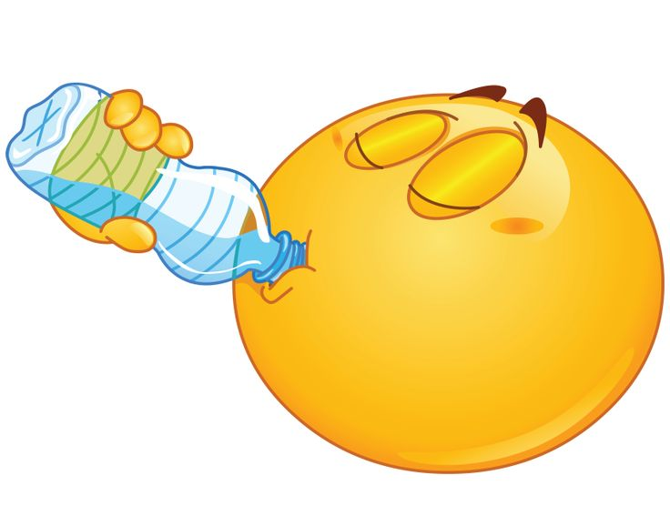
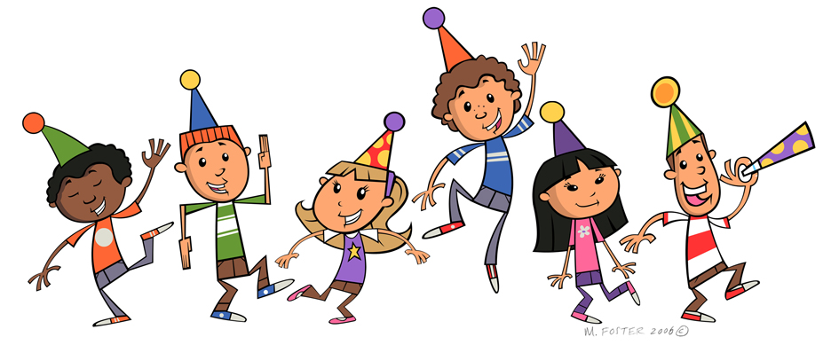
Vokabeln
Sag die Wörter.
Wörter
(die) Angst (vor)
(der) Hunger
[fear (of)]
[Hunger]
froh
(der) Durst
[glad, happy]
[thirst]
müde
bitte
[tired]
(der) Spaß
danke
[fun]
Notes:
[1/3]
Timing: 4 minutes (three slides)
Aim: to introduce new vocabulary.
Procedure 1. Pupils either work by themselves or in pairs, reading out the words and recapping their English meaning (1 minute).
2. Teachers elicit pronunciation from pupils, chorally. (In the audio version, click on each word to hear it pronounced (1 minute). 3. Then, on the next slide, students try to recall the English orally (chorally), looking at the German (1 minute). 4. Then, on the following slide, they to recall the German meanings orally (again, chorally), looking at the English (1 minute).
Note:
Note that images/words won’t disappear and appear in this activity as in previous resources.
5

Slide 6
Vokabeln
h_ _ _ _ _
f_ _ _ (o_)
hunger
Wörter
fear (of)
die Angst (vor)
der Hunger
g_ _ _ , h_ _ _ _
glad, happy
t_ _ _ _ _
froh
thirst
der Durst
t_ _ _ _
please
tired
müde
p_ _ _ _ _
bitte
fun
thank you
danke
f_ _
t_ _ _ _ y _ _
der Spaß
Notes:
[2/3]
Procedure: 1. Students try to recall the English orally (chorally), looking at the German (1 minute). 2. Elicit answers and click to reveal
3. Then, in the following slide, they to recall the German meanings orally (again, chorally), looking at the English (1 minute).
Note: in the audio version of the resource, teachers can click on each German item to hear it pronounced.
6

Slide 7
Vokabeln
d _ _ A_ _ _ _ (v_ _)
d_ _
H_ _ _ _ _
Wörter
fear (of)
die Angst (vor)
hunger
der Hunger
glad, happy
f_ _ _
der
Durst
froh
thirst
d_ _
D_ _ _ _
m_ _ _
bitte
müde
please
b_ _ _ _
tired
d_ _ _ _
fun
d _ _ S_ _ _
thank you
danke
der Spaß
Notes:
[3/3]
Procedure: 1. Students recall the German meanings orally (again, chorally), looking at the English (1 minute)
2. Click to reveal the answers.
Note: in the audio version of the resource, each German item is pronounced when the item appears.
7

Slide 8
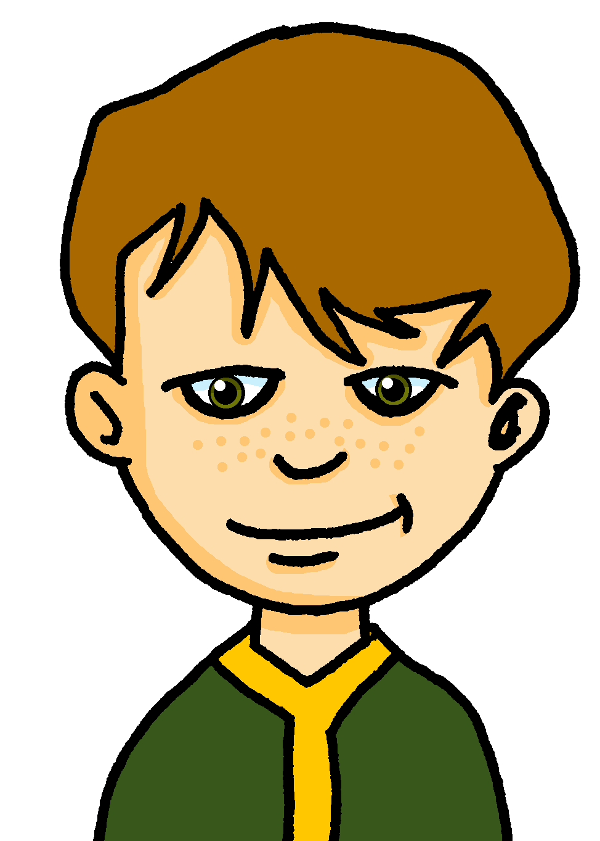
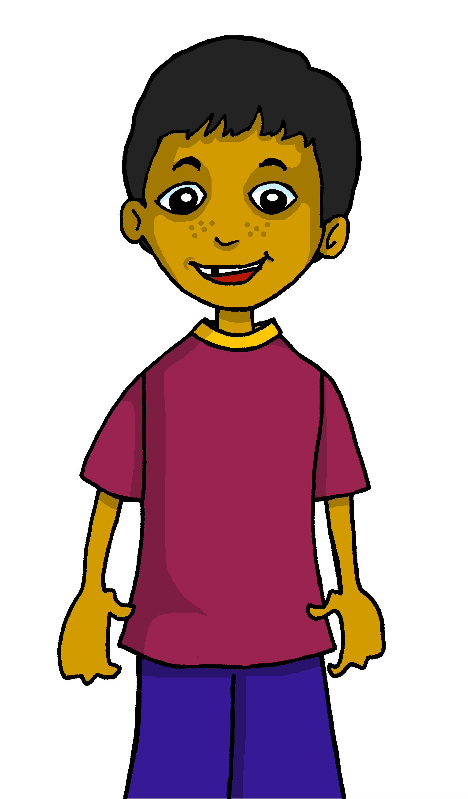
Kultur
Bitte und danke
Hast du einen Bleistift, bitte?
Höflich* sein ist nett!
höflich – polite
Hier, bitte!
Britische Leute sind höflich* – das denken viele Leute in Deutschland.
Danke!
Here, bitte means ‘please’!
Bitte!
Warum? Die Leute in Großbritannien sagen oft ‘bitte’ und ‘danke’!
“Hier, bitte” means ‘Here you go!
And here, bitte means ‘you’re welcome’!
‘Bitte’ und ‘danke’ sagen ist nett. Aber ist es immer höflich? Was denkst du?
Bitte has several meanings. Read the dialogue. What does bitte mean each time?
Notes:
Timing: 5 minutes
Aim: to start a discussion on the culture around the use of ‘please’ and ‘thank you’, and to present multiple meanings of ‘bitte’.
Procedure:
Read the text with the class (or play the recording by clicking on each paragraph).
This is an opportunity to discuss with your class the notion of politeness in connection with language use (please/thank you). Are there maybe also quite rude/impolite ways of using please/thank you, in English? Does it depend on the tone of voice? Expression on your face?
Present the two meanings of bitte (please and you’re welcome) by clicking to bring up the callout bubble.
Pupils read the dialogue in pairs, and work out the different meanings of bitte.
Click to bring up the answers.
Frequency of unknown words and cognates:
britisch [1419] Großbritannien [1640] höflich [4735] sagen [40]
Jones, R.L & Tschirner, E. (2019). A frequency dictionary of German: Core vocabulary for learners. London: Routledge.
8

Slide 9
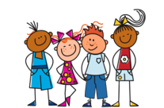
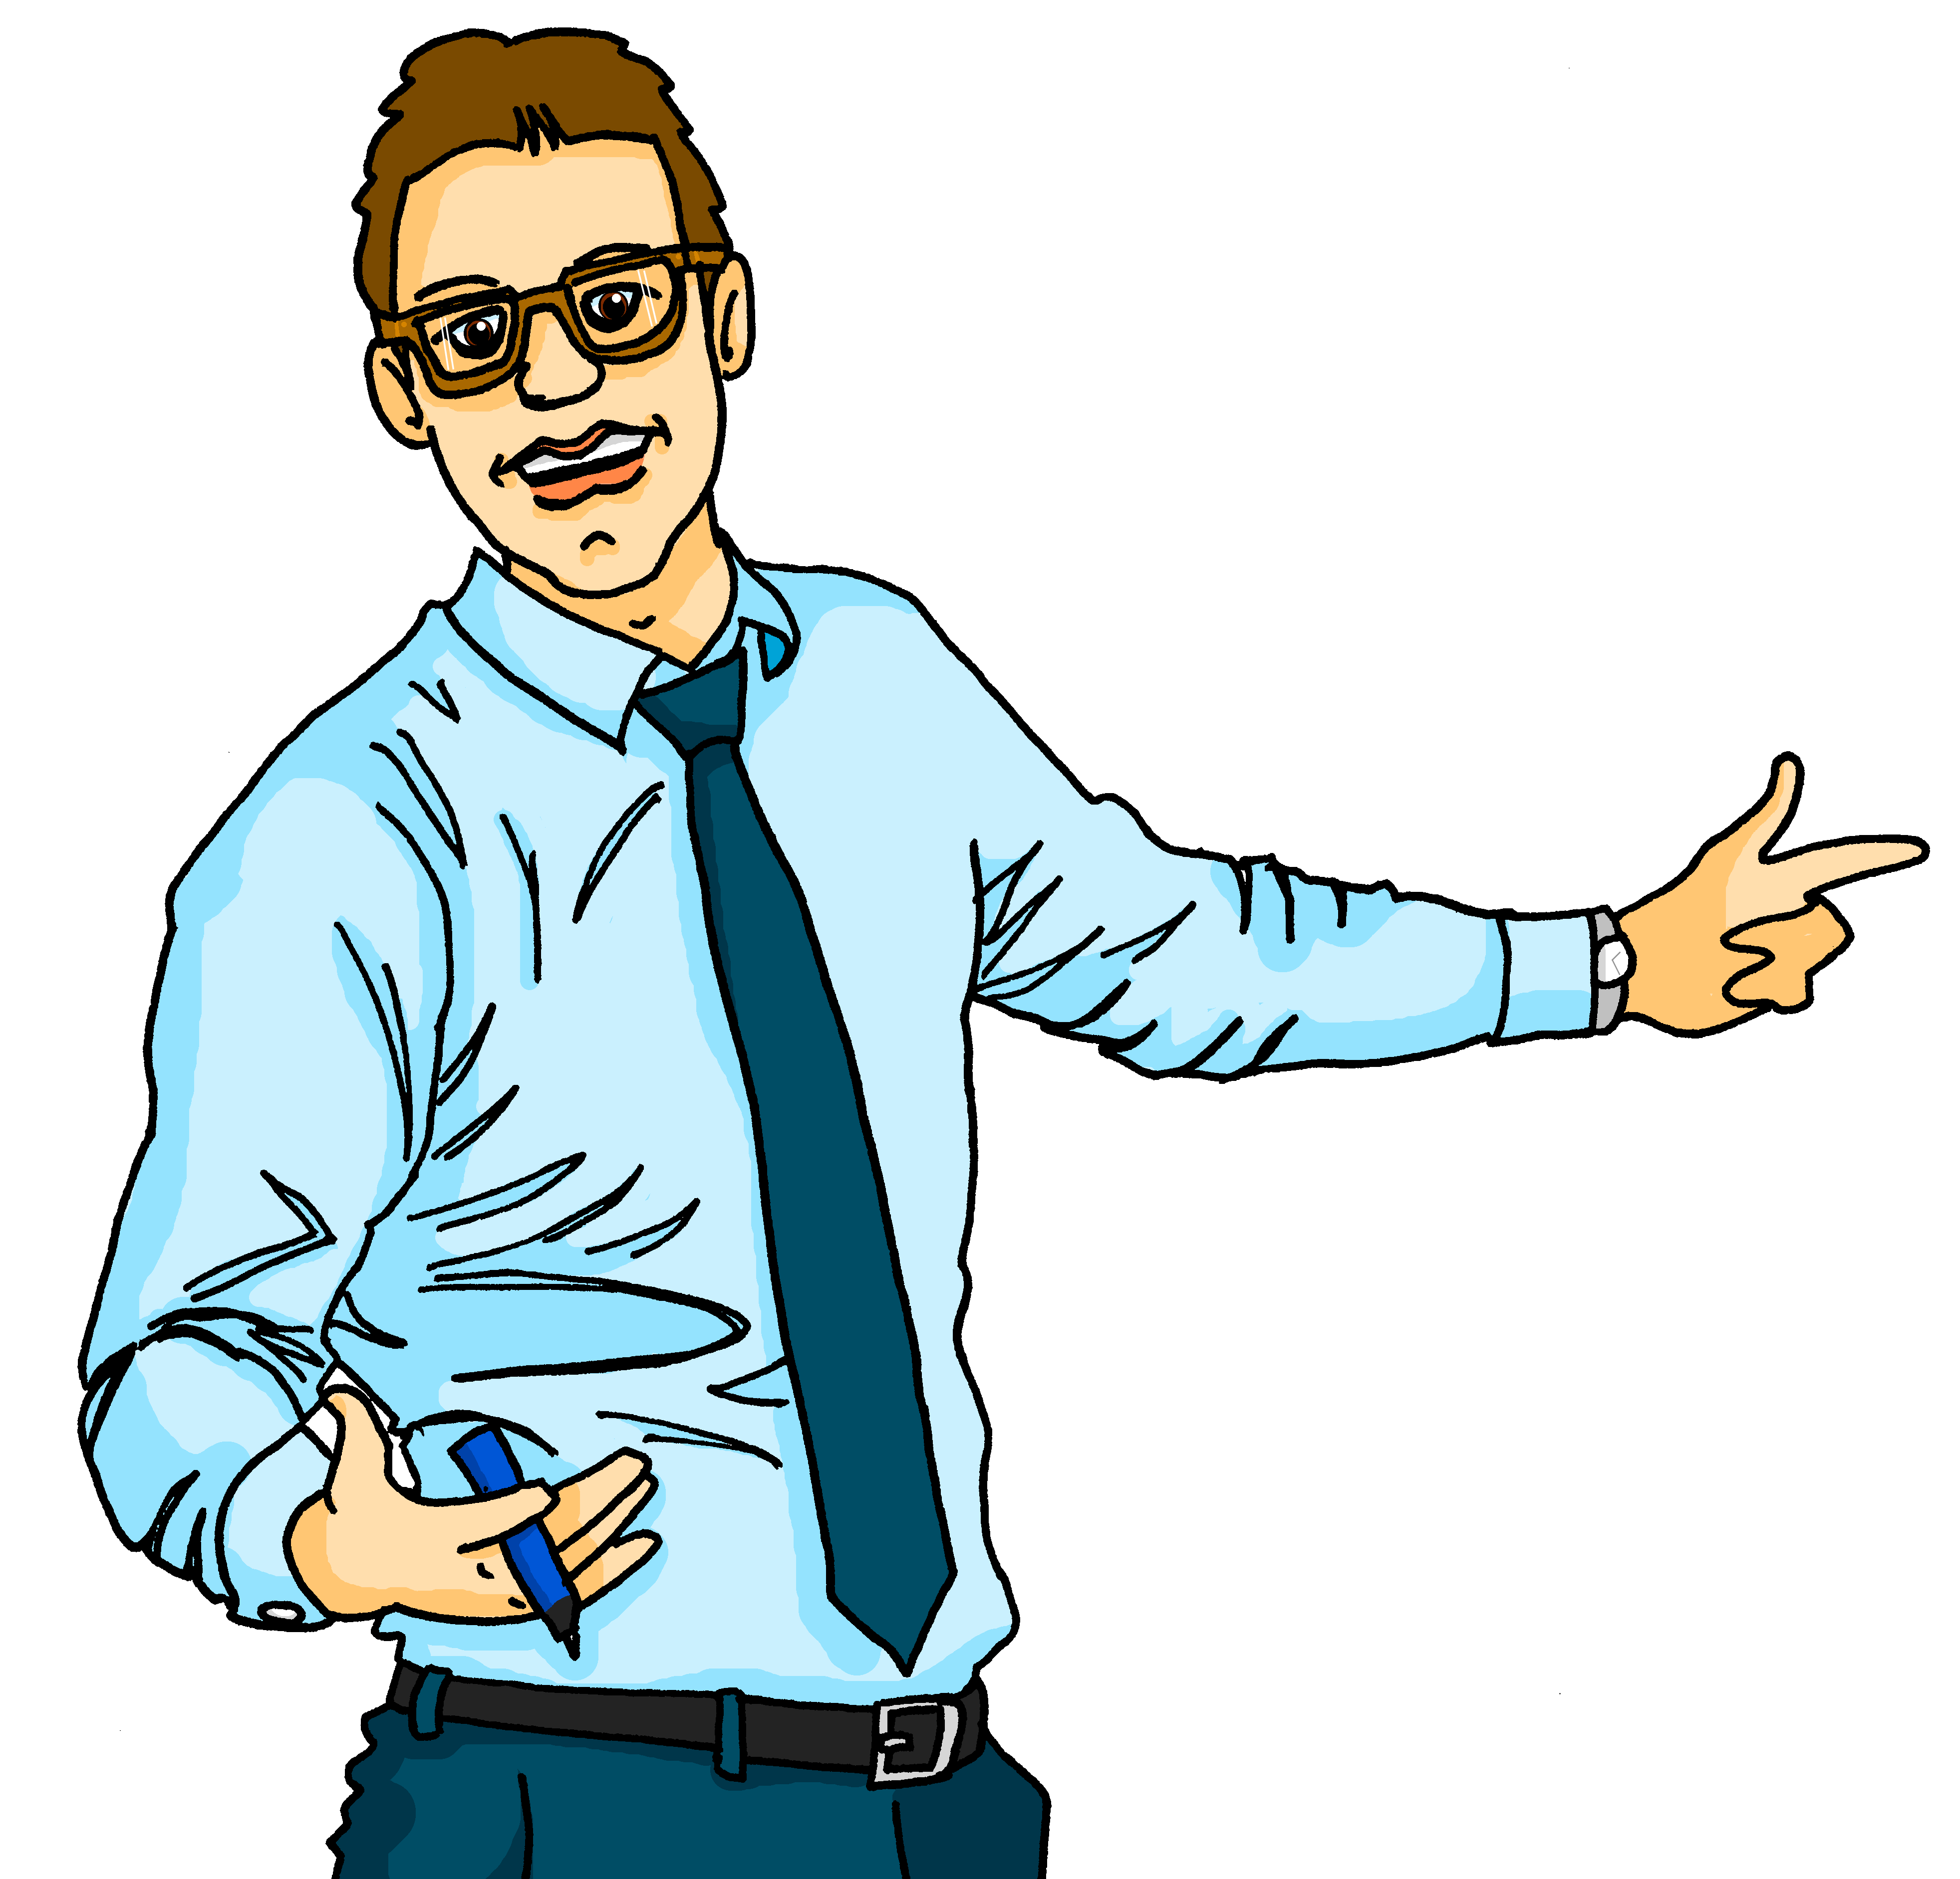
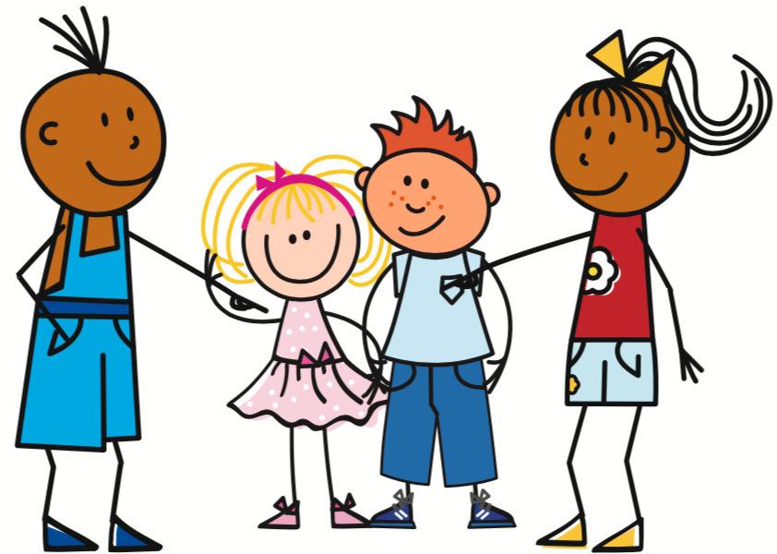
SEIN – to be, being
Remember that the verb SEIN (to be, being) is irregular:
ich bin
wir sind
Ich bin hier.
I am
Also: es ist = it is
we are
I am here.
du bist
ihr seid
Ihr seid da.
you are
you (all) are
You (all) are there.
er ist
Sie sind
Sie sind da.
you (formal) are
You (formal) are there
AND
they are there.
he is
sie sind
sie ist
she is
they are
Notes:
Timing: 3 minutes
Aim: to revisit the present tense of the irregular verb sein verbs in the present tense.
Procedure: 1. Click to present the information step by step.
2. Elicit the German forms of the verbs from students.
9

Slide 10
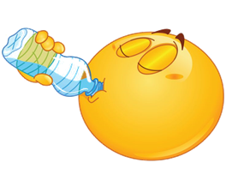
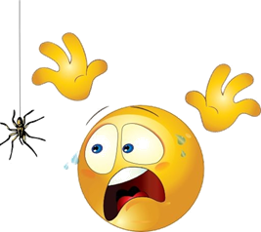
HABEN – to have, having
Haben can sometimes mean ‘to be, being’!
Remember that the verb haben (to have, having) is irregular:
ich habe
wir haben
Ich habe Hunger.
I have
Also: es hat = it has
we have
I am hungry.
du hast
ihr habt
Du hast Durst.
you have
you (all) have
You are thirsty.
er hat
Sie haben
Er hat Angst vor Spinnen*.
he has
you (formal) have
He is scared of spiders.
sie hat
sie haben
she has
they have
die Spinne – spider
Notes:
Timing: 3 minutes
Aim: to revisit the present tense of the irregular verb haben verbs in the present tense, and to introduce the new idea that haben can sometimes also mean ‘to be’.
Procedure: 1. Click to present the information step by step.
2. Elicit the German forms of the verbs from students.
10

Slide 11
Singen
Hör zu. Dann sing mit!
Hallo! Hallo! Guten Tag! Hallo! Hallo! Guten Tag!
Hallo! Wir sind hier,
Hallo! Ihr seid da, Wie schön, nicht wahr? Wunderbar!
Notes:
Timing: 2 minutes
Aim: to practise some previously learnt vocabulary in a simple song (to the tune of ‘If you’re happy and you know it’).
Procedure: 1. Click to play the audio of the song.
2. Repeat the words of each line to practise saying them clearly (borrow the rhythm of the song so that this is a rehearsal stage before singing).
3. Click to play the audio again and this time, pupils join in. The 2nd version of the recording has the song three times, increasing in speed each time.
Note: Teachers might like to re-use this song as part of their lesson starting routine in future lessons. Soon pupils will not need to see the words to recall it.

Slide 12
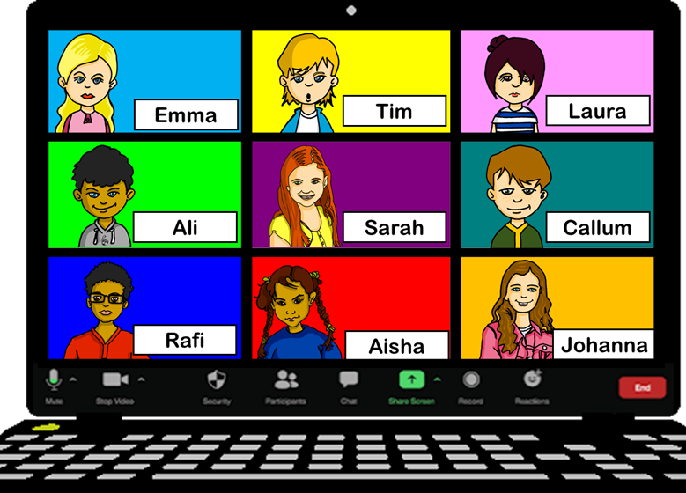
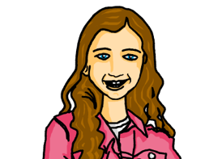
lesen
Johanna and Aisha haben ein Zoom-Meeting mit der Austausch*klasse aus England. Nächste Woche kommen die englischen Freunde nach Deutschland!
der Austausch - exchange
Wie geht’s?
Notes:
Timing: 1 minute
Aim: to explain the context of the next two tasks.
Procedure:
Make sure that the context of the next two tasks is clear:
Johanna and Aisha are on Zoom with their exchange class, getting ready to welcome them next week on a visit to their school, and they are asking how people are feeling, via the chat so that everyone can reply at
once.
Frequency of unknown words and cognates:
Austausch [2560]
12

Slide 13
lesen
Die zwei Klassen schreibt im Chat.
Was schreiben sie?
Wie geht’s?
Chatbox 1
To: everyone
Wir haben Hunger!
Chatbox 5
To: everyone
Er ist froh!
 | who | be/have | details
1 | we | are (be) | hungry
2 | you (formal) | have | questions
3 | you (sg) | are (be) | thirsty
4 | I | am (be) | scared
5 | he | is (be) | happy
6 | you (plural) | have | uniform
7 | they | are (be) | not scared
8 | she | has | fun
Chatbox 2
To: Frau Bahlsen
Haben Sie Fragen?
Chatbox 6
To: everyone
Habt ihr eine Uniform?
Chatbox 3
To: Johanna
Du hast Durst!
Chatbox 7
To: everyone
Sie haben keine Angst.
Chatbox 4
To: everyone
Ich habe ein bisschen* Angst!
Chatbox 8
To: everyone
Sie hat Spaß!
ein bisschen – a little
Notes:
Timing: 8 minutes
Aim: to decide whether the meaning is ‘be’ or ‘have’, and to recognise the meanings of different parts of haben.
Procedure:
The scenario was explained on the previous slide.
Pupils extract the following information form the chat boxes: who is the message about (grammatical person), is the meaning ‘be’ or ‘have’, and what is the message about.
Elicit answers, then click to reveal the answers in the table on the right.
Frequency of unknown words and cognates:
ein bisschen [301]
13

Slide 14
hören
Jetzt mit dem Mikro!
Wie geht’s?
Was sagen sie?
who | be/have | details
you (all) | are (be) | scared
I | am (be) | thirsty
she | has | fun
we | are (be) | hungry
you | are (be) | tired
they | are (be) | not scared
you (formal) | have | a pen
we | are (be) | in Germany next week
1
2
3
4
5
6
7
8
Notes:
Timing: 8 minutes
Aim: to continue the task, switching to the listening modality.
Procedure:
1. Explain that this is the same task, only now pupils have to listen rather than to extract the answers.
2. Click on the audio buttons to play the recordings. Pupils listen out for the three pieces of information.
3. Elicit the answers.
4. Click to reveal the answers in turn.
Transcript:
Habt ihr ein bisschen Angst?
Ich habe Durst.
Sie hat Spaß.
Wir haben Hunger.
Bist du müde?
Sie haben keine Angst.
Haben Sie einen Stift, Frau Bahlsen?
Nächste Woche sind wir in Deutschland!
14

Slide 15
Hör zu. Dann sing mit!
Tschüss, Tschüss, Tschüss, Tschüss,
Tschüss, Tschüss, Auf Wiedersehen!
Bis bald, bis bald, bis bald, bis bald.
Tschüss, Tschüss, Tschüss, Tschüss, Auf Wiedersehen!
Bis bald! = See you soon!
Notes:
Timing: 3 minutes
Aim: to practise the language for bye and goodbye in a simple song (to the tune of ‘Hi ho Hi ho it’s off to work we go’).
Procedure: 1. Click to play the audio of the song.
2. Repeat the words of each line to practise saying them clearly (borrow the rhythm of the song so that this is a rehearsal stage before singing).
3. Click to play the audio again and this time, pupils join in.
Note: Teachers might like to re-use this song as part of their lesson finishing routine in future lessons. Soon pupils will not need to see the words to recall it.

Slide 16
Tschüss!
blau
Notes:
16

