Slide 1
Experiences at home and away
blau
Follow ups 1-5
Term 3 Week 2
Notes:
Artwork by Steve Clarke. Pronoun pictures from NCELP (www.ncelp.org). All additional pictures selected from Pixabay and are available under a Creative Commons license, no
attribution required.
Phonics:
[r] consonantal [r] rot [477] drei [106] rechts [829] Frage [157] warum? [192]
vocalic [r] Ort [341] Uhr [348] lernen [288] Antwort [522] Farbe [1079]
Vocabulary: werden, werde, wirst, wird [8] Ei [1999] Frühstück [2600] Frohe Ostern [n/a] Guten Appetit [n/a] Gute Nacht [n/a] viel Spaß [n/a]
Revisit 1: gehen [66] kommen [62] sein [3] tanzen [1497] Fest [2089] Platz [326] Straße [391] auf [16] nach Hause [n/a]
Revisit 2: Revisit language from Term 1 & Term 2 Week 2 :bekommen [212] bleiben [113] lesen [305] machen [58] schreiben [184] sein [3] spielen [205] Abend [342] Essen [323] Film [505] Geschichte [262] Hausaufgabe(n) [n/a] Morgen [621]
Nachmittag [1464] Schule [359] heute [116] manchmal [382] oft [223] nie [196] jeden Tag [n/a]
Jones, R.L & Tschirner, E. (2019). A frequency dictionary of German: Core vocabulary for learners. London: Routledge.

Slide 2
aussprechen
[r]
…
[r] before a vowel is a roll from the back of your throat. Open your mouth, tongue flat, lips still and growl ‘rrrr’.
Touch your throat and feel the vibration!
rot
Notes:
Timing: 1 minute
Aim: to revisit the SSC [r] before a vowel.
Procedure:
Introduce the SSC and present the source word ‘rot’ (with gesture, if using).
Click to bring on the picture and get pupils to repeat the word ‘rot’ (with gesture, if using).
Note:
a gesture for ‘rot’ might be to hold up some red classroom tems e.g. a pen/book/flag/clothing
2

Slide 3
aussprechen
[r]
…
3
Why?
warum?
drei
rot
?
Frage
rechts
[question]
Notes:
Timing: 1 minute
Aim: to consolidate the SSC [r] before a vowel.
Procedure:
Re-present the SSC and the source word ‘rot’ (with gesture, if using).
Click to bring on the picture and get pupils to repeat the word ‘rot’ (with gesture, if using).
Present the cluster words in the same way, bringing on the picture and getting pupils to pronounce the words.
Word frequency: rot [477] drei [106] rechts [829] Frage [157] warum? [192]
Jones, R.L & Tschirner, E. (2019). A frequency dictionary of German: Core vocabulary for learners. London: Routledge.
3

Slide 4
aussprechen
[r]
…
[r] after a vowel sounds like ‘uh’!
Ort
[place]
Notes:
Timing: 1 minute
Aim: to revisit the SSC [r] after a vowel.
Procedure:
Re-present the SSC and the source word ‘Ort’ (with gesture, if using).
Click to bring on the picture and get pupils to repeat the word ‘Ort’ (with gesture, if using).
Note:
a gesture for ‘Ort’ might be to point to a particular place on a map.

Slide 5
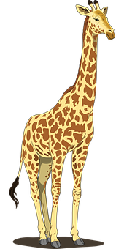
aussprechen
[r]
…
Farbe
lernen
Ort
[place]
When ‘h’ follows a vowel, it makes a long vowel sound.
Uhr
Tier
[clock, watch, o’clock]
Notes:
Timing: 1 minute
Aim: to consolidate the SSC [r] after a vowel
Procedure:
Re-present the SSC and the source word ‘Ort’ (with gesture, if using).
Click to bring on the picture and get pupils to repeat the word ‘Ort’ (with gesture, if using).
Present the cluster words in the same way, bringing on the picture and getting pupils to pronounce the words.
Note: ‘Uhr’ is a slight exception as the ‘r’ does not directly follow the vowel. However, ‘h’ following a vowel makes a long vowel sound, so the ‘r’ sound here is the same as after a vowel.
Word frequency: Ort [341] Uhr [348] Tier [614] lernen [288] Farbe [1079]
Jones, R.L & Tschirner, E. (2019). A frequency dictionary of German: Core vocabulary for learners. London: Routledge.

Slide 6
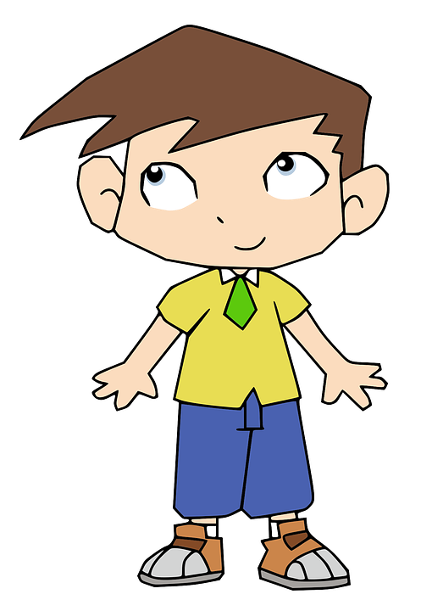
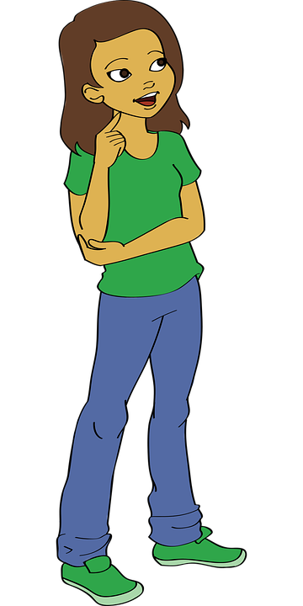
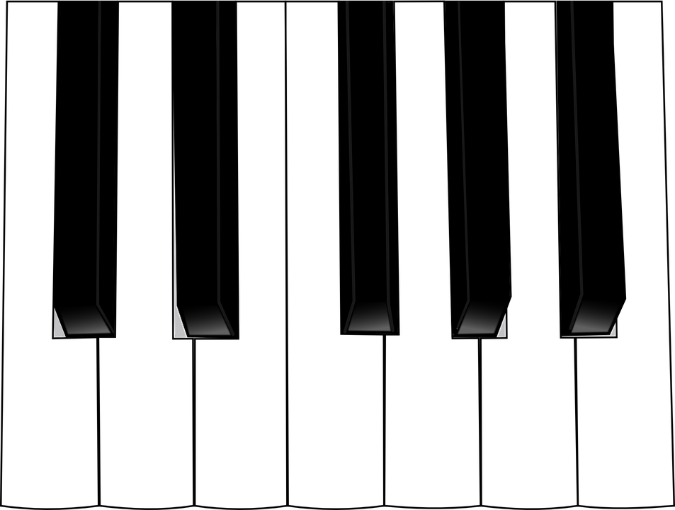
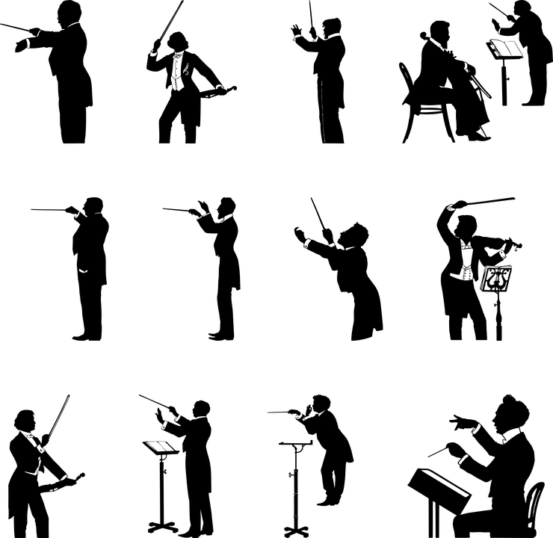
Follow up 1
Wie viele [r] hörst du?
1
Robin röstet dreizehn runde Rosskastanien.
aussprechen
Robin is roasting thirteen round horse chestnuts.
 | [r] before vowel | [r] after vowel
1 | 5
2 |  | 7
3 | 6
2
Orthild spielt Orgel und organisiert Erbsen für ihr Orchester.
Orthild plays the organ and is organising peas for her orchestra.
3
Riesige Rehe reisen mit richtigen Reisepässen nach Rumänien.
Huge deer are travelling with real passports to Romania .
Notes:
Timing: 5 minutes
Aim: to practise aural comprehension and pronunciation of [r] before a vowel and [r] after a vowel.
Procedure:
Click on the audio button to play the recording of the first tongue twister, without revealing the written form.
Pupils count how many [r]’s they hear and what type (before or after a vowel). NB each tongue twister only contains one type of [r].
Click to reveal the answer.
Continue for 2 and 3.
Then click to reveal the written forms of the tongue twisters, and the English translations.
Pupils practise the tongue twisters themselves, in pairs.

Slide 7
Follow up 2
Laura’s German is improving, but she finds it difficult to hear the difference between ihr (you all) and du (you). Can you help?
??
Hör zu. Ist das you (all) oder you?
hören
 | you (all) | you | English?
1
Are you (all) getting homework every day?
2
Are you (all) coming home in the afternoon?
3
Are you playing in the street?
4
Are you reading stories in the evening?
5
Breakfast! Are you (all) eating eggs?
6
Are you at the festival?
Notes:
Timing: 5 minutes Aim: to practise comprehension of questions and differentiating between the ihr and du forms of strong and weak verbs.
Procedure:
1. Pupils write down 1-6. 2. Click on the audio buttons to play each item 1-6.
3. Pupils write down you (all) or you, depending on which pronoun and verb form they hear.
4. Pupils listen again to each question and try to translate the question into English. 5. Elicit answers and click to display answers.
Transcript:
Bekommt [ihr] jeden Tag Hausaufgaben?
Kommt [ihr] am Nachmittag nach Hause?
Spielst [du] auf der Straße?
Liest [du] am Abend Geschichten?
Frühstück! Esst [ihr] Eier?
Bist [du] auf dem Fest?

Slide 8
Follow up 3
Hör zu.
C Take turns to say the following German words out loud.
Partner A
werden
das Frühstück
Guten Appetit
viel Spaß!
du wirst
jeden Tag
schreiben
A Listen. Write the word that is mentioned.
B
eat | play | dance
hören
Partner B
Ei
Frohe Ostern
Gute Nacht!
sie wird
der Nachmittag
bekommen
der Abend
1
meal | lesson | school
…
2
stories | breakfast | homework
sprechen
3
street | square | festival
4
enjoy | stay | dance
5
dinner | lunch | breakfast
B Write the number of the matching word.
D Ping Pong translation in pairs
Round 1: Challenge each other by testing whether you can translate the new German words into English.
Round 2: Now challenge your partner by asking for the German words.
4
3
bleiben ____ 4. Straße ____
Essen____ 5. Frühstück ____
spielen ____ 6.Geschichte ____
1
5
B
2
Notes:
Timing: 5 minutes
Aim: to practise aural comprehension of this week’s new vocabulary; written comprehension
Procedure:
A: Click to listen. Pupils write down 1,2 or 3 to correspond to which answer they think is correct. Click for answers.
B: Pupils refer to their listening table, and write the corresponding numbers into the gaps in Section B.
Click to reveal answers.
C: Pupils take turn to pronounce the words. Click to remove the green splats and hear the pronunciation.
D: Pupils take turns translating the words.
Transcript: Beispiel. Sie tanzen auf dem Fest. 1. Er kommt spät zum Essen. 2. Wir machen am Abend Hausaufgaben. 3. Seid ihr am Morgen auf dem Platz? 4. Wir bleiben oft lange auf dem Fest. 5. Frühstück! Wir essen Ostereier!

Slide 9
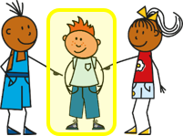
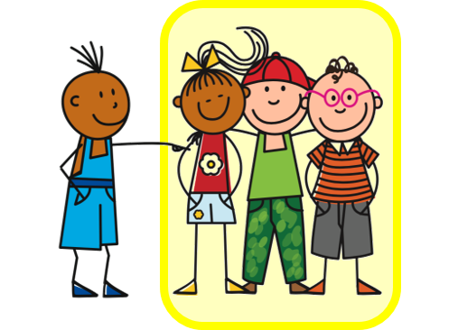
Follow up 4
Rede mit deinem Partner/deiner Partnerin.
sprechen
Beispiel:
I
A
B
Siehst du?
1 | Do you see? Are you seeing?
2 | ……….. ……….
I
A
Notes:
Example slide.
Timing: 5 minutes (two slides)
Aim: to practise asking questions using du and ihr forms of you.
Procedure:
Click through the animations to explain the task. Person A says Siehst du?
Person B chooses the correct letter from two and writes down the letter.
Person A continues to ask the remaining eight questions in Round 1.
At the end, Person B will have a nine-letter phrase to read out to Person A who should recognise and translate it.
Then pupils swap and repeat the task. Person B will now make the questions using Round 2.

Slide 10
Follow up 4
Rede mit deinem Partner/deiner Partnerin.
1
2
3
sprechen
W
V
I
I
E
R
4
5
6
T
L
S
A
P
N
7
8
9
A
Z
ß
E
N
!
Notes:
Timing: 5 minutes
Aim: to practise asking questions using du and ihr forms of you.
Procedure:
Give out handouts to pupils. Both face the board. Display this slide.
Pupil A translates English prompts into German questions, working in numerical order from 1 – 9.
Pupils B identifies the correct letter according to his/her understanding of what A says.
After all nine questions have been asked by Pupil A, Pupil B reads aloud the sentence/message produced by the answer letters.
It should read ‘Wir tanzen’.
Pupils swap roles and repeat the activity. Pupil A’s sentence should read: ‘Viel Spaß!’.
Click to hear each of the sentences by clicking on the letters in the circles below each picture in the audio version. Answers are also included below.
Round 1
Esst ihr Frühstück? (W)
Liest du Geschichten? (I)
Werdet ihr groß? (R)
Kommst du nach Hause? (T)
Gehst du auf den Platz? (A)
Werdet ihr jeden Tag froh? (N)
Siehst du einen Film am Abend? (Z)
Bekommst du Hausaufgaben am Nachmittag? (E)
Seid ihr in der Schule? (N)
Round 2
Isst du Frühstück? (V)
Lest ihr Geschicten? (I)
Wirst du groß? (E)
Kommt ihr nach Hause? (L)
Geht ihr auf den Platz? (S)
Wirst du jeden Tag froh? (P)
Seht ihr einen Film am Abend? (A)
Bekommt ihr Hausaufgaben am Nachmittag? (ß)
Bist du in der Schule? (!)

Slide 11
Follow up 5:

Schreib auf Englisch.
Can you get at least 15 points?
Wörter
 | der Abend | der Nachmittag | bleiben
 | der Nachmittag | lesen | bekommen
 | das Fest | auf | die Straße
 | der Platz | nach Hause | kommen
 | du wirst | werden | Guten Appetit!
 | sie wird | das Ei | Gute Nacht!
 | das Frühstück | Frohe Ostern! | Viel Spaß!
(the) evening
(the) afternoon
to stay, staying
x3
(the) afternoon
to read, reading
to receive, receiving
(the) festival, celebration
on, to, at
(the) street
(the) square, place, room
x2
(to) home
to come, coming
you become, get
to become, to get
Enjoy your meal!
she becomes, gets
(the) egg
Good night!
x1
(the) breakfast
Happy Easter!
Have fun!
Notes:
Timing: 5 minutes
Aim: to practise written production of vocabulary from this and revisited weeks.
Procedure: 1. Give pupils a blank grid. They fill in the English meanings of any of the words they know, trying to reach 15 points in total.
Note: The most recently learnt and practised words are pink, words from the previous week are green and those from week 1 are blue, thus more points are awarded for them, to recognise that memories fade and more effort (heavy lifting!) is needed to retrieve them.

Slide 12
Follow up 5:

Schreib auf Deutsch.
Can you get at least 15 points?
Wörter
 | (the) homework | to receive, receiving | to read, reading
 | to stay, staying | (the) evening | (the) afternoon
 | (the) street | on, to, at | (to) home
 | to come, coming | (the) festival, celebration | (the) square, place, room
 | Happy Easter! | (the) egg | (the) breakfast
 | Good night | Enjoy your meal! | Have fun!
 | to become, to get | you become, you get | she becomes, she gets
die Hausaufgaben
bekommen
lesen
x3
bleiben
der Abend
der Nachmittag
die Straße
auf
nach Hause
x2
kommen
das Fest
der Platz
Frohe Ostern!
das Ei
das Frühstück
Gute Nacht
Guten Appetit!
Viel Spaß!
x1
werden
du wirst
sie wird
Notes:
Timing: 5 minutes
Aim: to practise written production of vocabulary from this and revisited weeks.
Procedure: 1. Give pupils a blank grid. They fill in the German meanings of any of the words they know, trying to reach 15 points in total.
Note: The most recently learnt and practised words are pink, words from the previous week are green and those from week 1 are blue, thus more points are awarded for them, to recognise that memories fade and more effort (heavy lifting!) is needed to retrieve them.

Slide 13
Tschüss!
Notes:
13

Slide 14
Follow up 4
Follow up 4
Round 1
Round 2
A
…
B
…
1 | Do you (all) eat breakfast? Are you (all) eating breakfast?
2 | Do you read stories? Are you reading stories?
3 | Do you (all) get tall? Are you (all) getting tall?
4 | Do you come home? Are you coming home?
5 | Do you go to the square? Are you going to the square?
6 | Do you (all) get happy every day? Are you (all) getting happy every day?
7 | Do you watch a film in the evening? Are you watching a film in the evening?
8 | Do you get homework in the afternoon? Are you getting homework in the afternoon?
9 | Are you (all) in the school?
1 | Do you eat breakfast? Are you eating breakfast?
2 | Do you (all) read stories? Are you (all) reading stories?
3 | Do you get tall? Are you getting tall?
4 | Do you (all) come home? Are you (all) coming home?
5 | Do you (all) go to the square? Are you (all) going to the square?
6 | Do you get happy every day? Are you getting happy every day?
7 | Do you (all) watch a film in the evening? Are you (all) watching a film in the evening?
8 | Do you (all) get homework in the afternoon? Are you (all) getting homework in the afternoon?
9 | Are you in the school?
Notes:
HANDOUT

Slide 15
Follow up 5:

Schreib auf Englisch.
Can you get at least 15 points?
Wörter
 | der Abend | der Nachmittag | bleiben
 | der Nachmittag | lesen | bekommen
 | das Fest | auf | die Straße
 | der Platz | nach Hause | kommen
 | du wirst | werden | Guten Appetit!
 | sie wird | das Ei | Gute Nacht!
 | das Frühstück | Frohe Ostern! | Viel Spaß!
x3
x2
x1
Notes:
HANDOUT

Slide 16
Follow up 5:

Schreib auf Deutsch.
Can you get at least 15 points?
Wörter
 | (the) homework | to receive, receiving | to read, reading
 | to stay, staying | (the) evening | (the) afternoon
 | (the) street | on, to, at | (to) home
 | to come, coming | (the) festival, celebration | (the) square, place, room
 | Happy Easter! | (the) egg | (the) breakfast
 | good night | enjoy your meal! | have fun!
 | to become, to get | you become, you get | she becomes, she gets
x3
x2
x1
Notes:
HANDOUT

