Slide 1
Experiences at home and away
blau
Present tense – du and ihr
SSC [r]
Term 3 Week 2
Notes:
Artwork by Steve Clarke. Pronoun pictures from NCELP (www.ncelp.org). All additional pictures selected from Pixabay and are available under a Creative Commons license, no
attribution required.
Phonics:
[r] consonantal [r] rot [477] drei [106] rechts [829] Frage [157] warum? [192]
vocalic [r] Ort [341] Uhr [348] lernen [288] Antwort [522] Farbe [1079]
Vocabulary: werden, werde, wirst, wird [8] Ei [1999] Frühstück [2600] Frohe Ostern [n/a] Guten Appetit [n/a] Gute Nacht [n/a] viel Spaß [n/a]
Revisit 1: gehen [66] kommen [62] sein [3] tanzen [1497] Fest [2089] Platz [326] Straße [391] auf [16] nach Hause [n/a]
Revisit 2: Revisit language from Term 1 & Term 2 Week 2 :bekommen [212] bleiben [113] lesen [305] machen [58] schreiben [184] sein [3] spielen [205] Abend [342] Essen [323] Film [505] Geschichte [262] Hausaufgabe(n) [n/a] Morgen [621]
Nachmittag [1464] Schule [359] heute [116] manchmal [382] oft [223] nie [196] jeden Tag [n/a]
Jones, R.L & Tschirner, E. (2019). A frequency dictionary of German: Core vocabulary for learners. London: Routledge.
The frequency rankings for words that occur in this PowerPoint which have been previously introduced in these resources are given in the SOW and in the resources that first
introduced and formally re-visited those words.
For any other words that occur incidentally in this PowerPoint, frequency rankings will be provided in the notes field wherever possible.
Remember that at the start of the course (first three lessons of Rot/Gelb) pupils learnt language (for greetings and register taking) that can still be part of the lesson routines in upper KS2 (Blau/Grün). They are not re-taught, as we anticipate that teachers have built these in from early in lower KS2.
1

Slide 2
aussprechen
[r]
…
[r] before a vowel is a roll from the back of your throat. Open your mouth, tongue flat, lips still and growl ‘rrrr’.
Touch your throat and feel the vibration!
rot
Notes:
Timing: 1 minute
Aim: to revisit the SSC [r] before a vowel.
Procedure:
Introduce the SSC and present the source word ‘rot’ (with gesture, if using).
Click to bring on the picture and get pupils to repeat the word ‘rot’ (with gesture, if using).
Note:
a gesture for ‘rot’ might be to hold up some red classroom tems e.g. a pen/book/flag/clothing
2

Slide 3
aussprechen
[r]
…
3
Why?
warum?
drei
rot
?
Frage
rechts
[question]
Notes:
Timing: 1 minute
Aim: to consolidate the SSC [r] before a vowel.
Procedure:
Re-present the SSC and the source word ‘rot’ (with gesture, if using).
Click to bring on the picture and get pupils to repeat the word ‘rot’ (with gesture, if using).
Present the cluster words in the same way, bringing on the picture and getting pupils to pronounce the words.
Word frequency: rot [477] drei [106] rechts [829] Frage [157] warum? [192]
Jones, R.L & Tschirner, E. (2019). A frequency dictionary of German: Core vocabulary for learners. London: Routledge.
3

Slide 4
aussprechen
[r]
…
[r] after a vowel sounds like ‘uh’!
Ort
[place]
Notes:
Timing: 1 minute
Aim: to revisit the SSC [r] after a vowel.
Procedure:
Re-present the SSC and the source word ‘Ort’ (with gesture, if using).
Click to bring on the picture and get pupils to repeat the word ‘Ort’ (with gesture, if using).
Note:
a gesture for ‘Ort’ might be to point to a particular place on a map.

Slide 5
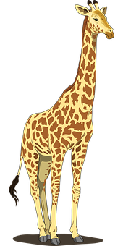
aussprechen
[r]
…
Farbe
lernen
Ort
[place]
When ‘h’ follows a vowel, it makes a long vowel sound.
Uhr
Tier
[clock, watch, o’clock]
Notes:
Timing: 1 minute
Aim: to consolidate the SSC [r] after a vowel
Procedure:
Re-present the SSC and the source word ‘Ort’ (with gesture, if using).
Click to bring on the picture and get pupils to repeat the word ‘Ort’ (with gesture, if using).
Present the cluster words in the same way, bringing on the picture and getting pupils to pronounce the words.
Note: ‘Uhr’ is a slight exception as the ‘r’ does not directly follow the vowel. However, ‘h’ following a vowel makes a long vowel sound, so the ‘r’ sound here is the same as after a vowel.
Word frequency: Ort [341] Uhr [348] Tier [614] lernen [288] Farbe [1079]
Jones, R.L & Tschirner, E. (2019). A frequency dictionary of German: Core vocabulary for learners. London: Routledge.

Slide 6
hören
Hör zu. Schreib A oder B. Dann schreib das Wort!
 | A: [r] like [rot] | B: [r] like [Ort] | Wort
1 |  |  | Arm
2 |  |  | über
3 |  |  | gerade
4 |  |  | führen
5 |  |  | unter
6 |  |  | Prozent
7 |  |  | während
8 |  |  | Recht
Notes:
Timing: 8 minutes
Aim: to consolidate the SSC [r] by identifying words with [r] before and after a vowel.
Procedure:
1. Pupils write down numbers 1-8. They will write down ‘A’ (r before a vowel) or ‘B’ (r after a vowel) for each answer. As an extra task they could try to transcribe the word they hear.
2. Click audio button 1 and discuss whether it is like rot or like Ort. Click to reveal answer. Click again to reveal correct spelling of the word.
3. Repeat for items 2-8.
Transcript/ Vocabulary:
Arm [527]
über [47]
gerade [159]
führen [162]
unter [89]
Prozent [172]
während [173]
Recht [242]
Jones, R.L & Tschirner, E. (2019). A frequency dictionary of German: Core vocabulary for learners. London: Routledge.
6

Slide 7
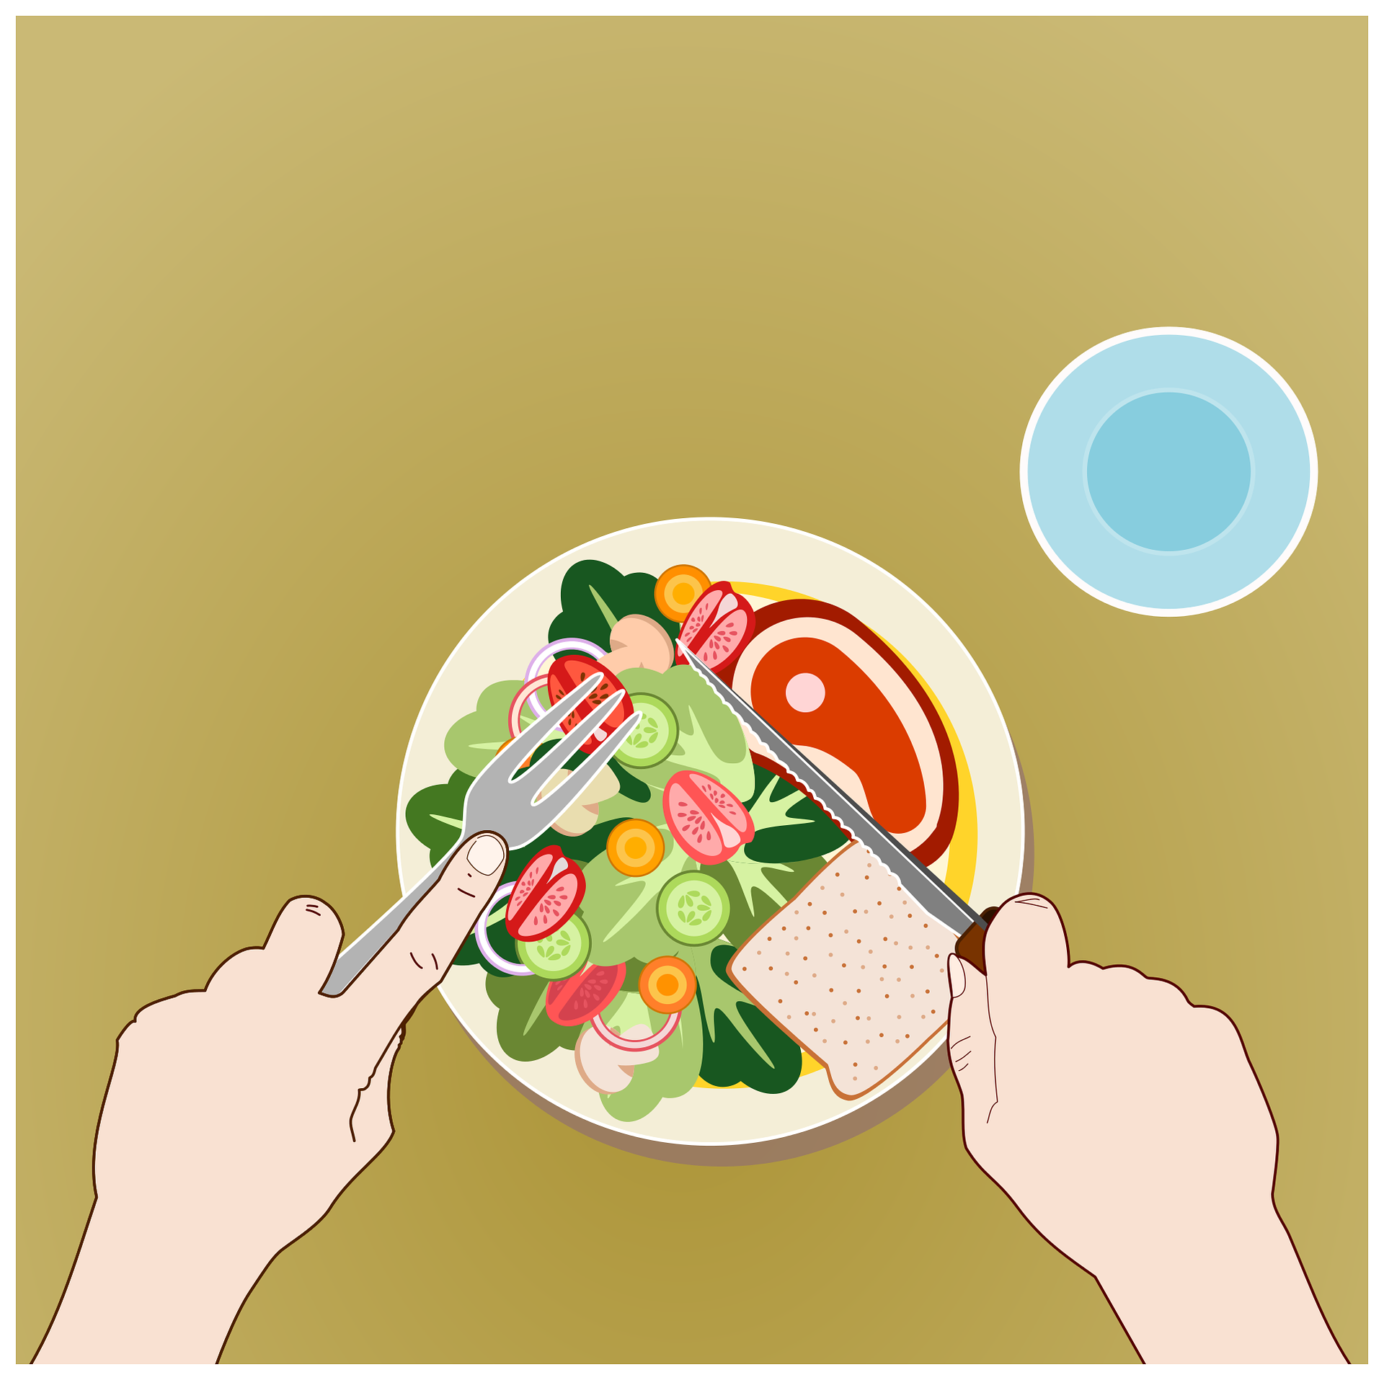
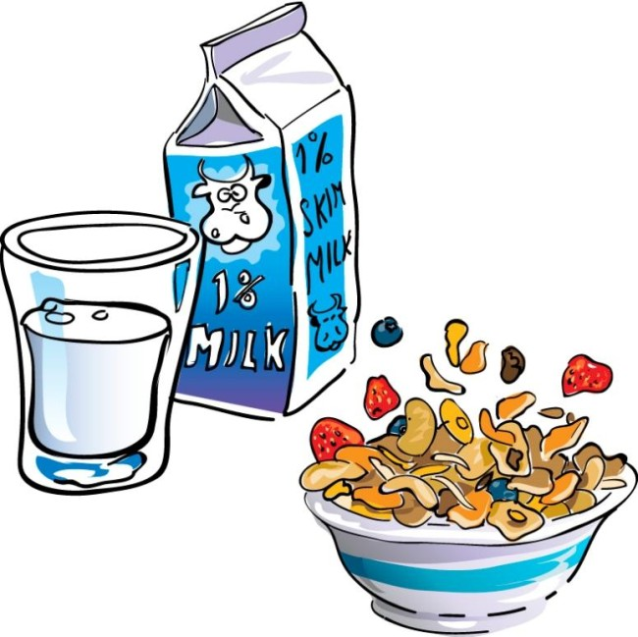
Vokabeln
Werden changes its spelling in du and er/sie/es forms: du wirst – you become, get er/sie es wird - s/he, it becomes, gets
Vokabeln lernen
Wörter
Enjoy your meal!
breakfast
Frohe Ostern
Guten Appetit
das Frühstück
das Ei
Have fun!
Gute Nacht
viel Spaß
werden
Notes:
Timing: 3 minutes (two slides)
Aim: to introduce the new items of vocabulary for this week.
Procedure 1. Click to introduce the new words and their pictures.
2. Check that pupils are clear what the words mean in English.
3. Draw attention to the callouts.
4. Practise pronouncing the new words as a class and individually. 5. Then, on the next slide, pupils try to match the German and the pictures, then try to recall the German words.
7

Slide 8
Vokabeln
Vokabeln lernen
Guten Appetit
das Ei
Frohe Ostern
Vokabeln
Gute Nacht
das Frühstück
viel Spaß!
werden
1
2
4
5
6
7
3
breakfast
Notes:
2/2
Aim: to provide written recognition and read aloud practice of the new vocabulary.
Procedure: 1. Pupils match the German nouns to the pictures in their heads.
2. The teacher gives the pupils a number and the pupils must say the correct word in German. The number prompts are the trigger (i.e. click on the number) for the lines to connect the correct word to the picture.
3. Click to make each German word disappear in turn. Can pupils say the German words aloud?

Slide 9
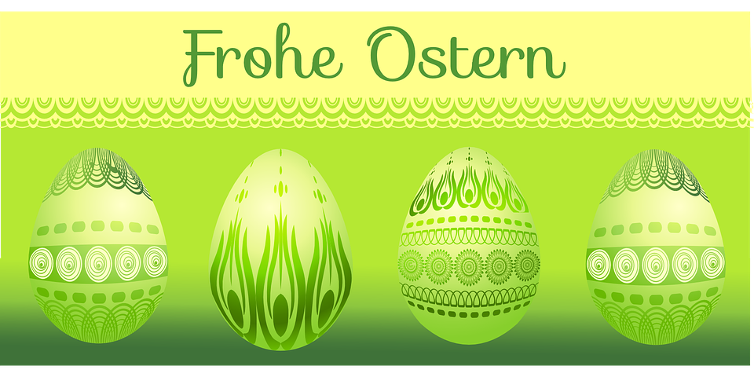
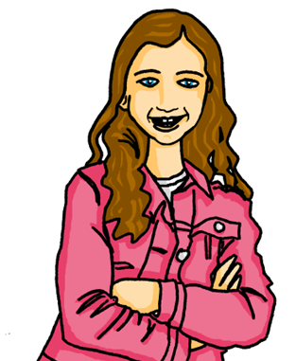
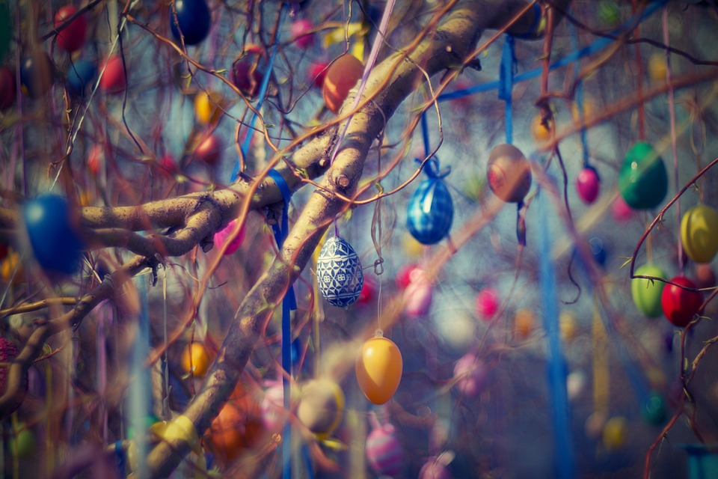
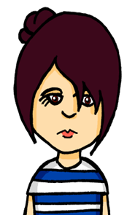
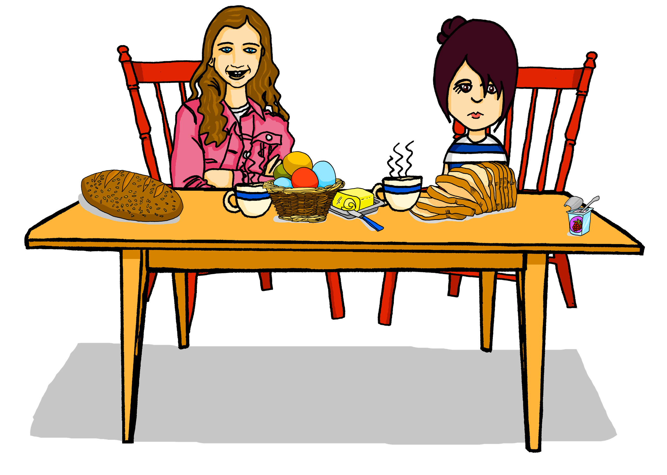
Kultur
Laura und die englische Klasse besuchen Johanna und Aishas Klasse für einen Austausch.
Es ist Ostern! Viele Menschen in Deutschland schmücken* Häuser und Bäume mit bunten* Eiern.
1. Suchen wir heute Eier?
2. Ich habe Hunger. Danke für das Frühstück!
Gute Nacht!
Guten Appetit!
Laura
Ja, frohe Ostern!
Viel Spaß!
3. Ich werde morgen elf! Ich mache eine Party!
4. Ich werde müde.
schmücken – to decorate
bunt – colourful
Notes:
Timing: 5 minutes
Aim: to present a mix of culture and new vocabulary in the Easter context setting.
Procedure:
Scenario: the English class is visiting Johanna and Aisha’s class for an exchange. The idioms introduced here are relevant to things pupils could hear when staying with a family.
1. Read the context text boxes with your class (or, if using the audio version, click on the text boxes to play the audio).
2. Pupils read Laura’s speech boxes and match the responses on the right to each speech bubble.
3. Click in turn for the green responses to move to the right place.
Vocabulary:
bunt [1817] schmücken [>5009]
9

Slide 10
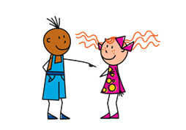
Present tense: du (you) | ihr (you all)
Remember! To mean ‘you’ to one person, use du:
Du suchst Ostereier.
You are looking for Easter eggs.
To mean ‘you all’ or ‘you both’, use ihr:
Ihr sucht Ostereier.
You (all) are looking for
Easter eggs.
Notes:
Timing: 1 minute
Aim: to recap the 2nd person singular (‘you) and plural form (‘you all’) of regular present tense.
Procedure:
Click through the animations to present the information.
Elicit English translation for the German examples provided.
10

Slide 11
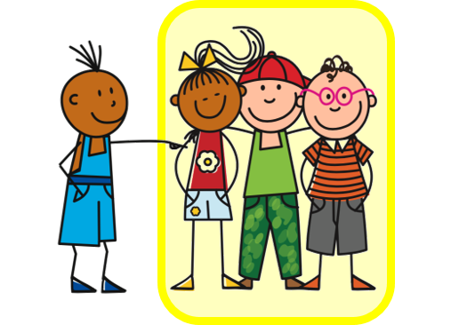
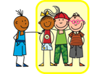
Present tense: strong verbs
You know that strong verbs change the vowel in singular forms du and er/sie/es:
Du trägst Partykleidung.
You are wearing party clothes.
You are watching a film.
Du siehst einen Film.
Du isst Ostereier.
You are eating easter eggs.
Remember that all other forms (I, you all, we, they) keep the original vowel:
Ihr tragt Partykleidung.
You (all) are wearing party clothes.
Ihr seht einen Film.
You (all) are watching a film.
Ihr esst Ostereier.
You (all) are eating Easter eggs.
Notes:
Timing: 3 minutes (two slides)
Aim: to recap singular forms of strong verbs change.
Procedure:
Click through the animations to present the information.
Elicit English translation for the German examples provided.
11

Slide 12
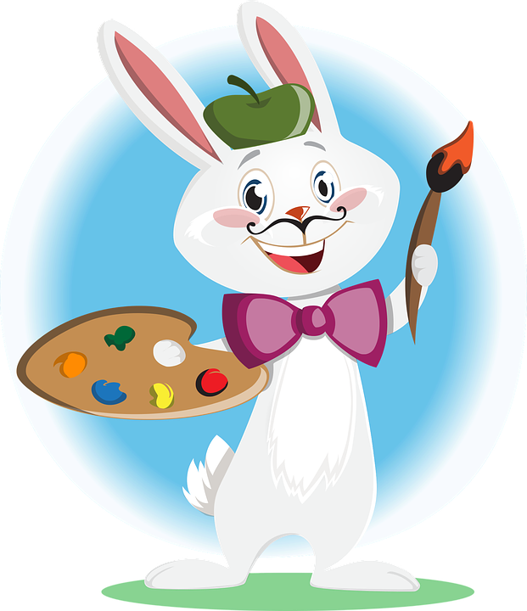
werden - to become, get
Remember that werden also changes:
Du wirst müde.
You get|are getting tired.
Ihr werdet müde.
You (all) get|are getting tired.
Das Bild wird schön.
The picture is becoming lovely.
Die Bilder werden schön.
The pictures are becoming lovely.
Es wird dunkel*!
Yes it is getting dark. Are you getting tired?
It is getting dark!
Ja, es wird dunkel! Werdet ihr müde?
Ja, wir werden müde.
Gute Nacht!
Yes we are getting tired.
dunkel – dark
Notes:
Timing: 3 minutes (two slides)
Aim: to explain vowel change in werden, and to showcase use of werden.
Procedure:
Click through the animations to present the information.
Elicit English translation for the German examples provided.
After the grammar examples, click for mini (grammar) dialogue and translations to appear in turn.
Vocabulary
dunkel [706]
12

Slide 13
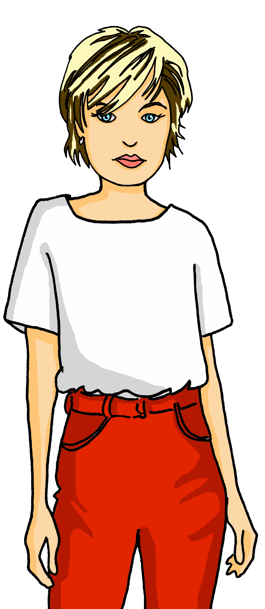
hören
Laura ist Johannas Austauschpartnerin.
Spricht Johannas Mutter Maike mit Johanna, oder mit Johanna UND Laura?
 | Johanna | Johanna und Laura
Was heißt das auf Englisch?
You (both) are going to the cinema.
You (both) are tired and are going to bed.
You are 12 today and are having a party.
You are buying an Easter cake.
You (both) are hungry! The food is here!
You (both) are wearing party clothes.
1
2
3
4
5
6
Notes:
1/2
Timing: 10 minutes (3 slides)
Aim: to practise aural identification of plural and singular verb forms.
Procedure:
1. Explain the scenario. Is Maike, Johnna’s mum, talking to just Johanna, or to Johanna and Laura, her exchange partner? Pupils decide, based on the verb form – the pronoun is bleeped out.
2. Click on the audio buttons to play the recordings.
3. Elicit the answers.
4. Click to bring up the green answer ticks.
5. Click to listen again. This time pupils write the message in English.
Transcript:
[Ihr] geht ins Kino...
[Ihr] seid müde und geht ins Bett…
[Du] wirst heute 12 und machst eine Party…
[Du] kaufst einen Osterkuchen…
[Ihr] habt Hunger! Das Essen ist hier!
[Ihr] tragt Partykleidung
13

Slide 14
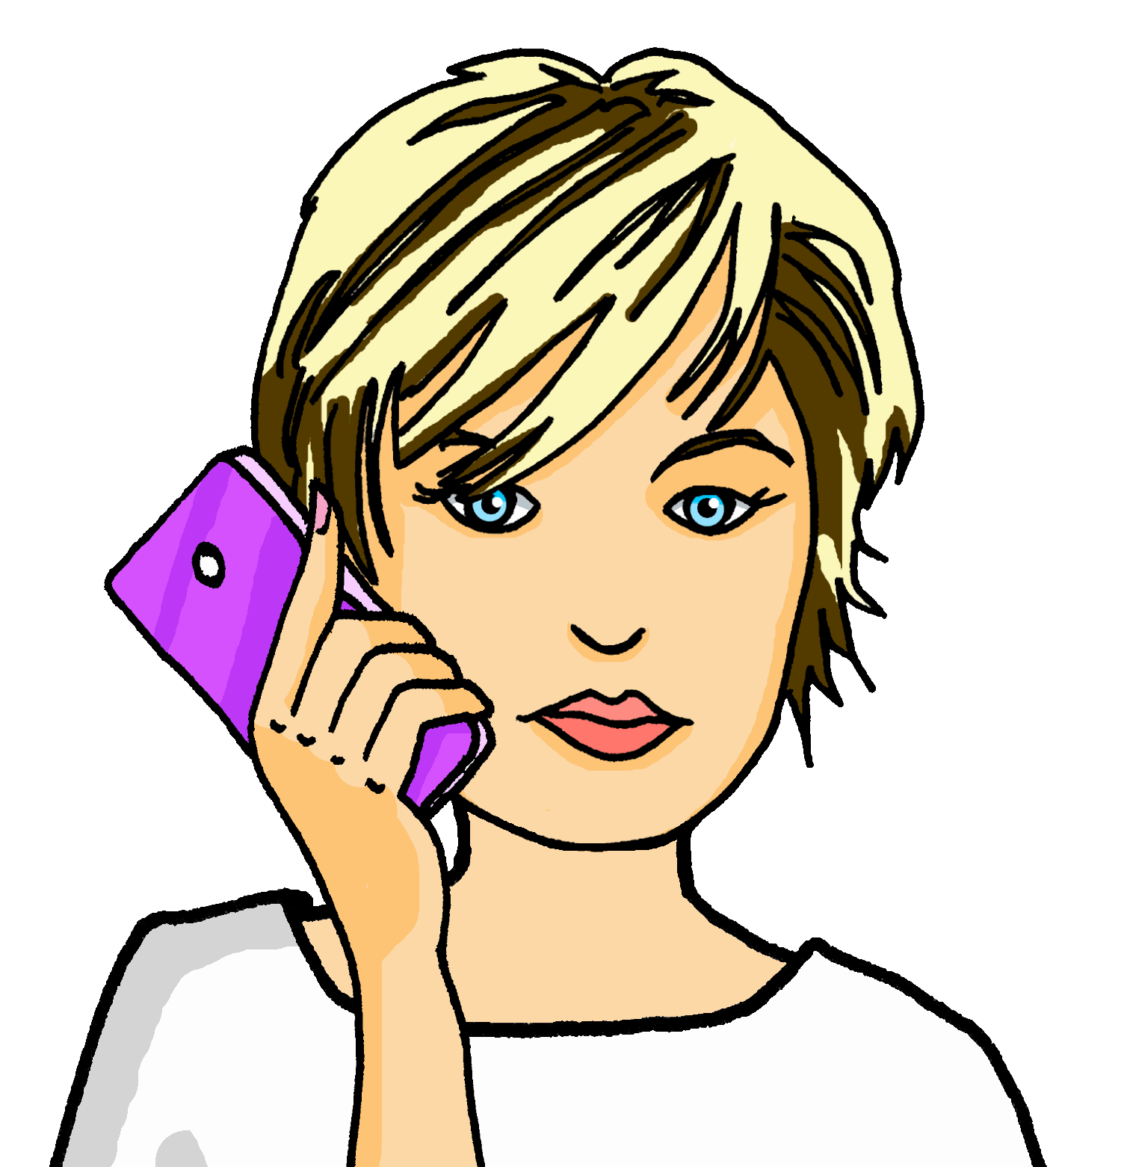
lesen
Maike ist in der Stadt. Was schreibt Maike? Was heißt das auf Englisch?
 | Maike | … | Englisch
1 | Ihr werdet müde… | Gute Nacht! | You (both) are getting tired…
2 | Du isst Ostereier… | Guten Appetit! Frohe Ostern! | You are eating Easter eggs…
3 | Ihr kommt sehr spät nach Hause… | Viel Spaß! | You (both) are coming home very late…
4 | Es ist zehn Uhr abends – du gehst ins Bett… | Gute Nacht! | It is ten o’clock in the evening – you are going to bed…
5 | Du kommst jetzt nach Hause… | Hausaufgaben machen! | You are coming home now…
6 | Ihr schlaft jetzt… | Gute Nacht! | You (both) are sleeping now…
1
2
3
4
5
6
Gute Nacht!
Frohe Ostern!
Viel Spaß!
Guten Appetit!
Hausaufgaben machen!
Notes:
2/2
Aim: to practise written comprehension of singular/plural verb forms, using this week’s vocabulary and context (Anglo-German exchange at Easter).
Procedure:
1. Pupils read what Maike says and select the best fit to each statement from the five phrases at the bottom, i.e. something that would follow logically. NB each phrase can be used more than once.
2. Elicit the phrases and click to reveal the answers.
3. Elicit the English meanings and click to reveal the translations.
Ihr werdet müde…
Du isst Ostereier…
Ihr kommt sehr spät nach Hause…
Es ist zehn Uhr abends – du gehst ins Bett…
Du kommst jetzt nach Hause…
Ihr schlaft jetzt…
14

Slide 15
Tschüss!
blau
Notes:
15

