Slide 1
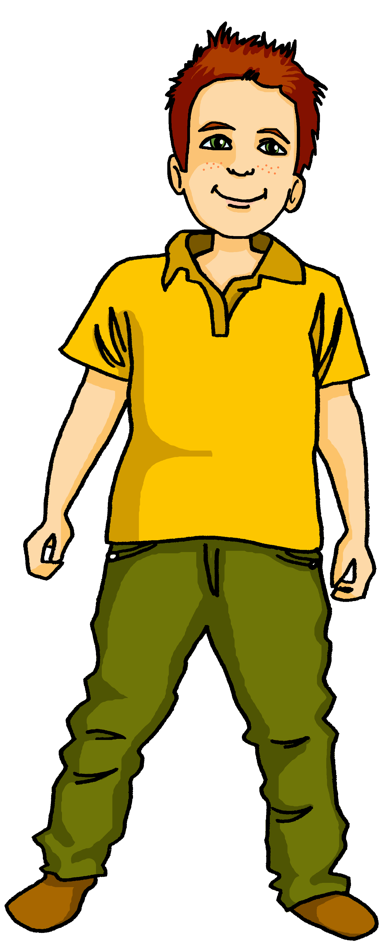
Talking about activities and events
Ich kann so viel machen!
rot
können, ich kann, du kannst
SSC [-g] [-d] [-b]
Term 3 Week 5
Notes:
Artwork by Steve Clarke. Pronoun pictures from NCELP (www.ncelp.org). All additional pictures selected from Pixabay and are available under a Creative Commons license, no
attribution required.
Phonics: [-g] [-d] [-b] Tag [111] und [2] gelb [1446] Berg [934] Zug [675] Lied [1733] Freund [273] Lieblings- [n/a] siebzehn [>5000]
Vocabulary: können, ich kann, du kannst [23] etwas [100] Instrument [1572]
Revisit 1: sitzen [231] wiederholen [988] Antwort [522] Frage [157] Satz [432] neben [266]
Revisit 2: denken [128] lernen [288] singen [1063] spielen [205] verstehen [211] viel [56] oft [223] ich weiß (es) nicht [n/a] wie sagt man…? [n/a]
Jones, R.L & Tschirner, E. (2019). A frequency dictionary of German: Core vocabulary for learners. London: Routledge.
The frequency rankings for words that occur in this PowerPoint which have been previously introduced in these resources are given in the SOW and in the resources that first
introduced and formally re-visited those words.
For any other words that occur incidentally in this PowerPoint, frequency rankings will be provided in the notes field wherever possible.
Note that the first three lessons of the year teach language that can be continuously recycled as lesson routine every lesson in Y3/4.
The idea would be that the class teacher (whether or not s/he teaches the class German can re-use the language as part of the daily routine with the class.
1

Slide 2
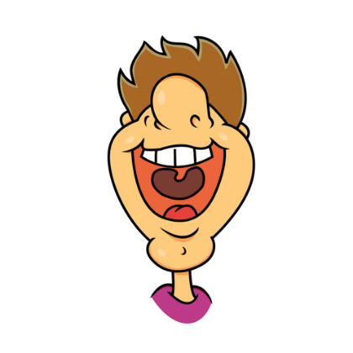
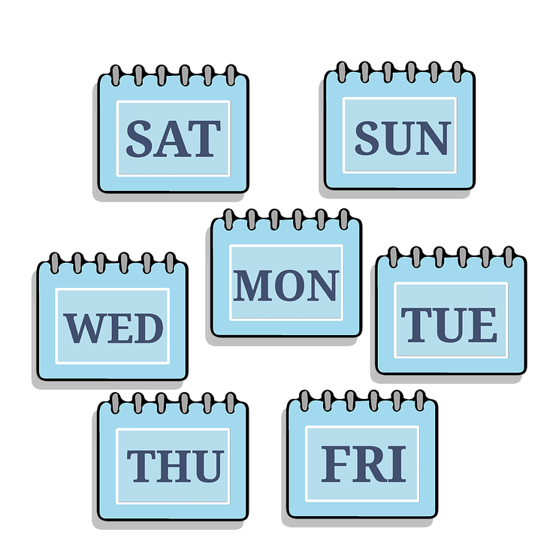
aussprechen
[-g]
[-d]
[-b]
When g, d, b come at the end of a word or before a consonant they sound like k, t, p and you don’t use your vocal chords.
…
and
Tag
und
gelb
Notes:
Timing: 2 minutes
Aim: To introduce/consolidate SSC [-g]
Procedure: 1. Present the letter(s) and say the final [-g] sound first, on its own. Pupils repeat it with you. Do the same with final [-d] and final [-b].
2. Click to bring up the callout to explain when these letters sound like this: i.e., g = k, d = t, b = p. 3. Bring up the word “Tag” on its own, say it, pupils repeat it, so that they have the opportunity to focus all of their attention on the connection between the written word and its sound.
4. A possible gesture for this would be to use the British Sign Language (BSL) sign for day, as here: https://www.signbsl.com/sign/day.
5. Click to bring up the image and say the word “Tag” again with pupils.
6. Click to bring up the word “und”. One gesture is to make the plus sign with two index fingers. Alternatively, the BSL sign for “and” is here: https://www.signbsl.com/sign/and
7. Click to bring up the image and say the word “und” again. 8. Finally, click to bring up the word “gelb”. BSL is here: https://www.signbsl.com/sign/yellow
9. Click to bring up the image and say the word again.
Word frequency (1 is the most frequent word in German): gelb [1446] Tag [111] und [2] Source: Jones, R.L. & Tschirner, E. (2019). A frequency dictionary of German: core vocabulary for learners. Routledge
2

Slide 3
aussprechen
[-g]
…
Tag
Berg
Zug
Notes:
Timing: 3 minutes (three slides)
Aim: To introduce/consolidate SSC [-g]
Procedure:
Introduce and elicit the pronunciation of the individual SSC [-g] and then the source word again ‘Tag’ (with gesture, if using).
Then present and elicit the pronunciation of the two cluster words.
The cluster words have been chosen for their high-frequency, from a range of word classes, with the SSC (where possible) positioned within a variety of syllables within the words (e.g. initial, 2nd, final etc.). Additionally, we have tried to use words that build cumulatively on previously taught SSCs (see the Phonics Teaching Sequence document) and do not include new SSCs. Where new SSCs are used, they are often consonants which have a similar symbol-sound correspondence in English.
Word frequency (1 is the most frequent word in German): Berg [] Tag [] Zug [] Source: Jones, R.L. & Tschirner, E. (2019). A frequency dictionary of German: core vocabulary for learners. Routledge

Slide 4
aussprechen
[-d]
…
and
und
Lied
Freund
Notes:
[2/3]
Aim: To introduce/consolidate SSC [-d]
Procedure:
Introduce and elicit the pronunciation of the individual SSC [-d] and then the source word again ‘und’ (with gesture, if using).
Then present and elicit the pronunciation of the two cluster words.
The cluster words have been chosen for their high-frequency, from a range of word classes, with the SSC (where possible) positioned within a variety of syllables within the words (e.g. initial, 2nd, final etc.). Additionally, we have tried to use words that build cumulatively on previously taught SSCs (see the Phonics Teaching Sequence document) and do not include new SSCs. Where new SSCs are used, they are often consonants which have a similar symbol-sound correspondence in English.
Word frequency (1 is the most frequent word in German): und [] Freund [] Lied [] Source: Jones, R.L. & Tschirner, E. (2019). A frequency dictionary of German: core vocabulary for learners. Routledge

Slide 5
aussprechen
[-b]
…
gelb
Lieblings-
siebzehn
Notes:
[3/3]
Aim: To introduce/consolidate SSC [-b]
Procedure:
Introduce and elicit the pronunciation of the individual SSC [-b] and then the source word again ‘gelb’ (with gesture, if using).
Then present and elicit the pronunciation of the two cluster words.
The cluster words have been chosen for their high-frequency, from a range of word classes, with the SSC (where possible) positioned within a variety of syllables within the words (e.g. initial, 2nd, final etc.). Additionally, we have tried to use words that build cumulatively on previously taught SSCs (see the Phonics Teaching Sequence document) and do not include new SSCs. Where new SSCs are used, they are often consonants which have a similar symbol-sound correspondence in English.
Word frequency (1 is the most frequent word in German): gelb [] Lieblings-[] siebzehn
Source: Jones, R.L. & Tschirner, E. (2019). A frequency dictionary of German: core vocabulary for learners. Routledge

Slide 6
[-g] [-d] [-b]
Hör zu. Ist es [-g], [-d] oder [-b]?
 |  | [-g] | [-d] | [-b]
1 | Bild
2 | Montag
3 | Deutschland
4 | Lieblingstier
5 | gelb
6 | Lied
7 | Kebab
8 | Geburtstag
9 | Tanzclub
Remember! At the end of words or before consonants, [-g] sounds like k [-d] sounds like t
[-b] sounds like p
Notes:
Timing: 5 minutes
Aim: to consolidate the SSC [-g] [-d] and [-b].
Procedure:
Click each audio button to hear the word.
Pupils listen and decide which SSC they hear. Note that these items are all unvoiced versions of the letters. In the follow ups, we will contrast voiced and unvoiced sounds.
Click to reveal answers.
Transcript:
Bild
Montag
Deutschland
Lieblingstier
Gelb
Lied
Kebab
Geburtstag
Tanzclub
Word frequency:
Bild [253] Montag [1044] Deutschland [140] Lieblingstier [n/a] gelb [1446] Lied [1733] Kebab [>5000] Geburtstag [1779] Tanzclub [n/a] Source: Jones, R.L. & Tschirner, E. (2019). A frequency dictionary of German: core vocabulary for learners. Routledge

Slide 7
Vokabeln
Vokabeln lernen
Wörter
Sag die Wörter
können
du kannst
[you can]
etwas
ich kann
das Instrument
[I can]
[instrument]
Notes:
Timing: 5 minutes
Aim: to present and practise new vocabulary for this week
Procedure:
Click for each new word to appear, then again for the supporting picture and English to appear.
Practise repeating the words as a whole class.
7

Slide 8
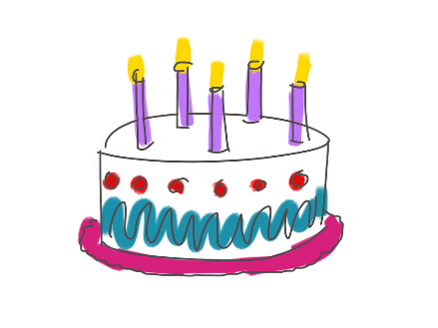
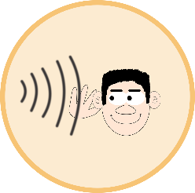
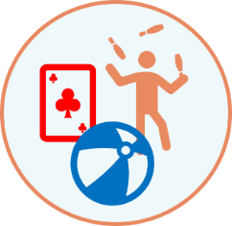
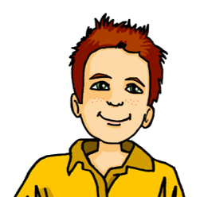
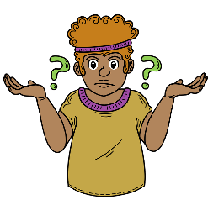
In der Schule
hören
Hör zu. Welches Bild ist das? Wie sagt man das auf Englisch?
1
K
2
F
A
E
I
3
I
4
A
5
C
B
F
J
6
D
7
H
8
J
C
G
K
9
G
10
B
11
L
D
H
L
12
E
1. ein Instrument lernen 2. ein Lied singen 3. ein Spiel gewinnen 4. einen Satz wiederholen
5. ein Bild machen
6. neben Moritz sitzen
7. dienstags schwimmen
8. heute tanzen
9. etwas spielen
10. Fragen und Antworten verstehen
11. denken: “ich weiß es nicht!”
12. Geburtstag haben
This uses almost all of the revisited and new words and we’re in our context of ‘Was kannst du in der Schule machen?
other verbs we have = hören
1. ein Instrument lernen 2. ein Lied singen 3. ein Spiel gewinnen 4. einen Satz wiederholen
5. ein Bild machen
6. neben Moritz sitzen
7. dienstags schwimmen
8. heute tanzen
9. etwas spielen
10. Fragen und Antworten verstehen
11. denken: “ich weiß es nicht!”
12. Geburtstag haben
Notes:
Timing: 5 minutes
Aim: to revisit vocabulary for this week.
Procedure:
Click on each audio button to hear a short infinitive phrase in German.
Students look carefully at the pictures on the right and decide which picture the phrase refers to. They write down the corresponding letter.
Click to reveal answers.
Transcript:
1. ein Instrument lernen 2. ein Lied singen 3. ein Spiel gewinnen 4. einen Satz wiederholen
5. ein Bild machen
6. neben Moritz sitzen
7. dienstags schwimmen
8. heute tanzen
9. etwas spielen
10. Fragen und Antworten verstehen
11. denken: “ich weiß es nicht!”
12. Geburtstag haben
8

Slide 9
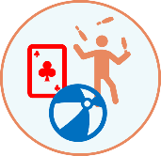
können – to be able to, can
To say what you can do use the verb können and a 2nd verb in the infinitive form.
Können is irregular. The spelling changes.
Ich kann singen.
I can sing.
Du kannst spielen.
You can play.
The 2nd verb always goes to the end of the sentence:
Ich kann ein Lied singen.
I can sing a song.
Du kannst Fußball spielen.
You can play football.
The word order is different from English.
Notes:
Timing: 2 minutes
Procedure:
Click through the animations to present the new information.
Elicit English translation for the German examples provided.
9

Slide 10
hören
Hör zu.
Ist es Moritz oder Lukas? Was kann Moritz machen? → Ich kann Was kann Lukas machen? → Du kannst
 |  | Moritz (ich) | Lukas (du)
 | Du kannst neben Hamza sitzen.
 | Ich kann ein Instrument lernen.
 | Ich kann ein Bild machen.
 | Du kannst Fragen und Antworten verstehen.
 | Du kannst heute tanzen.
 | Ich kann ein Lied singen.
1
2
3
4
5
6
Notes:
Timing: 5 minutes
Aim: to practise aural identification and comprehension of können in first and second persons singular.
Procedure:
Explain the task. Lukas is still fairly new to school, and Moritz is explaining what they can each do.
Students listen carefully. If they hear ‘kann’ it is something Moritz can do and they tick Moritz. If they hear ‘kannst’ then it is something Lukas can do.
Click to play number 1 as an example. Ask pupils to write either a Moritz or Lukas.
Click to reveal the answer.
Repeat with items 2-6.
Transcript:
1. Du kannst neben Hamza sitzen.
2. Ich kann ein Instrument lernen.
3. Ich kann ein Bild machen.
4. Du kannst Fragen und Antworten verstehen.
5. Du kannst heute tanzen.
6. Ich kann ein Lied singen.
10

Slide 11
lesen
Moritz is writing what he and Robbie can do, but he has spilled juice!
Match the English sentence with the right German sentence.
Schreib 1-6 und ‘ich’ oder ‘du’.
1) Ich kann ein Spiel gewinnen.
2) Du kannst Geburtstag haben.
3) Du kannst denken: “ich weiß es s nicht!”
4) Ich kann montags schwimmen.
5) Ich kann etwas spielen.
6) Du kannst einen Satz wiederholen.
I can swim on Mondays.
I can play something.
I can win a game.
You can repeat a sentence.
You can think: “I don’t know!”
You can have a birthday.
1
2
3
4
5
6
Notes:
Timing: 5 minutes
Aim: to practise written comprehension of können in first and second persons singular.
Procedure:
Pupils write 1-6 and either ‘ich’ or ‘du’ depending on the form of ‘können’ that they see.
Click to reveal answers.
Click to reveal the second stage of the activity.
Students write down the correct English translation for each sentence.
Click to reveal answers.
In the audio version, click on the audio buttons to hear each sentence pronounced.
11

Slide 12
Kultur
Kann ich schon!
To say you can already do something say “kann ich schon!”
Can you do these things?
singen?
Deutsch lernen?
ein Instrument spielen?
Listen to these German children sing about what they can do, and join in with your best “kann ich schon!”
Du kannst in Deutschland in der Schule singen.
https://www.youtube.com/watch?v=2PrFEacUkn8
Notes:
Timing: 5 minutes
Aim: to watch and sing along to an authentic video about things children can do.
Procedure:
Click through the explanation to introduce the phrase “kann ich schon”.
Click to reveal three things that pupils might be able to do. The teacher reads out the question under each image. Anyone who can do the item says “kann ich schon!”
Click to reveal a callout explaining that children in Germany also sing at school.
Click to reveal a second callout preparing children for the video and asking them to join in with “kann ich schon!”
Click on the youtube link to play the video.
12

Slide 13
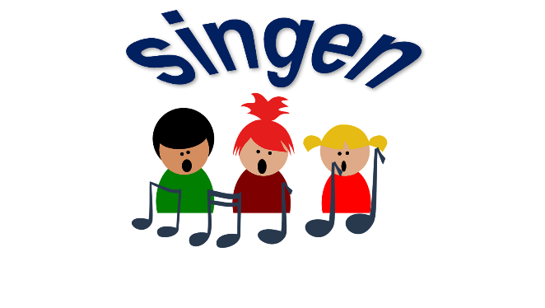
Hör zu und sing mit!
Tschüss, Tschüss, Tschüss, Tschüss,
Tschüss, Tschüss, Auf Wiedersehen!
Bis bald, bis bald, bis bald, bis bald.
Tschüss, Tschüss, Tschüss, Tschüss, Auf Wiedersehen!
Bis bald! = See you soon!
Notes:
Timing: 3 minutes
Aim: to revisit the goodbye song (to the tune of ‘Hi ho Hi ho it’s off to work we go’.)
Procedure: If there’s time, why not remind pupils about their German goodbye song and sing it through to finish the lesson.

Slide 14
Tschüss!
rot
Notes:
14

