Slide 1
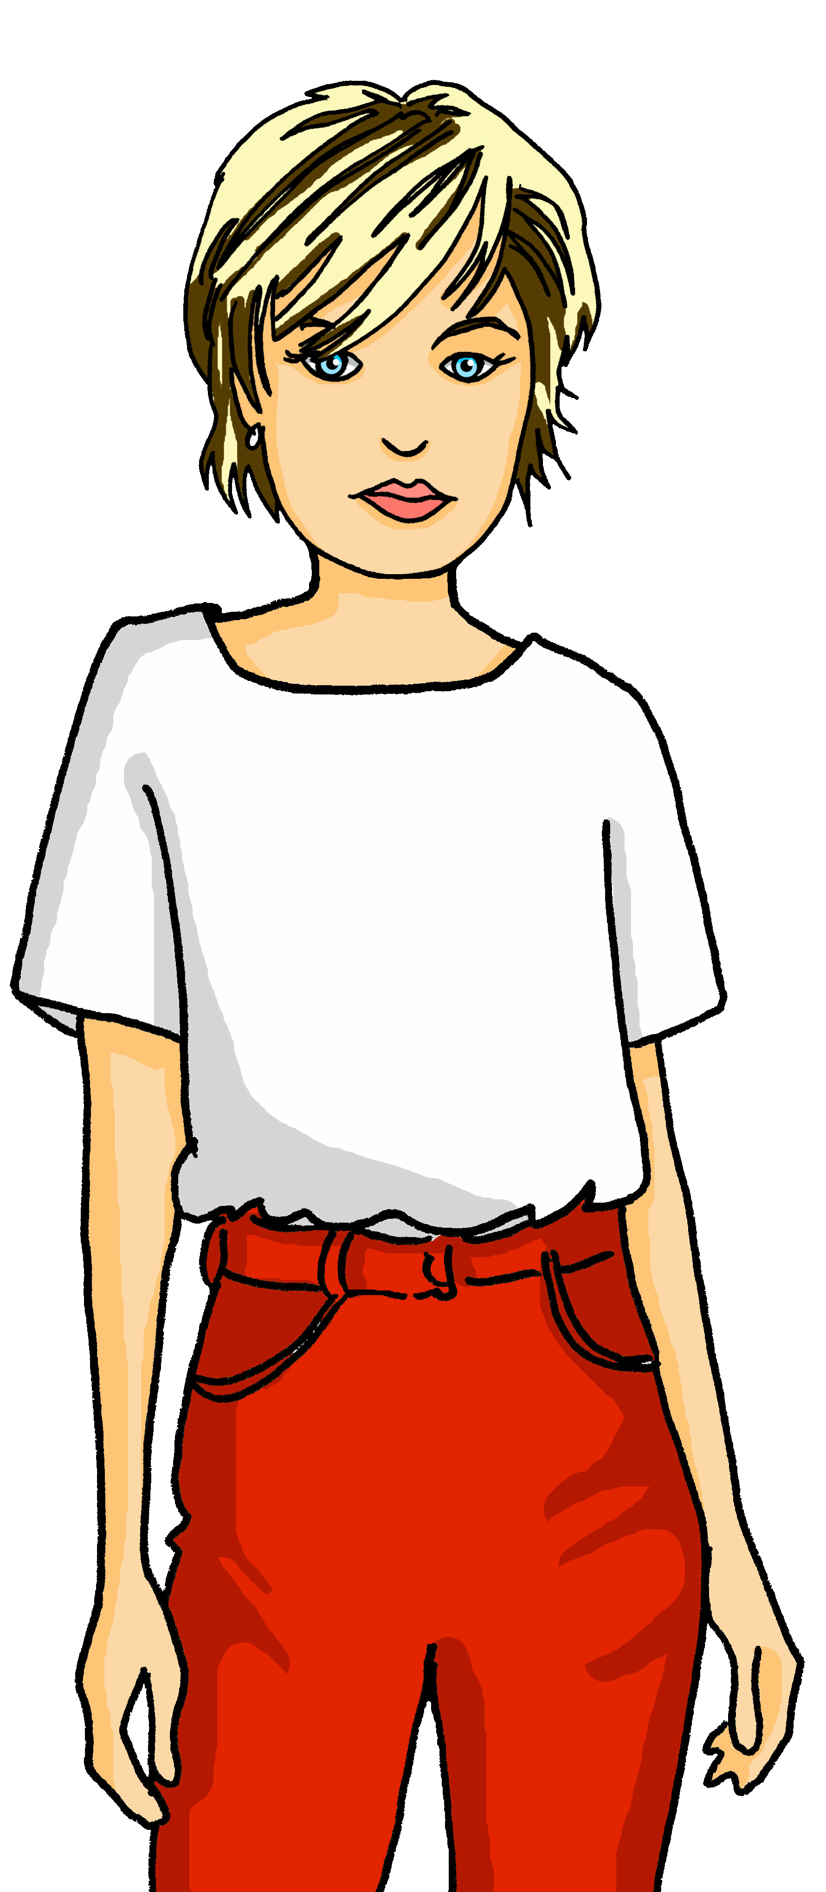
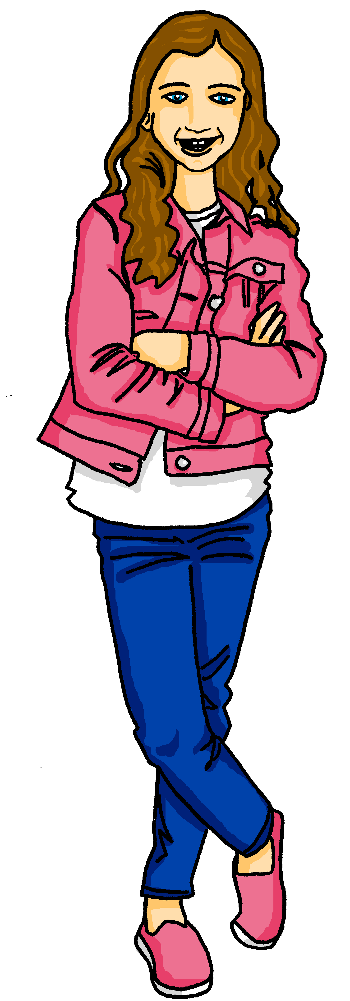
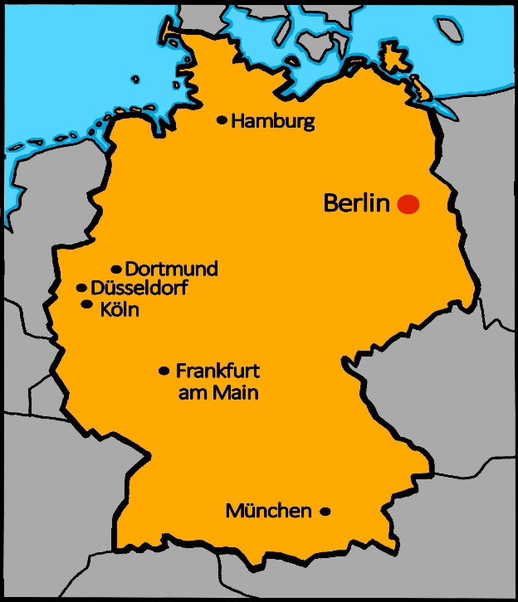
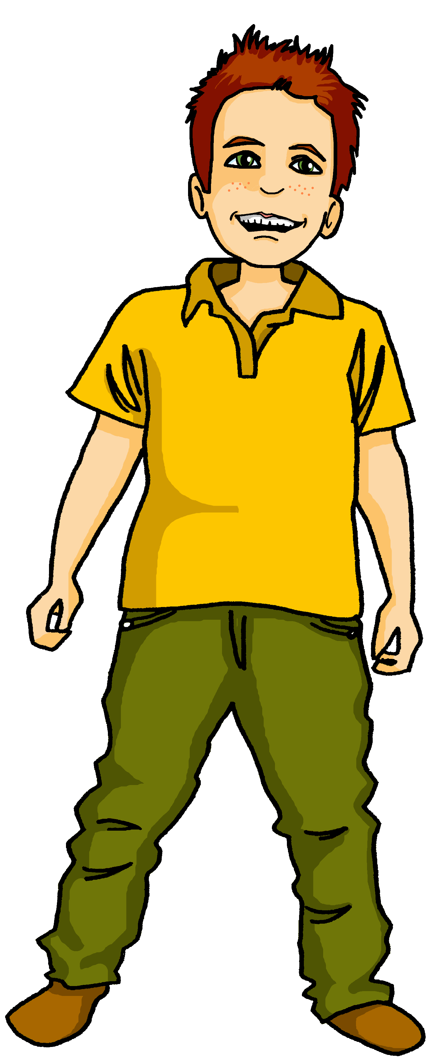
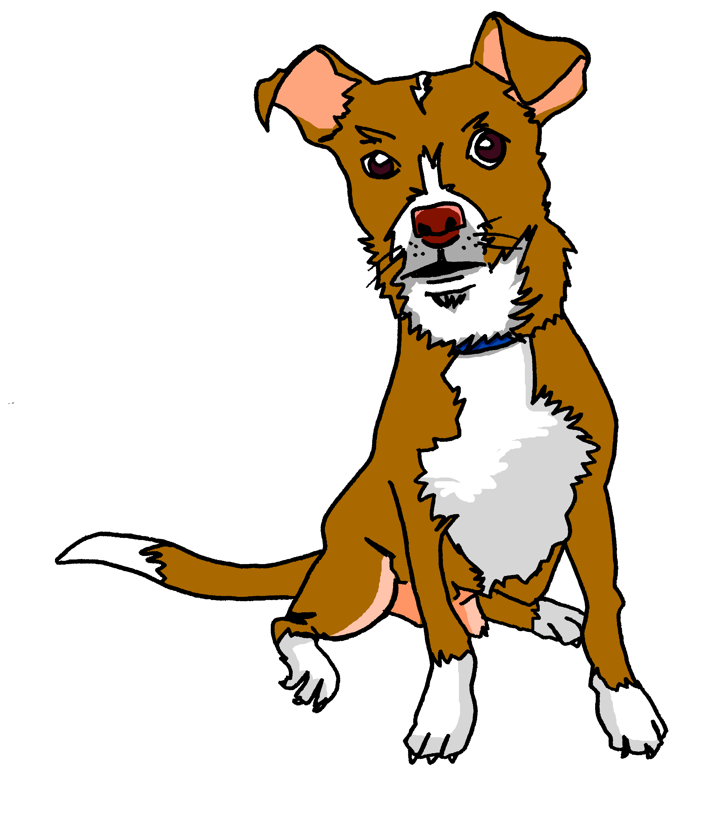
Talking about activities and events
rot
Follow ups 1-5
Term 3 Week 7
Notes:
Artwork by Steve Clarke. Pronoun pictures from NCELP (www.ncelp.org). All additional pictures selected from Pixabay and are available under a Creative Commons license, no
attribution required.
Phonics: Revisit [ie] [ei] Liebe [844] sie [7] Brief [838] frei [318] ein [5] klein [114] sein [3] allein [258]
Vocabulary: Bruder [730] Mutter [218] Schwester [974] Vater [232] freundlich [1566] nett [1565]
Revisit 1: Januar [1052] Februar [1093] März [987] April [1004] Mai [1048] Juni [1148] Juli [1544] August [1929] September [1035] Oktober [1223] November [1273] Dezember [1527] Geburtstag [1779] Monat [316] wann [657]
Revisit 2: Nummer [806] null [1680] eins [774] zwei [70] drei [106] vier [200] fünf [274] sechs [428] sieben [611] acht [645] neun [1053] zehn [333] elf [1507] zwölf [1080] es gibt [n/a]
Jones, R.L & Tschirner, E. (2019). A frequency dictionary of German: Core vocabulary for learners. London: Routledge.
The frequency rankings for words that occur in this PowerPoint which have been previously introduced in these resources are given in the SOW and in the resources that first
introduced and formally re-visited those words.
For any other words that occur incidentally in this PowerPoint, frequency rankings will be provided in the notes field wherever possible.
Note that the first three lessons of the year teach language that can be continuously recycled as lesson routine every lesson in Y3/4.
The idea would be that the class teacher (whether or not s/he teaches the class German can re-use the language as part of the daily routine with the class.

Slide 2
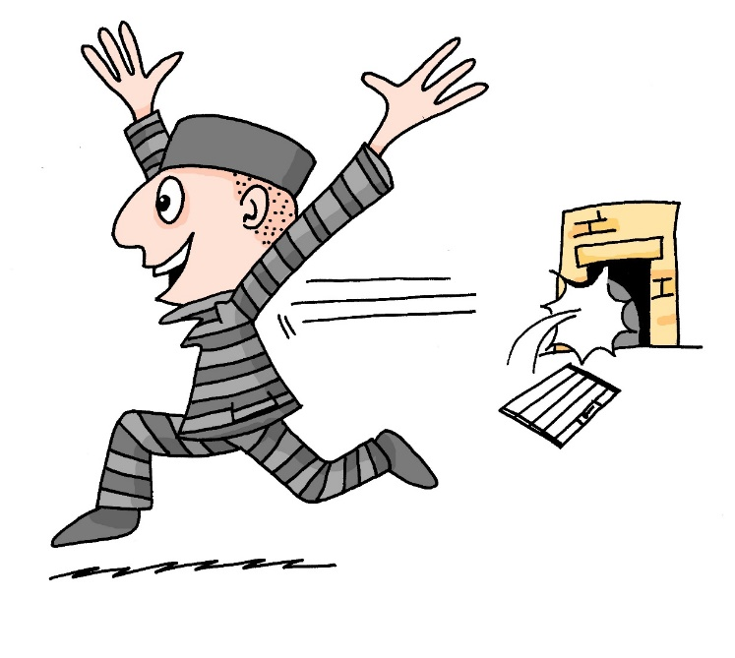
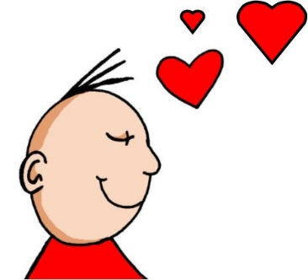
aussprechen
[ei]
[ie]
…
free
frei
Liebe
Notes:
Timing: 1 minute
Aim: to revisit the SSC [ei] and [ie].
Procedure:
Re-present the SSC [ei] and present the source word ‘frei’ (with gesture, if using).
Click to bring on the picture and get pupils to repeat the word ‘frei’ (with gesture, if using).
Note:
a gesture for frei’ might be to throw you hands up in the air and pretend to run away.
Re-present the SSC [ie] and present the source word ‘Liebe’ (with gesture, if using).
Click to bring on the picture and get pupils to repeat the word ‘Liebe’ (with gesture, if using).
Note:
A gesture for ‘Liebe’ might be to make a ‘heart’ shape with both hands approximately where your heart is in your body.
Vocabulary:
frei [318] Liebe [844]
Jones, R.L & Tschirner, E. (2019). A frequency dictionary of German: Core vocabulary for learners. London: Routledge.
2

Slide 3
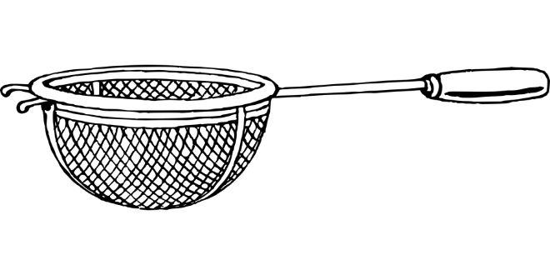
Follow up 1
Tongue Twisters!
Sag den Satz.
aussprechen
How quickly can you say the sentence?
1
Sie hat ein Lieblingslied, sie hat kein Lieblingssieb.
2
She has a favourite song, she doesn’t have a favourite sieve.
3
Notes:
Timing: 5 minutes (for three slides) Aim: To apply SSC knowledge of [ie] and [ei] in the oral production of longer sentences. Procedure: 1. Pupils read the tongue twister aloud. They try to say it as quickly as possible. 2. Listen and check (three different speeds). 3. Clarify meaning, using the English translation and pictures. 4. Repeat the steps for the next two slides.
Word frequency of unknown or cognate words (1 is the most frequent word in German):
Sieb [>5000] Preis [334] Bein [884] schreien [1104] Eis [1874] Source: Jones, R.L. & Tschirner, E. (2019). A frequency dictionary of German: core vocabulary for learners. Routledge

Slide 4
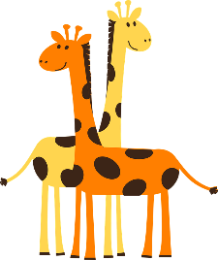
Tongue Twisters!
Sag den Satz.
aussprechen
How quickly can you say the sentence?
1
Zwei Tiere, drei Spiele, vier Preise, sieben Beine.
Two animals, three games, four prizes, seven legs.
2
3
Notes:
[2/3]

Slide 5
Tongue Twisters!
Sag den Satz.
aussprechen
How quickly can you say the sentence?
1
Schrei Eis! Hier Eis, viel Eis, mein Eis, dein Eis, sein Eis!
2
Shout ice cream! Here ice cream, lots of ice cream, my ice cream, your ice cream, his ice cream!
3
Notes:
[3/3]

Slide 6
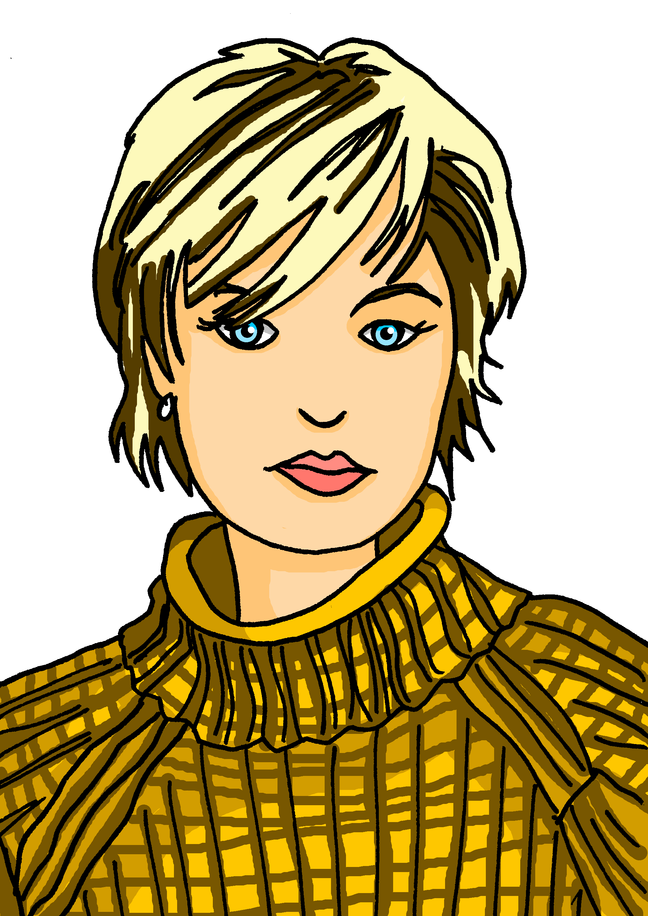
Follow up 2
Was sagt Maike? Was sagt Steffen?
Ich bin Steffen. Und das ist Johanna. Ich bin ihr Vater. Ich kann Fotos machen. Meine Lieblingsfarbe ist gelb. Ich habe im März Geburtstag. März ist mein Lieblingsmonat! Ich höre oft Musik.
lesen
1
2
3
4
5
 | Maike | Steffen
Who are they? | She is Moritz’s mother. | He is Johanna’s father.
What can she or he do? | She can help Moritz and Johanna. | He can take photos.
Favourite thing | Her favourite number is 5. | His favourite colour is yellow.
Birthday | Her birthday is in July. | His birthday is in March (his favourite month).
Hobby | She swims a lot. | He often listens to music.
Notes:
Timing: 10 minutes
Aim: to practise comprehension of possessive adjectives, present tense weak verbs, können, and some of this week’s new and revisited vocabulary.
Procedure:
Explain the task. Maike and Steffen are talking about themselves. Pupils fill in the table below using what they hear and read.
Click on the audio buttons to hear what Maike says. Students fill in the table in English with the relevant information elicited in the first column. Note, the audio presents information in the same order as the table.
Students read the text next to Steffen, and fill in the table accordingly.
Click to reveal answers.
Transcript:
1. Ich bin Maike. Und das ist Moritz. Ich bin seine Mutter.
2. Ich kann oft Moritz und Johanna helfen.
3. Meine Lieblingsnummer ist fünf.
4. Ich habe im Juli Geburtstag.
5. Ich schwimme viel.

Slide 7
Follow up 3

Schreib die Wörter auf Deutsch und auf Englisch.
Steffen, ___ ______, ist freundlich.
_______ Lieblingsfarbe ist gelb.
Er hat im _____ Geburtstag.
Maike, die Mutter, ist _____.
______ Lieblingsnummer ist fünf.
Steffen, the father, is ________.
His _________ _______ is yellow.
His _________ is in March.
Maike, ___ ________, is nice.
Her _________ ________ is ______.
schreiben
1
der Vater
friendly
2
Seine
favourite colour
3
März
birthday
4
nett
the mother
5
Ihre
favourite number
five
Notes:
Timing: 5-10 minutes
Aim: to practise written production and comprehension of ihr and sein, and this week’s new and revisited vocabulary.
This is a jigsaw translation task.
Procedure:
Students write the missing words in both German and English to complete the sentences.
Teacher clicks to provide the written answers and/or clicks the audio buttons to hear the full German sentences.
Differentiation: 1. For a different challenge (i.e. to practise spelling rather than full written recall of the missing German words), the task could be completed as a transcription task initially, by listening to the full sentences and writing the words.
2. Then pupils could complete the English part of the jigsaw.

Slide 8
Follow up 4
Wer bin ich?
Ist dein/ deine Partner/in Moritz oder Johanna?
sprechen
Ich habe im Mai Geburtstag
Meine Lieblingsfarbe ist rot
Ich habe kein Lieblingsbuch
Ich lerne ein Instrument, die Trompete
Mein Lieblingstier ist mein Hund, Tasso.
May birthday
Favourite colour red
No favourite book
I learn an instrument, the trumpet*
Favourite animal, my dog Tasso.
Ich habe im September Geburtstag
Ich spiele Fußball
Ich höre Musik
Mein Lieblingsfilm ist Oben
Mein Lieblingsmonat ist August.
September birthday
I play football
I listen to music
Favourite film Oben
Favourite month August
*the trumpet – die Trompete
Notes:
Timing: 5 minutes
Aim: to practise using mein, meine, some of this week’s revisited vocabulary, and present tense weak singular verbs.
Procedure:
Pupils work in pairs.
Partner A chooses a bullet point from either Moritz or Johanna and says it in German in the first person. Partner B tries to work out who Partner A is. If they cannot, Partner A chooses a second bullet point from the same person. When Partner B works it out, they then choose a bullet point from either Moritz or Johanna and Partner A listens and identifies the correct person.
Partners continue choosing a person, speaking, listening and working out until they have read all the bullet points.
Click to reveal German translations of the bullet points for information.

Slide 9
Follow up 5:

Schreib auf Englisch.
Can you get at least 15 points?
Wörter
 | die Nummer | fünf | null
 | zwölf | drei | es gibt
 | wann? | Januar | der Geburtstag
 | März | Juni | der Monat
 | freundlich | der Bruder | die Schwester
 | der Vater | nett | die Mutter
(the) number
five
zero
Vokabeln
x3
twelve
three
there is, there are
when?
January
(the) birthday
x2
March
June
(the) month
friendly
(the) brother
(the) sister
x1
(the) father
nice
(the) mother
Notes:
Timing: 5 minutes
Aim: to practise written comprehension of vocabulary from this and revisited weeks.
Procedure: 1. Give pupils a blank grid. They fill in the English meanings of any of the words they know, trying to reach 15 points in total. 2. Remind pupils that adjectives can refer to male or female persons and they should note this in their translations. E.g. pleased (f), short (m).
Note: The most recently learnt and practised words are pink, words from the previous week are green and those from week 1 are blue, thus more points are awarded for them, to recognise that memories fade and more effort (heavy lifting!) is needed to retrieve them.

Slide 10
Follow up 5:

Schreib auf Deutsch.
Can you get at least 15 points?
Wörter
 | one | there is, there are | eleven
 | (the) number | eight | nine
 | (the) month | February | May
 | December | when? | (the) birthday
 | nice | (the) mother | (the) brother
 | (the) sister | friendly | (the) father
eins
es gibt
elf
Vokabeln
x3
die Nummer
acht
neun
der Monat
Februar
Mai
x2
Dezember
wann?
der Geburtstag
nett
die Mutter
der Bruder
x1
die Schwester
freundlich
der Vater
Notes:
Timing: 5 minutes
Aim: to practise written production of vocabulary from this and revisited weeks.
Procedure: 1. Give pupils a blank grid. They fill in the German meanings of any of the words they know, trying to reach 15 points in total. 2. Remind pupils that adjectives can refer to male or female persons and they should note this in their translations. E.g. pleased (f), short (m).
Note: The most recently learnt and practised words are pink, words from the previous week are green and those from week 1 are blue, thus more points are awarded for them, to recognise that memories fade and more effort (heavy lifting!) is needed to retrieve them.

Slide 11
Tschüss!
rot
Notes:
11

Slide 12
Follow up 5:

Schreib auf Englisch.
Can you get at least 15 points?
Wörter
 | die Nummer | fünf | null
 | zwölf | drei | es gibt
 | wann? | Januar | der Geburtstag
 | März | Juni | der Monat
 | freundlich | der Bruder | die Schwester
 | der Vater | nett | die Mutter
Vokabeln
x3
x2
x1
Notes:
HANDOUT

Slide 13
Follow up 5:

Schreib auf Deutsch.
Can you get at least 15 points?
Wörter
 | one | there is, there are | eleven
 | (the) number | eight | nine
 | (the) month | February | May
 | December | when? | (the) birthday
 | nice | (the) mother | (the) brother
 | (the) sister | friendly | (the) father
Vokabeln
x3
x2
x1
Notes:
HANDOUT

