Slide 1
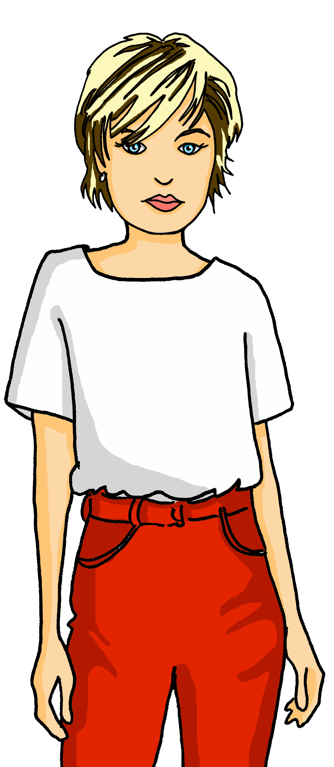
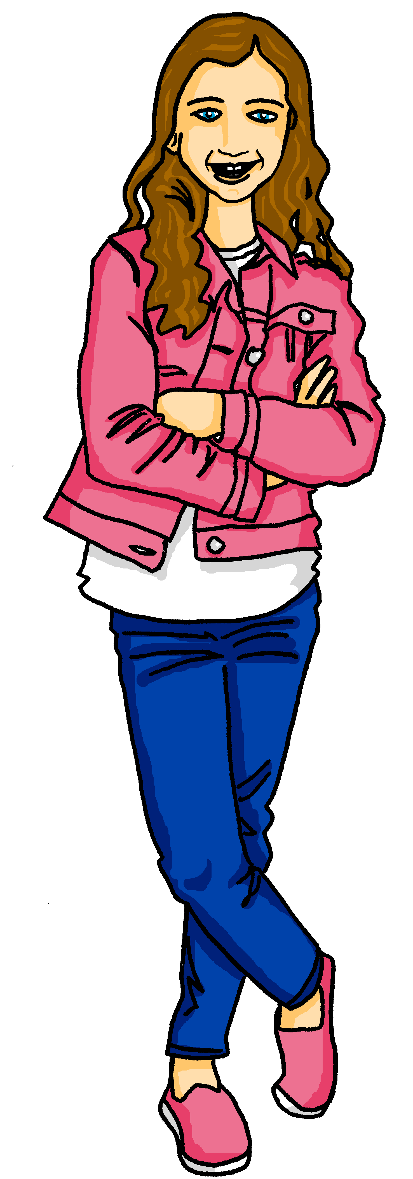
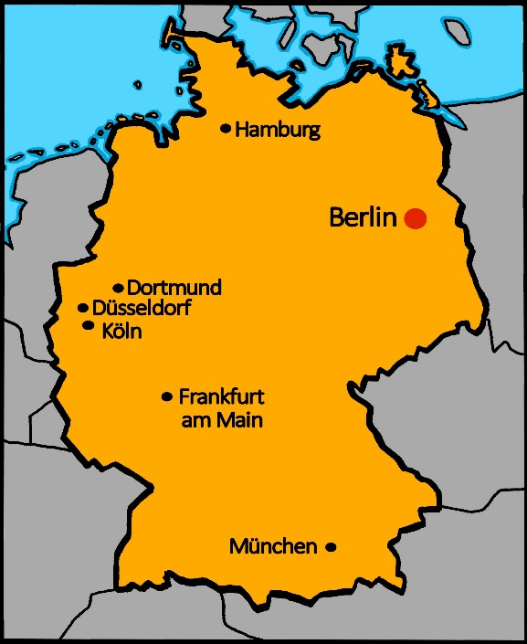
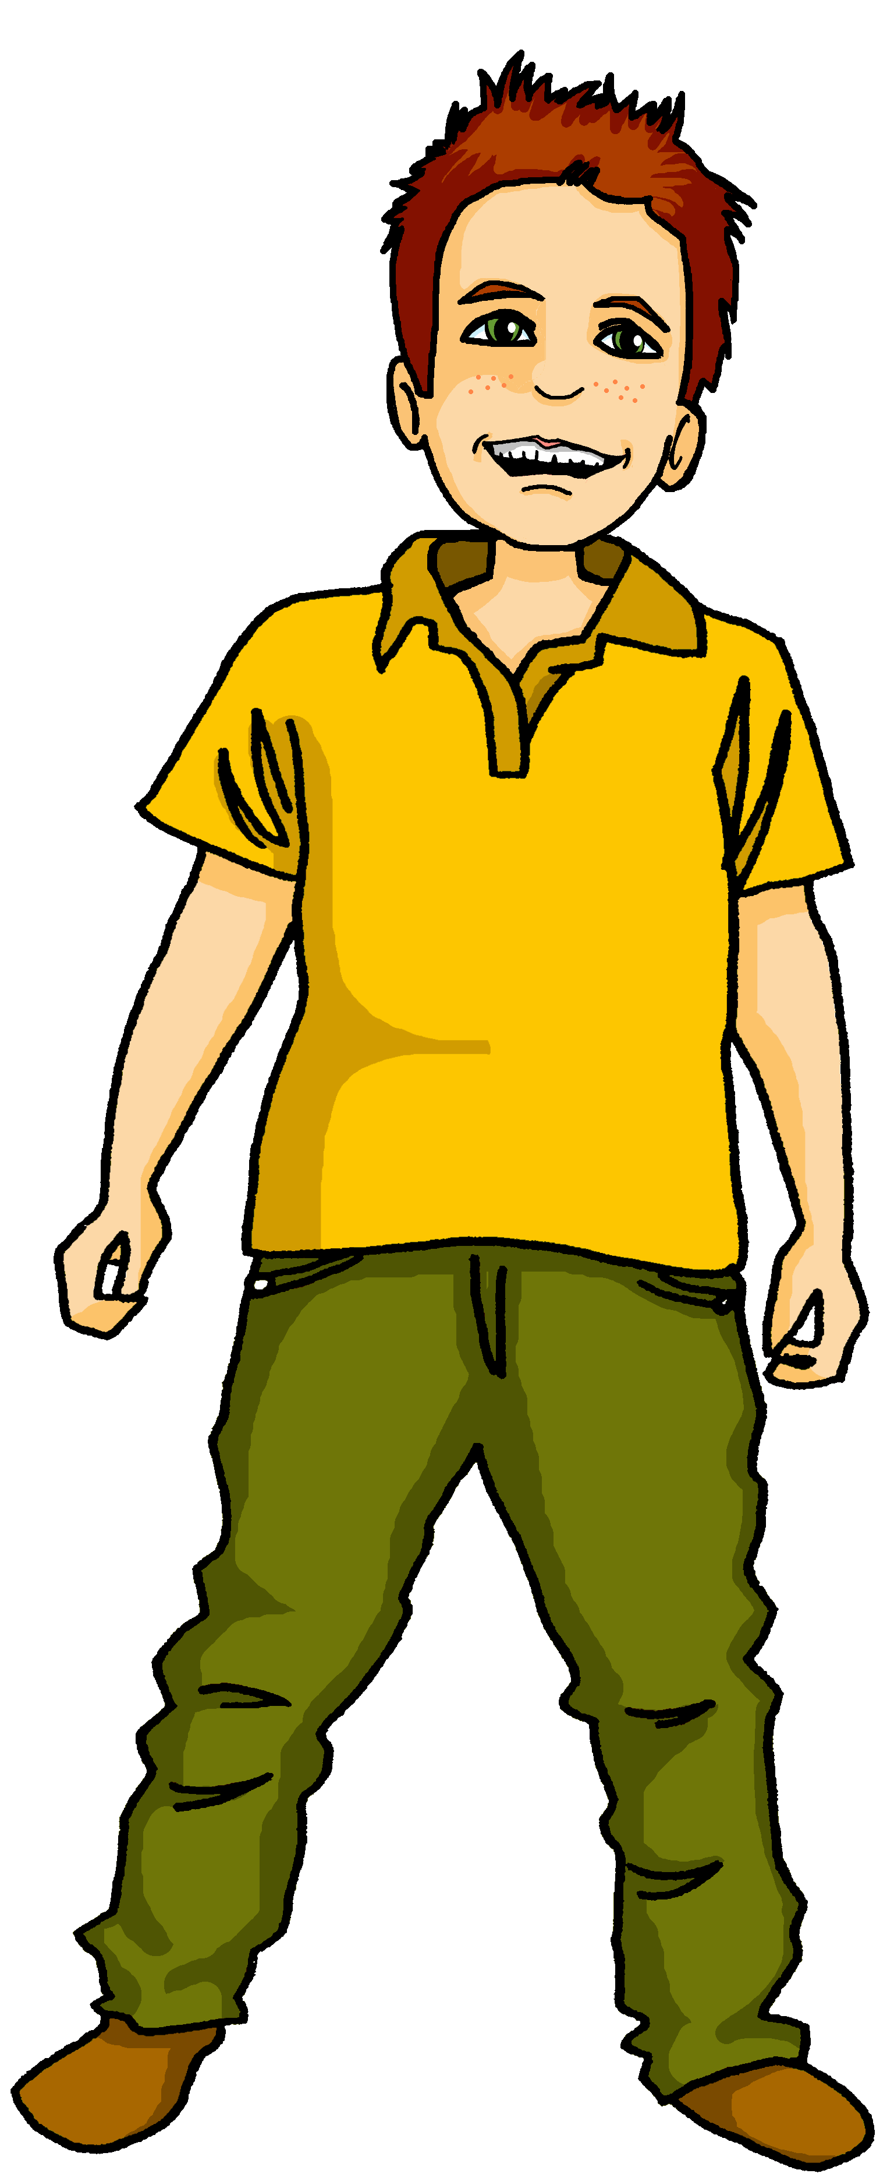
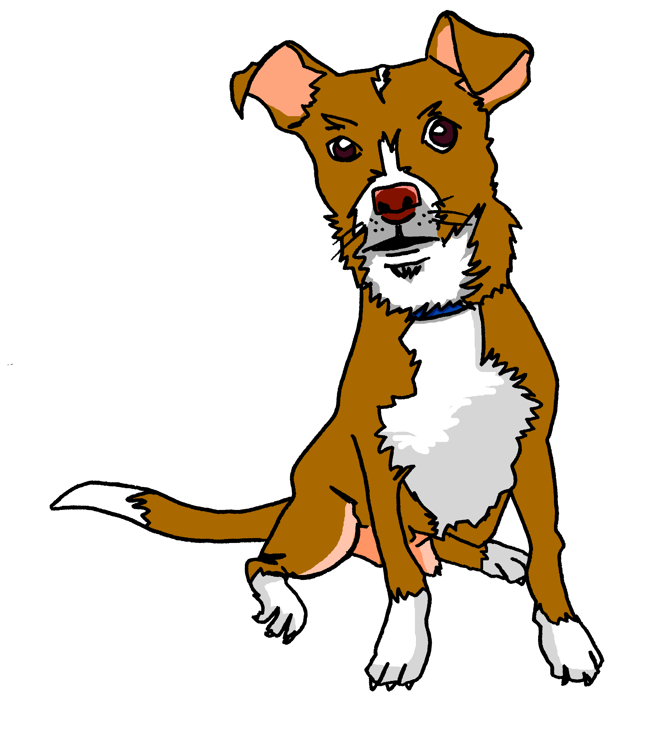
Talking about activities and events
rot
Possessive adjectives mein, dein, sein, ihr
SSC [ei] [ie]
Term 3 Week 7
Notes:
Artwork by Steve Clarke. Pronoun pictures from NCELP (www.ncelp.org). All additional pictures selected from Pixabay and are available under a Creative Commons license, no
attribution required.
Phonics: Revisit [ie] [ei] Liebe [844] sie [7] Brief [838] frei [318] ein [5] klein [114] sein [3] allein [258]
Vocabulary: Bruder [730] Mutter [218] Schwester [974] Vater [232] freundlich [1566] nett [1565]
Revisit 1: Januar [1052] Februar [1093] März [987] April [1004] Mai [1048] Juni [1148] Juli [1544] August [1929] September [1035] Oktober [1223] November [1273] Dezember [1527] Geburtstag [1779] Monat [316] wann [657]
Revisit 2: Nummer [806] null [1680] eins [774] zwei [70] drei [106] vier [200] fünf [274] sechs [428] sieben [611] acht [645] neun [1053] zehn [333] elf [1507] zwölf [1080] es gibt [n/a]
Jones, R.L & Tschirner, E. (2019). A frequency dictionary of German: Core vocabulary for learners. London: Routledge.
The frequency rankings for words that occur in this PowerPoint which have been previously introduced in these resources are given in the SOW and in the resources that first
introduced and formally re-visited those words.
For any other words that occur incidentally in this PowerPoint, frequency rankings will be provided in the notes field wherever possible.
Note that the first three lessons of the year teach language that can be continuously recycled as lesson routine every lesson in Y3/4.
The idea would be that the class teacher (whether or not s/he teaches the class German can re-use the language as part of the daily routine with the class.
1

Slide 2
aussprechen
[ei]
…
free
frei
Notes:
Timing: 1 minute
Aim: to revisit the SSC [ei].
Procedure:
Re-present the SSC [ei] and present the source word ‘frei’ (with gesture, if using).
Click to bring on the picture and get pupils to repeat the word ‘frei’ (with gesture, if using).
Note:
a gesture for frei’ might be to throw you hands up in the air and pretend to run away.
Vocabulary: frei [318
Jones, R.L & Tschirner, E. (2019). A frequency dictionary of German: Core vocabulary for learners. London: Routledge.
2

Slide 3
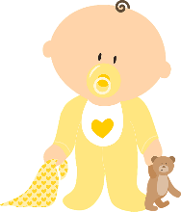
aussprechen
[ei]
…
frei
/a
sein
ein
alone
klein
allein
Notes:
Timing: 1 minute
Aim: to revisit the SSC [ei].
Procedure:
Re-present the SSC and the source word ‘frei’ (with gesture, if using).
Click to bring on the picture and get pupils to repeat the word ‘frei’ (with gesture, if using).
Present the cluster words in the same way, bringing on the picture and getting pupils to pronounce the words.
Vocabulary: frei [318] ein [5] klein [114] sein [3] allein [258]
Jones, R.L & Tschirner, E. (2019). A frequency dictionary of German: Core vocabulary for learners. London: Routledge.

Slide 4
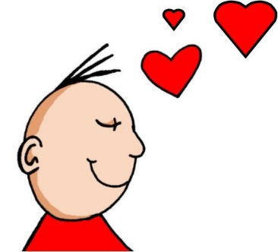
aussprechen
[ie]
…
Liebe
Notes:
Timing: 1 minute
Aim: to revisit the SSC [ie].
Procedure:
Re-present the SSC [ie] and present the source word ‘Liebe’ (with gesture, if using).
Click to bring on the picture and get pupils to repeat the word ‘Liebe’ (with gesture, if using).
Note:
A gesture for ‘Liebe’ might be to make a ‘heart’ shape with both hands approximately where your heart is in your body.
Liebe [844]
Jones, R.L & Tschirner, E. (2019). A frequency dictionary of German: Core vocabulary for learners. London: Routledge.
4

Slide 5
aussprechen
[ie]
…
sie
Liebe
Brief
Notes:
Timing: 1 minute
Aim: to revisit the SSC [ie].
Procedure:
Re-present the SSC and present the source word ‘Liebe’ (with gesture, if using).
Click to bring on the picture and get pupils to repeat the word ‘Liebe’ (with gesture, if using).
Present the cluster words in the same way, bringing on the picture and getting pupils to pronounce the words.
sie [7] Brief [838]
Jones, R.L & Tschirner, E. (2019). A frequency dictionary of German: Core vocabulary for learners. London: Routledge.
5

Slide 6
[ie] [ei]
Hör zu. Wie viele [ei] und [ie] hörst du?
hören
 |  | ei | ie
1 | Mein Bleistift schreibt einen Satz. | I I I I
2 | Sie wiederholt das Lied. |  | I I I
3 | Nein, das ist kein Lieblingsbeispiel. | I I I | I I
4 | Drei Tiere spielen in der Schweiz. | I I | I I
5 | Die Spielerin gewinnt vier Preise*. | I | I I I
6 | Heinrich spielt viele einfache* Spiele. | I I | I I I
*Preise – prizes
einfache - easy
Notes:
Timing: 5 minutes
Aim: to consolidate the SSC [ei] and [ie] in a listening activity.
Procedure:
Explain the task. Pupils are going to hear six sentences which contain a mixture of [ei] and [ie] sounds.
For each sentence they hear, pupils count the number of times they hear each SSC, noting down their answers.
Click to reveal answers.
To aid comprehension, click to reveal a gloss box for the two unknown words.
Transcript:
1. Mein Bleistift schreibt einen Satz.
2. Sie wiederholt das Lied.
3. Nein, das ist kein Lieblingsbeispiel.
4. Drei Tiere spielen in der Schweiz.
5. Die Spielerin gewinnt vier Preise*.
6. Heinrich spielt viele einfache* Spiele.

Slide 7
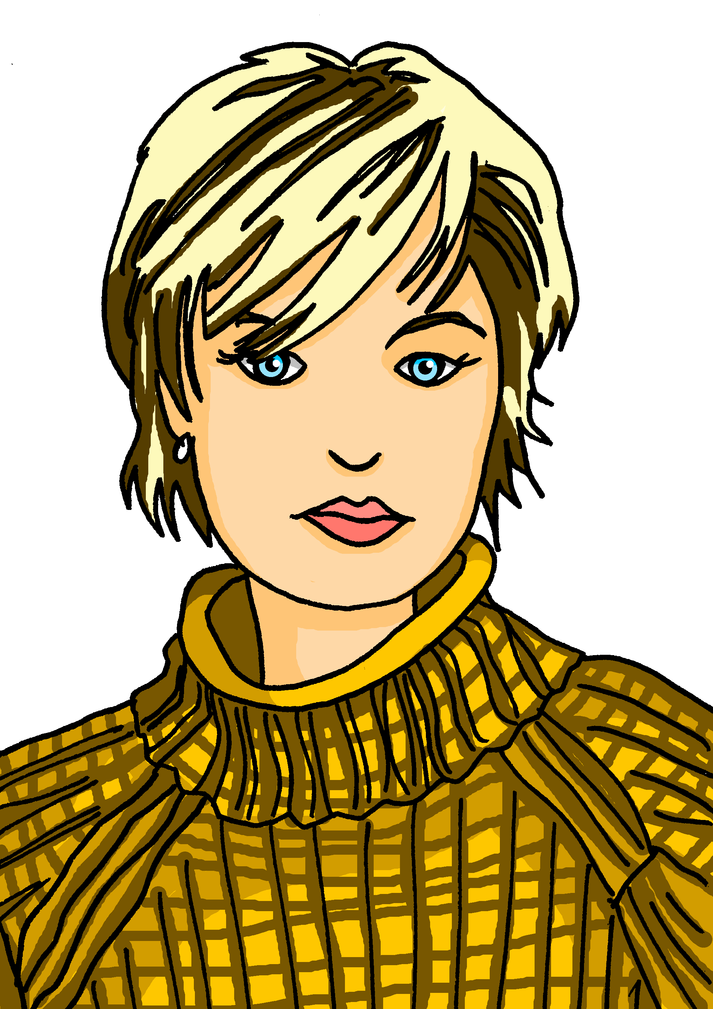
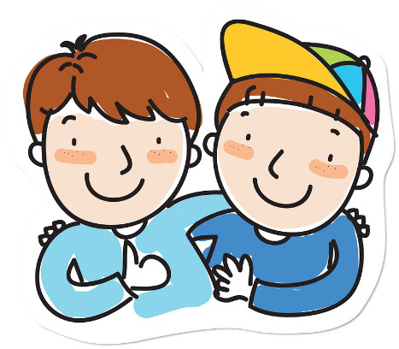
Vokabeln
Vokabeln lernen
Wörter
Hör zu und wiederhole.
the mother
the father
the sister
die Mutter
der Vater
die Schwester
friendly
nice
the brother
freundlich
nett
der Bruder
Notes:
Timing: 5 minutes
Aim: to present and practise new vocabulary for this week
Procedure:
Click on each text box to hear a native speaker say each word. Pupils repeat.
Click to hide the English translations, students chorally suggest the English answers.
Click to reveal the English and hide the German, students chorally suggest the German.
Click to reveal answers.
7

Slide 8
mein | dein (possessive adjectives)
To say ‘my’ use mein or meine:
masculine
feminine
neuter
mein Film
meine Musik
mein Lied
e
my film
my music
my song
The word ‘mein’ must agree with the gender of the noun that follows. The feminine form is ‘meine’.
To say ‘your’ use dein or deine:
dein Film
deine Musik
dein Lied
e
your film
your music
your song
Notes:
Timing: 2 minutes
Aim: to recap the possessive adjectives ‘mein’ and ‘dein’.
Procedure:
Click through the animations recap the information.
Elicit English translation for the German examples provided.
8

Slide 9
sprechen
Wer ist das?
…
Und ich bin deine Schwester.
Du bist mein Bruder, Moritz. Du bist auch nett!
Das ist mein Vater, Steffen. Er ist sehr nett.
Das ist meine Mutter, Maike. Sie ist freundlich.
Maike
Steffen
Johanna
Moritz
Notes:
Timing: 8 minutes
Aim: to provide further practice of this week’s vocabulary and to recap mein and dein.
Procedure:
Explain the task. Johanna is talking about her family.
Click to bring up the first speech bubble. Click to hear what Johanna says while students read along.
Repeat for a further 3 speech bubbles.
9

Slide 10
sein| ihr (possessive adjectives)
To say ‘his’ use sein or seine:
masculine
feminine
neuter
sein Vater
seine Mutter
sein Haustier
e
his father
his mother
his pet
The word ‘sein’ must agree with the gender of the noun that follows. The feminine form is ‘seine’.
To say ‘her’ use ihr or ihre:
ihr Vater
e
ihre Mutter
ihr Haustier
her father
her mother
her pet
Notes:
Timing: 2 minutes
Aim: to introduce the possessive adjectives ‘sein’ and ‘ihr’.
Procedure:
Click through the animations to present the new information.
Elicit English translation for the German examples provided.
10

Slide 11
hören
Lias und Ronja
Hör zu. Was ist das?
Johanna is talking with Aisha about Lias and Ronja.
She shows her a photo of the family.
Masculine/ Neuter | Feminine
Vater | Mutter
Vater | Mutter
Bruder | Schwester
Bruder | Schwester
Geburtstag | Nummer
Foto | Tasche
Bild | Mutter
Ex
1
2
3
4
5
6
Notes:
Timing: 8 minutes
Aim: to practise aural comprehension of ‘ihr’ and ‘ihre’ and ‘sein’ and ‘seine’ and relate them to the gender of previously taught nouns and nouns taught this lesson.
Procedure:
Explain the scenario.
Explain the pupils need to listen out for ihr/sein or ihre/seine and decide which thing Johanna is talking about, based on gender.
Click on the example audio button to hear an example sentence. Click to reveal the answer.
Complete the exercise and then click to reveal the answers.
Transcript:
Das ist ihre [Mutter].
Und das ist ihr [Vater].
Das ist seine [Schwester].
Und das ist ihr [Bruder].
Ist es sein [Geburtstag]?
Ist das ihr [Foto]?
Das ist seine [Mutter].
11

Slide 12
lesen
Johanna beschreibt Mutti und Vati…
Was sagt Johanna? Schreib die Details auf Englisch auf.
 | Sein Handy | Tasche ist blau. | His phone is blue.
 | Seine Lieblingsperson | Lieblingsfoto ist hier. | His favourite person is here.
 | Sein Lieblingsperson | Lieblingsort ist zu Hause. | His favourite place is at home.
1
2
Steffen
3
 | Ihre Freund | Freundin sitzt neben Moritz. | Her (female) friend is sitting next to Moritz.
 | Ihr Lieblingsbuch | Lieblingsfarbe ist rot. | Her favourite book is red.
 | Ihre Flasche | Film ist oben. | Her bottle is above.
4
5
Maike
6
Notes:
Timing: 6 minutes
Aim: to practise written comprehension of the forms ‘sein(e)’ and ‘ihr(e)’.
Procedure:
Explain the task. Johanna is describing her mother and father.
Pupils read each sentence and translate it to English. For each sentence they decide which of the words in bold to use. If they see sein or ihr, then they need to choose the masculine/ neuter noun. If they see seine or ihre, then they need to choose the feminine noun.
Click to reveal the answers.
Full sentences are attached to the blue buttons. Click to hear them, if desired. 1. Sein Handy ist blau.
2. Seine Lieblingsperson ist hier.
3. Sein Lieblingsort ist zu Hause.
4. Ihre Freundin sitzt neben Mortiz.
5. Ihr Lieblingsbuch ist rot.
6. Ihre Flasche ist oben.
12

Slide 13
Was ist der Film?
Match the title to the film.
German versions of English-language films often have German names.
Die Monster-AG
Some titles aren’t exact translations.
Die Monster-AG
The Monsters Inc.
Alles steht Kopf
Alles steht Kopf
Everything is upside down
Oben
Oben
Above
Findet Nemo
Findet Nemo
Pixar, Public domain, via Wikimedia Commons
Find Nemo
Notes:
Timing: 2 minutes
Aim: to develop cultural knowledge of and interest in German-speaking countries.
Procedure:
Explain the task. German versions of English-language films often have German names and these are sometimes not word-for word translations of the English titles. They can be a bit different.
Students read each German-language film title and decide which film it corresponds to.
Click to reveal answers.
Click again to reveal the German film titles and click one by one to reveal the word-for-word English translations. Ask pupils to tell you what they notice about the differences.
Image attribution:
Monsters Inc. poster By http://eu.movieposter.com/poster/MPW-48844/Monsters_Inc_.html, Fair use, https://en.wikipedia.org/w/index.php?curid=982187
Finding Nemo poster By © 2003 Disney/Pixar. All Rights Reserved., Fair use, https://en.wikipedia.org/w/index.php?curid=34252717
Inside out poster By The cover art can or could be obtained from http://www.impawards.com/2015/inside_out_ver13.html, Fair use, https://en.wikipedia.org/w/index.php?curid=45669660

Slide 14
Tschüss!
rot
Notes:
14

