Slide 1
Experiences at home and away
Karneval
blau
Follow ups 1-5
Term 3 Week 3
Notes:
Artwork by Steve Clarke. Pronoun pictures from NCELP (www.ncelp.org). All additional pictures selected from Pixabay and are available under a Creative Commons license, no
attribution required.
Phonics:
[er]: er [15] fertig [n/a] Konzert [2350] schwer [256] wer? [173]
[-er]: wieder [74] aber [31] oder [35] Oktober [1223] wunderbar [1603]
Vocabulary: essen [323] gehen [66] sehen [79] singen [1063] tanzen [1497] tragen [271] man [32] (Party)Kleidung [2820] dann [41]
Revisit 1: words from Term 2
Revisit 2: finden [103] Sie [7] Arbeit [208] Essen [323] Pause [1441] Uniform [3857] Unterricht [1823]
Jones, R.L & Tschirner, E. (2019). A frequency dictionary of German: Core vocabulary for learners. London: Routledge.
The frequency rankings for words that occur in this PowerPoint which have been previously introduced in these resources are given in the SOW and in the resources that first
introduced and formally re-visited those words.
For any other words that occur incidentally in this PowerPoint, frequency rankings will be provided in the notes field wherever possible.
Remember that at the start of the course (first three lessons of Rot/Gelb) pupils learnt language (for greetings and register taking) that can still be part of the lesson routines in upper KS2 (Blau/Grün). They are not re-taught, as we anticipate that teachers have built these in from early in lower KS2.

Slide 2
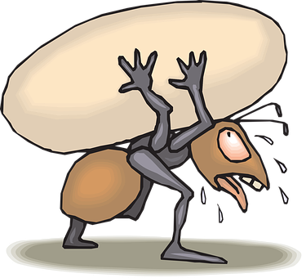
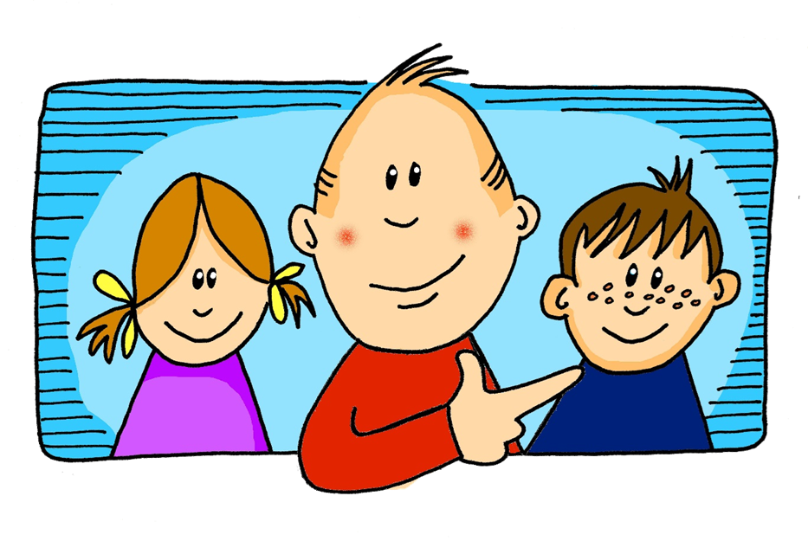
aussprechen
[er]
In all of these words, the [er] is part of the stressed syllable. This means it is emphasised or stronger than the other part of the word.
…
schwer
fertig
[heavy, difficult]
er
Konzert
wer?
Notes:
Timing: 2 minutes
Aim: to introduce/consolidate SSC [er]
Procedure:
Introduce and elicit the pronunciation of the individual SSC [er] and then the source word again ‘er’ (with gesture, if using).
Then present and elicit the pronunciation of the five cluster words.
The cluster words have been chosen for their high-frequency, from a range of word classes, with the SSC (where possible) positioned within a variety of syllables within the words (e.g. initial, 2nd, final etc.). Additionally, we have tried to use words that build cumulatively on previously taught SSCs (see the Phonics Teaching Sequence document) and do not include new SSCs. Where new SSCs are used, they are often consonants which have a similar symbol-sound correspondence in English.
Word frequency (1 is the most frequent word in German): er [15] fertig [n/a] Konzert [2350] schwer [256] wer? [173]
Source: Jones, R.L. & Tschirner, E. (2006). A frequency dictionary of German: core vocabulary for learners. Routledge

Slide 3
aussprechen
[er]
In all of these words, a different part of the word is the stressed syllable, not the [er] sound.
…
aber
Oktober
[but]
wieder
?
Wonderful!
[again]
oder
wunderbar
[or]
Notes:
Timing: 2 minutes
Aim: To introduce/consolidate SSC [er]
Procedure:
Introduce and elicit the pronunciation of the individual SSC [er] and then the source word again ‘wieder’ (with gesture, if using).
Then present and elicit the pronunciation of the five cluster words.
The cluster words have been chosen for their high-frequency, from a range of word classes, with the SSC (where possible) positioned within a variety of syllables within the words (e.g. initial, 2nd, final etc.). Additionally, we have tried to use words that build cumulatively on previously taught SSCs (see the Phonics Teaching Sequence document) and do not include new SSCs. Where new SSCs are used, they are often consonants which have a similar symbol-sound correspondence in English.
Word frequency (1 is the most frequent word in German): wieder [74] aber [31] oder [35] Oktober [1223] wunderbar [1603] Source: Jones, R.L. & Tschirner, E. (2006). A frequency dictionary of German: core vocabulary for learners. Routledge

Slide 4
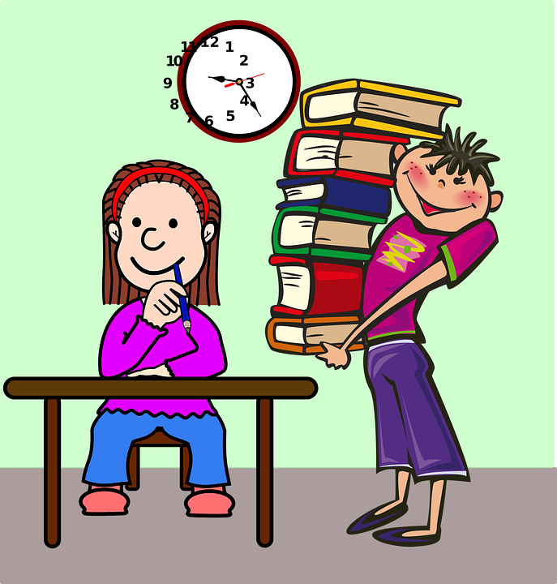
Follow up 1
Sag die Sätze und hör zu.
aussprechen
1. Er erntet Erbsen – oder erntet er Erdbeeren?
1. He is harvesting peas – or is he harvesting strawberries?
2. Es gibt vierzehn Schülerinnen und vier Schüler im Klassenzimmer.
2. There are fourteen female pupils and four male pupils in the classroom.
3. Erna macht einen Fehler, aber ihre Partnerin merkt es.
3. Erna makes a mistake, but her partner notices (it).
4. Welcher Spieler sitzt am Computer?
4. Which player is sitting at the computer?
5. Erst im Winter lesen die Kinder Bilderbücher im Zimmer.
5. Only in winter are the children reading picture books indoors (in the room).
Notes:
Handout at end of presentation
Timing: 5 minutes
Aim: to practise applying knowledge of [er] in stressed and unstressed syllables.
Procedure: 1. Each pupil will need a copy of the handout at the end of the presentation to annotate.
2. Click to bring up the first sentence. As a class, identify and underline the stressed [er] syllables and circle the unstressed [er] syllables in the sentence. Listen to the sentence to check, then click bring up the answers.
3. Elicit the translation, then click to reveal the English written form.
3. Click to bring up items 2-5. Ask pupils to read the sentences aloud in pairs and 1) underline the stressed [er] syllable and 2) circle the unstressed [er] in each sentence. You could encourage them to clap the syllables in the [er] words if you did this in the main lesson.
3. Listen to sentences 2-5 to allow pupils to check their answers. It is ok for them to change their mind now they have listened!
4. Click to bring up answers and translations.
5. Encourage pupils to read aloud again now that they have the answers, clapping if appropriate.
Word frequency:
Erbse [>5009] Erdbeere [>5009] ernten [4914] merken [566]

Slide 5
You already know the difference between ‘sie’ (they) and ‘man’ (people/you in general):
To say they + verb in German: use they + verb ending –en.
Sie gehen auf das Fest.
They are going to the festival.
Use ‘man’ + verb ending –t to mean people/you in general:
Man geht auf das Fest.
People/ you in general are going to the festival.
Remember this question:
Wie sagt man das auf Deutsch / Englisch? (How do you say that in German/English?) This is not a question just to you. It means ‘how do people/you in general say that in German / English?
Notes:
Timing: 2 minutes (two slides)
Procedure:
Click through the animations to remind pupils of the difference between sie and man, and the vowel change in the stem for strong verbs.
Elicit English translation for the German examples provided.
The last text section reminds pupils that they know a question with ‘man’ already.
5

Slide 6
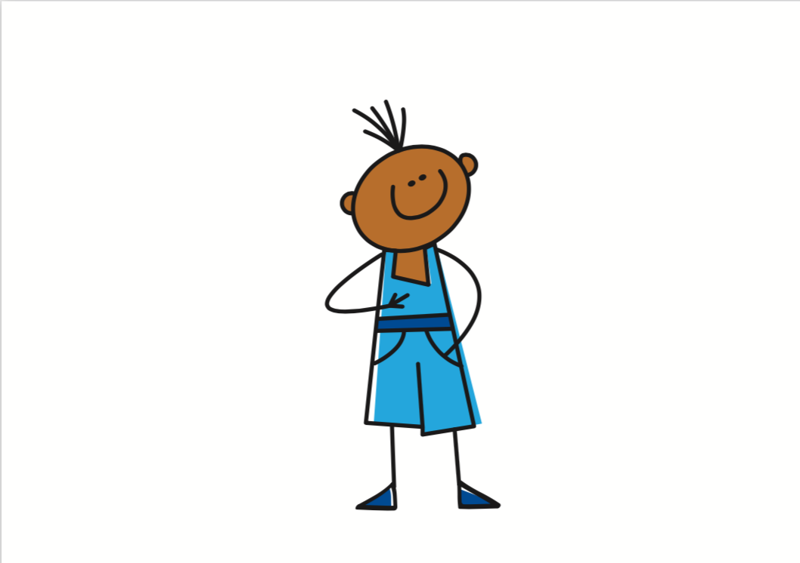
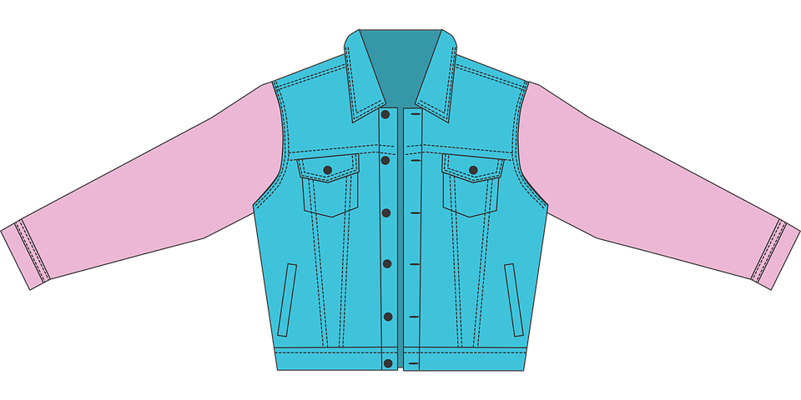
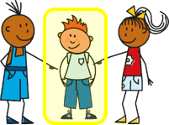
grammar
Remember also: strong verbs (e.g. tragen, essen, sehen, werden) change the vowel in the stem for 2nd and 3rd persons singular:
Ich trage eine Jacke.
I wear / am wearing a jacket.
Du trägst eine Jacke.
You wear / are wearing a jacket.
Er/sie trägt eine Jacke.
He/she wears / is wearing a jacket.
Man trägt eine Jacke.
People/you in general are wearing a jacket.
Notes:
6

Slide 7
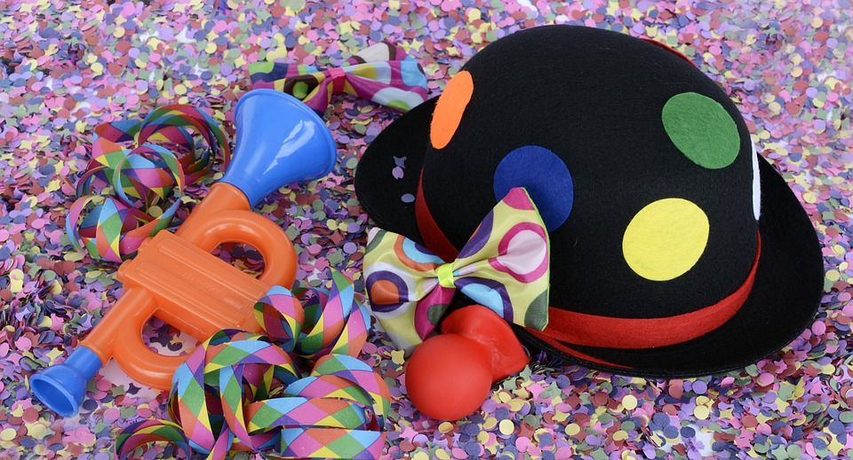
Follow up 2
Auf dem Karneval. Hör zu. Wer macht was?
 | they | people (you, in general) | Englisch?
hören
1
People dance in the square in the morning.
2
They sing / are singing songs in the street.
3
They say / are saying: Have fun!
4
People go / are going home.
5
They say ‘enjoy your meal’ and eat sandwiches.
6
People are getting tired and are having a break.
7
People wear / are wearing party clothes.
8
They see nice uniforms and jackets.
Notes:
Timing: 4 minutes
Aim: to practise aural comprehension of ‘man’ and ‘sie (they)’ verb forms and vocabulary from this week.
Procedure:
Tell pupils that they will hear the sentence without the pronoun ‘man’ or ‘sie’
Click to listen. Pupils write ‘they’ or ‘you in general’.
Listen again and focus on the remainder of the sentence. What is happening? Pupils write in English.
Transcript:
[Man] tanzt am Morgen auf dem Platz.
[Sie] singen Lieder auf der Straße.
[Sie] sagen Viel Spaß!
[Man] geht nach Hause.
[Sie] sagen “Guten Appetit!” und essen Butterbrote.
[Man] wird müde und macht eine Pause.
[Man] trägt Partykleidung.
[Sie] sehen schöne Uniformen und Jacken.

Slide 8
Follow up 3:

Schreib auf Deutsch.
You know ‘dann’ (then) and other time expressions to link sentences – but don’t forget to swap the subject and the verb!
Beschreib den Karneval. Schreib 5 Sätze.
schreiben
E.g.:
Am Morgen…
Dann…
Am Nachmittag…
Am Abend…
Enjoy your meal!
Have fun!
sie
man
The red words are strong verbs!
singen | gehen | tanzen | sagen | essen | tragen | sehen | werden
Notes:
Timing: 6 mins (2 slides)
Aim: to practise more independent written production of third person singular (with man) and plural sentences, drawing on a variety of previously taught vocabulary.
Procedure:
Pupils write 5 sentences using the third person singular with ‘man’ and plural ‘sie’ to describe the Karneval activities, according to which circle the activity is in.
Click for explanatory speech bubbles about linking sentences and hint that the verbs in red are strong verbs.
The next slide has some suggested answers.
Note: Teachers can remove the list of verbs if appropriate OR simply encourage some pupils to challenge themselves and turn away from the board to write.

Slide 9
Follow up 3:
Zum Beispiel:
man
sie
schreiben
Sie singen Lieder auf der Straße.
Man tanzt auf dem Platz.
Enjoy your meal!
Man sieht schöne Uniformen und Jacken.
Man sagt ‘Guten Appetit’ und dann isst man Butterbrote.
Am Nachmittag werden sie müde, und am Abend gehen sie nach Hause.
Have fun!
Sie tragen Partykleidung und man sagt ‘Viel Spaß!’
singen | gehen | tanzen | sagen | essen | tragen | sehen | werden
Notes:
Example answers for the activity on previous slide

Slide 10
Follow up 4
Sprich mit einem Partner/einer Partnerin…
…
Person A spricht.
Person B identifiziert* das richtige Bild.
sprechen
Person A
They sing songs in the street.
[A] [B]
Sie singen Lieder auf der Straße.
They sing songs in the street.
B
A
identifizieren - to identify
Notes:
Timing: 5-10 minutes
Aim: to practise receptive and productive knowledge of ‘man’ and ‘sie’ verb forms in present tense.
Procedure: 1. Use this slide to model the task.
2. Pupil A produces the sentence in German.
3. Pupil B identifies the correct picture – A or B and then writes the English down.
4. Complete items 1-5.
5. Then pupils swap roles and repeat the task. 6. See next slides for answers, and handouts at the end of the presentation.
Vocabulary
identifizieren [2420]
Jones, R.L & Tschirner, E. (2019). A frequency dictionary of German: Core vocabulary for learners. London: Routledge.

Slide 11
Round 1
…
B
Person A
1) People are going home.
……………………………….
2) They are getting tired.
……………………………….
3) They are having a break.
……………………………….
4) People are wearing party clothes.
……………………………….
5)They say “Have fun!”
………………………………..
Person B
A
sprechen
[A] [B]
People are going home.
Man geht nach Hause.
They are getting tired.
Sie werden müde.
They are having a break.
Sie machen eine Pause.
People are wearing party clothes.
Man trägt Partykleidung.
They say “Have fun!”
Sie sagen “Viel Spaß!”
B
A
Notes:
ANSWERS ROUND 1

Slide 12
Round 2
…
B
Person A
1) They are dancing in the square.
……………………………….
2) They are eating sandwiches.
……………………………….
3) People see nice uniforms.
……………………………….
4) People say “Enjoy your meal!”
……………………………….
5)People are not in lessons.
………………………………..
A
Person B
sprechen
[A] [B]
They are dancing on the square.
Sie tanzen auf dem Platz.
They are eating sandwiches.
Sie essen Butterbrote.
People see nice uniforms.
Man sieht schöne Uniformen.
People say “enjoy your meal!”
Man sagt “Guten Appetit!”
Man ist nicht im Unterricht.
People are not in lessons.
B
A
Notes:
ANSWERS ROUND 2

Slide 13
Follow up 5:

Schreib auf Englisch.
Can you get at least 15 points?
Wörter
 | die Pause | finden | die Arbeit
 | Sie | der Unterricht | das Essen
 | am Morgen | am Abend | am Nachmittag
 | für | bekannt | dort
 | dann | man | sie sieht
 | es wird | man isst | er trägt
(the) break
to find, finding
(the) work
Vokabeln
x3
you (formal)
(the) lesson
(the) meal
in the morning
in the evening
in the afternoon
x2
for
famous
there
then
you (in general), people
she sees, is seeing
x1
it gets, is getting
people/ you (general) eat
he wears, is wearing
Notes:
Timing: 5 minutes
Aim: to practise written production of vocabulary from this and revisited weeks.
Procedure: 1. Give pupils a blank grid. They fill in the English meanings of any of the words they know, trying to reach 15 points in total.
Note: The most recently learnt and practised words are pink, words from the previous week are green and those from week 1 are blue, thus more points are awarded for them, to recognise that memories fade and more effort (heavy lifting!) is needed to retrieve them.

Slide 14
Follow up 5:

Schreib auf Deutsch.
Can you get at least 15 points?
Wörter
 | (the) meal | (the) break | (the) lesson
 | to find, finding | you (formal) | (the) work
 | famous | for | there
 | in the evening | in the morning | in the afternoon
 | people/you eat | he wears, is wearing | it gets, is getting
 | then | you (in general), people | she sees
das Essen
die Pause
der Unterricht
Vokabeln
x3
finden
Sie
die Arbeit
bekannt
für
dort
x2
am Abend
am Morgen
am Nachmittag
man isst
er trägt
es wird
x1
dann
man
sie sieht
Notes:
Timing: 5 minutes
Aim: to practise written production of vocabulary from this and revisited weeks.
Procedure: 1. Give pupils a blank grid. They fill in the German meanings of any of the words they know, trying to reach 15 points in total.
Note: The most recently learnt and practised words are pink, words from the previous week are green and those from week 1 are blue, thus more points are awarded for them, to recognise that memories fade and more effort (heavy lifting!) is needed to retrieve them.

Slide 15
Tschüss!
blau
Notes:
15

Slide 16
Follow up 1
1. Er erntet Erbsen – oder erntet er Erdbeeren?
2. Es gibt vierzehn Schülerinnen und vier Schüler im
Klassenzimmer.
3. Erna macht einen Fehler, aber ihre Partnerin merkt es.
4. Welcher Spieler sitzt am Computer?
5. Erst im Winter lesen die Kinder Bilderbücher im Zimmer.
Notes:
Handout at end of presentation
Timing: 5 minutes
Aim: to practise applying knowledge of [er] in stressed and unstressed syllables.
Procedure: 1. Each pupil will need a copy of the handout at the end of the presentation to annotate.
2. Click to bring up the first sentence. As a class, identify and underline the stressed [er] syllables and circle the unstressed [er] syllables in the sentence. Listen to the sentence to check, then click bring up the answers.
3. Elicit the translation, then click to reveal the English written form.
3. Click to bring up items 2-5. Ask pupils to read the sentences aloud in pairs and 1) underline the stressed [er] syllable and 2) circle the unstressed [er] in each sentence. You could encourage them to clap the syllables in the [er] words if you did this in the main lesson.
3. Listen to sentences 2-5 to allow pupils to check their answers. It is ok for them to change their mind now they have listened!
4. Click to bring up answers and translations.
5. Encourage pupils to read aloud again now that they have the answers, clapping if appropriate.
Word frequency:
Erbse Erdbeere ernten

Slide 17
Follow up 4 Person A
…
Round 1
Round 2
Person A
1) People are going home.
……………………………….
2) They are getting tired.
……………………………….
3) They are having a break.
……………………………….
4) People are wearing party clothes.
……………………………….
5)They say “Have fun!”
………………………………..
Person A
sprechen
[A] [B]
B
A
Notes:
HANDOUT PERSON A

Slide 18
Follow up 4 Person B
…
Round 1
Round 2
Person B
Person B
1) They are dancing in the square.
……………………………….
2) They are eating sandwiches.
……………………………….
3) People see nice uniforms.
……………………………….
4) People say “Enjoy your meal!”
……………………………….
5)People are not in lessons.
………………………………..
sprechen
[A] [B]
B
A
Notes:
HANDOUT PERSON B

Slide 19
Follow up 5:

Schreib auf Englisch.
Can you get at least 15 points?
Wörter
 | die Pause | finden | die Arbeit
 | Sie | der Unterricht | das Essen
 | am Morgen | am Abend | am Nachmittag
 | für | bekannt | dort
 | dann | man | sie sieht
 | es wird | man isst | er trägt
Vokabeln
x3
x2
x1
Notes:
HANDOUT

Slide 20
Follow up 5:

Schreib auf Deutsch.
Can you get at least 15 points?
Wörter
 | (the) meal | (the) break | (the) lesson
 | to find, finding | you (formal) | (the) work
 | famous | for | there
 | in the evening | in the morning | in the afternoon
 | people/you eat | he wears, is wearing | it gets, is getting
 | then | you (in general), people | she sees
Vokabeln
x3
x2
x1
Notes:
HANDOUT

