Slide 1
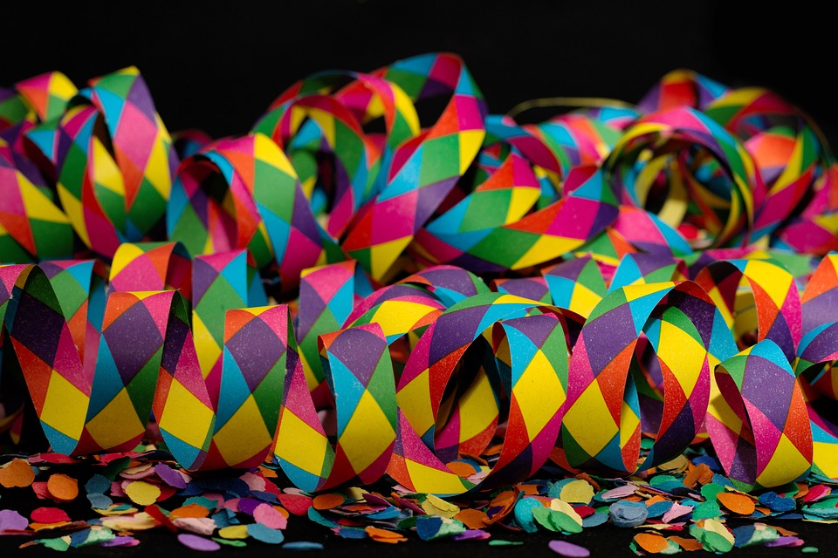
Experiences at home and away
Karneval
blau
man (you, in general)
[er] [-er]
Term 3 Week 3
Notes:
Artwork by Steve Clarke. Pronoun pictures from NCELP (www.ncelp.org). All additional pictures selected from Pixabay and are available under a Creative Commons license, no attribution required.
Phonics:
[er]: er [15] fertig [n/a] Konzert [2350] schwer [256] wer? [173]
[-er]: wieder [74] aber [31] oder [35] Oktober [1223] wunderbar [1603]
Vocabulary: essen [323] gehen [66] sehen [79] singen [1063] tanzen [1497] tragen [271] man [32] (Party)Kleidung [2820] dann [41]
Revisit 1: words from Term 2
Revisit 2: finden [103] Sie [7] Arbeit [208] Essen [323] Pause [1441] Uniform [3857] Unterricht [1823]
Jones, R.L & Tschirner, E. (2019). A frequency dictionary of German: Core vocabulary for learners. London: Routledge.
The frequency rankings for words that occur in this PowerPoint which have been previously introduced in these resources are given in the SOW and in the resources that first
introduced and formally re-visited those words.
For any other words that occur incidentally in this PowerPoint, frequency rankings will be provided in the notes field wherever possible.
Remember that at the start of the course (first three lessons of Rot/Gelb) pupils learnt language (for greetings and register taking) that can still be part of the lesson routines in upper KS2 (Blau/Grün). They are not re-taught, as we anticipate that teachers have built these in from early in lower KS2.
1

Slide 2
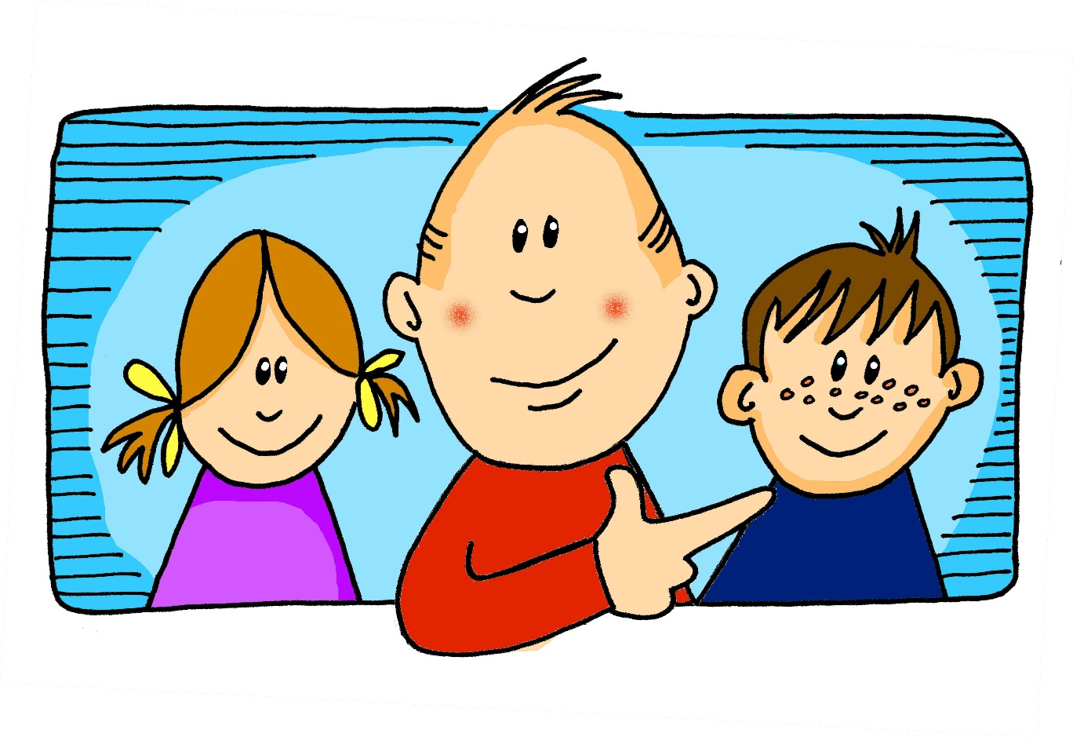
aussprechen
[er]
…
er
When the [er] is the stressed syllable, it usually sounds like two short syllables: e-uh
Remember, words are made up of different parts called syllables. A stressed syllable means the part of the word that is most emphasised when you say it aloud.
Notes:
Timing: 1 minute
Aim: to introduce/consolidate SSC [er]
Procedure: 1. Present the letter(s) and say the [er] sound first, on its own. Students repeat it with you. 2. Bring up the word ”er” on its own, say it, students repeat it, so that they have the opportunity to focus all of their attention on the connection between the written word and its sound.
3. A possible gesture for this would be to point to an imaginary ‘he’, using your index finger, thumb point upwards (to make the gesture more exaggerated), as per the image.
4. Roll back the animations and work through 1-3 again, but this time, dropping your voice completely to listen carefully to the students saying the [er] sound, pronouncing ”er” and, if using, doing the gesture. Word frequency (1 is the most frequent word in German): er [15] Source: Jones, R.L. & Tschirner, E. (2006). A frequency dictionary of German: core vocabulary for learners. Routledge
2

Slide 3
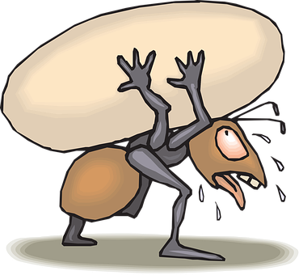
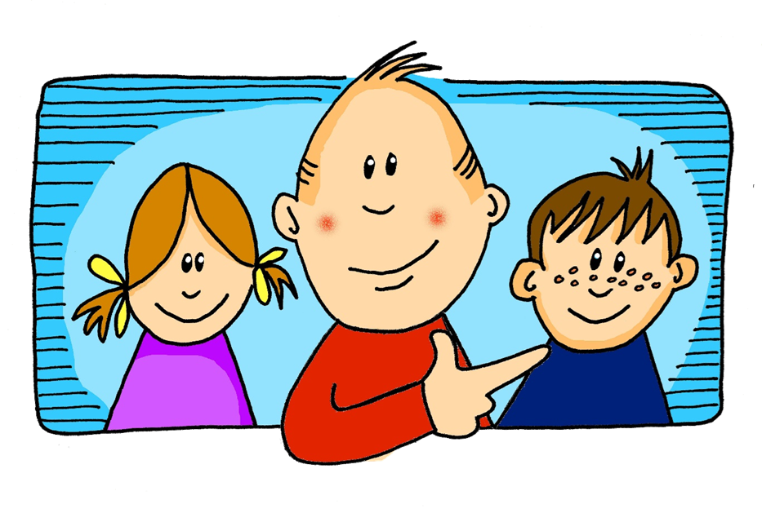
aussprechen
[er]
In all of these words, the [er] is part of the stressed syllable. This means it is emphasised or stronger than the other part of the word.
…
schwer
fertig
[heavy, difficult]
er
Konzert
wer?
Notes:
Timing: 2 minutes
Aim: to introduce/consolidate SSC [er]
Procedure:
Introduce and elicit the pronunciation of the individual SSC [er] and then the source word again ‘er’ (with gesture, if using).
Then present and elicit the pronunciation of the five cluster words.
The cluster words have been chosen for their high-frequency, from a range of word classes, with the SSC (where possible) positioned within a variety of syllables within the words (e.g. initial, 2nd, final etc.). Additionally, we have tried to use words that build cumulatively on previously taught SSCs (see the Phonics Teaching Sequence document) and do not include new SSCs. Where new SSCs are used, they are often consonants which have a similar symbol-sound correspondence in English.
Word frequency (1 is the most frequent word in German): er [15] fertig [n/a] Konzert [2350] schwer [256] wer? [173]
Source: Jones, R.L. & Tschirner, E. (2006). A frequency dictionary of German: core vocabulary for learners. Routledge

Slide 4
aussprechen
[er]
…
As you know [er] can also sound like ‘uh’. This is when the syllable is unstressed, most often at the end of the word.
wieder
[again]
Notes:
Timing: 1 minute
Aim: To introduce/consolidate SSC [er]
Procedure: 1. Present the letter(s) and say the [er] sound first, on its own. Students repeat it with you. 2. Bring up the word ”wieder” on its own, say it, students repeat it, so that they have the opportunity to focus all of their attention on the connection between the written word and its sound.
3. A possible gesture for this would be to roll your hands over in the air, clockwise. Your hands are in front of your body.
4. Roll back the animations and work through 1-3 again, but this time, dropping your voice completely to listen carefully to the students saying the [er] sound, pronouncing ”wieder” and, if using, doing the gesture. Word frequency (1 is the most frequent word in German): wieder [74] Source: Jones, R.L. & Tschirner, E. (2006). A frequency dictionary of German: core vocabulary for learners. Routledge
4

Slide 5
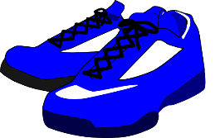
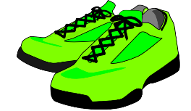
aussprechen
[er]
In all of these words, a different part of the word is the stressed syllable, not the [er] sound.
…
aber
Oktober
[but]
wieder
?
Wonderful!
[again]
oder
wunderbar
[or]
Notes:
Timing: 2 minutes
Aim: To introduce/consolidate SSC [er]
Procedure:
Introduce and elicit the pronunciation of the individual SSC [er] and then the source word again ‘wieder’ (with gesture, if using).
Then present and elicit the pronunciation of the five cluster words.
The cluster words have been chosen for their high-frequency, from a range of word classes, with the SSC (where possible) positioned within a variety of syllables within the words (e.g. initial, 2nd, final etc.). Additionally, we have tried to use words that build cumulatively on previously taught SSCs (see the Phonics Teaching Sequence document) and do not include new SSCs. Where new SSCs are used, they are often consonants which have a similar symbol-sound correspondence in English.
Word frequency (1 is the most frequent word in German): wieder [74] aber [31] oder [35] Oktober [1223] wunderbar [1603] Source: Jones, R.L. & Tschirner, E. (2006). A frequency dictionary of German: core vocabulary for learners. Routledge

Slide 6
hören
[er]
Listen to and read the 8 words. Can you find the stressed syllable?
Is the [er] stressed or unstressed?
Hör zu.
 |  | stressed [er] | unstressed [er]
1 | Fenster
2 | lernen
3 | Lehrerin
4 | Donnerstag
5 | Schmerzen
6 | Vater
7 | Wert
8 | Partner
Can you clap the syllables in each word, clapping louder for the stressed syllables?
Notes:
Timing: 5 minutes
Aim: to consolidate the SSC [er] by identifying the stressed and unstressed syllables in known and unknown words.
Procedure:
1. Explain that pupils are going to hear words with [er]. On first listening they need to highlight/circle/jot down the syllable of the word they hear that is stressed/emphasised.
2. Play number one and click to show the syllable they should have highlighted. Then discuss as a class whether it is a stressed or unstressed [er].
3. Repeat for items 2-8.
4. Try clapping through the words together as a class, clapping louder for the stressed syllable in each word.
Transcript:
Fenster
lernen
Lehrerin
Donnerstag
Schmerzen
Vater
Wert
Partner
Word frequency:
Schmerz [1483] Wert [290]
6

Slide 7
Vokabeln
Vokabeln
Finde die Verbindung*
Verbindung – connection
Wörter
1
2
3
4
5
6
places
Platz
Straße
nach Hause
dann
am Abend
am Morgen
times of day
die
Partykleidung
die Uniform
clothing
die Jacke
sein
gehen
sehen
verbs
das Butterbrot
das Frühstück
essen
food
man singt
man tanzt
Viel Spaß!
having fun
places
having fun
food
times of day
clothing
verbs
Notes:
Timing: 2 minutes
Aim: to practise written comprehension of previously taught words by associating them with a broader theme.
Procedure: 1. Explain the task. Pupils can volunteer answers for any line in any order.
2. To volunteer a connection, pupils say the three German words followed by the English category word they suggest.
3. Teacher clicks on the English category – it will reappear next to the correct row of German words that it links to.
Vocabulary
Verbindung [434]
Jones, R.L & Tschirner, E. (2019). A frequency dictionary of German: Core vocabulary for learners. London: Routledge.
7

Slide 8
Vokabeln
Vokabeln
Was ist das auf Deutsch?
Wörter
gehen
dann
werden
then
machen
gewinnen
to become, becoming, to get, getting
to do, doing, to make, making
to win, winning
to go, going
then
Notes:
Timing: 4 minutes
Aim: to present and practise written comprehension and read aloud of the new vocabulary for this week, and to revise previous vocabulary.
Procedure: 1. Click for an English prompt.
2. Elicit the German word from pupils where they can recognise and read it aloud. Or say the word for pupils to repeat.
3. Continue until all 5 items have been seen and heard.
8

Slide 9
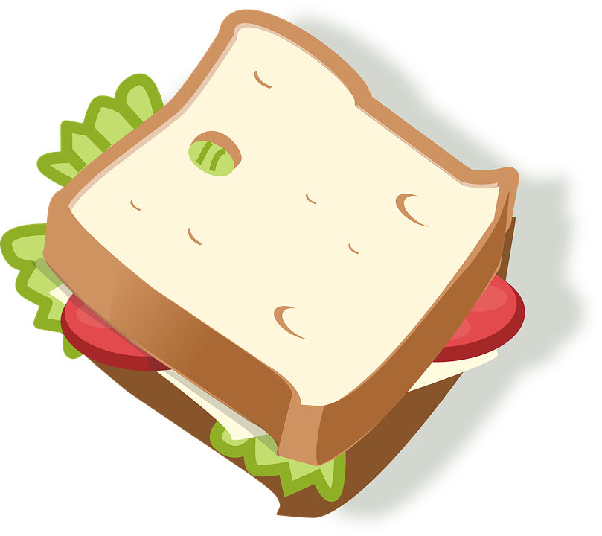
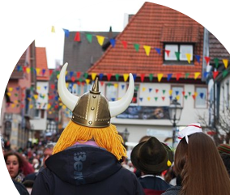
hören
Karneval
Hör zu. Schreib auf Englisch.
 | auf Englisch?
B
dance in the square
1
become tired
2
sing songs in the street
3
go home
4
see nice uniforms and jackets
5
eat sandwiches
6
wear party clothes
Notes:
Timing: 5 minutew
Aim: to practise aural comprehension of the new vocabulary for this week and from previously, in short phrases.
Procedure:
1. Click to listen.
2. Pupils write or say the English meaning.
3. Click to correct.
Transcript:
Beispiel: auf dem Platz tanzen
müde werden
auf der Straße Lieder singen
nach Hause gehen
schöne Uniformen und Jacken sehen
Butterbrote essen
Partykleidung tragen
9

Slide 10
‘Sie’ (they) and ‘man’ (people/you in general)
To say they + verb in German: use sie + verb ending –en.
Sie gehen auf das Fest.
They go/ are going to the festival.
Use man + verb ending –t to mean people/you in general:
Man geht auf das Fest.
People/ you in general go/ are going to the festival.
Careful! ‘Man’ does NOT mean man in English!
Notes:
Timing: 2 minutes
Procedure:
Click through the animations to present the new information.
Elicit English translation for the German examples provided.
10

Slide 11
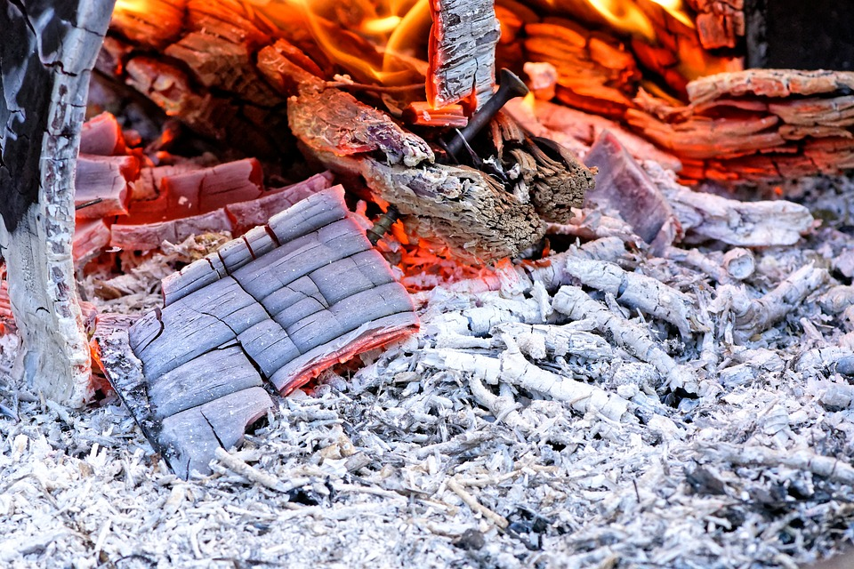
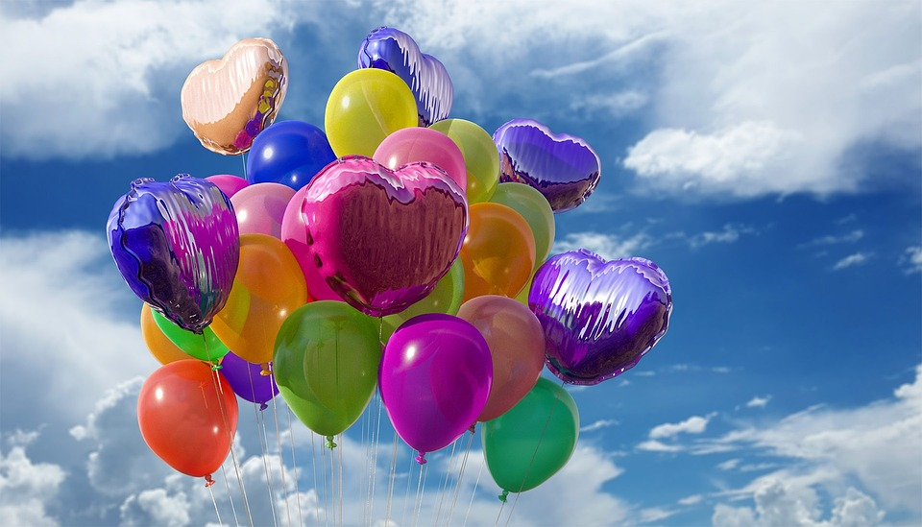
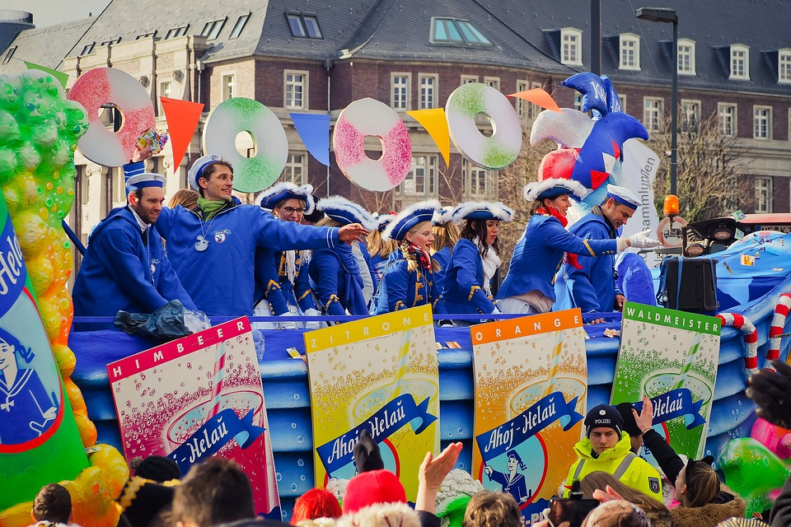
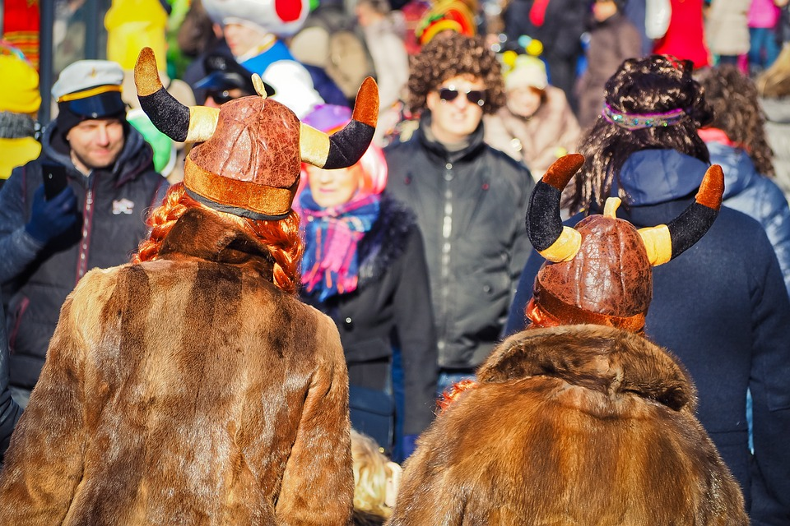
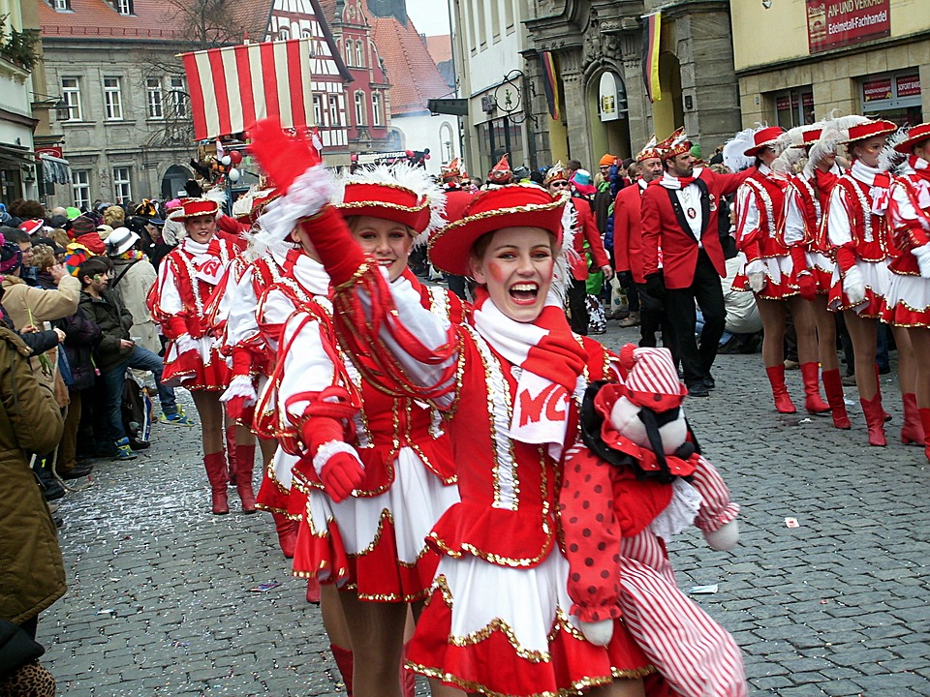
Kultur
Karneval
Can you work out the literal meaning of Rosenmontag and Aschermittwoch?
bunt – colourful zu Ende – finished
Karneval in Deutschland ist eine alte Tradition. Am Rosenmontag trägt man bunte* Kleidung. Man
geht man auf die Straße, man tanzt, singt und macht Musik!
Am Aschermittwoch ist das Fest zu Ende*. Dann geht man nach Hause und man schläft – man ist sehr müde!
Notes:
Timing: 5 minutes
Aim: to present some cultural information on this week’s theme, Karneval, and to practise new and previously taught vocabulary.
Procedure:
1. Read through the text, or play the recordings. Make sure the meaning is clear.
A rough translation is:
Karneval in Germany is an old tradition. On ‘Rose-Monday’ people wear colourful costumes. One goes out into the streets, dances, sings and makes music.
On Ash-Wednesday the festival is over. Then one goes home and sleeps – people are very tired!
If desired, play a ‘Rosenmontagszug’ Video on Youtube.
This video gives a speeded up 60 second version: https://www.youtube.com/watch?v=ukNNYlUZAJk
Vocabulary
bunt [1817] Ende [183]
Jones, R.L & Tschirner, E. (2019). A frequency dictionary of German: Core vocabulary for learners. London: Routledge.
11

Slide 12
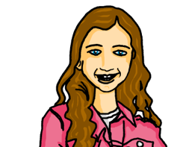
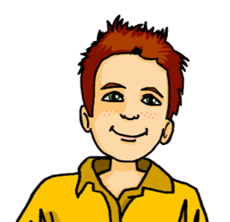
lesen
Karneval
Es ist Rosenmontag. Johanna und Moritz sind in Köln für Karneval.
Is it Johanna and Moritz (sie-they), or people in general (man)?
 |  | sie (they) | man (people, you in general)
1 | … singt Lieder auf der Straße.
2 | … sagen: Viel Spaß!
3 | … sagt “Guten Appetit!” und isst Butterbrote.
4 | … sieht schöne Uniformen und Jacken.
5 | … gehen nach Hause.
6 | … tanzen am Morgen auf dem Platz.
7 | … trägt Partykleidung.
8 | … werden müde und machen eine Pause.
Karneval in Köln
1
2
3
4
5
6
7
8
Notes:
Timing: 5 minutes
Aim: to practise written recognition man and sie verb endings, and their connection with meaning.
Procedure:
1. Students write 1-8 and sie (they) or man (people, you in general) according to whether the verb is singular or plural.
2. Answers are revealed on a mouse click.
3. Move on to the next slide for a comprehension task based on the same text.
12

Slide 13
lesen
Karneval
Es ist Rosenmontag. Johanna und Moritz sind in Köln für Karneval.
Was ist das auf Englisch?
1 | …. singt Lieder auf der Straße.
2 | …. sagen: Viel Spaß!
3 | …. sagt “Guten Appetit!”
4 | …. sieht schöne Uniformen und Jacken.
5 | …. gehen nach Hause.
6 | …. tanzen auf dem Platz.
7 | … trägt Partykleidung.
8 | … werden müde und machen eine Pause.
Karneval in Köln
1
People/you (general) sing songs in the street.
2
They say: Have fun!
3
People/you (general) say ‘enjoy your meal!
4
People/you see nice uniforms and jackets.
5
They go/are going home.
6
They dance/are dancing in the square.
7
People/you wear/ are wearing partyclothes.
8
They get/are getting tired and have a break.
Notes:
Timing: 5 minutes
Aim: to practise written comprehension of man and sie and vocabulary associated with Karneval.
Procedure:
Pupils volunteer English meanings of each sentence.
Teacher clicks to reveal written answers.
If desired, click the buttons to play full sentence audio.
13

Slide 14
Tschüss!
blau
Notes:
14

