Slide 1
Experiences at home and away
Karneval
blau
Present tense – weak and strong
SSC [-ig]
Term 3 Week 4
Notes:
Artwork by Steve Clarke. Pronoun pictures from NCELP (www.ncelp.org). All additional pictures selected from Pixabay and are available under a Creative Commons license, no
attribution required.
Phonics:
[-ig] richtig [177] dreißig [2046] fertig [n/a] ruhig [911] wichtig [144]
Vocabulary: laufen [252] lesen [288] schlafen [679] sehen [79] sprechen [161]
Revisit 1: Angst (vor) [392] Durst [n/a] Hunger [2097] Spaß [1045] froh [1424] müde [2000] bitte [471] danke [877]
Revisit 2: bleiben [113] kaufen [506] laufen [252] machen [58] schlafen [679] tragen [271] verkaufen [721] waschen [2315] Auto [361] (Party)Kleidung [2820] Stunde [276] Nacht [325] ruhig [991]
Jones, R.L & Tschirner, E. (2019). A frequency dictionary of German: Core vocabulary for learners. London: Routledge.
The frequency rankings for words that occur in this PowerPoint which have been previously introduced in these resources are given in the SOW and in the resources that first
introduced and formally re-visited those words.
For any other words that occur incidentally in this PowerPoint, frequency rankings will be provided in the notes field wherever possible.
Remember that at the start of the course (first three lessons of Rot/Gelb) pupils learnt language (for greetings and register taking) that can still be part of the lesson routines in upper KS2 (Blau/Grün). They are not re-taught, as we anticipate that teachers have built these in from early in lower KS2.
1

Slide 2
aussprechen
[-ig]
…
The [-ig] sound is mostly found at the end of words.
richtig
Notes:
Timing: 1 minute
Aim: To introduce/consolidate SSC [-ig]
Procedure: 1. Present the letter(s) and say the [-ig] sound first, on its own. Students repeat it with you. 2. Bring up the word ”richtig” on its own, say it, students repeat it, so that they have the opportunity to focus all of their attention on the connection between the written word and its sound.
3. A possible gesture for this would be to mime ‘correct’ by tracing a tick in the air with the index finger on your right hand.
4. Roll back the animations and work through 1-3 again, but this time, dropping your voice completely to listen carefully to the students saying the [-ig] sound, pronouncing ”richtig” and, if using, doing the gesture. Word frequency (1 is the most frequent word in German): richtig [177]
Source: Jones, R.L. & Tschirner, E. (2019). A frequency dictionary of German: core vocabulary for learners. Routledge
2

Slide 3
aussprechen
[-ig]
…
30
fertig
dreißig
richtig
[ready, finished]
ruhig
wichtig
[quiet, calm]
[important]
Notes:
Timing: 2 minutes
Aim: To introduce/consolidate SSC [-ig]
Procedure:
Introduce and elicit the pronunciation of the individual SSC [-ig] and then the source word again ‘richtig’ (with gesture, if using).
Then present and elicit the pronunciation of the five cluster words.
The cluster words have been chosen for their high-frequency, from a range of word classes, with the SSC (where possible) positioned within a variety of syllables within the words (e.g. initial, 2nd, final etc.). Additionally, we have tried to use words that build cumulatively on previously taught SSCs (see the Phonics Teaching Sequence document) and do not include new SSCs. Where new SSCs are used, they are often consonants which have a similar symbol-sound correspondence in English.
Word frequency (1 is the most frequent word in German): richtig [177] dreißig [2046] fertig [n/a] ruhig [911] wichtig [144] Source: Jones, R.L. & Tschirner, E. (2019). A frequency dictionary of German: core vocabulary for learners. Routledge

Slide 4
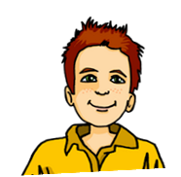
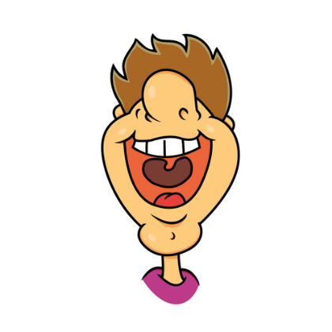
[ig]
Hör zu und wiederhole.
In Germany, Austria and Switzerland, there are lots of dialects.
In Southern Germany, Austria and Switzerland, where I live, [-ig] is pronounced like [-ik].
In Northern Germany, where I live, [-ig] is pronounced like [-ich].
1
hungrig _{[hungry]} einzig _{[only]} niedrig _{[low]} übrig _{[leftover]} nötig _{[necessary]} heutig _{[present-day]}
1
hungrig _{[hungry]} einzig _{[only]} niedrig _{[low]} übrig _{[leftover]} nötig _{[necessary]} heutig _{[present-day]}
2
Deutschland
2
3
3
4
4
Österreich
Whether you pronounce [-ig] as [ich] as in North Germany or [ik] as in Switzerland, you don’t use your vocal chords.
5
Schweiz
5
6
6
Notes:
Timing: 5 minutes
Aim: to consolidate the SSC [ig] and to introduce pupils to the idea of regional variation in pronunciation.
Procedure:
Click to bring up Moritz and speech bubble, then Lias and speech bubble, to introduce the idea of regional variation.
Click to bring up the two sets of the identical 6 words.
Click each number to hear the two versions of each word. Pupils listen and repeat. Which do they prefer?
Click to bring up the call-out to point out that we don’t use our vocal chords for either pronunciation of [ig]. This means that both are ‘unvoiced’ sounds, that pupils feel at the back of their throats but not in vibrations in the neck.
Extension activity: pupils turn away from the board or close their eyes. Click on a number – pupils listen and identify whether it was Moritz [-ich] or Lias [-ik]. Repeat as many times as appropriate.
Transcript:
hungrig
einzig
niedrig
übrig
nötig
heutig
Word frequency:
einzig [343] heutig [1077] hungrig [N/A] niedrig [778] nötig [1039] übrig [922] Source: Jones, R.L. & Tschirner, E. (2019). A frequency dictionary of German: core vocabulary for learners. Routledge

Slide 5
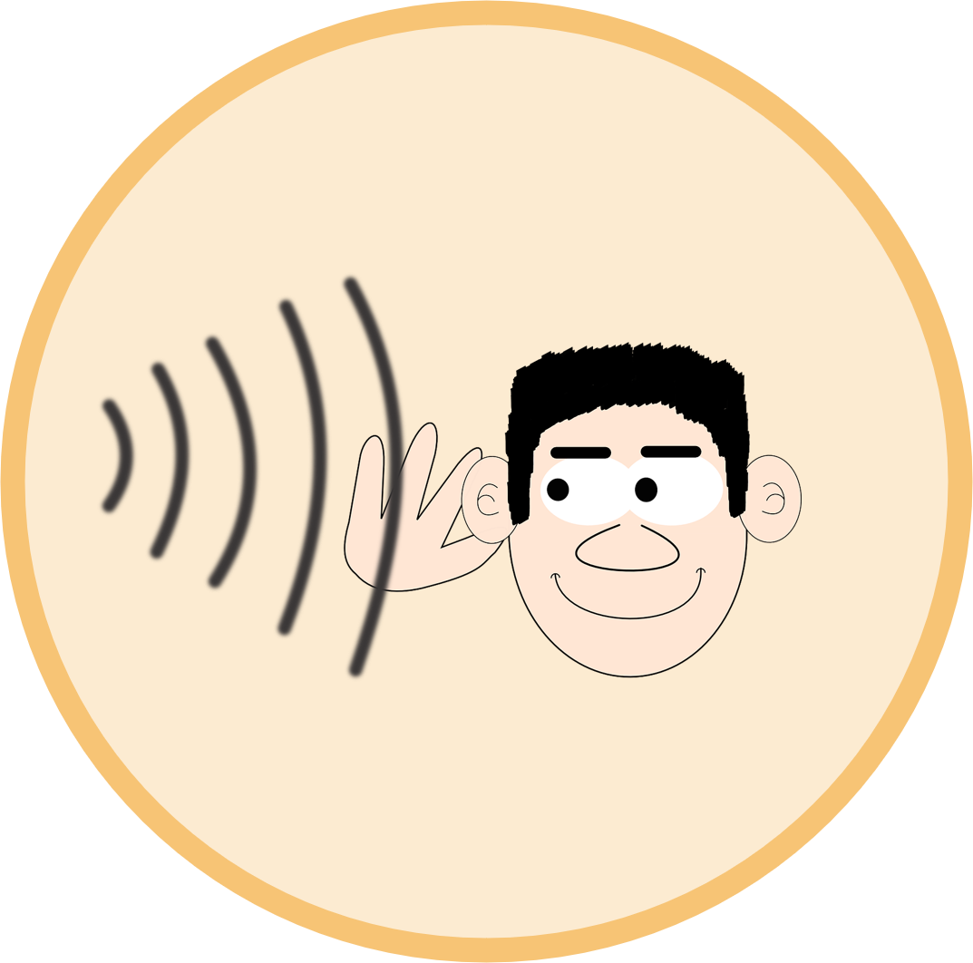
Vokabeln
Vokabeln lernen
Was heißt das auf Deutsch?
Wörter
lesen
werden
kaufen
hören
gehen
trinken
tanzen
schlafen
machen
essen
laufen
sehen
tragen
singen
Notes:
Timing: 5 minutes
Aim: to revisit and practise written recognition and pronunciation of 14 previously taught infinitive verbs.
Procedure:
Click to bring up a symbol.
Pupils choose one of the German verbs – elicit which one.
Click for the answer (correct verb turns green).
Click for next symbol and carry on until all the verbs have been identified.
Note: the task will gradually get easier as the correctly identified verbs stay green and can therefore be ruled out as a choice.
5

Slide 6
Vokabeln
Weak or strong? Sortiere die Verben.
Wörter
sehen
lesen
weak
strong
trinken
schlafen
werden
singen
schlafen
hören
gehen
hören
essen
gehen
laufen
machen
machen
tragen
kaufen
trinken
tanzen
sehen
laufen
kaufen
werden
tanzen
singen
lesen
tragen
essen
Notes:
Timing: 5 minutes
Aim: to practise sorting taught verbs into weak and strong categories.
Procedure:
Each item is triggered, allowing the teacher to elicit answers in any order from pupils.
When pupils say a verb with its correct category, e.g. weak, the teacher clicks on the word and the animation sees it slot into the correctly labelled box.
3. Repeat for all 14 verbs.
6

Slide 7
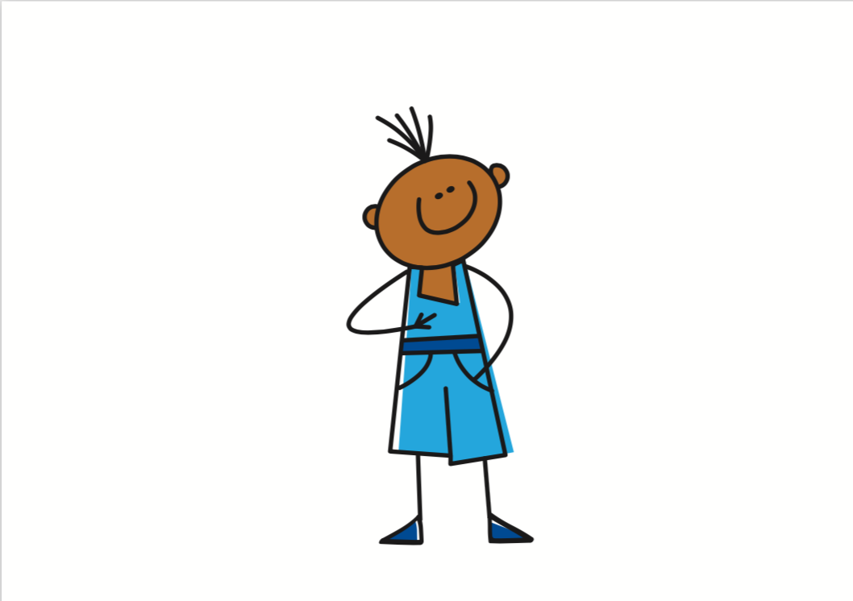
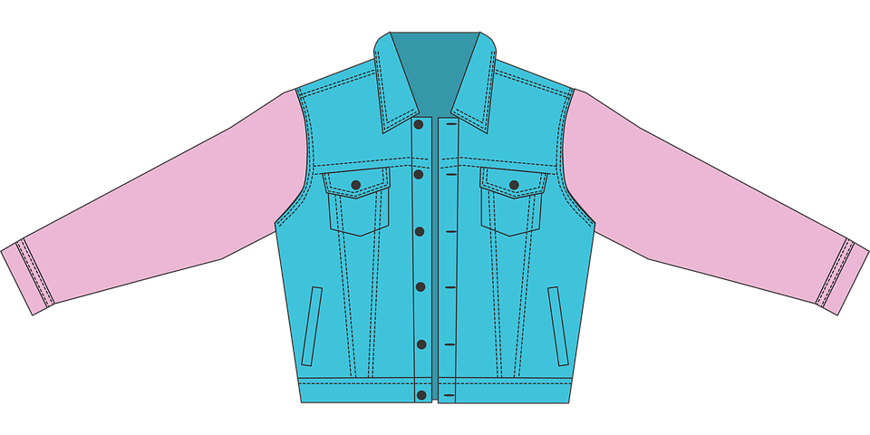
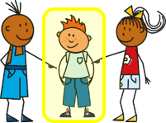
Grammatik
Remember that strong verbs (e.g., tragen, sehen, sprechen) change the vowel in the stem for 2nd and 3rd persons singular:
Ich trage eine Jacke.
I wear/ am wearing a jacket.
Du trägst eine Jacke.
You wear/ are wearing a jacket.
Er/sie trägt eine Jacke.
S/he wears/ is wearing a jacket.
Ich sehe einen Film.
I watch/ am watching a film.
Du siehst einen Film.
You watch/ are watching a film.
Er/sie sieht einen Film.
S/he watches/ is watching a film.
Ich spreche Deutsch.
I speak/ am speaking German.
Du sprichst Deutsch.
You speak/ are speaking German.
Er/sie spricht Deutsch.
S/he speaks/ is speaking German.
Notes:
Timing: 2 minutes
Procedure:
Click through the animations to remind pupils of the vowel change in the stem for strong verbs.
Elicit English translation for the German examples provided.
7

Slide 8
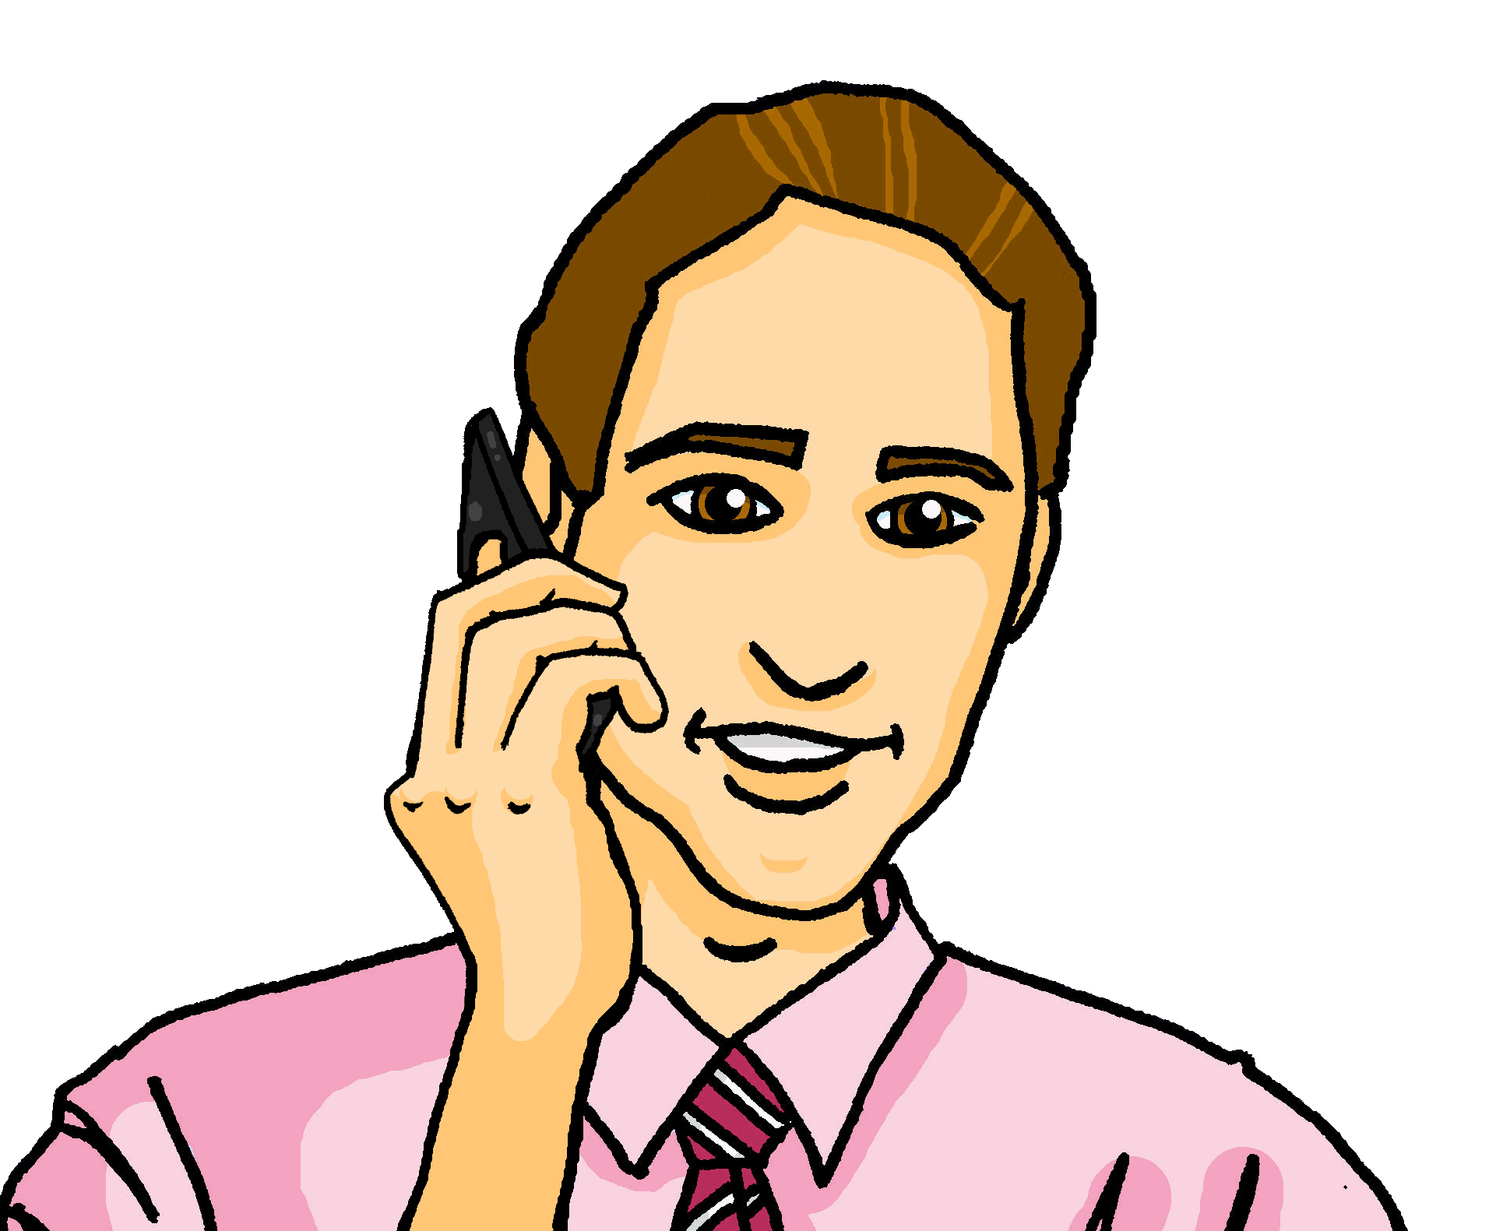
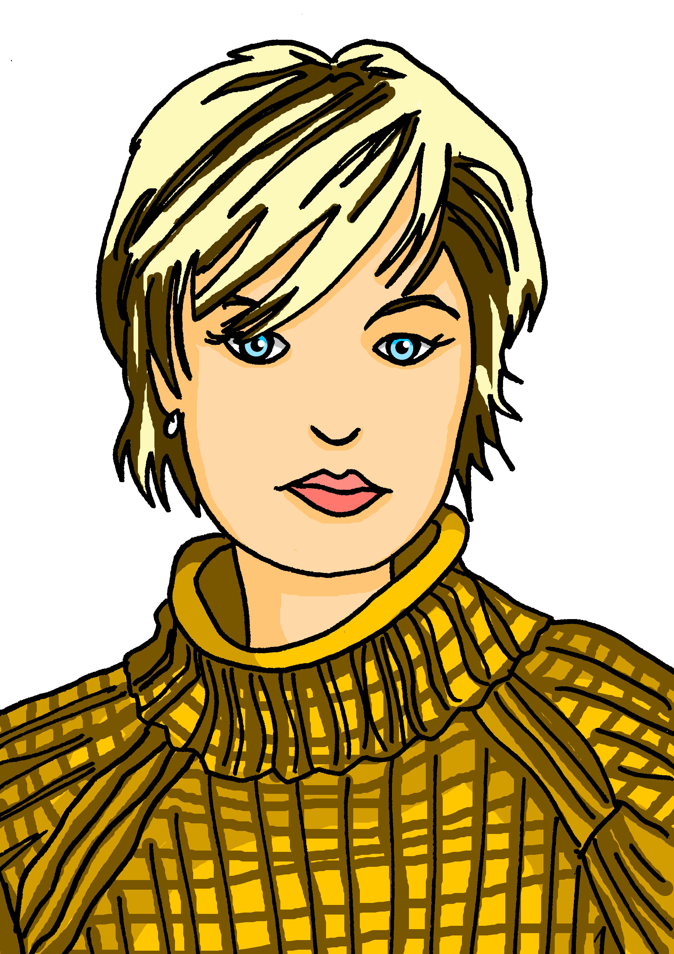
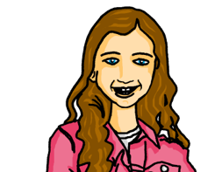
hören
Johanna ist in Köln mit Mutti Maike. Johanna spricht mit Vati Steffen am Telefon.
Wer macht was? Maike (sie) oder Johanna (ich)?
 | Auf Englisch?
 | I walk/run into town.
 | She is getting tired.
 | I’m not sleeping – I’m having fun!
 | I speak on the phone.
 | She is seeing many people.
 | I am reading a book. It is called: Karneval in Cologne!
 | She is wearing partyclothes.
Maike:
sie
Johanna:
ich
B.
1
2
3
4
5
6
Notes:
Timing: 5 minutes
Aim: to practise aural distinction between verb endings 1st and 3rd person singular.
Procedure:
1. Explain the scenario. Based on the verb endings, pupils listen out for whether Johanna is talking about herself (ich) or her mum Maike (sie).
2. Click on the sound button for the example. Elicit the answer. Note that laufen can be used to mean both running and walking so either translation of the example is correct.
3. Click to reveal the answer tick. Click on sound button again – pupils listen out for the meaning. Elicit the meaning in English.
4. Click to reveal the English meaning. Note that the German present tense translates two ways into English – both answers can be correct, depending on context (e.g., I’m not sleeping / I don’t sleep). Ensure pupils know that the two translations are possible here.
5. Continue for 1-6.
Transcript:
Beispiel: [Ich] laufe in die Stadt.
[Sie] wird müde.
[Ich] schlafe nicht – ich habe viel Spaß!
[Ich] spreche am Telefon.
[Sie] sieht viele Menschen.
[Ich] lese ein Buch. Es heißt: Karneval in Köln!
[Sie] trägt Partykleidung.
8

Slide 9
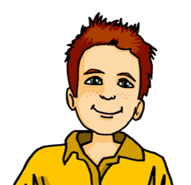
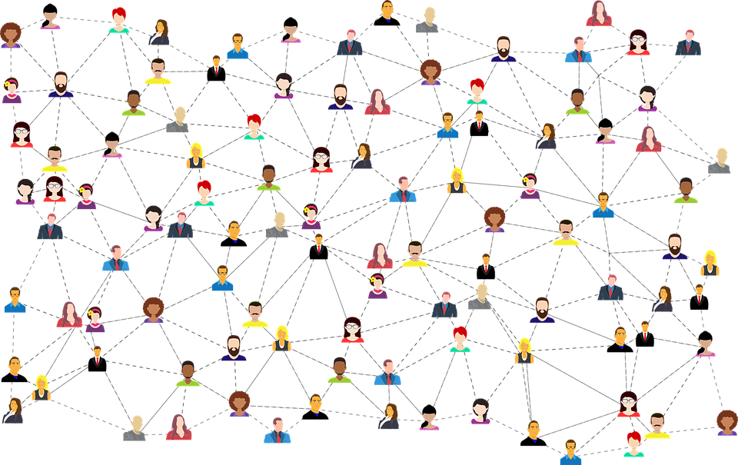
lesen
Moritz textet Vati Steffen.
Wer macht was? Moritz (ich) oder Johanna (sie)?
Johanna:
sie
Moritz:
ich
1 | Ich sehe viele Menschen in Köln.
2 | Ich spreche mit Mutti.
3 | Sie läuft in die Stadt
4 | Sie ist müde und froh – sie schläft!
5 | Ich lese das Buch: Karneval in Köln!
6 | Sie trägt Partykleidung auf der Straße.
1
2
3
4
5
6
Notes:
Timing: 6 minutes
Aim: to practise written comprehension of the first versus the third person singular verb endings.
Procedure:
Explain the scenario.
Pupils read the items 1-6 and decide, based on the verb endings, whether Moritz is talking about himself (ich) or about Johanna (sie).
Click to reveal the answers in turn.
Elicit English sentence meanings, orally.
Translations
I see lots of people in Köln/Cologne.
I am talking with Mum.
She is walking/running into town.
She is tired and happy – she is sleeping!
I am reading the book ‘Carnival in Cologne’.
She is wearing party clothes on the street.
9

Slide 10
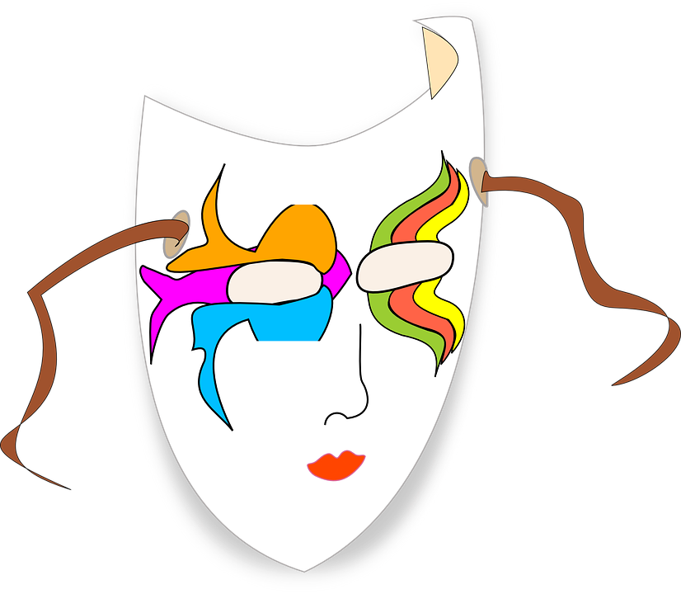
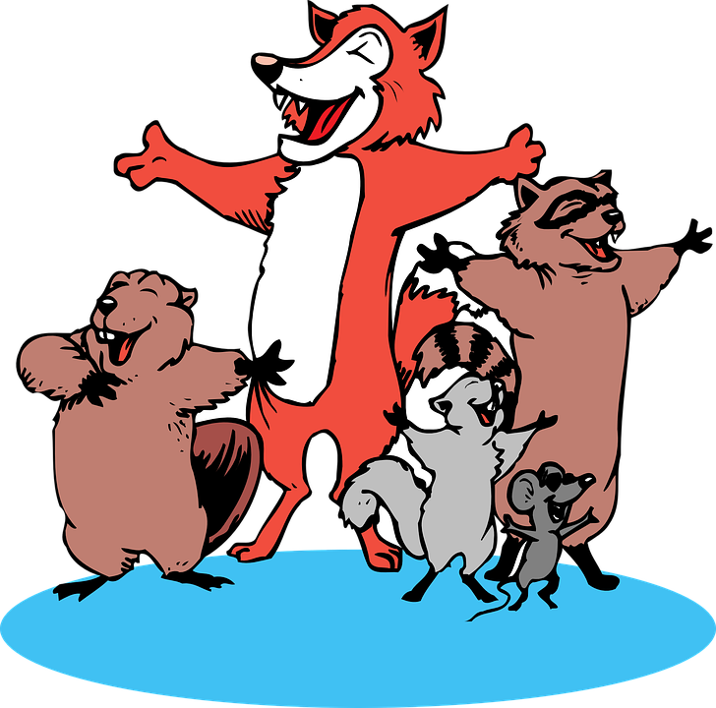
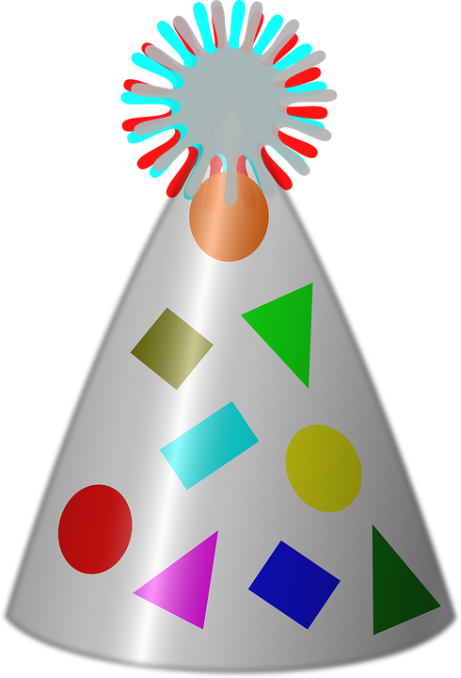
Kultur
Hör zu und sing mit!
Wir feiern heut den Karneval
Wir feiern heut den Karneval,
die schönste Zeit im Jahr
Wir feiern heut den Karneval und alle sind schon da
Piraten, Clowns und Zauberer,
die Prinzen und die Feen
Wie schön, dass ihr gekommen seid,
wie schön euch, hier zu sehn.
Ihr seid alle super drauf
Jetzt stellt euch in der Reihe auf!
We‘re celebrating Karneval today,
the best time in the year
We‘re celebrating Karneval today
and everyone is already there
Pirates, clowns und magicians,
the princes and the fairies
How lovely that you‘ve come
how lovely to see you here.
You are all feeling super, oh...
now line up in a row.
A special greeting for Karneval in Köln is…
Try saying it to each other!
Alaaf, Freddie!
Alaaf, Mimi!
Notes:
Timing: 5 minutes
Link to Youtube video: https://www.youtube.com/watch?v=hz6igR1E4qQ
Aim: to present some cultural information Karneval and have fun by joining in with a song.
Procedure:
Explain that there is special greeting in Köln, only used for Karneval.
Model the sound or click on the purple Alaaf and the speech bubbles to play the sound.
Pupils go round the classes (shaking hands or not) greeting each other with ‘Alaaf Ali’, Alaaf Olivia’, etc.
If desired, go over the first stanza of the song on the slide, reading it out or playing the recording.
Play the Youtube video via the link in these notes, pupils join in with the words and actions.
Note: The full lyrics are in the Youtube notes if you click ‘Show more’.
Approximate/creative translation of first stanza:
We‘re celebrating Karneval today,
the best time in the year
We‘re celebrating Karneval today
and everyone is already there
Pirates, clowns und magicians,
the princes and the fairies
How lovely that you‘ve come
how lovely to see you here.
You are all feeling super, oh...
now line up in a row.
10

Slide 11
Tschüss!
blau
Notes:
11

