Slide 1
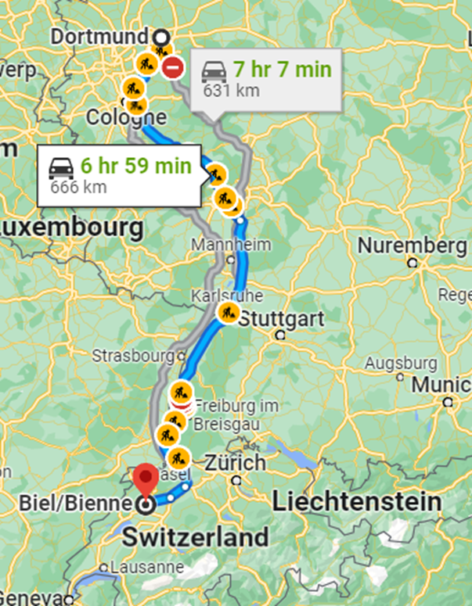
Experiences at home and away
travelling ‘to’: nach |zu
present tense (future meaning)
SSC [-g] [-d] [-b]
blau
Term 3 Week 5
Notes:
Artwork by Steve Clarke. Pronoun pictures from NCELP (www.ncelp.org). All additional pictures selected from Pixabay and are available under a Creative Commons license, no
attribution required.
Phonics: [-g] Tag [111] Berg [934] Zug [675] [-d] und [2] Lied [1733] Freund [273] [-b] gelb [1446] Lieblings- [n/a] siebzehn [>5000]
Vocabulary: fahren [215] Ausflug [4014] Norden, Nord- [1516] Osten, Ost- [1208] Süden, Süd- [1771] Strand [1966] Wald [1028] Westen, West- [1010] diesmal [1384] dort [139] nach [34] zu [21] nach Hause [n/a]
Revisit 1: werden, werde, wirst, wird [8] Ei [1999] Frühstück [2600] Frohe Ostern [n/a] Guten Appetit [n/a] Gute Nacht [n/a] viel Spaß [n/a]
Revisit 2: Uhr³ [348] spät [169] um¹ [44] zusammen [533] - revisit numbers 1-12
Jones, R.L & Tschirner, E. (2019). A frequency dictionary of German: Core vocabulary for learners. London: Routledge.
The frequency rankings for words that occur in this PowerPoint which have been previously introduced in these resources are given in the SOW and in the resources that first
introduced and formally re-visited those words.
For any other words that occur incidentally in this PowerPoint, frequency rankings will be provided in the notes field wherever possible.
Remember that at the start of the course (first three lessons of Rot/Gelb) pupils learnt language (for greetings and register taking) that can still be part of the lesson routines in upper KS2 (Blau/Grün). They are not re-taught, as we anticipate that teachers have built these in from early in lower KS2.
1

Slide 2
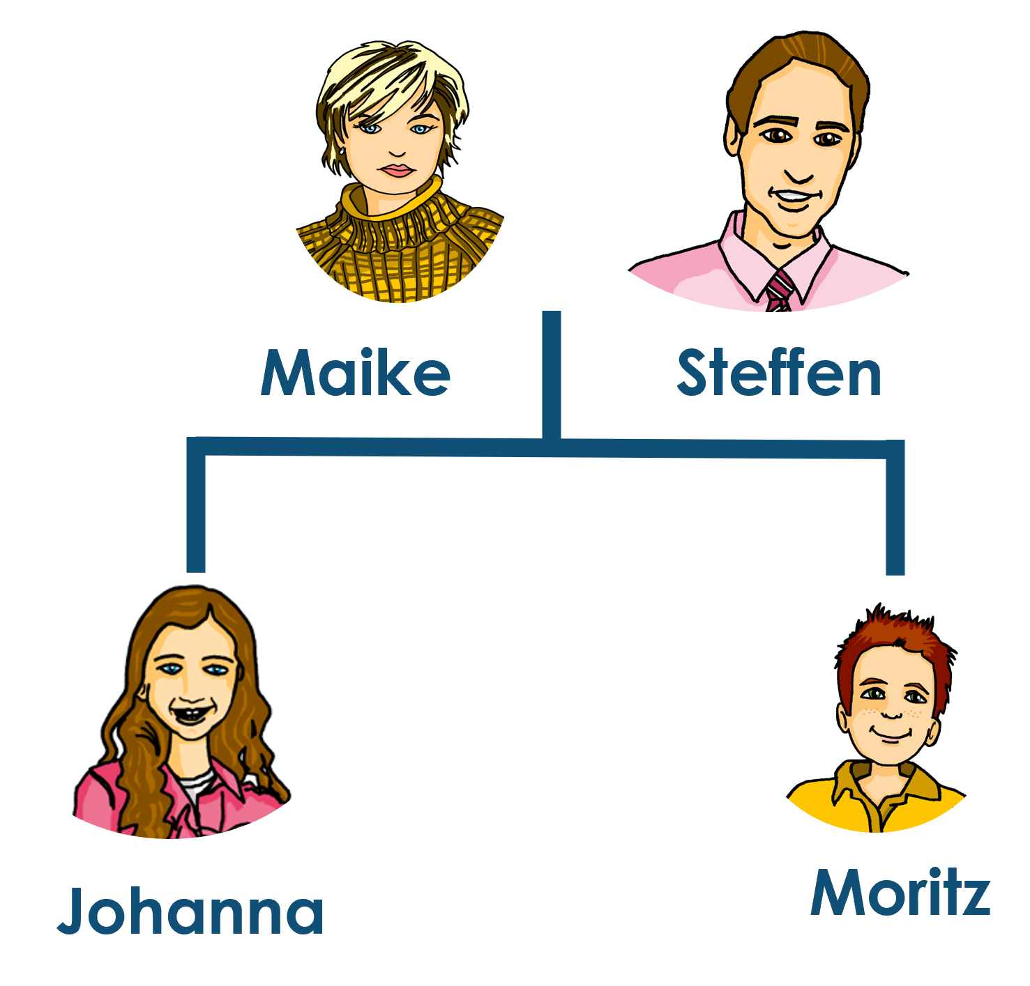
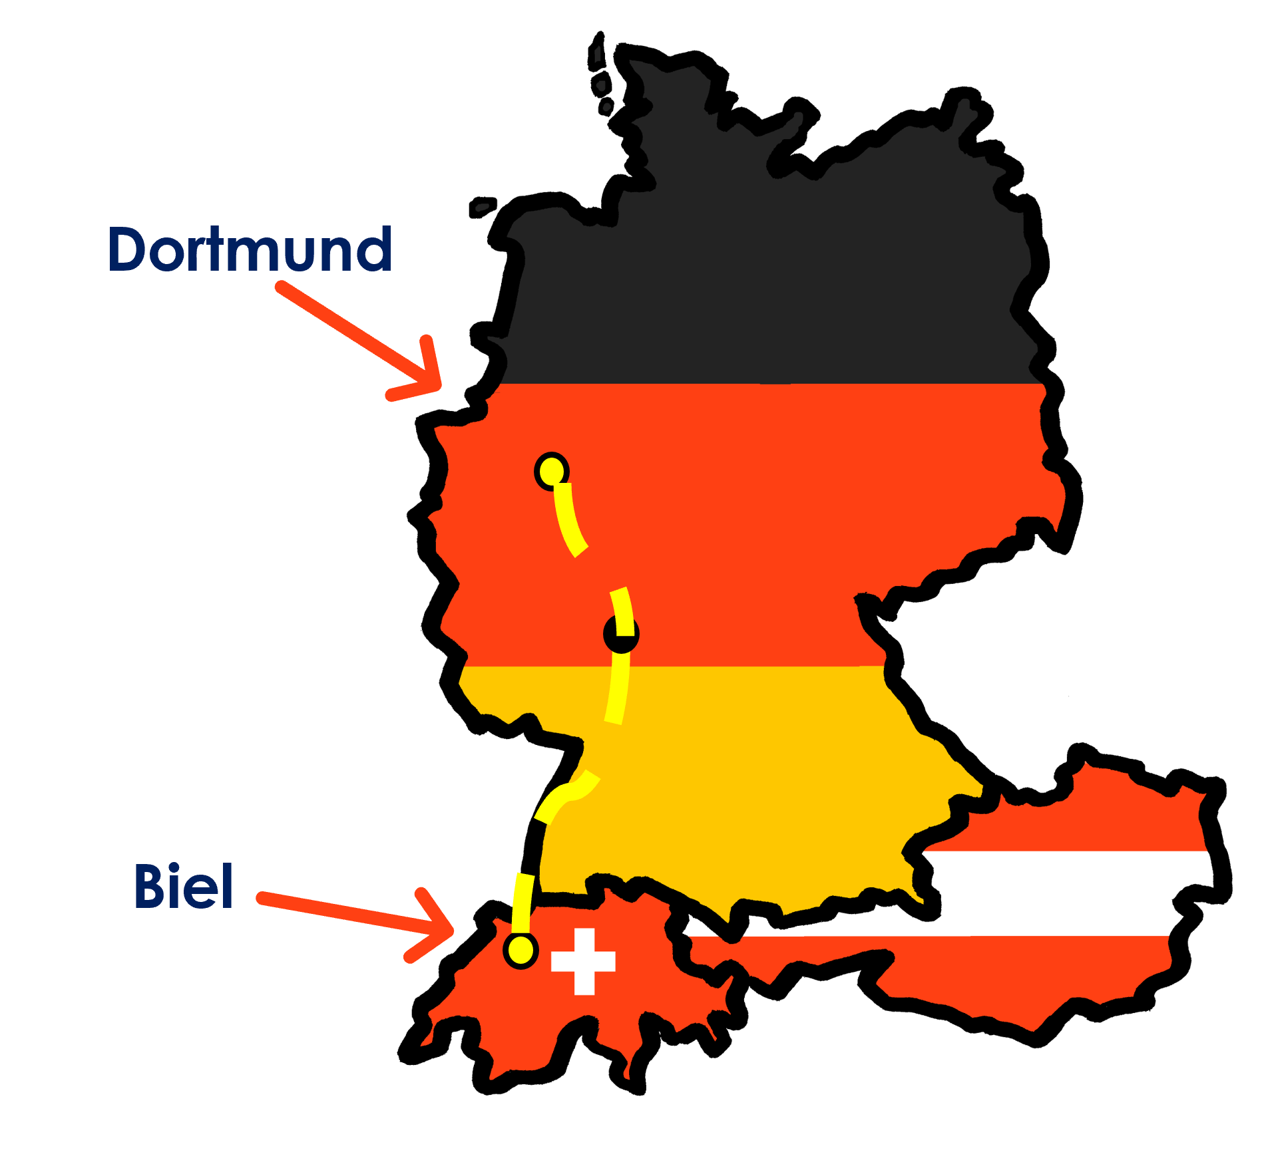
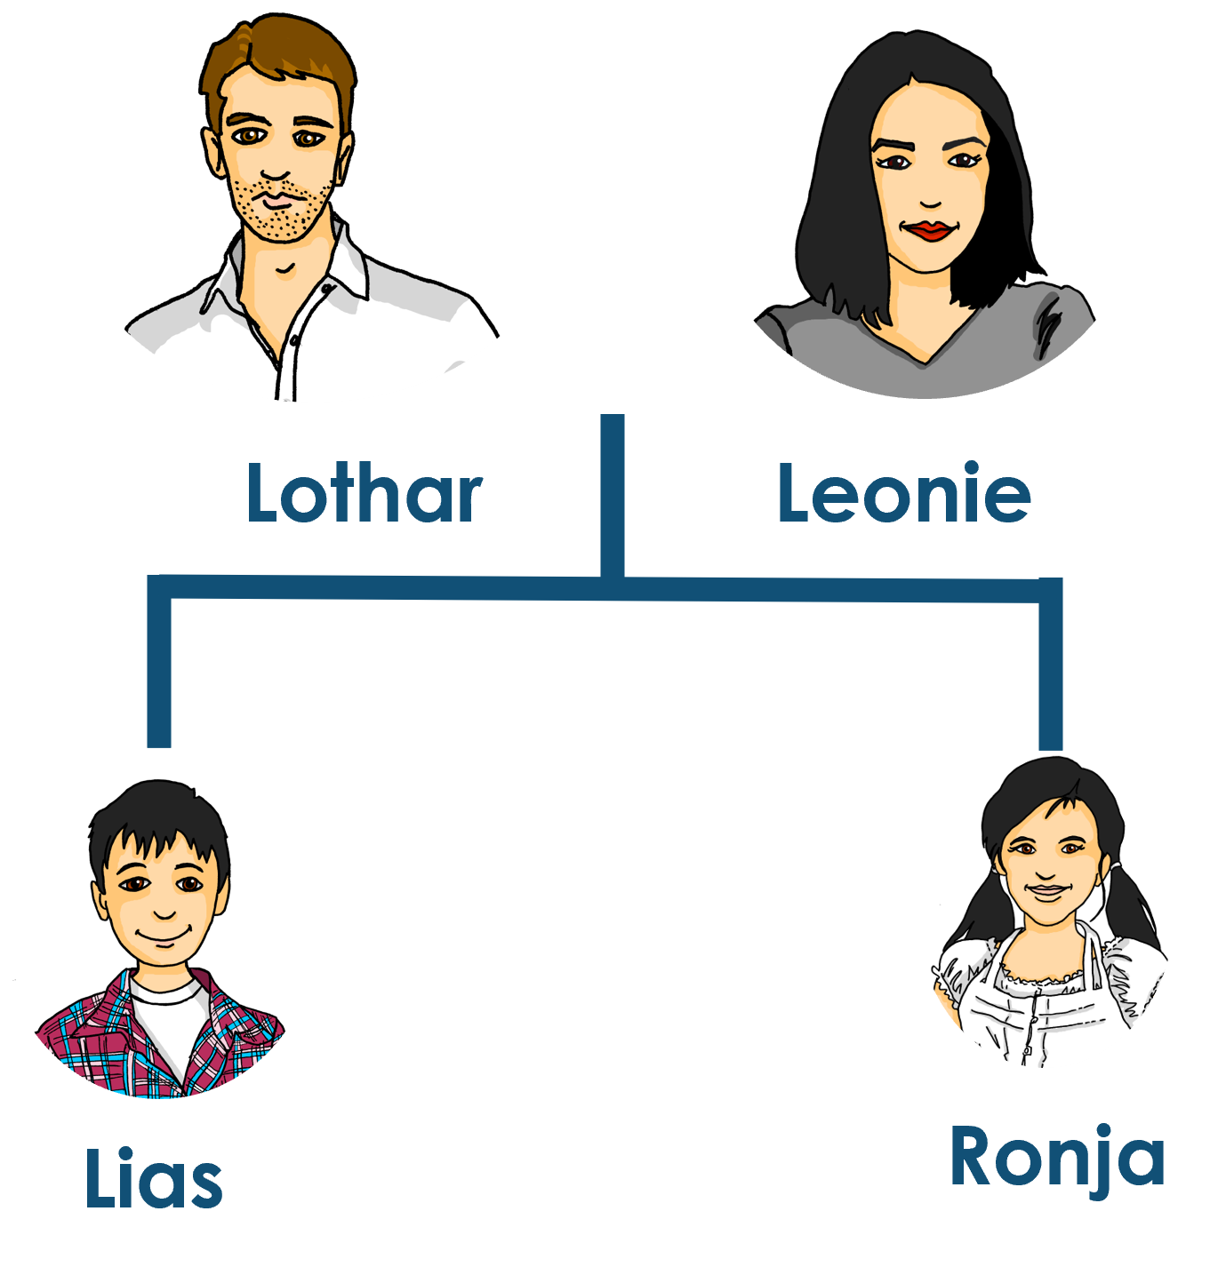
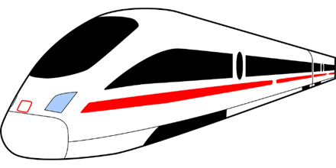
Kultur
Sie fahren nach Deutschland!
Lies den Text.
Steffen, Maike, Johanna und Moritz Brandt wohnen in Dortmund. Das liegt in Westdeutschland.
Lothar (Steffens Bruder) und seine Familie wohnen in Biel, in der Schweiz. In zwei Wochen fahren sie nach Deutschland. Sie fahren 7 Stunden 31 Minuten mit dem Zug*! Das sind 488 Kilometer!
Zug = train
Notes:
Timing: 5 minutes
Aim: to present and practise new vocabulary and context for this week.
Procedure:
Read the texts or play the recordings. Make sure the lesson’s context is clear.
Vocabulary:
Zug [675]
Jones, R.L & Tschirner, E. (2019). A frequency dictionary of German: Core vocabulary for learners. London: Routledge.
2

Slide 3
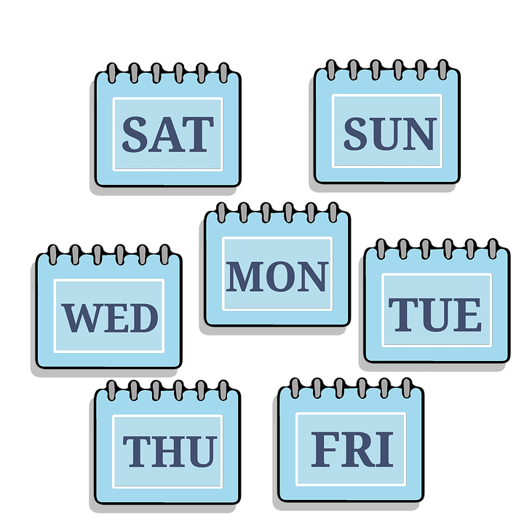
aussprechen
[-b]
[-d]
[-g]
When g, d, b come at the end of a word or before a consonant they sound like k, t, p and you don’t use your vocal chords.
…
and
Tag
und
gelb
Notes:
Timing: 2 minutes
Aim: To introduce/consolidate SSC [-g]
Procedure: 1. Present the letter(s) and say the final [-g] sound first, on its own. Pupils repeat it with you. Do the same with final [-d] and final [-b].
2. Click to bring up the callout to explain when these letters sound like this: i.e., g = k, d = t, b = p. 3. Bring up the word “Tag” on its own, say it, pupils repeat it, so that they have the opportunity to focus all of their attention on the connection between the written word and its sound.
4. A possible gesture for this would be to use the British Sign Language (BSL) sign for day, as here: https://www.signbsl.com/sign/day.
5. Click to bring up the image and say the word “Tag” again with pupils.
6. Click to bring up the word “und”. One gesture is to make the plus sign with two index fingers. Alternatively, the BSL sign for “and” is here: https://www.signbsl.com/sign/and
7. Click to bring up the image and say the word “und” again. 8. Finally, click to bring up the word “gelb”. BSL is here: https://www.signbsl.com/sign/yellow
9. Click to bring up the image and say the word again.
Word frequency (1 is the most frequent word in German): gelb [1446] Tag [111] und [2] Source: Jones, R.L. & Tschirner, E. (2019). A frequency dictionary of German: core vocabulary for learners. Routledge
3

Slide 4
aussprechen
[-g]
…
Tag
Berg
Zug
Notes:
Timing: 3 minutes (three slides)
Aim: To introduce/consolidate SSC [-g]
Procedure:
Introduce and elicit the pronunciation of the individual SSC [-g] and then the source word again ‘Tag’ (with gesture, if using).
Then present and elicit the pronunciation of the two cluster words.
The cluster words have been chosen for their high-frequency, from a range of word classes, with the SSC (where possible) positioned within a variety of syllables within the words (e.g. initial, 2nd, final etc.). Additionally, we have tried to use words that build cumulatively on previously taught SSCs (see the Phonics Teaching Sequence document) and do not include new SSCs. Where new SSCs are used, they are often consonants which have a similar symbol-sound correspondence in English.
Word frequency (1 is the most frequent word in German): Berg [934] Tag [11] Zug [675] Source: Jones, R.L. & Tschirner, E. (2019). A frequency dictionary of German: core vocabulary for learners. Routledge

Slide 5
aussprechen
[-d]
…
and
und
Lied
Freund
Notes:
[2/3]
Aim: To introduce/consolidate SSC [-d]
Procedure:
Introduce and elicit the pronunciation of the individual SSC [-d] and then the source word again ‘und’ (with gesture, if using).
Then present and elicit the pronunciation of the two cluster words.
The cluster words have been chosen for their high-frequency, from a range of word classes, with the SSC (where possible) positioned within a variety of syllables within the words (e.g. initial, 2nd, final etc.). Additionally, we have tried to use words that build cumulatively on previously taught SSCs (see the Phonics Teaching Sequence document) and do not include new SSCs. Where new SSCs are used, they are often consonants which have a similar symbol-sound correspondence in English.
Word frequency (1 is the most frequent word in German): und [2] Freund [273] Lied [1733] Source: Jones, R.L. & Tschirner, E. (2019). A frequency dictionary of German: core vocabulary for learners. Routledge

Slide 6
aussprechen
[-b]
…
gelb
Lieblings-
siebzehn
Notes:
[3/3]
Aim: To introduce/consolidate SSC [-b]
Procedure:
Introduce and elicit the pronunciation of the individual SSC [-b] and then the source word again ‘gelb’ (with gesture, if using).
Then present and elicit the pronunciation of the two cluster words.
The cluster words have been chosen for their high-frequency, from a range of word classes, with the SSC (where possible) positioned within a variety of syllables within the words (e.g. initial, 2nd, final etc.). Additionally, we have tried to use words that build cumulatively on previously taught SSCs (see the Phonics Teaching Sequence document) and do not include new SSCs. Where new SSCs are used, they are often consonants which have a similar symbol-sound correspondence in English.
Word frequency (1 is the most frequent word in German): gelb [1446] Lieblings-[N/A] siebzehn [N/A]
Source: Jones, R.L. & Tschirner, E. (2019). A frequency dictionary of German: core vocabulary for learners. Routledge

Slide 7
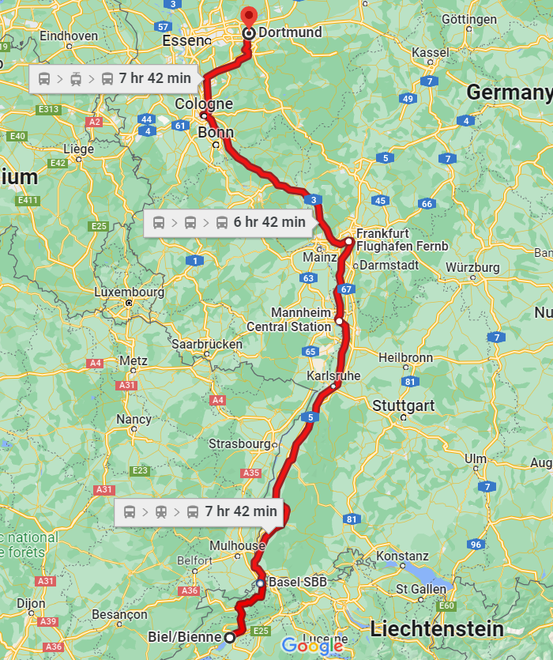
[-g] [-d] [-b]
Auf der Reise sehen sie Schilder*!
Hör zu. Ist es [-g], [-d] oder [-b]?
 |  | [-g] | [-d] | [-b]
1 | Orpund
2 | Bad Herrenalb
3 | Himmelried
4 | Sulzburg
5 | Windschlag
6 | Kaub
7 | Niederfeld
8 | Bad Orb
9 | Kleinmeischeid
O
die Fahrt – journey Schilder – signs
Notes:
Timing: 5 minutes
Aim: to consolidate the SSC [-g] [-d] and [-b].
Procedure:
Click each audio button to hear the place name. Pupils listen out particularly for the last sound of the word.
Pupils listen and decide which SSC they hear. Note that these items are all unvoiced versions of the letters.
Optional stage: listen again and pupils try transcribing the full place name (Note: pupils could do this the first time around, too, if able).
4. Click to reveal answers.
NB: the places ending in –d and –g are situated near/along the family’s train route. The places ending in –b are a bit further away – selected for phonics rather than geography! ☺
Transcript:
Orpund
Bad Herrenalb
Himmelried
Sulzburg
Windschlag
Kaub
Niederfeld
Bad Orb
Kleinmeischeid
Word frequency:
Fahrt [1569] Schild [3366]
Source: Jones, R.L. & Tschirner, E. (2019). A frequency dictionary of German: core vocabulary for learners. Routledge

Slide 8
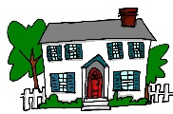
nach und zu
Nach and zu can both mean ‘to’. Nach means ‘to’ with:
City or town names
Ich fahre nach Berlin.
I’m going to Berlin.
Most countries
Ich fahre nach Deutschland.
I’m going to Germany.
Directions
Ich gehe nach rechts.
I’m going (to the) right.
Nach meaning ‘to’ is never followed by an article (word for ‘the’).
You also know:
Ich gehe nach Hause.
I’m going (to) home.
Remember: gehen is go on foot, fahren is go by transport.
Notes:
Timing: 2 minutes
Procedure:
Click through the animations to present the new information.
Elicit English translation for the German examples provided.
8

Slide 9
Nach and zu
We shorten zu dem to zum and zu der to zur.
Use zu (to) for places and events with articles.
In this case, the words for ‘the’ (der, die, das) are:
masculine
feminine
neuter
Ich gehe…
zu dem Dom
zu der Party
zu dem Kino
… zum Dom
… zur Party
… zum Kino
I’m going…
…to the cathedral
…to the party
…to the cinema
But… Ich bin zu Hause. I am at home.
Also use zu (to) for people:
Ich gehe zu Anna.
I’m going to Anna’s (place).
Ich gehe nach Hause. I’m going (to) home.
Notes:
Timing: 2 minutes
Procedure:
Click through the animations to present the new information.
Elicit English translation for the German examples provided.

Slide 10
lesen
Johanna plant einen Ausflug für die zwei Familien. Sie schreibt Ronja.
Lies die SMS. Was heißen ‘nach’ und ‘zu’ auf Englisch?
to
1
In German we use future time phrases with the present to say what we are doing in the future.
to
Wir machen einen Ausflug nach Norddeutschland.
4
Am Abend bleiben wir zu Hause.
to the
to the
at
at
In German we say ‘einen Ausflug machen’. In English, we say ‘go on a trip.’
(-)
(-)
2
to
5
to
Wir gehen nach unten zum Frühstück.
Am Montag fahren wir zurück* nach Dortmund.
to the
to the
at
at
(-)
(-)
to
to
3
In German we say ‘zum Frühstück’ to mean ‘for/at breakfast’.
Um vier Uhr gehen wir zum Strand.
6
Wir kommen spät nach Hause.
to the
to the
at
at
(-)
(-)
zurück – back
Notes:
Time: 3 minutes.
Aim: to practise the meanings of ‘zu’ and ‘nach’ in a reading activity.
Procedure:
Pupils read the text messages and identify the correct meaning of zu or nach.
Click for answer ticks to appear. Note that in no. 2 it is potentially possible to say go *to* breakfast but it’s more likely to be translated as go *for* breakfast.
Then elicit meanings of the whole messages.
Click to bring up callouts to draw pupils’ attention to English meanings and cross-linguistic differences.
Word frequency:
zurück [1683]
Source: Jones, R.L. & Tschirner, E. (2019). A frequency dictionary of German: core vocabulary for learners. Routledge

Slide 11
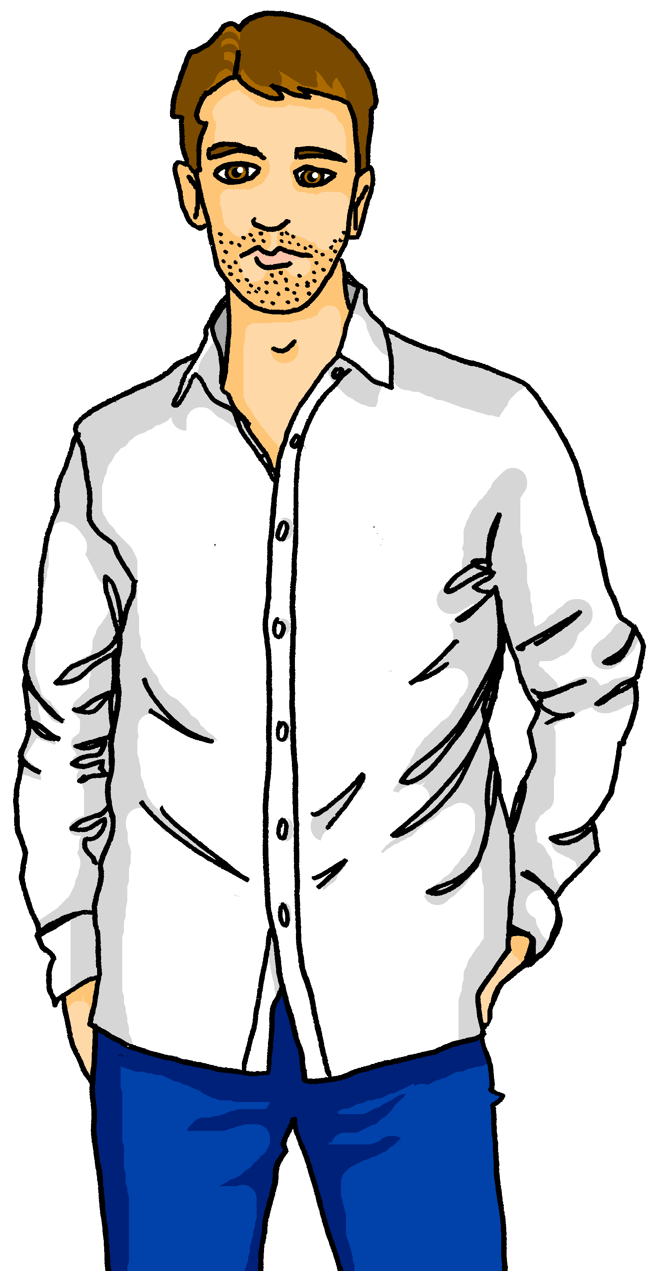
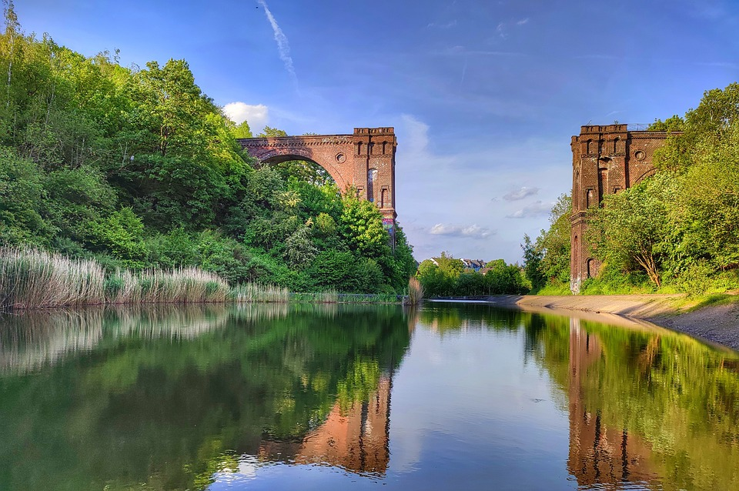
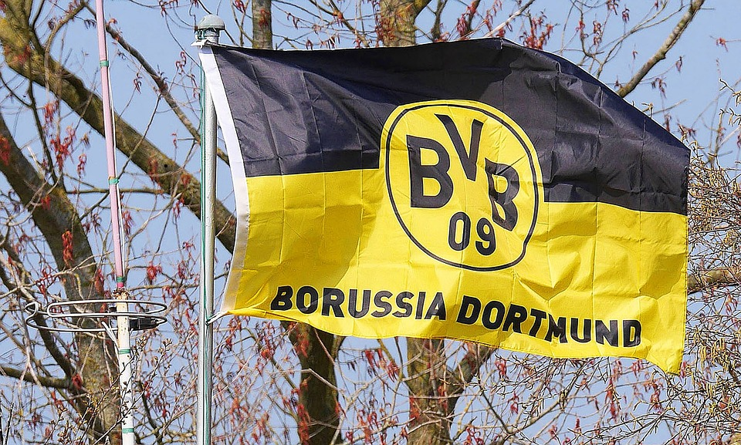
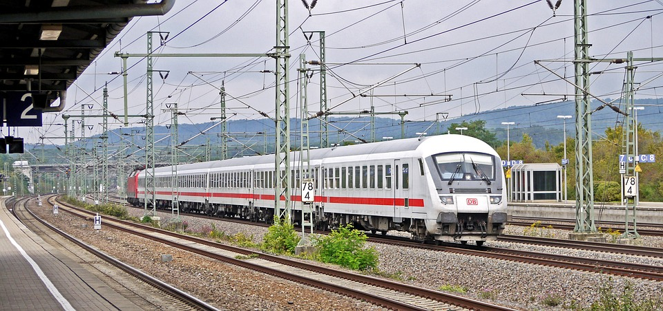
hören
Die Familie plant den Ausflug
Hör zu. Ist es ‘nach’ oder ‘zu’?
Wie heißt das auf Englisch?
 | nach | zu, zum, zur | Englisch
 |  |  | travel from Biel to Dortmund
 |  |  | trip to the North
 |  |  | go to Maike, Steffen, etc.’s place
 |  |  | take the train to Dortmund
 |  |  | go on a trip to the river ‘Ruhr’
 |  |  | go to the forest to play football there
 |  |  | say good night and go home
Ex
1
2
3
4
5
6
Notes:
Time: 5 minutes.
Aim: to practice aural comprehension of the different uses of ‘to’ (‘nach’ and ‘zu’).
Procedure:
Click to play the example. Pupils identify the correct word for ‘to’: zu or nach.
Click to reveal the answer tick. Elicit translation.
Click to reveal the meaning.
Continue for items 1-6.
Transcript:
Beispiel: Wir fahren von* Biel [nach] Dortmund.
Das ist ein Ausflug [nach] Norden.
Wir fahren [zu] Maike, Steffe, Johanna und Moritz!
Wir nehmen den Zug [nach] Dortmund.
In Dortmund machen wir einen Ausflug [zum] Fluss ‘die Ruhr’.
Wir gehen [zum] Wald und spielen dort Fußball.
Um zehn Uhr sagen wir Gute Nacht zusammen und fahren [nach] Hause.
Word frequency:
nehmen [142]
Source: Jones, R.L. & Tschirner, E. (2019). A frequency dictionary of German: core vocabulary for learners. Routledge

Slide 12
Tschüss!
blau
Notes:
12

