Slide 1
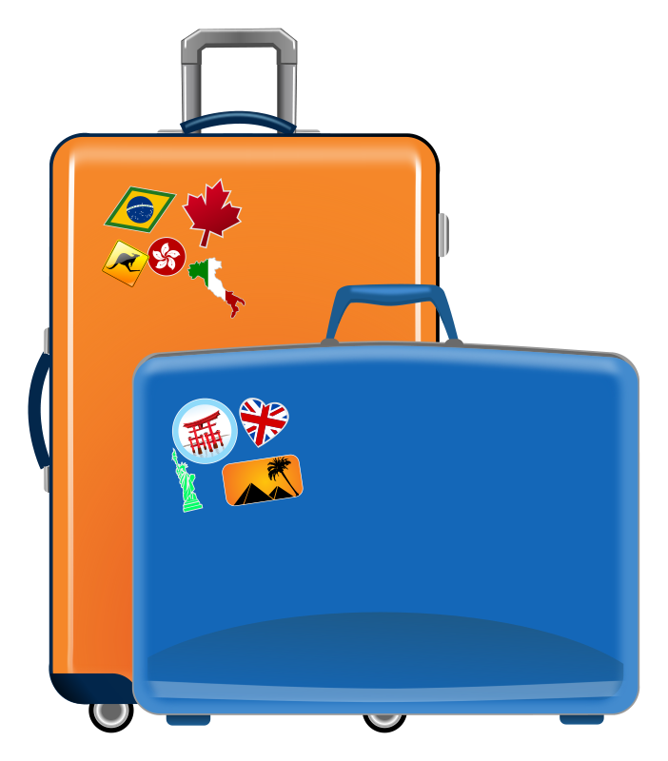
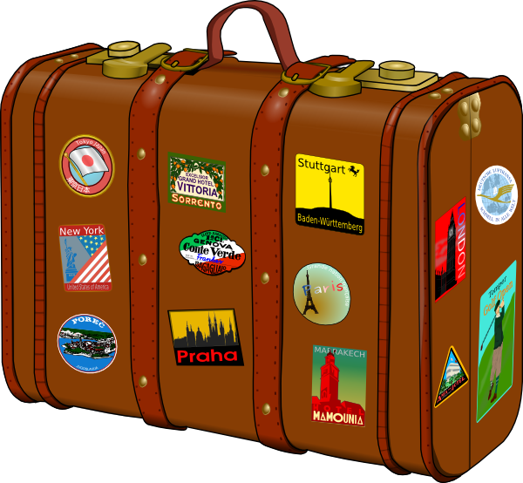
Describing me and others
blau
Follow ups 1-5
Term 3 Week 6
Notes:
Artwork by Steve Clarke. Pronoun pictures from NCELP (www.ncelp.org). All additional pictures selected from Pixabay and are available under a Creative Commons license, no attribution required.
Phonics: [-tion] [z] Information [465] funktionieren [677] international [465] Position [944] Tradition [1650]
Vocabulary: Buch [300] Fußball [1277] Handy [1693] Jacke [3287] Rucksack [3180] Spiel [328] T-Shirt [3914] Uhr [348]
Revisit 1: essen [323] gehen [66] sehen [79] singen [1063] tanzen [1497] tragen [271] man [32] (Party)Kleidung [2820] dann [41]
Revisit 2: gehen [66] sein [3] Bibliothek [2366] Dom [4916] Garten [1158] Haus [147] Kino [2020] Stadt [204] Wohin? [1811]
Jones, R.L & Tschirner, E. (2019). A frequency dictionary of German: Core vocabulary for learners. London: Routledge.
The frequency rankings for words that occur in this PowerPoint which have been previously introduced in these resources are given in the SOW and in the resources that first
introduced and formally re-visited those words.
For any other words that occur incidentally in this PowerPoint, frequency rankings will be provided in the notes field wherever possible.

Slide 2
aussprechen
[-tion]
…
Information
Notes:
Timing: 1 minute
Aim: to introduce the SSC [-tion].
Procedure:
1. Present the SSC and say the [-tion] sound first, on its own. Pupils repeat it with you.
2. Present the source word ‘Information’ on its own, say it, pupils repeat it, so that they have the opportunity to focus all of their attention on the connection between the written word and its sound.
3. A possible gesture for this would be to use the British Sign Language (BSL) sign for information, as here: https://www.signbsl.com/sign/information
4. Click to bring up the image and say the word “Information” again with pupils.
Word frequency (1 is the most frequent word in German): Information [465] Source: Jones, R.L. & Tschirner, E. (2019). A frequency dictionary of German: core vocabulary for learners. Routledge
2

Slide 3
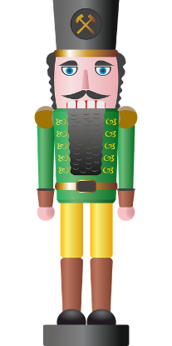
aussprechen
[-tion]
…
Tradition
Position
Information
international
funktionieren
Notes:
Timing: 1 minute
Aim: to consolidate the SSC [-tion].
Procedure:
Re-present the SSC and the source word ‘Information’ (with gesture, if using).
Click to bring on the picture and get pupils to repeat the word ‘Information’ (with gesture, if using).
Present the cluster words in the same way, bringing on the picture and getting pupils to pronounce the words.
Word frequency (1 is the most frequent word in German): Information [465] Tradition [1650] Position [944] international [426] funktionieren [677] Source: Jones, R.L. & Tschirner, E. (2019). A frequency dictionary of German: core vocabulary for learners. Routledge

Slide 4
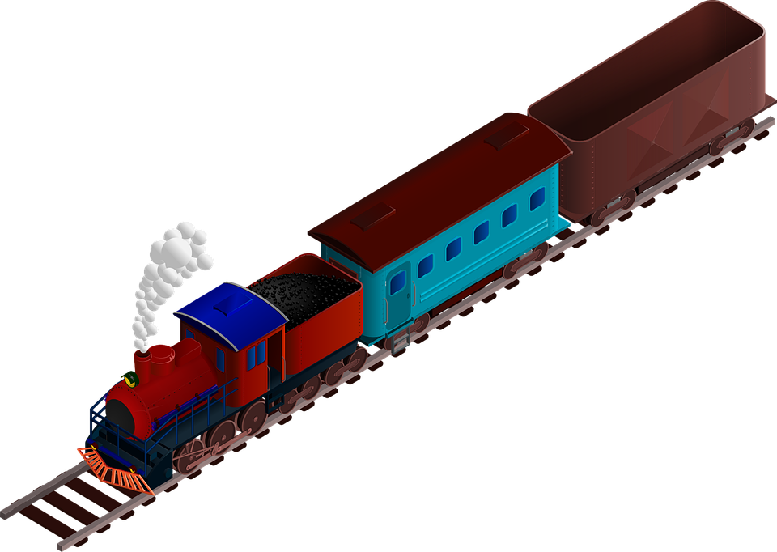
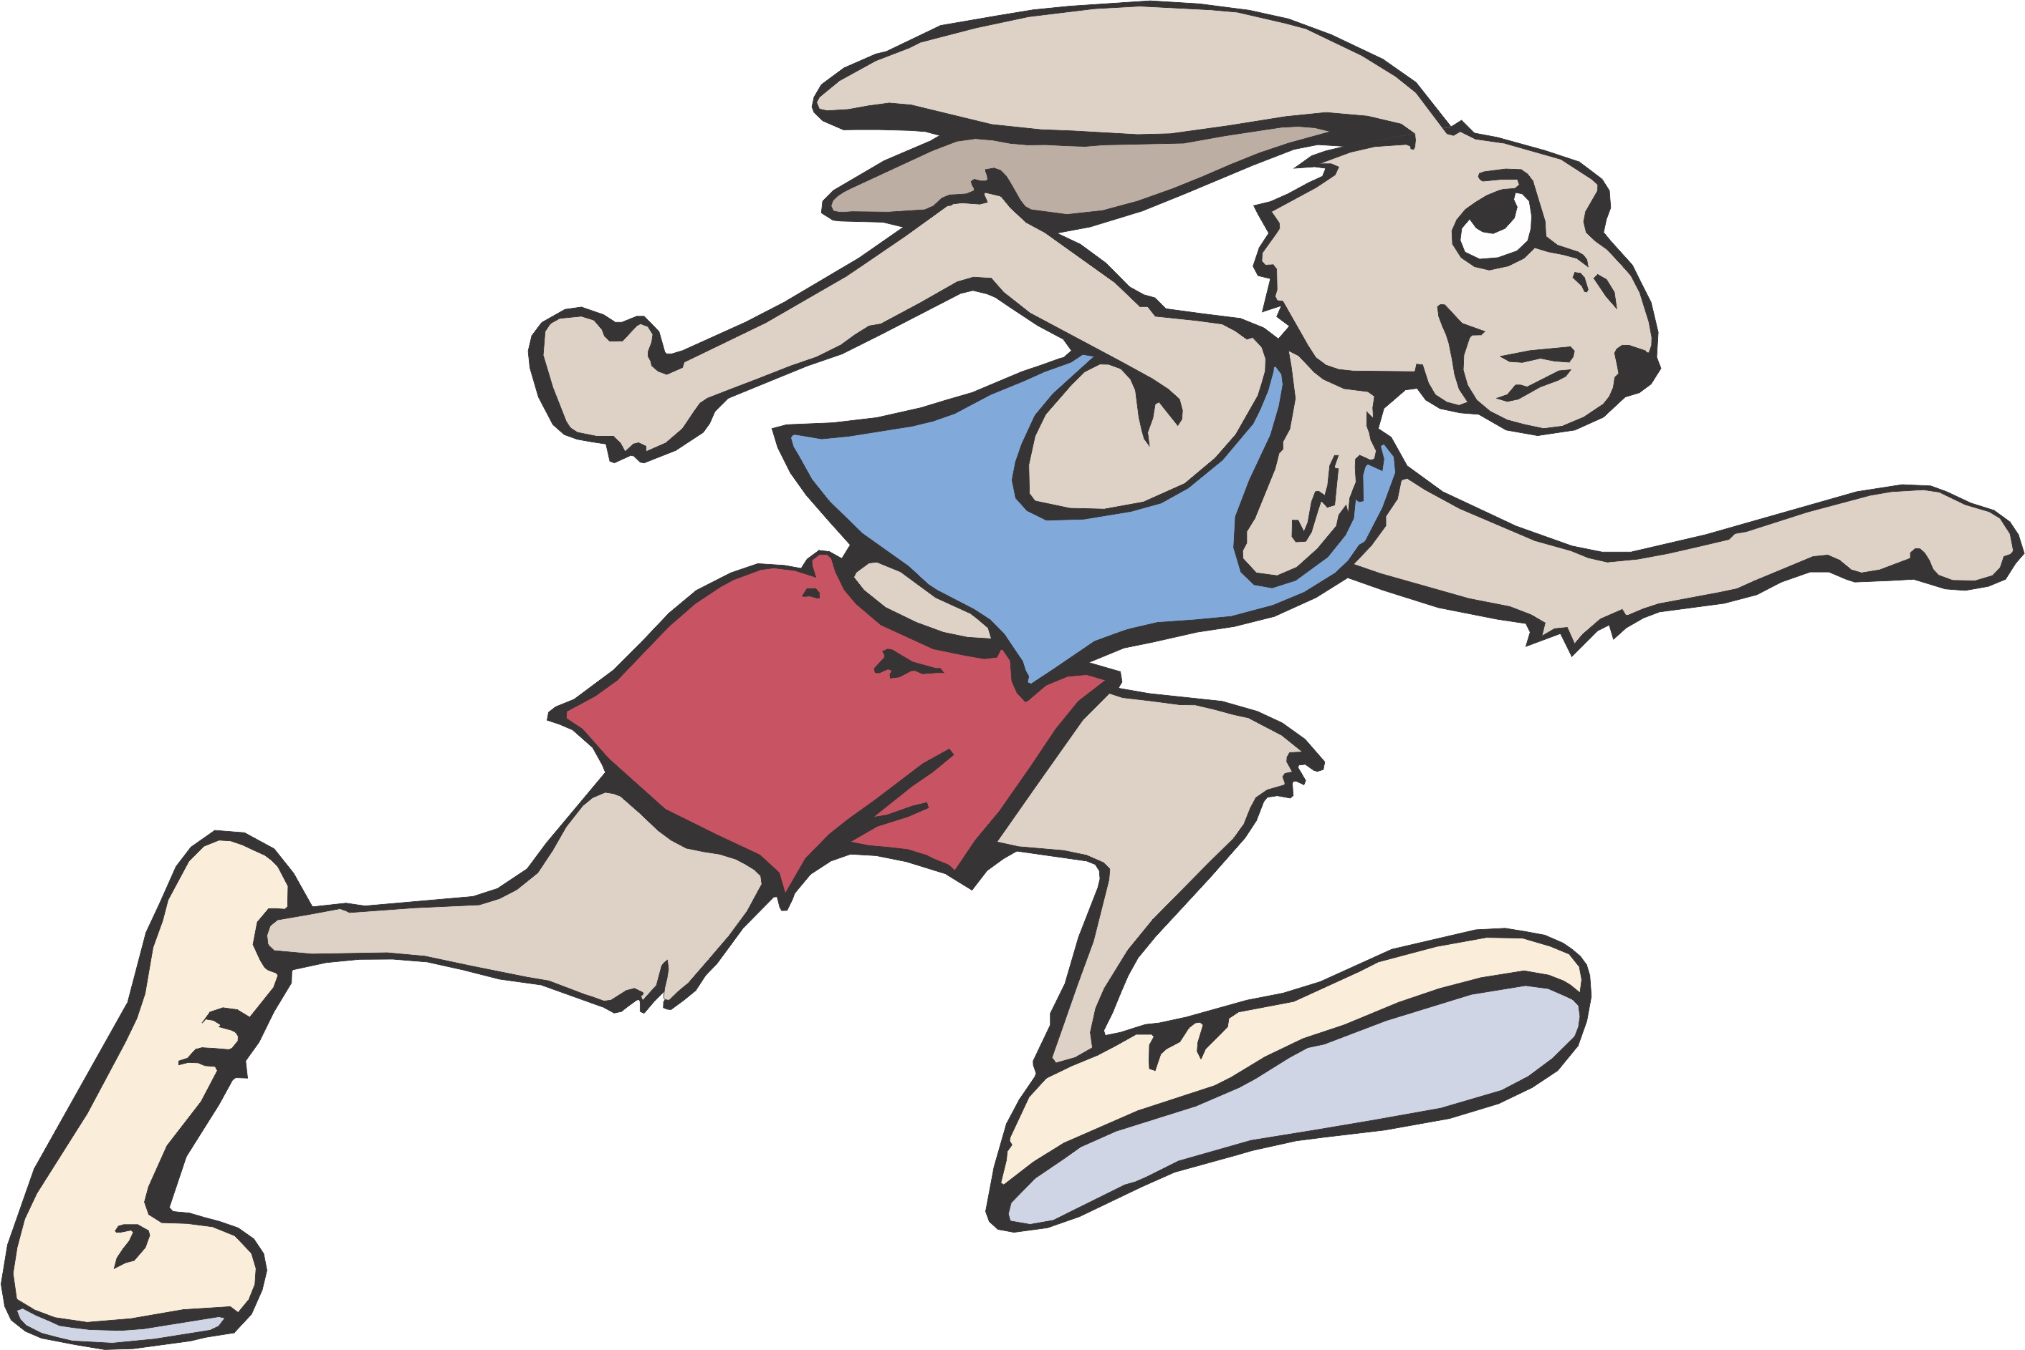
Follow up 1
Zungenbrecher (tongue twisters)!
Sag den Satz.
The [t] in [-tion] sounds like German [z]. It’s like the –ts at the end of the English word boots.
aussprechen
How quickly can you say the sentence?
1
Witzige Kombination: Zehn Züge ziehen ein Fahrzeug in Position.
Funny combination: 10 trains pull a vehicle into position.
Finanzielle Information: Die Organisation zahlt siebzehn Zahnärzten eine Million. Eine Investition!
2
Financial information: the organisation pays 17 dentists a million. An investment!
Jetzt bitte Konzentration: zur Zeit kein Zugang zur Institution. Traditionelle Produktion!
3
Now concentration please: at the moment no access to the institution. Traditional production!
Notes:
Timing: 5 minutes (for three slides) Aim: To apply SSC knowledge of [z] and [-tion] in the oral production of longer sentences. Procedure: 1. Click to bring up the reminder callout re the pronounciation of the ‘t’ in [tion]
2. Pupils read the tongue twister aloud. They try to say it as quickly as possible. 3. Listen and check (three different speeds). Slow versions (tortoise), medium speed (audio button), fast speed (hare). 4. Clarify meaning, using the English translations (click to bring up translations).
Word frequency of unknown or cognate words (1 is the most frequent word in German):
witzig [4500] Kombination [1895] ziehen [ 193 ] Fahrzeug [1721] Position [ 944]
finanziell [1332] Information [465] Organisation [1113] zahlen [832] Zahn [1871] Arzt [622] Investition [1406]
jetzt [72] Konzentration [1320] Zeit [96] Zugang [1507] Institution [1995] traditionell [1555] Produktion [ 923] Source: Jones, R.L. & Tschirner, E. (2019). A frequency dictionary of German: core vocabulary for learners. Routledge

Slide 5
Follow up 2
Hör zu. Ist die Antwort A, B oder C richtig?
A
B
C
Do you have your ball and your phone? | You have your ball but you aren’t finding my phone. | You have your ball but you aren’t finding your phone.
hören
1
I buy your jacket and my watch in (the) town. | Do I buy your jacket and my watch in (the) town? | I buy my jacket and your watch in (the) town.
2
People are wearing your party clothes at home! | Are people wearing my or your party clothes at home? | Are people wearing my party clothes are home?
3
4
Are your game and my book in the library then? | My game and your book are in the library then. | Your game and my book are in the library then.
In my garden you see your phone. | In my garden you don’t see your phone. | In your garden you see my phone.
5
Are we singing my song for your birthday? | We are singing my song for my birthday. | We are singing my song for your birthday.
6
Notes:
Timing: 5 minutes
Aim: to practise aural comprehension of sentences containing ’mein’ and ‘dein’ and this week’s vocabulary.
Procedure:
Click on the first audio button to hear a sentence. Pupils listen carefully and decide whether option A, B or C contains the correct answer. NB: they may need to listen to each sentence more than once.
Repeat for questions 2-6.
Click to reveal the answers.
Transcript: 1. Du hast deinen Ball aber du findest dein Handy nicht.
2. Ich kaufe deine Jacke und meine Uhr in der Stadt.
3. Trägt man meine oder deine Partykleidung zu Hause?
4. Dein Spiel und mein Buch sind dann in der Bibliothek.
5. In meinem Garten sieht man dein Handy.
6. Wir singen mein Lied für deinen Geburtstag.

Slide 6
Follow up 3

Schreib die Wörter auf Deutsch und auf Englisch.
schreiben
Dein Haus ist schön und _____ _____ auch.
_______ Lieblingsbuch heißt Matilda.
Du trägst _______ Partykleidung.
Siehst du ______ Mutter im _______?
______ Fußball sieht sie im ______ !
____ _______ is nice and my house also.
My _________ _______ is called Matilda.
You are _________ your party clothes.
Do you ____ your mother in the garden?
Your __________she sees in the house!
mein
1
Your house
Haus
2
Mein
favourite book
3
deine
wearing
4
deine
Garten
see
5
Deinen
Haus
football
Notes:
Timing: 5-10 minutes
Aim: to practise written production and comprehension of ihr and sein, and this week’s new and revisited vocabulary.
This is a jigsaw translation task.
Procedure:
Students write the missing words in both German and English to complete the sentences.
Teacher clicks to provide the written answers and/or clicks the audio buttons to hear the full German sentences.
Differentiation: 1. For a different challenge (i.e. to practise spelling rather than full written recall of the missing German words), the task could be completed as a transcription task initially, by listening to the full sentences and writing the words.
2. Then pupils could complete the English part of the jigsaw.

Slide 7
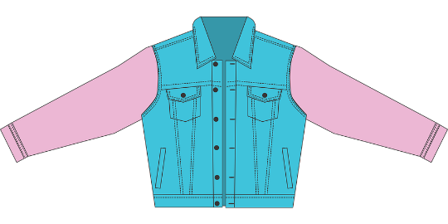
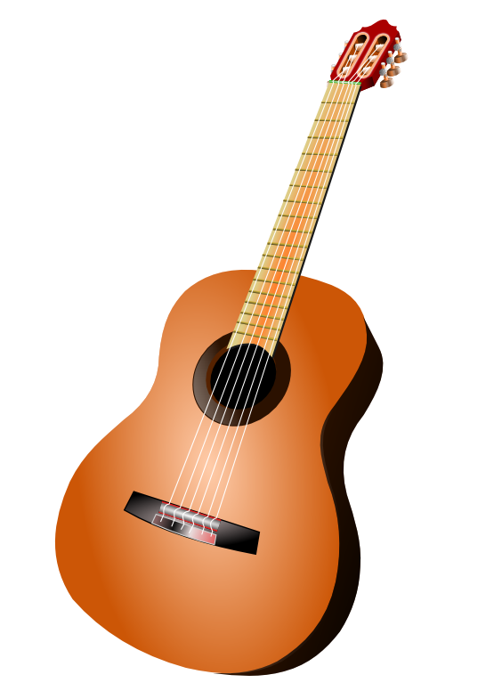
Follow up 4
Was packst du? Was packt dein*e Partner*in?
…
Ich packe in meinem Rucksack…
sprechen
Ich packe in meinem Rucksack ein T-Shirt!
Ich packe in meinem Rucksack ein T-Shirt und …eine Wasserflasche!
A
B
Notes:
Timing: 5 minutes
Aim: to revise vocabulary and practise saying nouns with accusative articles after a verb. Procedure: 1. Following the examples on the screen, the first player says ‘Ich packe in meinen Rucksack…’ and follows it with an accusative article + noun.
2. The second player repeats what the first player said and adds a second accusative article + noun to the list.
3. The next player repeats what the second player said and adds a third accusative article + noun to the list.
4. Play continues until someone forgets an item or gets an article wrong!
Word frequency of unknown words used in task instructions (1 is the most frequent word in German): packen [1639]

Slide 8
Follow up 5:

Schreib auf Englisch.
Can you get at least 15 points?
Wörter
Vokabeln
 | die Bibliothek | gehen | der Dom
 | die Stadt | Wohin? | das Kino
 | ich trage | dann | tragen
 | die Kleidung | man | er/sie/es trägt
 | die Uhr | das T-Shirt | sehen
 | du siehst | der Rucksack | ich sehe
(the) library
to go, going
(the) cathedral
x3
(the) town
Where (to)?
(the) cinema
I wear, I carry
then
to wear, to carry
x2
(the) clothing
you, one
he/she/it wears, carries
(the) watch,
clock, o’clock
(the) t-shirt
to see, seeing
x1
you see, are seeing
(the) backpack
I see, am seeing
Notes:
Timing: 5 minutes
Aim: to practise written production of vocabulary from this and revisited weeks.
Procedure: 1. Give pupils a blank grid. They fill in the English meanings of any of the words they know, trying to reach 15 points in total.
Note: The most recently learnt and practised words are pink, words from the previous week are green and those from week 1 are blue, thus more points are awarded for them, to recognise that memories fade and more effort (heavy lifting!) is needed to retrieve them.

Slide 9
Follow up 5:

Schreib auf Deutsch.
Can you get at least 15 points?
Wörter
Vokabeln
 | (the) cinema | (the) town | Where (to)?
 | to go, going | (the) library | (the) cathedral
 | to wear, to carry | I wear, I carry | he/she/it wears, carries
 | you, one | then | (the) clothing
 | to see, seeing | I see/ am seeing | you see/ are seeing
 | (the) backpack | (the) t-shirt | (the) watch, clock, o’clock
das Kino
die Stadt
Wohin?
x3
gehen
die Bibliothek
der Dom
tragen
ich trage
er/sie/es trägt
x2
man
dann
die Kleidung
sehen
ich sehe
du siehst
x1
der Rucksack
das T-Shirt
die Uhr
Notes:
Timing: 5 minutes
Aim: to practise written production of vocabulary from this and revisited weeks.
Procedure: 1. Give pupils a blank grid. They fill in the German meanings of any of the words they know, trying to reach 15 points in total.
Note: The most recently learnt and practised words are pink, words from the previous week are green and those from week 1 are blue, thus more points are awarded for them, to recognise that memories fade and more effort (heavy lifting!) is needed to retrieve them.

Slide 10
Tschüss!
blau
Notes:
10

Slide 11
Follow up 5:

Schreib auf Englisch.
Can you get at least 15 points?
Wörter
 | die Bibliothek | gehen | der Dom
 | die Stadt | Wohin? | das Kino
 | ich trage | dann | tragen
 | die Kleidung | man | er/sie/es trägt
 | die Uhr | das T-Shirt | sehen
 | du siehst | der Rucksack | ich sehe
Vokabeln
x3
x2
x1
Notes:
HANDOUT

Slide 12
Follow up 5:

Schreib auf Deutsch.
Can you get at least 15 points?
Wörter
 | (the) cinema | (the) town | Where (to)?
 | to go, going | (the) library | (the) cathedral
 | to wear, to carry | I wear, I carry | He/she/it wears, carries
 | you, one | then | (the) clothing
 | to see, seeing | I see/ am seeing | you see/ are seeing
 | (the) backpack | (the) t-shirt | (the) watch, clock, o’clock
Vokabeln
x3
x2
x1
Notes:
HANDOUT

