Slide 1
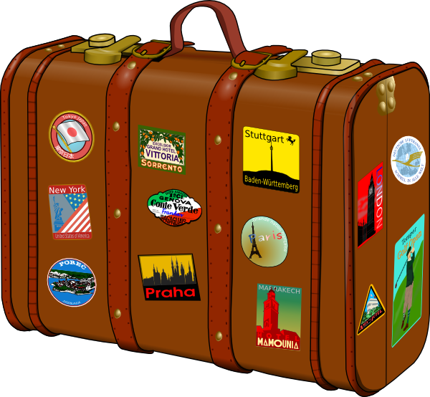
Experiences at home and away
blau
Possessive adjectives mein, dein, sein, ihr
SSC [-tion]
Term 3 Week 6
Notes:
Artwork by Steve Clarke. Pronoun pictures from NCELP (www.ncelp.org). All additional pictures selected from Pixabay and are available under a Creative Commons license, no
attribution required.
Phonics: [-tion] [z] Information [465] funktionieren [677] international [465] Position [944] Tradition [1650]
Vocabulary: Buch [300] Fußball [1277] Handy [1693] Jacke [3287] Rucksack [3180] Spiel [328] T-Shirt [3914] Uhr [348]
Revisit 1: essen [323] gehen [66] sehen [79] singen [1063] tanzen [1497] tragen [271] man [32] (Party)Kleidung [2820] dann [41]
Revisit 2: gehen [66] sein [3] Bibliothek [2366] Dom [4916] Garten [1158] Haus [147] Kino [2020] Stadt [204] Wohin? [1811]
Jones, R.L & Tschirner, E. (2019). A frequency dictionary of German: Core vocabulary for learners. London: Routledge.
The frequency rankings for words that occur in this PowerPoint which have been previously introduced in these resources are given in the SOW and in the resources that first
introduced and formally re-visited those words.
For any other words that occur incidentally in this PowerPoint, frequency rankings will be provided in the notes field wherever possible.
1

Slide 2
aussprechen
[-tion]
…
Information
Notes:
Timing: 1 minute
Aim: to introduce the SSC [-tion].
Procedure:
1. Present the SSC and say the [-tion] sound first, on its own. Pupils repeat it with you.
2. Present the source word ‘Information’ on its own, say it, pupils repeat it, so that they have the opportunity to focus all of their attention on the connection between the written word and its sound.
3. A possible gesture for this would be to use the British Sign Language (BSL) sign for information, as here: https://www.signbsl.com/sign/information
4. Click to bring up the image and say the word “Information” again with pupils.
Word frequency (1 is the most frequent word in German): Information [465] Source: Jones, R.L. & Tschirner, E. (2019). A frequency dictionary of German: core vocabulary for learners. Routledge
2

Slide 3
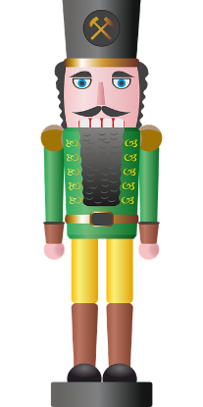
aussprechen
[-tion]
…
Tradition
Position
Information
international
funktionieren
Notes:
Timing: 1 minute
Aim: to consolidate the SSC [-tion].
Procedure:
Re-present the SSC and the source word ‘Information’ (with gesture, if using).
Click to bring on the picture and get pupils to repeat the word ‘Information’ (with gesture, if using).
Present the cluster words in the same way, bringing on the picture and getting pupils to pronounce the words.
Word frequency (1 is the most frequent word in German): Information [465] Tradition [1650] Position [944] international [426] funktionieren [677] Source: Jones, R.L. & Tschirner, E. (2019). A frequency dictionary of German: core vocabulary for learners. Routledge

Slide 4
aussprechen
[-tion]
Karaoke SSC
Sag die Wörter.
‘c’ in English is often ‘k’ in German. How many examples can you find?
60
6
Kommunikation
3
Position
2
Integration
1
Investition
10
Tradition
4
Kombination
5
Institution
9
Konzentration
8
Information
7
Aktion
START
Notes:
Timing: 5 minutes
Aim: to practise read aloud of SSC [-tion] with some unfamiliar cognates. Pronunciation is very different from English, the ‘t’ in –tion like the [-ts] at the end of ‘boots’, plus long German ‘I’ and ‘o’ sounds.
Procedure:
Click to highlight a word.
Say the word out loud, focusing on the SSC.
Click on the number button next to the word to check pronunciation.
Repeat for items 2-10.
Finally, click to bring up the call out to remind pupils that English ‘c’ is often German ‘k’ and pupils volunteer examples (4, 6, 7, 9)
Click once to highlight the examples.
Transcript and word frequency (1 is the most frequent word in German):
Aktion [1838] Information [465] Integration [1282] Investition [1406] Kombination [1895] Kommunikation [1523] Konzentration [1319] Position [944] Tradition [1650]
Source: Jones, R.L. & Tschirner, E. (2019). A frequency dictionary of German: core vocabulary for learners. Routledge

Slide 5
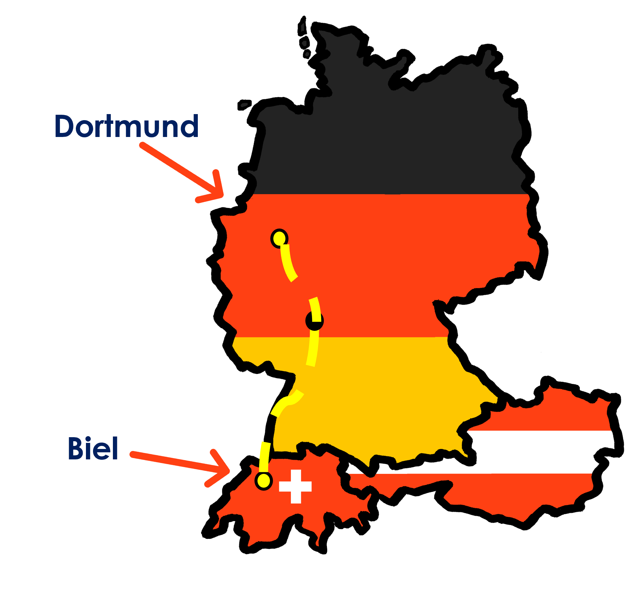
Kultur
Sie fahren nach Deutschland!
Lies den Text. Was macht Ronja?
Die Familie fährt in einer Woche nach Dortmund.
Ronja packt den Rucksack. Sie sucht viele Dinge…
Notes:
Timing: 5 minutes
Aim: to present the context for this week.
Procedure:
Read the text or click on it to hear the recording. Make sure the lesson context is clear.
Vocabulary:
packen [1639]
Jones, R.L & Tschirner, E. (2019). A frequency dictionary of German: Core vocabulary for learners. London: Routledge.
5

Slide 6
mein | dein (possessive adjectives)
To say ‘my’ use mein or meine:
masculine
feminine
neuter
Das ist…
mein Rucksack
e
mein T-Shirt
meine Uhr
my rucksack
my watch
my t-shirt
The word ‘mein’ must agree with the gender of the noun that follows. The feminine form is ‘meine’.
To say ‘your’ use dein or deine:
Lias! Hier ist…
dein Ball
deine Flasche
dein Spiel
e
your ball
your bottle
your game
Notes:
Timing: 2 minutes
Aim: to recap the possessive adjectives ‘mein’ and ‘dein’.
Procedure:
Click through the animations recap the information.
Elicit English translation for the German examples provided.
6

Slide 7
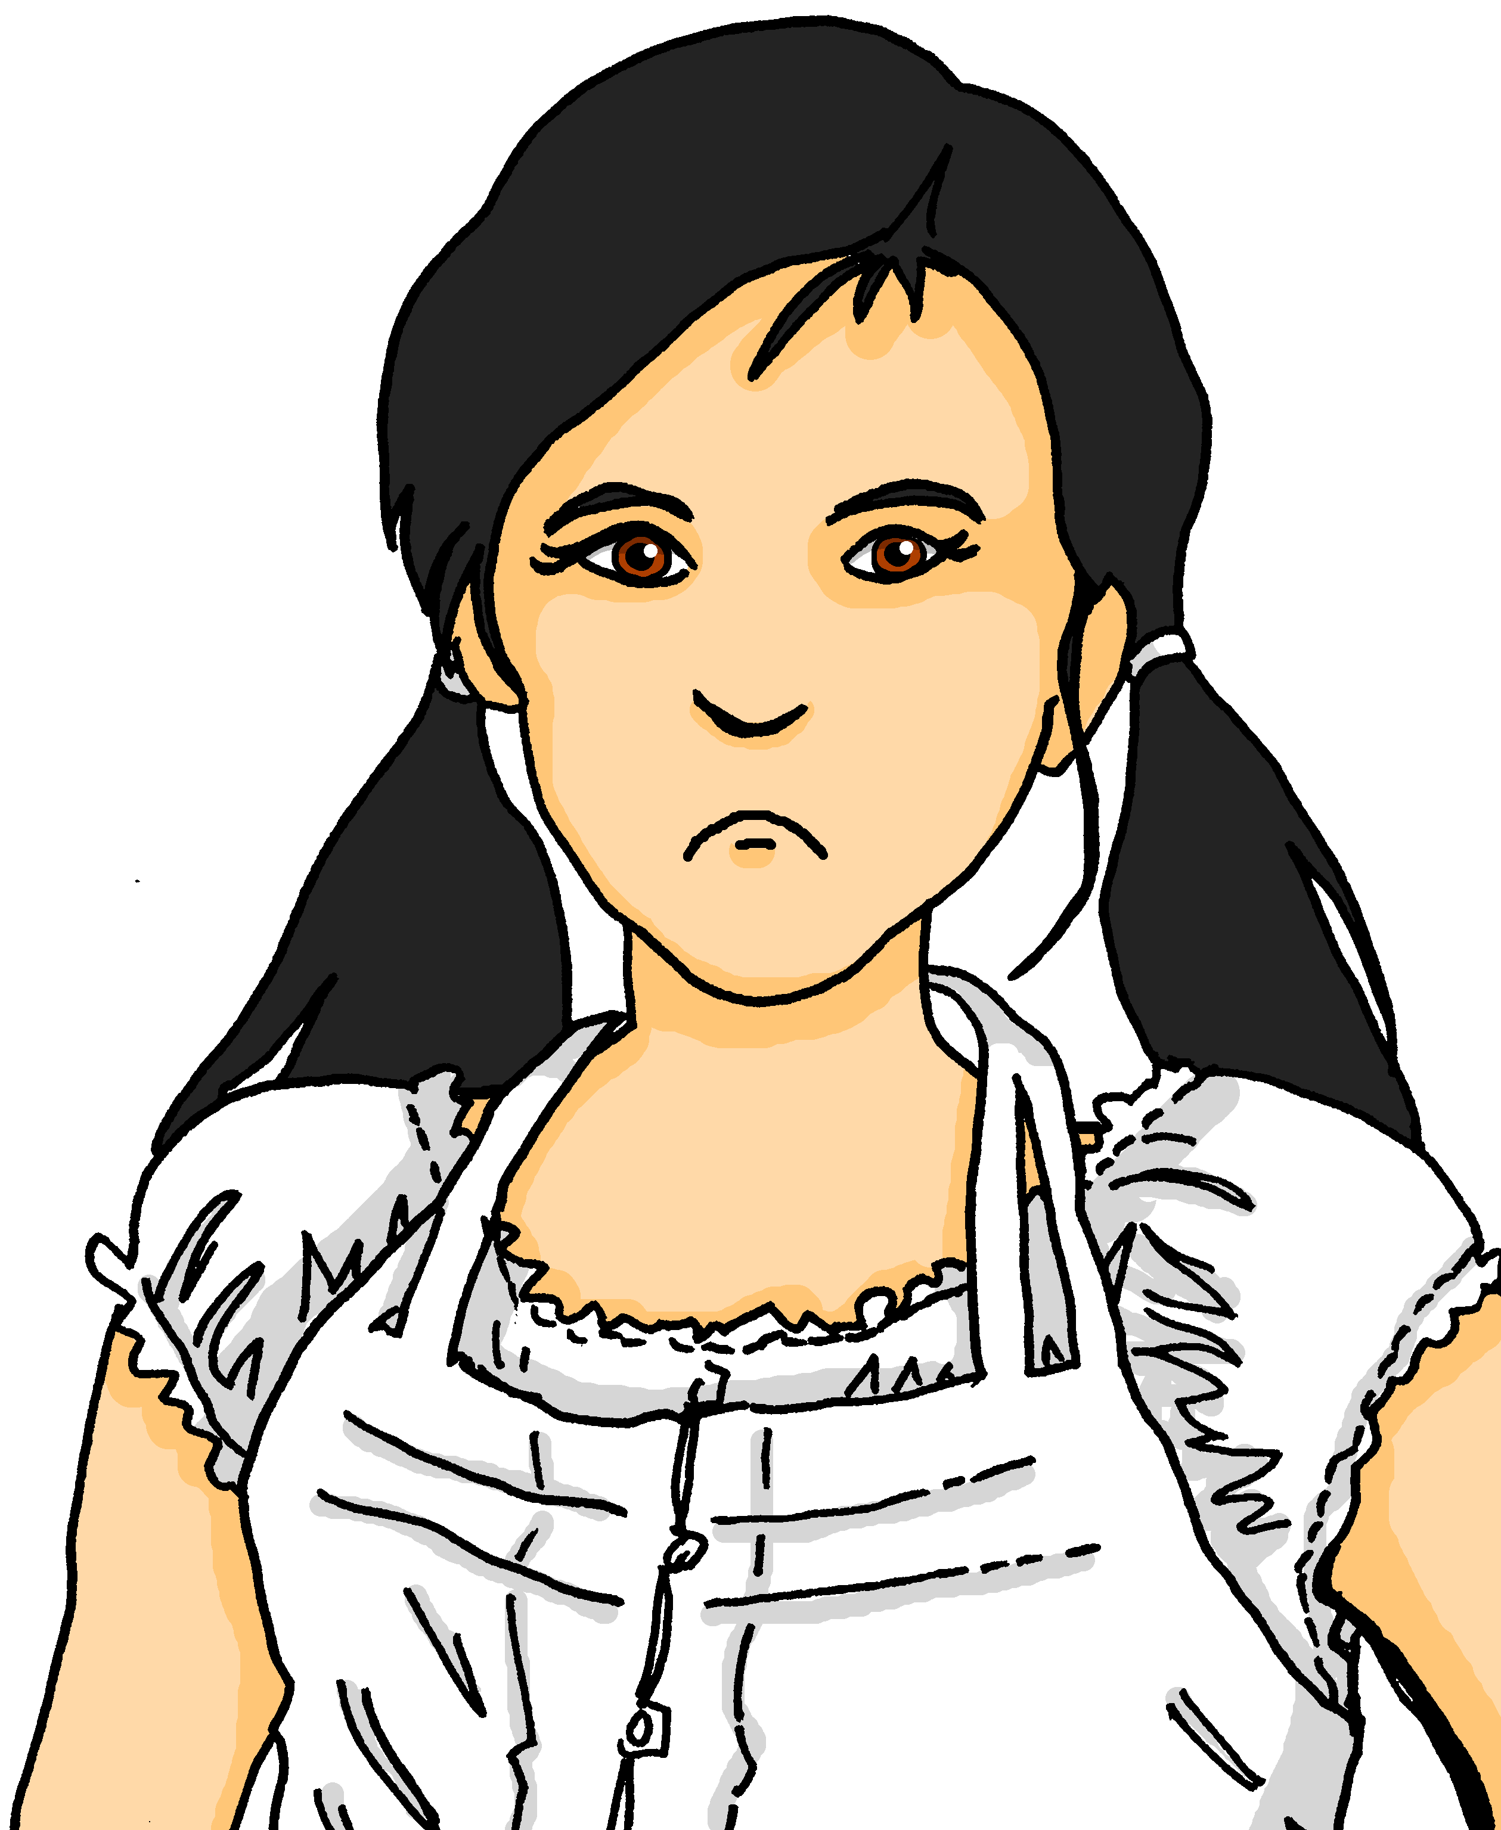
meinen | deinen
You know the masculine words for ‘the’ and ‘a’ change after most verbs:
Das ist der Rucksack.
Du hast den Rucksack.
That is the rucksack.
You have the rucksack.
Das ist ein Rucksack.
Du hast einen Rucksack.
That is a rucksack.
You have a rucksack.
This also happens for masculine forms of mein and dein:
Das ist mein Rucksack.
Du hast meinen Rucksack!
That is my rucksack.
You have my rucksack!
Feminine and neuter words for ‘the’,‘a’, ‘my’, ‘your’ do not change after a verb.
Notes:
Timing: 2 minutes
Aim: to recap the forms and uses of articles in row 1 (nominative) and row 2 (accusative), and introduce the same pattern for masculine possessive pronouns.
Procedure:
Click through the animations recap the information.
Elicit English translation for the German examples provided.
7

Slide 8
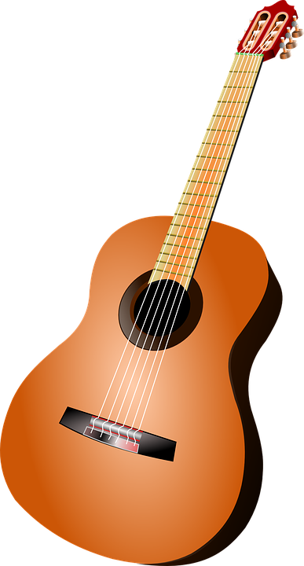
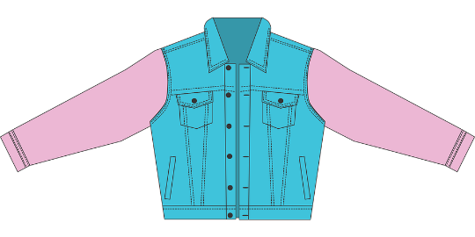
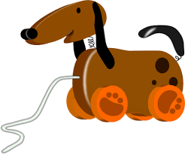
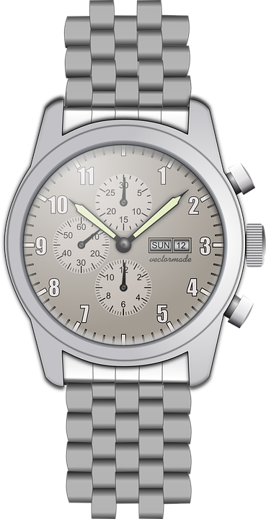
hören
Ronja und Lias packen den Rucksack
Hör zu. Was ist das? Schreib A oder B, und R (Ronja - my) oder L (Lias - your).
 | R (my) L (your) | A | B
1
2
3
 | R (my) L (your) | A | B
1
2
3
R
L
1
4
R
R
2
5
L
L
3
6
Notes:
Timing: 5 minutes
Aim: to practise aural comprehension of possessive adjectives and their connection to nouns of different genders.
Procedure:
1. Click on the first audio box to play the recording. Based on the possessive adjective, pupils write down A or B for the object, and R or L for Ronja/my and Lias/your.
2. Click to reveal the answer tick for the object that Ronja is looking for. Complete sentence audio is attached to each answer tick.
3. Click again to reveal R or L.
4. Continue for items 2-6.
Transcript:
Lias, hast du meine [Jacke]?
Findest du meinen [Fußball], bitte?
Hier habe ich dein [Handy].
Ich packe jetzt deinen [Hund].
Ich finde meine [Tasche] nicht!
Siehst du deinen [Brief]?
8

Slide 9
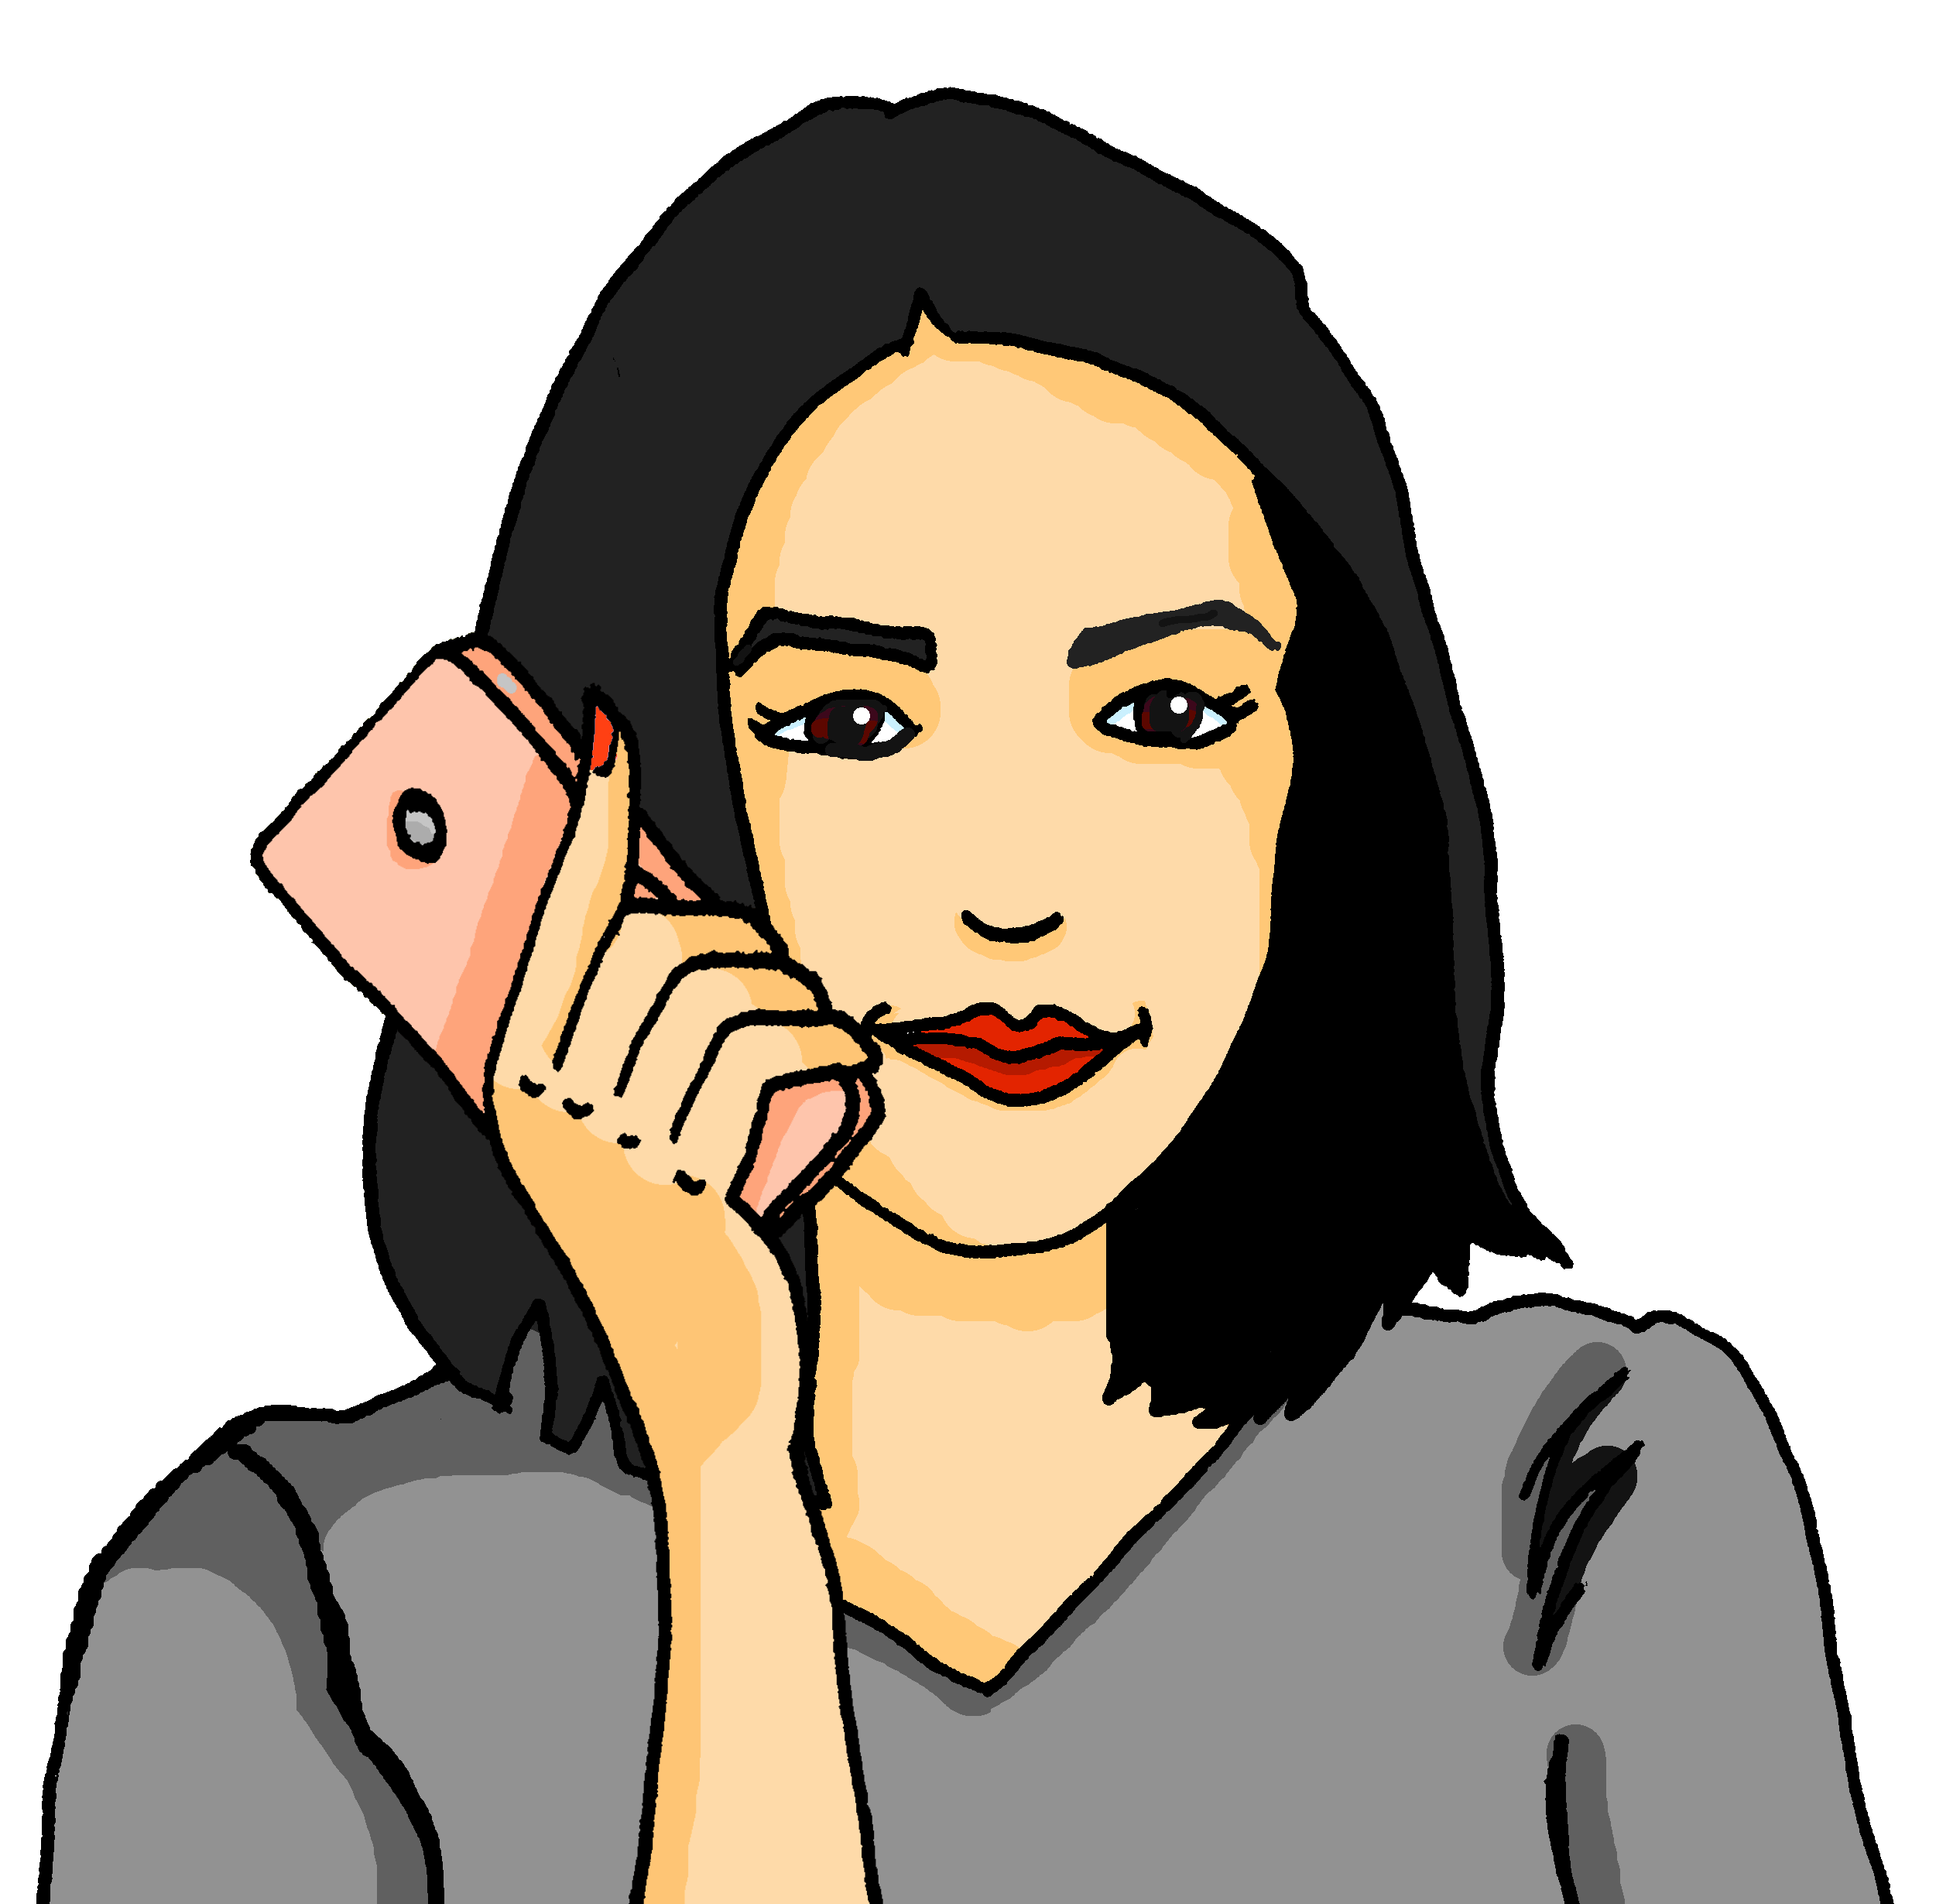
lesen
Mutti bekommt viele SMS* von Ronja.
die SMS – text message
Ist es mein oder meinen?
1
Mutti, wo ist mein Rucksack?
mein
meinen
2
4
mein
mein
Siehst du meinen Ball?
Hast du meinen Bleistift?
meinen
meinen
3
5
mein
Wo ist mein
Brief von Johanna?
mein
Du hast meinen Kuchen, nicht wahr?
meinen
meinen
Notes:
Timing: 5 minutes
Aim: to practise written comprehension of Row 1 and Row 2 masculine nouns by focussing on the possessive adjective ending.
Procedure:
Pupils write 1-5 and the correct option from the two options given – mein or meinen.
Click to reveal answers.
9

Slide 10
Tschüss!
blau
Notes:
10

