Slide 1
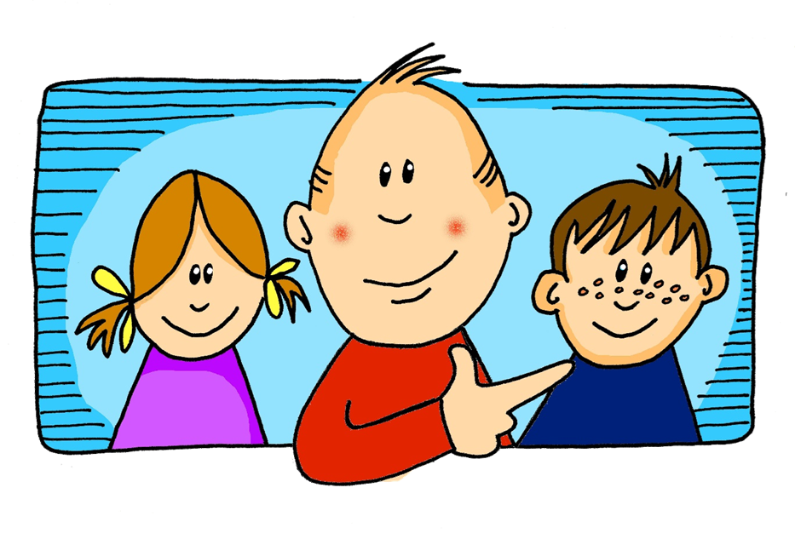
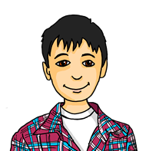
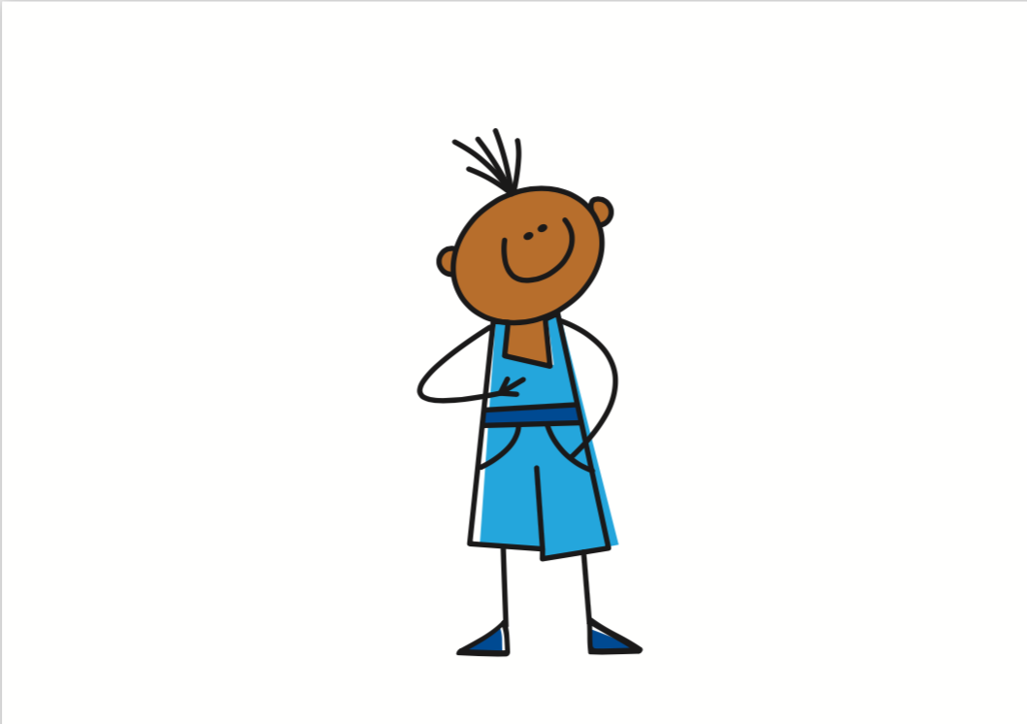
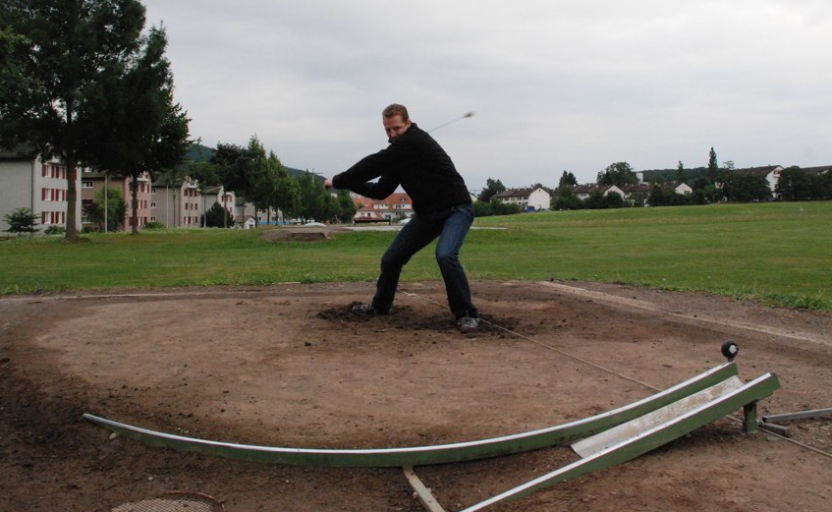
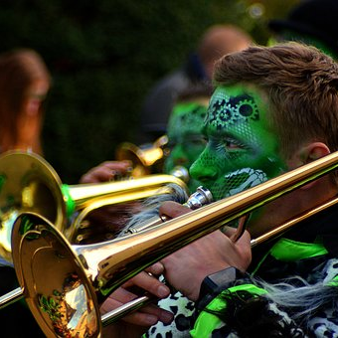
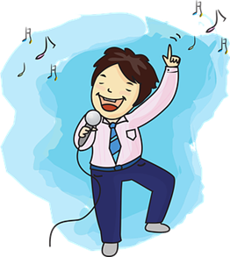
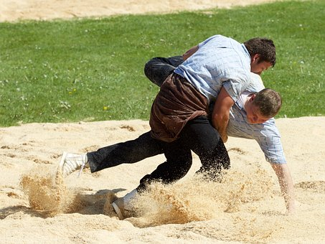
Rot Knowledge Organiser - Autumn Term A
Monate
Januar – January
Februar - February
März – March
April – April
May – May
Juni – June
Juli – July
August – August
September – September
Oktober – October
November – November
Dezember – December
Tage
Montag – Monday
Dienstag – Tuesday
Mittwoch – Wednesday
Donnerstag – Thursday
Freitag – Friday
Samstag – Saturday
Sonntag – Sunday
Things and people
der Geburtstag – birthday (m)
der Monat – month (m)
der Satz – sentence (m)
der Tag – day (m)
die Frage – question (f)
die Antwort – answer (f)
die Woche – week (f)
Useful words
schwimmen – to swim, swimming
sitzen – to sit, sitting
tanzen – to dance, dancing
wiederholen – to repeat, repeating
heute – today
morgen – tomorrow
wann? – when?
neben – next to, beside
Phonics
 | [v] | [w] | consonantal [r] | vocalic [r]
…
vier
Welt
rot
Ort
stressed [er] | unstressed [er] | [-ig]
er
Many German-speaking children learn which months have 31 days by using their knuckles!
wieder
richtig
Mai (31)
März (31)
April
Juni
Oktober (31)
Februar
Juli (31)
September
November
Januar (31)
August (31)
Dezember (31)
Present tense German has one present tense, but English has two: Ich wiederhole die Frage I repeat the question I am repeating the question | Time adverbs The time adverb suggests which English present tense to use: Ich sitze montags neben Lukas. I sit next to Lukas on Mondays. Du sitzt heute neben Moritz. You are sitting next to Moritz today. | Word order In German the time adverb often comes straight after the verb.
Nicht + verb We use nicht after a verb to say what we don’t do: | Nicht + noun phrases When nicht negates a whole noun phrase, it goes to the end of the phrase: | Wann questions
Ich lerne freitags Deutsch.
In English, the time adverb often comes at the end of the sentence.
I learn German on Fridays.
Hornussen is a traditional Alpine sport. It is a combination of golf and baseball.
Use wann to ask when:
Ich schwimme nicht.
Wann hast du Geburtstag?
Ich singe das Lied nicht.
When is your birthday?
In many parts of Germany, Karneval celebrations are a highlight of the year. Karneval is an opportunity to celebrate together before Lent.
Schwingen is an Alpine wrestling sport.
I don’t swim.
I don’t sing the song.
Note the word order difference between English and German!
Again, note the word order difference between English and German!
This actually means ‘When do you have birthday?’

Slide 2
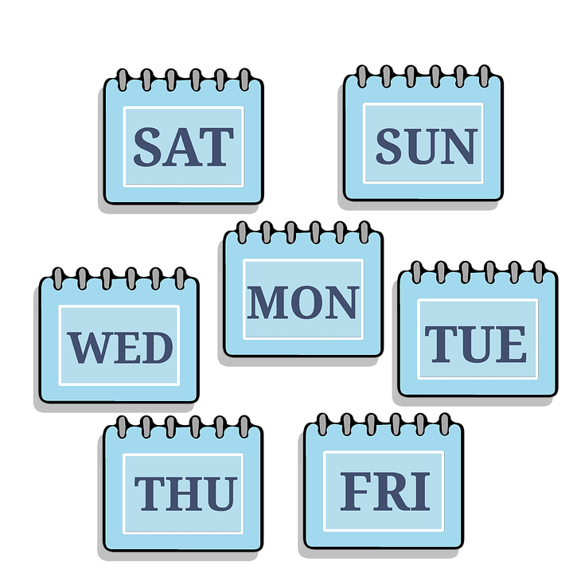
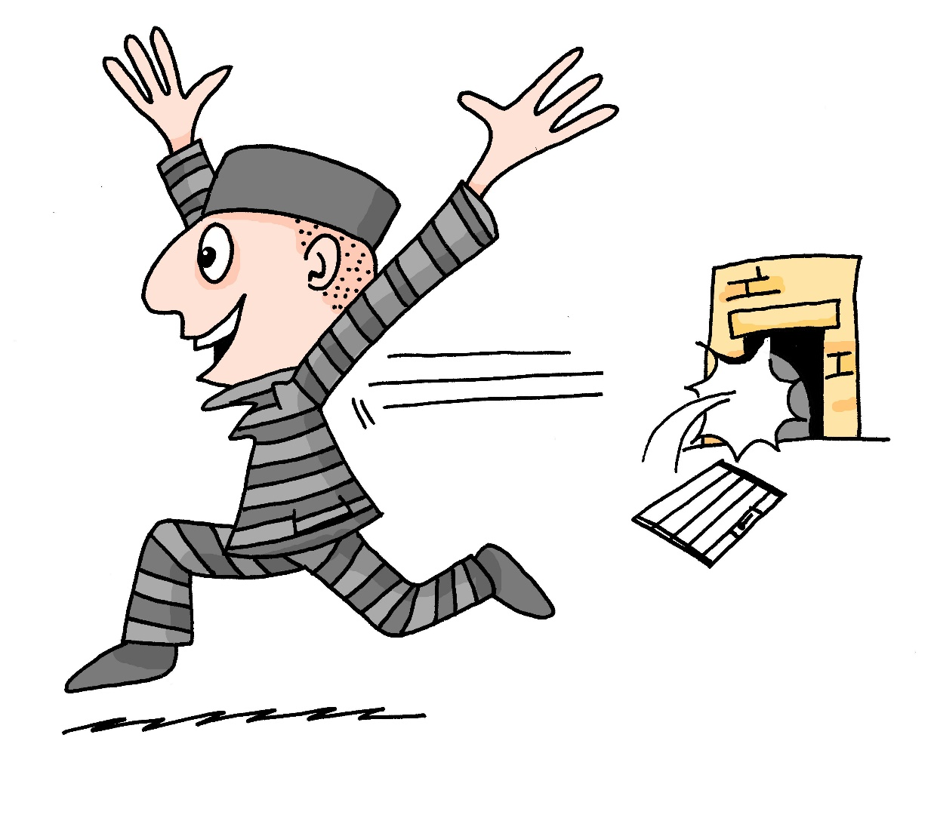
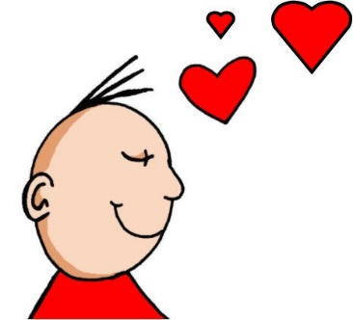
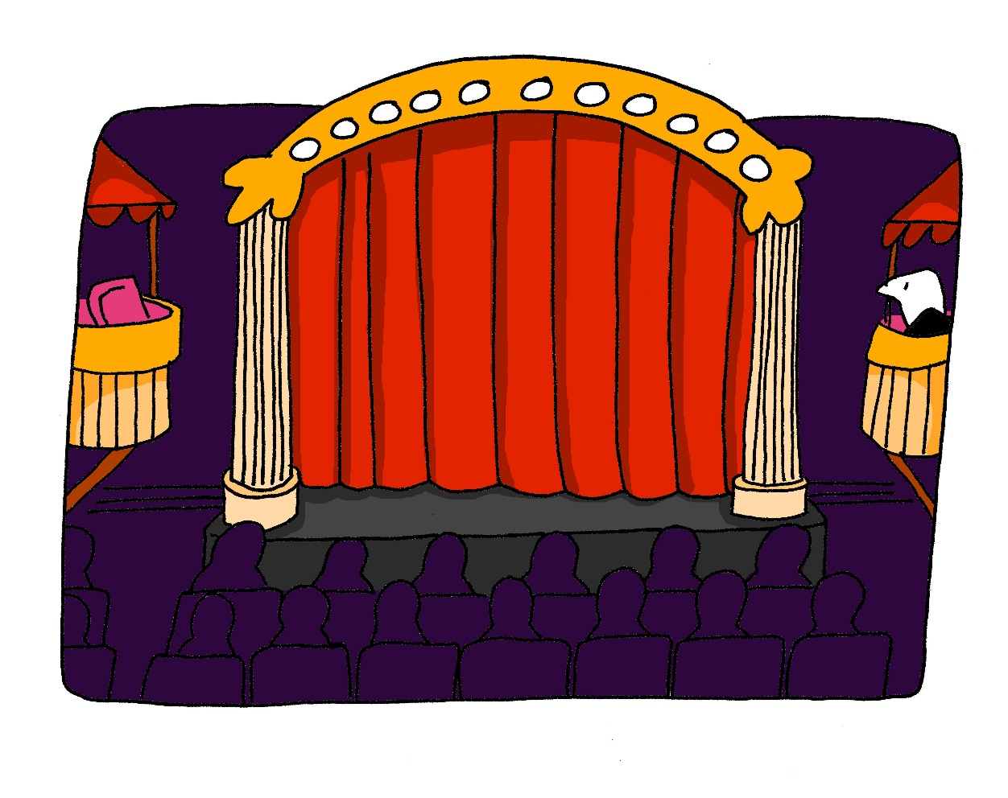
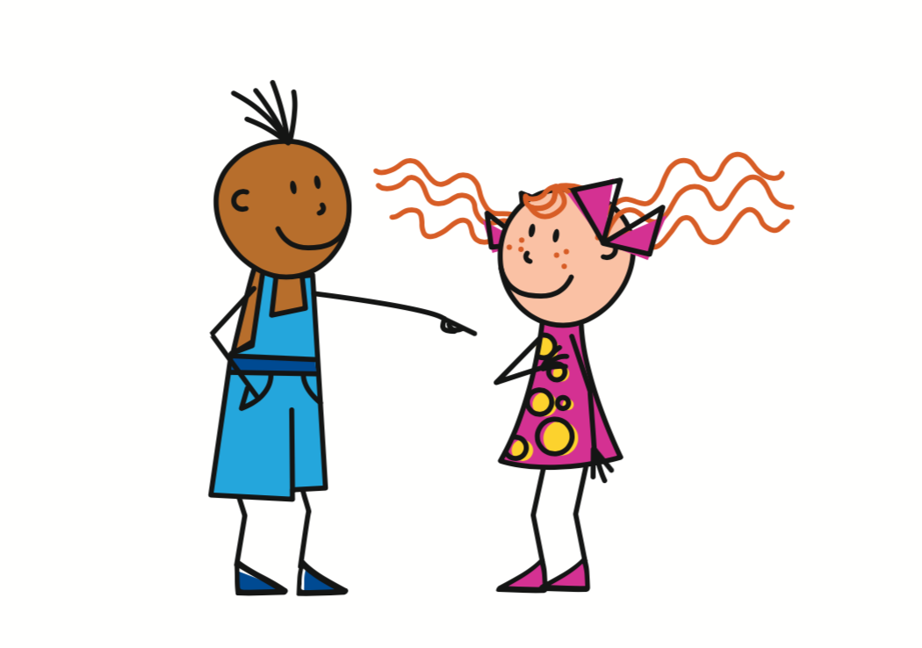
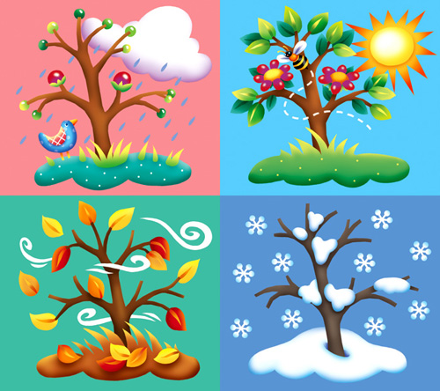
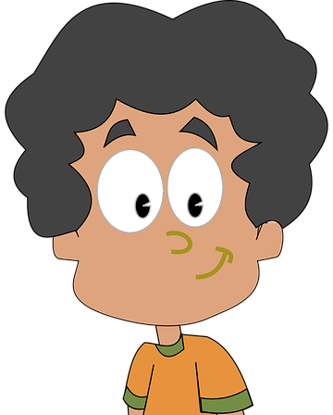
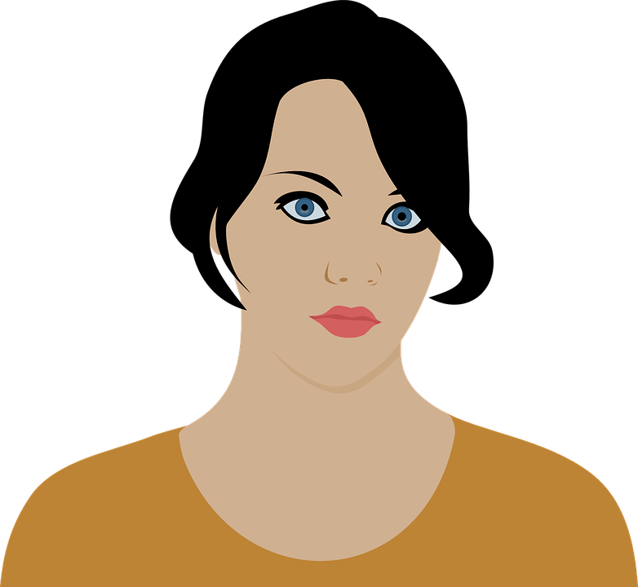
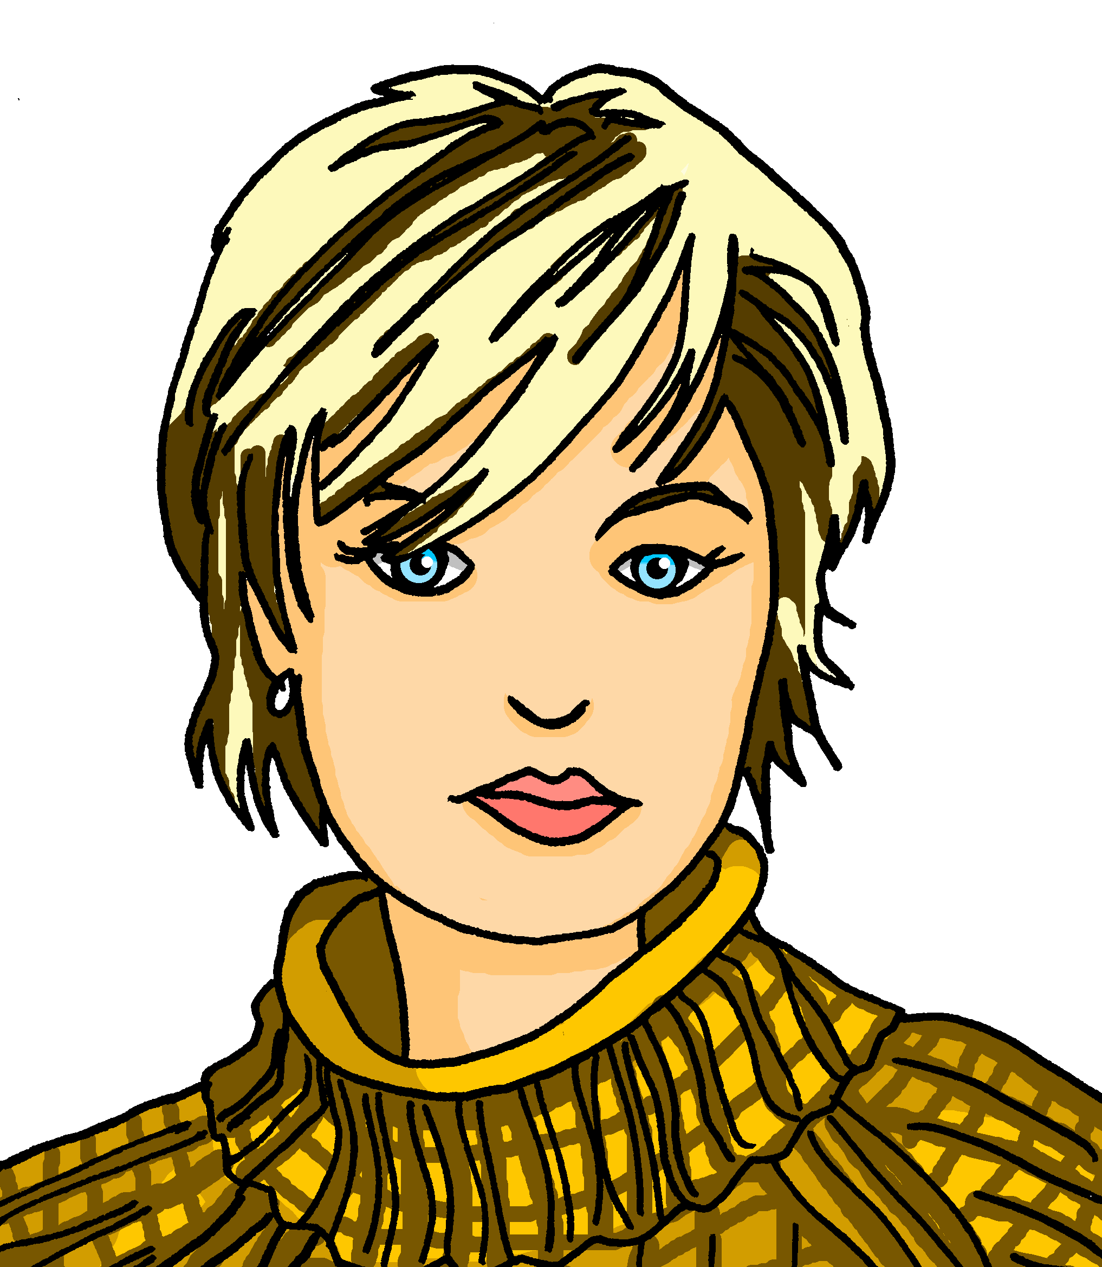
Rot Knowledge Organiser - Autumn Term B
More useful words
heißen – to be called
helfen – to help, helping
können – to be able to, can
ich kann – I can
du kannst – you can
er kann – he can
sie kann – she can
es kann – it can
wohnen – to live, living
etwas – something
People and things
der Bruder – brother (m)
der Vater – father (m)
die Mutter – mother (f)
die Schwester – sister (f)
das Instrument – instrument (n)
das Jahr – year (n)
Describing things
ihr - her
sein - his
alt – old
freundlich – friendly
jung – young
nett – nice
Phonics
[-g] | [-d] | [-b] | [-tion] | [z]
Tag
and
gelb
Information
und
Zug
[ei] | [ie] | [th]
frei
Liebe
Theater
To ask someone how old they are in German say ‘wie alt bist du?’
To say how old you are in German say ‘ich bin xxx Jahre alt’
Ich bin drei Jahre alt.
I am three years old.
Saying what you can do with können | Using können To say what you can do use the verb können and a 2nd verb in the infinitive form. Ich kann singen. I can sing. The 2nd verb always goes to the end of the sentence: Ich kann ein Lied singen. I can sing a song. | Können and yes/ no questions In German we can swap the subject and verb to ask a question. We do the same with können.
ich kann
I can
es kann
du kannst
Du kannst singen.
You can sing.
it can
können
you can
German versions of English-language films often have German names.
Kannst du singen?
Can you sing?
sie kann
er kann
she can
he can
Note that the verb kannst swaps with the subject du.
Können and information questions We also swap the subject and verb with information questions. | Können, nicht, kein To say what you cannot/can’t do use nicht before the 2nd verb. | Possessive adjectives sein|ihr To say ‘his’ use sein or seine. To say ‘her’ use ihr or ihre:
Findet Nemo
Oben
Die Monster-AG
Er kann nicht singen.
masculine
feminine
neuter
He can’t sing.
ihr
ihre
ihr
Wo kannst du singen?
sein
seine
sein
Ich heiße Mia, Emma, Hannah
Ich heiße Ben, Jonas, Paul
Ich heiße Julia, Katharina, Stefanie
Ich heiße Tobias, Christian, Sebastian
But remember that to negate nouns you need kein instead:
The words ‘sein’ (his) and ‘ihr’ (her) must agree with the gender of the noun that follows. E.g.:
Where can you sing?
Er kann kein Lied singen.
He can’t sing a song.
ihre Mutter (f)
These names are popular in Germany.
her mother
Notes:
Image attribution:
Monsters Inc. poster By http://eu.movieposter.com/poster/MPW-48844/Monsters_Inc_.html, Fair use, https://en.wikipedia.org/w/index.php?curid=982187
Finding Nemo poster By © 2003 Disney/Pixar. All Rights Reserved., Fair use, https://en.wikipedia.org/w/index.php?curid=34252717

