Slide 1
Describing me and others
Hallo!
Guten Morgen!
gelb
Follow ups 1-5
Term 1 Week 1
Notes:
Artwork by Steve Clarke. Pronoun pictures from NCELP (www.ncelp.org). All additional pictures selected from Pixabay and are available under a Creative Commons license, no attribution required.
Phonics:
long [a] ja [45] da [239] Tag [111]
short [a] hallo [1077] danke [877] was? [38]
Vocabulary: ich [10] er [15] sie [7] sein, bin, ist [4] da [239] hier [68] Hallo [1077] Guten Morgen [n/a]
Jones, R.L & Tschirner, E. (2019). A frequency dictionary of German: Core vocabulary for learners. London: Routledge.
The frequency rankings for words that occur in this PowerPoint which have been previously introduced in these resources are given in the SOW and in the resources that first
introduced and formally re-visited those words.
For any other words that occur incidentally in this PowerPoint, frequency rankings will be provided in the notes field wherever possible.

Slide 2
Follow up 1: Listen and read aloud.
Tag = day auch = also
klar = clear
Hallo! Guten Tag!
Ist Frank da?
aussprechen
Ja, Herr Lehmann, er ist da.
Lias
Hallo, Herr Lehmann, ich bin Lara, und ich bin auch da!
Danke Lara,
das ist klar!
Lara
Notes:
Timing: 5 minutes
Aim: to practise applying knowledge of long and short [a] to mostly previously taught words.
Procedure:
1. Click each speech bubble to play the audio recording of each part of the dialogue.
2. Pupils read aloud after each part, paying particular attention to short and long a-sounds.
3. Pupils could have a print out of the dialogue (see end of the PPT for b/w version) and colour the [a]s in 2 colours: one colour for long [a], one colour for short [a].
Frequency: Tag [111] auch [18] klar [239]
Jones, R.L & Tschirner, E. (2019). A frequency dictionary of German: Core vocabulary for learners. London: Routledge.

Slide 3
Follow up 2: long and short [a]
German [a] can be short or long.
aussprechen
It is short when followed by more than one consonant, e.g. Herr Lehmann, Gast (guest).
It is long when:
there is a double vowel, e.g. Paar (pair).
or when followed by the letter ‘h’, e.g. Jahr (year),
or by a single consonant, e.g. sagen (to say)
Notes:
Timing: 1 minute
Aim:
Explanation of long and short [a] and how it is formed
Procedure:
Click through the animations.
Frequency: Gast [576] Paar [241] Jahr [53] sagen [40]
Jones, R.L & Tschirner, E. (2019). A frequency dictionary of German: Core vocabulary for learners. London: Routledge.

Slide 4
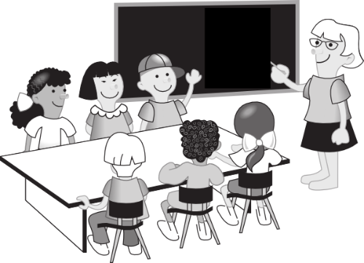
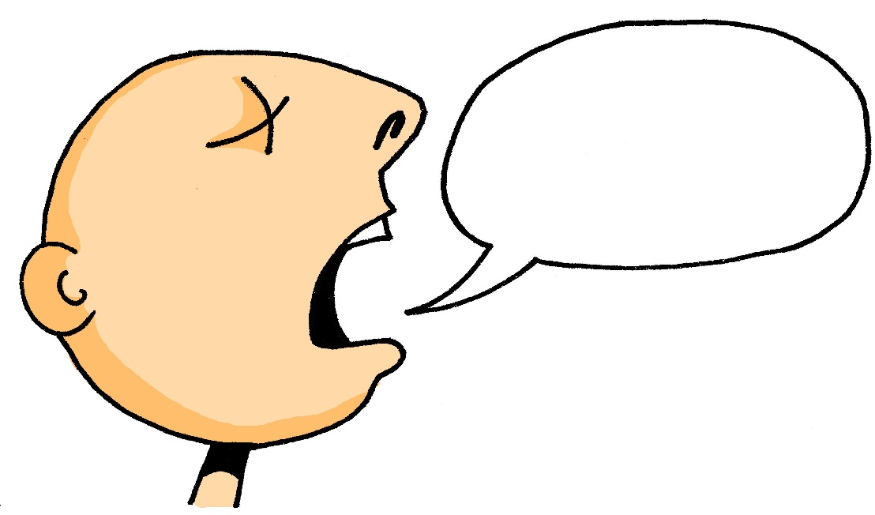
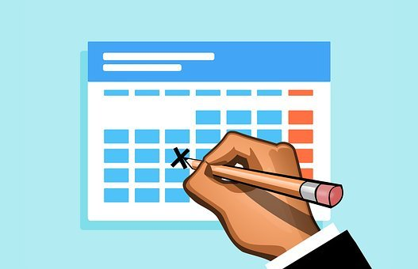
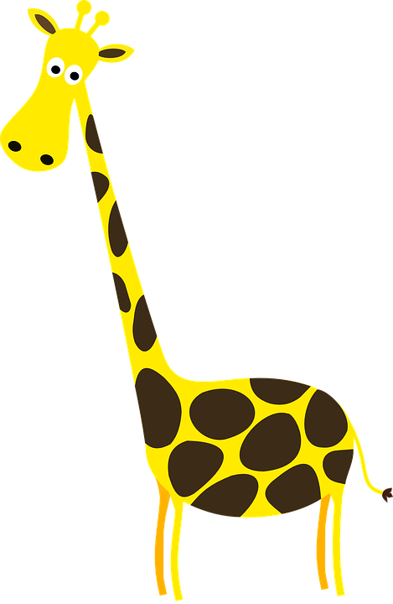
Follow up 2: Sag die Wörter.
aussprechen
klar
Klasse
60
sagen
da
ja
Tag
Mann
S
was?
Ball
Hallo
lang
danke
0
START
Notes:
Timing: 5 minutes
Aim: to practise applying knowledge of long and short [a] to known and unknown words.
Procedure: 1. Start the timer. Pupil A tries to read aloud all of the words paying attention to the short or long a, within the 60 seconds allowed.
2. Pupil B listens. If Pupil A says the wrong length [a] by mistake, Pupil B can direct him/her to start again from the beginning. 3. They swap roles and repeat the task.
Frequency:
klar [239] sagen [40] Klasse [961] Mann [121] Ball [1782] lang [97] ja [45] da [239] Tag [111] hallo [1077] danke [877] was? [38]
Jones, R.L & Tschirner, E. (2019). A frequency dictionary of German: Core vocabulary for learners. London: Routledge.

Slide 5
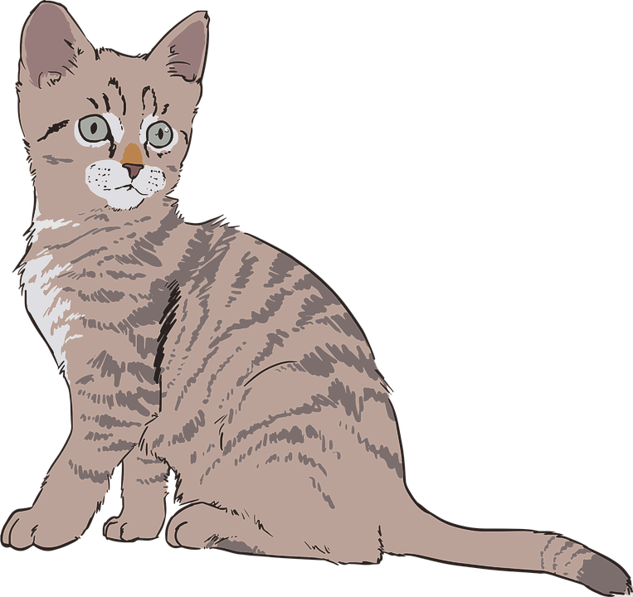
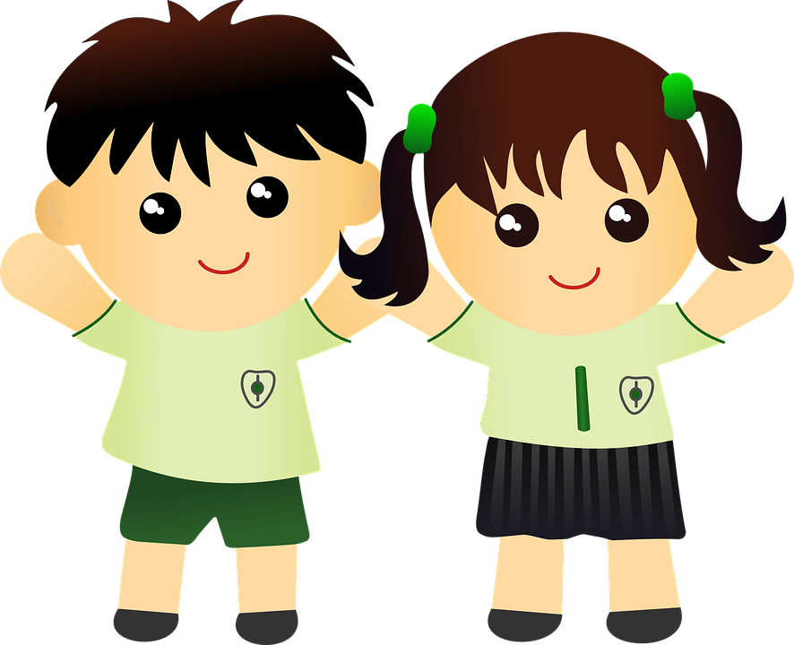
Follow up 3
Hör zu. Which is the odd one out?
1 | Mann | schlafen | dann
2 | da | Tag | Hallo
3 | Karte | Katze | fahren
4 | Wald | Partner | Abend
then
Notes:
Timing: 5 minutes
Aim: to practise aural distinction of long and short [a] sounds.
Procedure:
Use the first row as an example. Click on each picture/ translation to listen to each word.
Pupils listen and decide which of the three words is the odd one out, based on long and short [a].
Click to reveal answers.
Repeat for the next 3 rows.
Note:
For a less challenging exercise, click on each individual picture and ask pupils to identify whether they hear a long or short [a].
Frequency:
Mann [121] da [239] Tag [111] hallo [1077] schlafen [679] dann [41] Karte [1474] Katze [2235] fahren [215] Wald [1028] Partner [1172] Abend [342]
Jones, R.L & Tschirner, E. (2019). A frequency dictionary of German: Core vocabulary for learners. London: Routledge.

Slide 6
Follow up 4
Ja (yes) and nein (no).
Wörter
Vokabeln
Ja!
Nein!
Notes:
Timing: 5-10 minutes (two slides)
Aim: to recap the meaning and pronunciation of ‘ja’ and introduce ‘nein’.
Procedure:
Click to present ‘ja’ and elicit repetition from pupils. Clarify meaning = yes.
Click to present ‘nein’ and elicit repetition from pupils. Clarify meaning = no.
Use gestures to elicit ‘ja’ and ‘nein’ several times.

Slide 7
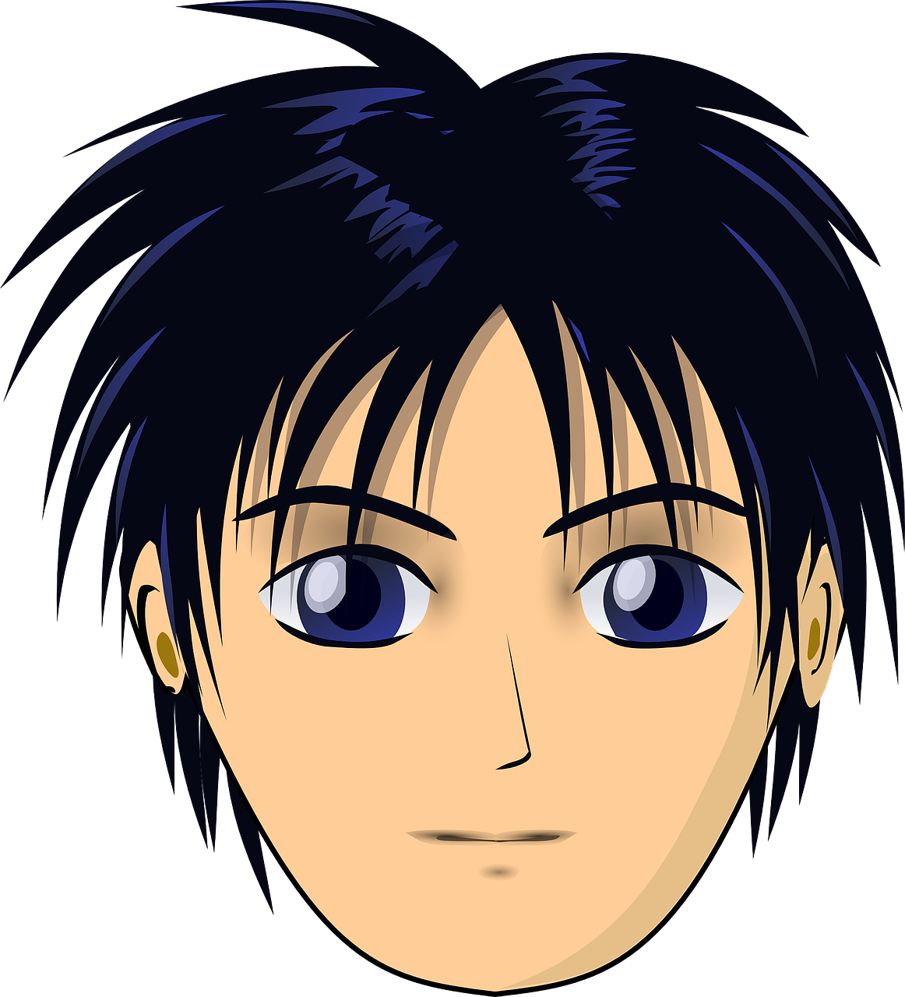
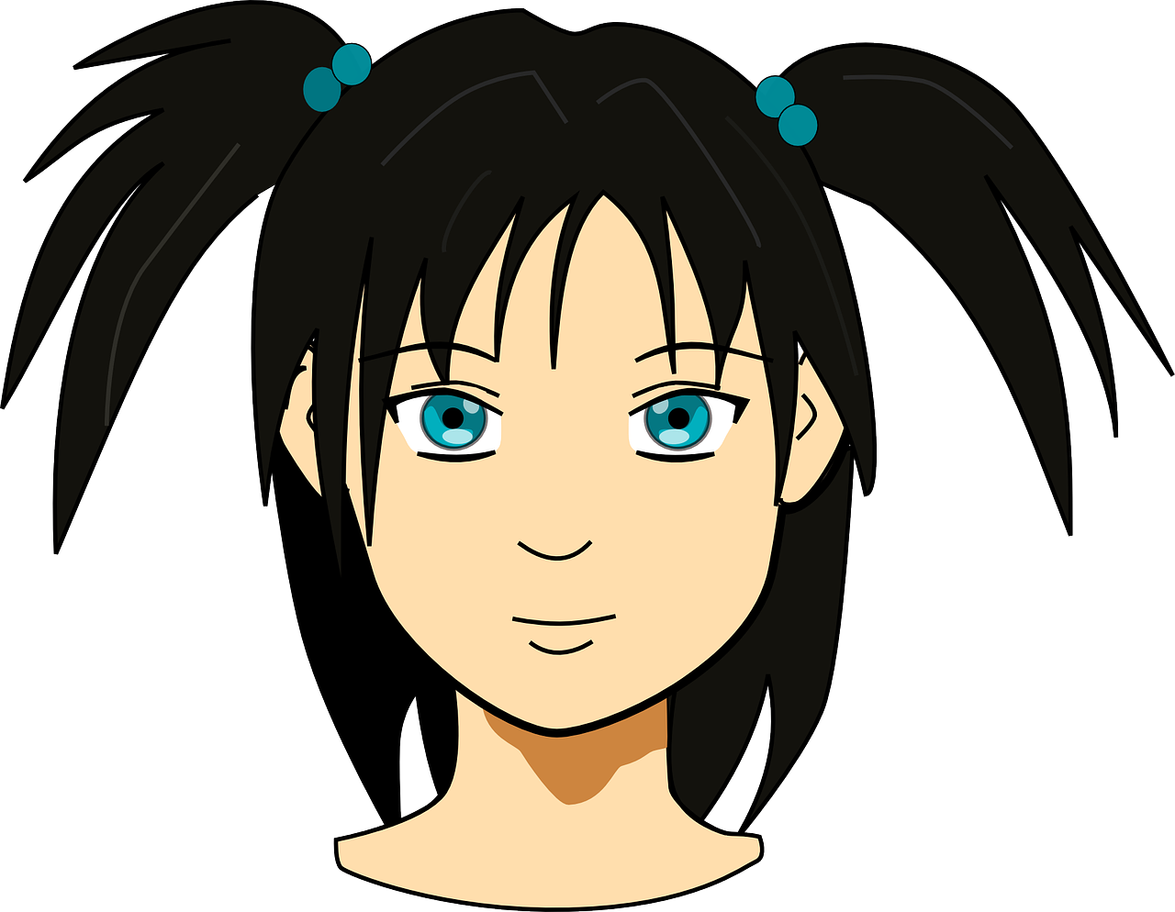
Follow up 4
Ja!
Nein!
Ich bin Lea.
…
Make statements to find out who you are in less than one minute.
Max | Karl | Sabrina | Nina
Vanessa | Astrid | Lara | Marco
Fabian | Annika | Pascal | Omar
Ali | Karola | David | Lars
sprechen
60
S
0
START
Notes:
Timing: 5 minutes
Aim: to practise pronunciation of long and short [a] sounds in a short sentence; to practise pronunciation of ‘ich bin’; to practise use of ‘ja’ and ‘nein’ in a communicative context.
Procedure:
The teacher models the activity by asking a pupil to select a sticker and putting on his/her back. S/he shows the class briefly and then says ‘Ich bin XXX’ statements with all the names until the pupils say ‘Ja’. When the name is wrong they say ‘Nein’.
Teacher puts sticker or post-it with one of the names on each pupil’s back.
Pupils circulate in the room. Each pupil they meet they have one chance to guess their own identity, saying ‘Ich bin XXX’.
The listening pupil checks the sticker and says either ‘ja’ or ‘nein’.
Pupils have to try to find out their identity in less than one minute.
Swap stickers and repeat the activity.
Note: The teacher can develop the activity by eliciting naming of pupils by other pupils. E.g. Sie ist Lara. Er ist Omar.

Slide 8
Follow up 5:

Schreib auf Englisch.
Can you get at least 8 points?
Wörter
 | ja | nein | Hallo
 | da | hier | Guten Morgen
 | sein | bin | ist
 | ich | er | sie
Vokabeln
yes
no
hello / hi
there
here
Good morning
to be /being
am
is
I
he
she
Notes:
Timing: 5 minutes
Aim: to practise written comprehension of vocabulary from this week.
Procedure: 1. Give pupils a blank grid. They fill in the English meanings of any of the words they know, trying to reach at least 8 points in total.

Slide 9
Follow up 5:

Schreib auf Deutsch.
Can you get at least 8 points?
Wörter
 | no | here | yes
 | hello/hi | Good morning | there
 | she | is | he
 | I | to be, being | am
Vokabeln
nein
hier
ja
Hallo
Guten Morgen
da
sie
ist
er
ich
sein
bin
Notes:
Timing: 5 minutes
Aim: to practise written production of vocabulary from this week.
Procedure: 1. Give pupils a blank grid. They fill in the German meanings of any of the words they know, trying to reach at least 8 points in total.

Slide 10
Tschüss!
gelb
Notes:
10

Slide 11
Follow up 1: Listen and read aloud.
Tag = day auch = also
klar = clear
Hallo! Guten Tag!
Ist Frank da?
aussprechen
Ja, Herr Lehmann, er ist da.
Lias
Hallo, Herr Lehmann, ich bin Lara, und ich bin auch da!
Danke Lara,
das ist klar!
Lara
Notes:
HANDOUT

Slide 12
Follow up 5:

Schreib auf Englisch.
Can you get at least 8 points?
Wörter
 | ja | nein | Hallo
 | da | hier | Guten Morgen
 | sein | bin | ist
 | ich | er | sie
Vokabeln
Notes:
HANDOUT

Slide 13
Follow up 5:

Schreib auf Deutsch.
Can you get at least 8 points?
Wörter
 | no | here | yes
 | hello/hi | Good morning | there
 | she | is | he
 | I | to be, being | am
Vokabeln
Notes:
HANDOUT

