Slide 1
Describing me and others
Hallo!
Guten Morgen!
rot
Follow ups 1-5
Term 1 Week 2
Notes:
Artwork by Steve Clarke. Pronoun pictures from NCELP (www.ncelp.org). All additional pictures selected from Pixabay and are available under a Creative Commons license, no
attribution required.
Phonics:
long [u] du [54] gut [76] super [1772]
short [u] Punkt [248] Nummer [806] dunkel [706]
Vocabulary: du [54] bist [4]
Jones, R.L & Tschirner, E. (2019). A frequency dictionary of German: Core vocabulary for learners. London: Routledge.
The frequency rankings for words that occur in this PowerPoint which have been previously introduced in these resources are given in the SOW and in the resources that first
introduced and formally re-visited those words.
For any other words that occur incidentally in this PowerPoint, frequency rankings will be provided in the notes field wherever possible.
Note that the first three lessons of the year teach language that can be continuously recycled as lesson routine every lesson in Y3/4.
The idea would be that the class teacher (whether or not s/he teaches the class German can re-use the language as part of the daily routine with the class.

Slide 2
Follow up 1
Hör zu. Find the hidden picture!
hören
A Listen. Write the word that is mentioned. B Write the English translation.
1
 | 1 | 2 | 3
A
B
C
2
are
Good morning
yes
bist
Guten Morgen
ja
3
Hallo! Ich bin Lias.
4
is
you
to be, being
ist
du
sein
Du bist Ronja.
5
6
she
no
he
sie
nein
er
7
8
9
Notes:
Timing: 5 minutes
Aim: to practise aural comprehension of this week’s new vocabulary; written comprehension
Procedure:
Click on an audio button to listen. Pupils write down the German word they have heard. They then write down the English translation. Teacher asks pupils which word they have heard. If the pupils answer correctly, the teacher then asks for the English translation. If the pupils answer correctly, the teacher double clicks on the German word and the English translation to make them disappear, revealing part of the hidden picture below.
Repeat for the remaining nine items.
Pupils read the speech bubbles in the hidden picture, and chorally translate into English.
Transcript: 1. er
2. du
3. Guten Morgen
4. sie
5. bist
6. nein
7. ja
8. sein
9. ist

Slide 3
Follow up 2: long and short [u]
German [u] can be short or long.
aussprechen
It is short when followed by more than one consonant, e.g., Nummer (number), Punkt (dot, full stop).
It is long when it comes after a single consonant e.g. du
or, when
followed by the letter ‘h’, e.g., Frau Kuhl
or by a single consonant, e.g., gut (good).
Notes:
Timing: 1 minute
Aim: to explain long and short [u] sounds.
Procedure:
Click through the animations, clicking also on the audio buttons to hear each word.

Slide 4
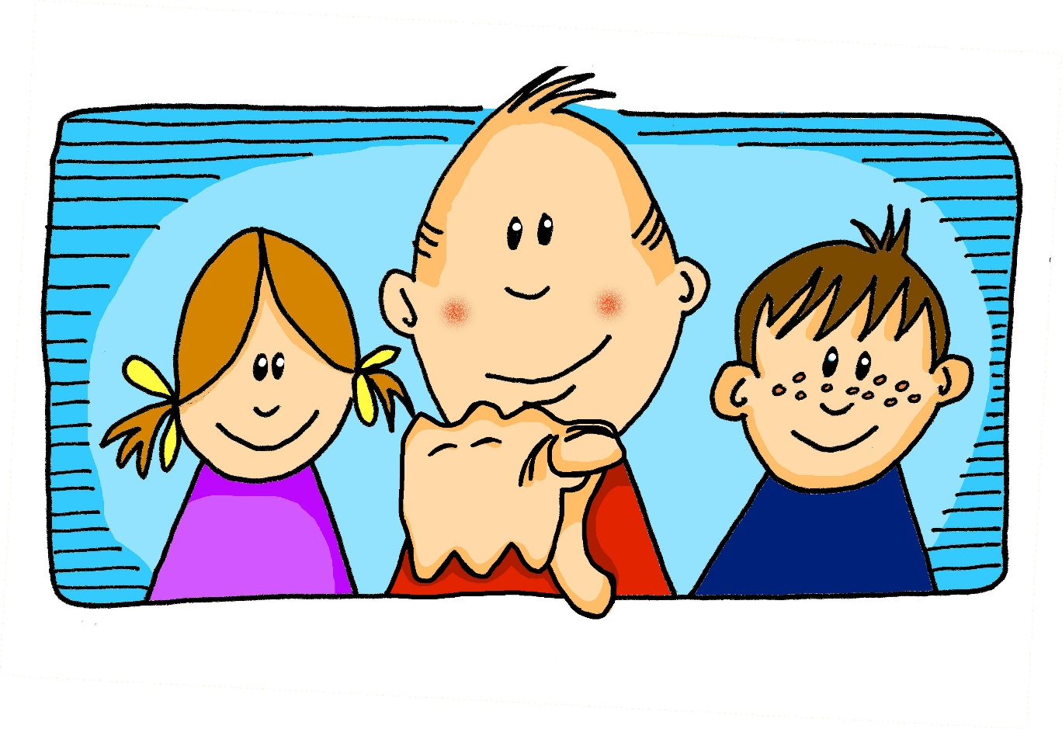
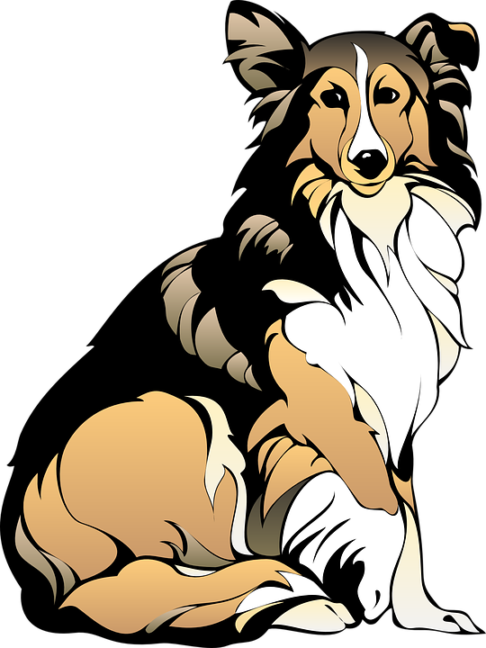
Follow up 2
[a] oder* [u]?
Hör zu.
1
2
hören
da
du
Band
Bund
The ‘d’ sound at the end sounds more like a ’t’
3
4
Hand
Hund
lange
Lunge
5
6
Bach
Buch
Rand
rund
oder – or
Notes:
Timing: 5 minutes
Aim: to practise distinguishing between [a] and [u] in minimal pairs.
Procedure:
Click on an audio button to hear a word.
Pupils decide whether they have heard an [a] or a [u] and circle the word they have heard on their handout.
Click to reveal answers.
Click to reveal a callout.
Transcript:
da
Bund
Hund
lange
Bach
rund
Frequency:
da [48] du [54] Band [1025] Bund [1126] Hand [180] Hund [825] lang [97] Lunge [3167] Bach [>5000] Buch [300] Rand [1203] rund [296]
Jones, R.L & Tschirner, E. (2019). A frequency dictionary of German: Core vocabulary for learners. London: Routledge.

Slide 5
Follow up 3: Listen and read aloud.
auch = also
Hallo! Guten Morgen!
Ist Uschi da?
aussprechen
Ja, Frau Fuhre, sie ist da.
Susie
Hallo Frau Fuhre, ich bin Ursula, und ich bin auch da!
Danke Ursula,
das ist super!
Ursula
Notes:
Timing: 5 minutes
Aim: to practise applying knowledge of long and short [u] to mostly previously taught words.
Procedure:
1. Click each speech bubble to play the audio recording of each part of the dialogue.
2. Pupils read aloud after each part, paying particular attention to short and long a-sounds.
3. Pupils could have a print out of the dialogue (see end of the PPT for b/w version) and colour the [u]s in 2 colours: one colour for long [u], one colour for short [u].

Slide 6
Follow up 4
Bin ich Uli?
Remember that in English we swap ‘I am ‘ to ‘Am I’ to make a yes/no question:
I am Uli.
Am I Uli?
In German we do the same:
Ich bin Uli.
Bin ich Uli?
Notes:
Timing: 5 minutes
Aim: lead in grammar slide in preparation for follow up 4.
Procedure:
Click through the explanation, then click to reveal the following slide.

Slide 7
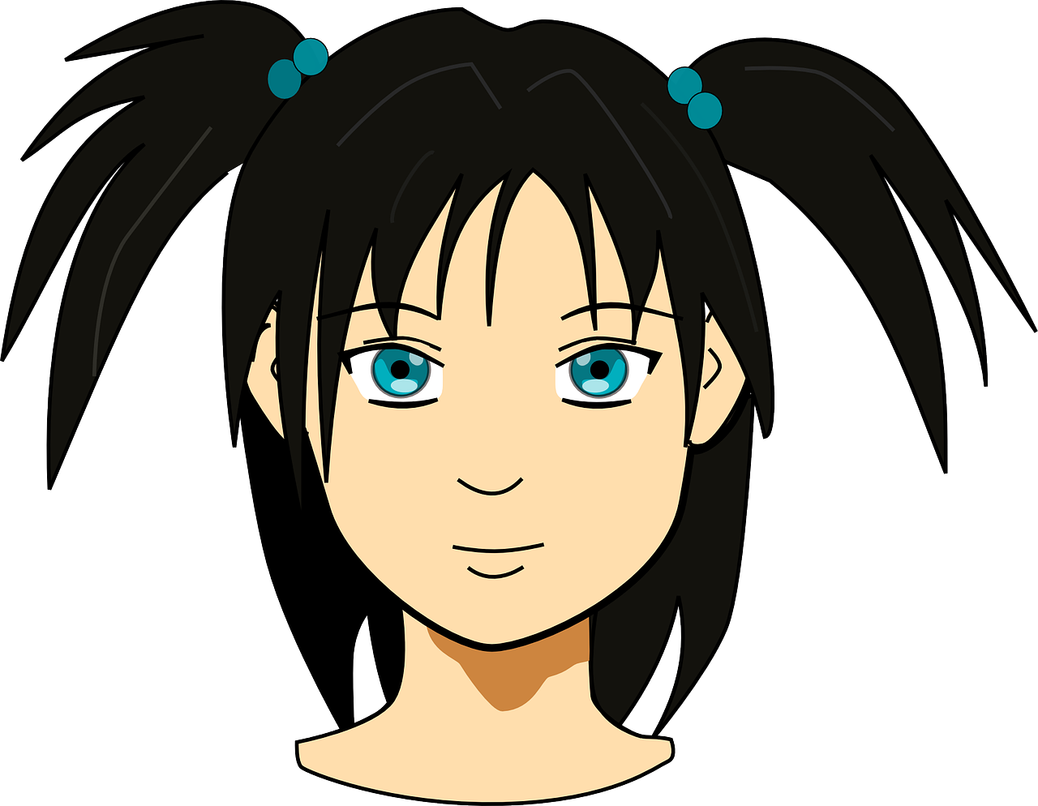
Follow up 4
Bin ich…?
Ja!
Nein!
…
Ask questions to find out who you are in less than one minute.
Bruno | Imamu | Ulrike | Trude
Ursel | Ulla | Susanne | Zuri
Luan | Munja | Gustav | Yusuf
Mustafa | Uta | Rudi | Rudolf
sprechen
60
S
0
START
Notes:
Timing: 5 minutes
Aim: to practise pronunciation of long and short [u] sounds in a short sentence; to practise pronunciation of ‘ich bin’; to practise use of ‘ja’ and ‘nein’ in a communicative context.
Procedure:
The teacher models the activity by asking a pupil to select a sticker and putting on his/her back. S/he shows the class briefly and then says ‘Ich bin XXX’ statements with all the names until the pupils say ‘Ja’. When the name is wrong they say ‘Nein’.
Teacher puts sticker or post-it with one of the names on each pupil’s back.
Pupils circulate in the room. Each pupil they meet they have one chance to guess their own identity, saying ‘Ich bin XXX’.
The listening pupil checks the sticker and says either ‘ja’ or ‘nein’.
Pupils have to try to find out their identity in less than one minute.
Swap stickers and repeat the activity.
Note: The teacher can develop the activity by eliciting naming of pupils by other pupils. E.g. Sie ist Ulla. Er ist Lukas, etc.

Slide 8
Follow up 5:

Schreibe auf Englisch.
Can you get at least 8 points?
Wörter
 | ja | nein | Hallo
 | da | hier | Guten Morgen
 | sein | ich bin | ist
 | du bist | er | sie
Vokabeln
yes
no
hello / hi
there
here
Good morning
to be /being
I am
is
you are
he
she
Notes:
Timing: 5 minutes
Aim: to practise written comprehension of vocabulary from this week.
Procedure: 1. Give pupils a blank grid. They fill in the English meanings of any of the words they know, trying to reach at least 8 points in total.

Slide 9
Follow up 5:

Schreibe auf Deutsch.
Can you get at least 8 points?
Wörter
 | no | here | yes
 | hello/hi | Good morning | there
 | she | is | he
 | I am | to be, being | you are
Vokabeln
nein
hier
ja
Hallo
Guten Morgen
da
sie
ist
er
ich bin
sein
du bist
Notes:
Timing: 5 minutes
Aim: to practise written production of vocabulary from this week.
Procedure: 1. Give pupils a blank grid. They fill in the German meanings of any of the words they know, trying to reach at least 8 points in total.

Slide 10
Tschüss!
gelb
Notes:
10

Slide 11
Follow up 2
Hör zu.
[a] oder* [u]?
1
2
hören
Da
Du
Band
Bund
3
4
Hand
Hund
lange
Lunge
5
6
Bach
Buch
Rand
Rund
oder – or
Notes:
HANDOUT

Slide 12
Follow up 3: Listen and read aloud.
auch = also
Hallo! Guten Morgen!
Ist Uschi da?
aussprechen
Ja, Frau Fuhre, sie ist da.
Susie
Hallo Frau Fuhre, ich bin Ursula, und ich bin auch da!
Danke Ursula,
das ist super!
Ursula
Notes:
HANDOUT

Slide 13
Follow up 5:

Schreibe auf Englisch.
Can you get at least 8 points?
Wörter
 | ja | nein | Hallo
 | da | hier | Guten Morgen
 | sein | ich bin | ist
 | du bist | er | sie
Vokabeln
Notes:
HANDOUT

Slide 14
Follow up 5:

Schreibe auf Deutsch.
Can you get at least 8 points?
Wörter
 | no | here | yes
 | hello/hi | Good morning | there
 | she | is | he
 | I am | to be, being | you are
Vokabeln
Notes:
HANDOUT

