Slide 1
Describing me and others
Hallo!
Guten Morgen!
gelb
saying ‘hello’ and ‘hi’
sein (to be): du bist
Long and short [u]
Term 1 Week 2
Notes:
Artwork by Steve Clarke. Pronoun pictures from NCELP (www.ncelp.org). All additional pictures selected from Pixabay and are available under a Creative Commons license, no
attribution required.
Phonics:
long [u] du [54] gut [76] super [1772]
short [u] Punkt [248] Nummer [806] dunkel [706]
Vocabulary: du [54] bist [4]
Jones, R.L & Tschirner, E. (2019). A frequency dictionary of German: Core vocabulary for learners. London: Routledge.
The frequency rankings for words that occur in this PowerPoint which have been previously introduced in these resources are given in the SOW and in the resources that first
introduced and formally re-visited those words.
For any other words that occur incidentally in this PowerPoint, frequency rankings will be provided in the notes field wherever possible.
Note that the first three lessons of the year teach language that can be continuously recycled as lesson routine every lesson in Y3/4.
The idea would be that the class teacher (whether or not s/he teaches the class German can re-use the language as part of the daily routine with the class.
1

Slide 2
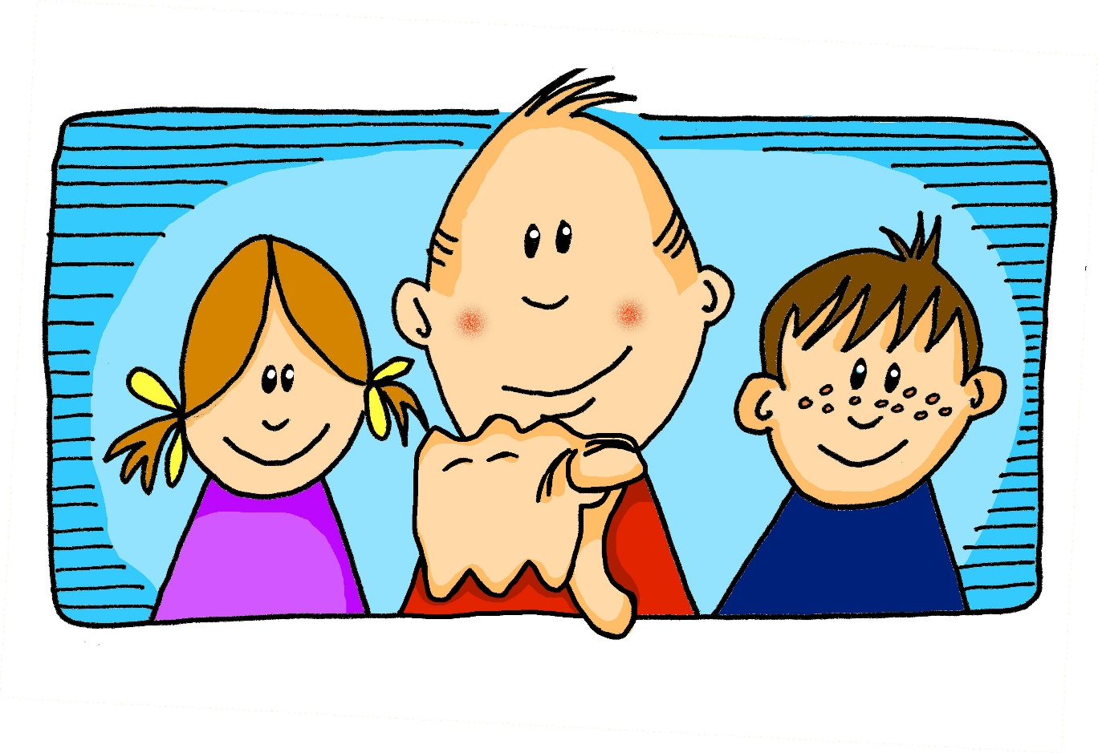
aussprechen
long[u]
…
du
Notes:
Timing: 1 minute
Aim: to introduce the SSC long [u].
Procedure:
Introduce the SSC and present the source word ‘du’ (with gesture, if using).
Click to bring on the picture and get pupils to repeat the word ‘du’ (with gesture, if using).
Note: a gesture for ‘du’ might be to point at someone.
2

Slide 3
aussprechen
long[u]
…
gut
du
super
[good]
[you]
Ruth
Lukas
Notes:
Timing: 2 minutes
Aim: to consolidate the SSC long [u].
Procedure:
Re-present the SSC and the source word ‘du’ (with gesture, if using).
Click to bring on the picture and get pupils to repeat the word ‘du’ (with gesture, if using).
Present the cluster words in the same way, bringing on the picture and getting pupils to pronounce the words.
Note:
a gesture for ‘du’ might be to point at someone else.
3

Slide 4
aussprechen
short [u]
…
Punkt
(dot, full stop)
Notes:
Timing: 1 minute
Aim: to introduce the SSC short [u].
Procedure:
Introduce the SSC and present the source word ‘Punkt’ (with gesture, if using.
Click to bring on the picture and get pupils to repeat the word ‘Punkt’ (with gesture, if using).
Note: a gesture might be to tip an imaginary dot onto a table or a piece of paper with your index finger.

Slide 5
aussprechen
short [u]
…
Nummer
Punkt
dunkel
[number]
[dot, full stop]
[dark]
Notes:
Timing: 2 minutes
Aim: to consolidate the SSC short [u].
Procedure:
Re-present the SSC and the source word ‘Punkt’ (with gesture, if using).
Click to bring on the picture and get pupils to repeat the word ‘Punkt’ (with gesture, if using).
Present the cluster words in the same way, bringing on the picture and getting pupils to pronounce the words.

Slide 6
aussprechen
[u]
long and short [u]
Say the words aloud. Is it long or short [u]?
 |  | long [u] | short [u]
1 | Nummer
2 | gut
3 | super
4 | Punkt
5 | du
6 | dunkel
Ruth
Lukas
Notes:
Timing: 4 minutes
Aim: to consolidate the SSC long [u] and short [u] by practising the difference in pronunciation.
Procedure:
1. Pupils practise in pairs saying the words out loud, paying particular attention to short [u] or long [u].
2. Click audio button to check.
Answers:
short
long
long
short
long
short

Slide 7
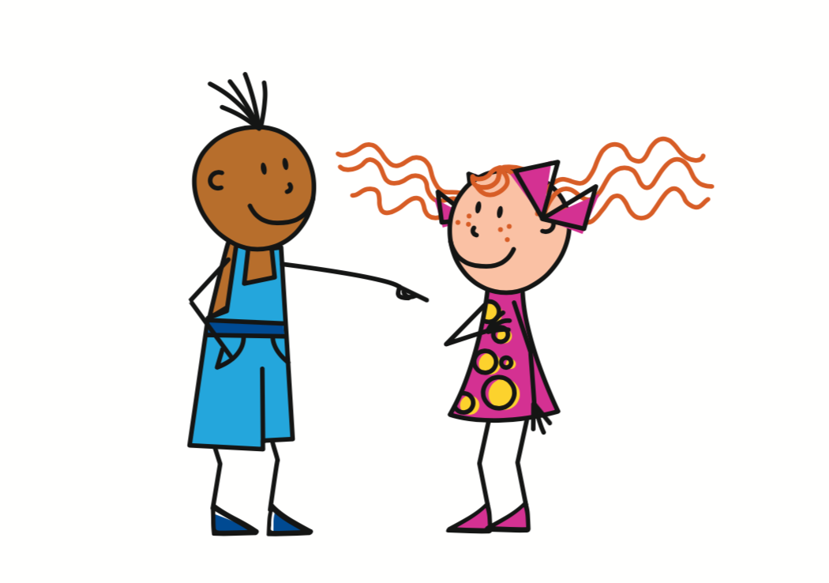
Sein
to be | being
In German the verb sein means ‘to be’, ‘being’.
ich bin
To mean I am we say _______________ .
er ist
To mean he is we say _______________ .
sie ist
To mean she is we say _______________ .
du bist
To mean you are, we say _______________ .
Notes:
Timing: 2 minutes
Aim: to remind pupils of the use and meaning of sein.
Procedure:
Click to remind pupils of the use and meaning of sein.
Elicit English translation for the German examples provided line by line.
7

Slide 8
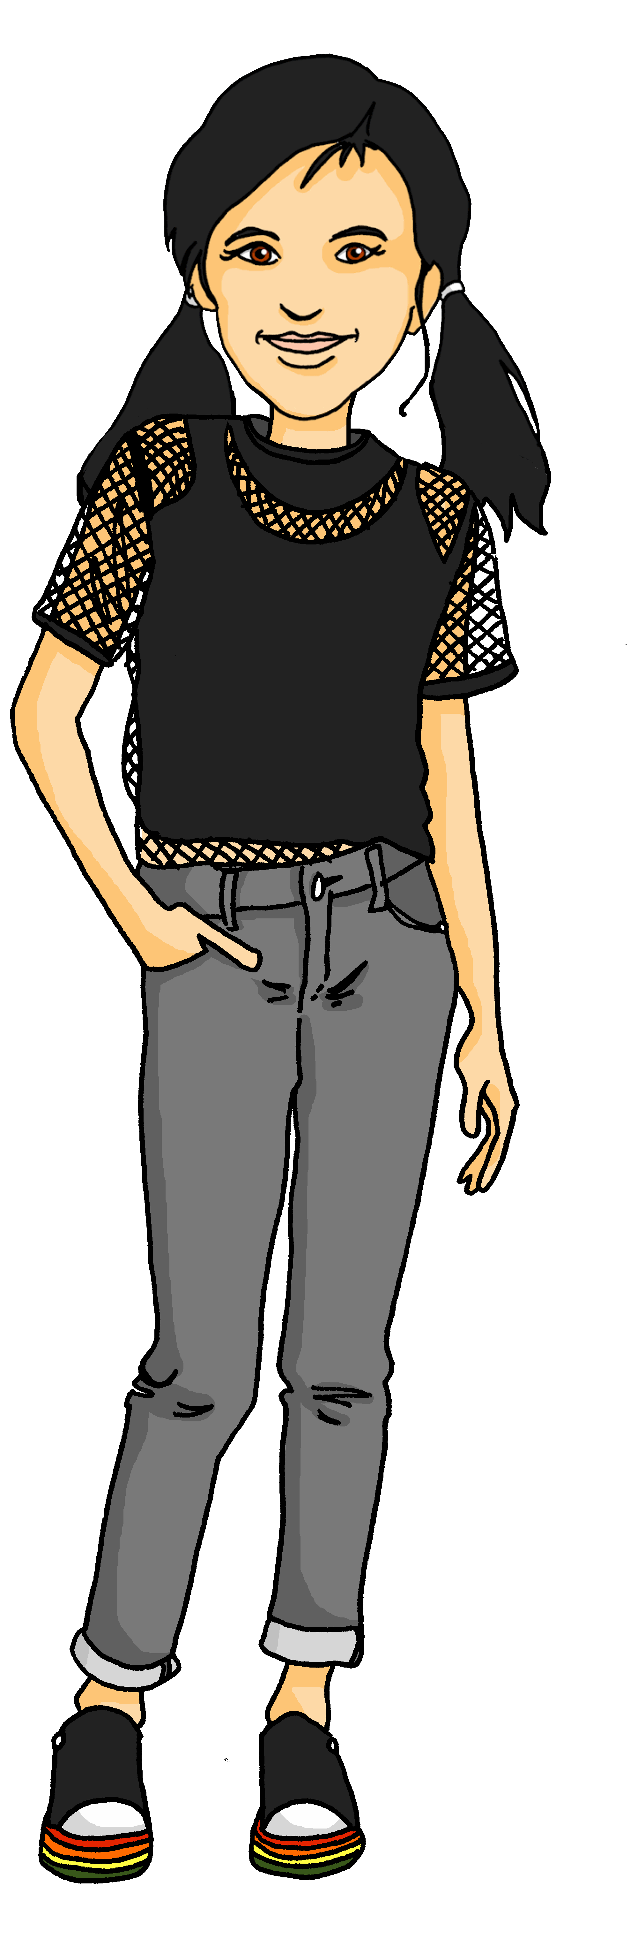
Ronja und Lias
Sie ist Ronja.
Er ist Lias.
Notes:
Timing: 2 minutes
Procedure:
Click to remind pupils of the use and meaning of sein.
Elicit English translation for the German examples provided line by line.
8

Slide 9
Lias gets lots of messages from his friend Gabriel.
Who is the message about? Lias (du) or Ronja (sie) ?
Write 1-6 and Lias ‘du’ or Ronja ‘sie’.
lesen
1
4
Sie ist gut in Englisch.
😊
Du bist da.
2
5
Sie ist wunderbar*.
Sie ist hier.
3
Du bist super.
6
😊
Du bist hier! Guten Morgen!
*wunderbar - wonderful
Notes:
Timing: 5 minutes
Aim: to practise recognition of 2nd and 3rd person forms of sein.
Procedure:
Explain the task. Lias has received some messages from his friend Gabriel.
Using their knowledge of sein, pupils decide whether the scribble hides ‘du’ or ‘sie’.
Click to reveal answers.
9

Slide 10
Yes/no questions
In English we swap ‘I am’ to ‘Am I’ to make a yes/no question:
I am Hannah.
Am I Hannah?
In German we do the same:
Ich bin Hannah.
Bin ich Hannah?
Du bist Lukas.
Bist du Lukas?
Sie ist Luisa.
Ist sie Luisa?
Notes:
Timing: 2 minutes
Aim: to teach the formation of yes/ no questions by swapping the subject and verb.
.
Procedure:
Click through the animations to demonstrate the formation of yes/no questions.
Elicit English translation for the German examples provided line by line.
10

Slide 11
hören
Hör zu. Robbie der Roboter* spricht.
*Roboter - robot
Is it a statement, or is it a question?
 |  | Statement | Question
 | Louisa
 | Susie
 | Linus
 | Julian
 | Luna
 | Ludwig
 | Muhammed
 | Ursula
1
2
3
4
5
6
7
8
Notes:
Timing: 5 minutes
Aim: to practise aural comprehension of the yes/ no questions and to distinguish between the two based on syntax.
Procedure:
1. Ask pupils to write 1-8 in their books, with two headings ‘statement’ and ‘question’ to the side.
2. Tell them that they will hear Robbie der Roboter/ Robbie the robot saying three word phrases (there is always a name at the end), but Robbie has a robot voice with no inflection, so they can’t tell whether it’s a statement or a question based on whether Robbie’s voice goes up at the end of the phrase or not.
3. Click the audio buttons in turn. Pupils listen, then decide based on word order, whether what they hear is a statement or a question.
4. Click to bring up the answers.
5. Extension activity: Depending on the level of the class and on time, pupils can then try and produce the items by saying them out loud, this time using inflection as appropriate.
Transcript:
1. Bin ich Louisa
2. Ich bin Susie
3. Du bist Linus
4. Er ist Julian
5. Bist du Luna
6. Ist er Ludwig
7. Ist er Muhammad
8. Sie ist Ursula
Vocabulary: Roboter [4124]
Jones, R.L & Tschirner, E. (2019). A frequency dictionary of German: Core vocabulary for learners. London: Routledge.
11

Slide 12
Tschüss!
gelb
Notes:
12

