Slide 1
Describing me and others
Wo ist die Schweiz?
gelb
Wo ist er/ sie? Wo bist du?
Wo ist das?
long and short [o]
Term 1 Week 3
Notes:
Artwork by Steve Clarke. Pronoun pictures from NCELP (www.ncelp.org). All additional pictures selected from Pixabay and are available under a Creative Commons license, no attribution required.
Phonics:
long [o] wo? [94] wohnen [380] Million [206] short [o] Kopf [279] offen [382] kommen [61]
Vocabulary:
es [12] wo [94] England [1762] die Schweiz [763] wunderbar [1603] und [2]
Jones, R.L & Tschirner, E. (2019). A frequency dictionary of German: Core vocabulary for learners. London: Routledge.
The frequency rankings for words that occur in this PowerPoint which have been previously introduced in these resources are given in the SOW and in the resources that first
introduced and formally re-visited those words.
For any other words that occur incidentally in this PowerPoint, frequency rankings will be provided in the notes field wherever possible.
1

Slide 2
aussprechen
long [o]
…
wo
Notes:
Timing: 1 minute
Aim: to introduce the SSC long [o].
Procedure:
Introduce the SSC and present the source word ‘wo’ (with gesture, if using).
Click to bring on the picture and get pupils to repeat the word ‘wo’ (with gesture, if using).
Note:
a gesture for ‘wo’ might be to put your hand on your forehead and look into the distance as if to spot something on the horizon
Word frequency (1 is the most frequent word in German): wo? [94]
Jones, R.L & Tschirner, E. (2019). A frequency dictionary of German: Core vocabulary for learners. London: Routledge.
2

Slide 3
aussprechen
long [o]
…
[to live, living]
wohnen
wo
Million
Notes:
Timing: 1 minute
Aim: to consolidate the SSC long [o].
Procedure:
Re-present the SSC and the source word ‘wo’ (with gesture, if using).
Click to bring on the picture and get pupils to repeat the word ‘wo’ (with gesture, if using).
Present the cluster words in the same way, bringing on the picture and getting pupils to pronounce the words.
Word frequency (1 is the most frequent word in German): Million [206]] ohne [119] wo? [94] wohnen [380]
Jones, R.L & Tschirner, E. (2019). A frequency dictionary of German: Core vocabulary for learners. London: Routledge.

Slide 4
aussprechen
short [o]
…
Kopf
[head]
Notes:
Timing: 1 minute
Aim: to introduce the SSC short [o].
Procedure:
Introduce the SSC and present the source word ‘Kopf’ (with gesture, if using).
Click to bring on the picture and get pupils to repeat the word ‘Kopf’ (with gesture, if using).
Note:
a gesture for ‘Kopf’ might be to point to your head.
Word frequency (1 is the most frequent word in German): Kopf [279]
Jones, R.L & Tschirner, E. (2019). A frequency dictionary of German: Core vocabulary for learners. London: Routledge.
4

Slide 5
aussprechen
short [o]
…
[head]
kommen
Kopf
offen
kommen – to come
Notes:
Timing: 1 minute
Aim: to consolidate the SSC short [o].
Procedure:
Re-present the SSC and the source word ‘Kopf’ (with gesture, if using).
Click to bring on the picture and get pupils to repeat the word ‘Kopf’ (with gesture, if using).
Present the cluster words in the same way, bringing on the picture and getting pupils to pronounce the words.
Word frequency (1 is the most frequent word in German): kommen [61] Kopf [279] offen [382]
Jones, R.L & Tschirner, E. (2019). A frequency dictionary of German: Core vocabulary for learners. London: Routledge.
5

Slide 6
aussprechen
[o]
long and short [o]
Hör zu.
hören
 | L: long [o] | S: short [o] | word
1 |  |  | offen
2 |  |  | wohnen
3 |  |  | wo
4 |  |  | Kopf
5 |  |  | Million
6 |  |  | kommen
Notes:
Timing: 5 minutes
Aim: to consolidate the SSC long [o] and short [o] by practising listening to the different pronunciations.
Procedure:
1. Click audio button 1 to play the recording for item 1. Pupils need to decide is it long [o] or short [o] and write list of S for short and L for long
2. Elicit the answer; encourage pupils to pay particular attention to short [o] or long [o].
3. Click to bring up the answer tick for item 1.
4. Elicit the whole word; if necessary click the audio button again to play recording again.
5. Click to bring up the written version of the German word, together with picture.
6. Continue for items 2-6.
Transcript: offen
wohnen
wo?
Kopf Million kommen

Slide 7
Vokabeln
Hör zu und sag das Wort.
Wörter
und
wo?
where?
and
Notice that final ‘d’ in German sounds like English ‘t’!
England
die Schweiz
Switzerland
Notice that ‘Switzerland’ is two words in German.
wunderbar
es
wonderful
Notes:
Timing: 5 minutes
Aim: to present and practise written comprehension and read aloud of the new vocabulary for this week.
Procedure: 1. Click for a German word. Elicit pronunciation from pupils.
2. Click for the English meaning and picture prompt. Elicit the German word again.
3. Present all five words like this, in order.
4. Click for one English meaning to disappear. Elicit the English meaning from pupils. Continue with the remaining items.
5. Click for the German word to disappear. Elicit the German from pupils. Continue with the remaining items.
Vocabulary:
es [12] wo [94] England [1762] Schweiz [763] wunderbar [1603] und [2]
Jones, R.L & Tschirner, E. (2019). A frequency dictionary of German: Core vocabulary for learners. London: Routledge.
7

Slide 8
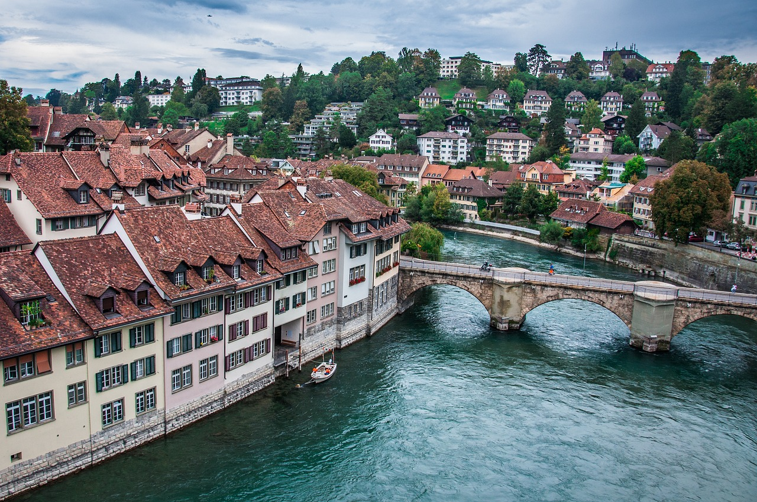
Asking questions
ist
Remember, to mean ‘is’ we say ______ .
wo ist
To ask ‘where is’, say ________ ?
Wo ist Bern?
Where is Bern?
Es ist in der Schweiz.
It is in Switzerland.
After ‘in’ die Schweiz becomes der Schweiz.
Notes:
Timing: 2 minutes
Procedure:
Click through the animations to present the new information.
Elicit English translation for the German examples provided.
8

Slide 9
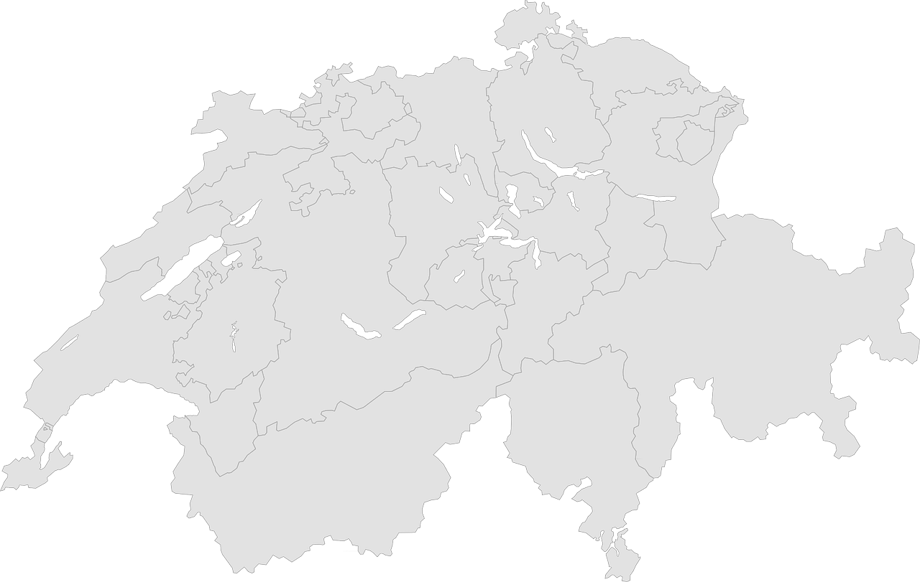
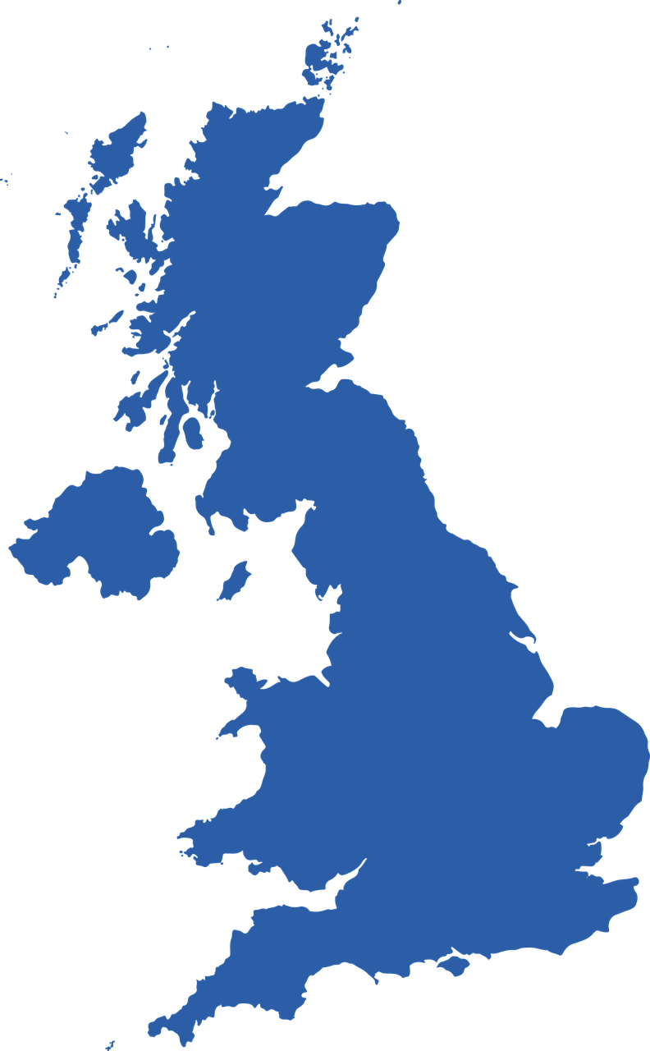
Kultur
Kultur
Wo ist…?
Bern
Bern ist in der Schweiz. Es ist die Hauptstadt*.
Bern ist wunderbar!
London ist in England. Es ist die Hauptstadt.
London ist super!
London
Hauptstadt – capital city
Notes:
Timing: 5 minutes
Aim: to present and practise new vocabulary for this week
Procedure:
Click to bring up the first text box about Bern. Click again to bring up the map.
Click to bring up the nest text box about London. Click again to bring up the map.
Click to bring up speech bubble about Bern.
Click to bring up speech bubble about London.
9

Slide 10
schreiben
Writing die Schweiz and England
Let’s practise some writing!
I’m sure you know how to spell England!
Now let’s practise writing it on your sleeve with your finger!
In German, the ‘E’ in England is a different sound, and you don’t hear the ‘g’.
England
Now let’s try the words for Switzerland!
die Schweiz
Now practise writing ‘die Schweiz’ on your sleeve.
Notes:
Timing: 2 minutes
Aim: to prepare for the written production of England and die Schweiz.
Procedure:
Introduction to writing in German – pupils practise by writing on their sleeve with their finger.
Click through the animations.
Click on the words England and die Schweiz to bring up the sound, if you wish.
Help pupils break down the words into syllables: Sch-weiz, Eng-land. After each word on the next click a line will appear to indicate where the word can be separated.
10

Slide 11
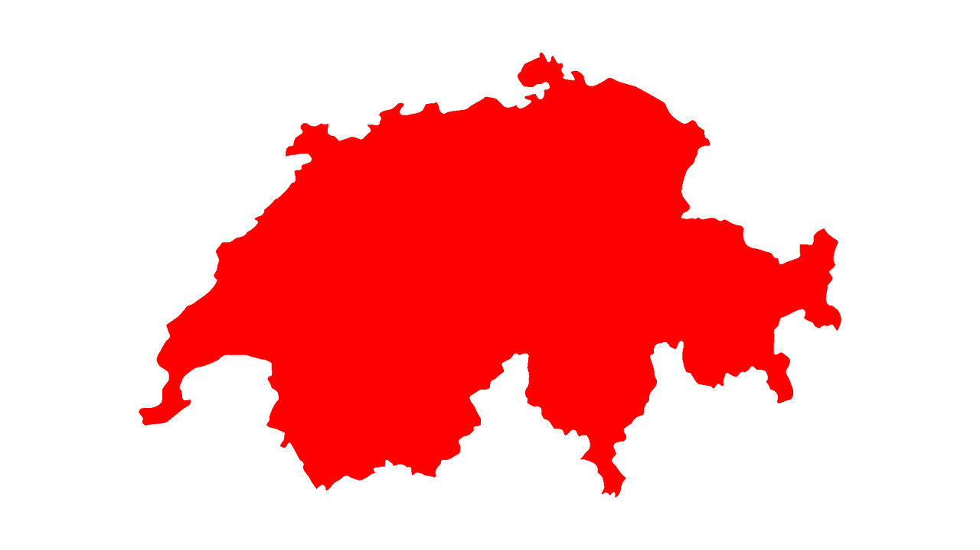
hören
Hör zu. Wo ist es?
Write the correct country name in German.
 | die Schweiz
 | England
 | die Schweiz
 | die Schweiz
 | die Schweiz
 | England
 | die Schweiz
 | England
1
2
Bottighofen
Olten
3
Solothurn
Altdorf
Durham
4
Obergoms
Sheffield
5
6
Cambridge
7
8
Notes:
Timing: 5 minutes
Aim: to practise aural comprehension of place names, matching sound to print, and to practise writing die Schweiz and England.
Procedure:
1. Click to play the recording of the first question and answer. The answer will be beeped out.
2. Remind pupils to break down the words into syllables like on the last slide: die Sch-weiz, Eng-land. Pupils may write the words on their sleeves with their fingers for practice just the once.
3. Now pupils write 1-8 and the words die Schweiz or England as appropriate for each item.
4. Click in turn to bring up the answer.
3. Ask: Wo ist…? Pupils repeat chorally – es ist in England, etc.
Transcript:
Wo ist Olten? Es ist in [der Schweiz].
Wo ist Durham? Es ist in [England].
Wo ist Obergoms? Es ist in [der Schweiz].
Wo ist Bottighofen? Es ist in [der Schweiz].
Wo ist Solothurn? Es ist in [der Schweiz].
Wo ist Cambridge? Es ist in [England].
Wo ist Altdorf? Es ist in [der Schweiz].
Wo ist Sheffield? Es ist in [England].
11

Slide 12
sprechen
Leonie und Lothar
…
Ich bin Lothar.
Ich bin Leonie.
Er ist Lothar.
Sie ist Leonie.
Leonie
Lothar
Ich bin Lias.
Ronja
Lias
Er ist Lias.
Ich bin Ronja.
Sie ist Ronja.
Notes:
Timing: 8 minutes
Aim: to introduce two new characters – the parents Leonie and Lothar. To practise spoken production of ich bin and er/sie ist.
Procedure:
Click to bring up a picture of the new character Leonie. Click to bring up speech bubble Ich bin Leonie. Pupils repeat chorally.
Elicit a presentation of Leonie in the 3rd person – Sie ist Leonie. (Click to bring up the icon of another person with an empty speech bubble and then model ‘Sie ist Leonie’.
Continue for the other characters.
Practise once again with all of the sentences – two of the names are new and will need some practice.
12

Slide 13
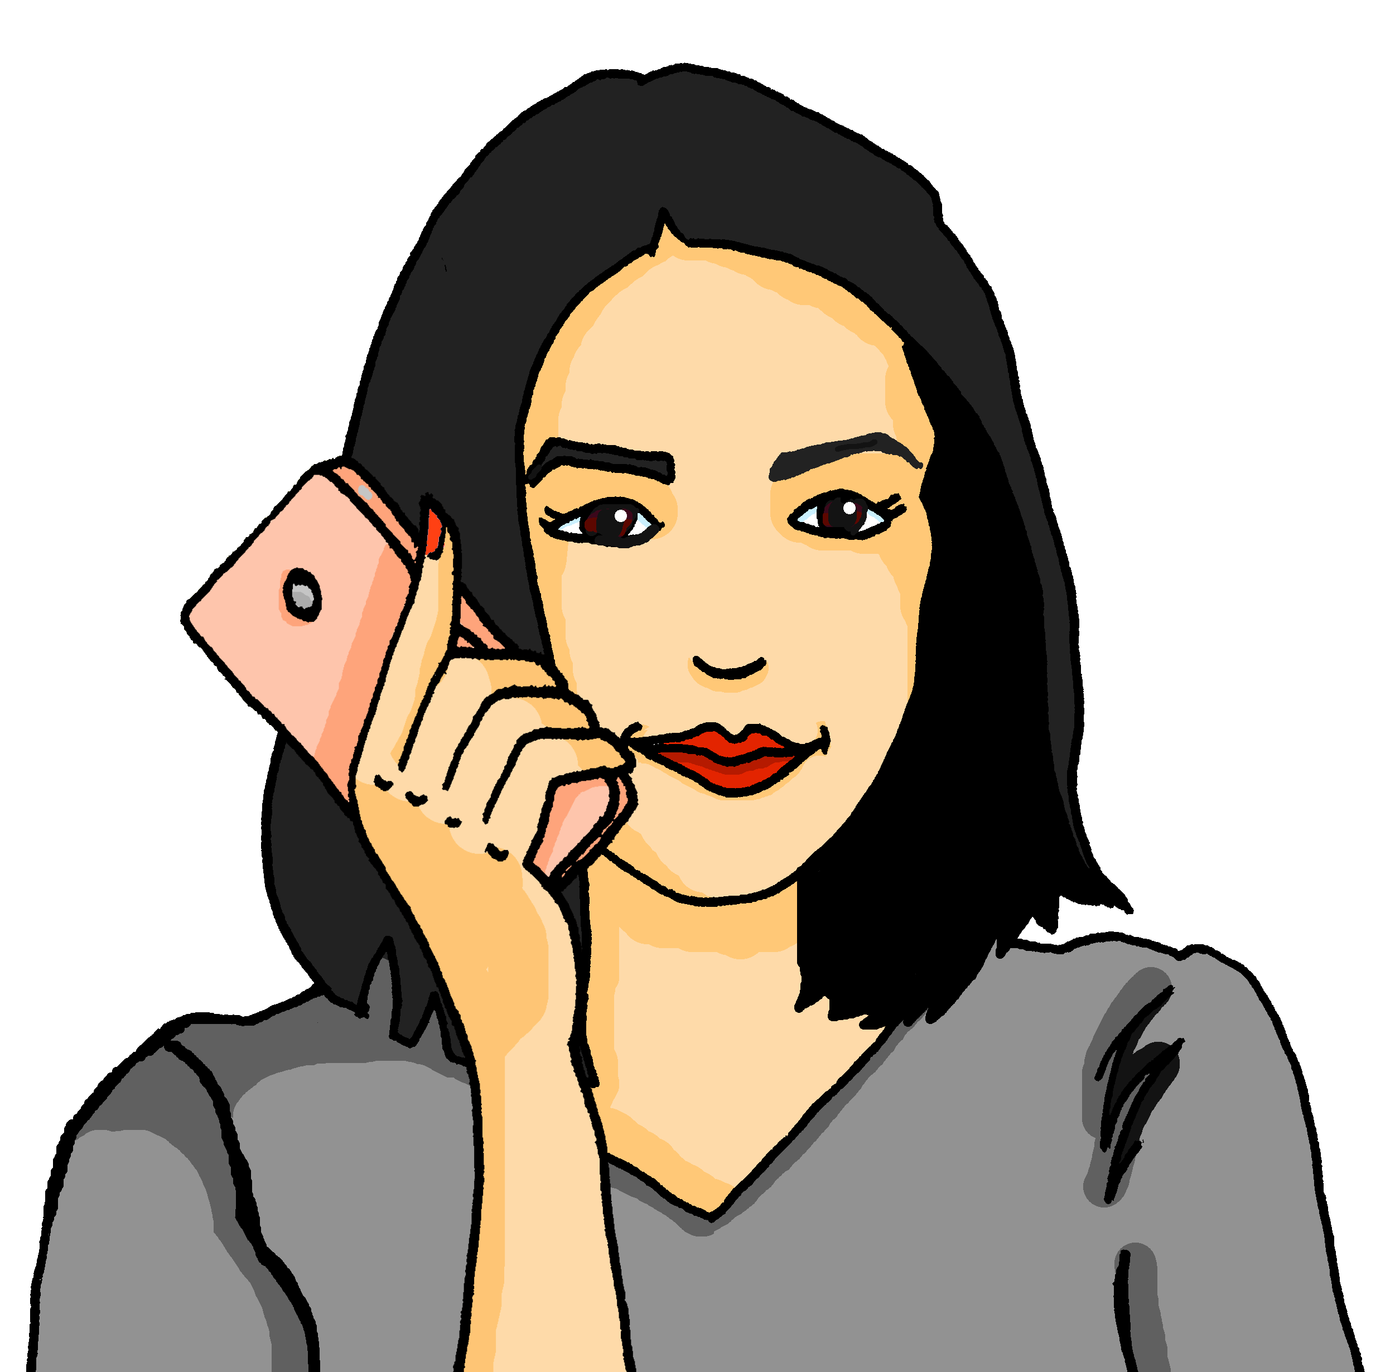
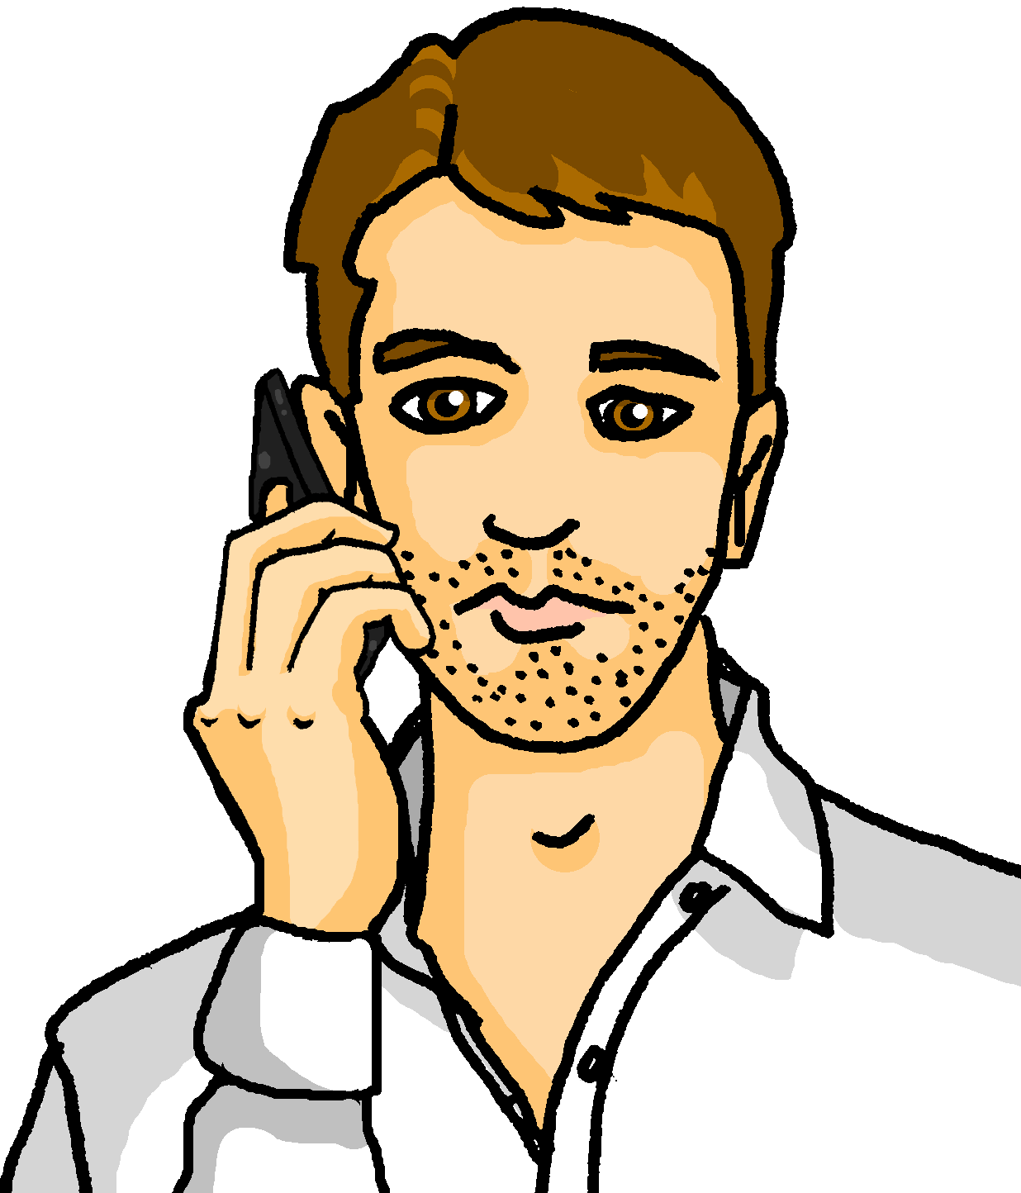
lesen
Leonie and Lothar are travelling for work but they are never in the same place.
Leonie messages Lothar. Lothar’s phone screen is dirty! Who is where?
Leonie (I am in…)
 | ______
 | ______
 | ______
 | _____
 | _____
 | _____
1 | Ich bin in Bottighofen. Du bist in Sheffield.
2 | Du bist jetzt in Cambridge und ich bin in Altdorf.
3 | Hallo! Du bist in Durham und ich bin in Zürich.
4 | Ich bin jetzt in Obergoms, wo bist du ?
5 | Du bist in Olten! Oh, ich bin in Genf.
6 | Du bist in Biel? Ich bin in Solothurn!
1
1
Bottighofen
2
2
Altdorf
3
Zürich
3
4
Obergoms
Lothar (you are in…)
 | ______
 | ______
 | ______
 | _____
 | _____
4
5
Genf
6
Solothurn
5
1
Sheffield
2
Cambridge
6
3
Durham
5
Olten
6
Biel
Notes:
Timing: 8 minutes
Aim: to practise written comprehension of the learnt vocab and placenames, and to distinguish between first and second person singular.
Procedure:
Pupils write: Leonie, and Lothar. They need to work out six places where Leonie and Lothar are right now. NB Leonie is writing the messages, so ich bin = Leonie, du bist = Lothar.
Click to bring up the answers (the place names) in the Leonie and Lothar tables, in the order in which they appear in the text.
Click again to remove the splodges from Lothar’s phone screen.
Continue for items 2-6. NB there is no place for Lothar for number 4.
Click to play the recording of the sentences if you wish.
13

Slide 14
Tschüss!
gelb
Notes:
14

