Slide 1
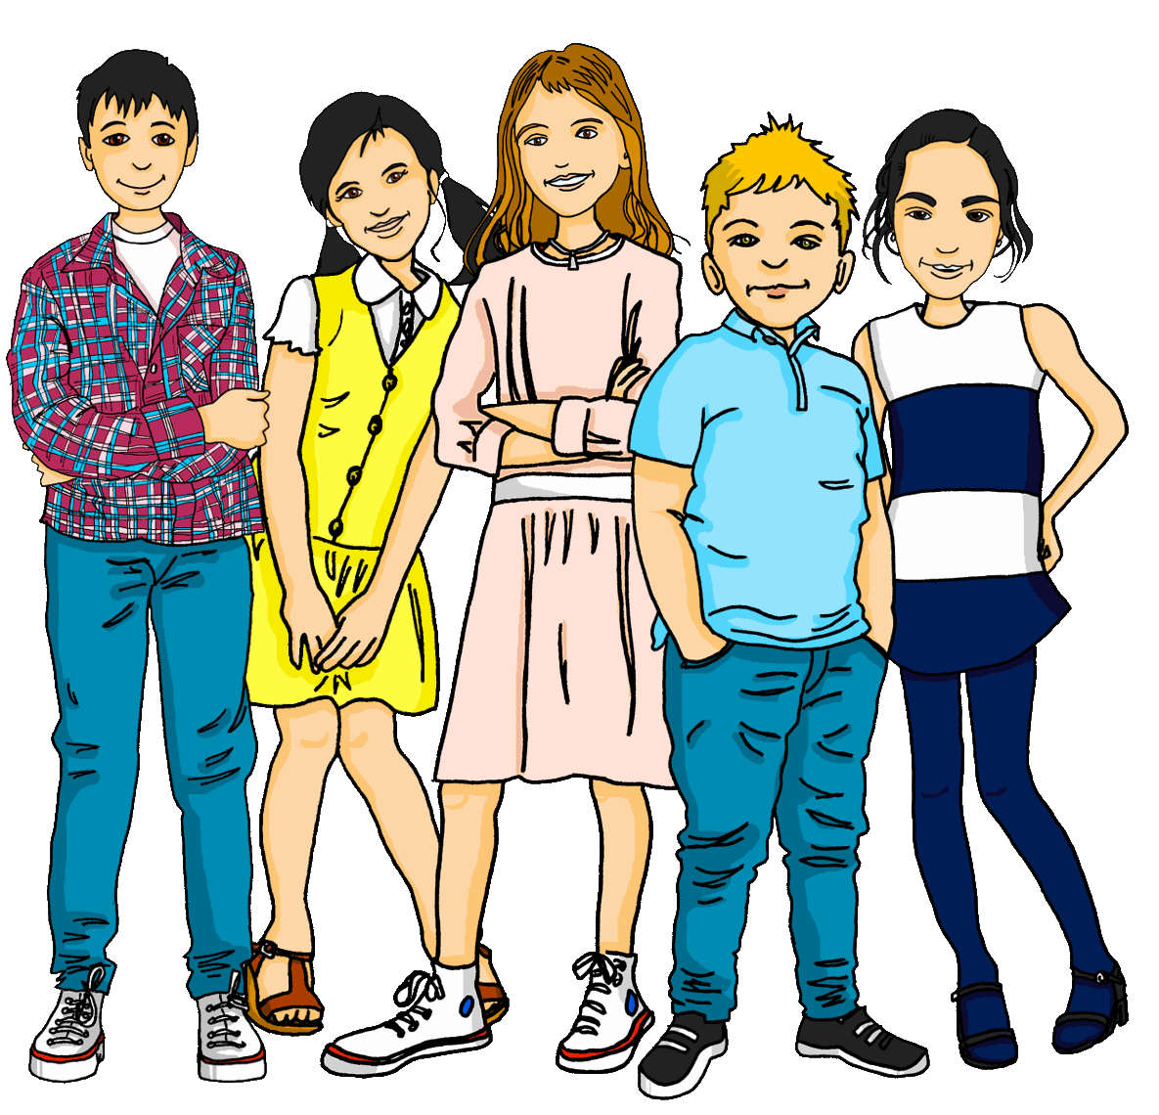
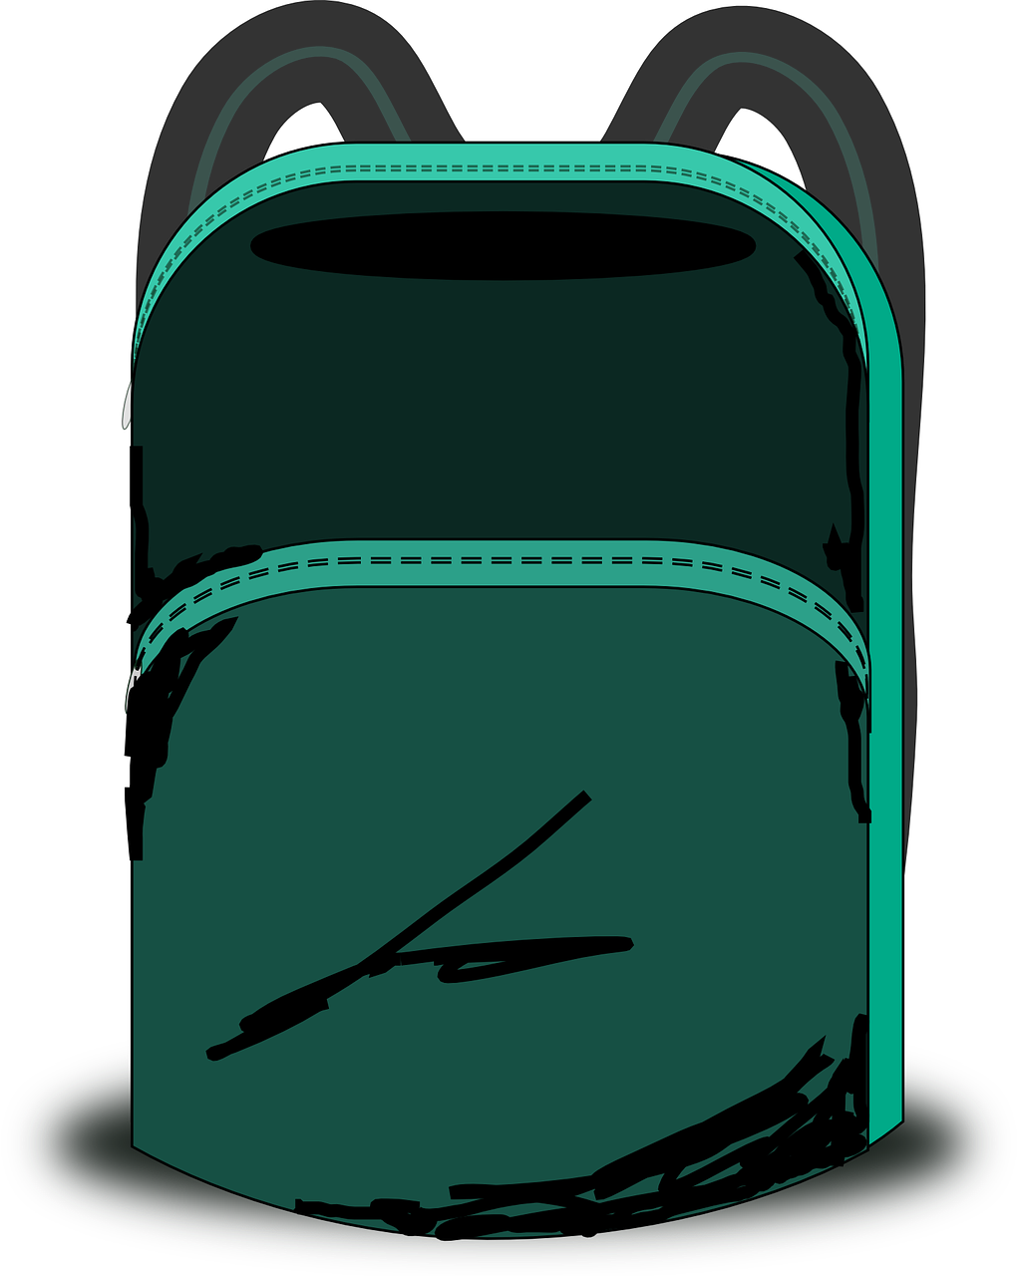
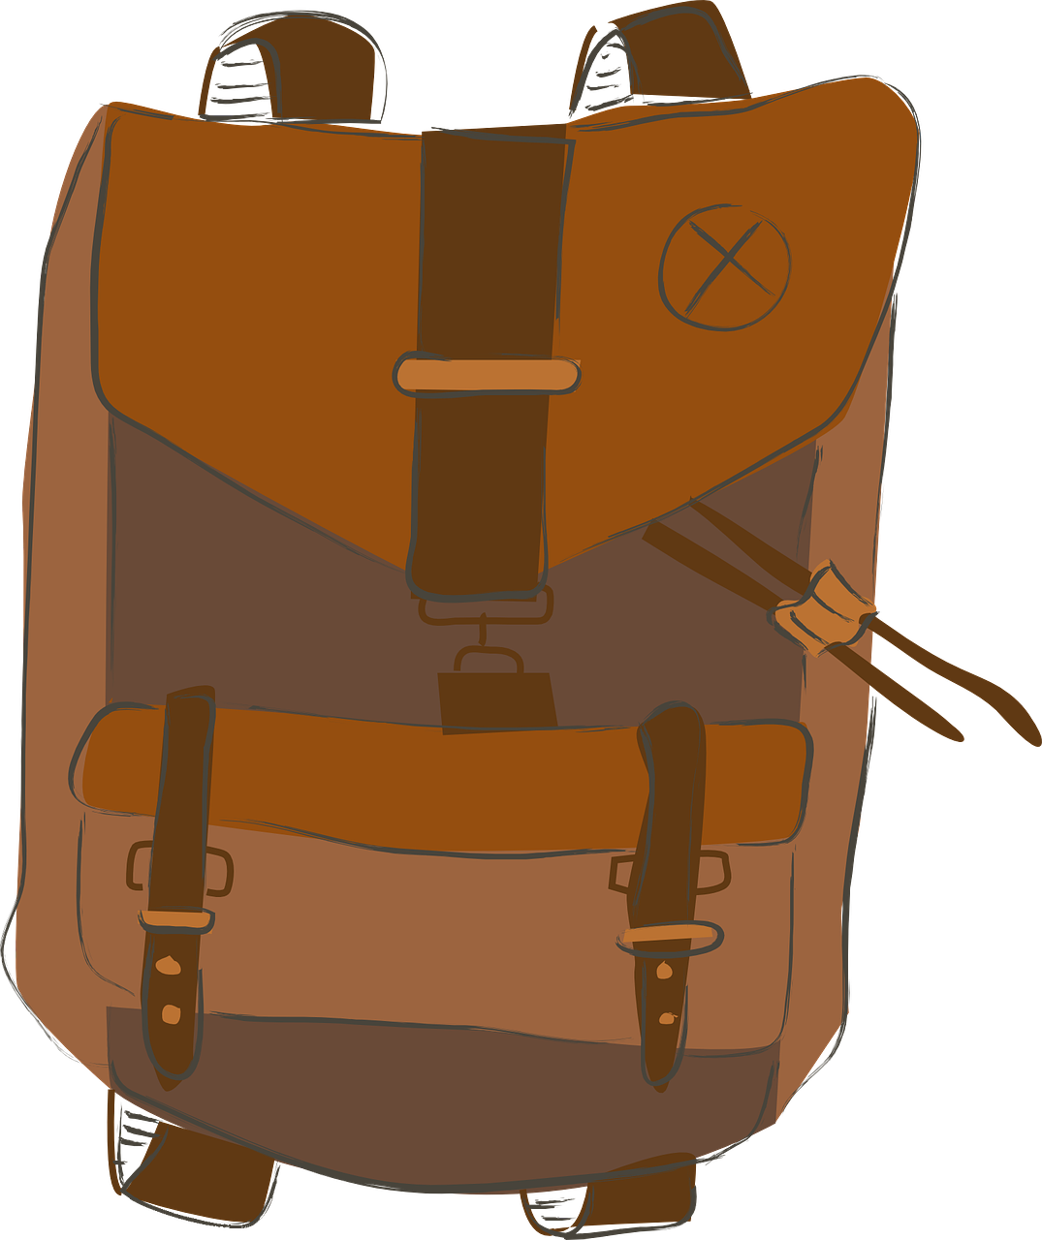
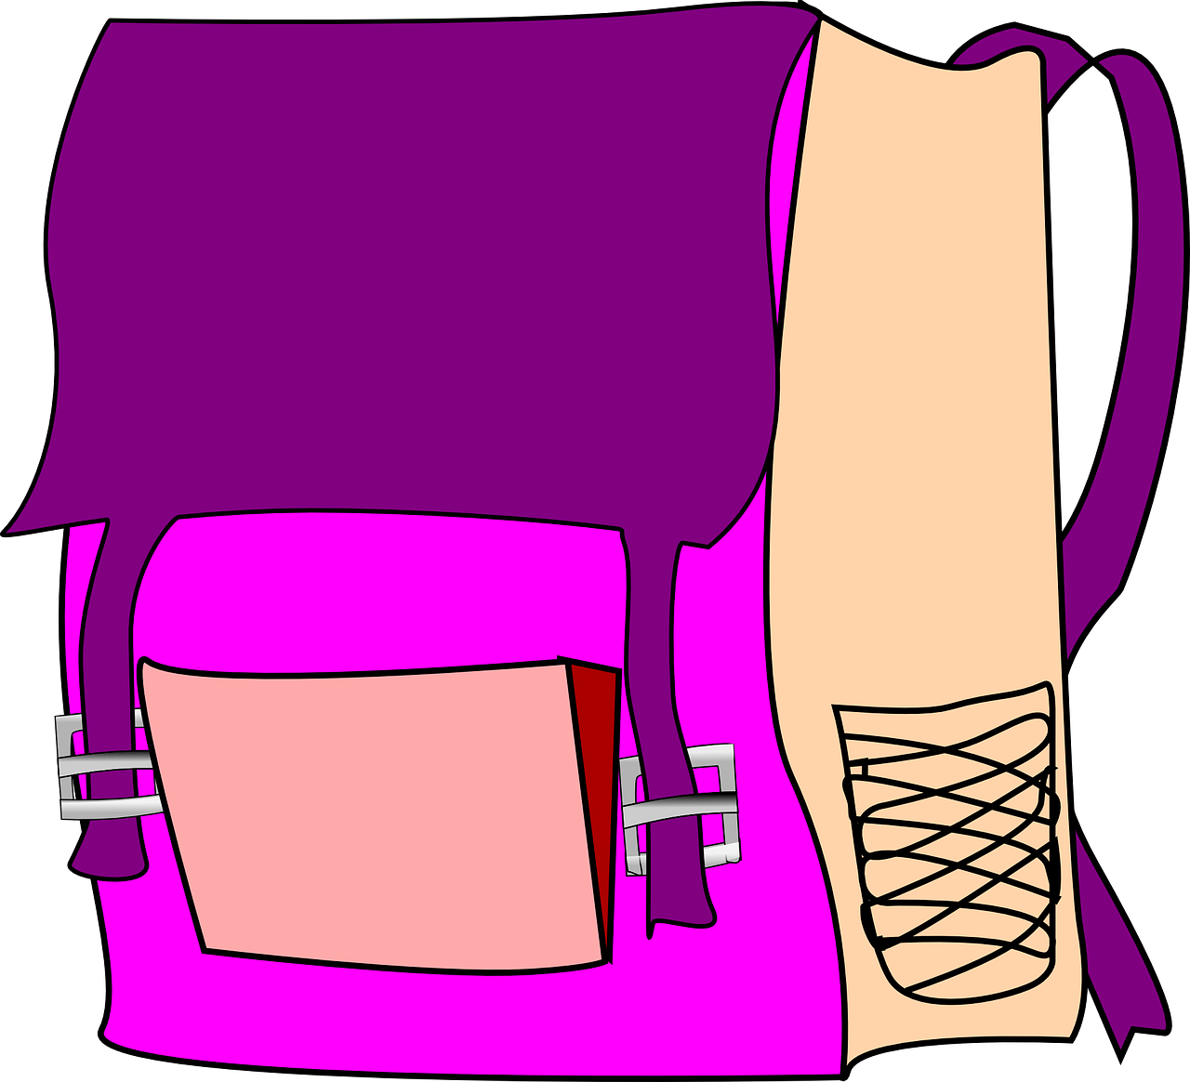
Describing me and others
rot
Follow ups 1-5
Term 1 Week 4
Notes:
Artwork by Steve Clarke. Pronoun pictures from NCELP (www.ncelp.org). All additional pictures selected from Pixabay and are available under a Creative Commons license, no
attribution required.
Phonics:
[ei] frei [318] ein [5] klein [114] sein [3] allein [258]
Vocabulary (new): Apfel [3490] Ball [1783] Blatt [1270] Butterbrot [n/a] Jacke [3287] Uhr [348] der, die, das [1]
Revisit 1: ich [10] er [15] sie [7] sein, bin, ist [4] da [239] hier [68] Guten Morgen [n/a] Hallo [1077] ja [45] nein [148]
Jones, R.L & Tschirner, E. (2019). A frequency dictionary of German: Core vocabulary for learners. London: Routledge.
The frequency rankings for words that occur in this PowerPoint which have been previously introduced in these resources are given in the SOW and in the resources that first introduced and formally re-visited those words.
For any other words that occur incidentally in this PowerPoint, frequency rankings will be provided in the notes field wherever possible.
Note that the first three lessons of the year teach language that can be continuously recycled as lesson routine every lesson in Y3/4.
The idea would be that the class teacher (whether or not s/he teaches the class German can re-use the language as part of the daily routine with the class.

Slide 2
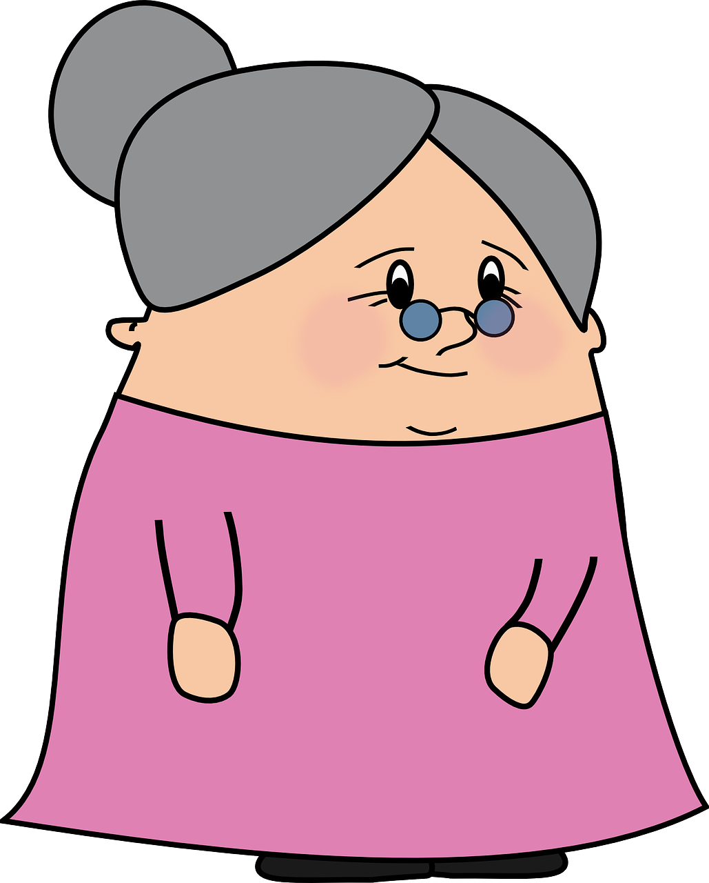
Follow up 1
Hör zu. [ei] oder* [o]?
1
w o h n e n
k ei n
O ma
_
2
_
3
_
hören
4
ei n s
5
N o r d e n
6
S o m m e r
_
_
_
7
B ei n
8
S t o f f
Ei s
_
_
9
_
oder – or
Notes:
Timing: 5 minutes
Aim: to practise transcribing the missing vowels in unknown words.
Procedure:
Click to listen to each word.
Listen and write the missing letter(s).
Click to reveal answers.
Vocabulary: wohnen [560] kein [46] Oma [2175] eins [774] Norden [1516] Sommer [771] Bein [884] Stoff [758] Eis [1874]
Jones, R.L & Tschirner, E. (2019). A frequency dictionary of German: Core vocabulary for learners. London: Routledge.

Slide 3
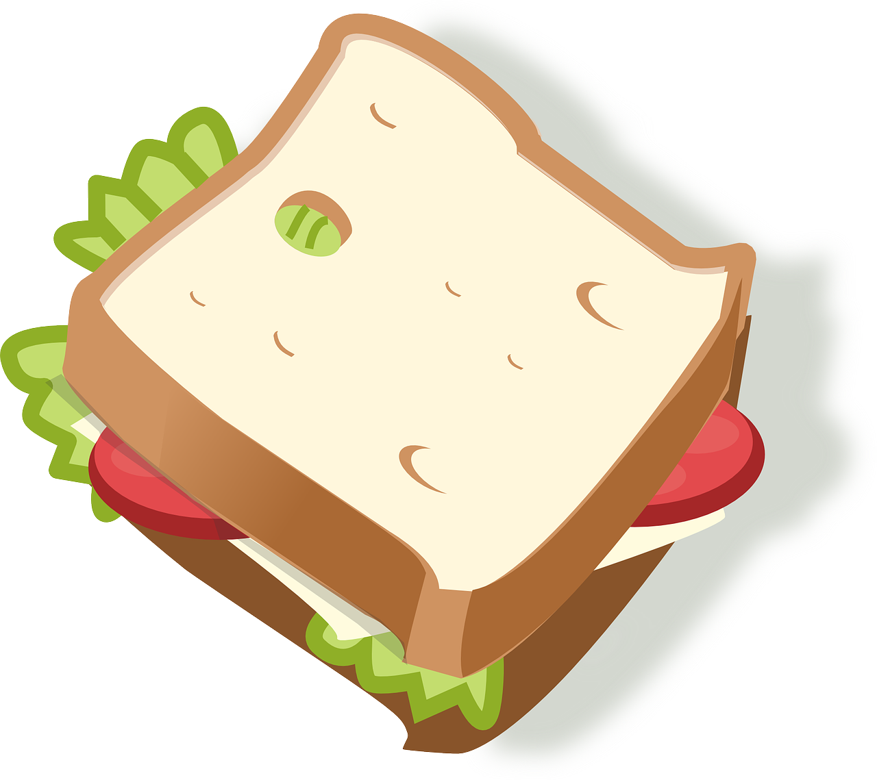
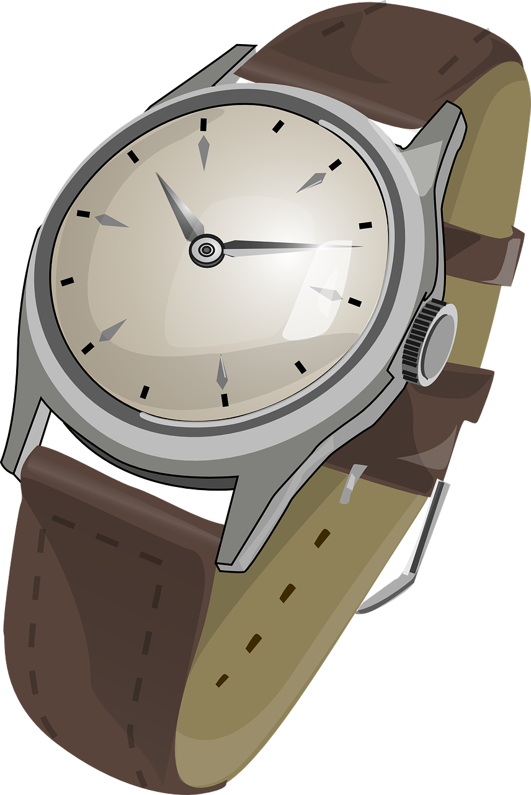
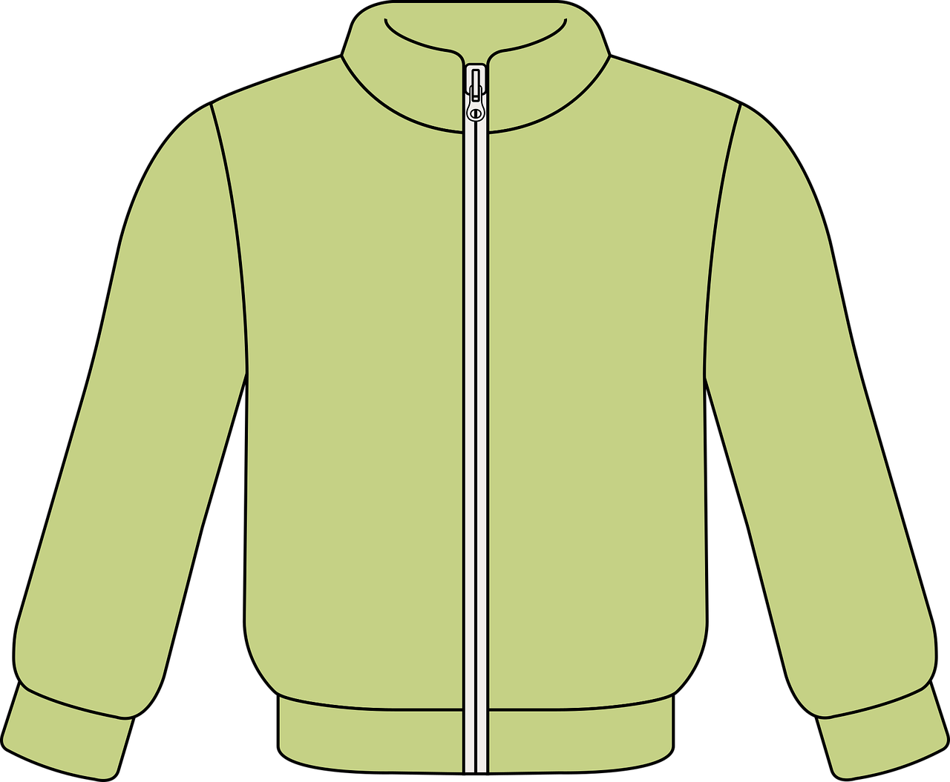
Follow up 2
Was ist das auf Deutsch?
Wörter
d__ A____l
der Apfel
Vokabeln
d__ J____e
…
die Jacke
sprechen
die Uhr
d__ U__
das Butterbrot
d__ B________t
das Blatt
d__ B___t
d__ B__l
der Ball
Notes:
Timing: 3 minutes
Aim: to practise the new vocabulary further and to establish the knowledge of gender for the six nouns learnt this week. Procedure: 1. Read the teacher instruction for the activity in German. Elicit the meaning from pupils or tell them what it means. They do not know all the words yet but they do know (was and ist)
2. Bring up gapped version of the word. Allow pupils to recall the word and its article. 3. Reveal the full version of the word. Repeat for other nouns. 4. Bring up the pictures and ask pupils to say the nouns and their articles.
5. Ask pupils which is their favourite German word so far, and to think about why. Is it the sound, the meaning, the fact it is easy (or difficult) to remember?

Slide 4
Follow up 3a
Ist es der, die oder das?
…
sprechen
m
nt
___ Butterbrot
___ Jacke
___ Blatt
___ Ball
___ Uhr
___ Apfel
nt
f
f
Notes:
Timing: 5 minutes (two slides)
Aim: to revise gender and word knowledge. Procedure: 1. The six nouns appear as pictures with word (without article) on separate mouse clicks. Say the word (chorally) with its definite article. 2. On second click, the noun moves into the ‘appropriately gendered’ mouth.

Slide 5
Follow up 3b
Was ist das auf Deutsch?
…
sprechen
m
nt
nt
m
f
f
Notes:
Procedure: 1. This time, only the images for the six nous appear on separate mouse clicks. Say the word (chorally) with its definite article. 2. On second click, the noun moves into the ‘appropriately gendered’ mouth.

Slide 6
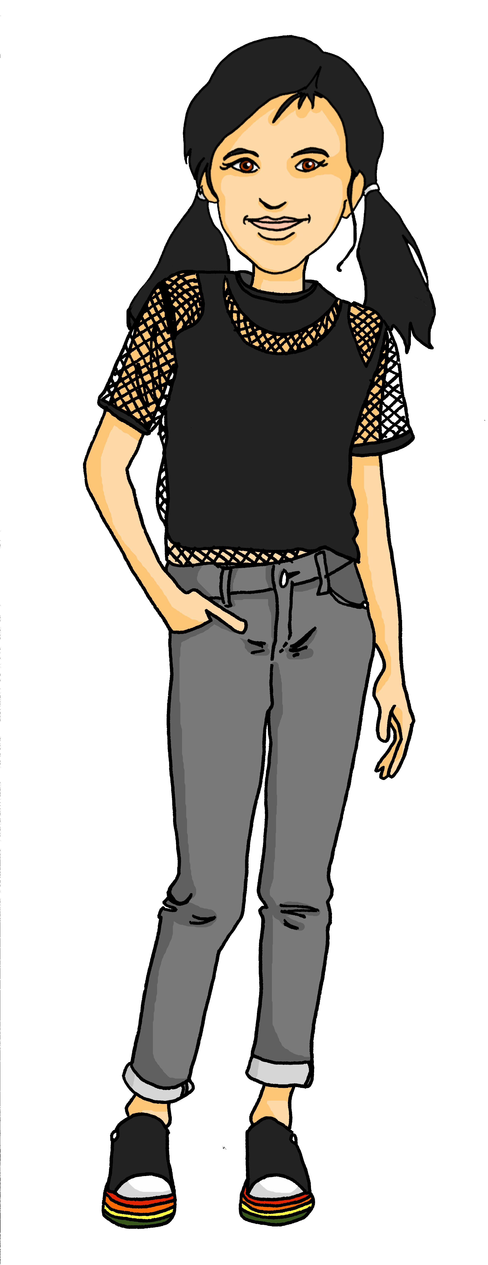
Follow up 4:

Schreib auf Deutsch.
Ronja is also going on the school trip. What is she bringing?
schreiben
1
Hier ist die
A
B
Uhr
2
Da ist das
A
B
Blatt
3
Da ist die
A
B
Jacke
4
Da ist der
A
B
Ball
5
Hier ist der
A
B
Apfel
6
A
B
Butterbrot
Hier ist das
Notes:
Timing: 5 minutes
Aim: to practise gender knowledge and written recall of the new vocabulary.
Procedure: 1. Explain the task. Ronja is also packing for the school trip and writes a list of things she is bringing.
2. Pupils write 1-6 in their books (or on whiteboards). 2. Identify which item Ronja is bringing based on the definite article. Write A or B. Click to reveal answers. 3. If pupils can, they also try to write the full missing word in German. Click to reveal Ronja’s list. Note: Reassure pupils that they are not expected to know these spellings 100% yet, but that trying to write them from memory, trying to remember, is a key part of learning.

Slide 7
Follow up 5:

Schreib auf Englisch.
Can you get at least 15 points?
Wörter
 | Guten Morgen | sein | ich
 | er | bin | sie
 | ist | Hallo | da
 | hier | ja | nein
 | der Apfel | die Jacke | das Blatt
 | der Ball | die Uhr | das Butterbrot
 | der | die | das
Good morning
to be, being
I
Vokabeln
x3
he
am
she
is
hello
there
x2
here
yes
no
apple
jacket
sheet
ball
watch, clock
sandwich
x1
the (m)
the (f)
the (nt)
Notes:
Timing: 5 minutes
Aim: to practise written comprehension of vocabulary from this and revisited weeks.
Procedure: 1. Give pupils a blank grid. They fill in the English meanings of any of the words they know, trying to reach 15 points in total. 2. Remind pupils that adjectives can refer to male or female persons and they should note this in their translations. E.g. pleased (f), short (m).
Note: The most recently learnt and practised words are pink, words from the previous week are green and those from week 1 are blue, thus more points are awarded for them, to recognise that memories fade and more effort (heavy lifting!) is needed to retrieve them.

Slide 8
Follow up 5:

Schreib auf Deutsch.
Can you get at least 15 points?
Wörter
 | Hello | here | yes
 | there | no | is
 | she | Good morning | he
 | to be, being | I | am
 | (the) sandwich | the (m) | (the) apple
 | the (nt) | (the) jacket | (the) sheet
 | (the) ball | (the) watch, clock | the (f)
Hallo
hier
ja
Vokabeln
x3
da
nein
ist
sie
Guten Morgen
er
x2
sein
ich
bin
das Butterbrot
der
der Apfel
das
die Jacke
das Blatt
x1
der Ball
die Uhr
die
Notes:
Timing: 5 minutes
Aim: to practise written comprehension of vocabulary from this and revisited weeks.
Procedure: 1. Give pupils a blank grid. They fill in the English meanings of any of the words they know, trying to reach 15 points in total. 2. Remind pupils that adjectives can refer to male or female persons and they should note this in their translations. E.g. pleased (f), short (m).
Note: The most recently learnt and practised words are pink, words from the previous week are green and those from week 1 are blue, thus more points are awarded for them, to recognise that memories fade and more effort (heavy lifting!) is needed to retrieve them.

Slide 9
Tschüss!
gelb
Notes:
9

Slide 10
Follow up 5:

Schreibe auf Englisch.
Can you get at least 15 points?
Wörter
 | Guten Morgen | sein | ich
 | er | bin | sie
 | ist | Hallo | da
 | hier | ja | nein
 | der Apfel | die Jacke | das Blatt
 | der Ball | die Uhr | das Butterbrot
 | der | die | das
Vokabeln
x3
x2
x1
Notes:
HANDOUT

Slide 11
Follow up 5:

Schreibe auf Deutsch.
Can you get at least 15 points?
Wörter
 | Hello | here | yes
 | there | no | is
 | she | Good morning | he
 | to be, being | I | am
 | sandwich | the (m) | apple
 | the (nt) | jacket | sheet
 | watch, clock | ball | the (f)
Vokabeln
x3
x2
x1
Notes:
HANDOUT

