Slide 1
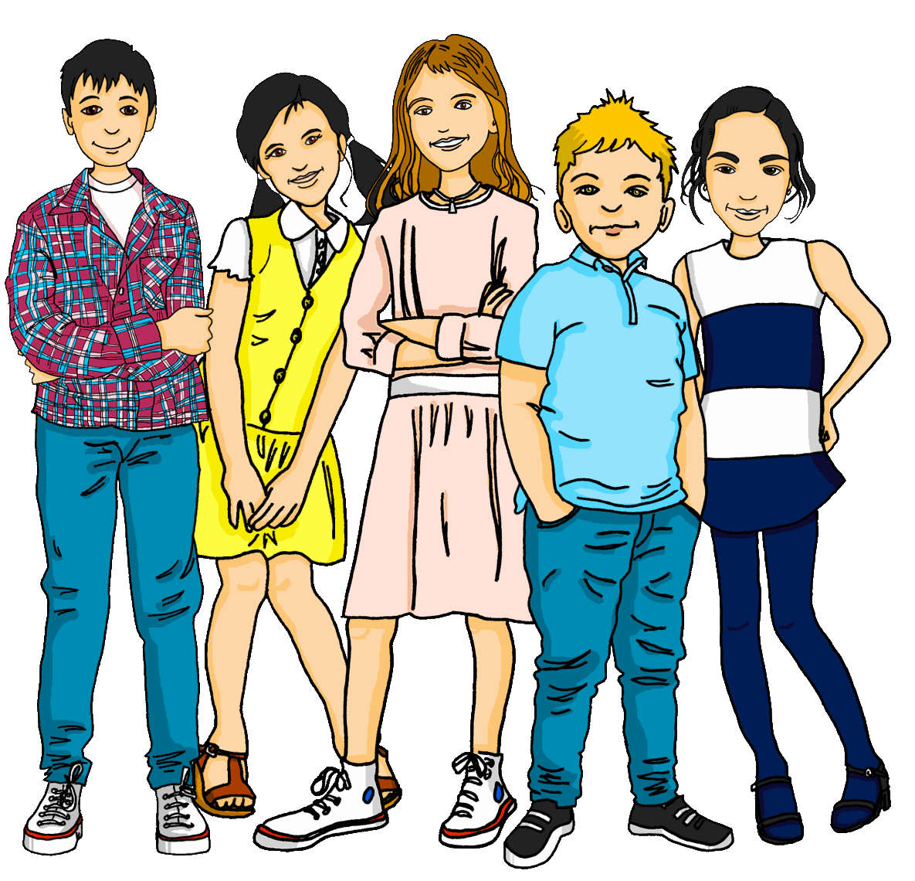
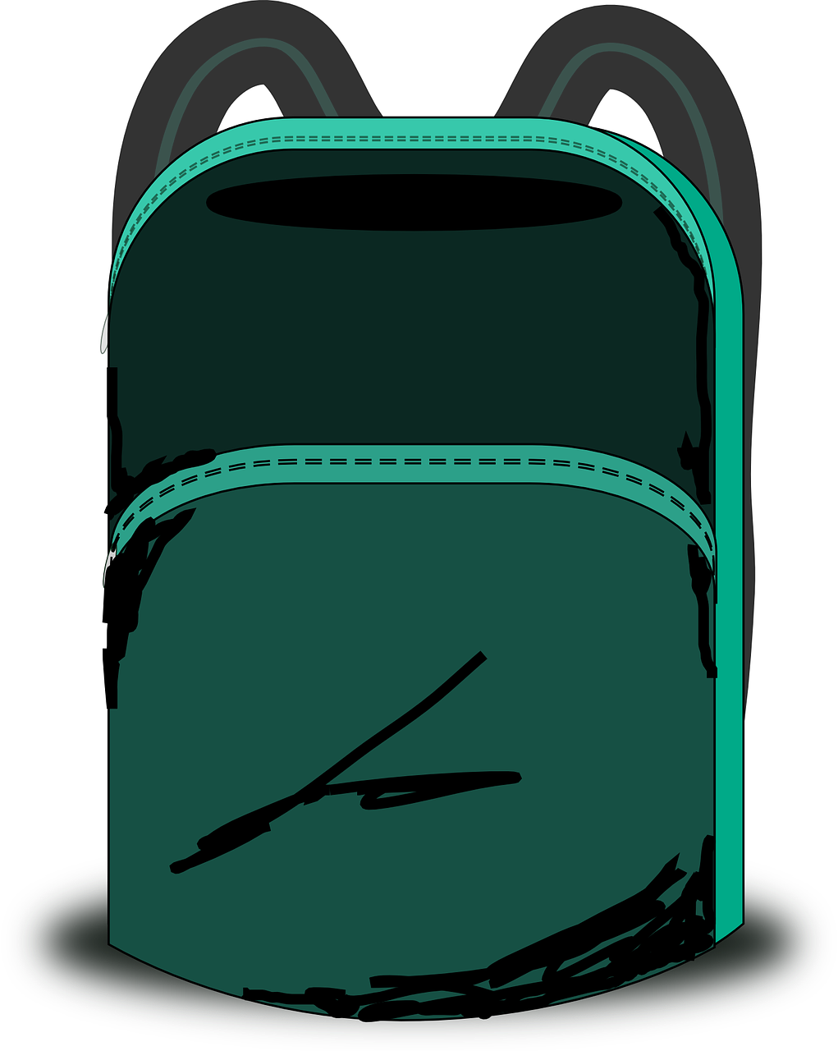
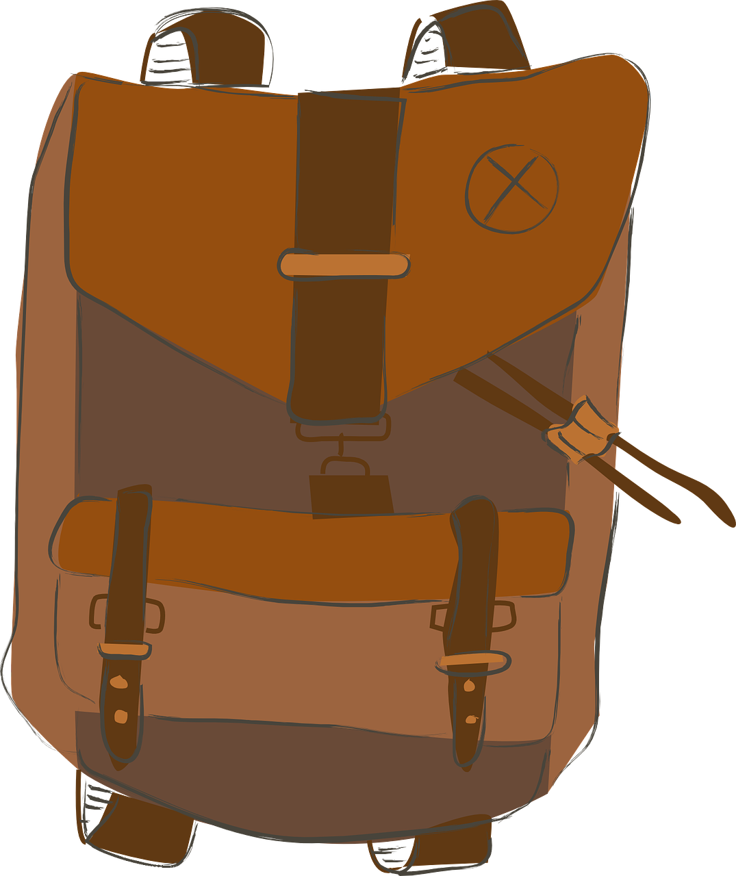
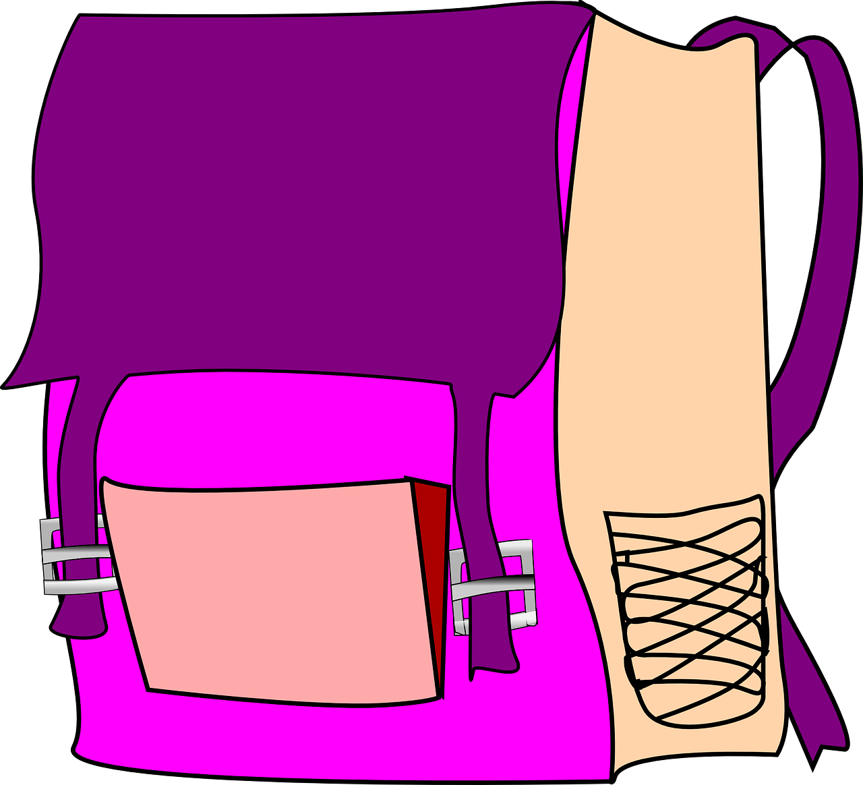
Describing me and others
gelb
German nouns
Words for ‘the’
SSC [ei]
Term 1 Week 4
Notes:
Artwork by Steve Clarke. Pronoun pictures from NCELP (www.ncelp.org). All additional pictures selected from Pixabay and are available under a Creative Commons license, no
attribution required.
Phonics:
[ei] frei [318] ein [5] klein [114] sein [3] allein [258]
Vocabulary (new): Apfel [3490] Ball [1783] Blatt [1270] Butterbrot [n/a] Jacke [3287] Uhr [348] der, die, das [1]
Revisit 1: ich [10] er [15] sie [7] sein, bin, ist [4] da [239] hier [68] Guten Morgen [n/a] Hallo [1077] ja [45] nein [148]
Jones, R.L & Tschirner, E. (2019). A frequency dictionary of German: Core vocabulary for learners. London: Routledge.
The frequency rankings for words that occur in this PowerPoint which have been previously introduced in these resources are given in the SOW and in the resources that first introduced and formally re-visited those words.
For any other words that occur incidentally in this PowerPoint, frequency rankings will be provided in the notes field wherever possible.
Note that the first three lessons of the year teach language that can be continuously recycled as lesson routine every lesson in Y3/4.
The idea would be that the class teacher (whether or not s/he teaches the class German can re-use the language as part of the daily routine with the class.
1

Slide 2
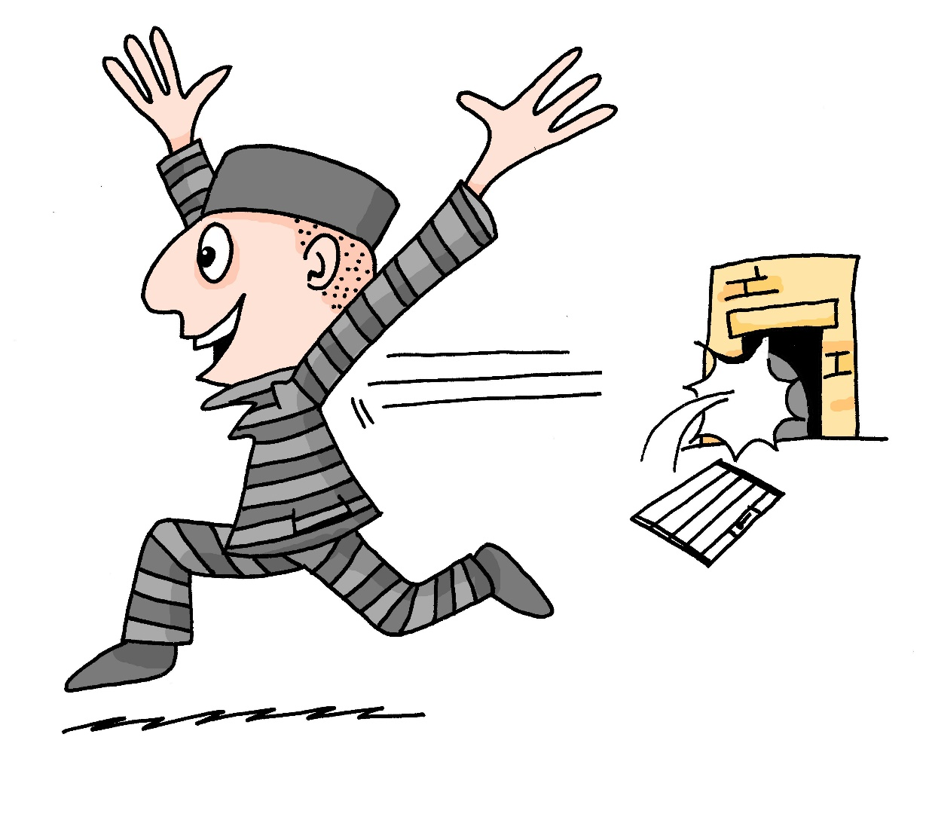
aussprechen
[ei]
…
free
frei
Notes:
Timing: 1 minute
Aim: to introduce the SSC [ei].
Procedure:
Introduce the SSC and present the source word ‘frei’ (with gesture, if using).
Click to bring on the picture and get pupils to repeat the word ‘frei’ (with gesture, if using).
Note:
a gesture for ‘frei’ might be to throw you hands up in the air and pretend to run away.
Vocabulary: frei [318]
Jones, R.L & Tschirner, E. (2019). A frequency dictionary of German: Core vocabulary for learners. London: Routledge.
2

Slide 3
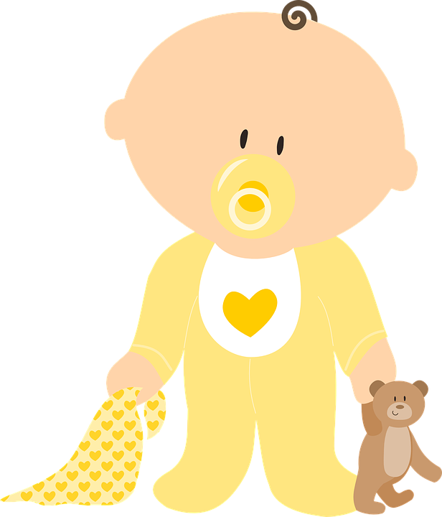
aussprechen
[ei]
…
frei
/a
sein
ein
alone
klein
allein
Notes:
Timing: 1 minute
Aim: to consolidate the SSC [ei].
Procedure:
Re-present the SSC and the source word ‘frei’ (with gesture, if using).
Click to bring on the picture and get pupils to repeat the word ‘frei’ (with gesture, if using).
Present the cluster words in the same way, bringing on the picture and getting pupils to pronounce the words.
Vocabulary: frei [318] ein [5] klein [114] sein [3] allein [258]

Slide 4
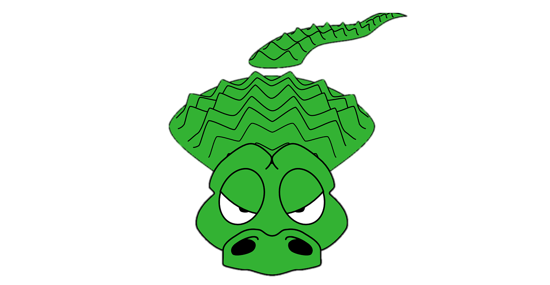
aussprechen
[ei]
Say the words in German.
…
Watch out! There are crocodiles in the water!
frei
bei
sein
seid
klein
15
Preis
Arbeit
ein
S
meist
0
START
Notes:
Timing: 1 minute
Aim: to consolidate the SSC [ei].
Procedure:
Start the timer. Pupil A tries to say all 9 words with correct pronunciation within 15 seconds.
Pupil B listens and if pupil A uses English pronunciation for a word s/he can stop her/his partner as they will have fallen into crocodile-infested waters and their turn is over!
They swap roles and repeat.
If either pupil hasn’t completed the task in the time, the teacher can offer additional rounds of practice against the timer.
Click on each word to listen and check.
Vocabulary:
frei [318] sein [3] Preis [334] klein [114] ein [5] meist [379] Arbeit [208] seid [4] bei [29]
Jones, R.L & Tschirner, E. (2019). A frequency dictionary of German: Core vocabulary for learners. London: Routledge.

Slide 5
Nouns
All German nouns start with a capital letter, wherever they are in the sentence:
Der Apfel ist hier.
The apple is here.
Which nouns do this in English?
Proper nouns, e.g. London, September, Monday, Emily.
German proper nouns do this as well.
Notes:
Timing: 2 minutes
Aim: to present information about capitalisation of German nouns.
Procedure:
Click through the animations to present the new information.
Elicit English translation for the German example provided.
5

Slide 6
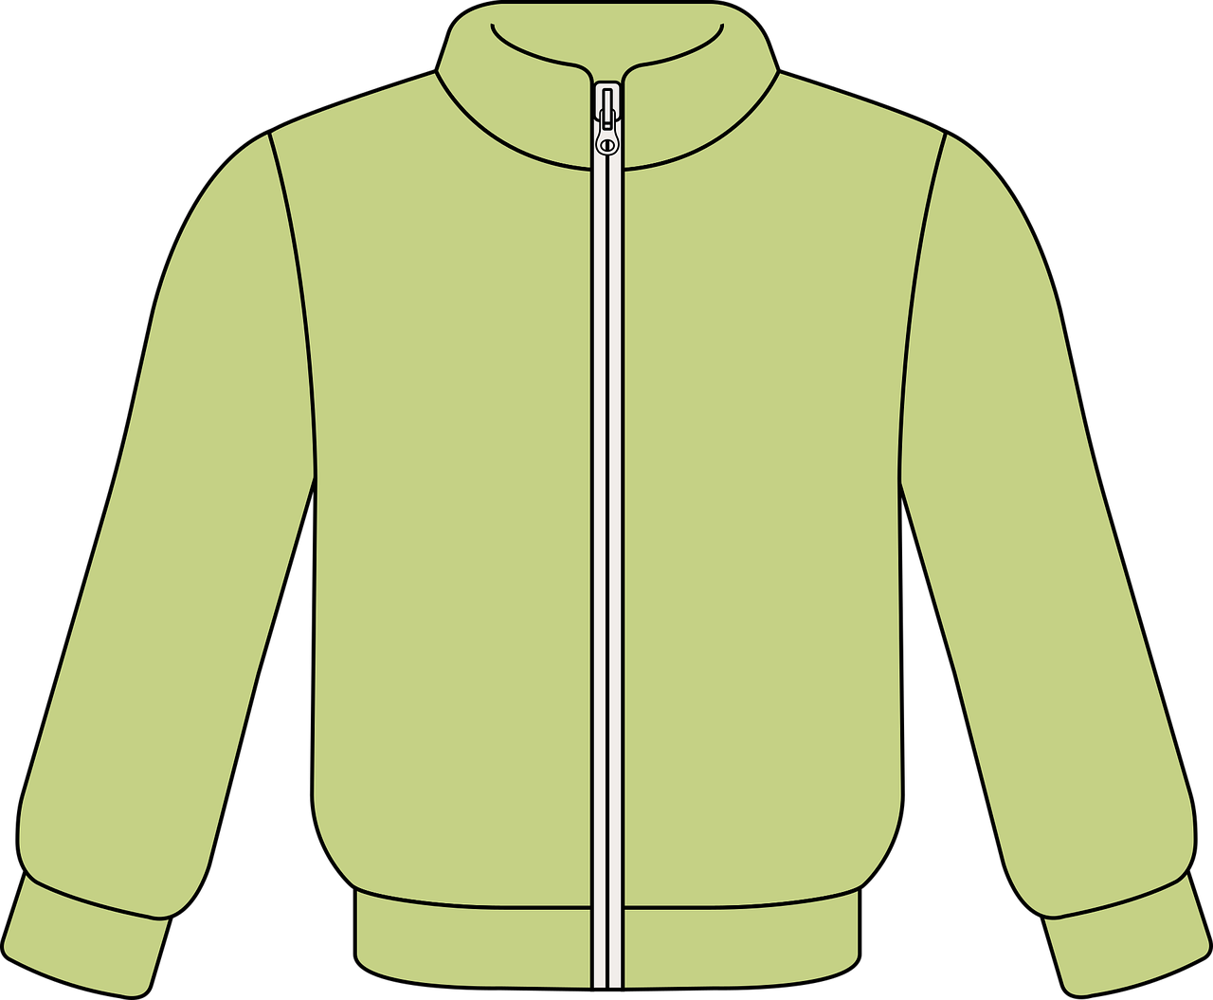
der, die, das (the)
German has three words for the:
masculine
feminine
neuter
der
das Blatt
der Apfel
die Jacke
das
die
English speakers might find this tricky because English only uses the.
Every noun has a gender, but grammatical gender is not the same as biological gender.
Notes:
Timing: 3 minutes Aim: To introduce the concept of noun gender and the three singular definite articles (words for ‘the’) in German. Procedure: 1. Bring up the text and read it carefully, with helpful intonation.
2. Try to elicit the nouns from students before revealing them. Students have learnt two possible nouns for ‘die’ and ‘das’.
Note: It’s important for teachers to draw out the importance of learning gender. One point of interest is native speaker prediction based on gender. Depending on the class, it might be interesting for students to know that native speakers of languages with gender begin to predict what is going to be talked about as soon as the gender word is said – i.e. if there are two objects in view and just the word for ‘the’ is said, it is already clear what is being talked about. This classification of nouns by gender serves to speed up identification (fractions of a second, but still interesting and important!)
The key point for teachers to emphasise is that students need to learn nouns with their gender from the first encounter and practise recalling them frequently.
Vocabulary:
der, die, das [1] Flasche [1602] Heft [3862] Tisch [529]
Jones, R.L & Tschirner, E. (2019). A frequency dictionary of German: Core vocabulary for learners. London: Routledge.
6

Slide 7
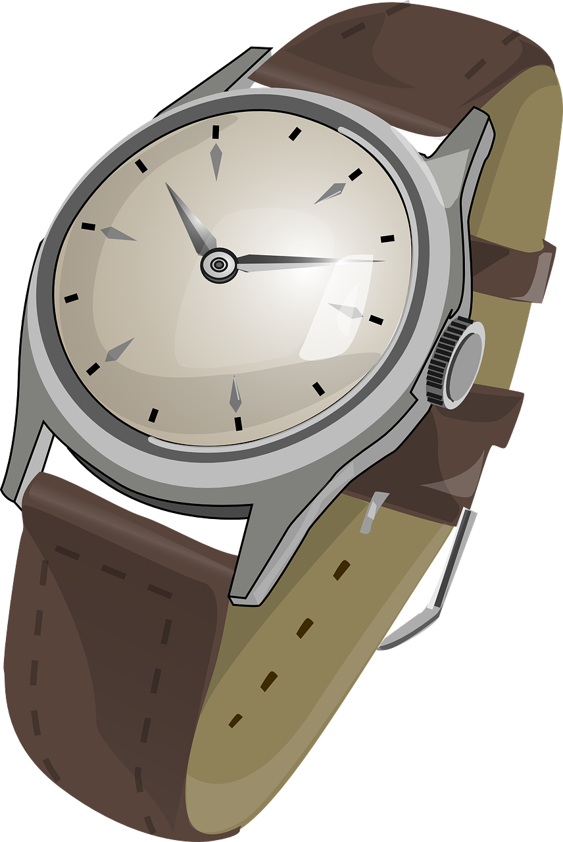
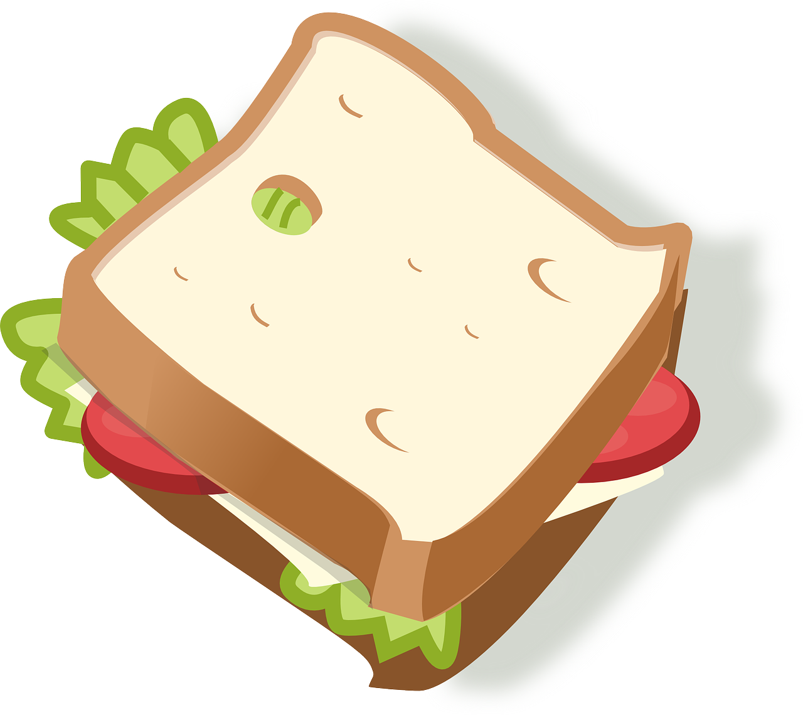
Vokabeln
Let’s learn six nouns in German.
Wörter
der Apfel
die Jacke
das Blatt
der Ball
die Uhr
das Butterbrot
Notes:
Timing: 5 minutes
Aim: to present and practise written comprehension and read aloud of the new vocabulary for this week.
Procedure: 1. Click for a German word. Elicit pronunciation from pupils.
2. Click for the English meaning and picture prompt. Elicit the German word again.
3. Present all six words like this, in order.
4. Click for one English meaning to disappear. Elicit the English meaning from pupils. Continue with the remaining items.
5. Click for the German word to disappear. Elicit the German from pupils. Continue with the remaining items.
7

Slide 8
Nouns
Which words need a capital letter in German?
1
The
apple
is
there.
1. Der Apfel ist da.
2
Where
is
the
jacket?
2. Wo ist die Jacke?
3
The
sandwich
is
here.
3. Das Butterbrot is hier.
4
Where
is
Ronja?
4. Wo ist Ronja?
5
Ronja
is
in
Biel.
5. Ronja ist in Biel.
Notes:
Timing: 3 minutes Aim: To practise the concept of capital letters on German nouns. Procedure: 1. Bring up each question.
2. Students identify the words that need capitals. Point out that both German and English always start sentences with a capital letter. 3. Elicit and/or present the German sentence.
Note that pupils have only just been introduced to these words so may remember some of them, but it is fine to just present the German sentences.
8

Slide 9
hören
Lias is going on a school trip! Help him find his things to take.
Wo ist…?
Notes:
Slide 1 of 6
Timing: 2 minutes (6 slides) Aim: To practise knowledge of noun gender and the three singular definite articles (words for ‘the’) in German. Procedure: 1. Click to bring up both pictures at once. 2. Say the gender of either one and students have to respond by either turning their heads to the left or right or pointing at the correct picture, whichever is clearer. The teacher can frame this as the partially completed question ‘Wo ist die…? OR ‘Wo ist das…? OR click on the ‘Wo ist…?’ speech bubble to hear the audio.
Transcript:
Wo ist die…?
9

Slide 10
hören
Lias is going on a school trip! Help him find his things to take.
Wo ist…?
Notes:
[2/6]
Transcript:
Wo ist das…?
10

Slide 11
hören
Lias is going on a school trip! Help him find his things to take.
Wo ist…?
Notes:
[3/6]
Transcript:
Wo ist das…?
11

Slide 12
hören
Lias is going on a school trip! Help him find his things to take.
Wo ist…?
Notes:
[4/6]
Transcript:
Wo ist die…?
12

Slide 13
hören
Lias is going on a school trip! Help him find his things to take.
Wo ist…?
Notes:
[5/6]
Transcript:
Wo ist der…?
13

Slide 14
hören
Lias is going on a school trip! Help him find his things to take.
Wo ist…?
Notes:
[6/6]
Transcript:
Wo ist der…?
14

Slide 15
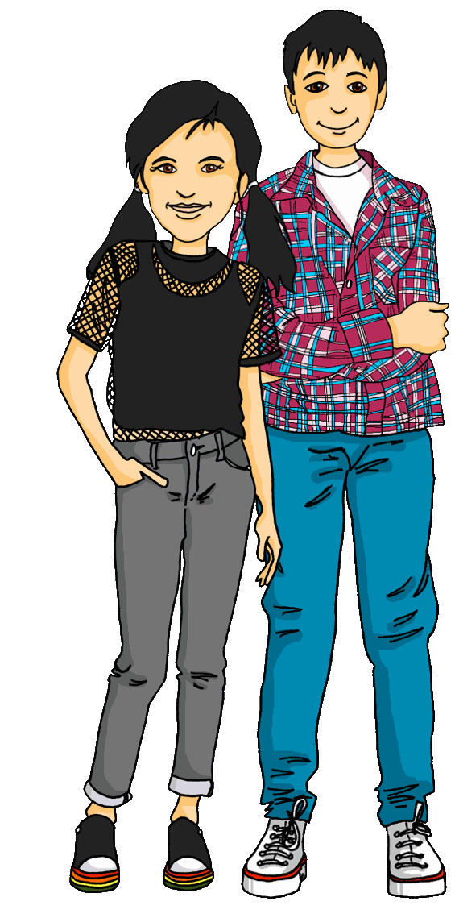
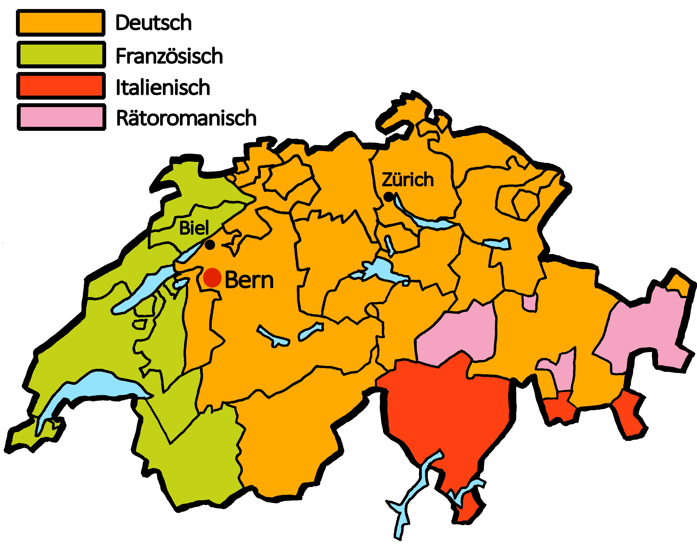
Kultur
Die Schweiz
There are four official languages in Switzerland!
People speak different languages in different regions.
German
We live in Biel!
French
Italian
Romansh
We speak German and French at school!
Notes:
Timing: 5 minutes
Aim: to present an introduction to Switzerland and the languages spoken there.
Procedure:
Read the text about languages in Switzerland.
Ask pupils if they can guess any of the languages that people speak in Switzerland. Pupils may be able to guess German.
Click to reveal a map of Switzerland and the languages spoken there.
Click to reveal Ronja and Lias and a speech bubble.
Explain that Ronja and Lias live in Biel (indicated on the map), where people speak both German and French.
15

Slide 16
Tschüss!
gelb
Notes:
16

