Slide 1
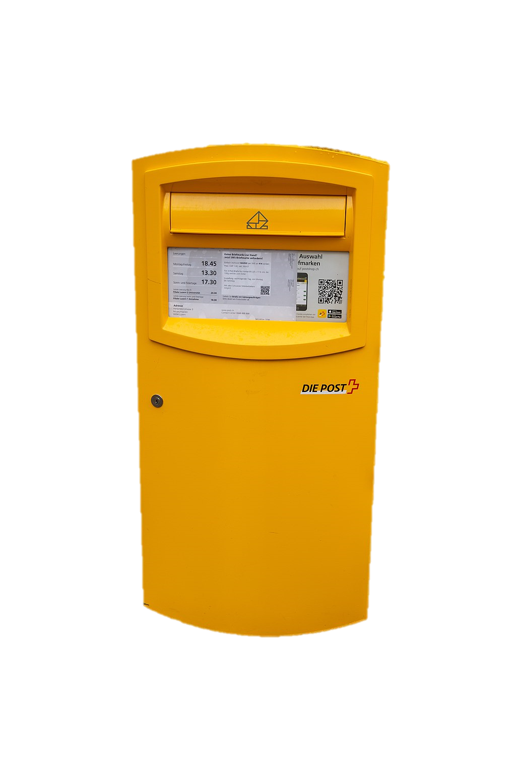
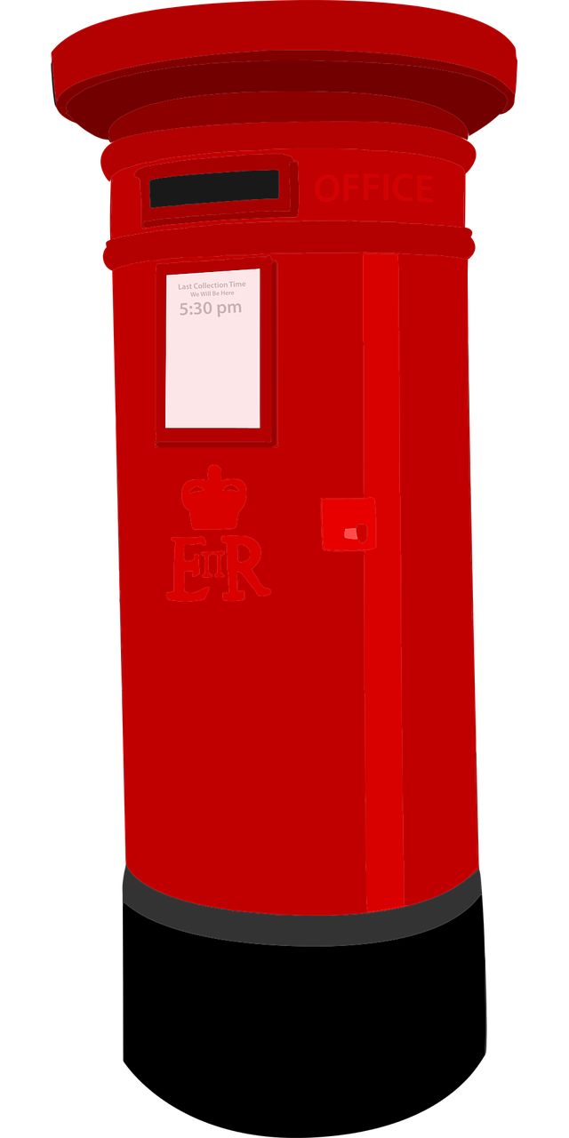
Describing me and others
rot
Follow ups 1-5
Term 1 Week 5
Notes:
Artwork by Steve Clarke. Pronoun pictures from NCELP (www.ncelp.org). All additional pictures selected from Pixabay and are available under a Creative Commons license, no
attribution required.
Phonics:
long [e] geben [49] Idee [451] mehr [52]
short [e] denken [128] Bett [659] helfen [338]
Vocabulary (new): was [38] falsch [524] grau [1560] grün [682] richtig [177] schwarz [471] weiß [474] das2 [1]
Revisit 1: du [54] bist [4]
Jones, R.L & Tschirner, E. (2019). A frequency dictionary of German: Core vocabulary for learners. London: Routledge.
The frequency rankings for words that occur in this PowerPoint which have been previously introduced in these resources are given in the SOW and in the resources that first introduced and formally re-visited those words.
For any other words that occur incidentally in this PowerPoint, frequency rankings will be provided in the notes field wherever possible.
Note that the first three lessons of the year teach language that can be continuously recycled as lesson routine every lesson in Y3/4.
The idea would be that the class teacher (whether or not s/he teaches the class German can re-use the language as part of the daily routine with the class.

Slide 2
aussprechen
Follow up 1
…
long [e]
geben
to give
more
Idee
mehr
Notes:
Timing: 1 minute
Aim: to remind pupils of the SSC long [e].
Procedure:
Re-present the SSC and the source word ‘geben’ (with gesture, if using).
Click to bring on the picture and get pupils to repeat the word ‘geben’ (with gesture, if using).
Present the cluster words in the same way, bringing on the picture and getting pupils to pronounce the words.
Vocabulary:
Idee [451] mehr [52]
2

Slide 3
aussprechen
short [e]
…
denken
to think
to help
Bett
helfen
Notes:
Timing: 1 minute
Aim: to consolidate the SSC short [e].
Procedure:
Re-present the SSC and the source word ‘denken’ (with gesture, if using).
Click to bring on the picture and get pupils to repeat the word ‘denken’ (with gesture, if using).
Present the cluster words in the same way, bringing on the picture and getting pupils to pronounce the words.
Note: a gesture for ‘denken’ might be to pretend to to put your finger to your mouth and as if you’re concentrating and thinking about something.
Bett [659] helfen [338]

Slide 4
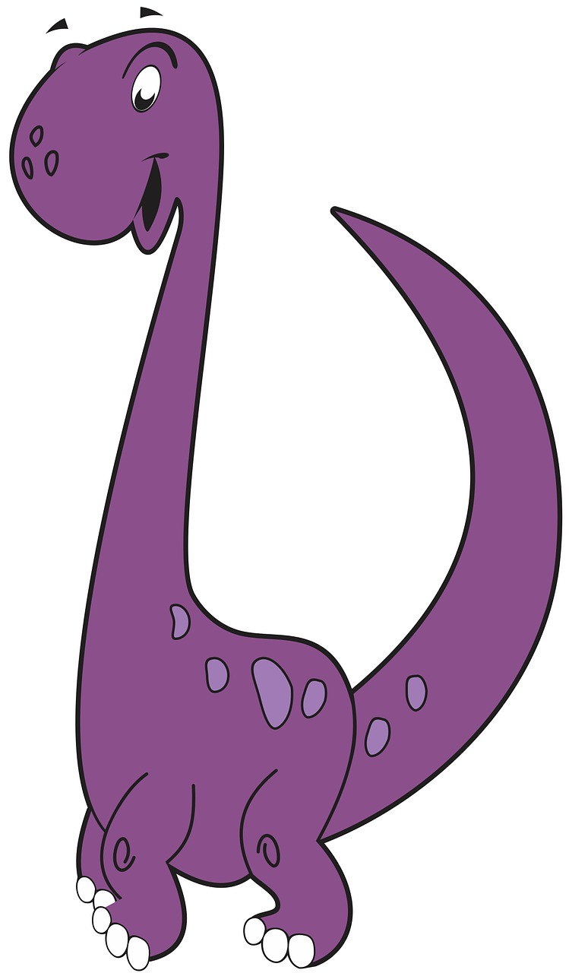
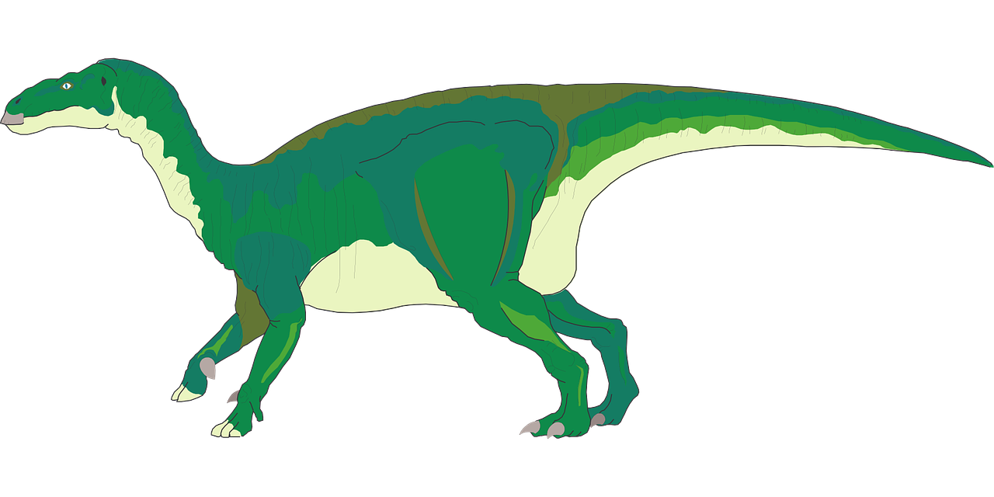
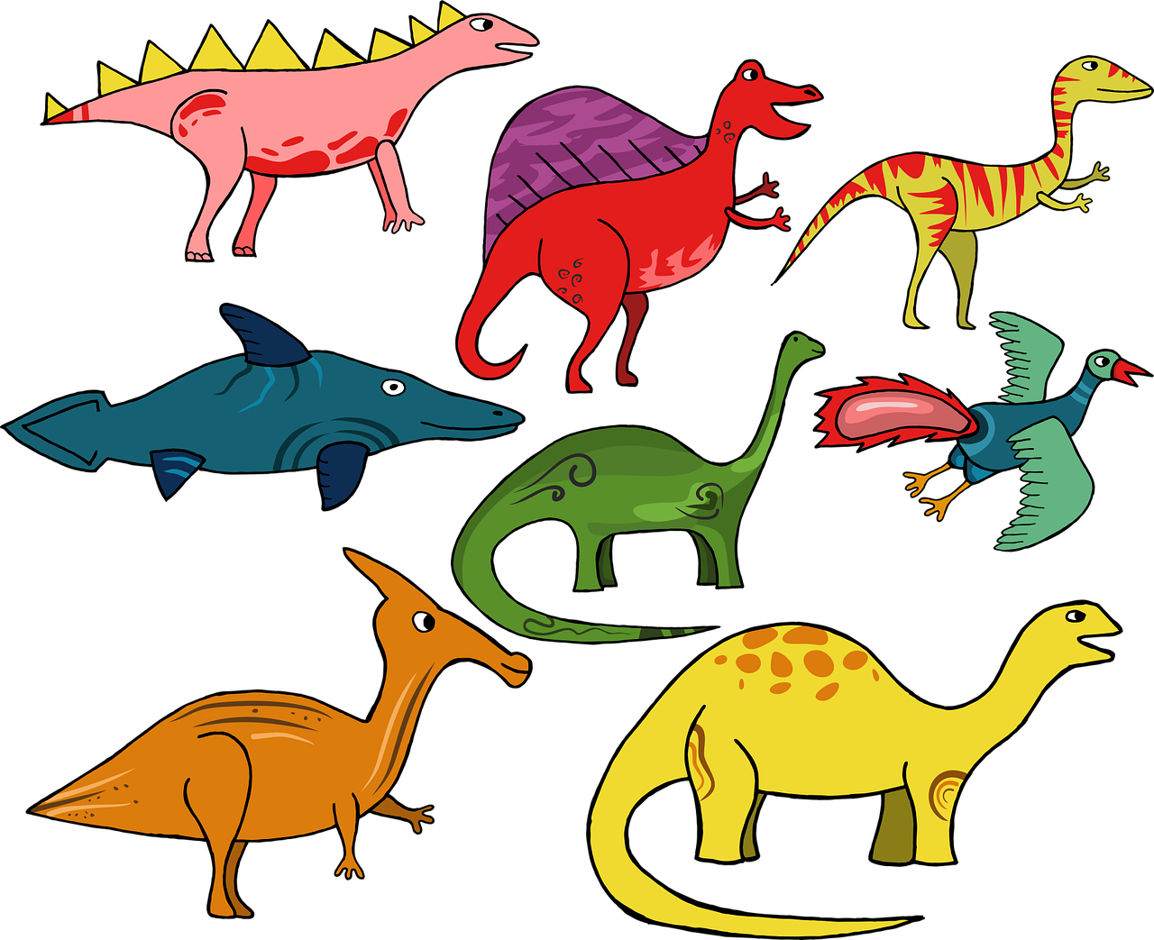
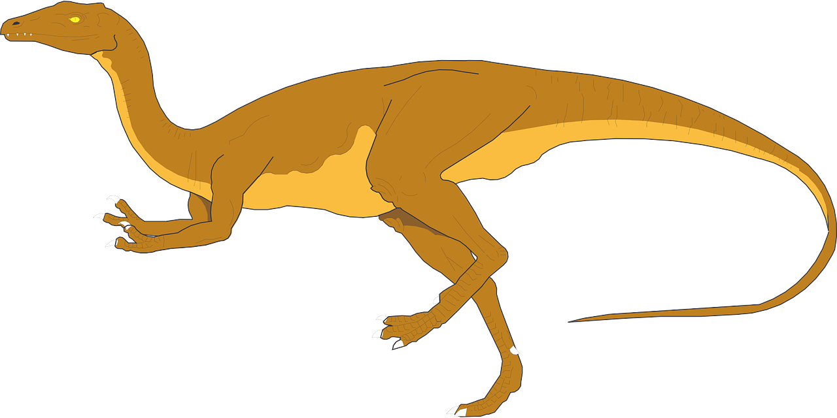
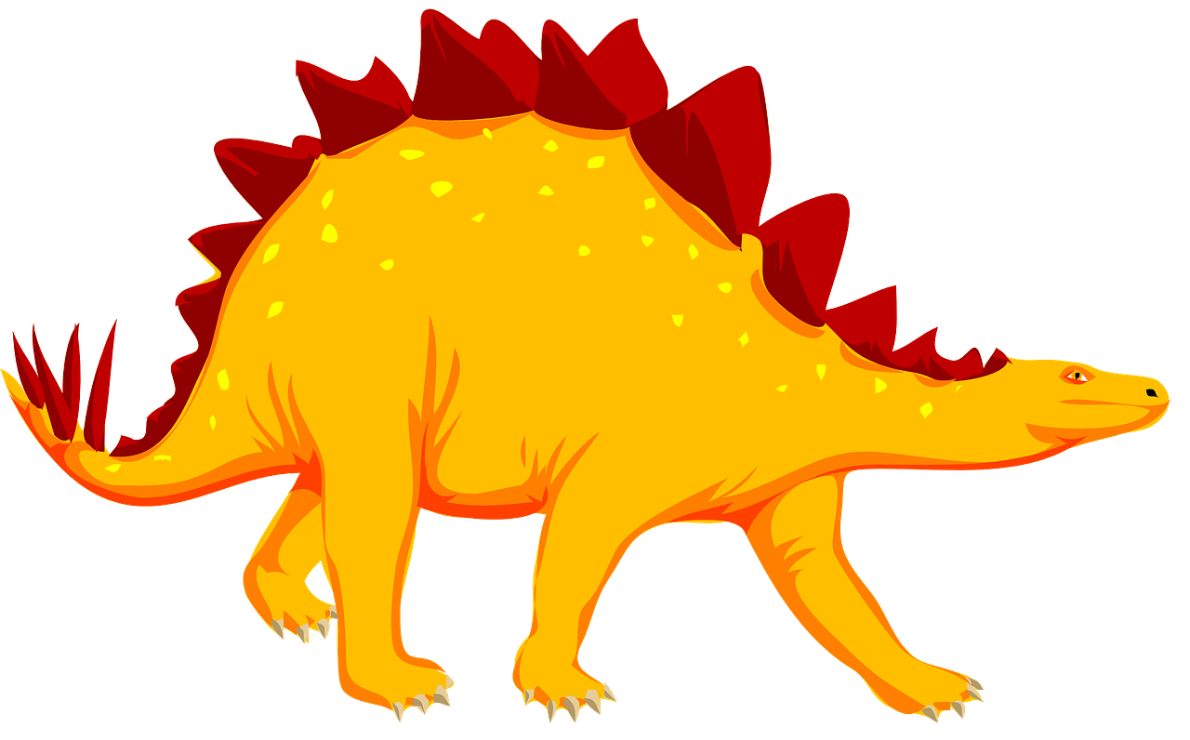
Follow up 1
…
Bist du Lena?
aussprechen
Helmut
Lena
Gisela
Helga
Lea
Felix
Petra
Bettina
Eva
Nele
20
Kornelia
S
Lennard
Leon
Andreas
0
START
Notes:
Timing: 3 minutes
Aim: to practise read aloud of long and short [e].
Procedure:
Pupil A secretly selects 5 dinosaurs.
Pupil B has 20 seconds to ‘find’ them all by saying them.
If s/he pronounces inaccurately, his/her partner can impose a 2-second penalty.
When time elapses, swap roles.
Continue for several rounds of activity to build up familiarity and fluency in production.
Additional task suggestions:
1. Click on each name to hear a native speaker say the name. Pupils note whether they hear long or short [e].

Slide 5
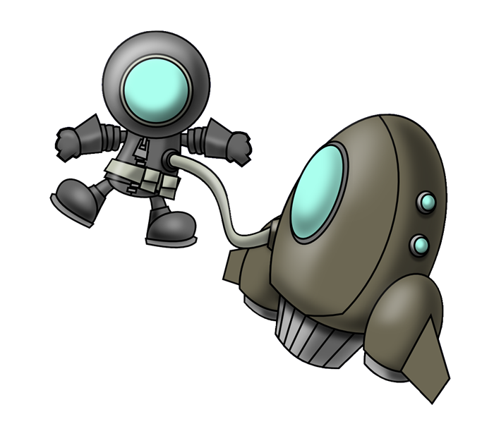
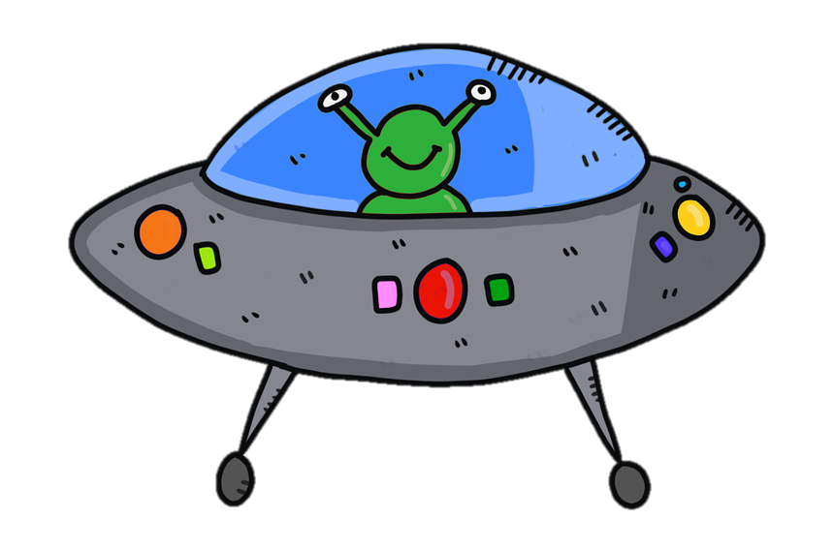
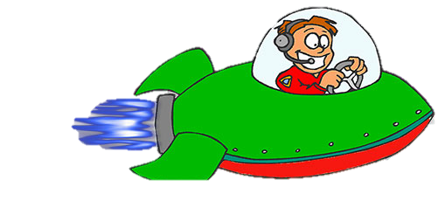
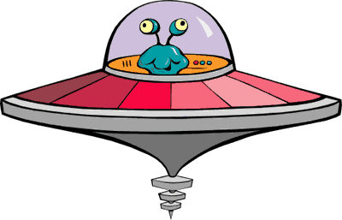
Follow up 2: Schreib auf Englisch*.
die Uhr
das Butterbrot
auf Englisch – in English
Watch out! They disappear fast! Then try to say the German for all the words on your list.
was
das
du
weiß
bist
schwarz
falsch
grün
grau
richtig
Notes:
With thanks to Amanda Izquierdo for the task design.
Timing: 5 minutes
Aim: to practise written recall of meanings of 12 items of vocabulary from this week’s new and revisited list.
Procedure:
Click to animate. A word will pass across the screen.
Pupils write down the English meaning.
Repeat for items 2-12.
In pairs, pupils try to say the German for all the items on their list. Note: they may not manage to do them all but should not worry at this stage. Follow up 5 offers another opportunity to revisit much of the same vocabulary.
The next slide presents the answers, in order, with audio.
Answers: du
grün
das Butterbrot
was
schwarz
falsch
grau
weiß
das
richtig
bist
die Uhr

Slide 6
Follow up 2: Antworten
das Butterbrot
du
was
grün
falsch
schwarz
grau
weiß
die Uhr
richtig
bist
das
Notes:
Aim: to practise written recall of meanings of 12 items of vocabulary from this week’s new and revisited list.
Procedure:
Click to animate. Words appear in answer order, with audio to check, if required.
Answers: du
grün
das Butterbrot
was
schwarz
falsch
grau
weiß
das
richtig
bist
die Uhr

Slide 7
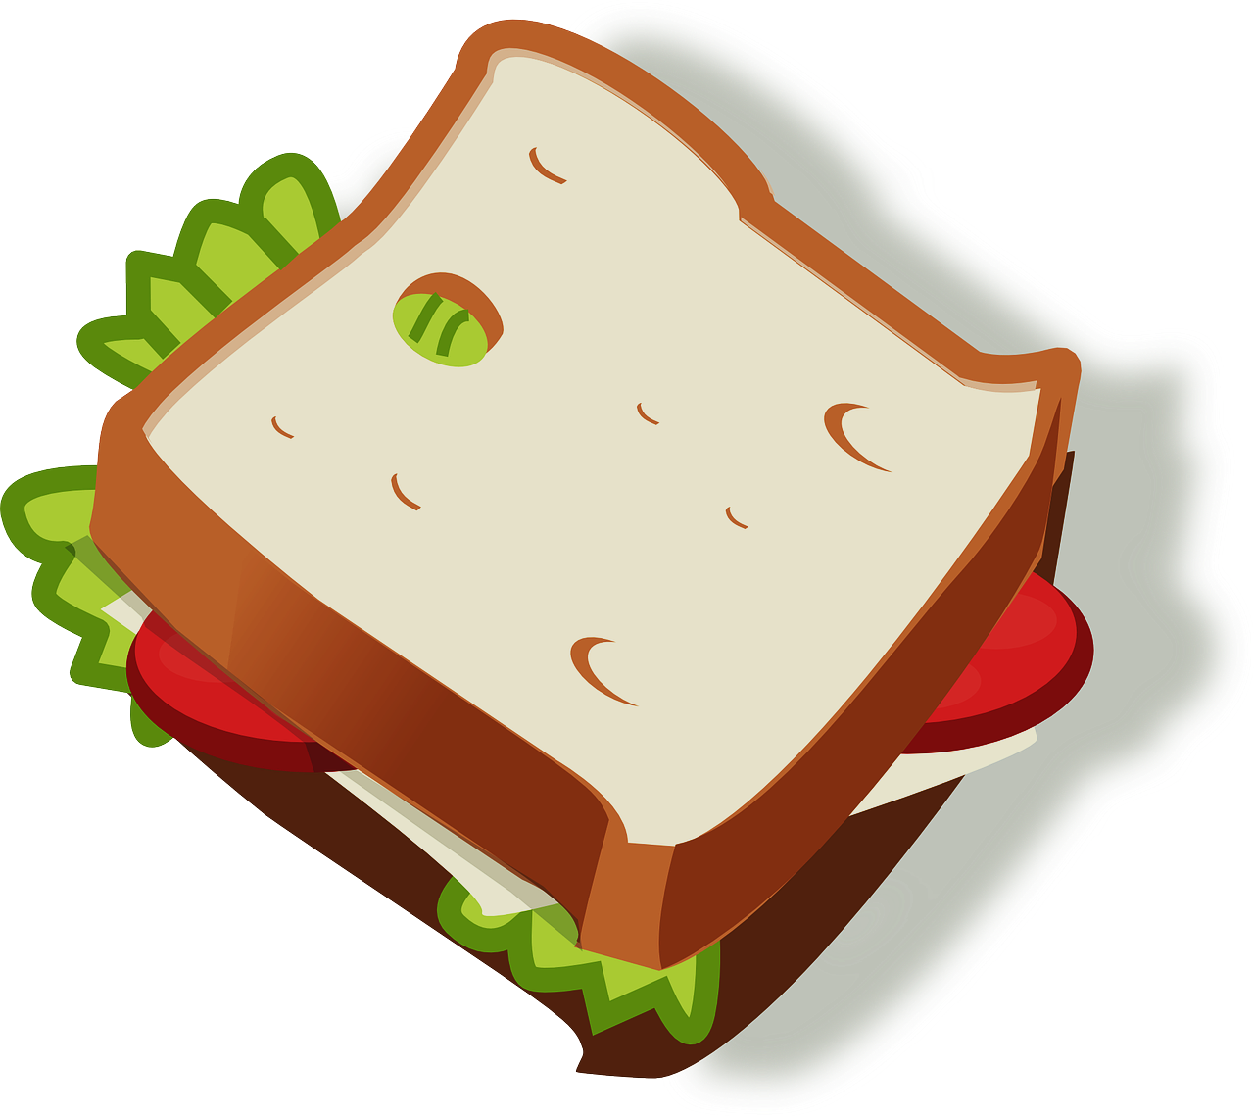
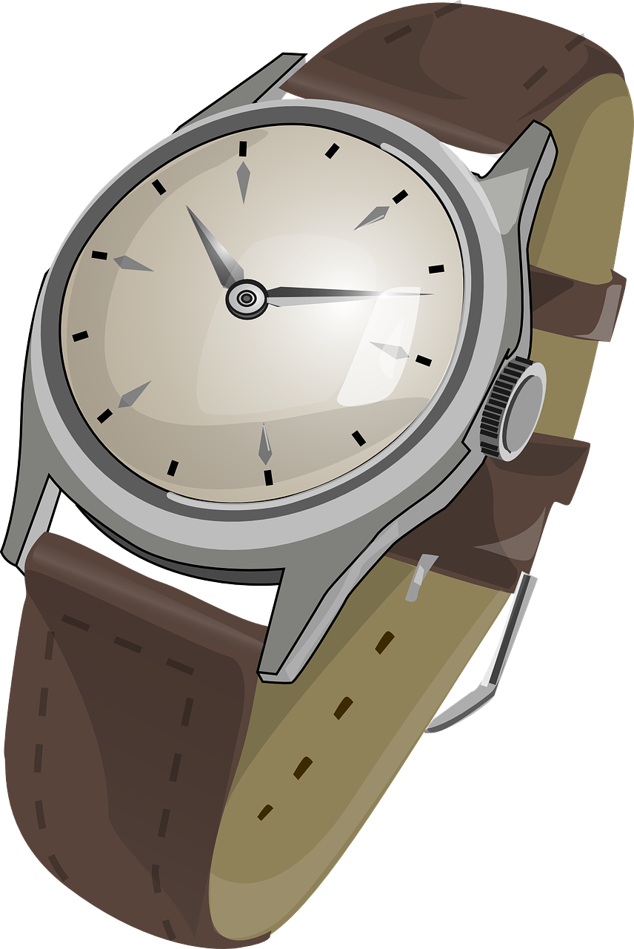
Follow up 3
Was ist das?
…
Your partner has four secret items, each one a different colour. Find out what they are!
sprechen
Was ist weiß?
Das Blatt ist weiß.
Notes:
Timing: 5 minutes
Aim: to practise spoken production and aural comprehension of ‘was…?’, colours, and six previously taught nouns with articles. Procedure:
Use this slide to model the activity. Each pupil will be given a handout (at end of presentation) with four differently coloured obejcts, which they must keep hidden from their partner. The goal is to find out each other’s objects.
Pupils take it in turns to ask each other a question using ‘was…?’ and one of the four colours at the top of the slide.
Their partner answers using their handout.
If a pupil can’t remember the word for one of the colours, they forfeit their go, and their partner has another go.
The first partner to find out all four of their partner’s items wins.

Slide 8
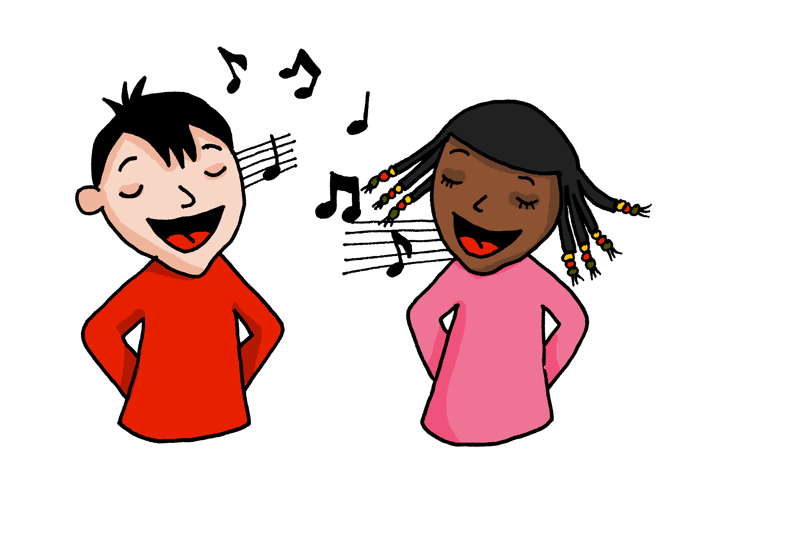
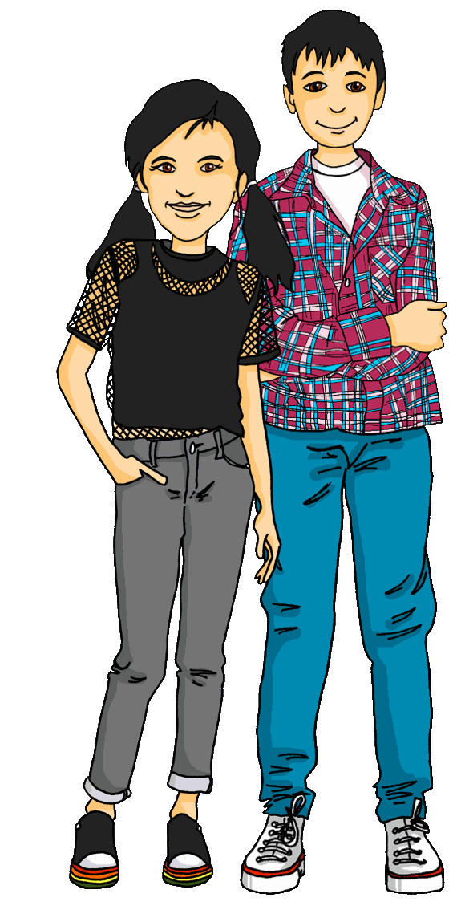
Follow up 4:

Hör zu. Dann sing mit!
singen
Hallo! Hallo! Guten Tag! Hallo! Hallo! Guten Tag!
Hallo! Ich bin hier,
Hallo! Du bist da, Hallo! Hallo! Guten Tag!
Notes:
Timing: 5 minutes (3 slides)
Aim: to practise some previously learnt vocabulary in a simple song (to the tune of ‘If you’re happy and you know it’).
Procedure: 1. Click to play the audio of the song.
2. Repeat the words of each line to practise saying them clearly (borrow the rhythm of the song so that this is a rehearsal stage before singing).
3. Click to play the audio again and this time, pupils join in.
Note: Teachers might like to re-use this song as part of their lesson starting routine in future lessons. Soon pupils will not need to see the words to recall it.

Slide 9
Follow up 5:

Schreib auf Englisch.
Can you get at least 15 points?
Wörter
 | ja | ist | Guten Morgen
 | sie | da | er
 | die Uhr | der Apfel | der Ball
 | die Jacke | das Blatt | du bist
 | das | richtig | was
 | falsch | grau | grün
yes
is
good morning
Vokabeln
x3
she
there
he
(the) watch, clock
(the) apple
(the) ball
x2
(the) jacket
(the) sheet
you are
that
right
what
x1
false
grey
green
Notes:
Timing: 5 minutes
Aim: to practise written comprehension of vocabulary from this and revisited weeks.
Procedure: 1. Give pupils a blank grid. They fill in the English meanings of any of the words they know, trying to reach 15 points in total. 2. Remind pupils that adjectives can refer to male or female persons and they should note this in their translations. E.g. pleased (f), short (m).
Note: The most recently learnt and practised words are pink, words from the previous week are green and those from week 1 are blue, thus more points are awarded for them, to recognise that memories fade and more effort (heavy lifting!) is needed to retrieve them.

Slide 10
Follow up 5:

Schreib auf Deutsch.
Can you get at least 15 points?
Wörter
 | there | he | is
 | Good morning | she | yes
 | (the) sandwich | (the) ball | (the) sheet
 | you are | (the) jacket | (the) apple
 | white | black | false
 | what | right | that
da
er
ist
Vokabeln
x3
Guten Morgen
sie
ja
das Butterbrot
der Ball
das Blatt
x2
du bist
die Jacke
der Apfel
weiß
schwarz
falsch
x1
was
richtig
das
Notes:
Timing: 5 minutes
Aim: to practise written comprehension of vocabulary from this and revisited weeks.
Procedure: 1. Give pupils a blank grid. They fill in the English meanings of any of the words they know, trying to reach 15 points in total. 2. Remind pupils that adjectives can refer to male or female persons and they should note this in their translations. E.g. pleased (f), short (m).
Note: The most recently learnt and practised words are pink, words from the previous week are green and those from week 1 are blue, thus more points are awarded for them, to recognise that memories fade and more effort (heavy lifting!) is needed to retrieve them.

Slide 11
Tschüss!
gelb
Notes:
11

Slide 12
Follow up 3
Partner A
…
sprechen
Notes:
HANDOUT

Slide 13
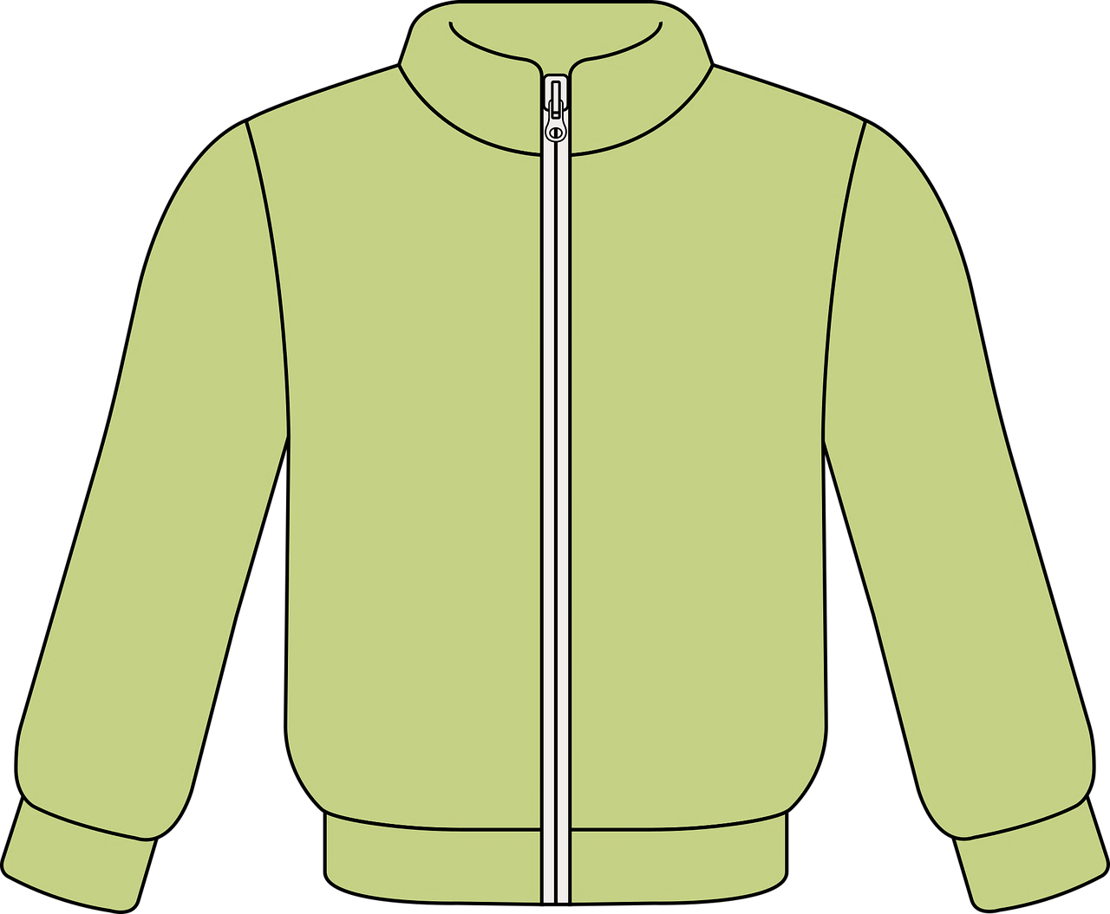
Follow up 3
Partner B
…
sprechen
Notes:
HANDOUT

Slide 14
Follow up 5:

Schreib auf Englisch.
Can you get at least 15 points?
Wörter
 | ja | ist | Guten Morgen
 | sie | da | er
 | die Uhr | der Apfel | der Ball
 | die Jacke | das Blatt | du bist
 | das | richtig | was
 | falsch | grau | grün
Vokabeln
x3
x2
x1
Notes:
HANDOUT

Slide 15
Follow up 5:

Schreib auf Deutsch.
Can you get at least 15 points?
Wörter
 | there | he | is
 | Good morning | she | yes
 | (the) sandwich | (the) ball | (the) sheet
 | you are | (the) jacket | (the) apple
 | white | black | falsch
 | what | right | that
Vokabeln
x3
x2
x1
Notes:
HANDOUT

