Slide 1
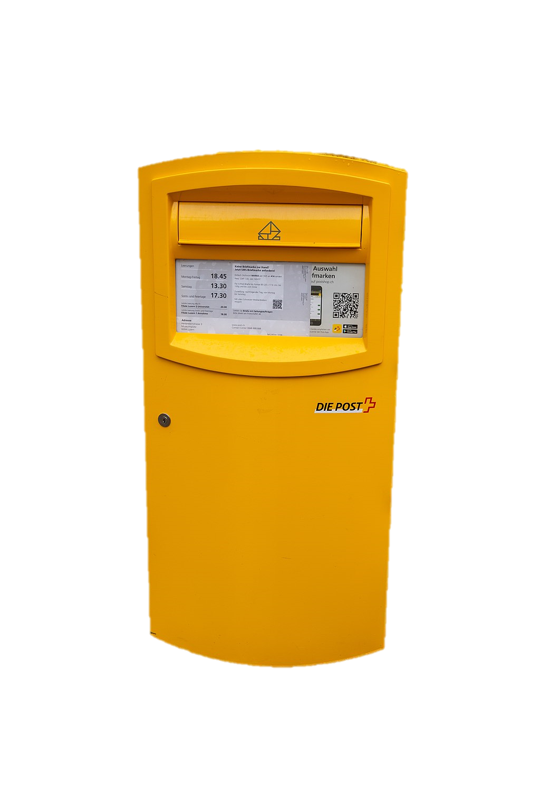
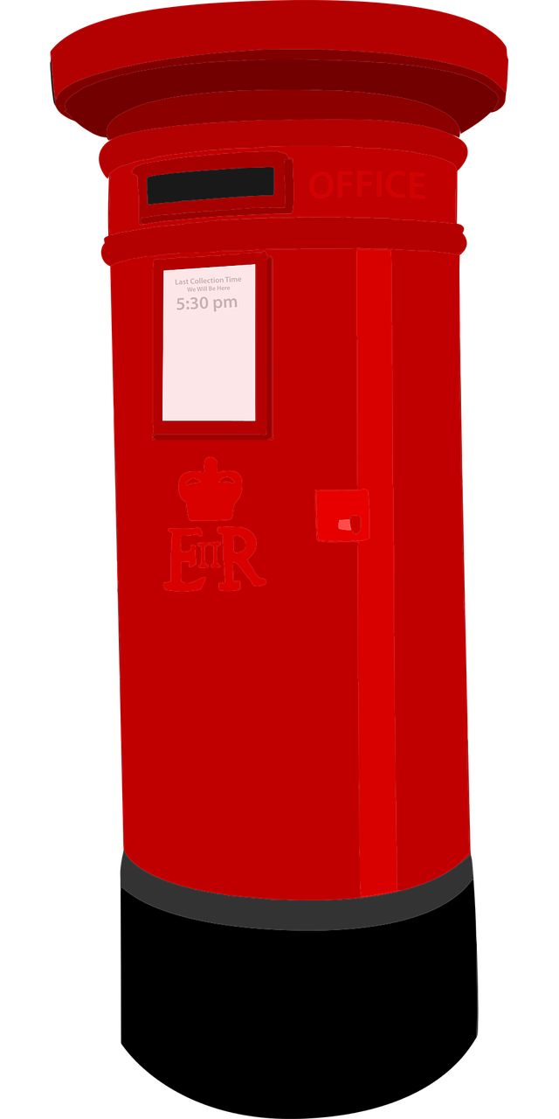
Describing me and others
gelb
Describing nouns
SSC long and short [e]
Term 1 Week 5
Notes:
Artwork by Steve Clarke. Pronoun pictures from NCELP (www.ncelp.org). All additional pictures selected from Pixabay and are available under a Creative Commons license, no
attribution required.
Phonics:
long [e] geben [49] Idee [451] mehr [52]
short [e] denken [128] Bett [659] helfen [338]
Vocabulary (new): was [38] falsch [524] grau [1560] grün [682] richtig [177] schwarz [471] weiß [474] das2 [1]
Revisit 1: du [54] bist [4]
Jones, R.L & Tschirner, E. (2019). A frequency dictionary of German: Core vocabulary for learners. London: Routledge.
The frequency rankings for words that occur in this PowerPoint which have been previously introduced in these resources are given in the SOW and in the resources that first introduced and formally re-visited those words.
For any other words that occur incidentally in this PowerPoint, frequency rankings will be provided in the notes field wherever possible.
Note that the first three lessons of the year teach language that can be continuously recycled as lesson routine every lesson in Y3/4.
The idea would be that the class teacher (whether or not s/he teaches the class German can re-use the language as part of the daily routine with the class.
1

Slide 2
aussprechen
long [e]
…
Notice that the 2nd ‘e’ sounds like the ‘a’ in ‘ago’.
to give
geben
Notes:
Timing: 1 minute
Aim: to introduce the SSC long [e].
Procedure:
Introduce the SSC and present the source word ‘geben’ (with gesture, if using).
Click to bring on the picture and get pupils to repeat the word ‘geben’ (with gesture, if using).
Note: a gesture for ‘geben’ might be to pretend to give someone an object.
geben [49]
2

Slide 3
aussprechen
long [e]
…
geben
to give
more
Idee
mehr
Notes:
Timing: 1 minute
Aim: to introduce the SSC long [e].
Procedure:
Re-present the SSC and the source word ‘geben’ (with gesture, if using).
Click to bring on the picture and get pupils to repeat the word ‘geben’ (with gesture, if using).
Present the cluster words in the same way, bringing on the picture and getting pupils to pronounce the words.
Idee [451] mehr [52]
3

Slide 4
aussprechen
short [e]
…
Notice that the 2nd ‘e’ sounds like the ‘a’ in ‘ago’.
to think
denken
Notes:
Timing: 1 minute
Aim: to consolidate the SSC short [e].
Procedure:
Introduce the SSC and present the source word ‘denken’ (with gesture, if using).
Click to bring on the picture and get pupils to repeat the word ‘denken’ (with gesture, if using).
Note: a gesture for ‘denken’ might be to pretend to to put your finger to your temple as though you are pondering something.
denken [128]

Slide 5
aussprechen
short [e]
…
denken
to think
to help
Bett
helfen
Notes:
Timing: 1 minute
Aim: to consolidate the SSC short [e].
Procedure:
Re-present the SSC and the source word ‘denken’ (with gesture, if using).
Click to bring on the picture and get pupils to repeat the word ‘denken’ (with gesture, if using).
Present the cluster words in the same way, bringing on the picture and getting pupils to pronounce the words.
Note: a gesture for ‘denken’ might be to pretend to to put your finger to your mouth and as if you’re concentrating and thinking about something.
Bett [659] helfen [338]

Slide 6
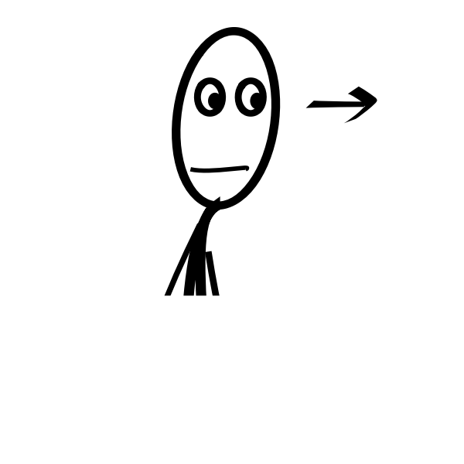
hören
long and short [e]
Hör zu. Ist das long[e] oder short [e]?
hören
 | long [e] | short [e] | word
1 |  |  | Bett
2 |  |  | sehen
3 |  |  | Idee
4 |  |  | gelb
5 |  |  | mehr
6 |  |  | Fest
Notes:
Timing: 5 minutes
Aim: to consolidate the SSC long [e] and short [e] by practising listening to the different pronunciations.
Procedure:
1. Click audio button 1 to play the recording for item 1. Pupils need to decide is it long [e] or short [e] and write list of S for short and L for long.
2. Elicit the answer; encourage pupils to pay particular attention to short [e] or long [e].
3. Click to bring up the answer tick for item 1.
4. Elicit the whole word; if necessary click the audio button again to play recording again.
5. Click to bring up the written version of the German word, together with picture.
6. Continue for items 2-6.
Transcript: Bett
sehen
Idee
gelb
mehr
Fest
Vocabulary:
Fest [2089] gelb [1446] sehen [79]

Slide 7
Vokabeln
Vokabeln lernen
You already know that ‘das’ means ‘the’, but it also means ‘that’! E.g. Was ist das?
What is that?
Wörter
das
richtig
falsch
was
Listen carefully to this word. You know how to say ‘ich’; the ‘ig’ here sounds the same as ‘ich’!
In German, ‘ß’ sounds like an ‘s’
grau
grün
schwarz
weiß
Notes:
Timing: 5 minutes
Aim: to present and practise written comprehension and read aloud of the new vocabulary for this week.
Procedure: 1. Click for a German word. Elicit pronunciation from pupils.
2. Click for the English meaning and picture prompt. Elicit the German word again.
3. Present all six words like this, in order.
4. Click for one English meaning to disappear. Elicit the English meaning from pupils. Continue with the remaining items.
5. Click for the German word to disappear. Elicit the German from pupils. Continue with the remaining items.
7

Slide 8
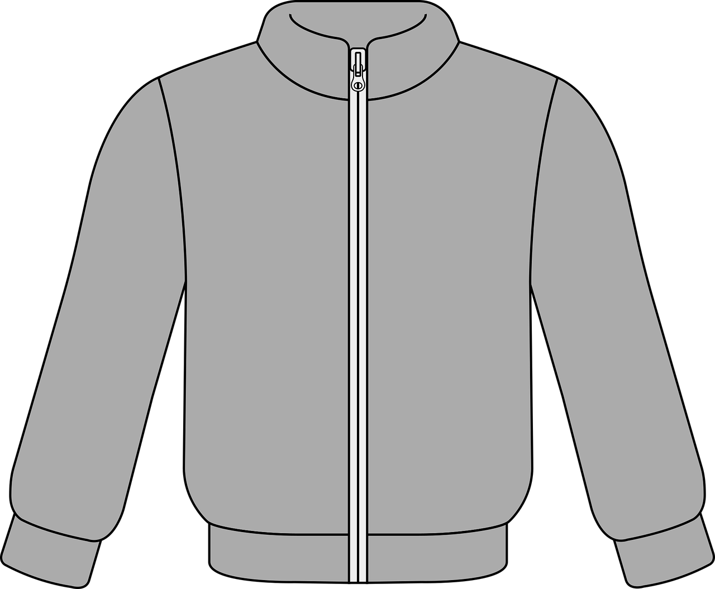
hören
Richtig oder* falsch?
Robbie the robot is learning colours. Help him out. Is he right or wrong?
Hör zu
 | richtig
 | richtig
 | falsch
 | richtig
 | falsch
 | falsch
1
2
3
4
5
6
oder - or
Notes:
Timing: 5 minutes
Aim: to practise aural comprehension of ‘was’ and the colours. To practise writing ‘richtig’ and ‘falsch’
Procedure:
1. Click on an audio button to hear a question and Robbie’s answer.
2. Pupils look at the objects on the right and decide whether Robbie is right or wrong, noting ‘richtig’ or ‘falsch’.
3. Click to reveal answers.
Transcript
Was ist grün? Der Apfel ist grün.
Was ist grau? Der Ball ist grau.
Was ist schwarz? Die Uhr ist schwarz.
Was ist weiß? Das Blatt ist weiß.
Was ist grau? Die Jacke ist grau.
Was ist schwarz? Das Butterbrot ist schwarz.
8

Slide 9
Kultur
Farben* in der Schweiz und England
*die Farbe - colour
Countries have different colours for some things.
Look at the pictures:
Wo ist das?
Wo ist das?
Richtig! Das ist in England.
Ja, das ist in der Schweiz.
Notes:
Timing: 5 minutes (5 x slides)
Aim: to raise intercultural awareness of different uses of colours for different things in Switzerland and England.
Procedure:
Read the short explanation about colours in Switzerland and England.
Click to present the example of the post boxes, asking Wo ist das? and eliciting Das ist in England/ der Schweiz from the whole class.
Click to reveal the correct answers.
Then repeat steps 2-3 with the next 4 slides.
Picture attribution: Swiss post box
Shesmax, CC BY-SA 4.0 <https://creativecommons.org/licenses/by-sa/4.0>, via Wikimedia Commons
9

Slide 10
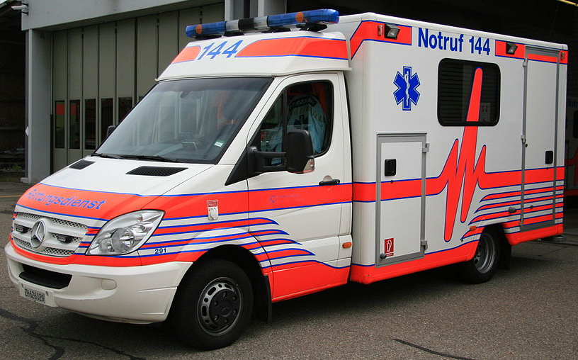
Kultur
Farben* in der Schweiz und England
Wo ist das?
Wo ist das?
Richtig! Das ist in der Schweiz.
Ja, das ist in England.
Notes:
[2/5]
Attribution: Swiss ambulance
Schutz & Rettung Zürich, CC BY-SA 3.0 <https://creativecommons.org/licenses/by-sa/3.0>, via Wikimedia Commons
Attribution: UK ambulance
By MANHATTAN RESEARCH INC (MANHATTAN RESEARCH INC) from MANHATTAN RESEARCH INC , MANHATTAN RESEARCH INC - LJ58OJX LONDON AMBULANCE QUEEN VICTORIA STREET CITY OF LONDON, CC BY 2.0, https://commons.wikimedia.org/w/index.php?curid=49339063
10

Slide 11
Kultur
Farben* in der Schweiz und England
Wo ist das?
Wo ist das?
Richtig! Das ist in der Schweiz.
Ja, das ist in England.
Notes:
[3/5]
11

Slide 12
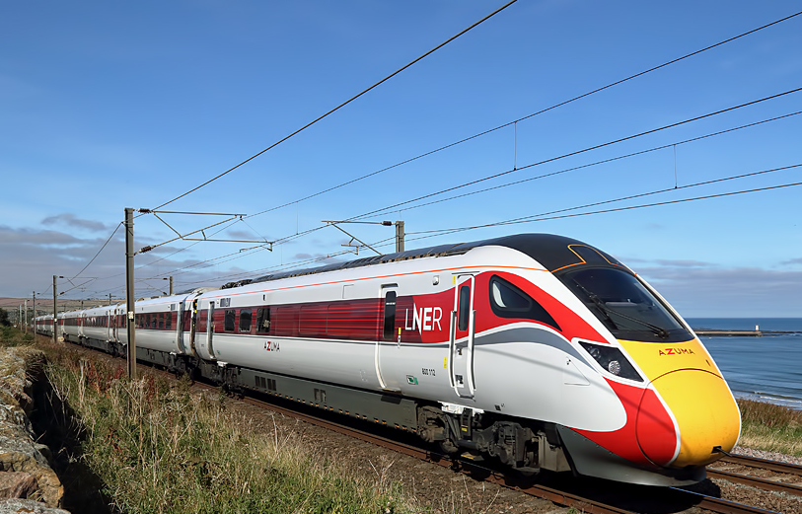
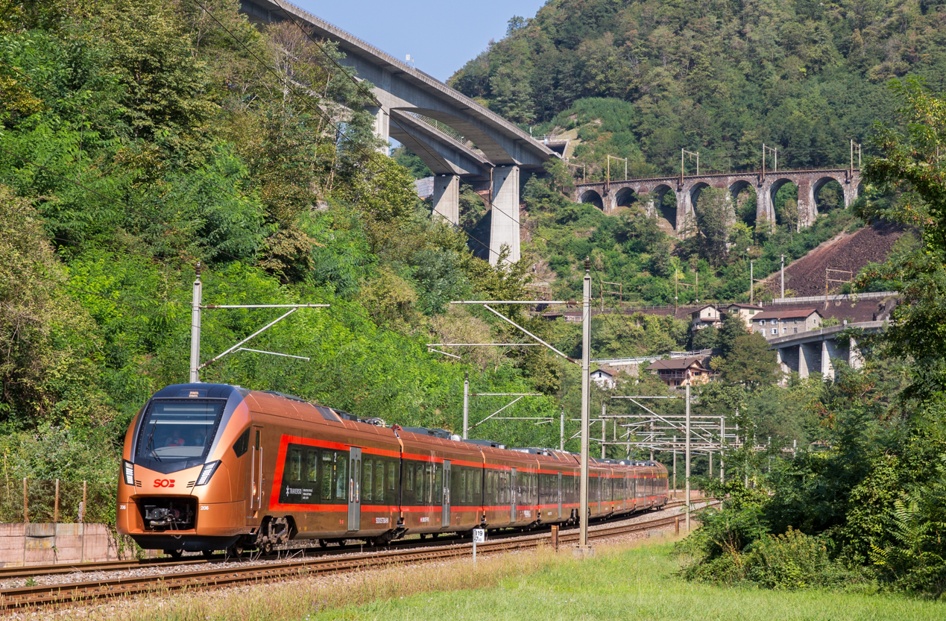
Kultur
Farben* in der Schweiz und England
Wo ist das?
Wo ist das?
Richtig! Das ist in England.
Ja, das ist in der Schweiz.
Notes:
[4/5]
Attribution: Swiss train
By SOB Suedostbahn - https://www.flickr.com/photos/suedostbahn/50746556233/, CC BY 2.0, https://commons.wikimedia.org/w/index.php?curid=103871406
Attribution: British train
By Walter Baxter, CC BY-SA 2.0, https://commons.wikimedia.org/w/index.php?curid=110865841
12

Slide 13
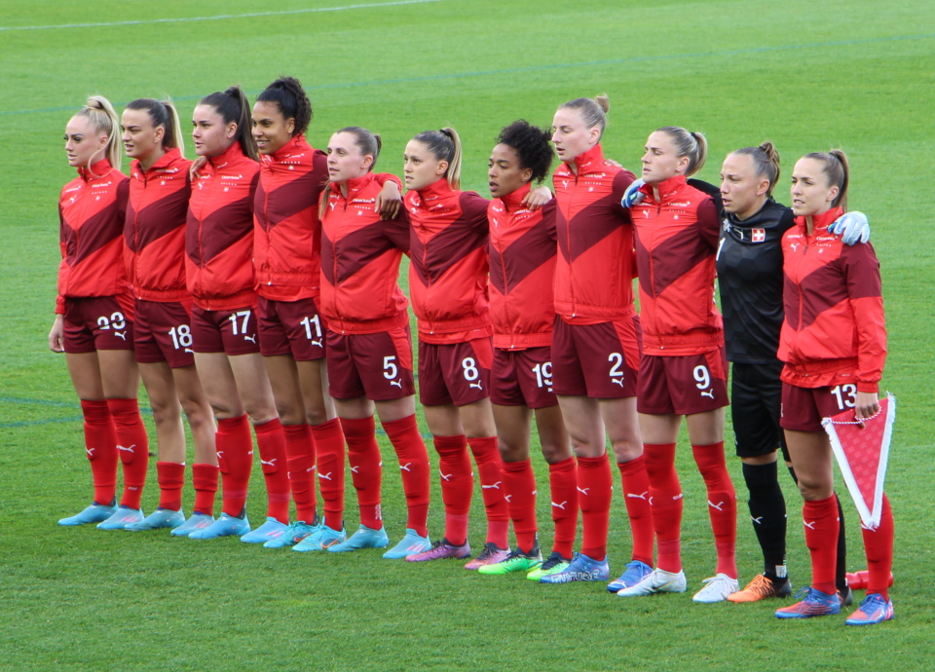
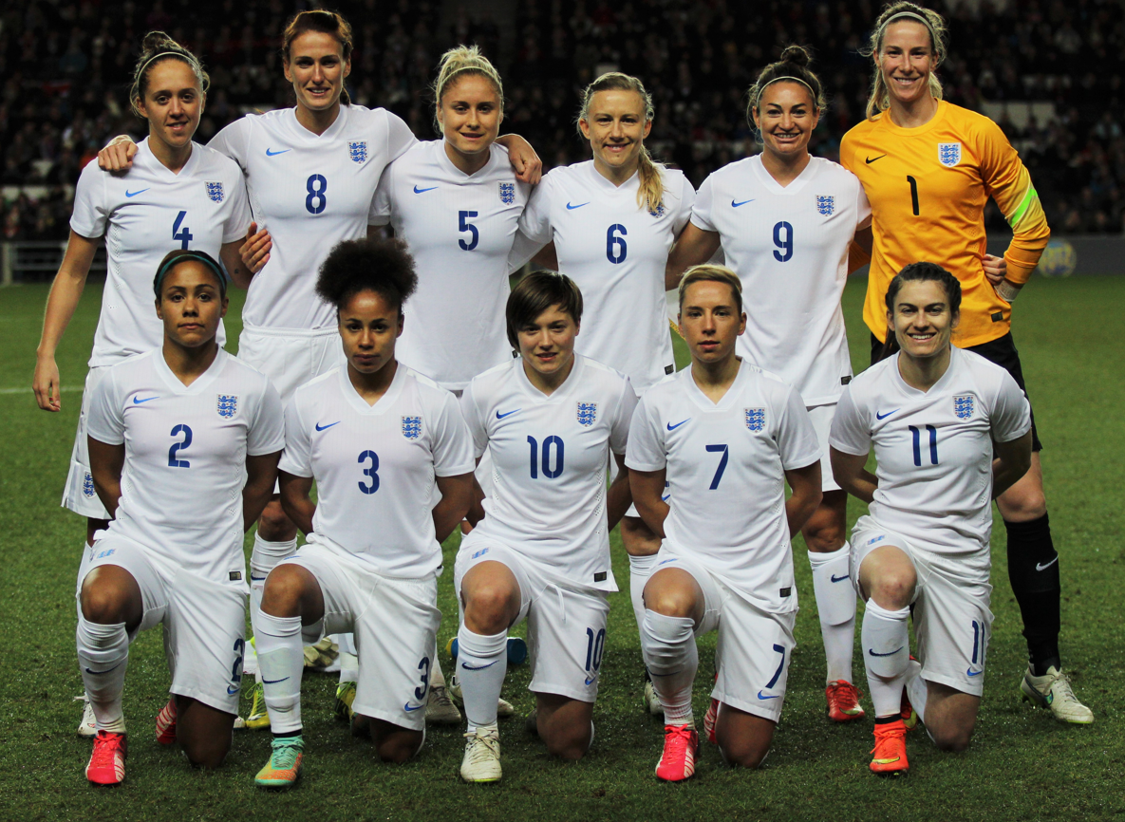
Kultur
Farben* in der Schweiz und England
Wo ist das?
Wo ist das?
Richtig! Das ist in der Schweiz.
Ja, das ist in England.
Notes:
[5/5]
Attribution: Switzerland national football team
By Frank Haug - Own work, CC BY 3.0, https://commons.wikimedia.org/w/index.php?curid=116996988
Attribution: England national football team
By joshjdss - England Women&#039;s Vs USA, CC BY 2.0, https://commons.wikimedia.org/w/index.php?curid=38466640
13

Slide 14
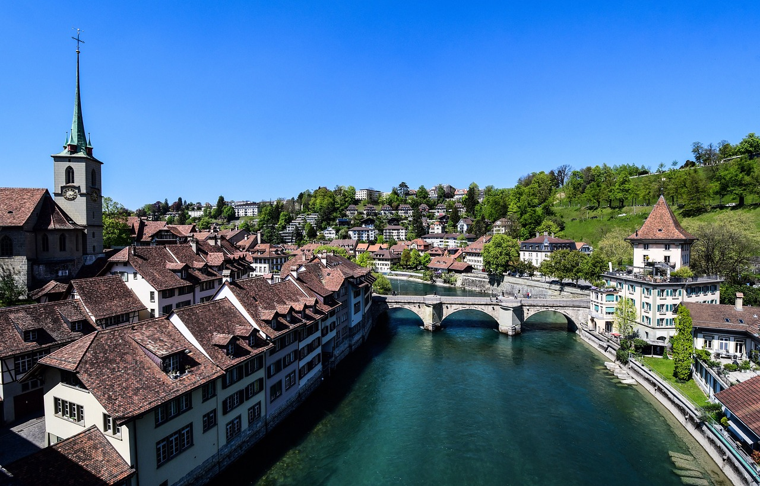
Nouns
Remember that all German nouns start with a capital letter, wherever they are in the sentence:
Der Ball ist da.
The ball is there.
All German proper nouns also start with capital letters, just like in English:
And don’t forget that all sentences start with a capital letter in both German and English!
e.g. Bern, Lias.
Notes:
Timing: 2 minutes
Aim: to recap information about capitalisation of German (and English) nouns.
Procedure:
Click through the animations to present the new information.
Elicit English translation for the German example provided.
14

Slide 15
schreiben
Schreib das richtig.
Lias’s computer screen isn’t working. All his sentences have lost their punctuation. Can you help put them right?
1
der
film
ist
wunderbar
1. Der Film ist wunderbar.
2
du
bist
in
der
schweiz
2. Du bist in der Schweiz.
3
da
ist
ronja
3. Da ist Ronja.
4
sie
ist
in
bern
4. Sie ist in Bern.
5
der
apfel
ist
grün
5. Der Apfel ist grün.
6
der
laptop
ist
schwarz
6. Der Laptop ist schwarz.
Notes:
Timing: 6 minutes Aim: To practise applying the rules about capitalisation to simple German sentences. Procedure: 1. Ensure that pupils are clear about the scenario and the task.
2. Do the first item to model the activity with pupils. 3. Pupils write each sentence.
4. Click to bring up the written answers.
Frequency of unknown words and cognates:
Film [505] Laptop [4516]
Jones, R.L & Tschirner, E. (2019). A frequency dictionary of German: Core vocabulary for learners. London: Routledge.
15

Slide 16
Tschüss!
gelb
Notes:
16

