Slide 1
Describing me and others
gelb
Follow ups 1-5
Term 1 Week 6
Notes:
Artwork by Steve Clarke. Pronoun pictures from NCELP (www.ncelp.org). All additional pictures selected from Pixabay and are available under a Creative Commons license, no
attribution required.
Phonics:
long [i] Familie [329] Linie [926] ihn [92]
short [i] bitte [471] mit [13] Hilfe [481]
Vocabulary (new): Ding [370] Farbe [1079] Ort [341] Person [357] klar [239] oder [35]
Revisit 1: es [12] wo [94] England [1762] die Schweiz [763] wunderbar [1603] und [2]
Jones, R.L & Tschirner, E. (2019). A frequency dictionary of German: Core vocabulary for learners. London: Routledge.
The frequency rankings for words that occur in this PowerPoint which have been previously introduced in these resources are given in the SOW and in the resources that first introduced and formally re-visited those words.
For any other words that occur incidentally in this PowerPoint, frequency rankings will be provided in the notes field wherever possible.
Note that the first three lessons of the year teach language that can be continuously recycled as lesson routine every lesson in Y3/4.
The idea would be that the class teacher (whether or not s/he teaches the class German can re-use the language as part of the daily routine with the class.

Slide 2
aussprechen
Follow up 1
…
long [i]
Familie
Linie
ihn
Notes:
Timing: 1 minute
Aim: to revisit long [i].
Procedure:
Re-present the SSC and the source word ‘Familie’ (with gesture, if using).
Click to bring on the picture and get pupils to repeat the word ‘Familie’ (with gesture, if using).
Present the cluster words in the same way, bringing on the picture and getting pupils to pronounce the words.
ihn [52] Linie [451]
2

Slide 3
aussprechen
Follow up 1
…
short [i]
bitte
with
🙏
Hilfe!
mit
Notes:
Timing: 1 minute
Aim: to revise the SSC short [i].
Procedure:
Re-present the SSC and the source word ‘bitte’ (with gesture, if using).
Click to bring on the picture and get pupils to repeat the word ‘bitte’ (with gesture, if using).
Present the cluster words in the same way, bringing on the picture and getting pupils to pronounce the words.
Note: a gesture for ‘bitte’ might be to put your hands together as though asking for something.
Hilfe [481] mit [13]

Slide 4
Follow up 1
Some German words look very similar to English words.
However, they may sound different. Is the [i] in the German word the same sound as in English?
Hör zu
hören
1
2
3
Film
Finger
Triumph
4
5
6
Musik
Tipp
Insekt
7
8
9
Tennis
Berlin
privat
Notes:
Timing: 5 minutes
Aim: to practise aural distinction between English and German SSC [i], by listening to cognates.
Procedure:
Do number 1 with pupils to model the task.
Click to hear the German word.
Ask them to tick if they think it is the same [i] sound as in the English word.
Click to reveal the written word and the answer tick or cross.
Repeat steps 2-4 with the remaining eight words.
Transcript:
Film Finger
Triumph Musik
Tipp
Insekt
Tennis
Berlin
privat
Frequency of unknown words and cognates:
Berlin [n/a] Film [505] Finger [1019] Insekt [4736] Musik [509] privat [746] Tennis [4671] Tipp [3088] Triumph [4616]
Jones, R.L & Tschirner, E. (2019). A frequency dictionary of German: Core vocabulary for learners. London: Routledge.

Slide 5
Follow up 2
Yes/no questions
Remember! In German, change a statement into a question by swapping the verb and subject round:
Statement
Das ist eine Farbe.
That is a colour.
Question
Ist das eine Farbe?
Is that a colour?
Notes:
Timing: 2 minutes
Aim: to recap yes / no questions = swapping verb and subject to form questions.
Procedure:
Read the grammar explanation.
Elicit English translation for the German examples provided.

Slide 6
Follow up 2
Ist das ein Ort, eine Person oder ein Ding?
Das ist ein Ort.
lesen
A
Ronja
B
die Schweiz
C
der Ball
Notes:
Timing: 5 minutes (6 slides)
Aim: to practise reading comprehension of a range of the new language learnt so far in the course. To scaffold for the following speaking task.
Procedure:
Explain the task. Lias and Gabriel are playing a game of place, person, thing.
Pupils read the speech bubbles and then note down A, B, or C. Pictures are hidden at this stage to encourage comprehension.
Click to reveal answer and pictures to clarify meaning.
Click to bring up the next slide.

Slide 7
Follow up 2
Ist das ein Ort, eine Person oder ein Ding?
Ist das eine Person?
Ja
lesen
A
Herr Lehmann
B
England
C
die Uhr
Notes:
[2/6]

Slide 8
Follow up 2
Ist das ein Ort, eine Person oder ein Ding?
Ist das ein Ding?
Nein
lesen
A
Leonie
B
der Apfel
C
das Butterbrot
Notes:
[3/6]

Slide 9
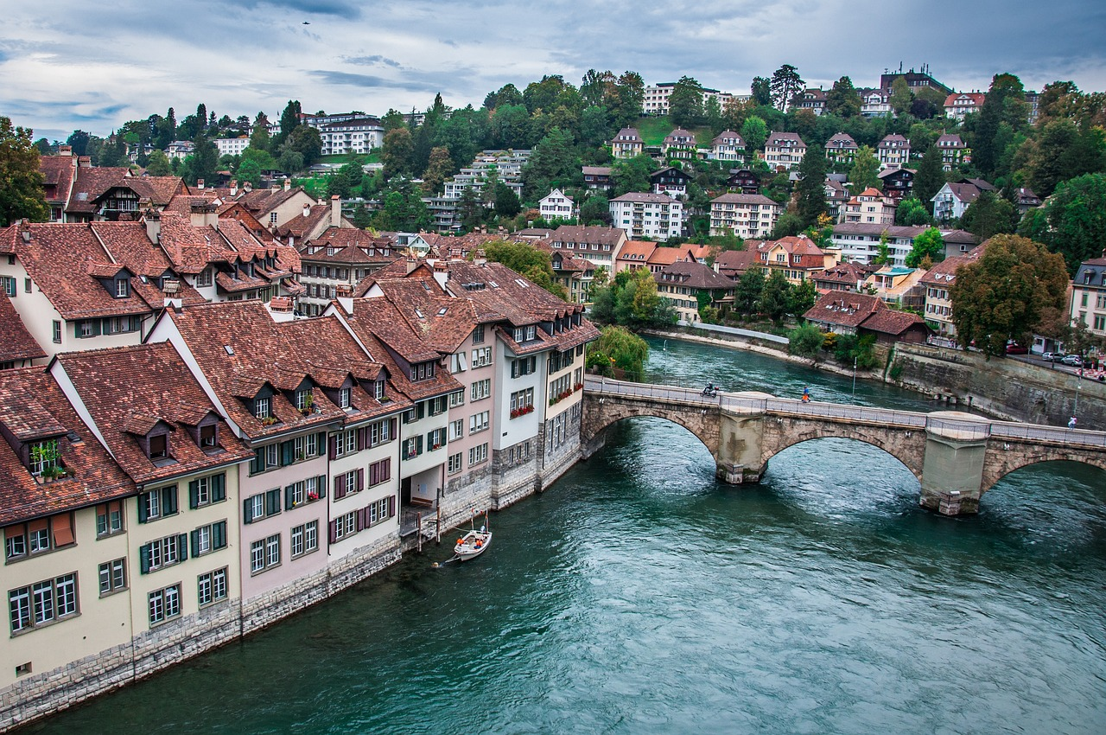
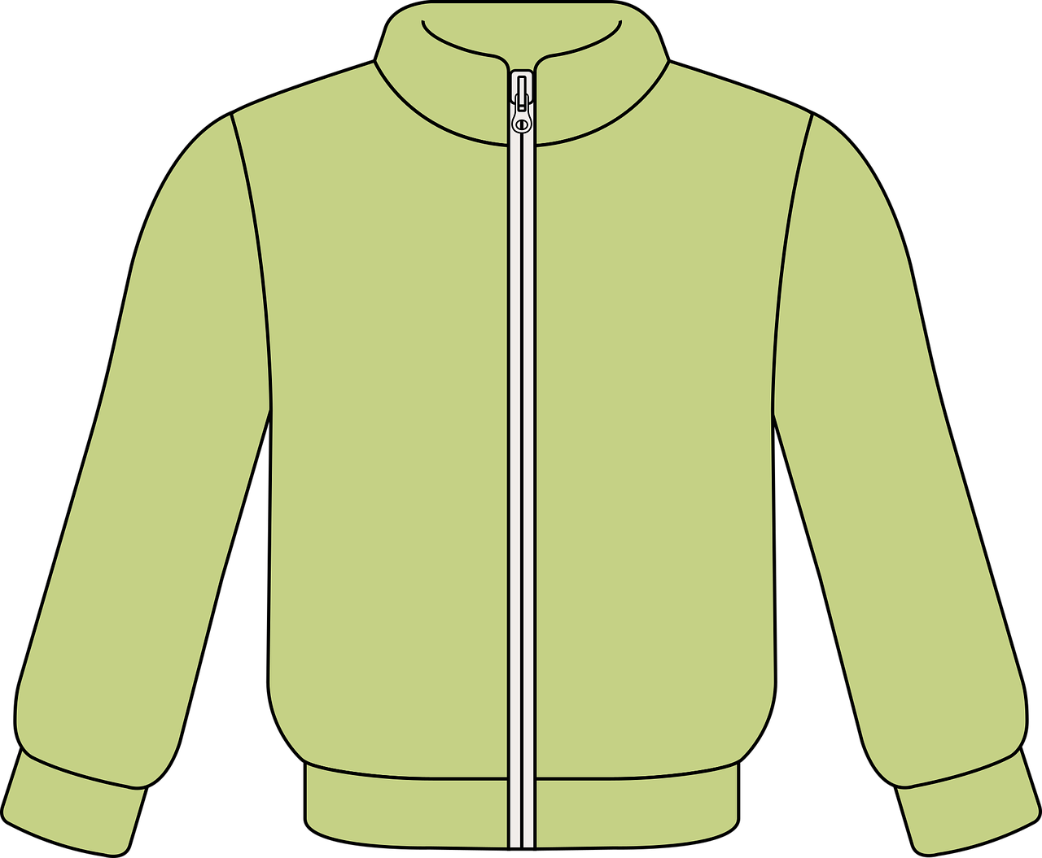
Follow up 2
Ist das ein Ort, eine Person oder ein Ding?
Das ist ein Ding.
lesen
A
Lothar
B
Bern
C
die Jacke
Notes:
[4/6]

Slide 10
Follow up 2
Ist das ein Ort, eine Person oder ein Ding?
Ist das ein Ort?
Ja
lesen
A
Ronja
B
London
C
das Blatt
Notes:
[5/6]

Slide 11
Follow up 2
Ist das ein Ort, eine Person oder ein Ding?
Das ist eine Person.
lesen
A
Lothar
B
die Schweiz
C
der Apfel
Notes:
[6/6]

Slide 12
Follow up 3
Person, place, colour or thing?
…
Person B: Write 5 words in German from the table below. Person A: Ask yes/no questions in German to work out the words.
sprechen
Ist es eine Farbe?
Nein!
Ist es eine Person?
Ja!
Person A
Person B
Ist es Leonie?
Nein!
Then swap roles and play again!
Ist es Lothar?
Ja!
England | die Uhr | schwarz | Lias | Bern
das Blatt | Biel | Ronja | der Apfel | Leonie
das Butterbrot | London | die Jacke | die Schweiz | der Ball
grün | Herr Lehmann | weiß | Lothar | grau
Notes:
Timing: 5 minutes
Aim: to practise asking and answering yes/no questions to identify previously taught vocabulary and the new vocabulary from this week. Procedure:
Pupil B chooses 5 words and writes them down secretly.
Pupil A asks yes/no questions using the categories Person, Ort, Farbe and Ding and then asks ‘Ist es…’ until they work out the 5 words on B’s list.
Then pupils swap roles and play again.

Slide 13
Follow up 4
Schreib ‘a’ auf Deutsch.
Robbie is learning German. Ronja is helping him. Ronja and Robbie have forgotten to write ‘ein’ and ‘eine’. Help them out!
schreiben
Was ist das? Ist das ein Apfel?
_1_
Richtig, das ist ein Apfel. Der Apfel ist grün.
_2_
Was ist grün?
Grün ist eine Farbe. Ein Blatt ist ein Ding. Und eine Uhr ist ein Ding. Bern ist ein Ort. Und ich bin eine Person.
_3_
_4_
_5_
_6_
_7_
_8_
_9_
Wunderbar! Das ist klar.
Notes:
Timing: 5 minutes
Aim: to practise written production of the correct indefinite articles and to associate them with some previously taught nouns. To recap a variety of vocabulary that pupils have learned so far.
Note: A more challenging version of this activity can be found on the following slide.
Procedure:
1. Read the instruction in German.
2. Pupils read the conversation between Ronja and Robbie and fill in the gaps with ‘ein’ or ‘eine’.
3. Click to reveal answers.
4. If time allows, an additional activity could be for pupils to chorally suggest the English translation of each sentence.

Slide 14
Follow up 4
Schreib ‘a’ auf Deutsch.
Robbie is learning German. Ronja is helping him. Ronja and Robbie have forgotten to write ‘ein’, ‘eine’ and nouns. Help them out!
schreiben
Was ist das? Ist das ein Apfel?
1.
Richtig, das ist ein Apfel. Der Apfel ist grün.
2.
Was ist grün?
Grün ist eine Farbe. Ein Blatt ist ein Ding. Und eine Uhr ist ein Ding. Bern ist ein Ort. Und ich bin eine Person.
3.
4.
5.
6.
7.
8.
9.
Wunderbar! Das ist klar.
Notes:
Timing: 5 minutes
Aim: to practise written production of nouns and their correct indefinite articles. To recap a variety of vocabulary that pupils have learned so far.
Note: A less challenging version of this activity can be found on the previous slide.
Procedure:
1. Read the instruction in German.
2. Pupils read the conversation between Ronja and Robbie and fill in the gaps with ‘ein’ or ‘eine’ and the appropriate noun.
3. Click to reveal answers.
4. If time allows, an additional activity could be for pupils to chorally suggest the English translation of each sentence.

Slide 15
Follow up 5:

Schreib auf Englisch.
Can you get at least 15 points?
Wörter
 | sein | ja | sie ist
 | er ist | nein | ich bin
 | es | wunderbar | England
 | wo | die Schweiz | und
 | der Ort | oder | die Person
 | die Farbe | oder | das Ding
to be, being
yes
she is
Vokabeln
x3
he is
no
I am
it
wonderful
England
x2
where
Switzerland
and
place
or
person
x1
colour
or
thing
Notes:
Timing: 5 minutes
Aim: to practise written comprehension of vocabulary from this and revisited weeks.
Procedure: 1. Give pupils a blank grid. They fill in the English meanings of any of the words they know, trying to reach 15 points in total. 2. Remind pupils that adjectives can refer to male or female persons and they should note this in their translations. E.g. pleased (f), short (m).
Note: The most recently learnt and practised words are pink, words from the previous week are green and those from week 1 are blue, thus more points are awarded for them, to recognise that memories fade and more effort (heavy lifting!) is needed to retrieve them.

Slide 16
Follow up 5:

Schreib auf Deutsch.
Can you get at least 15 points?
Wörter
 | she is | no | yes
 | to be, being | I am | he is
 | England | where | it
 | and | wonderful | Switzerland
 | place | clear | or
 | thing | person | colour
sie ist
nein
ja
Vokabeln
x3
sein
ich bin
er ist
England
wo
es
x2
und
wunderbar
die Schweiz
der Ort
klar
oder
x1
das Ding
die Person
die Farbe
Notes:
Timing: 5 minutes
Aim: to practise written comprehension of vocabulary from this and revisited weeks.
Procedure: 1. Give pupils a blank grid. They fill in the German meanings of any of the words they know, trying to reach 15 points in total. 2. Remind pupils that adjectives can refer to male or female persons and they should note this in their translations. E.g. pleased (f), short (m).
Note: The most recently learnt and practised words are pink, words from the previous week are green and those from week 1 are blue, thus more points are awarded for them, to recognise that memories fade and more effort (heavy lifting!) is needed to retrieve them.

Slide 17
Tschüss!
gelb
Notes:
17

Slide 18
Follow up 5:

Schreib auf Englisch.
Can you get at least 15 points?
Wörter
 | sein | ja | sie ist
 | er ist | nein | ich bin
 | es | wunderbar | England
 | wo | die Schweiz | und
 | der Ort | oder | die Person
 | die Farbe | oder | das Ding
Vokabeln
x3
x2
x1
Notes:
HANDOUT

Slide 19
Follow up 5:

Schreib auf Deutsch.
Can you get at least 15 points?
Wörter
 | she is | no | yes
 | to be, being | I am | he is
 | England | where | it
 | and | wonderful | Switzerland
 | place | clear | or
 | thing | person | colour
Vokabeln
x3
x2
x1
Notes:
HANDOUT

