Slide 1



Describing me and others
gelb
Follow ups 1-5
Term 1 Week 7
Notes:
Artwork by Steve Clarke. Pronoun pictures from NCELP (www.ncelp.org). All additional pictures selected from Pixabay and are available under a Creative Commons license, no
attribution required.
Phonics:
[ie] Liebe [844] sie [7] Brief [838]
Vocabulary (new): Idee [451] Preis [334] Problem [210] einfach [131] gut [76] schwer [257] Auf Wiedersehen [n/a] tschüss [3766]
Revisit 1: Apfel [3490] Ball [1783] Blatt [1270] Butterbrot [n/a] Jacke [3287] Uhr12 [348] der, die, das [1]
Jones, R.L & Tschirner, E. (2019). A frequency dictionary of German: Core vocabulary for learners. London: Routledge.
The frequency rankings for words that occur in this PowerPoint which have been previously introduced in these resources are given in the SOW and in the resources that first introduced and formally re-visited those words.
For any other words that occur incidentally in this PowerPoint, frequency rankings will be provided in the notes field wherever possible.
Note that the first three lessons of the year teach language that can be continuously recycled as lesson routine every lesson in Y3/4.
The idea would be that the class teacher (whether or not s/he teaches the class German can re-use the language as part of the daily routine with the class.

Slide 2


aussprechen
Follow up 1
…
[ie]
Liebe
Notes:
Timing: 1 minute
Aim: to revisit the SSC [ie].
Procedure:
Introduce the SSC and present the source word ‘Liebe’ (with gesture, if using).
Click to bring on the picture and get pupils to repeat the word ‘Liebe’ (with gesture, if using).
Note:
A gesture for ‘Liebe’ might be to make a ‘heart’ shape with both hands approximately where your heart is in your body.
Liebe [844]
2

Slide 3


aussprechen
Follow up 1
…
[ie]
sie
Liebe
Brief
Notes:
Timing: 1 minute
Aim: to revisit SSC [ie].
Aim: to introduce the SSC [ie].
Procedure:
Re-present the SSC and present the source word ‘Liebe’ (with gesture, if using).
Click to bring on the picture and get pupils to repeat the word ‘Liebe’ (with gesture, if using).
Present the cluster words in the same way, bringing on the picture and getting pupils to pronounce the words.
Liebe [844] sie [7] Brief [838]
3

Slide 4

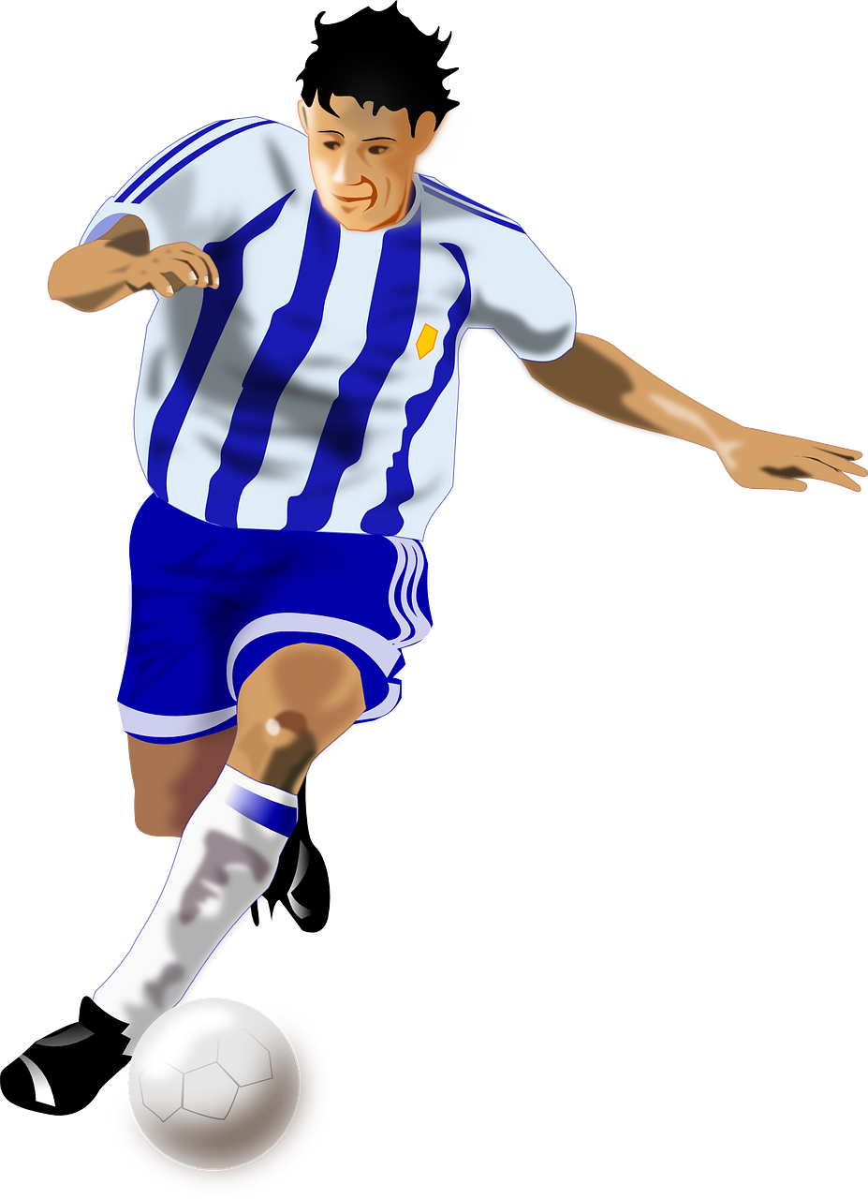


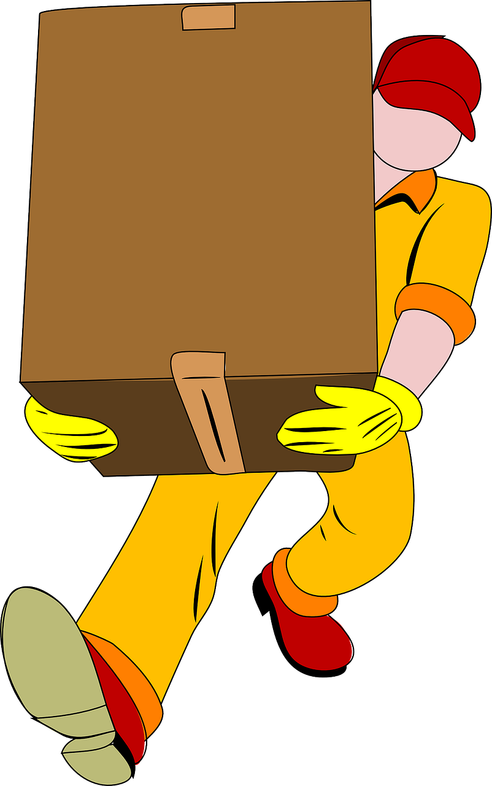
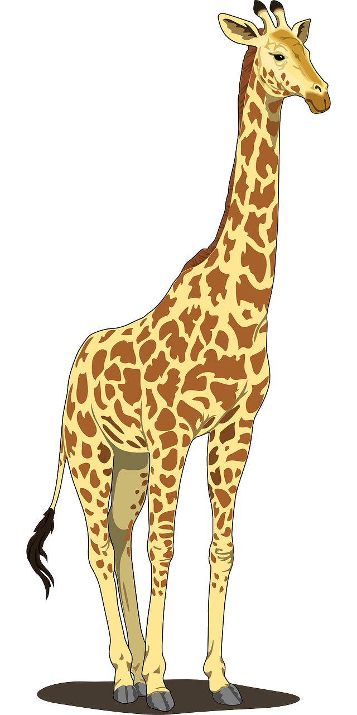



aussprechen
Follow up 1
Say all the words.
45
Brief
sie
S
Spieler
Liebe
liegen
nie
liefern
0
Tier
Galerie
Fliege
START
Notes:
Timing: 4 minutes (4 slides)
Aim: to practise [ie] knowledge with unfamiliar words. The time limit helps automatization.
Note: This is one of a set of four slides with different timer settings. The speed of the exercise can be chosen to match the ability level of the class, or the teacher may wish to start with the slowest speed and increase gradually.
Procedure:
1. Pupils work in pairs.
2. Teacher clicks ‘los’.
3. Pupil A reads the list of words out loud to Pupil B. Pupil B listens carefully to their partner’s pronunciation, and stops Pupil A if the [ie] sound is pronounced incorrectly.
4. Pupils count how many words Pupil A managed to say correctly.
5. Pupils swap roles. The pupil with the most points at the end is the winner.
6. After two rounds, the teacher plays the correct pronunciation by clicking on the audio. Pupils repeat.
Word frequency (1 is the most frequent word in German):
Brief [838] Fliege [3994] Galerie [4328] Liebe [844] liefern [781] liegen [107] nie [186] sie [7] Spieler [822] Tier [614]
Source: Jones, R.L. & Tschirner, E. (2019). A frequency dictionary of German: core vocabulary for learners. Routledge

Slide 5
aussprechen
Follow up 1
Say all the words.
Brief
30
sie
Spieler
S
Liebe
liegen
nie
0
liefern
START
Tier
Galerie
Fliege
Notes:
[2/4]

Slide 6
aussprechen
Follow up 1
Say all the words.
Brief
sie
Spieler
20
Liebe
S
liegen
0
nie
START
liefern
Tier
Galerie
Fliege
Notes:
[3/4]

Slide 7
aussprechen
Follow up 1
Say all the words.
Brief
sie
Spieler
15
Liebe
S
0
liegen
nie
START
liefern
Tier
Galerie
Fliege
Notes:
[4/4]

Slide 8


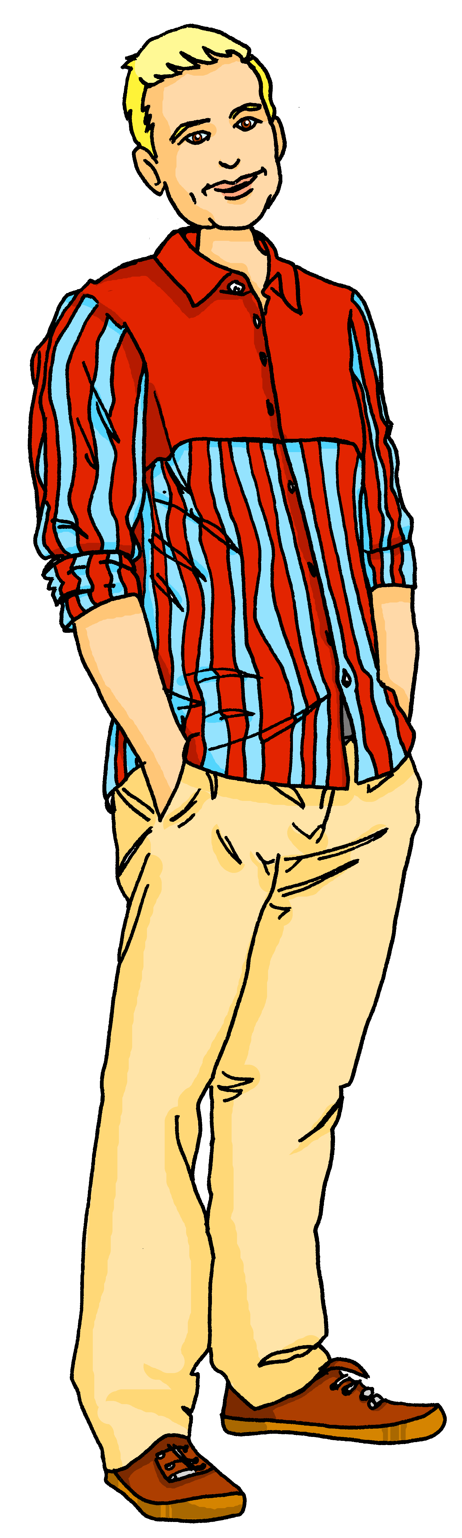
Follow up 2
Robbie can read German and English now, too. Can you?
lesen
Was ist das?
Hör zu.
Ist das einfach oder schwer?
Ist das klar?
Ist das richtig oder falsch?
Ist es der, die oder das?
Auf Wiedersehen!
Guten Morgen, Klasse 3!
Good morning, class 3!
Is it the (m), the (f) or the(n)?
Is that easy or difficult?
Is that right or wrong?
Goodbye!
Is that clear?
What is that?
Listen.
Notes:
Timing: 5 minutes
Aim: to practise translation of written phrases of classroom instructions.
Procedure:
1. Click to bring up the first item.
2. Pupils to translate.
3. Click to bring up English translation (by Robbie).
4. Continue for items 2-8.

Slide 9



Follow up 3:

Schreib auf Englisch.
Can you get at least 15 points?
Wörter
 | schwarz | das Ding | weiß
 | die Farbe | grün | der Ort
 | die Uhr | das Blatt | der Apfel
 | das Butterbrot | die Jacke | der Ball
 | die Idee | der Preis | das Problem
 | einfach | gut | schwer
black
(the) thing
white
Vokabeln
x3
(the) colour
green
(the) place
(the) watch, clock
(the) sheet
(the) apple
x2
(the) sandwich
(the) jacket
(the) ball
(the) idea
(the) prize
(the) problem
x1
easy, easily
good, well
difficult
Notes:
Timing: 5 minutes
Aim: to practise written comprehension of vocabulary from this and revisited weeks.
Procedure:
1. Give pupils a blank grid. They fill in the English meanings of any of the words they know, trying to reach 15 points in total.
2. Remind pupils that adjectives can refer to male or female persons and they should note this in their translations. E.g. pleased (f), short (m).
Note:
The most recently learnt and practised words are pink, words from the previous week are green and those from week 1 are blue, thus more points are awarded for them, to recognise that memories fade and more effort (heavy lifting!) is needed to retrieve them.

Slide 10
Follow up 3:

Schreib auf Deutsch.
Can you get at least 15 points?
Wörter
 | (the) place | white | green
 | (the) thing | grey | (the) colour
 | (the) apple | (the) ball | (the) sheet
 | (the) jacket | (the) watch, clock | (the) sandwich
 | difficult | (the) problem | good, well
 | (the) idea | (the) prize | easy, easily
der Ort
weiß
grün
Vokabeln
x3
das Ding
grau
die Farbe
der Apfel
der Ball
das Blatt
x2
die Jacke
die Uhr
das Butterbrot
schwer
das Problem
gut
x1
die Idee
der Preis
einfach
Notes:
Timing: 5 minutes
Aim: to practise written comprehension of vocabulary from this and revisited weeks.
Procedure:
1. Give pupils a blank grid. They fill in the German meanings of any of the words they know, trying to reach 15 points in total.
2. Remind pupils that adjectives can refer to male or female persons and they should note this in their translations. E.g. pleased (f), short (m).
Note:
The most recently learnt and practised words are pink, words from the previous week are green and those from week 1 are blue, thus more points are awarded for them, to recognise that memories fade and more effort (heavy lifting!) is needed to retrieve them.

Slide 11



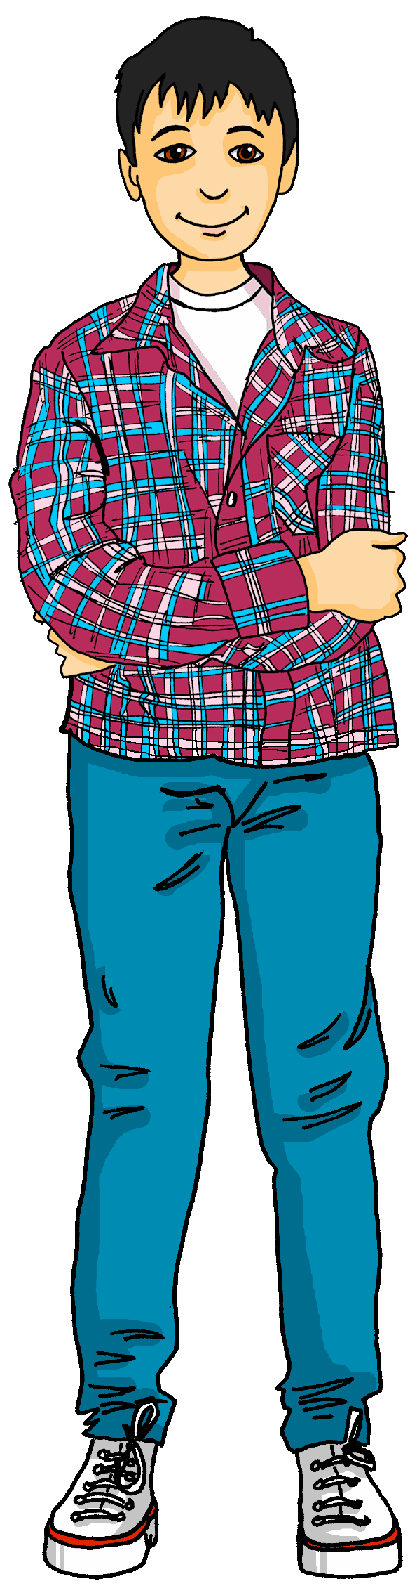






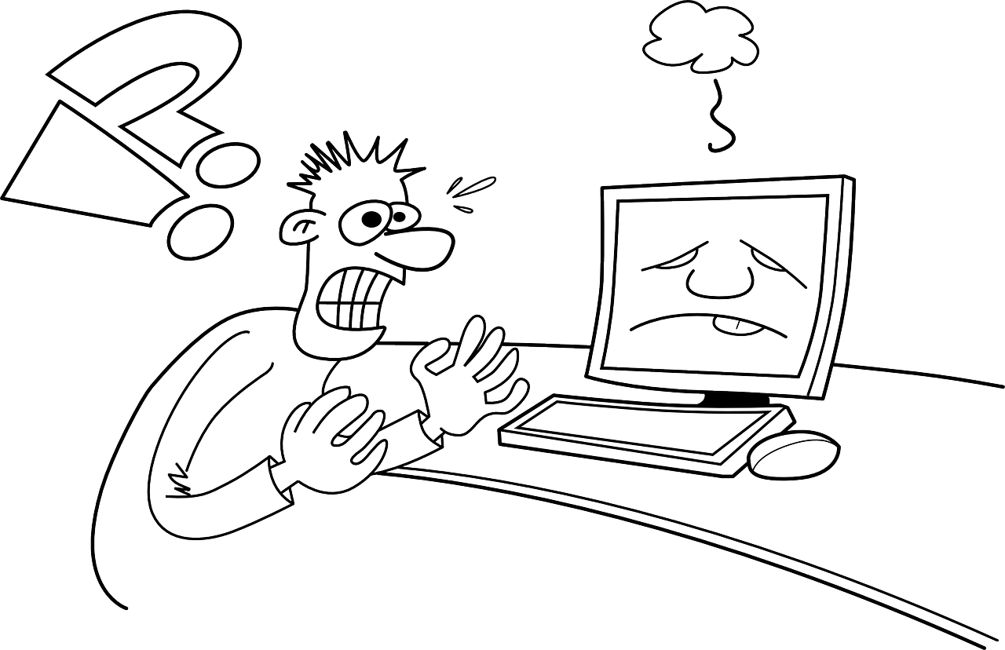


Follow up 4
Was ist richtig? Was ist faslch?
hören
1
2
3
The
A
The
Die Person ist Lias.
Das ist ein Preis.
Der Apfel ist schwarz.
4
5
6
An
The
A
Die Idee ist gut.
Das Problem ist einfach.
Das ist eine Farbe.
Notes:
Timing: 5 minutes
Aim: to practise identifying objects using articles, nouns from this week and previous weeks, and colours from this week and previous weeks in preparation for the speaking activity on the following slide.
Procedure:
Click on the first audio button to play the first sentence. Pupils listen carefully and decide whether the sentence is the same as the pictures.
Click to reveal the first answer and the written sentence.
Repeat for items 2-6.
Transcript:
Die Person ist Lias.
Das ist ein Preis.
Der Apfel ist schwarz.
Die Idee ist gut.
Das Problem ist einfach.
Das ist eine Farbe.

Slide 12

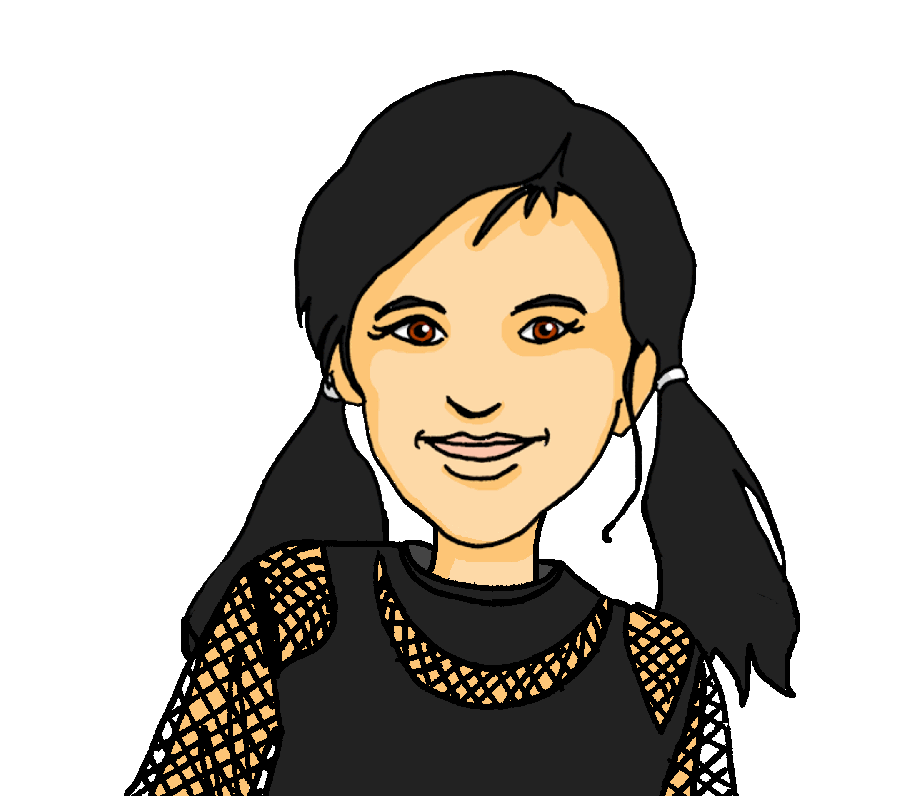
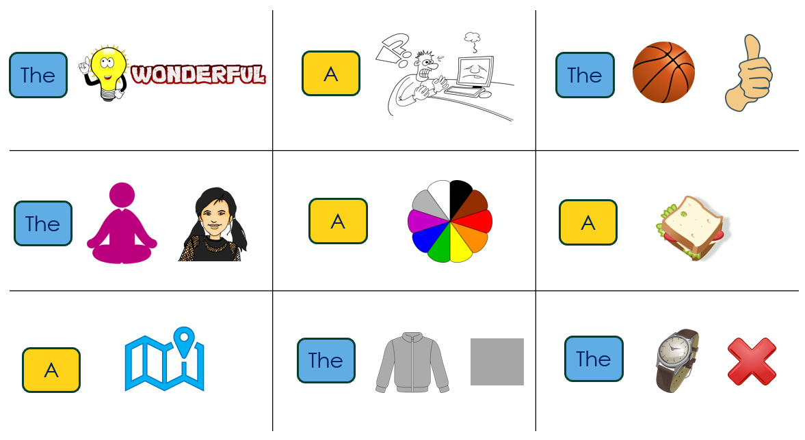
Follow up 5
Noughts and Crosses
Was ist das?
Die Jacke ist grau.
Das ist eine Farbe.
sprechen
Das ist ein Ort.
Notes:
Timing: 5 minutes
Aim: to practise identifying objects using ‘der, die, das’ and ‘ein, eine, ein’.
Procedure:
Explain the task by using the model.
Pupils work in pairs. Each pair is given a handout (there are two different versions to enable pupils to play two rounds). One person takes circles, the other crosses.
Pupils take it in turns to claim a square by saying what they can see in that square.
The aim is to get three in a row.

Slide 13
Tschüss!
gelb
Notes:
13

Slide 14
Follow up 5:

Schreib auf Englisch.
Can you get at least 15 points?
Wörter
 | schwarz | das Ding | weiß
 | die Farbe | grün | der Ort
 | die Uhr | das Blatt | der Apfel
 | das Butterbrot | die Jacke | der Ball
 | die Idee | der Preis | das Problem
 | einfach | gut | schwer
Vokabeln
x3
x2
x1
Notes:
HANDOUT

Slide 15
Follow up 5:

Schreib auf Deutsch.
Can you get at least 15 points?
Wörter
 | (the) place | white | green
 | (the) thing | grey | (the) colour
 | (the) apple | (the) ball | (the) sheet
 | (the) jacket | (the) watch, clock | (the) sandwich
 | difficult | (the) problem | good, well
 | (the) idea | (the) prize | easy, easily
Vokabeln
x3
x2
x1
Notes:
HANDOUT

Slide 16



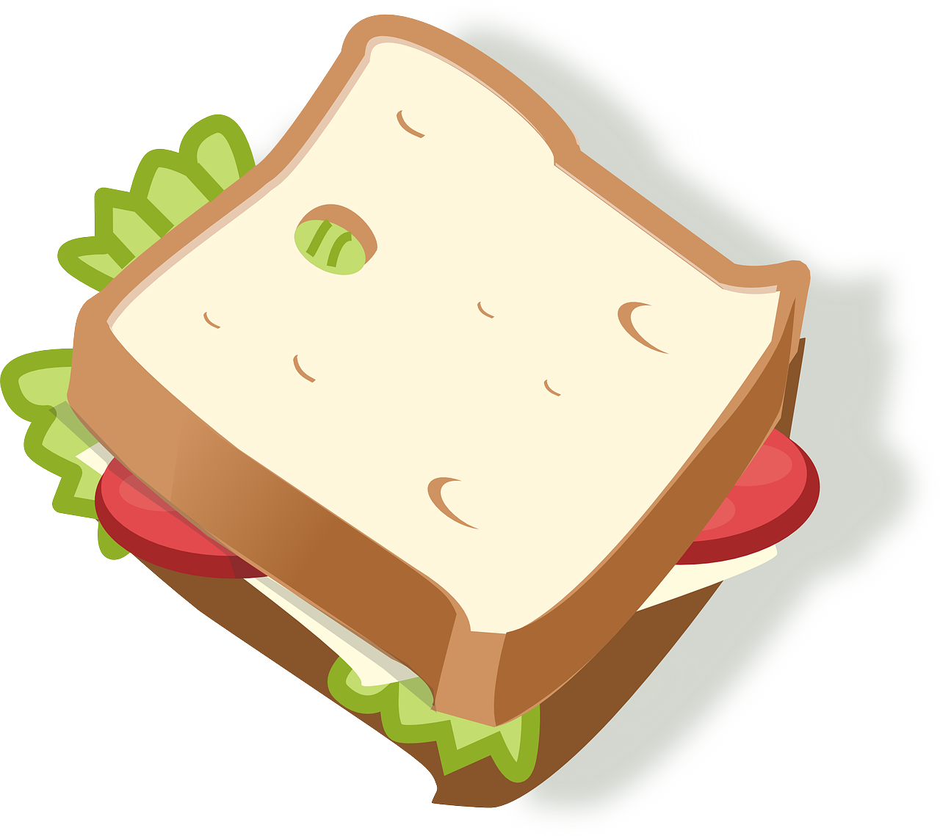


Follow up 4 Handout
The
A
The
The
The
A
The
A
A
Notes:
HANDOUT ROUND 1

Slide 17

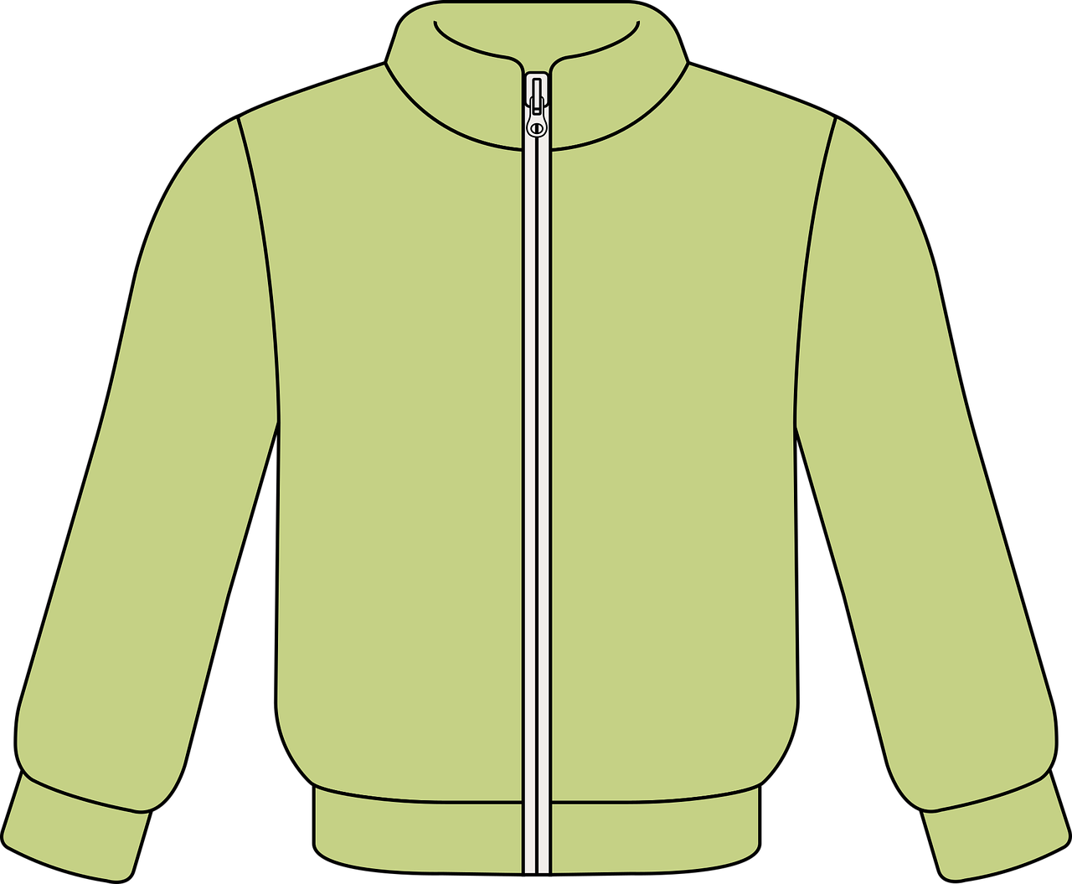

Follow up 4 Handout
The
The
A
A
A
The
The
The
A
Notes:
HANDOUT ROUND 2

