Slide 1



Describing me and others
Identifying things
Words for ‘a’:
ein, eine, ein
SSC [ie]
gelb
Term 1 Week 7
Notes:
Artwork by Steve Clarke. Pronoun pictures from NCELP (www.ncelp.org). All additional pictures selected from Pixabay and are available under a Creative Commons license, no
attribution required.
Phonics:
[ie] Liebe [844] sie [7] Brief [838]
Vocabulary (new): Idee [451] Preis [334] Problem [210] einfach [131] gut [76] schwer [257] Auf Wiedersehen [n/a] tschüss [3766]
Revisit 1: Apfel [3490] Ball [1783] Blatt [1270] Butterbrot [n/a] Jacke [3287] Uhr12 [348] der, die, das [1]
Jones, R.L & Tschirner, E. (2019). A frequency dictionary of German: Core vocabulary for learners. London: Routledge.
The frequency rankings for words that occur in this PowerPoint which have been previously introduced in these resources are given in the SOW and in the resources that first introduced and formally re-visited those words.
For any other words that occur incidentally in this PowerPoint, frequency rankings will be provided in the notes field wherever possible.
Note that the first three lessons of the year teach language that can be continuously recycled as lesson routine every lesson in Y3/4.
The idea would be that the class teacher (whether or not s/he teaches the class German can re-use the language as part of the daily routine with the class.
1

Slide 2


aussprechen
[ie]
…
Liebe
Notes:
Timing: 1 minute
Aim: to introduce the SSC [ie].
Procedure:
Introduce the SSC and present the source word ‘Liebe’ (with gesture, if using).
Click to bring on the picture and get pupils to repeat the word ‘Liebe’ (with gesture, if using).
Note:
A gesture for ‘Liebe’ might be to make a ‘heart’ shape with both hands approximately where your heart is in your body.
Liebe [844]
Jones, R.L & Tschirner, E. (2019). A frequency dictionary of German: Core vocabulary for learners. London: Routledge.
2

Slide 3
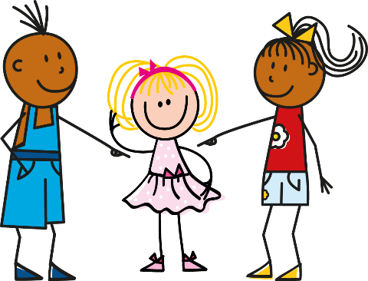

aussprechen
[ie]
…
sie
Liebe
Brief
Notes:
Timing: 1 minute
Aim: to introduce the SSC [ie].
Procedure:
Re-present the SSC and present the source word ‘Liebe’ (with gesture, if using).
Click to bring on the picture and get pupils to repeat the word ‘Liebe’ (with gesture, if using).
Present the cluster words in the same way, bringing on the picture and getting pupils to pronounce the words.
sie [7] Brief [838]
Jones, R.L & Tschirner, E. (2019). A frequency dictionary of German: Core vocabulary for learners. London: Routledge.
3

Slide 4







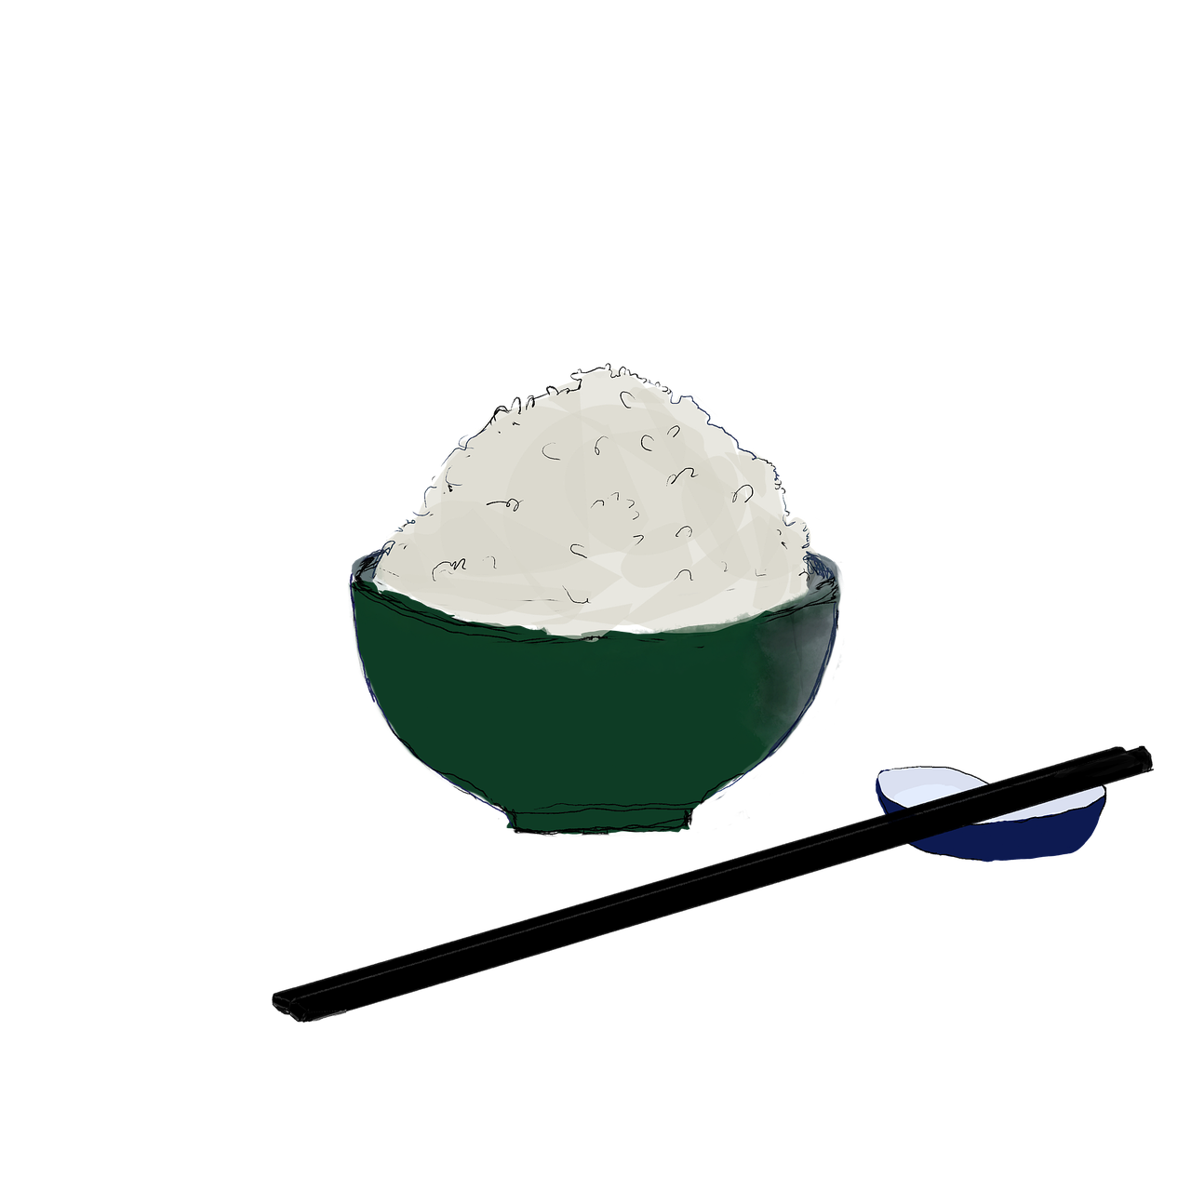



hören
Hör zu. Ist es [ei] oder [ie]?
Can you work out the meanings ?
Schreib 1-8 und [ei] oder [ie].
hören
1 | K o p i e
2 | E i s
3 | r e i c h
4 | G a l e r i e
5 | P a p i e r
6 | T e c h n o l o g i e
7 | R e i s
8 | a l l e i n
_ _
_ _
_ _
_ _
_ _
_ _
_ _
_ _
Notes:
Timing: 5 minutes
Aim: to distinguish between the SSCs [ei] and [ie] by listening to cognates and near-cognates and identifying the sounds.
Procedure:
Click for instructions to come up.
Click audio button 1 to play the recording for item 1. Pupils need to decide is it [ei] or [ie] and write down ei or ie.
Elicit the answer.
Click to reveal the spelling of word 1.
Elicit the meaning, based on the image and the words being cognates or near-cognates.
Continue for items 2-8.
Transcript:
Kopie
Eis
reich
Galerie
Papier
Technologie
Reis
allein
Word frequency (1 is the most frequent word in German):
allein [267] Eis [1874] Galerie [4328] Kopie [4949] Papier [1163] reich [1568] Reis [>5000] Technologie [2170]
Source: Jones, R.L. & Tschirner, E. (2019). A frequency dictionary of German: core vocabulary for learners. Routledge

Slide 5







Vokabeln
Vokabeln lernen
Wörter
the idea
the problem
the prize
die Idee
das Problem
der Preis
easy, easily
good, well
difficult
einfach
gut
schwer
Notes:
Timing: 5 minutes (3 slides)
Aim: to present and practise written comprehension and read aloud of the new vocabulary for this week.
Procedure:
1. Click for a German word. Elicit pronunciation from pupils.
2. Click for the English meaning and picture prompt. Elicit the German word again.
3. Present all six words like this, in order.
5

Slide 6
Vokabeln
Vokabeln lernen
Wörter
the idea
the problem
the prize
die Idee
das Problem
der Preis
easy, easily
good, well
difficult
einfach
gut
schwer
Notes:
Timing: 5 minutes
Aim: to present and practise written comprehension and read aloud of the new vocabulary for this week.
Procedure:
1. Click for one English meaning to disappear. Elicit the English meaning from pupils. Continue with the remaining items.
6

Slide 7
Vokabeln
Vokabeln lernen
Wörter
the idea
the problem
the prize
die Idee
das Problem
der Preis
easy, easily
good, well
difficult
einfach
gut
schwer
Notes:
Timing: 5 minutes
Aim: to present and practise written comprehension and read aloud of the new vocabulary for this week.
Procedure:
1. Click for the German word to disappear. Elicit the German from pupils. Continue with the remaining items.
7

Slide 8





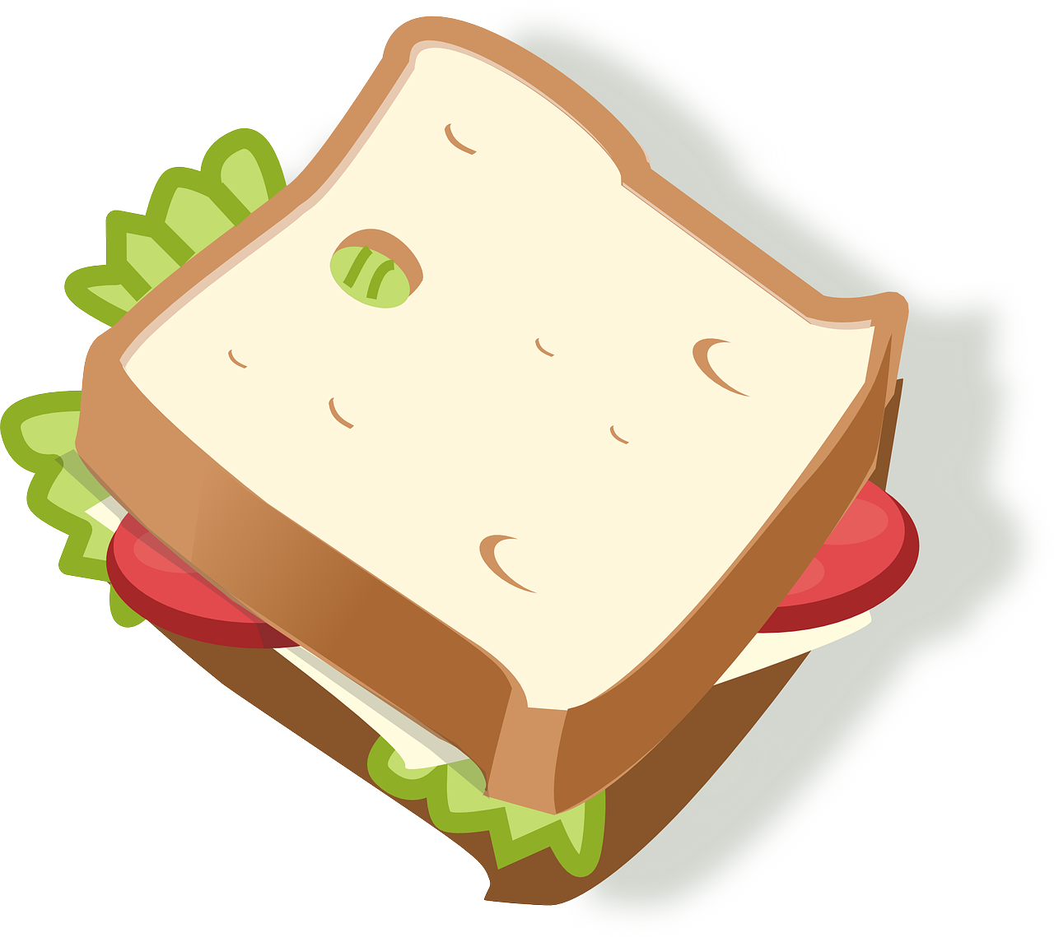
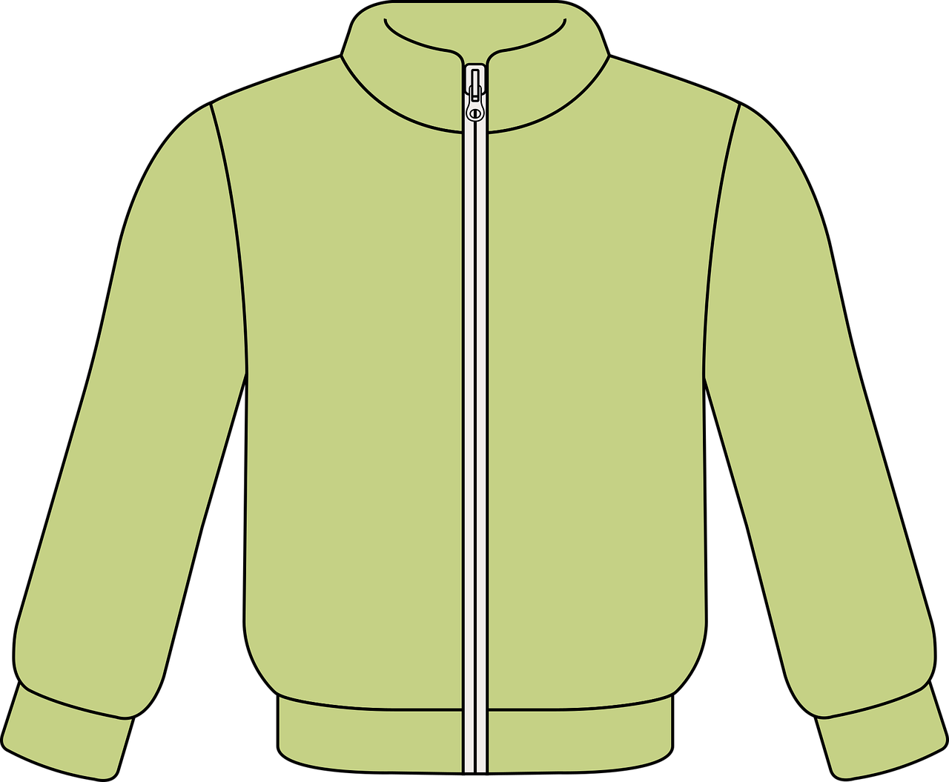

Was ist das Ding?
hören
Hör zu
1
K
2
F
A
E
I
3
I
4
A
5
C
B
F
J
6
D
7
H
8
J
C
G
K
9
G
10
B
11
L
D
H
L
12
E
1. ein Instrument lernen
2. ein Lied singen
3. ein Spiel gewinnen
4. einen Satz wiederholen
5. ein Bild machen
6. neben Moritz sitzen
7. dienstags schwimmen
8. heute tanzen
9. etwas spielen
10. Fragen und Antworten verstehen
11. denken: “ich weiß es nicht!”
12. Geburtstag haben
This uses almost all of the revisited and new words and we’re in our context of ‘Was kannst du in der Schule machen?
other verbs we have = hören
1. ein Instrument lernen
2. ein Lied singen
3. ein Spiel gewinnen
4. einen Satz wiederholen
5. ein Bild machen
6. neben Moritz sitzen
7. dienstags schwimmen
8. heute tanzen
9. etwas spielen
10. Fragen und Antworten verstehen
11. denken: “ich weiß es nicht!”
12. Geburtstag haben
Notes:
Timing: 5 minutes
Aim: to revisit nouns for this week.
Procedure:
Click on each audio button to hear a noun in German.
Pupils look carefully at the pictures on the right and decide which picture the noun refers to. They write down the corresponding letter.
Click to reveal answers.
Transcript:
1. das Butterbrot
2. der Apfel
3. der Ort
4. das Blatt
5. der Ball
6. die Jacke
7. das Problem
8. der Preis
9. die Farbe
10. die Idee
11. die Uhr
12. die Person
8

Slide 9

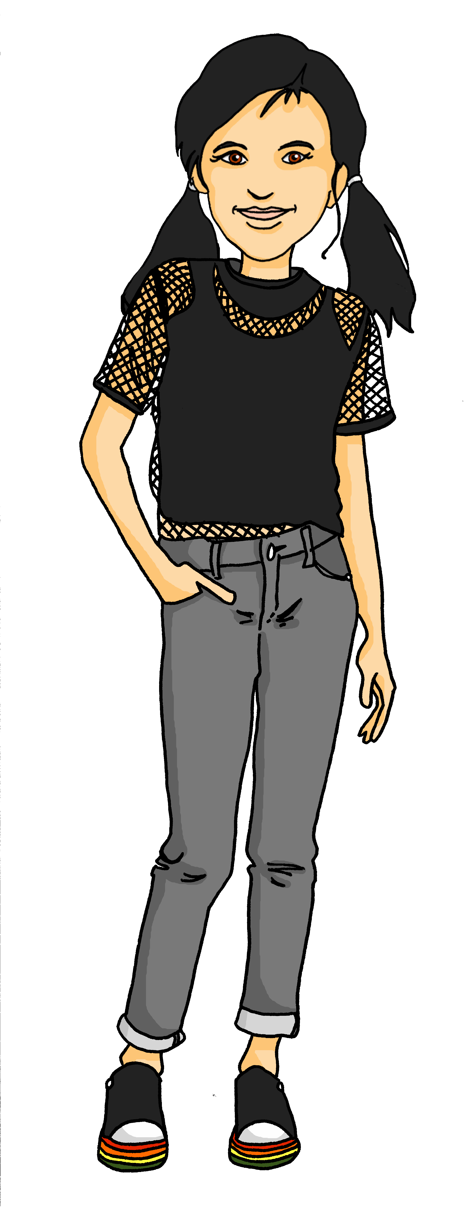
‘a’ (ein, eine, ein) oder ‘the’ (der, die, das)
‘a’ (ein, eine, ein) often introduces new information and identifies something to the listener:
Das ist eine Jacke.
Was ist das?
Ach! Die Jacke ist grün!
Robbie
‘the’ (der, die, das) refers to something already mentioned or known.
Notes:
Timing: 2 minutes
Aim: to contrast use of definitive and indefinite articles
Procedure:
1. Click on the mouse to animate the explanation.
2. Check students’ understanding at each stage.
9

Slide 10

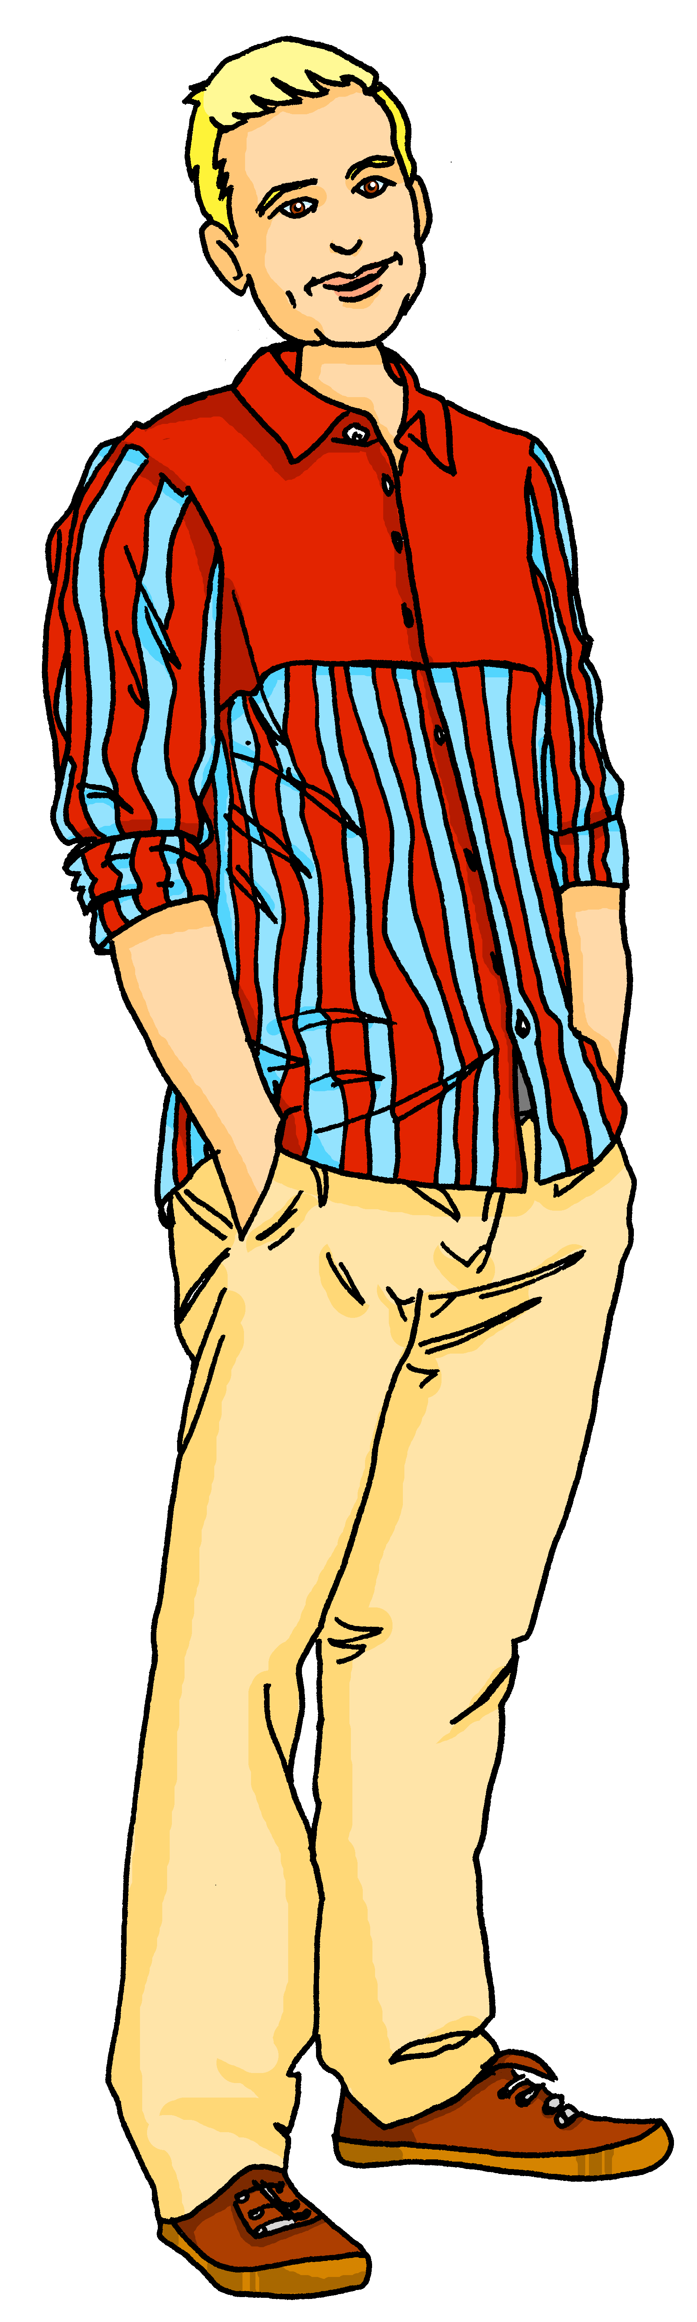

lesen
Herr Lehmann and Lias are talking about a class project
Ist es ‘der, die, das’ oder ‘ein, eine, ein’?
Tip! Say the sentence to yourself in English to help you decide!
Das ist das|ein Problem.
Das|ein Problem ist schwer!
Hier ist die|eine Idee.
Die|eine Idee ist gut.
Da ist der|ein Preis.
Wo ist der|ein Preis?
Der|ein Preis ist hier.
Notes:
Timing: 5 minutes
Aim: to practise understanding of when to use definite and indefinite articles.
Procedure:
Pupils read the conversation between Herr Lehmann and Lias and decide whether to use the definite or indefinite article. To reduce cognitive load, the correct gender of each article has already been selected.
If pupils are struggling, encourage them to say the sentence to themselves in English.
Click to reveal answers.
Note that often both articles can make sense, but with the general idea of identifying something first (indefinite article) and then referring back to it (definite article) pupils should be able to arrive at the most likely version of the dialogue.
10

Slide 11


singen
Hör zu. Dann sing mit!
We are singing the Hallo Song to Robbie to welcome them to our school.
Hallo Robbie!
Hallo! Hallo! Guten Tag!
Hallo! Hallo! Guten Tag!
Hallo! Ich bin hier,
Hallo! Du bist da,
Hallo! Hallo! Guten Tag!
Robbie
Guten Tag!
But sadly, Robbie can’t stay. Now we are teaching Robbie the goodbye song:
Notes:
Timing: 2 minutes
Aim: to revise and practise the Hallo song in preparation for learning the goodbye song on the next slide.
Procedure:
1. Click through the animations of the explanations.
2. Click to bring up speech bubble of teacher saying hello Robbie.
3. Click to bring up speech bubble of Robbie saying hello.
4. Click to play the audio of the sung version of the song.
2. Depending on how much revision is needed, repeat the words of each line to practise saying them clearly (borrow the rhythm of the song so that this is a rehearsal stage before singing).
3. Click to play the audio again and this time, pupils join in.
Note: Teachers might like to re-use this song as part of their lesson starting routine in future lessons. Soon pupils will not need to see the words to recall it.
11

Slide 12


Vokabeln
Goodbye!
Wörter
Auf Wiedersehen!
Tschüss!
‘Auf wiedersehen’ is formal and means ‘goodbye’.
‘Tschüss’ is informal and means ‘bye’.
Notes:
Timing: 2 minutes
Aim: to present and practise new vocabulary for this week
Procedure:
1. Click through the explanation. Pupils will revise both words on the following slide.
12

Slide 13

Hör zu. Dann sing mit!
Tschüss, Tschüss, Tschüss, Tschüss,
Tschüss, Tschüss, Auf Wiedersehen!
Bis bald, bis bald, bis bald, bis bald.
Tschüss, Tschüss, Tschüss, Tschüss,
Auf Wiedersehen!
Tschüss Robbie!
Auf Wiedersehen!
Notes:
Timing: 5 minutes
Aim: to practise some previously learnt vocabulary in a simple song (to the tune of ‘Hi ho Hi ho it’s off to work we go’.)
Procedure:
1. Click to play the audio of the song.
2. Repeat the words of each line to practise saying them clearly (borrow the rhythm of the song so that this is a rehearsal stage before singing).
3. Click to play the audio again and this time, pupils join in.
4. Click to bring speech bubble of the teacher saying bye Robbie!
5. Click again for speech bubble of Robbie saying goodbye.
7. Click on spaceship to send it flying back into space/ home.
Note: Teachers might like to re-use this song as part of their lesson finishing routine in future lessons. Soon pupils will not need to see the words to recall it.

Slide 14
Tschüss!
gelb
Notes:
14

