Slide 1


Was kann ich jetzt?
Ich wiederhole!
rot
Vocabulary &
Grammar quiz
Term 3 Week 10
Notes:
Word frequency (1 is the most frequent word in German):
Jones, R.L & Tschirner, E. (2019). A frequency dictionary of German: Core vocabulary for learners. London: Routledge.
The frequency rankings for words that occur in this PowerPoint which have been previously introduced in these resources are given in the SOW and in the resources that first introduced and formally re-visited those words. For any other words that occur incidentally in this PowerPoint, frequency rankings will be provided in the notes field wherever possible.
1

Slide 2

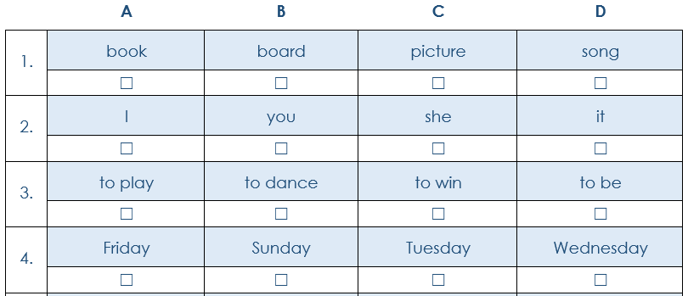
Vocabulary
A For each question, put a cross (x) under the English meaning that matches what you hear. You will hear each German word twice. Choose one correct answer only. (4 marks on this slide)
hören
1
2
3
4
Notes:
1/2.
Timing: 20-25 minutes (all assessment slides)
Aim: to practise aural comprehension of vocabulary taught in terms 1 and 2 of the course.
Procedure:
1. Click the audio buttons to play each item. (The words are recorded twice with a pause to allow pupils to process the information).
2. Pupils can either write 1C, etc.. or if they have the assessment on a print out they can put a X in the correct box.
3. After items 1-4, continue to the next slide to complete the remainder of the task.
Transcript:
das Lied
es
spielen
Dienstag
2

Slide 3
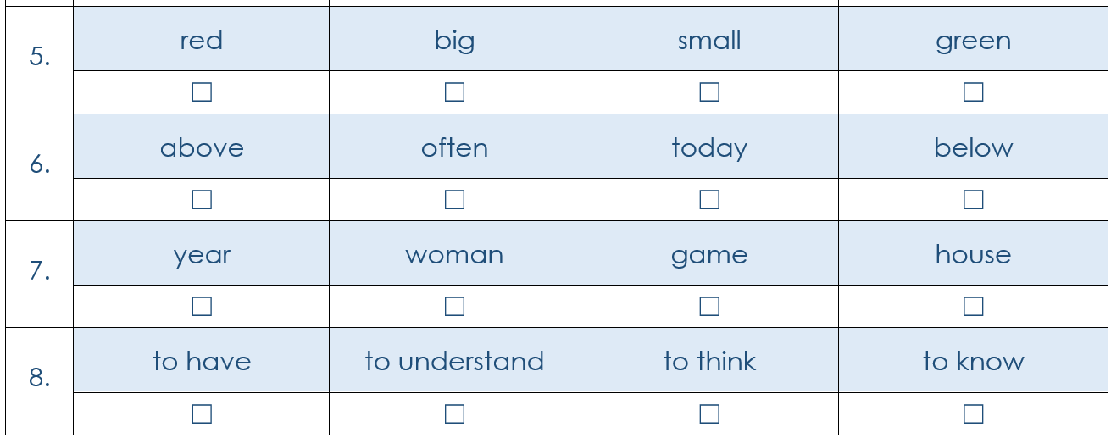
Vocabulary
A For each question, put a cross (x) under the English meaning that matches what you hear. You will hear each German word twice. Choose one correct answer only. (4 marks on this slide)
hören
A | B | C | D
5
6
7
8
Notes:
2/2
Transcript
5. groβ
6. heute
7. das Jahr
8. verstehen
3

Slide 4
Vocabulary
B For each question, put a cross (x) under the type of word you hear.
You will hear each German word twice. Choose one correct answer only. (5 marks)
hören
1
2
3
4
5
Notes:
1/1
Aim: to practise aural comprehension of vocabulary taught in terms 1 and 2 of the course.
Procedure:
1. Click the audio buttons to play each item. (The words are recorded twice with a pause to allow pupils to process the information).
2. Pupils can either write 1C, etc.. or if they have the assessment on a print out they can put a X in the correct box.
Transcript:
die Lehrerin
jung
März
zwölf
das Tier
4

Slide 5

Vocabulary
C Translate the underlined German word to complete each English sentence. (12 marks)
lesen
1. Er hat drei Fragen. He has _____________ _____________. (2)
2. Ich habe einen Bleistift aber kein Buch. I have a pencil _____________ no book. (1)
3. Ich kann die Flasche sehen. I can see _____________ _____________. (2)
4. Ich weiβ nicht. I _____________ _____________. (2)
5. Wer ist das? _____________ is that? (1)
6. Du bist freundlich. You are _____________. (1)
7. Die Musik ist toll! The music is _____________! (1)
8. Ich spiele samstags Fußball. I play football _____________ _____________. (2)
Notes:
1/1
Aim: to practise written recall of previously taught vocabulary.
Procedure:
Ensure that the task is clear.
Pupils could write 1 – 8 and the individual English word meanings (or they could fill in if they have printed assessment sheets).
5

Slide 6
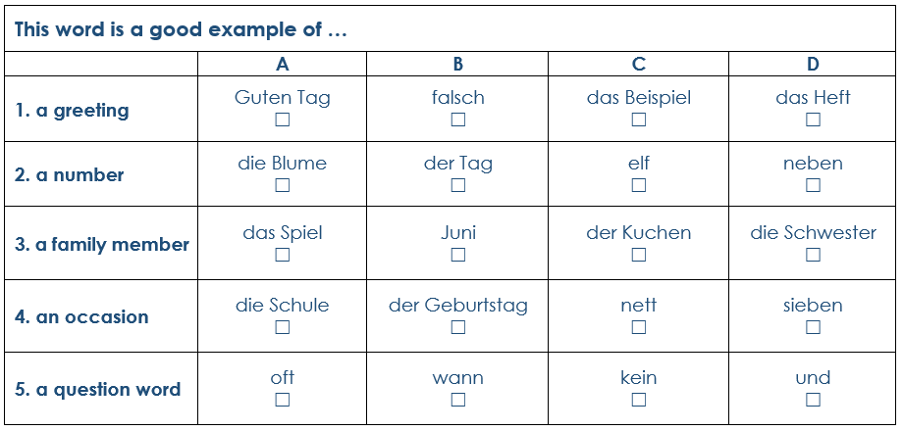
Vocabulary
D For each question, put a cross (x) under the word that best fits each category.
Choose one correct answer only. (5 marks)
lesen
Notes:
1/1
Aim: to practise written recall of previously taught vocabulary.
Procedure:
Ensure that the task is clear.
Pupils can either write 1C, etc.. or if they have the assessment on a print out they can put a X in the correct box.
6

Slide 7

Vocabulary
E Translate the underlined English words to complete the German sentence. (15 marks)
schreiben
1. Tomorrow is Monday. ___________ ist Montag. (Write one word.)
2. My brother is small. Mein ___________ ist klein. (Write one word.)
3. Today is Thursday. Heute ist ___________. (Write one word.)
4. Bye, Mr Schmidt! ___________, Herr Schmidt! (Write one word.)
5. Lisl is my (female) friend. Lisl ist meine ___________. (Write one word.)
6. I can dance. Ich kann ___________. (Write one word.)
7. Can he help? Kann er ___________? (Write one word.)
8. What is your favourite colour? Was ist deine ___________farbe. (Write one word.)
9. Max is very old. Max ist ___________ ___________. (Write two words.)
10. Do you have a pet? _________ _________ ein Haustier? (Write two words.)
Notes:
1/1
Aim: to practise written recall of previously taught vocabulary.
Procedure:
Ensure that the task is clear.
Pupils could write 1 – 10 and the individual English word meanings (or they could fill in if they have printed assessment sheets).
If necessary, explain that ‘Schmidt’ is a common German surname.
7

Slide 8

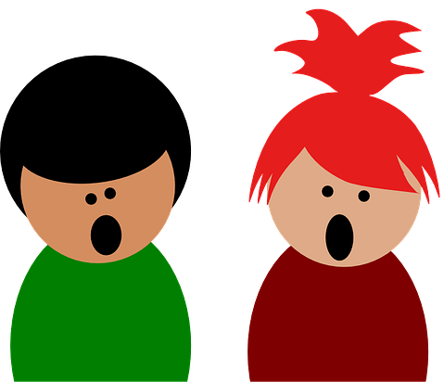


Grammar
A Put a (X) next to the person the sentence is about. (5 marks)
lesen
1 | ☐ I ☐ you _{[singular]} ☐ she/he | … ist nett.
2 | ☐ I ☐ you _{[singular]} ☐ she/he | … singe.
3 | ☐ I ☐ you _{[singular]} ☐ she/he | … habe ein Handy.
4 | ☐ I ☐ you _{[singular]} ☐ she/he | … schwimmst.
Notes:
1/1
Aim: to practise written understanding of previously taught grammar features (verb endings for 1st, 2nd, 3rd person with familiar verbs).
Procedure:
Ensure that the task is clear.
Pupils could write 1 – 4 and the correct English pronoun (or they could fill in if they have printed assessment sheets).
8

Slide 9





Grammar
B Put a (X) next to the person the sentence is about. (2 marks)
lesen
1 | ☐ I ☐ you _{[singular]} | … kannst eine Antwort lernen.
2 | ☐ you _{[singular]} ☐ she/he | … kann ein Instrument spielen.
Notes:
1/1
Aim: to practise written understanding of previously taught grammar features (subject-verb agreement with können).
Procedure:
Ensure that the task is clear.
Pupils could write 1 – 2 and the correct English pronoun (or they could fill in if they have printed assessment sheets).
9

Slide 10
Grammar
C Put a (X) next to the English meaning of the German sentence. (4 marks)
lesen
1 | Du bist nicht hier. | ☐ You are here. ☐ You are not here.
2 | Das ist kein Buch. | ☐ That is a book. ☐ That is not a book.
3 | Er gewinnt das Spiel. | ☐ He wins the game. ☐ He does not win the game.
4 | Sie tanzt nicht. | ☐ She dances. ☐ She does not dance.
Notes:
1/1
Aim: to practise written understanding of previously taught grammar features (negation)
Procedure:
Ensure that the task is clear.
Pupils could write 1 – 4 and 1 (top) or 2 (bottom) for each answer (or they could fill in if they have printed assessment sheets).
10

Slide 11
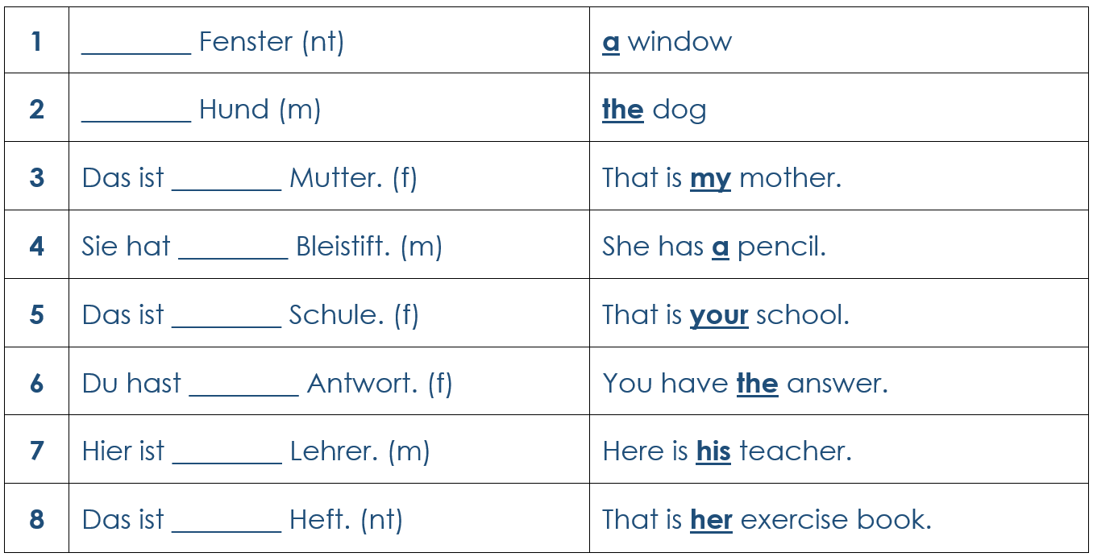
Grammar
D Write the correct determiner in the blanks to complete the German translations. (8 marks)
schreiben
Notes:
1/1
Aim: to practise written recall of previously taught grammar features (articles).
Procedure:
Ensure that the task is clear.
Pupils could write 1 – 8 and the target word (or they could fill in if they have printed assessment sheets).
11

Slide 12
Grammar
E Write the plural version of each noun in the table below. (2 marks)
schreiben
Notes:
1/1
Aim: to practise written recall of previously taught grammar features (articles).
Procedure:
Ensure that the task is clear.
Pupils could write 1 – 2 and the target word (or they could fill in if they have printed assessment sheets).
12

Slide 13

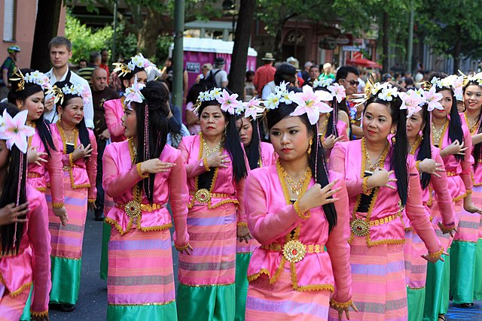
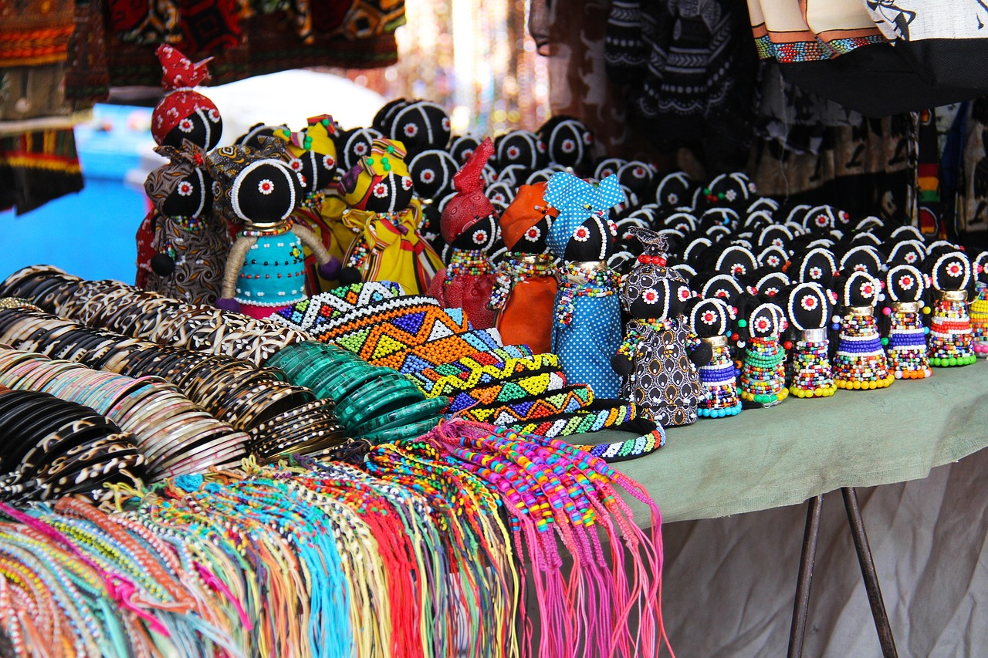
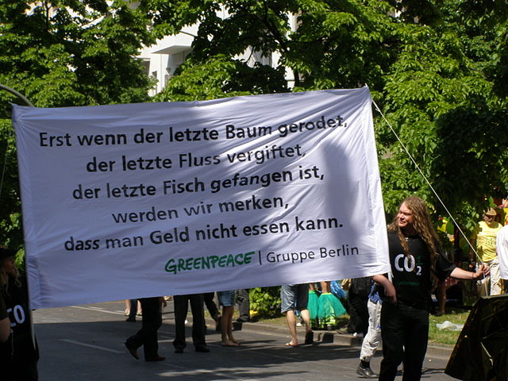
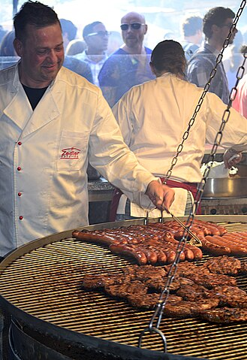
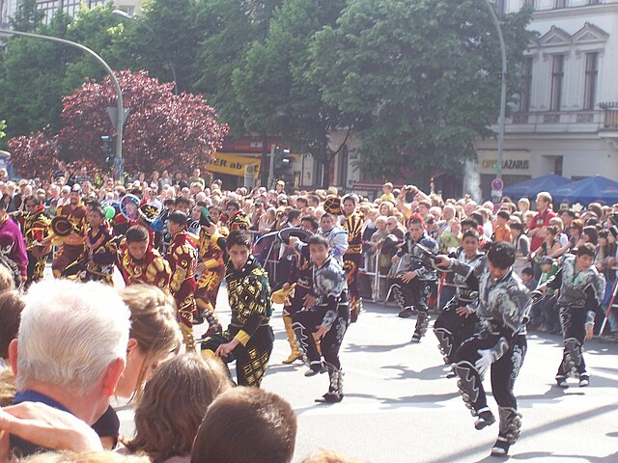
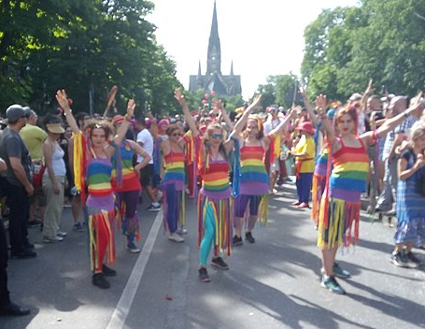
hören
Karneval der Kulturen
Was ist der Karneval der Kulturen?
In May, there is a carnival in Berlin that celebrates all the different cultures and people living in the city.
lesen
Umzug
Kunsthandwerk
Demonstration
_
_ _
_ _ _ _
On Sunday, there is a big parade through the city.
People can buy or make their own crafts.
There are protests and political messages.
Aufführung
Vielfalt
Ess en
_
_
_ _
There are lots of performances!
Diversity is celebrated.
There is food from all around the world.
Notes:
Timing: 5 minutes
Aim: to practise aural comprehension of several of this year’s SSCs; to learn about the carnival of cultures.
Procedure:
1. Click on the blue text boxes to hear each word. Pupils listen carefully and transcribe the missing SSC. Click to reveal answers.
2. Click to reveal further information about how people celebrate.
Word frequency:
Aufführung [3575] Demonstration [3235] Essen [323] Kunsthandwerk [>5000] Umzug [4954] Vielfalt [2326]
Source: Jones, R.L. & Tschirner, E. (2019). A frequency dictionary of German: core vocabulary for learners. Routledge
Image Attribution
Greenpeace: Von Berliner Schildkröte - Selbst fotografiert, CC BY-SA 3.0, https://commons.wikimedia.org/w/index.php?curid=4031880
Sausages: Von Hartmann Linge - Eigenes Werk, CC BY-SA 3.0, https://commons.wikimedia.org/w/index.php?curid=26225280
Dancing: Von MSchnitzler2000 - Eigenes Werk, CC BY-SA 3.0, https://commons.wikimedia.org/w/index.php?curid=11409668
Parade: Von Karneval der Kulturen - https://www.flickr.com/photos/mrarlivre/7766255762/, CC BY 2.0, https://commons.wikimedia.org/w/index.php?curid=59741080
Diversity: Von Sparrow (麻雀) - Eigenes Werk, CC BY-SA 4.0, https://commons.wikimedia.org/w/index.php?curid=79797807
13

Slide 14
lesen
Karneval der Kulturen
Was ist richtig? Was ist falsch?
helfen, nett, Spiel, tanzen, Instrumente, Film
tanzen, Musik, singen, Farben, freundlich, Instrumente
sitzen, Blume, singen, Musik, groß, Bild
Notes:
Timing: 5 minutes
Aim: to learn more about the carnival of cultures.
Procedure:
Click on the link to play the video showing the parade at the carnival of cultures. https://www.youtube.com/watch?v=e8N0FqcVF_k
Pupils read the descriptions in the blue bubbles and decide which description best matches the video.
14

Slide 15
Tschüss!
rot
Notes:
15

Slide 16
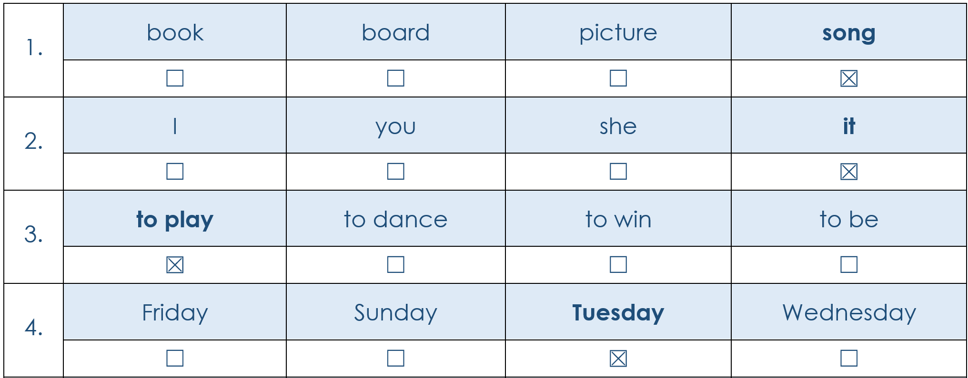
Vocabulary
A For each question, put a cross (x) under the English meaning that matches what you hear. You will hear each German word twice. Choose one correct answer only. (4 marks on this slide)
hören
1
2
3
4
Notes:
1/2.
ANSWERS
Transcript:
das Lied
es
spielen
Dienstag
16

Slide 17
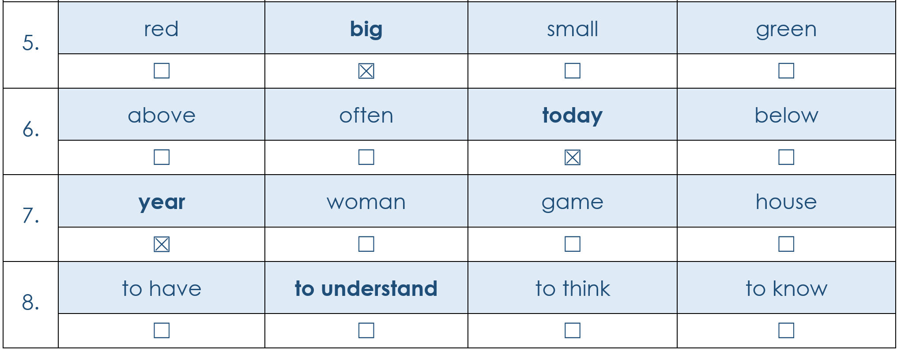
Vocabulary
A For each question, put a cross (x) under the English meaning that matches what you hear. You will hear each German word twice. Choose one correct answer only. (4 marks on this slide)
hören
A | B | C | D
5
6
7
8
Notes:
2/2
ANSWERS
Transcript
5. groβ
6. heute
7. das Jahr
8. verstehen
17

Slide 18
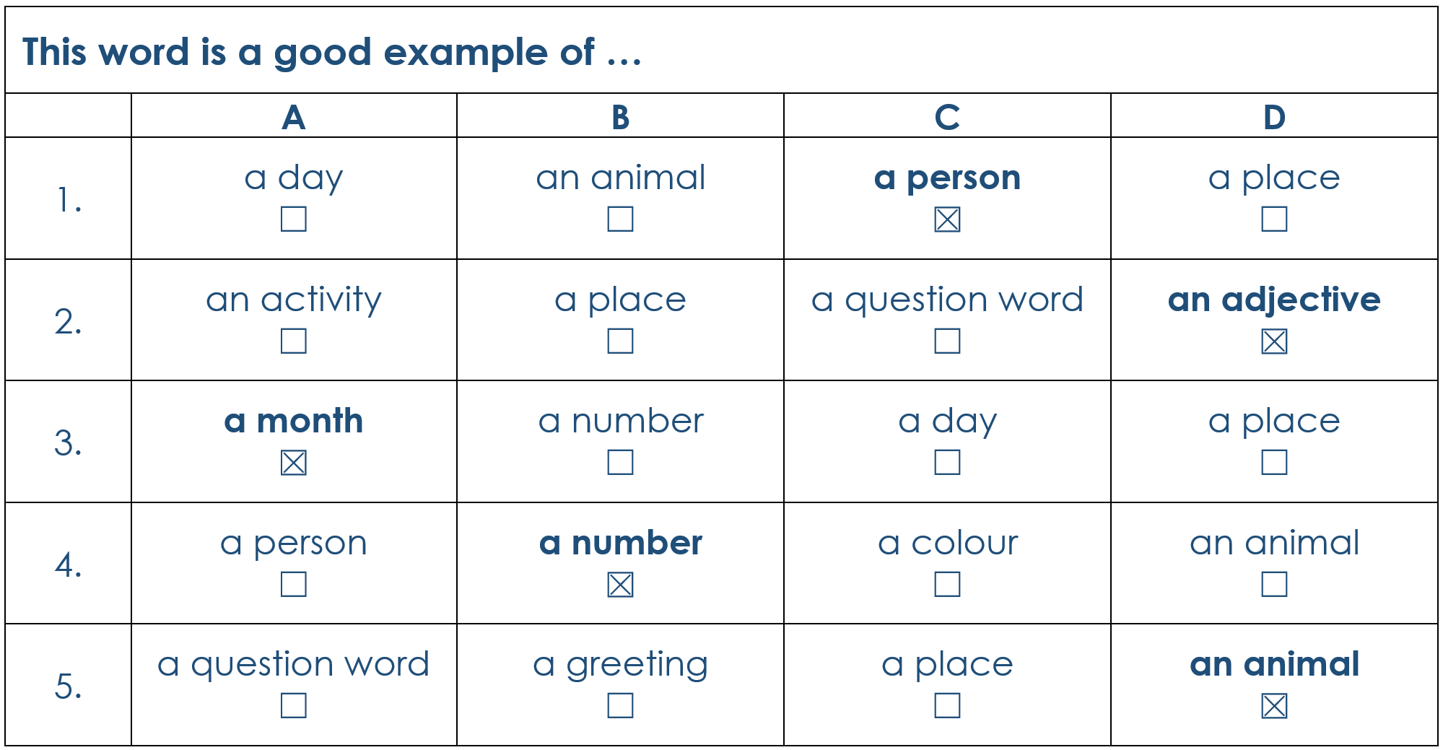
Vocabulary
B For each question, put a cross (x) under the type of word you hear.
You will hear each German word twice. Choose one correct answer only. (5 marks)
hören
1
2
3
4
5
Notes:
1/1
ANSWERS
Transcript:
die Lehrerin
jung
März
zwölf
das Tier
18

Slide 19
Vocabulary
C Translate the underlined German word to complete each English sentence. (12 marks)
lesen
1. Er hat drei Fragen. He has three questions. (2)
2. Ich habe einen Bleistift aber kein Buch. I have a pencil but no book. (1)
3. Ich kann die Flasche sehen. I can see the bottle. (2)
4. Ich weiβ nicht. I don’t know. (2)
5. Wer ist das? Who is that? (1)
6. Du bist freundlich. You are friendly. (1)
7. Die Musik ist toll! The music is great! (1)
8. Ich spiele samstags Fußball. I play football on Saturdays. (2)
Notes:
1/1
ANSWERS
19

Slide 20
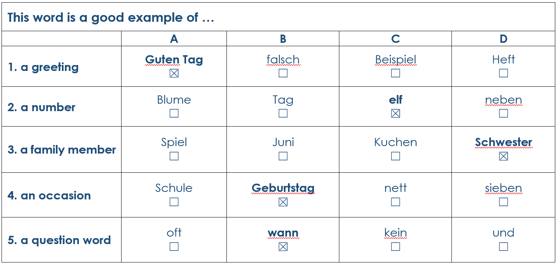
Vocabulary
D For each question, put a cross (x) under the word that best fits each category.
Choose one correct answer only. (5 marks)
lesen
Notes:
1/1
ANSWERS
20

Slide 21
Vocabulary
E Translate the underlined English words to complete the German sentence. (15 marks)
schreiben
1. Tomorrow is Monday. Morgen ist Montag. (Write one word.)
2. My brother is small. Mein Bruder ist klein. (Write one word.)
3. Today is Thursday. Heute ist Donnerstag. (Write one word.)
4. Bye, Mr Schmidt! Tschüss Herr Schmidt! (Write one word.)
5. Lisl is my (female) friend. Lisl ist meine Freundin. (Write one word.)
6. I can dance. Ich kann tanzen. (Write one word.)
7. Can he help? Kann er helfen? (Write one word.)
8. What is your favourite colour? Was ist deine Lieblingsfarbe. (Write one word.)
9. Max is very old. Max ist sehr alt. (Write two words.)
10. Do you have a pet? Hast du ein Haustier? (Write two words.)
Notes:
1/1
ANSWERS
21

Slide 22
Grammar
A Put a (X) next to the person the sentence is about. (5 marks)
lesen
1 | ☐ I ☐ you _{[singular]} ☒ she/he | … ist nett.
2 | ☒ I ☐ you _{[singular]} ☐ she/he | … singe.
3 | ☒ I ☐ you _{[singular]} ☐ she/he | … habe ein Handy.
4 | ☐ I ☒ you _{[singular]} ☐ she/he | … schwimmst.
Notes:
1/1
ANSWERS
22

Slide 23
Grammar
B Put a (X) next to the person the sentence is about. (2 marks)
lesen
1 | ☐ I ☒ you _{[singular]} | … kannst eine Antwort lernen.
2 | ☐ you _{[singular]} ☒ she/he | … kann ein Instrument spielen.
Notes:
1/1
ANSWERS
23

Slide 24
Grammar
C Put a (X) next to the English meaning of the German sentence. (4 marks)
lesen
1 | Du bist nicht hier. | ☐ You are here. ☒ You are not here.
2 | Das ist kein Buch. | ☐ That is a book. ☒ That is not a book.
3 | Er gewinnt das Spiel. | ☒ He wins the game. ☐ He does not win the game.
4 | Sie tanzt nicht. | ☐ She dances. ☒ She does not dance.
Notes:
1/1
ANSWERS
24

Slide 25
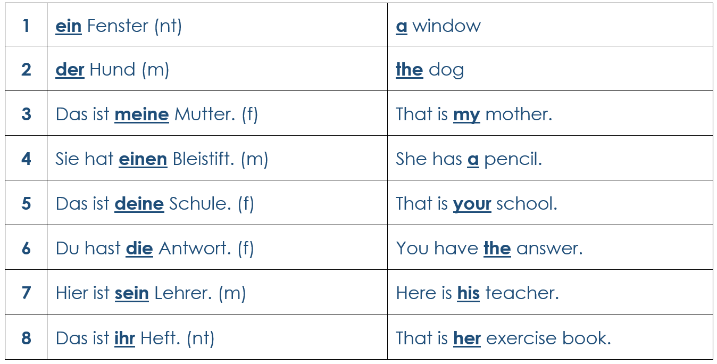
Grammar
D Write the correct determiner in the blanks to complete the German translations. (8 marks)
schreiben
Notes:
1/1
ANSWERS
25

Slide 26
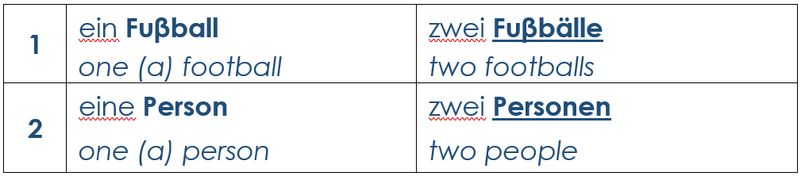
Grammar
E Write the plural version of each noun in the table below. (2 marks)
schreiben
Notes:
1/1
ANSWERS
26

