Slide 1
Was kann ich jetzt?
Ich wiederhole!
rot
Phonics quiz
Term 3 Week 11
Notes:
Word frequency (1 is the most frequent word in German):
Jones, R.L & Tschirner, E. (2019). A frequency dictionary of German: Core vocabulary for learners. London: Routledge.
The frequency rankings for words that occur in this PowerPoint which have been previously introduced in these resources are given in the SOW and in the resources that first introduced and formally re-visited those words. For any other words that occur incidentally in this PowerPoint, frequency rankings will be provided in the notes field wherever possible.
1

Slide 2
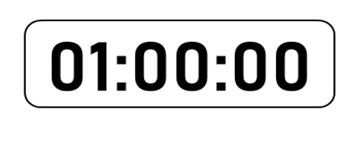
[st]
[ei]
aussprechen
aussprechen
Stunde
Bein
Notes:
Phonics quiz
Timing: flexible during Week 11 Procedure:
Print out one set of these 14 phonics cards.
Working with one pupil at a time, elicit the pronunciation of each word.
Say: You have not learnt these words, but you have learnt how to read aloud these sounds, so just have a go at reading each word aloud.
Focus only on the accurate pronunciation of the target SSC and tolerate any other inaccuracies.
Use the pupil scoring sheet at the end of this presentation to assess SSC knowledge and give feedback.
Note: Whilst working with individual children, others can be doing the Easter activities at the end of this presentation.
2

Slide 3
[ä]
long [u]
aussprechen
aussprechen
[only]
Gläser
nur
Notes:
Phonics quiz
Timing: flexible during Week 11 Procedure:
Print out one set of these 14 phonics cards.
Working with one pupil at a time, elicit the pronunciation of each word.
Say: You have not learnt these words, but you have learnt how to read aloud these sounds, so just have a go at reading each word aloud.
Focus only on the accurate pronunciation of the target SSC and tolerate any other inaccuracies.
Use the pupil scoring sheet at the end of this presentation to assess SSC knowledge and give feedback.
Note: Whilst working with individual children, others can be doing the Easter activities at the end of this presentation.
3

Slide 4
[äu]
[th]
aussprechen
aussprechen
[topic]
Bäume
Thema
Notes:
Phonics quiz
Timing: flexible during Week 11 Procedure:
Print out one set of these 14 phonics cards.
Working with one pupil at a time, elicit the pronunciation of each word.
Say: You have not learnt these words, but you have learnt how to read aloud these sounds, so just have a go at reading each word aloud.
Focus only on the accurate pronunciation of the target SSC and tolerate any other inaccuracies.
Use the pupil scoring sheet at the end of this presentation to assess SSC knowledge and give feedback.
Note: Whilst working with individual children, others can be doing the Easter activities at the end of this presentation.
4

Slide 5
[-tion]
[-d]
aussprechen
aussprechen
Fiktion
Nord
Notes:
Phonics quiz
Timing: flexible during Week 11 Procedure:
Print out one set of these 14 phonics cards.
Working with one pupil at a time, elicit the pronunciation of each word.
Say: You have not learnt these words, but you have learnt how to read aloud these sounds, so just have a go at reading each word aloud.
Focus only on the accurate pronunciation of the target SSC and tolerate any other inaccuracies.
Use the pupil scoring sheet at the end of this presentation to assess SSC knowledge and give feedback.
Note: Whilst working with individual children, others can be doing the Easter activities at the end of this presentation.
5

Slide 6
[-ig]
[v]
aussprechen
aussprechen
zwanzig
verkaufen
Notes:
Phonics quiz
Timing: flexible during Week 11 Procedure:
Print out one set of these 14 phonics cards.
Working with one pupil at a time, elicit the pronunciation of each word.
Say: You have not learnt these words, but you have learnt how to read aloud these sounds, so just have a go at reading each word aloud.
Focus only on the accurate pronunciation of the target SSC and tolerate any other inaccuracies.
Use the pupil scoring sheet at the end of this presentation to assess SSC knowledge and give feedback.
Note: Whilst working with individual children, others can be doing the Easter activities at the end of this presentation.
6

Slide 7
[er-]
[-er]
aussprechen
aussprechen
Berg
sauber
Notes:
Phonics quiz
Timing: flexible during Week 11 Procedure:
Print out one set of these 14 phonics cards.
Working with one pupil at a time, elicit the pronunciation of each word.
Say: You have not learnt these words, but you have learnt how to read aloud these sounds, so just have a go at reading each word aloud.
Focus only on the accurate pronunciation of the target SSC and tolerate any other inaccuracies.
Use the pupil scoring sheet at the end of this presentation to assess SSC knowledge and give feedback.
Note: Whilst working with individual children, others can be doing the Easter activities at the end of this presentation.
7

Slide 8
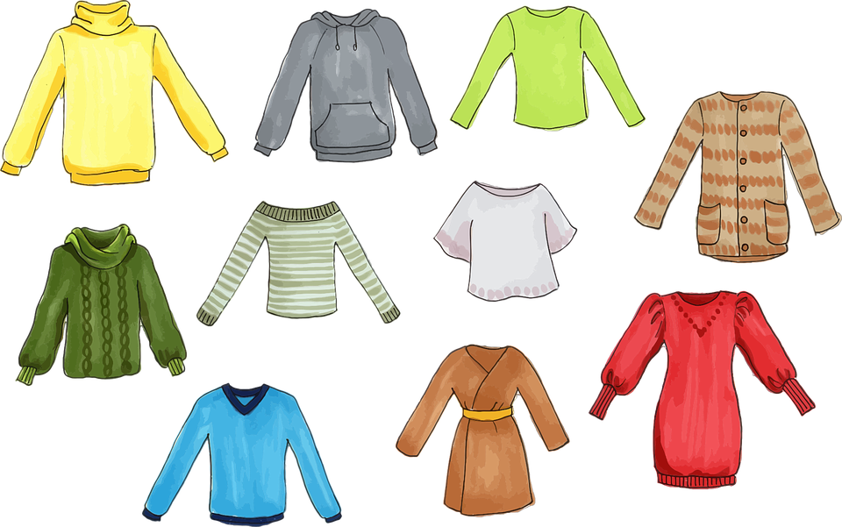
consonantal [r]
soft [ch]
aussprechen
aussprechen
[still]
[to wear]
tragen
noch
Notes:
Phonics quiz
Timing: flexible during Week 11 Procedure:
Print out one set of these 14 phonics cards.
Working with one pupil at a time, elicit the pronunciation of each word.
Say: You have not learnt these words, but you have learnt how to read aloud these sounds, so just have a go at reading each word aloud.
Focus only on the accurate pronunciation of the target SSC and tolerate any other inaccuracies.
Use the pupil scoring sheet at the end of this presentation to assess SSC knowledge and give feedback.
Note: Whilst working with individual children, others can be doing the Easter activities at the end of this presentation.
8

Slide 9
Pupil name:
Pupil name:
SSC and word | px
Stunde
Bein
Gläser
nur
Bäume
Thema
Fiktion
Nord
zwanzig
verkaufen
Berg
sauber
tragen
noch
SSC and word | px
Stunde
Bein
Gläser
nur
Bäume
Thema
Fiktion
Nord
zwanzig
verkaufen
Berg
sauber
tragen
noch
aussprechen
Notes:
Pupil feedback and assessment sheet
9

Slide 10
Teacher audio version
SSC and word | px
Stunde
Bein
Gläser
nur
Bäume
Thema
Fiktion
SSC and word | px
Nord
zwanzig
verkaufen
Berg
sauber
tragen
noch
Notes:
Teacher audio version for preparation
10

Slide 11
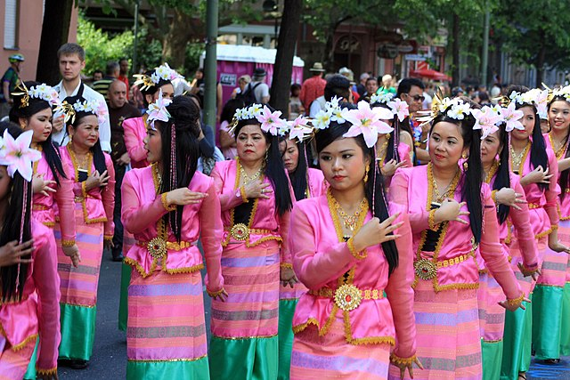
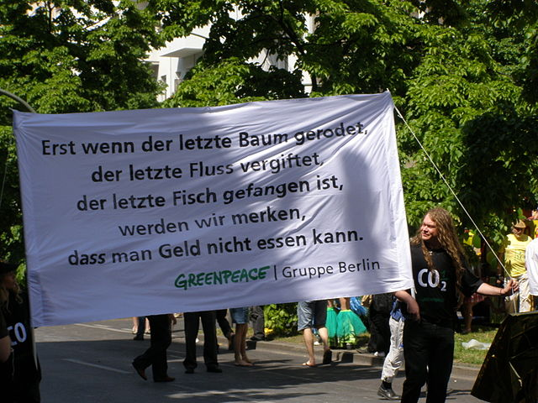
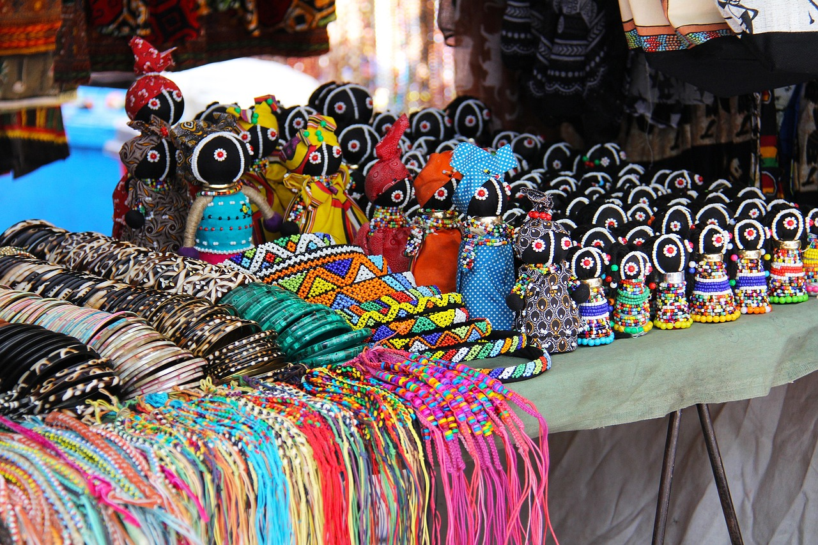
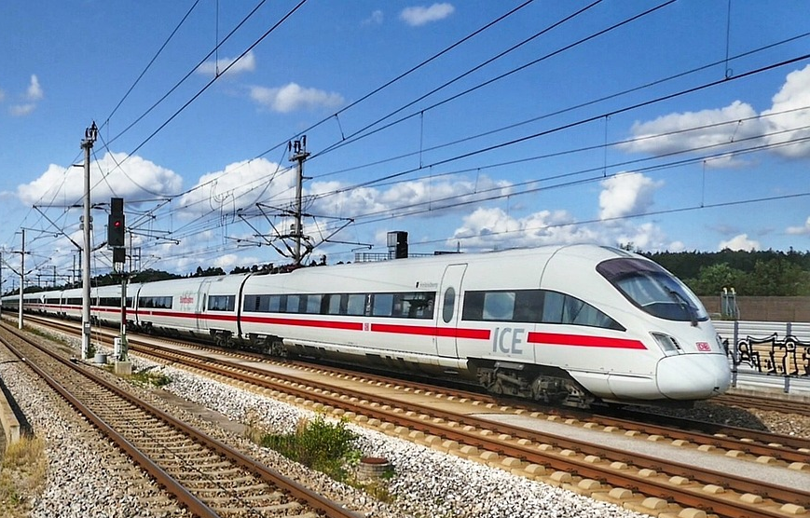
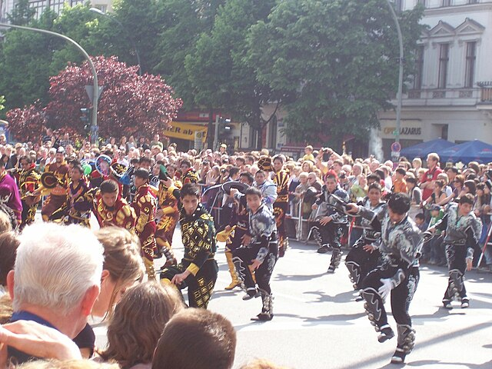
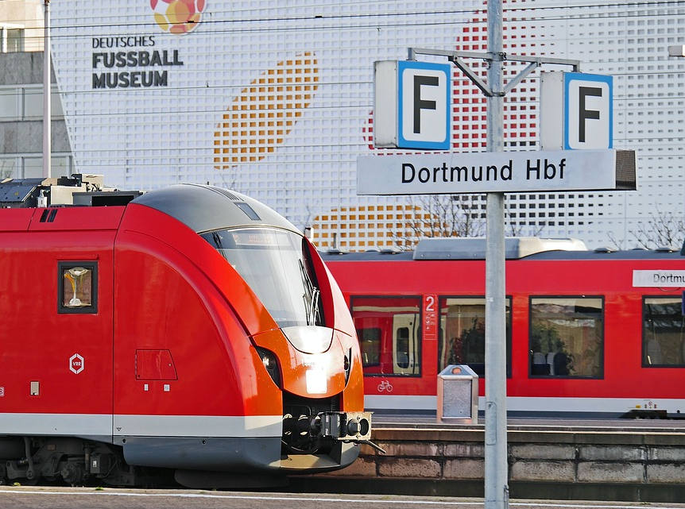
lesen
Karneval der Kulturen
Johanna is at the carnival. Put her pictures in order. Achtung! Johanna’s story starts on a Thursday!
*Umzug – parade
im Zug – on the train
Wann ist das?
4
3
5
Es ist Samstag. Ich denke.
Heute ist Sonntag. Der Umzug* ist toll!
Heute ist Montag. Ich mache ein Geschenk.
1
2
6
Heute ist Donnerstag. Ich sitze im Zug*.
Es ist Freitag. Ich kann auch tanzen.
Es ist Dienstag. Ich bin zu Hause.
Notes:
Timing: 5 minutes
Aim: to learn more about the carnival of cultures, to recap days of the week.
Procedure:
Pupils read Johanna’s notes from the carnival. They number the pictures 1 to 6 based on the days. Note: the first day in Johanna’s story is Thursday, so that will be 1.
Click to reveal answers.
11

Slide 12
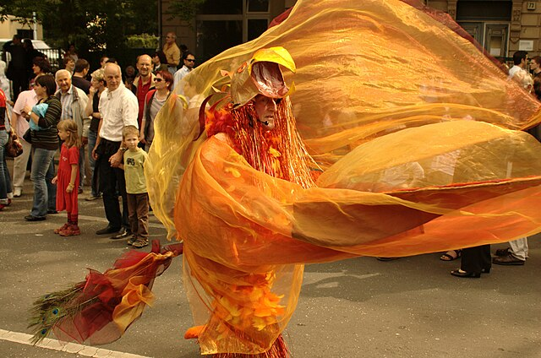
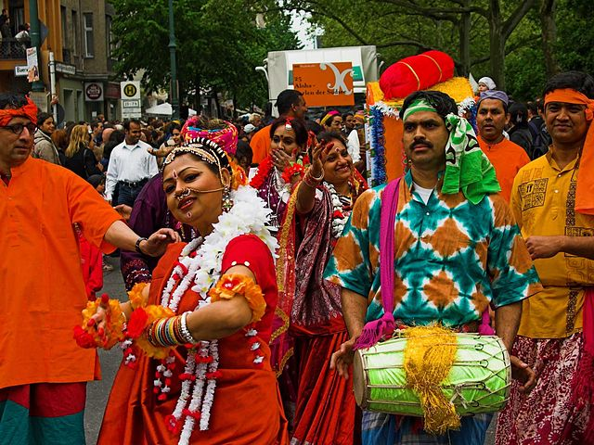
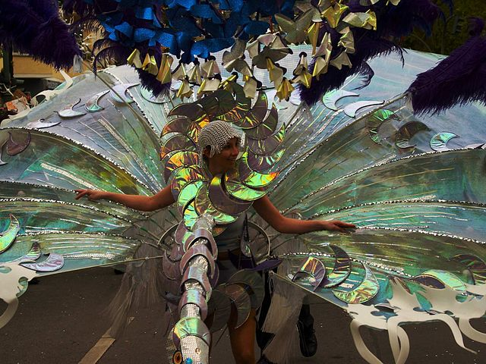
Johanna in Berlin
*im Umzug – in the parade
A Translate Johanna’s postcard.
schreiben
Hallo Aisha,
B Draw a picture of Johanna and her family at the festival based on what she says in her postcard.
¡Hola Ángela!
[I am] in Berlin. Es ist [May]. Hier ist
[a picture]. Da ist [my brother]. Und das ist [my mum] and [her (female) friend]. Sie [is playing] ein [instrument] im Umzug*. Ich [can dance tomorrow]. Und ich [am singing] heute. Der Karneval ist [great]!
Tschüss,
Johanna
Notes:
Timing: 10-15 minutes (independent) (2 slides)
Aim: to correctly use a range of grammatical structures and vocabulary from the year.
Procedure:
Pupils could number 1-11 for the gaps and translate each [prompt] into German.
On the following slide, click to reveal answers. Click on the mp3 player to hear audio.
Image attribution:
Karneval der Kulturen in Berlin 2009 Von Nikolas Becker (foto/at/nikolasbecker.de) - Eigenes Werk, CC BY-SA 3.0, https://commons.wikimedia.org/w/index.php?curid=13661786
Carnival of cultures, Berlin May 2005 Karneval der Kulturen in Berlin Von MyName (Panic) - Eigenes Werk, CC BY-SA 3.0, https://commons.wikimedia.org/w/index.php?curid=3367016
Carnival of cultures, Berlin May 2005 Karneval der Kulturen in Berlin Von MyName (Panic) - Eigenes Werk, CC BY-SA 3.0, https://commons.wikimedia.org/w/index.php?curid=3366853

Slide 13
Johanna in Berlin
*im Umzug – in the parade
A Translate Johanna’s postcard.
schreiben
Hallo Aisha,
B Draw a picture of Johanna and her family at the festival based on what she says in her postcard.
¡Hola Ángela!
[I am] in Berlin. Es ist [May]. Hier ist
Ich bin
Mai
[a picture]. Da ist [my brother]. Und das ist [my mum] and [her (female) friend]. Sie [is playing] ein [instrument] im Umzug*. Ich [can dance tomorrow]. Und ich [am singing] heute. Der Karneval ist [great]!
Tschüss,
Johanna
ein Bild
mein Bruder
meine Mutter
ihre Freundin
spielt
Instrument
kann morgen tanzen
singe
toll
Notes:
[2/2]

Slide 14
lesen
Karneval der Kulturen
Johanna is at the carnival. Put her pictures in order. Achtung! Johanna’s story starts on a Thursday!
*Umzug – parade
im Zug – on the train
Wann ist das?
Es ist Samstag. Ich denke.
Heute ist Sonntag. Der Umzug ist toll!
Heute ist Montag. Ich mache ein Geschenk.
Heute ist Donnerstag. Ich sitze im Zug*.
Es ist Freitag. Ich kann auch tanzen.
Es ist Dienstag. Ich bin zu Hause.
Notes:
HANDOUT
14

