Slide 1
Was kann ich jetzt?
Ich wiederhole!
rot
Phonics, Vocabulary and Grammar revision
Term 3 Week 9
Notes:
Artwork by Steve Clarke. Pronoun pictures from NCELP (www.ncelp.org). All additional pictures selected from Pixabay and are available under a Creative Commons
license, no attribution required.
Phonics: Revisit SSC: [v] [w] [r] [er-] [-er] [-ig] [-g] [-d] [-b] [-tion] [z] [ei] [ie] [th]
Vocabulary: Revisit language from Term 3
Revisit 1: helfen [338] er/sie/es kann [23]
Revisit 2: Montag [1044] Dienstag [1356] Mittwoch [1187] Donnerstag [1244] Freitag [981] Samstag [1112] Sonntag [804] Tag [111] Woche [219] heute
[116] morgen [752]
Jones, R.L & Tschirner, E. (2019). A frequency dictionary of German: Core vocabulary for learners. London: Routledge.
The frequency rankings for words that occur in this PowerPoint which have been previously introduced in these resources are given in the SOW and in the
resources that first introduced and formally re-visited those words.
For any other words that occur incidentally in this PowerPoint, frequency rankings will be provided in the notes field wherever possible.
Note that the first three lessons of the year teach language that can be continuously recycled as lesson routine every lesson in Y3/4.
The idea would be that the class teacher (whether or not s/he teaches the class German can re-use the language as part of the daily routine with the class.
1

Slide 2
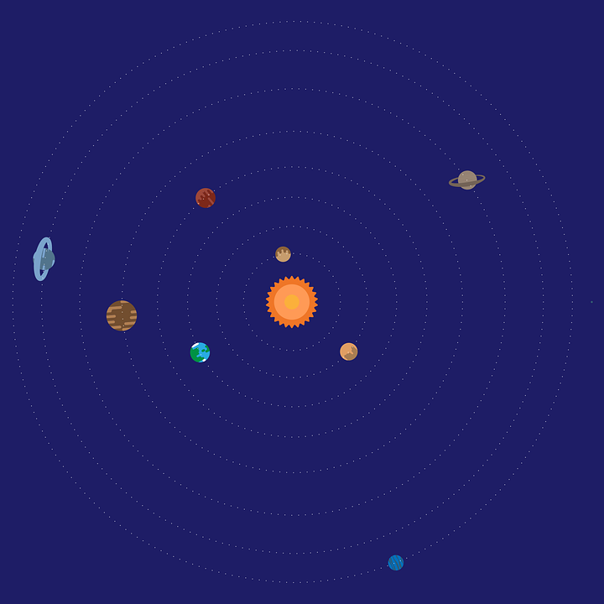
Follow up 1:
Runde 1: Person A 🗣
Person B 📝✅
…
Wie sagt man das richtig?
aussprechen
bevor
Erfolg
rufen
niedrig
weg
leider
Partei
Investition
Schuld
Notes:
Timing: 5-7 minutes [3 slides]
Aim: To practise the pronunciation of words containing sounds covered in Term 3.
Procedure:
Pupils work in pairs, as Person A and Person B. One pupil will pronounce words whilst the other checks pronunciation. There are 9 words for Person A to pronounce on this slide, and 9 more words for Person B to pronounce on the next slide. There is a handout at the end of the presentation for the checker to use, or pupils can simply write 1-9 in their books and tick or cross.
Click once to make the spaceship appear (This animation is timed - don’t click again until all words have appeared). Pupil A pronounces all of the words. Pupil B ticks the words pronounced correctly.
Move to next slide for Pupil B’s turn and repeat.
Frequency of unknown words and cognates:
bevor [537] Erfolg [541] rufen [530] niedrig [778] weg [965] leider [643] Partei [588] Investition [1406] Schuld [1583]
Source: Jones, R.L. & Tschirner, E. (2019). A frequency dictionary of German: core vocabulary for learners. Routledge

Slide 3
Follow up 1:
Runde 2: Person B 🗣
Person A📝✅
…
aussprechen
ab
These
Verbot
Humor
Bad
Helfer
reiten
gültig
Addition
Notes:
Procedure:
Pupil A now checks pronunciation, as Pupil B pronounces the 9 words.
Click to start the animation as on previous slide.
Move to slide 3 to show the ‘value’ of each word. Pupils can compare their results and see who earned the most.
Frequency of unknown words and cognates:
ab [544] These [3061] Verbot [3390] Humor [3410] Bad [1637] Helfer [3426] reiten [3470] gültig [3651] Addition [3708]
Source: Jones, R.L. & Tschirner, E. (2019). A frequency dictionary of German: core vocabulary for learners. Routledge

Slide 4
Follow up 1
…
How much are your words worth?
aussprechen
Person B
Person A
ab 💰 (off, away)
These 💰💰(thesis)
Verbot 💰 (ban)
Humor 💰 (humour)
Bad 💰💰 (bath)
Helfer 💰💰 (helper)
reiten 💰 (to ride)
gültig💰💰 (valid)
Addition 💰 (addition)
bevor 💰💰 (before)
Erfolg 💰 (success)
rufen 💰 (to call)
niedrig 💰💰 (low)
weg💰💰 (gone)
leider 💰 (unfortunately)
Partei 💰 (political party)
Investition 💰 (investment)
Schuld 💰💰 (guilt)
Notes:
1. Pupils can add up and compare their results.
2. Repeat the activity with pupils swapping slides, if time allows.
3. Click on the audio buttons to check pronunciation of individual words.
Frequency of unknown words and cognates:
ab [544] These [3061] Verbot [3390] Humor [3410] Bad [1637] Helfer [3426] reiten [3470] gültig [3651] Addition [3708]
bevor [537] Erfolg [541] rufen [530] niedrig [778] weg [965] leider [643] Partei [588] Investition [1406] Schuld [1583]
Source: Jones, R.L. & Tschirner, E. (2019). A frequency dictionary of German: core vocabulary for learners. Routledge

Slide 5
lesen
Follow up 2
Lies den Text. Was sagt Alex?
*alles - everything
Hallo!
Wie geht’s? Ich heiße Alex. Ich bin zehn Jahre alt und ich wohne in Frankfurt. Das ist in Deutschland. Heute ist Mittwoch und ich bin in der Schule. Ich sitze neben Julia. Sie ist meine Freundin.
Ich lerne Englisch und ich kann etwas verstehen, aber nicht alles*! Zum Beispiel: Haustier ist ‘pet’, nicht wahr? Mein Lieblingswort ist ‘window’! ‘Wie sagt man das auf Deutsch? Was ist dein Lieblingswort?
Ich habe morgen Geburtstag. Ja, das ist im Juli! Ich denke, das ist toll. Ich kann Fußball spielen oder schwimmen. Wann hast du Geburtstag?
Schreib bald! Tschüss
1. What two details do we find out about Alex?
They are 10 years old and they live in Frankfurt.
2. What does Alex say about today? (3 details)
Today is Wednesday, they are at school, and they are sitting next to their friend Julia.
3. What does Alex say about learning English? ….(2 details)
They can understand something, but not everything. Their favourite word is ‘window’.
4. What does Alex say about their birthday? ….(3 details)
Their birthday is tomorrow. In July. They find that great. They can play football or swim.
5. What questions does Alex ask in the letter? ….(5 details)
How are you? Does ‘Haustier’ mean ‘pet’? How do you say ‘window’ in German? What is your favourite word? When is your birthday?
Notes:
Timing: 8 minutes
Aim: to practise written comprehension of vocabulary and grammar from Term 3 in a longer text.
Procedure:
Pupils read what Alex has written, and then answer the questions to the right in English.
Click to reveal answers.
In the audio version, click on the blue text box to hear Alex.
Frequency of unknown words and cognates:
alles [36]
Source: Jones, R.L. & Tschirner, E. (2019). A frequency dictionary of German: core vocabulary for learners. Routledge
5

Slide 6
hören
Follow up 3 Mein Bild
Hör zu. Was ist wo? Schreib auf Englisch.
1
friend
dog
book
2
3
book
photo
friend
game
dog
4
game
photo
5
Notes:
Timing: 5 minutes
Aim: to practise aural comprehension of vocabulary and grammar from Term 3 in a more holistic activity.
Note: This is a simpler version of the activity, which requires pupils to label each square with one of the 5 words in the middle of the ‘picture’. The following slide is a more challenging version which requires pupils to label each square and then note additional details.
Procedure:
1. Explain the task. Pupils are going to listen to someone describing the blue picture on the board.
2. Click on the first audio button to hear the first sentence. Pupils listen to the description and label one of the 5 white squares with one of the 5 words in the middle of the picture.
3. Repeat for sentences 2-5.
4. Click to reveal answers.
Transcript:
Hier ist mein Bild. Oben links ist mein Freund Ralf. Er kann nicht singen, aber er kann gut tanzen.
Unten links ist mein Spiel. Das ist mein Lieblingsgeburtstagsgeschenk.
Oben rechts ist mein Lieblingsbuch. Es heißt Harry Potter.
Neben Ralf ist mein Hund, Bruno. Er ist sehr groß und er ist auch sehr freundlich.
Unten rechts ist mein Foto. Ja, ich bin das!
6

Slide 7
hören
Follow up 3 Mein Bild
Hör zu. Was ist wo? Schreib auf Englisch.
1
Ralf
Can’t sing
Can dance well
Bruno
Very big
Very friendly
Favourite
Harry Potter
2
friend
dog
book
3
book
photo
friend
game
dog
Favourite
birthday present
4
Photo of me
5
game
photo
Notes:
Timing: 5 minutes
Aim: to practise aural comprehension of vocabulary and grammar from Term 3 in a more holistic activity.
Note: This is a more challenging version which requires pupils to label each square and then note additional details. The previous slide is a simpler version of the activity, which requires pupils to label each square with one of the 5 words in the middle of the ‘picture’.
Procedure:
1. Explain the task. Pupils are going to listen to someone describing the blue picture on the board.
2. Click on the first audio button to hear the first sentence. Pupils listen to the description and label one of the 5 white squares with one of the 5 words in the middle of the picture.
3. Repeat for sentences 2-5.
4. Click to reveal answers.
5. Play each sentence again. Pupils listen for extra details and add them to each square accordingly.
Transcript:
Hier ist mein Bild. Oben links ist mein Freund Ralf. Er kann nicht singen, aber er kann gut tanzen.
Unten links ist mein Spiel. Das ist mein Lieblingsgeburtstagsgeschenk.
Oben rechts ist mein Lieblingsbuch. Es heißt Harry Potter.
Neben Ralf ist mein Hund, Bruno. Er ist sehr groß und er ist auch sehr freundlich.
Unten rechts ist mein Foto. Ja, ich bin das!
7

Slide 8
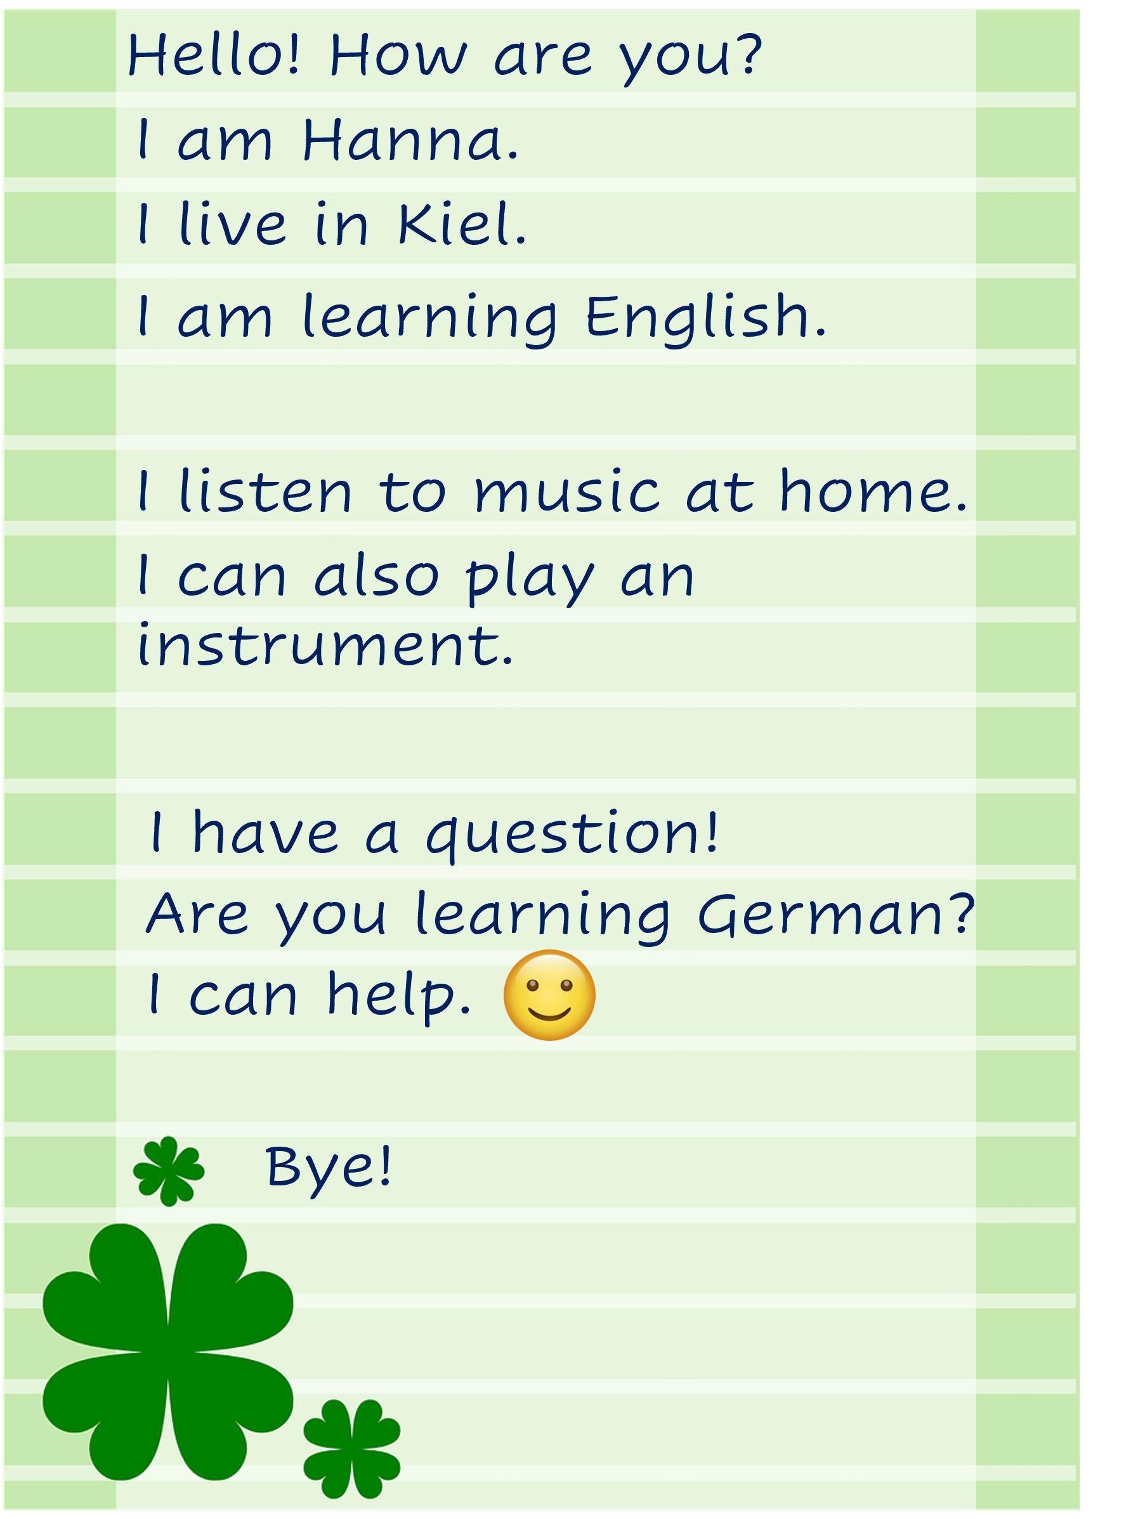
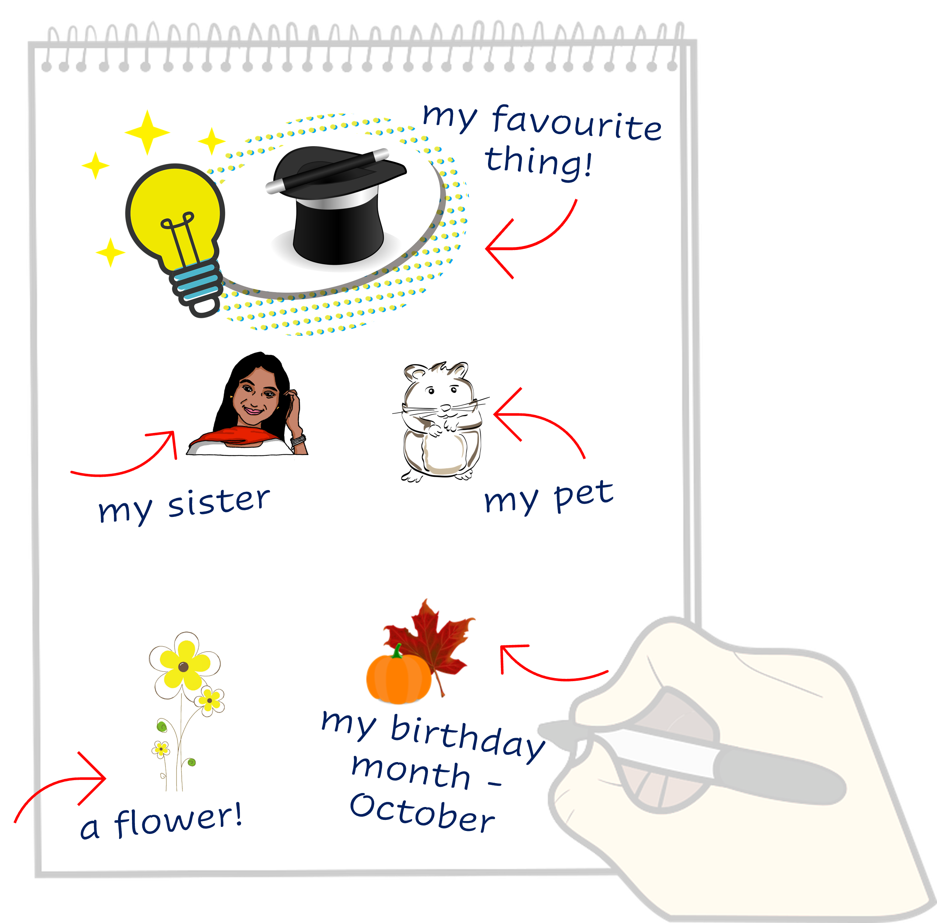
Vokabeln
Follow up 4
Lies den Text. Schreib Vokabeln auf Deutsch.
Just have a go! Write any of these English words in German. You can add different words, too.
Wörter
Notes:
Timing: 5 minutes
Aim: to practise written production of this term’s vocabulary.
Note: This is a more straightforward version of the activity, asking pupils for individual words. A more challenging version can be found on the following slide, where pupils are encouraged to write a mixture of sentences and words.
Procedure:
Pupils read the message from Hanna in the green text box.
Pupils use Hanna’s message and the words and pictures on the notebook to the right as inspiration. They use the lines on the left to write any words in German that they could use to reply to Hanna. They could use any of the words on the notebook, and any other words they know.
8

Slide 9
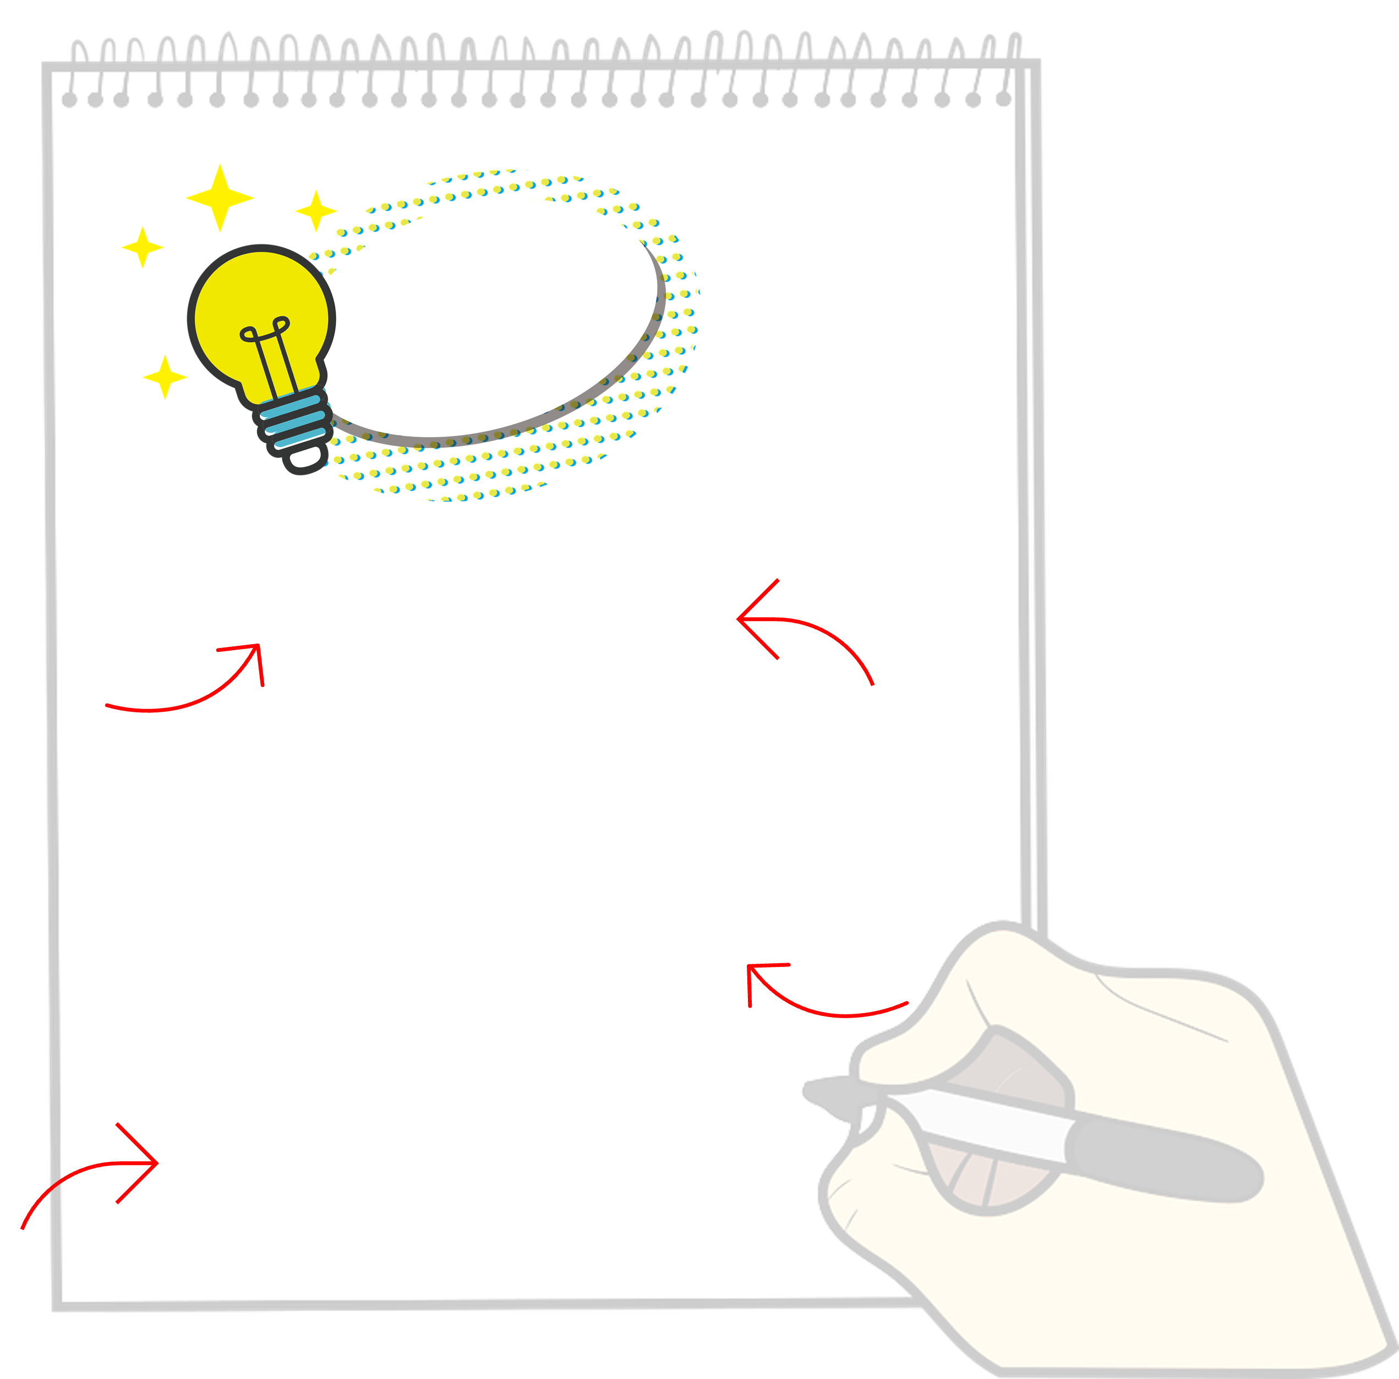
schreiben
Follow up 4
Write a message to Hanna in German. Write anything you like. You can write short sentences or words or a mixture, like Hanna.
Schreib auf Deutsch.
Notes:
Timing: 8 minutes
Aim: to practise written production of this term’s vocabulary and to practise written production of short sentences.
Note: This is a more challenging version of the activity, where pupils are encouraged to write a mixture of sentences and words. A more straightforward version of the activity can be found on the previous slide, where pupils are asked to write individual words.
Procedure:
Pupils read the message from Hanna in the green text box.
Pupils use Hanna’s message and the words and pictures on the notebook to the right as inspiration. They use the lines on the left and the empty notepad to write any words or sentences in German that they could use to reply to Hanna.
9

Slide 10
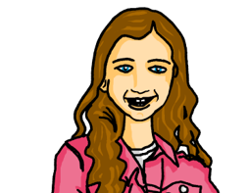
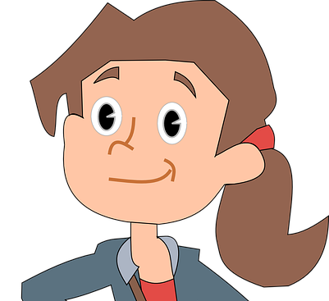
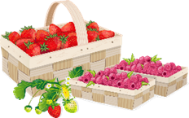
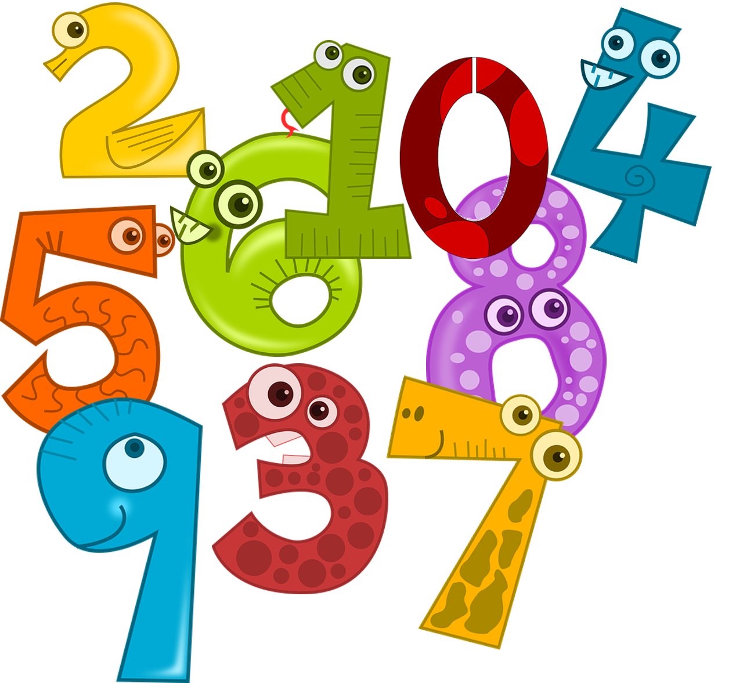
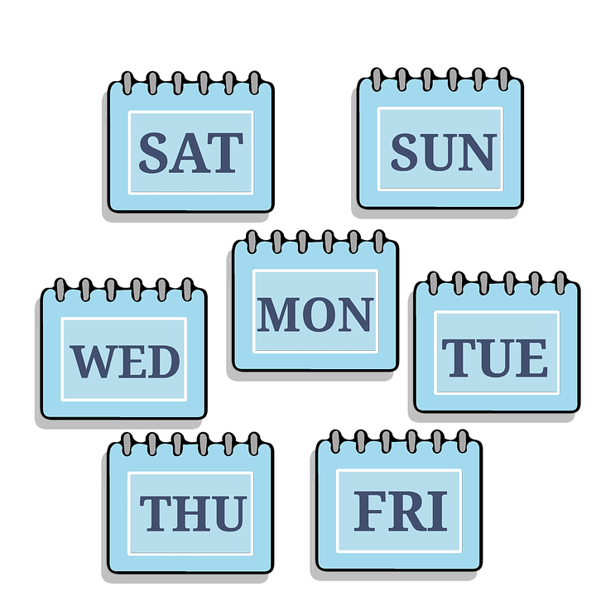
sprechen
Follow up 5
…
Wer ist dein Partner/deine Partnerin?
Ask only ‘yes|no’ questions in German. Work out who your partner has chosen to be!
Hast du ein Lieblingsort?
Bist du Ahmet?
Hast du eine Lieblingsfarbe?
Hast du im Dezember Geburtstag?
Bist du acht Jahre alt?
Wohnst du in Deutschland?
Ja
Nein
Ja
Ja
Ja
Nein
Tim
Mia
Ahmet
Notes:
Timing: 8 minutes (3 slides)
Aim: to practise spoken production of yes/no questions.
Procedure:
Use this slide to model the activity. Johanna and Moritz are playing a game of guess who using the characters below. Click through the animations to see the questions Johanna asks Moritz.
Click to reveal the following slide.
Pupils work in pairs. Partner A chooses a character. Partner B asks a series of yes/no questions to work out who they have picked. Partners swap roles.
Click to reveal the second activity slide, pupils play the game again.
10

Slide 11
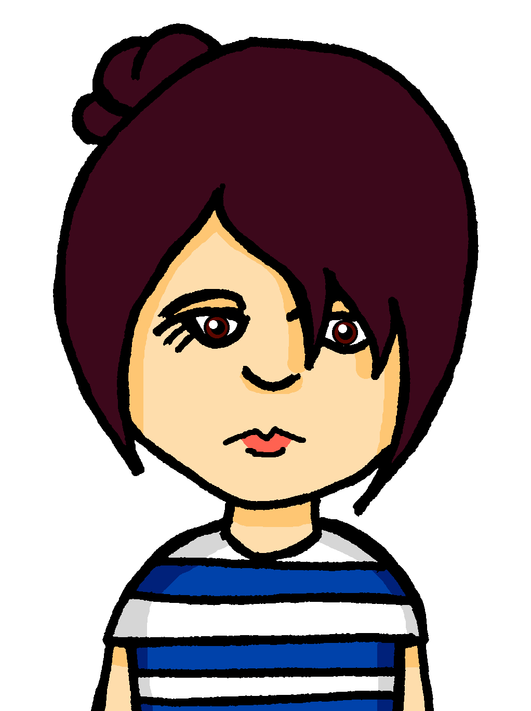
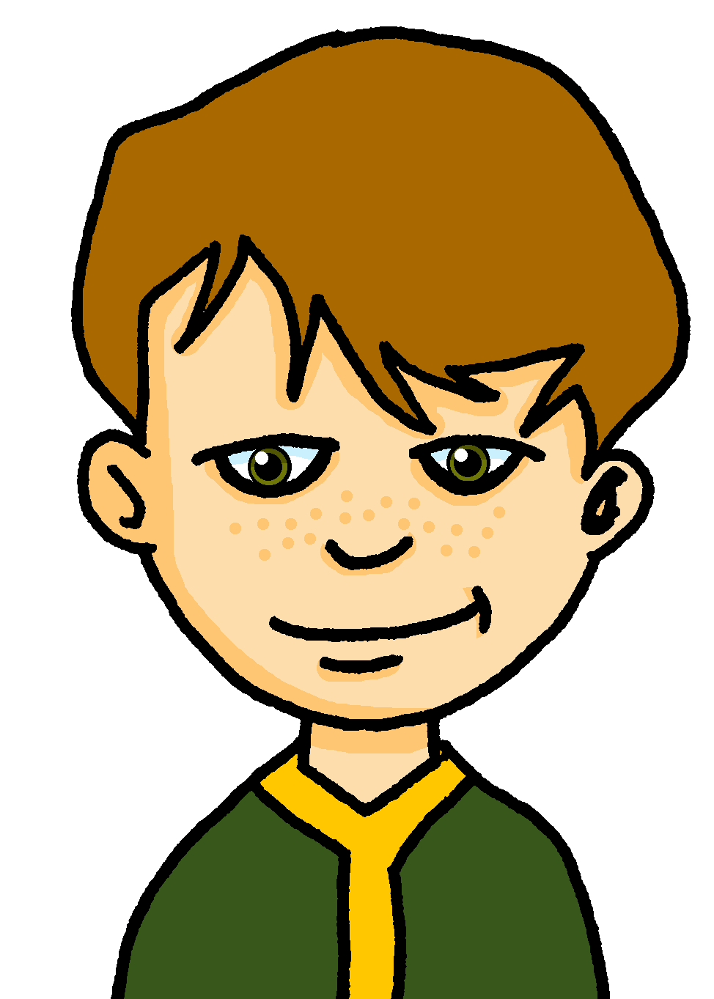
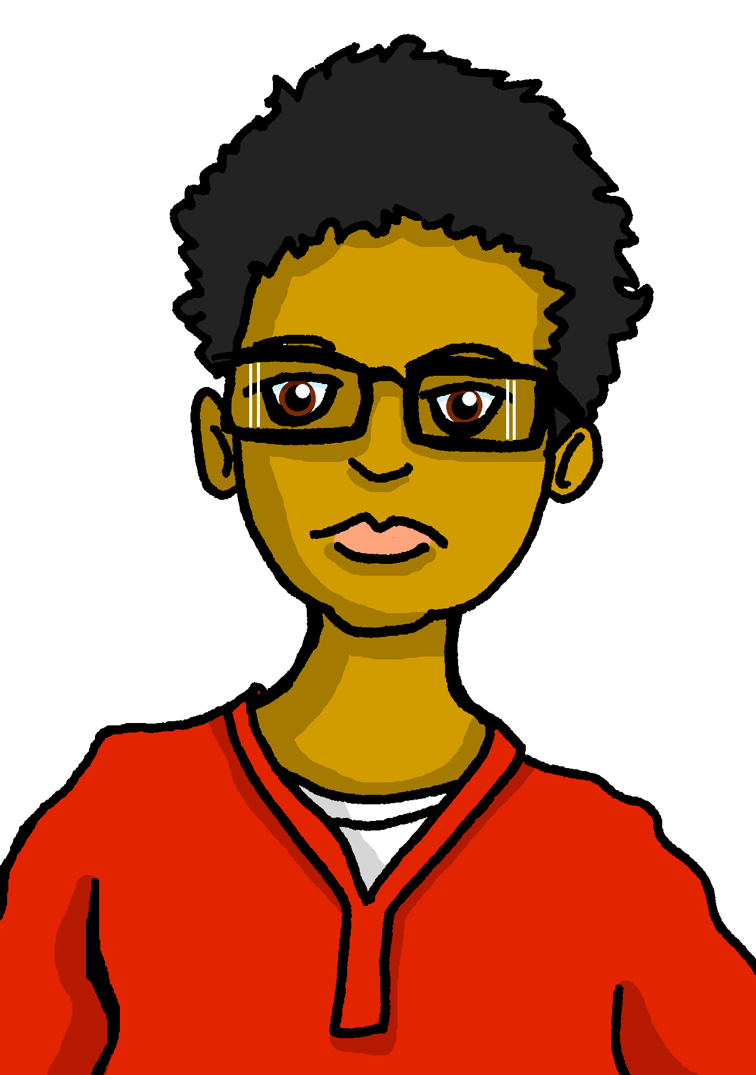
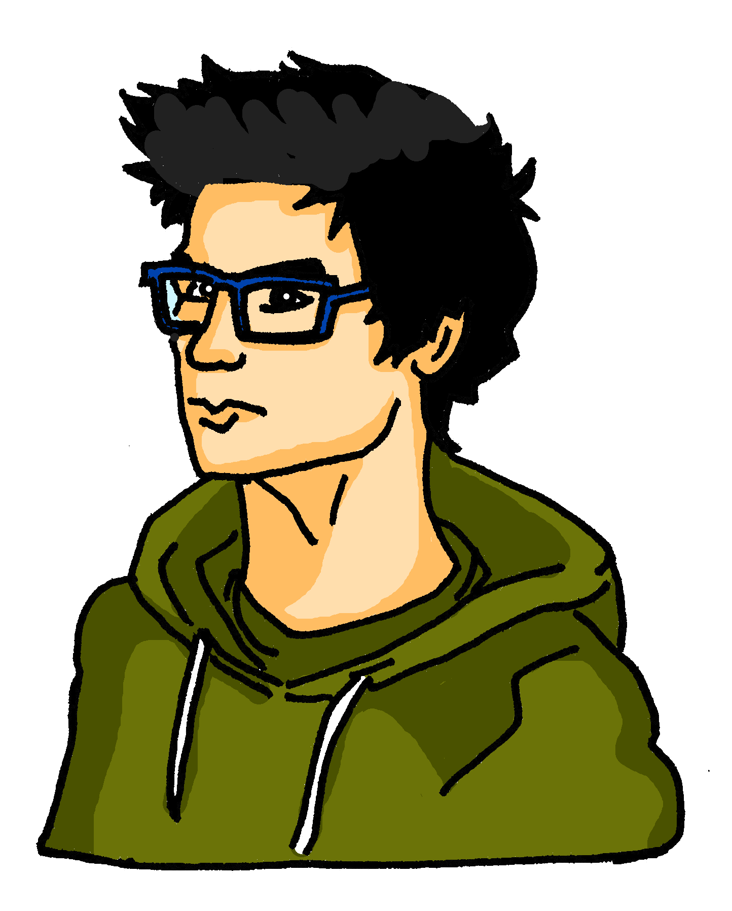
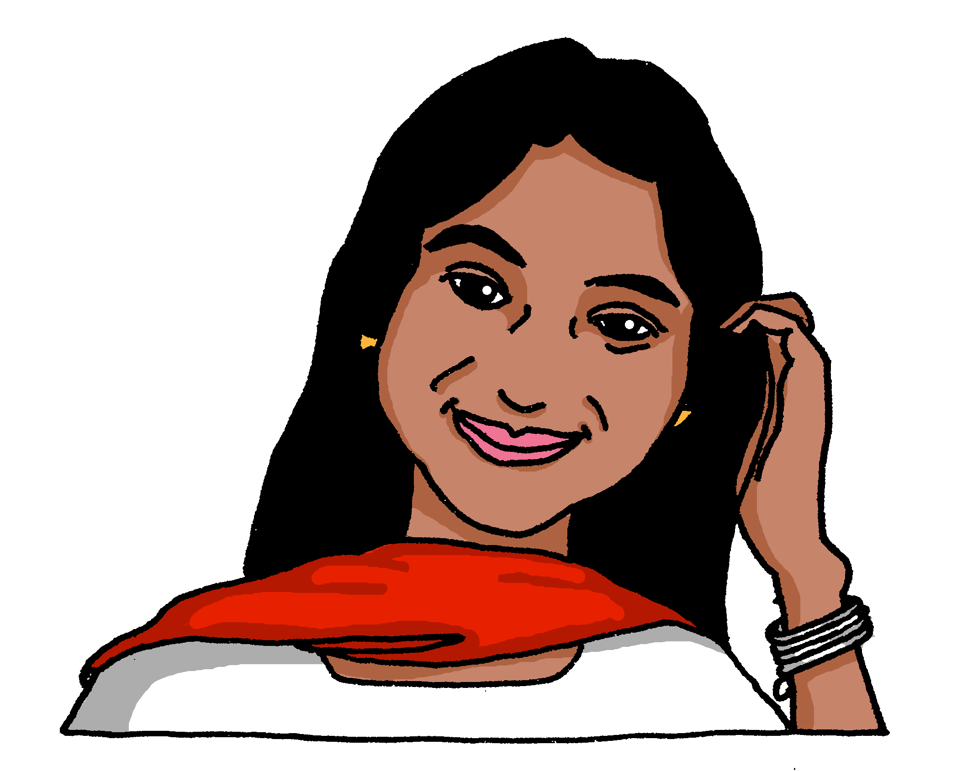
sprechen
Follow up 5
…
Wer ist dein Partner/deine Partnerin?
Ask only ‘yes|no’ questions in German. Work out who your partner has chosen to be!
Laura
Callum
Ella
Ali
Rafi
Alara
Emma
Martin
Notes:
[2/3]
The questions students need for this round are: 1. Wohnst du in England? | Wohnst du in Deutschland?
2. Bist du zehn Jahre alt? | Bist du acht Jahre alt? 3. Hast du im Dezember Geburtstag? | Hast du im Juni Geburtstag?
4. Hast du eine Lieblingsfarbe? | Hast du eine Lieblingsnummer?
5. Hast du einen Lieblingstag? | Hast du einen Lieblingsort?
11

Slide 12
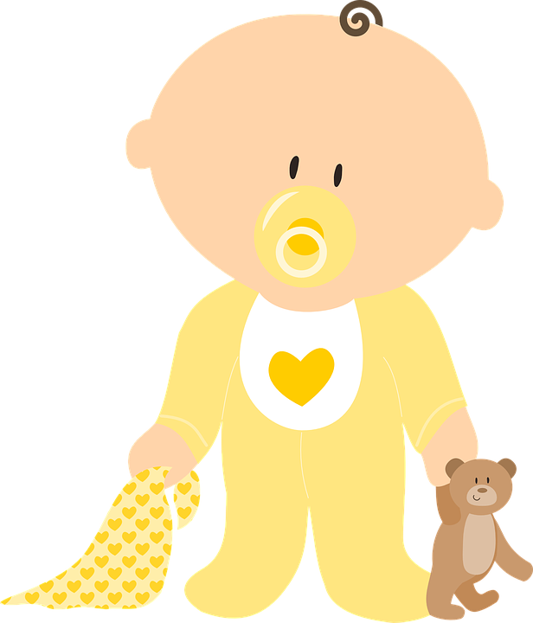
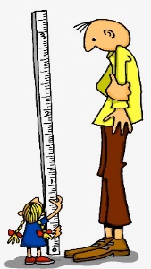
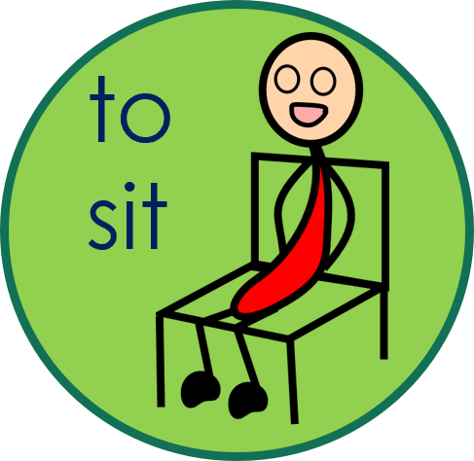
sprechen
Follow up 5
…
Wer ist dein Partner/deine Partnerin?
Ask only ‘yes|no’ questions in German. Work out who your partner has chosen to be!
Laura
Callum
Ella
Ali
word
word
Rafi
Alara
Emma
Martin
word
word
Notes:
[3/3]
The questions students need for this round are: 1. Bist du klein? | Bist du groß?
2. Sitzt du neben Tim? | Sitzt du neben Mia?
3. Hast du einen Bruder? | Hast du eine Schwester? 4. Hast du ein Lieblingstier? | Hast du ein Lieblingswort? 5. Bist du nett? | Bist du freundlich?
12

Slide 13
Extra follow up:

Schreib auf Englisch.
Can you get at least 15 points?
Wörter
 | Mittwoch | Sonntag | Donnerstag
 | Montag | Freitag | Dienstag
 | Samstag | der Tag | die Woche
 | heute | morgen | er kann
 | sie kann | helfen | es kann
 | Oktober | der Satz | der Monat
 | alt | jung | Mai
Wednesday
Sunday
Thursday
Vokabeln
x3
Monday
Friday
Tuesday
Saturday
(the) day
(the) week
today
tomorrow
he can
x2
she can
to help, helping
it can
October
(the) sentence
(the) month
x1
old
young
May
Notes:
Timing: 5 minutes
Aim: to practise written comprehension of vocabulary from this and revisited weeks.
Note: This week, this vocabulary activity is extra. Teachers may do this activity instead of one of the others, or in addition.
Procedure: 1. Give pupils a blank grid. They fill in the English meanings of any of the words they know, trying to reach 15 points in total. 2. Remind pupils that adjectives can refer to male or female persons and they should note this in their translations. E.g. pleased (f), short (m).
Note: The most recently learnt and practised words are pink, words from the previous week are green and those from week 1 are blue, thus more points are awarded for them, to recognise that memories fade and more effort (heavy lifting!) is needed to retrieve them.

Slide 14
Extra follow up:

Schreib auf Deutsch.
Can you get at least 15 points?
Wörter
 | Saturday | Wednesday | Sunday
 | Tuesday | (the) week | Friday
 | (the) day | Thursday | Monday
 | he can | to help, helping | tomorrow
 | it can | today | she can
 | May | October | old
 | young | (the) month | (the) sentence
Samstag
Mittwoch
Sonntag
Vokabeln
x3
Dienstag
die Woche
Freitag
der Tag
Donnerstag
Montag
er kann
helfen
morgen
x2
es kann
heute
sie kann
Mai
Oktober
alt
x1
jung
der Monat
der Satz
Notes:
Timing: 5 minutes
Aim: to practise written production of vocabulary from this and revisited weeks.
Procedure: 1. Give pupils a blank grid. They fill in the German meanings of any of the words they know, trying to reach 15 points in total. 2. Remind pupils that adjectives can refer to male or female persons and they should note this in their translations. E.g. pleased (f), short (m).
Note: The most recently learnt and practised words are pink, words from the previous week are green and those from week 1 are blue, thus more points are awarded for them, to recognise that memories fade and more effort (heavy lifting!) is needed to retrieve them.

Slide 15
Tschüss!
rot
Notes:
15

Slide 16
A
B
Richtig oder falsch?
Richtig oder falsch?
Focus on the underlined sounds. Does your partner pronounce them correctly? Tick or cross!
Focus on the underlined sounds. Does your partner pronounce them correctly? Tick or cross!
ab (off, away)
These (thesis)
Verbot (ban)
Humor (humour)
Bad (bath)
Helfer (helper)
reiten (to ride)
gültig (valid)
Addition (addition)
bevor (before)
Erfolg (success)
rufen (to call)
niedrig (low)
weg (gone)
leider (unfortunately)
Partei (political party)
Investition (investment)
Schuld (guilt)
Notes:
HANDOUT (to be divided in half and half given to Pupil A and half to pupil B).
Note: Handout A should be given to Pupil A and has the words Pupil B will pronounce; handout B should be given to Pupil B and has the words that Pupil A will pronounce.

Slide 17
Follow up 3 Mein Bild
Hör zu. Was ist wo? Schreib auf Englisch.
book
photo
friend
game
dog
Notes:
HANDOUT
17

Slide 18
Vokabeln
Follow up 4
Lies den Text. Schreib Vokabeln auf Deutsch.
Just have a go! Write any of these English words in German. You can add different words, too.
Wörter
Notes:
HANDOUT
18

Slide 19
schreiben
Follow up 4
Write a message to Hanna in German. Write anything you like. You can write short sentences or words or a mixture, like Hanna.
Schreib auf Deutsch.
Notes:
HANDOUT
19

Slide 20
Follow up 5:

Schreib auf Englisch.
Can you get at least 15 points?
Wörter
 | Mittwoch | Sonntag | Donnerstag
 | Montag | Freitag | Dienstag
 | Samstag | der Tag | die Woche
 | heute | morgen | er kann
 | sie kann | helfen | es kann
 | Oktober | der Satz | der Monat
 | alt | jung | Mai
Vokabeln
x3
x2
x1
Notes:
HANDOUT

Slide 21
Follow up 5:

Schreib auf Deutsch.
Can you get at least 15 points?
Wörter
 | Saturday | Wednesday | Sunday
 | Tuesday | (the) week | Friday
 | (the) day | Thursday | Monday
 | he can | to help, helping | tomorrow
 | it can | today | she can
 | May | October | old
 | young | (the) month | (the) sentence
Vokabeln
x3
x2
x1
Notes:
HANDOUT

