Slide 1
Was kann ich jetzt?
Ich wiederhole!
rot
Phonics, Vocabulary and Grammar revision
Term 3 Week 9
Notes:
Artwork by Steve Clarke. Pronoun pictures from NCELP (www.ncelp.org). All additional pictures selected from Pixabay and are available under a Creative Commons license, no
attribution required.
Phonics: Revisit SSC: [v] [w] [r] [er-] [-er] [-ig] [-g] [-d] [-b] [-tion] [z] [ei] [ie] [th]
Vocabulary: Revisit language from Term 3
Revisit 1: helfen [338] er/sie/es kann [23]
Revisit 2: Montag [1044] Dienstag [1356] Mittwoch [1187] Donnerstag [1244] Freitag [981] Samstag [1112] Sonntag [804] Tag [111] Woche [219] heute [116] morgen [752]
Jones, R.L & Tschirner, E. (2019). A frequency dictionary of German: Core vocabulary for learners. London: Routledge.
The frequency rankings for words that occur in this PowerPoint which have been previously introduced in these resources are given in the SOW and in the resources that first
introduced and formally re-visited those words.
For any other words that occur incidentally in this PowerPoint, frequency rankings will be provided in the notes field wherever possible.
Note that the first three lessons of the year teach language that can be continuously recycled as lesson routine every lesson in Y3/4.
The idea would be that the class teacher (whether or not s/he teaches the class German can re-use the language as part of the daily routine with the class.
1

Slide 2
Phonics Revision
Sag die Wörter.
Help Robbie to remember all of the sounds from this term.
frei
Welt
rot
aussprechen
vier
Liebe
Zug
Ort
Which sounds sound the same as each other?
Theater
er
gelb
wieder
und
richtig
Information
Tag
Notes:
Timing: 2 minutes
Aim: to remind pupils of previously taught SSCs and to practise pronunciation of these key sounds.
Procedure:
1. Explain that pupils are going to revise the key sounds learnt this term with Robbie.
2. Click to make the first word appear. Pupils listen to the correct pronunciation and repeat. The audio has the sound on its own, then the full word.
3. Repeat to bring up and practise all sounds covered this term.
4. Click to bring up the callout about similar sounds. Click again to highlight words that have the same sounds but different spellings.
5. Move to the next slide to practise recognition of these sounds in unknown words.

Slide 3
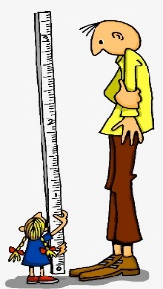
Phonics Revision
Schreib 1-10 und hör zu. Was ist richtig?
Write numbers 1-10. Listen and note down the missing sound in each word.
hören
1 | V e r e i n | v oder w?
2 | r i e s ig | -g oder ig?
3 | v e r b ie t e n | ei oder ie?
4 | M y th o s | th oder tion?
5 | G r u ß | r oder er?
6 | S i l b er | r oder er?
7 | K o r b | -b oder -d?
8 | F u n d | -g oder -d?
9 | K o a l i tion | z oder tion?
10 | W a l d | v oder w?
?
?
club
?
?
?
?
?
?
?
?
Notes:
Timing: 5 minutes
Aim: to practise aural recognition and transcription of previously taught SSCs.
Procedure:
Explain that this week pupils will be revising all the sounds covered this term. They will hear 10 words and need to identify which of the two sounds suggested is the correct missing sound. For a greater challenge, some pupils might like to look away from the board and identify the sound independently.
Click audio button 1 to play the recording for item 1. Pupils need to write down the missing SSC: v or w.
Elicit the answer and click to reveal the answer.
Repeat for items 2-10. Now that pupils have learnt numbers, encourage them to follow the numbers as they listen to each item.
Transcript: 1. Verein
2. riesig
3. verbieten
4. Mythos
5. Gruß
6. Silber
7. Korb
8. Fund
9. Koalition
10. Wald
Word frequency of unknown words (1 is the most frequent word in German): Verein [899] riesig [1075] verbieten [1320] Mythos [4576] Gruß [4722] Silber [4783] Korb [4724] Fund [4805] Koalition [2330] Wald [1028] Source: Jones, R.L. & Tschirner, E. (2019). A frequency dictionary of German: core vocabulary for learners. Routledge

Slide 4
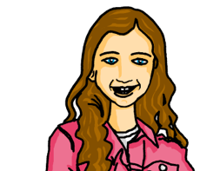
hören
Vocabulary Revision
Hör zu. Was ist das?
For each question, put a cross (x) under the type of word you hear. You will hear each German word twice. Choose one correct answer only.
This word is a good example of …
 | A | B | C | D
1. | a person ☐ | a month ☐ | a day ☐ | an object ☐
2. | a person ☐ | a month ☐ | a day ☐ | an object ☐
3. | a person ☐ | a month ☐ | a day ☐ | an object ☐
4. | a verb ☐ | a place ☐ | a question word ☐ | a description ☐
5. | a verb ☐ | a place ☐ | a question word ☐ | a description ☐
6. | a verb ☐ | a place ☐ | a question word ☐ | a description ☐
1
2
3
4
5
6
Notes:
Timing: 5 minutes
Procedure:
Pupils write 1-6 and write down A, B, C, or D for each word that they hear.
Click to reveal answers 1-6 in turn.
Transcript:
Mittwoch
Februar
die Schwester
wohnen
jung
Wann?
4

Slide 5
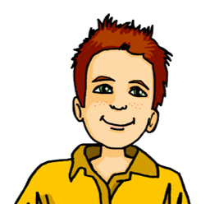
lesen
Revising verbs, present tense, nicht
Remember: to say what someone doesn’t do, use nicht.
Remember: the ending of a verb tells us who a sentence is about.
Ich singe = I sing. Er singt = he sings.
Was sagt Moritz?
Remember: we translate the German present tense in two ways:
Sie singt heute – she is singing today
Sie singt montags – she sings Mondays.
1 | Sie sitzt montags neben Aisha.
2 | Ich wiederhole heute die Frage.
3 | Ich schwimme freitags nicht.
4 | Sie tanzt heute nicht.
5 | Ich helfe heute Aisha.
6 | Sie lernt samstags zu Hause nicht.
Moritz (ich) | Johanna (sie)
do | am doing
1
2
3
4
5
6
Notes:
Timing: 5 minutes
Aim: to practise written comprehension of verbs in the present simple and continuous in the first and third persons; to practise written comprehension of sentences with nicht.
Procedure:
Explain the task. Moritz has written some sentences about himself and Johanna.
The pronouns have been blanked out so that pupils must focus on the verb ending to decide whether he is talking about himself or Johanna.
Pupils read the sentence again and decide whether it would translate into English as the present simple – ‘I do’ (montags) or the present continuous – ‘I am doing’ (heute).
Pupils read for a third time and decide whether the sentence is positive or negative (with nicht).
Click to reveal answers.
In the audio version, click on the blue squares to hear a native speaker.
5

Slide 6
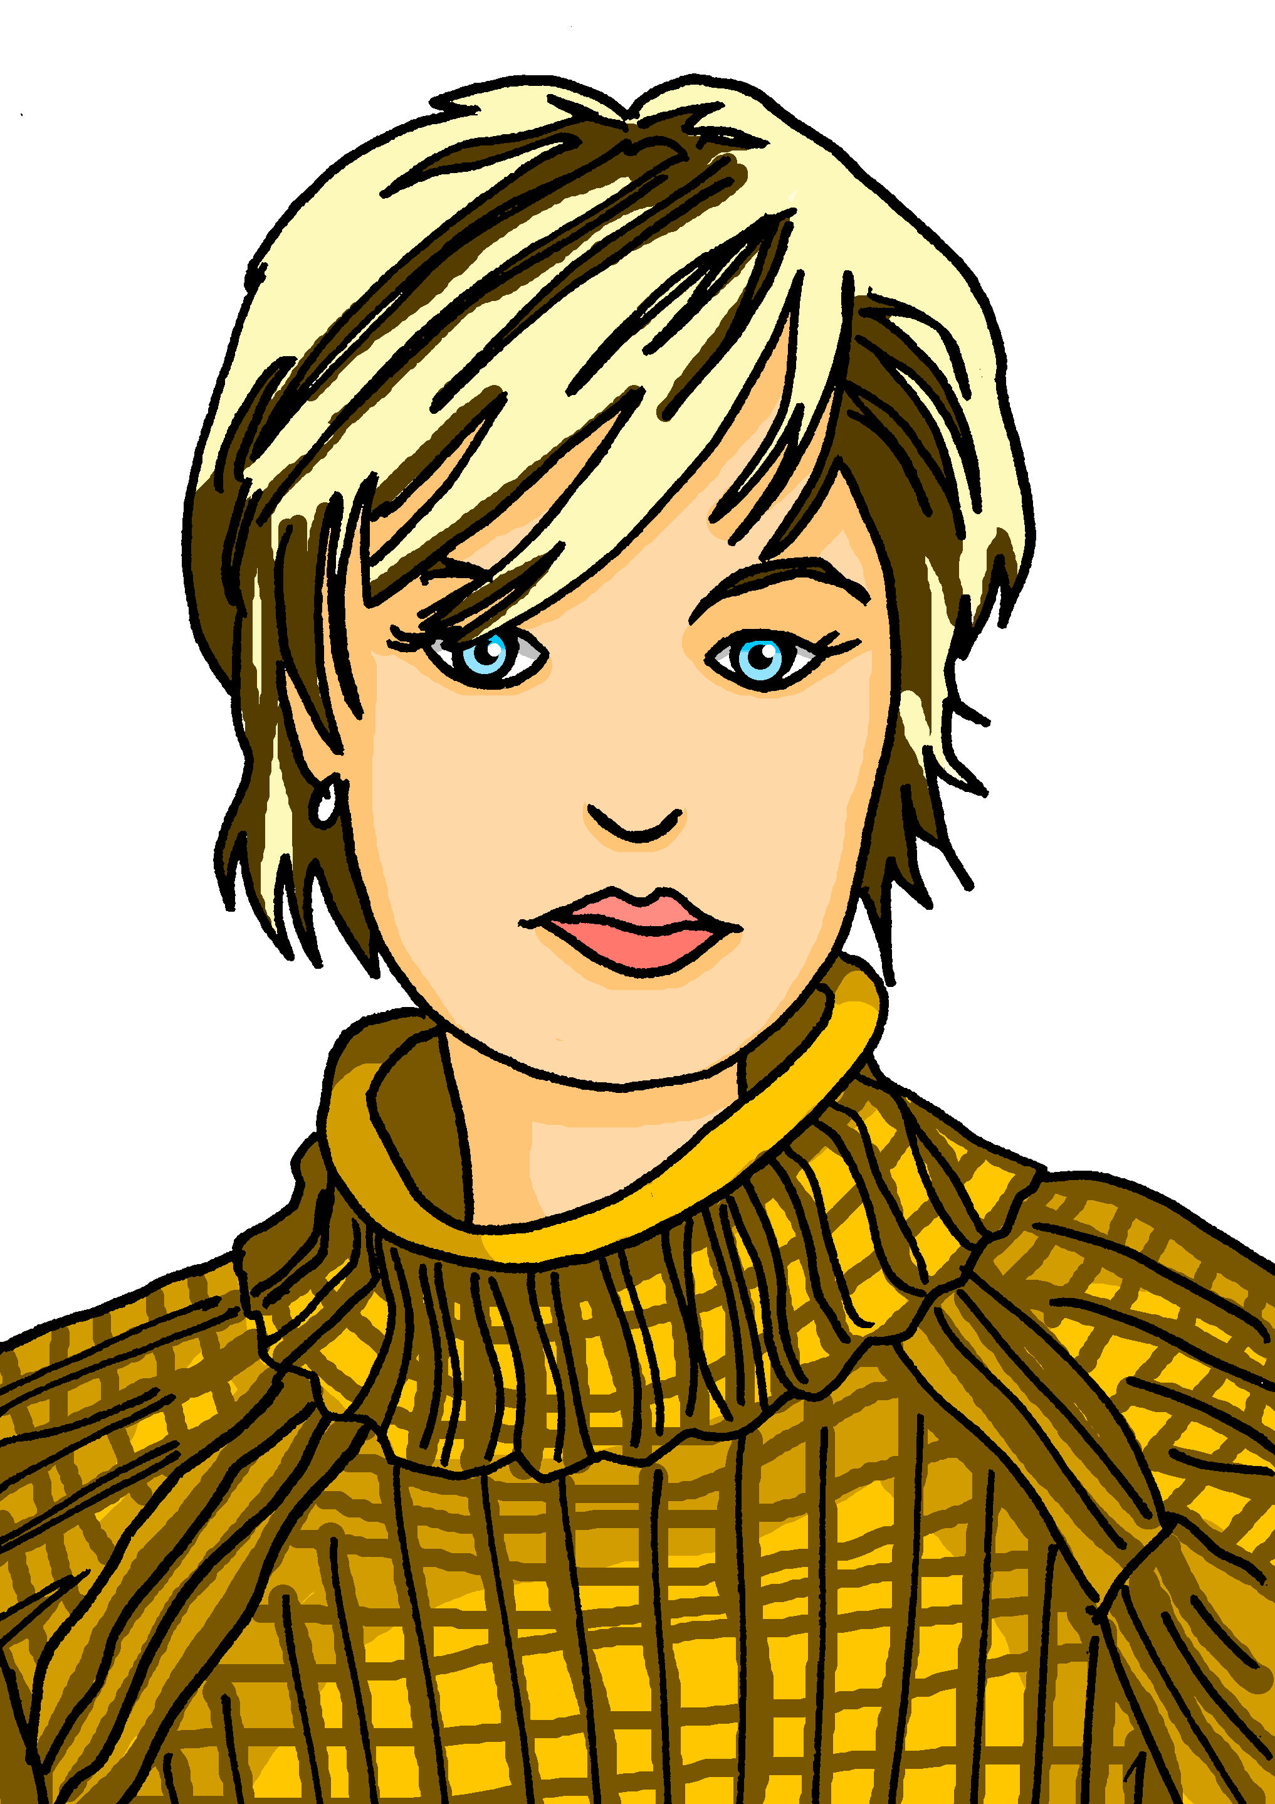
lesen
Revising können and possessive adjectives
*die Trompete - trumpet
Was sagt Johanna?
Sie kann|kannst gut schwimmen. Ihr|Ihre Freundin schwimmt auch.
Ich kann|kannst Fußball spielen. Das ist mein|meine Lieblingsspiel.
Remember: können works differently from other verbs you know: ich kann, du kannst, er kann, sie kann
Er kann|kannst super Fotos machen. Sein|Seine Lieblingsfarbe ist gelb.
Du kann|kannst ein Instrument spielen. Die Trompete* ist dein|deine Lieblingsinstrument.
Remember: mein, dein, sein, and ihr must agree with the noun that follows.
ihr Vater
ihre Mutter
Notes:
Timing: 5 minutes
Aim: to revise können and possessive adjectives.
Procedure:
Explain the task. Johanna is describing herself and her family.
Click to bring up two reminders to help pupils decide between the options.
Pupils read each speech bubble and decide which form of können and which possessive adjective they should use.
Click to reveal answers.
Word frequency of unknown words (1 is the most frequent word in German): Trompete [>5000]
Source: Jones, R.L. & Tschirner, E. (2019). A frequency dictionary of German: core vocabulary for learners. Routledge
6

Slide 7
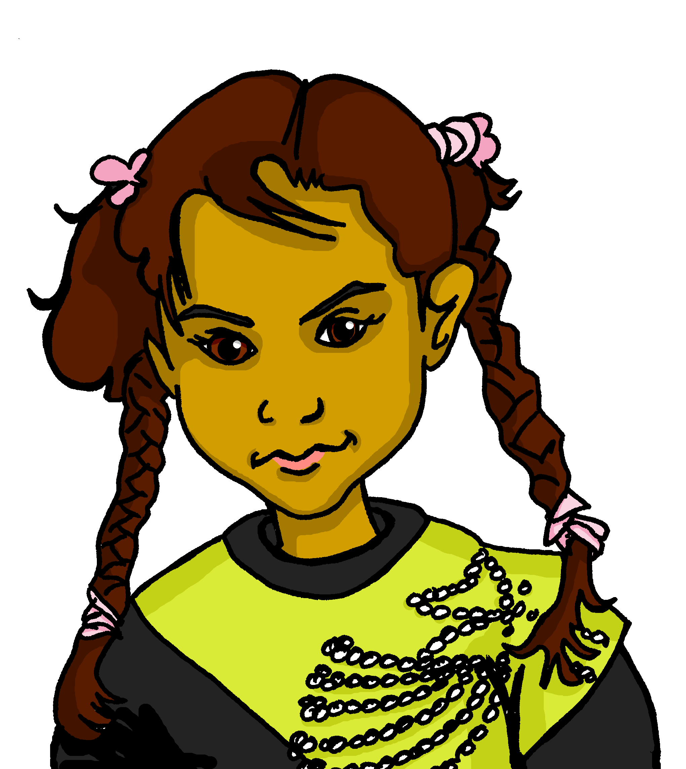
Fragen und Antworten
Partnerarbeit: Auf Deutsch sprechen.
Wie heißt du?
Ich heiße Aisha.
sprechen
Sie heißt Aisha.
Was
Wo
Wann
Wie
Kannst
du schwimmen?
wohnst du?
ist dein Lieblingsfilm?
alt bist du?
ist deine Lieblingsfarbe?
hast du Geburtstag?
machst du samstags zu Hause?
machst du heute in der Schule?
heißt du?
geht’s?
Notes:
Timing: 10 minutes
Aim: to practise building questions using a variety of question words and verbs; to practise using a variety of verbs in 1st, 2nd, 3rd persons; to practise some of this term’s vocabulary.
Procedure:
Pupils work in pairs. Partner A matches a blue question starter and with a yellow question ender and asks Partner B the question. Partner B responds in the first person.
Click to model how this would work with Aisha and Johanna.
Once partners have asked and answered all possible questions, they then write down their partner’s answers in the third person. Click to model this with Johanna.
In the audio version, click on the speech bubbles to hear a native speaker.

Slide 8
Tschüss!
rot
Notes:
8

