Slide 1
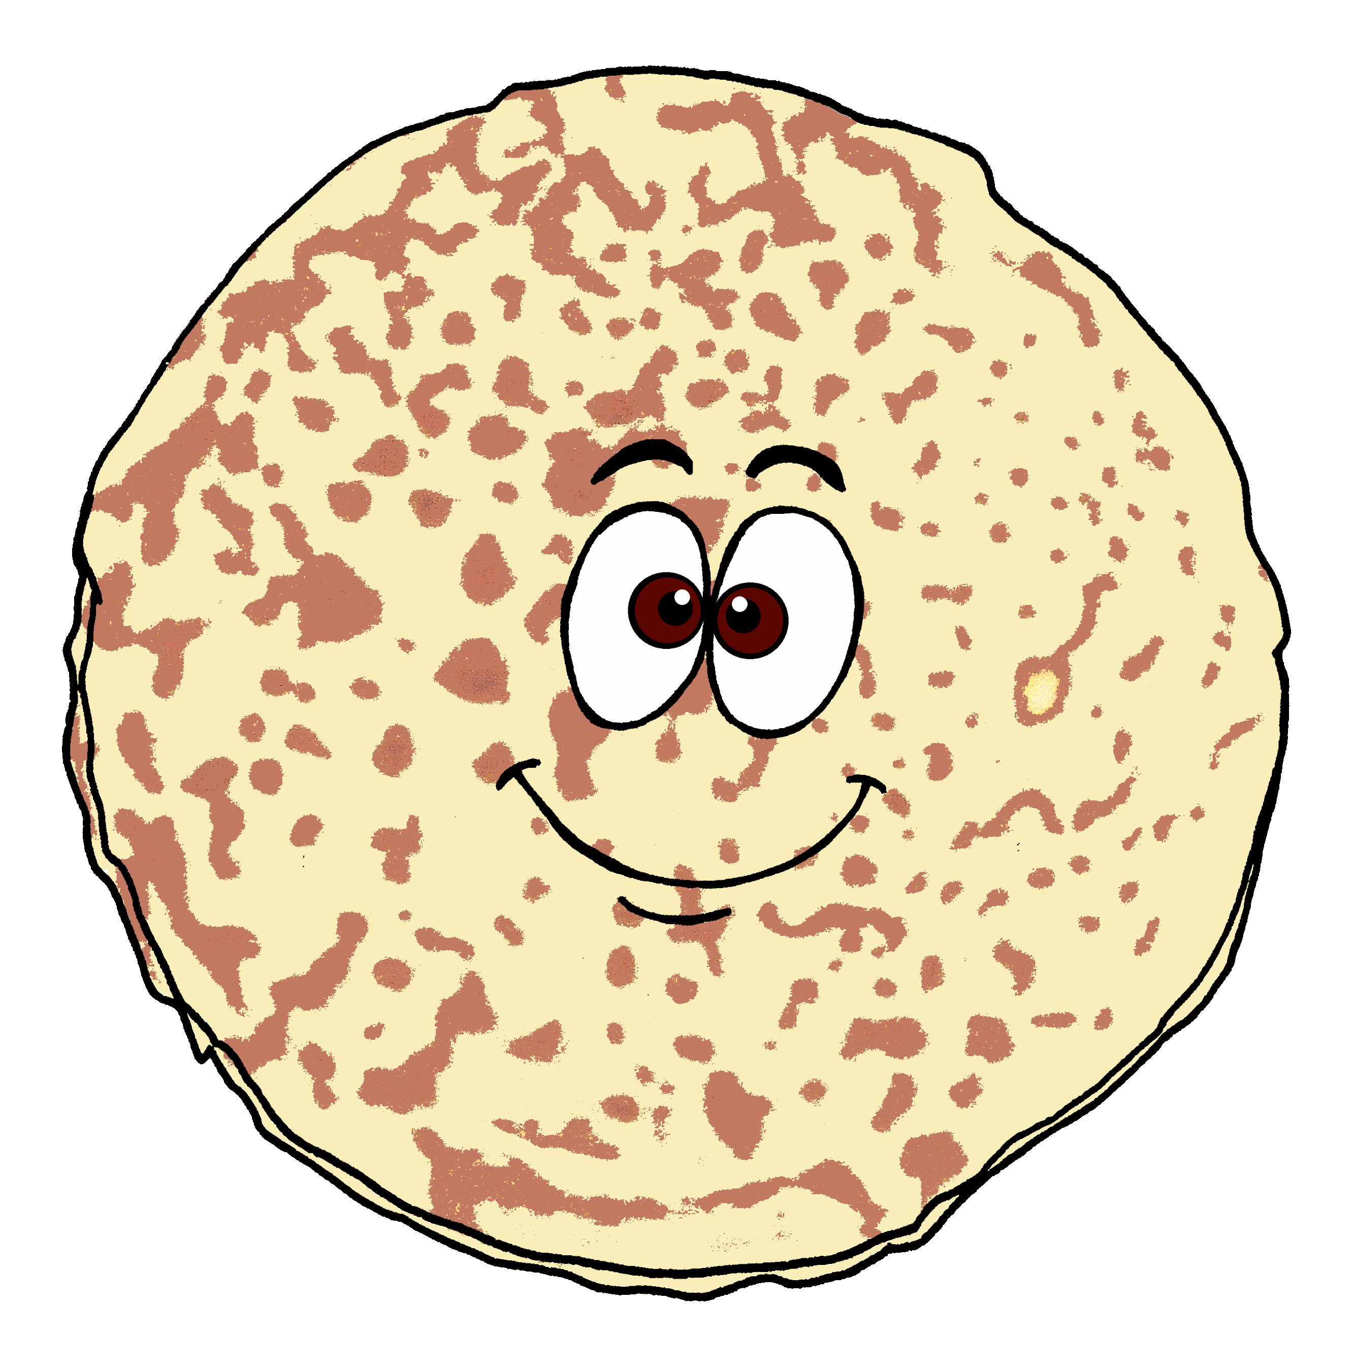
Der dicke fette Pfannkuchen
blau
Follow ups 1-5
Term 3 Week 12
Notes:
Artwork by Steve Clarke. Pronoun pictures from NCELP (www.ncelp.org). All additional pictures selected from Pixabay and are available under a Creative Commons license, no
attribution required.
Phonics: [pf] Kopf [279] Pflanze [1667] Apfel [3490]
[kn] Knie [1679] Knochen [1930] knüpfen [4564]
Vocabulary: Revisit vocabulary
Revisit 1: putzen [3586] waschen [2315] wollen, ich will, du willst, er/sie/es will [57] Auto [361] Frühstück [2600] Skateboard [n/a] Zimmer [665] sauber [2026] warum? [192]
Revisit 2: werden, werde, wirst, wird [8] Ei [1999] Frühstück [2600] Frohe Ostern [n/a] Guten Appetit [n/a] Gute Nacht [n/a] viel Spaß [n/a]
Jones, R.L & Tschirner, E. (2019). A frequency dictionary of German: Core vocabulary for learners. London: Routledge.
The frequency rankings for words that occur in this PowerPoint which have been previously introduced in these resources are given in the SOW and in the resources that first
introduced and formally re-visited those words.
For any other words that occur incidentally in this PowerPoint, frequency rankings will be provided in the notes field wherever possible.
Remember that at the start of the course (first three lessons of Rot/Gelb) pupils learnt language (for greetings and register taking) that can still be part of the lesson routines in upper KS2 (Blau/Grün). They are not re-taught, as we anticipate that teachers have built these in from early in lower KS2.

Slide 2
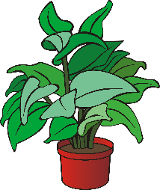
aussprechen
[pf]
…
Kopf
Pflanze
Apfel
Notes:
Timing: 1 minute
Aim: to consolidate the SSC [pf].
Procedure:
Re-present the SSC and the source word ‘Kopf’ (with gesture, if using).
Click to bring on the picture and get pupils to repeat the word ‘Kopf’ (with gesture, if using).
Present the cluster words in the same way, bringing on the picture and getting pupils to pronounce the words.
Frequency: Kopf [250] Pflanze [1667] Apfel [3490]
Jones, R.L & Tschirner, E. (2019). A frequency dictionary of German: Core vocabulary for learners. London: Routledge.

Slide 3
aussprechen
[kn]
…
Knie
Knochen
knüpfen
Notes:
Timing: 1 minute
Aim: to consolidate the SSC [kn].
Procedure:
Re-present the SSC and the source word ‘Knie’ (with gesture, if using).
Click to bring on the picture and get pupils to repeat the word ‘Knie’ (with gesture, if using).
Present the cluster words in the same way, bringing on the picture and getting pupils to pronounce the words.
Frequency: Knie [1679] Knochen [1930] knüpfen [4564]
Jones, R.L & Tschirner, E. (2019). A frequency dictionary of German: Core vocabulary for learners. London: Routledge.

Slide 4
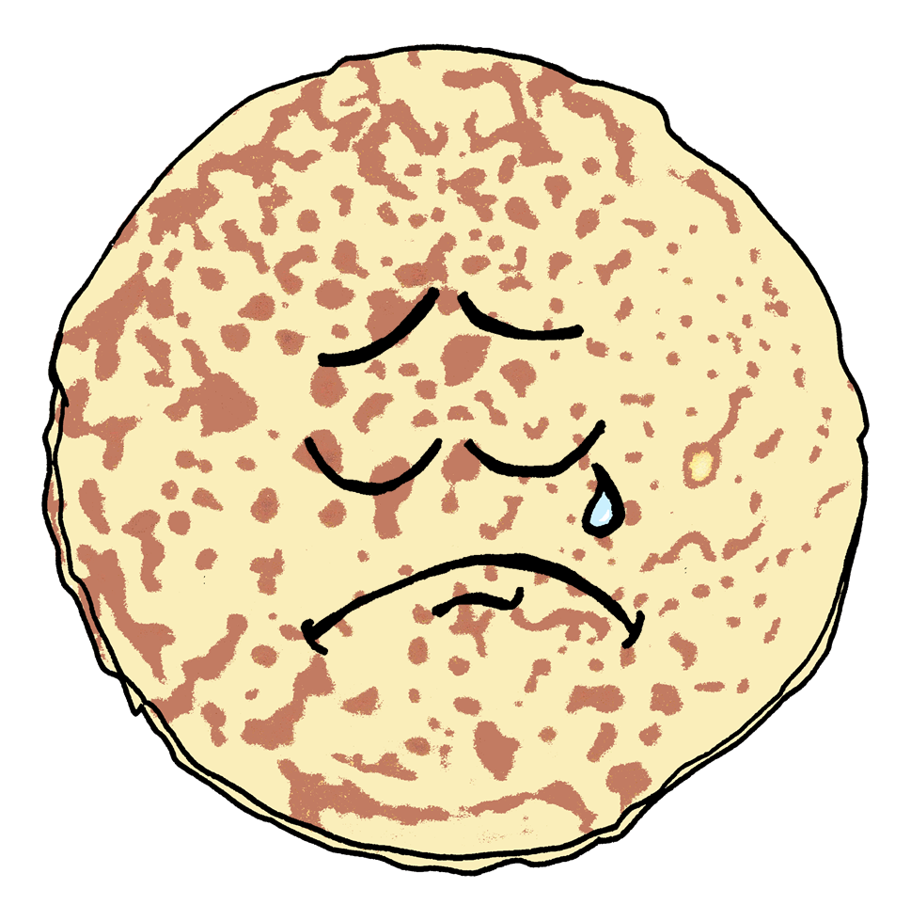
Follow up 1
Hör zu. Was kann Pfiff Pfannkuchen nicht machen?
aussprechen
Hallo! Ich bin Pfiff Pfannkuchen!
1
Pfiff Pfannkuchen kann keine Pfeife pfeifen.
Pfiff Pancake can’t whistle a whistle.
2
3
Notes:
Timing: 5 minutes (4 slides)
Aim: to practise applying knowledge of [pf] and [kn] to unknown words.
Procedure: 1. Pupils read the sentence and the English translation.
2. Click on the 3 audio buttons to hear the sentence read at increasing speeds.
3. Click to reveal the following slide. Teacher clicks on the 30 second timer, and pupils try to say the sentence before the timer runs out. Repeat for the 20 second and 15 second timers.
4. Repeat steps 1-3 for the next two slides.
Frequency: Pfeife [>5009] pfeifen [4545] knacken [4657] knistern [>5000]
Jones, R.L & Tschirner, E. (2019). A frequency dictionary of German: Core vocabulary for learners. London: Routledge.

Slide 5
Follow up 1
Sag den Satz.
aussprechen
How quickly can you say the sentence?
Piff Pfannkuchen kann keine Pfeife pfeifen.
30
S
20
15
S
S
0
0
0
START
START
START
Notes:
[2/4]

Slide 6
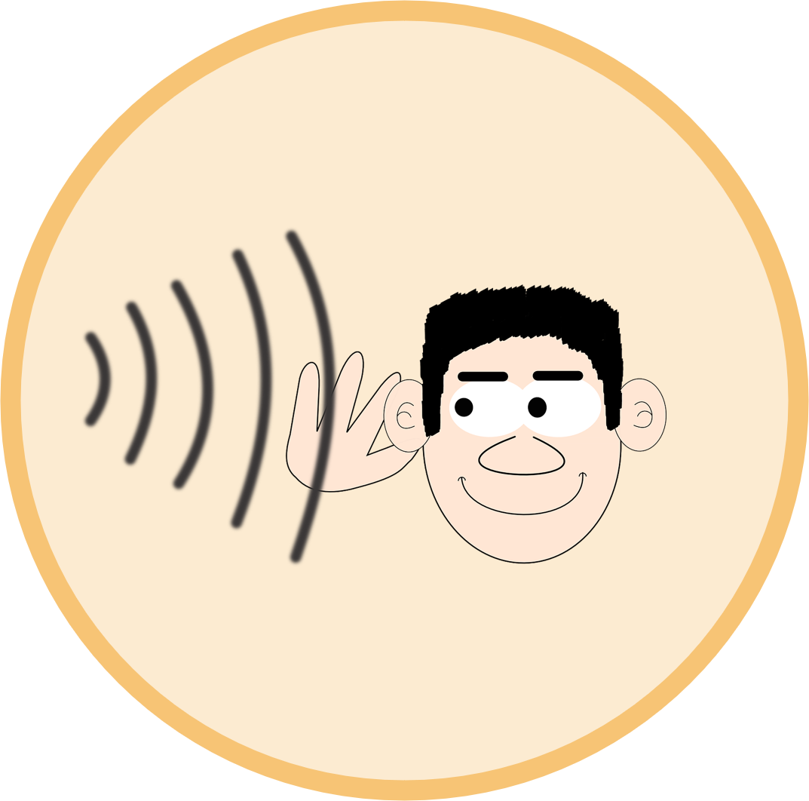
Follow up 1
Hör zu. Was kann Pfiff Pfannkuchen nicht machen?
aussprechen
1
Pfiff Pfannkuchen kann kein Knacken oder Knistern hören.
Pfiff Pancake can’t hear any crackles or rustling.
2
3
Notes:
[3/4]

Slide 7
Follow up 1
Sag den Satz.
aussprechen
How quickly can you say the sentence?
Pfiff Pfannkuchen kann kein Knacken oder Knistern hören.
30
S
20
15
S
S
0
0
0
START
START
START
Notes:
[4/4]

Slide 8
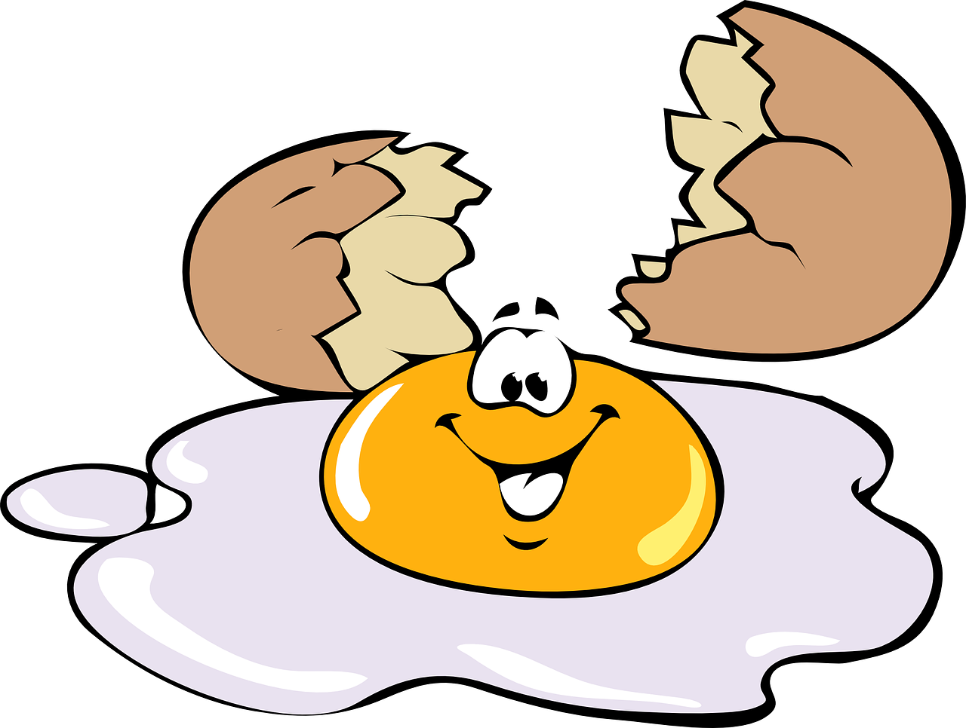
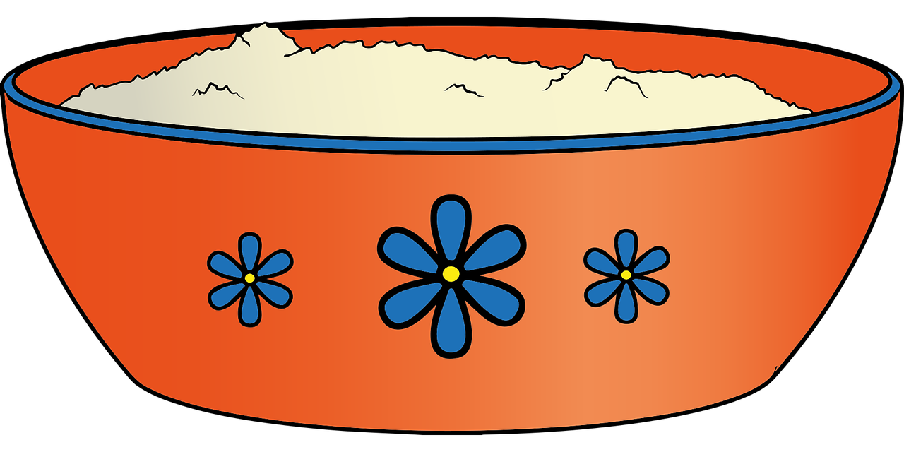
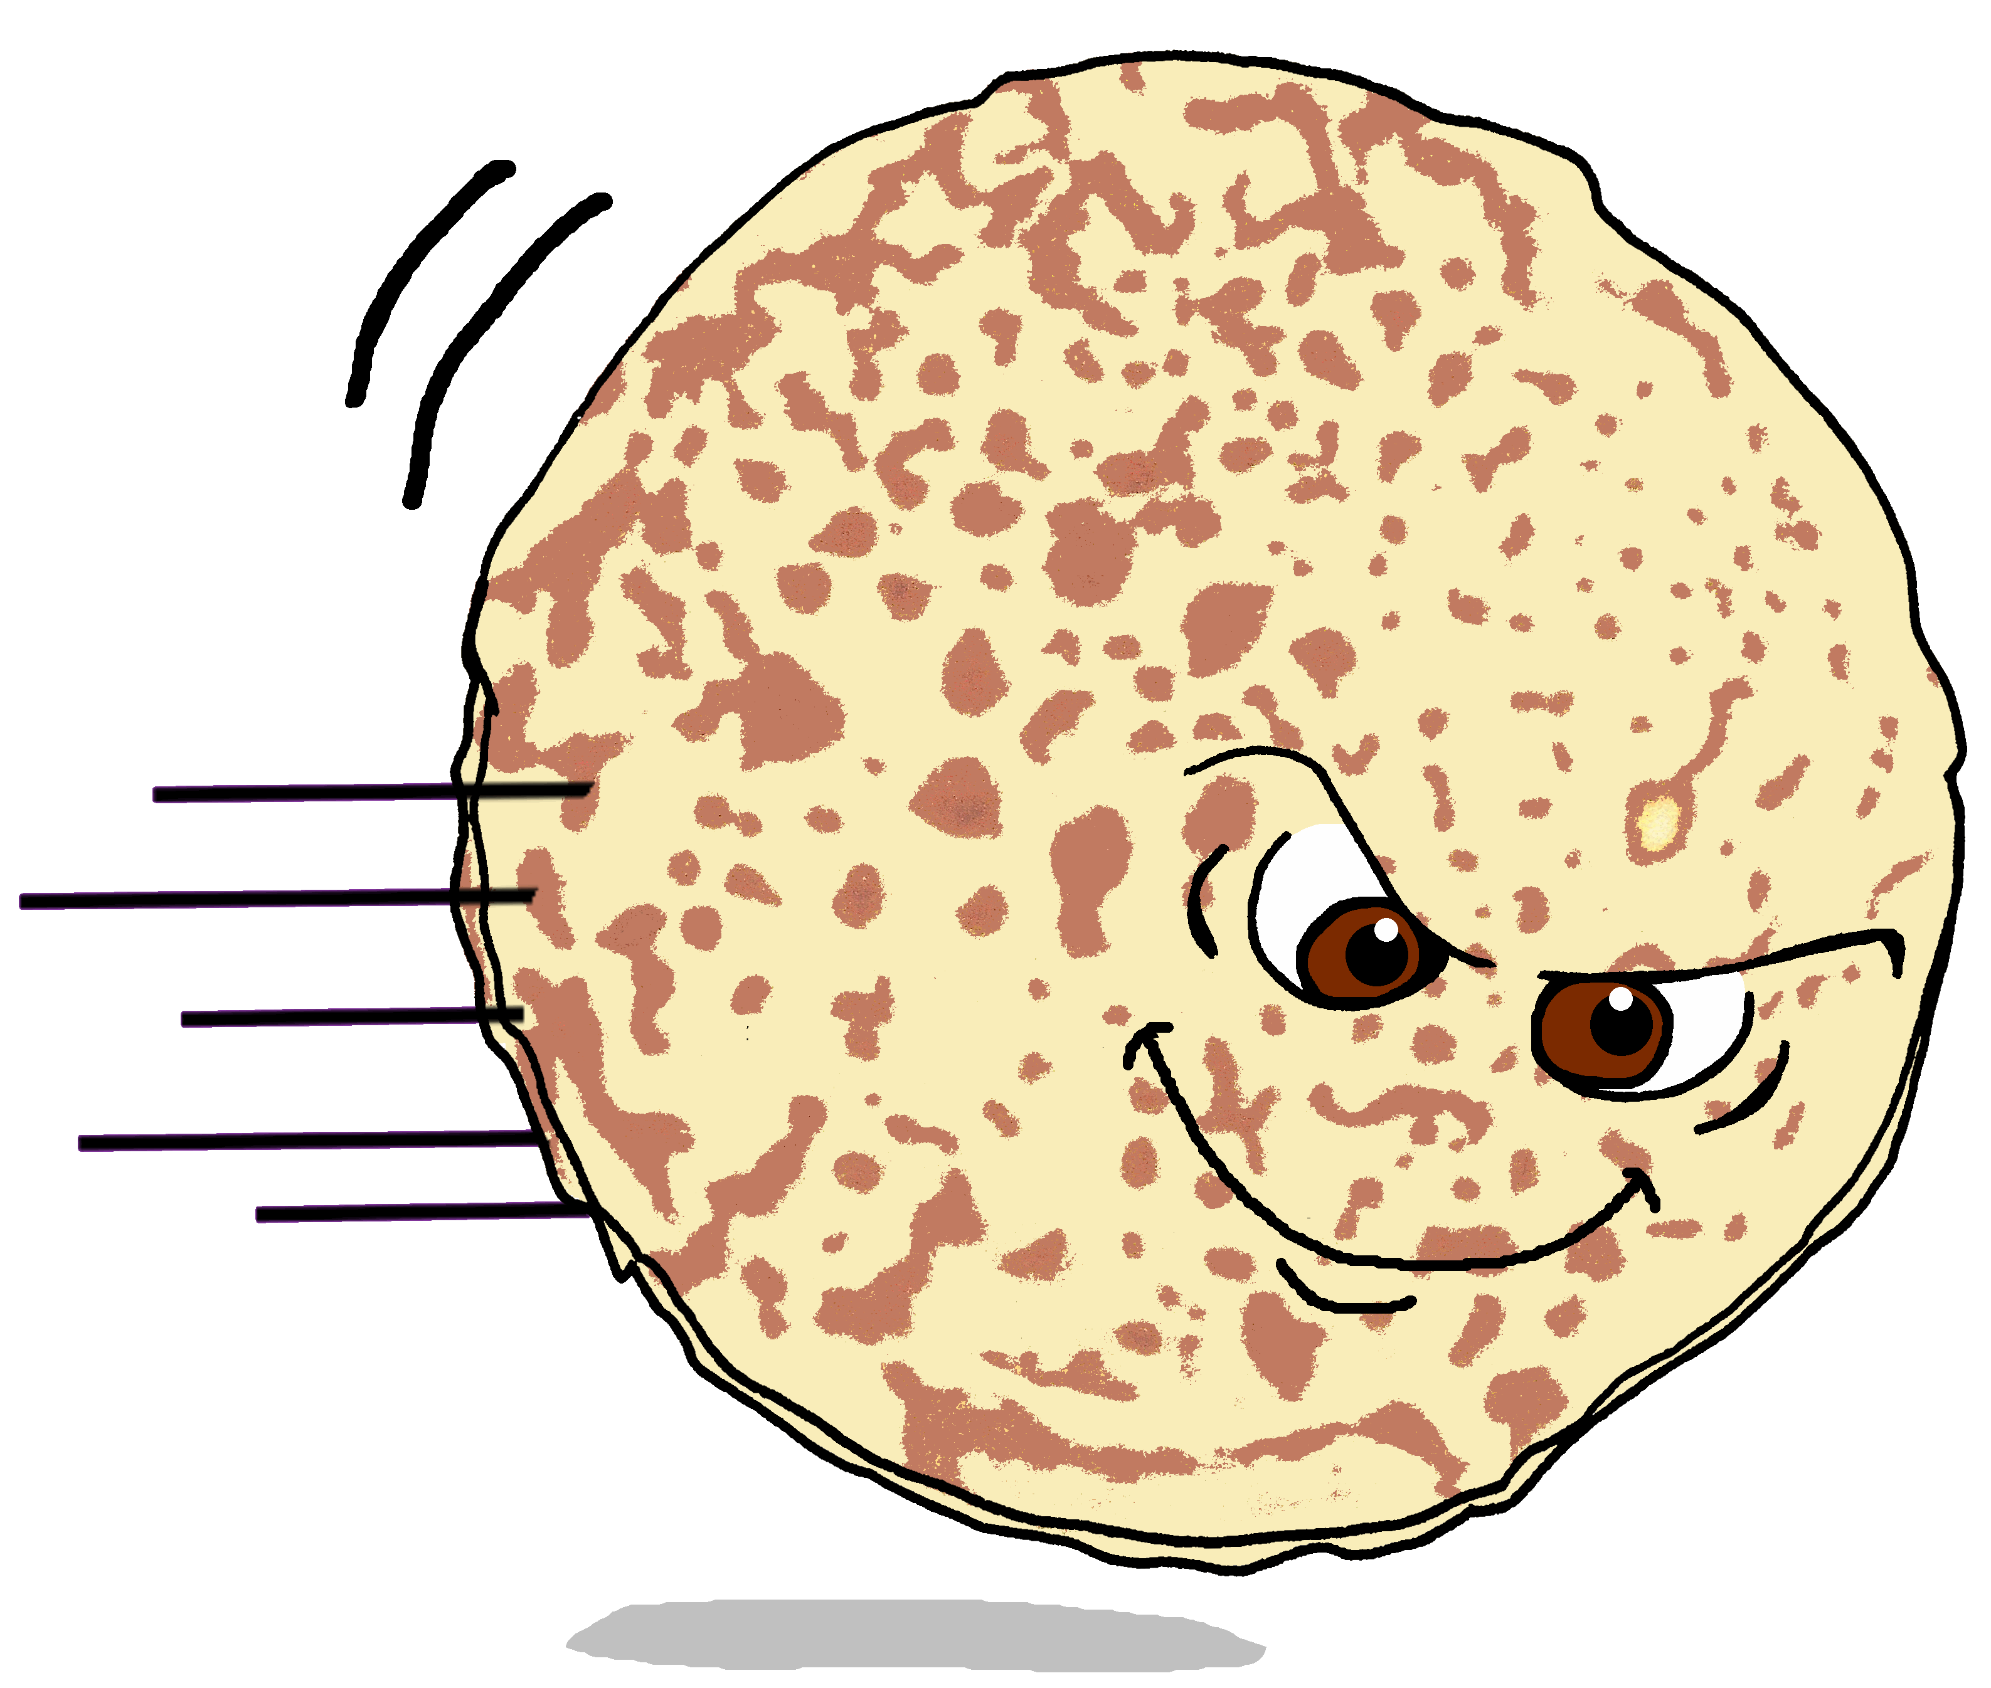
Der dicke fette Pfannkuchen [1/3]
Lies und spiel den Text.
Wir haben Hunger!
Es waren einmal drei Frauen. Sie haben Hunger.
Frauen: Wir haben Huuuunger! Wir essen ein Eis!
Alle: Es gibt kein Eis!
Frauen: Wir haben Huuuunger! Wir essen ein Ei!
Alle: Es gibt nur ein Ei!
Frauen: Wir haben Huuuunger! Wir essen Frühstück!
Alle: Es gibt kein Frühstück!
Frauen: Kein Eis? Ein Ei? Kein Frühstück? Wir machen einen Pfannkuchen!
Frauen: Pfannkuchen, du bist dick und fett! Wir wollen dich essen, denn* wir haben Hunger!
Pfannkuchen: Nein! Ich will frei sein!
denn - because
Notes:
Timing: Open-ended (this week/next week) (3 slides)
Aim: to consolidate the vocabulary and grammar learnt previously through acting out a short play.
Procedure:
Read through the lines in this play.
Ensure comprehension. Note that all vocabulary is re-used from previously taught vocabulary, except Pfannkuchen (pancake).
Allocate roles. Assign narrator roles if more roles are needed and incorporate the 12 lines of story text, too, from the lesson.
Practise for an assembly or class performance next week.
Addition: Watch video if time allows: “Der dicke fette Pfannkuchen”: https://www.youtube.com/watch?v=byn4zjvqVSo
Vocabulary
denn [93]

Slide 9
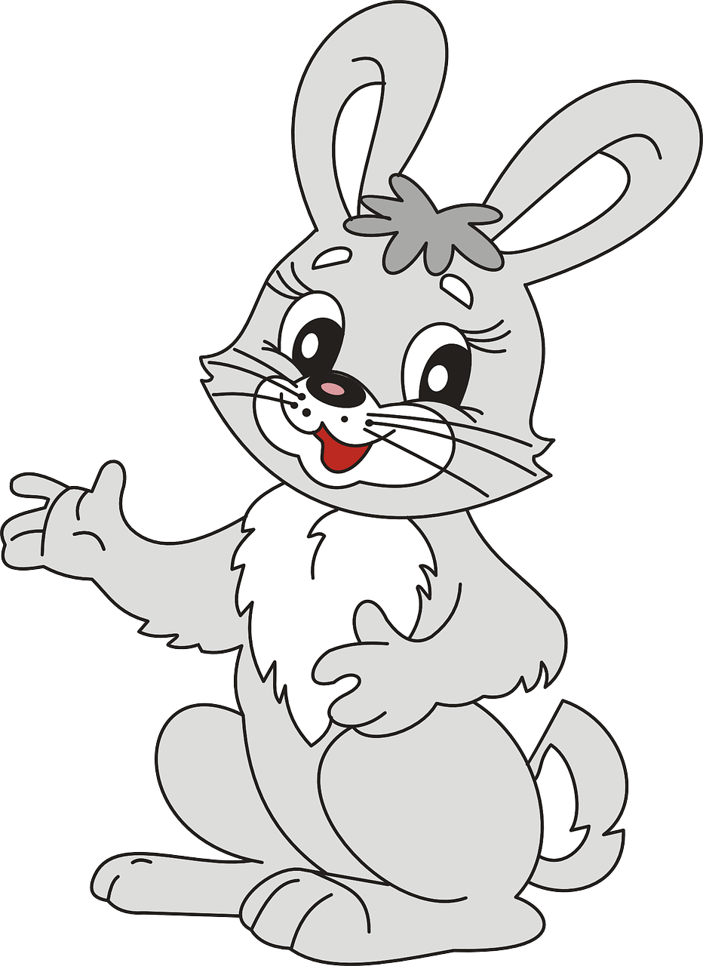
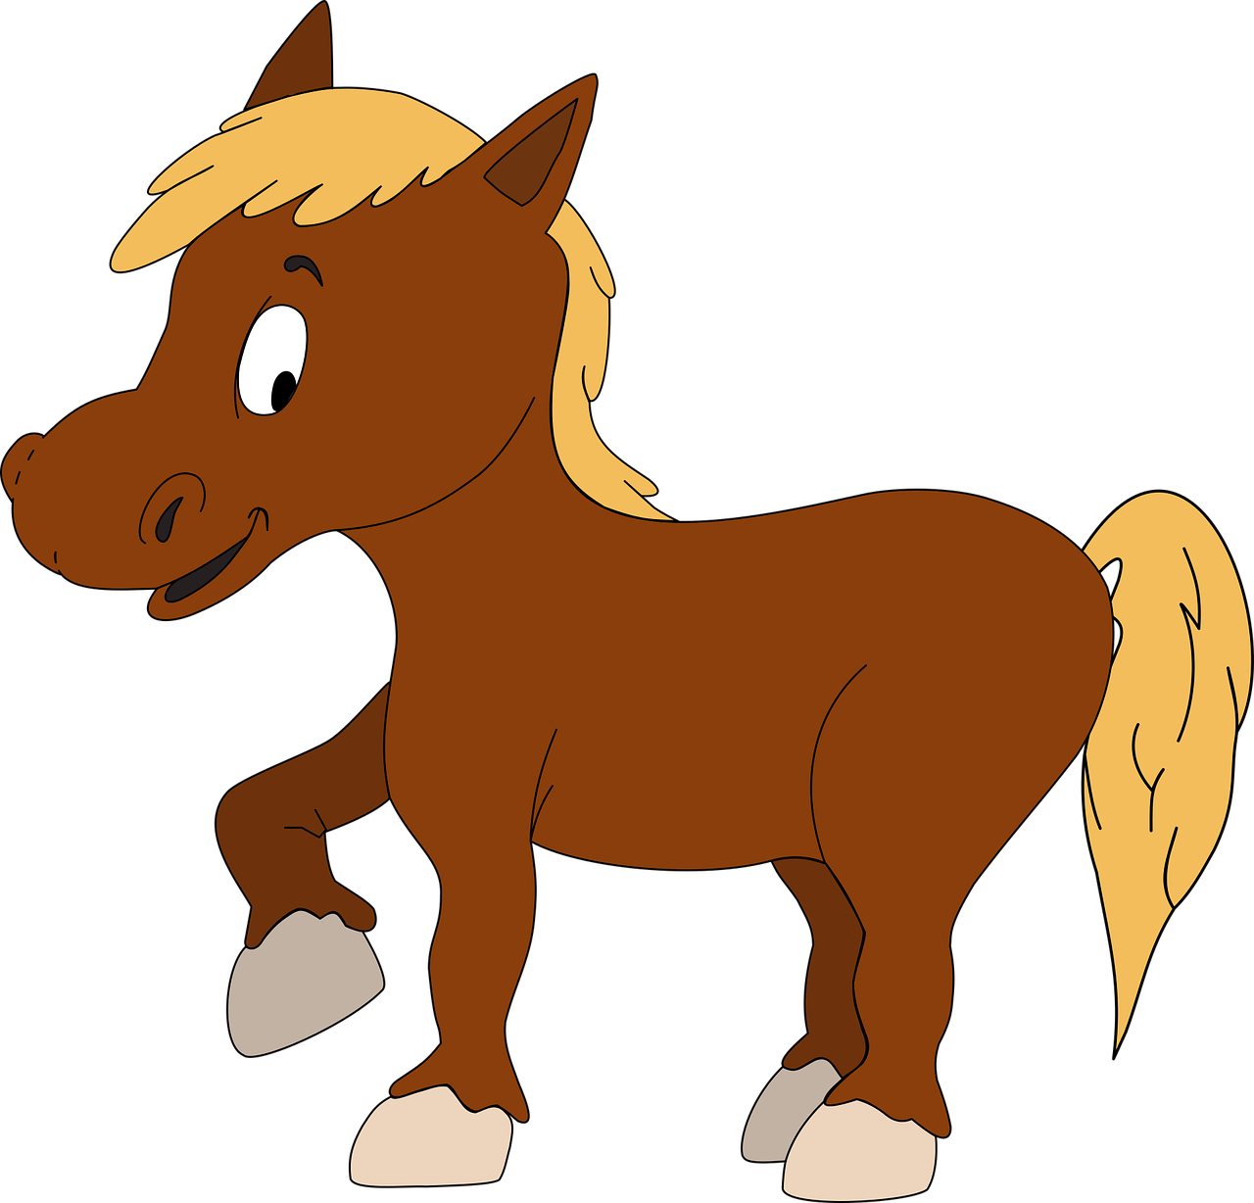
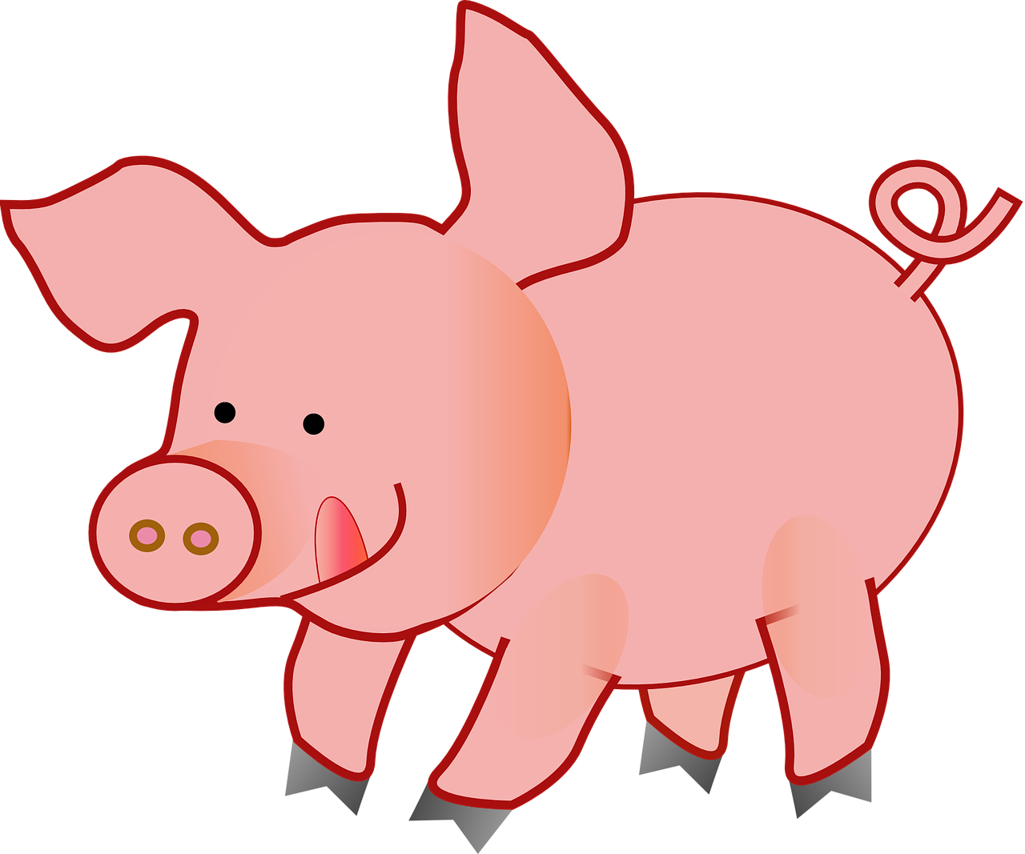
Der dicke fette Pfannkuchen [2/3]
Lies und spiel den Text.
Wir haben Hunger!
Wir haben Hunger!
Der Pfannkuchen ist im Wald.
Häschen: Ich habe Huuuunger! Ich will Pfannkuchen essen!
Pfannkuchen: Nein!! Ich will frei sein! (Er läuft weg).
Wolf: Ich habe Huuuunger! Ich will Pfannkuchen essen!
Pfannkuchen: Nein!! Ich will frei sein! (Er läuft weg).
Ziege: Ich habe Huuuunger! Ich will Pfannkuchen essen!
Pfannkuchen: Nein!! Ich will frei sein! (Er läuft weg).
Pferd: Ich habe Huuuunger! Ich will Pfannkuchen essen!
Pfannkuchen: Nein!! Ich will frei sein! (Er läuft weg).
Schwein: Ich habe Huuuunger! Ich will Pfannkuchen essen!
Pfannkuchen: Nein! Ich will frei sein! (Er läuft weg.).
Notes:
2/3

Slide 10
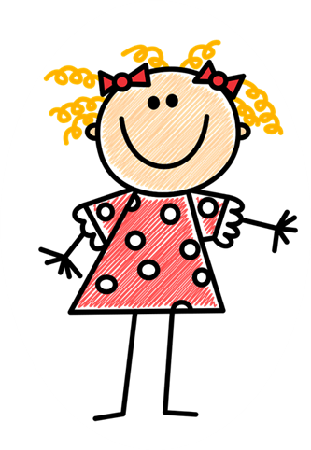
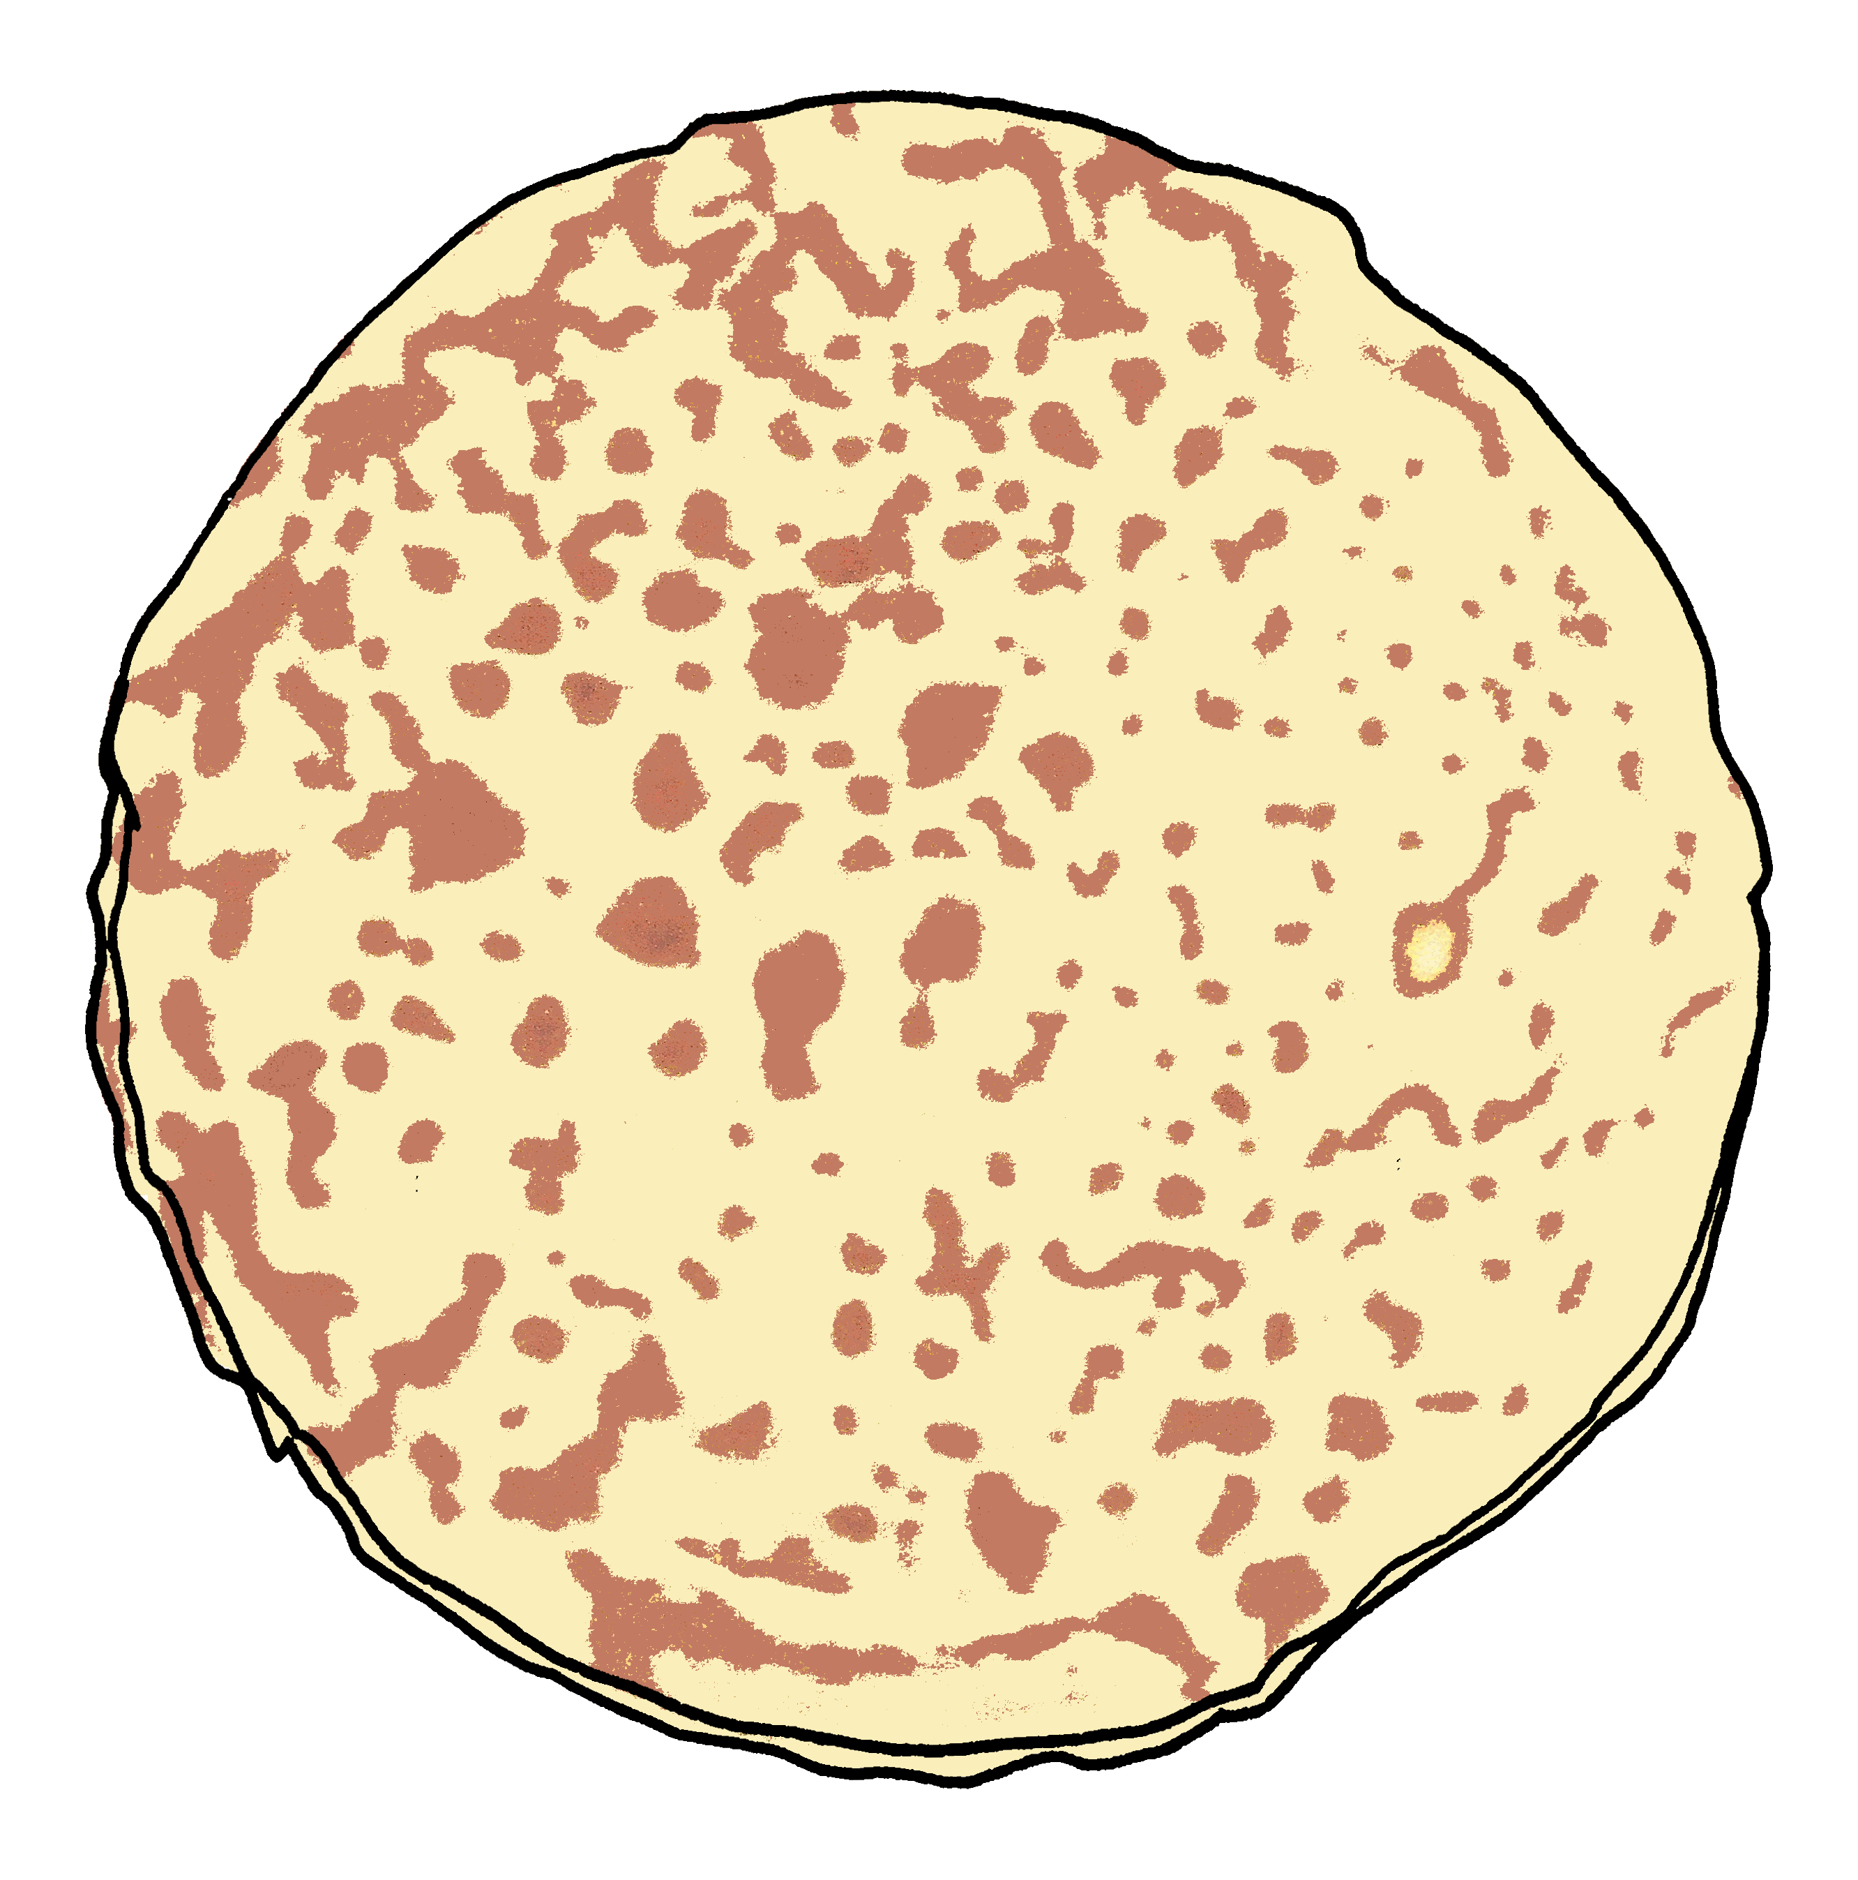
Der dicke fette Pfannkuchen [3/3]
Lies und spiel den Text.
Ich habe Hunger!
Ich habe Hunger!
Drei Kinder sind im Wald und sehen den Pfannkuchen.
Kind 1: Ich habe Huuuunger! Ich will Pfannkuchen essen!
Pfannkuchen: Nein!! Ich will frei sein! (Er läuft weg).
Kind 2: Ich habe Huuuunger! Ich will Pfannkuchen essen!
Pfannkuchen: Nein!! Ich will frei sein! (Er läuft weg).
Kind 3: Ich habe Huuuunger! Ich will Pfannkuchen essen!
Pfannkuchen: Nein!! Oder… ein Moment…
Kind 3: Ja, Pfannkuchen? Kann ich dich essen?
Kind 2: Ja, Pfannkuchen? Kann ich dich essen?
Pfannkuchen: Ja, kein Problem! Du kannst mich essen!
Kind 1: Huurrah! Ich esse dich auch! (Sie essen den Pfannkuchen).
Notes:
3/3

Slide 11
Können
As you know, to say ‘can’ with another verb, use können plus an infinitive verb. The second verb is at the end of the sentence:
Er kann sehen
He/It can see.
And to say cannot/can’t with verbs, use nicht before the infinitive verb:
Er kann nicht sehen
He/It can’t see.
Notes:
THESE ARE FURTHER OPTIONAL REVISION ACTIVITIES IN CASE TEACHERS DECIDE NOT TO REHEARSE THE PLAY.
Timing: 2 minutes
Aim: To revise können with 2-verb structures.
Procedure:
Click through the animations to present the information.
Elicit English translation for the German examples provided.
11

Slide 12
Follow up 3
Hör zu. Who, and: can or can’t?
 | I, she, or he? | can or can’t? | English
hören
I
can’t
1
I can’t do (any) homework.
2
she
can
She can eat an apple.
he
can’t
3
He can’t read a book.
4
he
can’t
He can’t take a photo.
5
I
can’t
I can’t drink (any) water.
6
she
can
She can help Mrs Bahlsen.
Notes:
Aim: to practise aural comprehension of 2-verb sentences with können.
Procedure:
Tell pupils that they will hear a sentence in German.
Click to listen for the pronoun, and ein(e/n) or kein(e/n).
Pupils write ‘I’, ‘she’, or ‘he’.
Listen again and focus on the ein*/kein*. Is it a can or can’t? Pupils write can or can’t.
Listen a third time, elicit the translation (orally), and click to reveal the English meaning.
Continue for items 2-6.
Transcript: 1. Ich kann keine Hausaufgaben machen. 2. Sie kann einen Apfel essen. 3. Er kann kein Buch lesen.
4. Er kann kein Foto machen. 5. Ich kann kein Wasser trinken.
6. Sie kann Frau Bahlsen helfen.

Slide 13
Follow up 4:

Schreib auf Deutsch.
A Write down in German the missing word in brackets.
schreiben
1 | Ich [am getting] müde.
2 | Viel [fun]!
3 | Sie [can] keinen Kuchen essen.
4 | Er will frei [to be].
5 | Sie [wants to] den Pfannkuchen essen.
werde
C Be ready to respond to the teacher in German! Write down your answer to your teacher:
I’m getting tired.
Spaß!
Have fun!
1 | Hello! Yes I can speak German!
2 | No I can’t drive a car.
kann
Guten Tag! Ja, ich kann Deutsch sprechen!
She cannot eat cake.
sein.
He wants to be free.
Nein, ich kann kein Auto fahren.
will
She wants to eat the pancake.
B Now translate the sentences into English.
Notes:
Timing: 5-10 minutes
Aim: to practise written comprehension and production of this week’s revised vocabulary and grammar.
Procedure:
pupils write the missing words.
Then they translate the sentences into English.
Finally they write down how they will respond to the teacher about one thing each that they can and can’t do.

Slide 14
Follow up 5:

Schreib auf Englisch.
Can you get at least 10 points?
Wörter
 | Viel Spaß! | Guten Appetit! | Gute Nacht!
 | er/sie/es wird | das Ei | das Frühstück
 | werden | ich werde | du wirst
 | das Skateboard | sauber | warum?
 | du willst | er/sie/es will | das Zimmer
 | putzen | wollen | ich will
Have fun!
Enjoy your meal!
Good night!
Vokabeln
x2
he/she/it becomes, gets
(the) egg
(the)breakfast
to become, get
I become, get
you become, get
(the) skateboard
clean
why?
you want (to)
he/she/it wants (to)
(the) room
x1
to clean, cleaning
to want (to),
wanting (to)
I want (to)
Notes:
Timing: 5 minutes
Aim: to practise written comprehension of vocabulary from this and revisited weeks.
Procedure: 1. Give pupils a blank grid. They fill in the English meanings of any of the words they know, trying to reach 15 points in total.
Note: The most recently learnt and practised words are pink, words from the previous week are green and those from week 1 are blue, thus more points are awarded for them, to recognise that memories fade and more effort (heavy lifting!) is needed to retrieve them.

Slide 15
Follow up 5:

Schreib auf Deutsch.
Can you get at least 10 points?
Wörter
 | you become, get | (the) egg | he/she/it becomes, gets
 | I become, I get | (the) breakfast | Enjoy your meal
 | I become, I get | Good night! | Have fun!
 | he/she/it wants (to) | to clean, cleaning | (the) room
 | (the) skateboard | I want (to) | clean
 | to want (to), wanting (to | why? | you want (to)
du wirst
das Ei
Vokabeln
er/sie/es wird
x2
ich werde
das Frühstück
Guten Appetit
werden
Gute Nacht!
Viel Spaß!
putzen
er/sie/es will
das Zimmer
das Skateboard
ich will
sauber
x1
wollen
warum?
du willst
Notes:
Timing: 5 minutes
Aim: to practise written comprehension of vocabulary from this and revisited weeks.
Procedure: 1. Give pupils a blank grid. They fill in the German meanings of any of the words they know, trying to reach 15 points in total.
Note: The most recently learnt and practised words are pink, words from the previous week are green and those from week 1 are blue, thus more points are awarded for them, to recognise that memories fade and more effort (heavy lifting!) is needed to retrieve them.

Slide 16
Tschüss!
blau
Notes:
16

Slide 17
Follow up 5:

Schreib auf Englisch.
Can you get at least 10 points?
Wörter
 | Viel Spaß! | Guten Appetit! | Gute Nacht!
 | er/sie/es wird | das Ei | das Frühstück
 | werden | ich werde | du wirst
 | das Skateboard | sauber | warum?
 | du willst | er/sie/es will | das Zimmer
 | putzen | wollen | ich will
Vokabeln
x2
x1
Notes:
HANDOUT

Slide 18
Follow up 5:

Schreib auf Deutsch.
Can you get at least 10 points?
Wörter
 | you become, get | (the) egg | he/she/it becomes, gets
 | I become, I get | (the) breakfast | Enjoy your meal!
 | I become, I get | Good night! | Have fun!
 | he/she/it wants (to) | to clean, cleaning | (the) room
 | (the) skateboard | I want (to) | clean
 | to want (to), wanting (to | why? | you want (to)
Vokabeln
x2
x1
Notes:
HANDOUT

