Slide 1
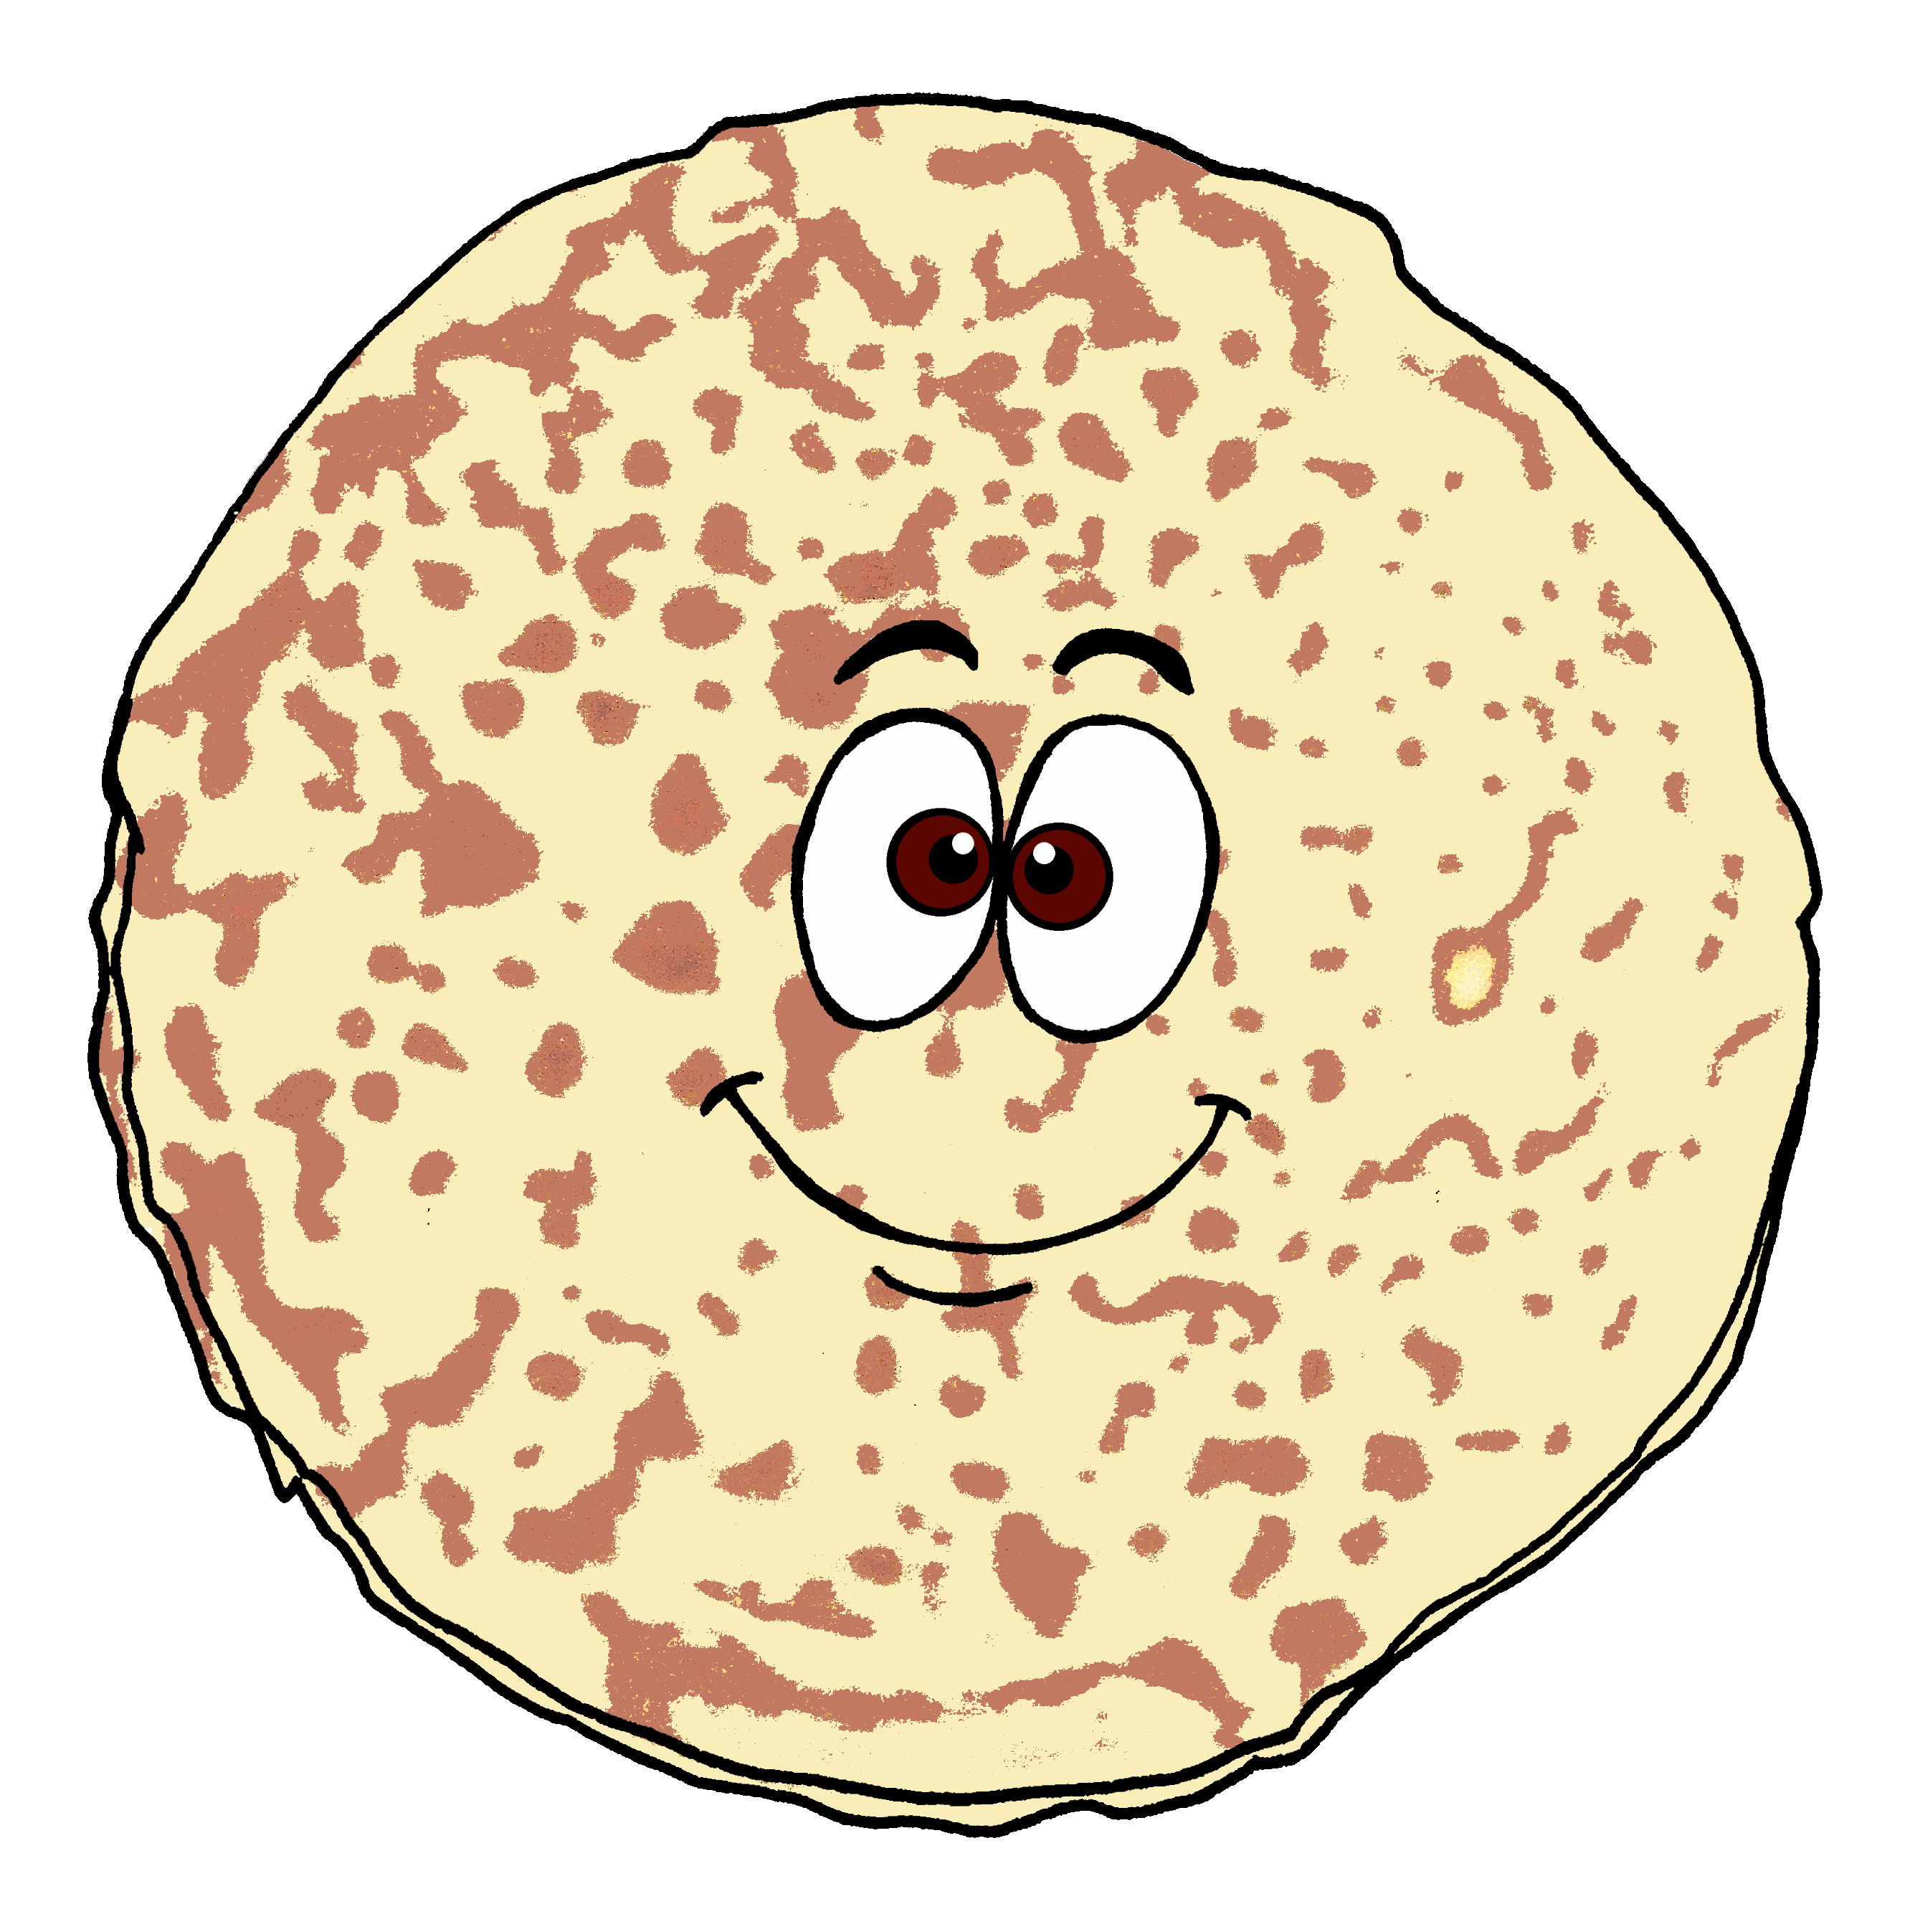
Der dicke fette Pfannkuchen
[The big fat pancake]
blau
2-verb structures with wollen, können
SSC [pf] [kn]
Term 3 Week 12
Notes:
Artwork by Steve Clarke. Pronoun pictures from NCELP (www.ncelp.org). All additional pictures selected from Pixabay and are available under a Creative Commons license, no
attribution required.
Phonics: [pf] Kopf [279] Pflanze [1667] Apfel [3490]
[kn] Knie [1679] Knochen [1930] knüpfen [4564]
Vocabulary: Revisit vocabulary
Revisit 1: putzen [3586] waschen [2315] wollen, ich will, du willst, er/sie/es will [57] Auto [361] Frühstück [2600] Skateboard [n/a] Zimmer [665] sauber [2026] warum? [192]
Revisit 2: werden, werde, wirst, wird [8] Ei [1999] Frühstück [2600] Frohe Ostern [n/a] Guten Appetit [n/a] Gute Nacht [n/a] viel Spaß [n/a]
Jones, R.L & Tschirner, E. (2019). A frequency dictionary of German: Core vocabulary for learners. London: Routledge.
The frequency rankings for words that occur in this PowerPoint which have been previously introduced in these resources are given in the SOW and in the resources that first
introduced and formally re-visited those words.
For any other words that occur incidentally in this PowerPoint, frequency rankings will be provided in the notes field wherever possible.
Remember that at the start of the course (first three lessons of Rot/Gelb) pupils learnt language (for greetings and register taking) that can still be part of the lesson routines in upper KS2 (Blau/Grün). They are not re-taught, as we anticipate that teachers have built these in from early in lower KS2.
1

Slide 2
aussprechen
[pf]
…
Kopf
Notes:
Timing: 1 minute
Aim: to introduce the SSC [pf].
Procedure:
1. Present the letter and say the [pf] sound first, on its own. Pupils repeat it with you. 2. Bring up the word ”Kopf” on its own, say it, pupils repeat it, so that they have the opportunity to focus all of their attention on the connection between the written word and its sound.
3. Click to bring up the picture and introduce the gesture, if using. Pupils repeat the word again.
4. Roll back the animations and work through 1-3 again, but this time, dropping your voice completely to listen carefully to the pupils saying the [pf] sound, pronouncing ”Kopf” and, if using, doing the gesture.
Note: A possible gesture for this would be to use the British Sign Language (BSL) sign for head, as here: https://www.signbsl.com/sign/head
Frequency: Kopf [250]
Jones, R.L & Tschirner, E. (2019). A frequency dictionary of German: Core vocabulary for learners. London: Routledge.
2

Slide 3
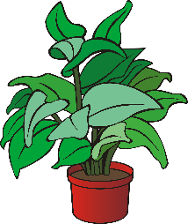
aussprechen
[pf]
…
Kopf
Pflanze
Apfel
Notes:
Timing: 1 minute
Aim: to consolidate the SSC [pf].
Procedure:
Re-present the SSC and the source word ‘Kopf’ (with gesture, if using).
Click to bring on the picture and get pupils to repeat the word ‘Kopf’ (with gesture, if using).
Present the cluster words in the same way, bringing on the picture and getting pupils to pronounce the words.
Frequency: Kopf [250] Pflanze [1667] Apfel [3490]
Jones, R.L & Tschirner, E. (2019). A frequency dictionary of German: Core vocabulary for learners. London: Routledge.

Slide 4
aussprechen
[kn]
In English the k in words starting with kn (e.g. knee, knot) is silent.
In German the k is pronounced, → K-nie.
…
Knie
Notes:
Timing: 1 minute
Aim: to introduce the SSC [kn].
Procedure:
1. Present the letter and say the [kn] sound first, on its own. Pupils repeat it with you. 2. Bring up the word ”Knie” on its own, say it, pupils repeat it, so that they have the opportunity to focus all of their attention on the connection between the written word and its sound.
3. Click to bring up the picture and introduce the gesture, if using. Pupils repeat the word again.
4. Roll back the animations and work through 1-3 again, but this time, dropping your voice completely to listen carefully to the pupils saying the [kn] sound, pronouncing ”Knie” and, if using, doing the gesture.
Note: A possible gesture for this would be to point to your knee.
Frequency: Knie [1679]
Jones, R.L & Tschirner, E. (2019). A frequency dictionary of German: Core vocabulary for learners. London: Routledge.
4

Slide 5
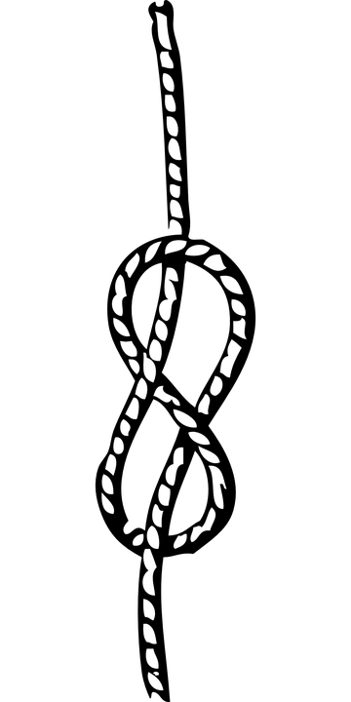
aussprechen
[kn]
…
Knie
Knochen
knüpfen
Notes:
Timing: 1 minute
Aim: to consolidate the SSC [kn].
Procedure:
Re-present the SSC and the source word ‘Knie’ (with gesture, if using).
Click to bring on the picture and get pupils to repeat the word ‘Knie’ (with gesture, if using).
Present the cluster words in the same way, bringing on the picture and getting pupils to pronounce the words.
Frequency: Knie [1679] Knochen [1930] knüpfen [4564]
Jones, R.L & Tschirner, E. (2019). A frequency dictionary of German: Core vocabulary for learners. London: Routledge.

Slide 6
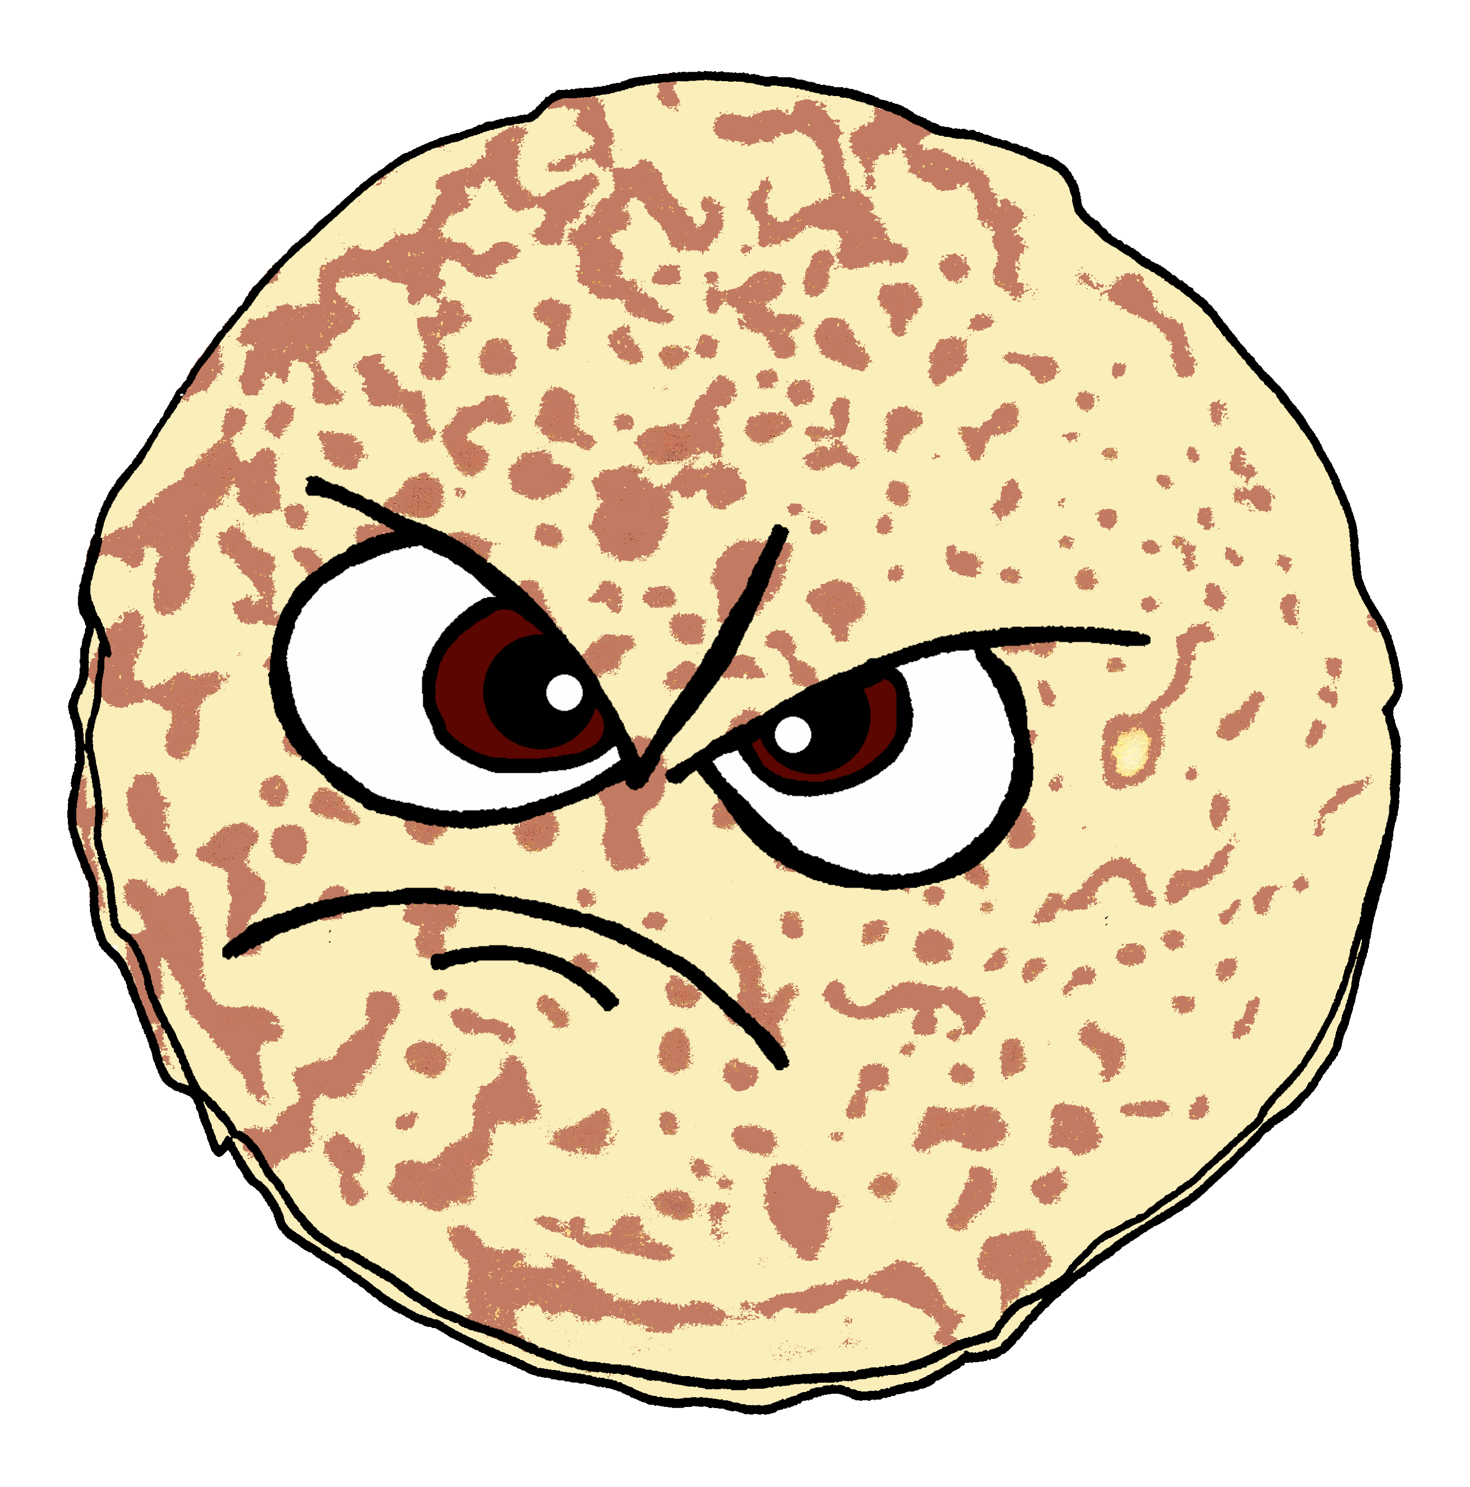
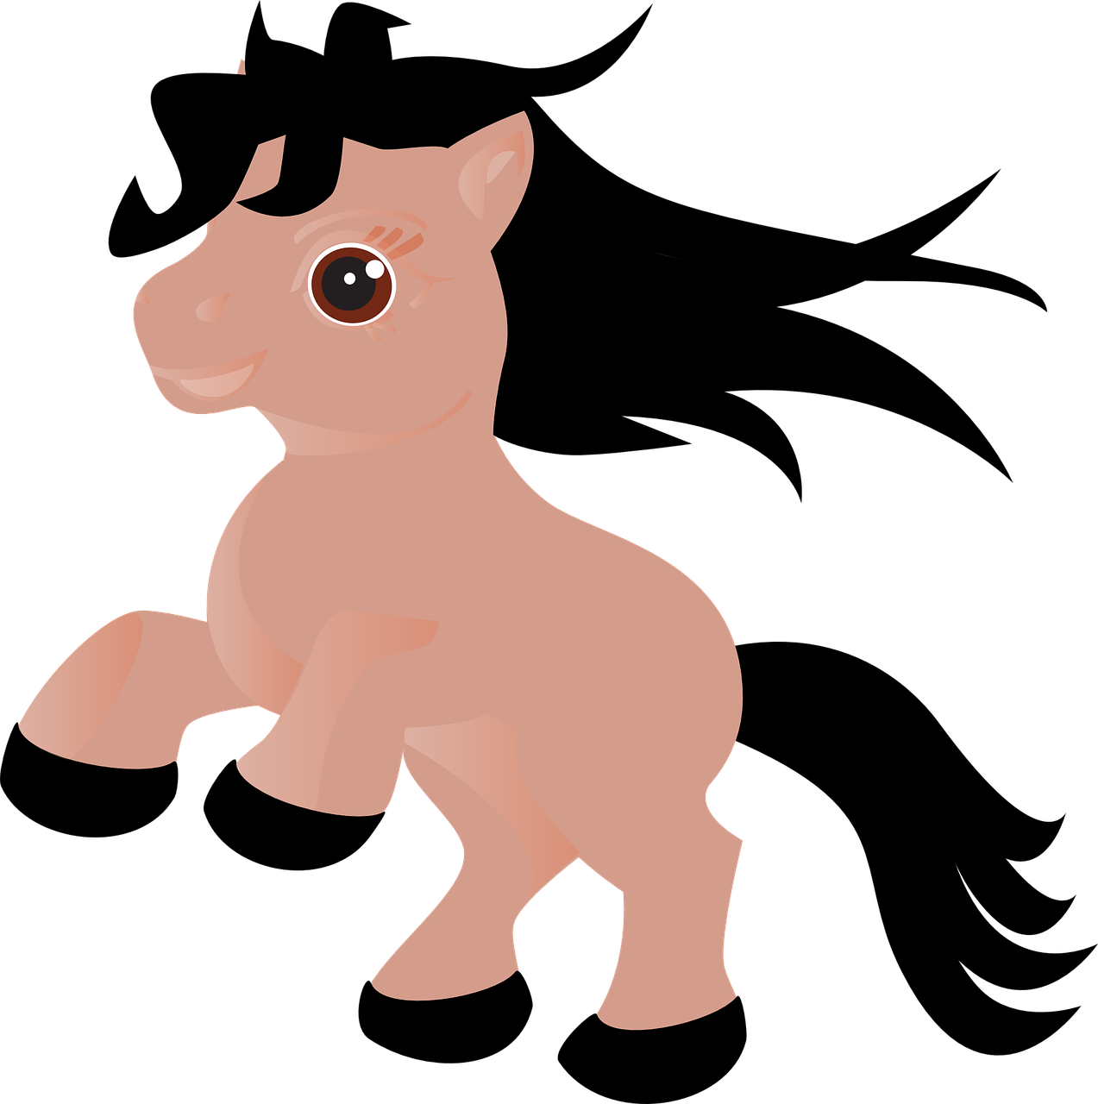
aussprechen
[pf] [kn]
Hör zu. Wie viele [pf] und [kn] hörst du?
Ich kann das nicht.
 |  | kn | pf
1 | Ein Pfannkuchen kann keine Knie knicken. | I I | I
2 | Ein Pfannkuchen kann keine Pfeifen pfeifen |  | I I I
3 | Ein Pfannkuchen kann keine Pferde pflegen. |  | I I I
4 | Ein Pfannkuchen kann keine Pflichten erfüllen. |  | I I
5 | Ein Pfannkuchen kann keine Pfirsiche essen. |  | I I
6 | Ein Pfannkuchen kann keine Knöpfe knipsen. | I I | I
knicken – to bend | das Pferd – horse | pflegen – to look after | die Pflicht – duty | knipsen – to snap
Notes:
Timing: 5 minutes
Aim: to consolidate the SSCs [pf] and [kn] in a listening activity.
Procedure:
Explain the task. Pupils are going to hear six sentences which contain a mixture of [pf] and [kn] sounds.
For each sentence they hear, pupils count the number of times they hear each SSC, noting down their answers.
Click to reveal answers.
To aid comprehension, pictures are revealed with the answers.
Transcript:
1. Ein Pfannkuchen kann keine Knie knicken.
2. Ein Pfannkuchen kann keine Pfeifen pfeifen!
3. Ein Pfannkuchen kann keine Pferde pflegen.
4. Ein Pfannkuchen kann keine Pflichten erfüllen.
5. Ein Pfannkuchen kann keine Pfirsiche essen.
6. Ein Pfannkuchen kann keine Knöpfe knipsen.
Frequency: knicken [>5009] Knie [1679] Pfeife [>5009] pfeifen [4545] Pferd [1504] pflegen [1842] Pflicht [2048] erfüllen [801] Pfirsich [>5009] Knoten [>5009] knipsen [>5009]
Jones, R.L & Tschirner, E. (2019). A frequency dictionary of German: Core vocabulary for learners. London: Routledge.

Slide 7
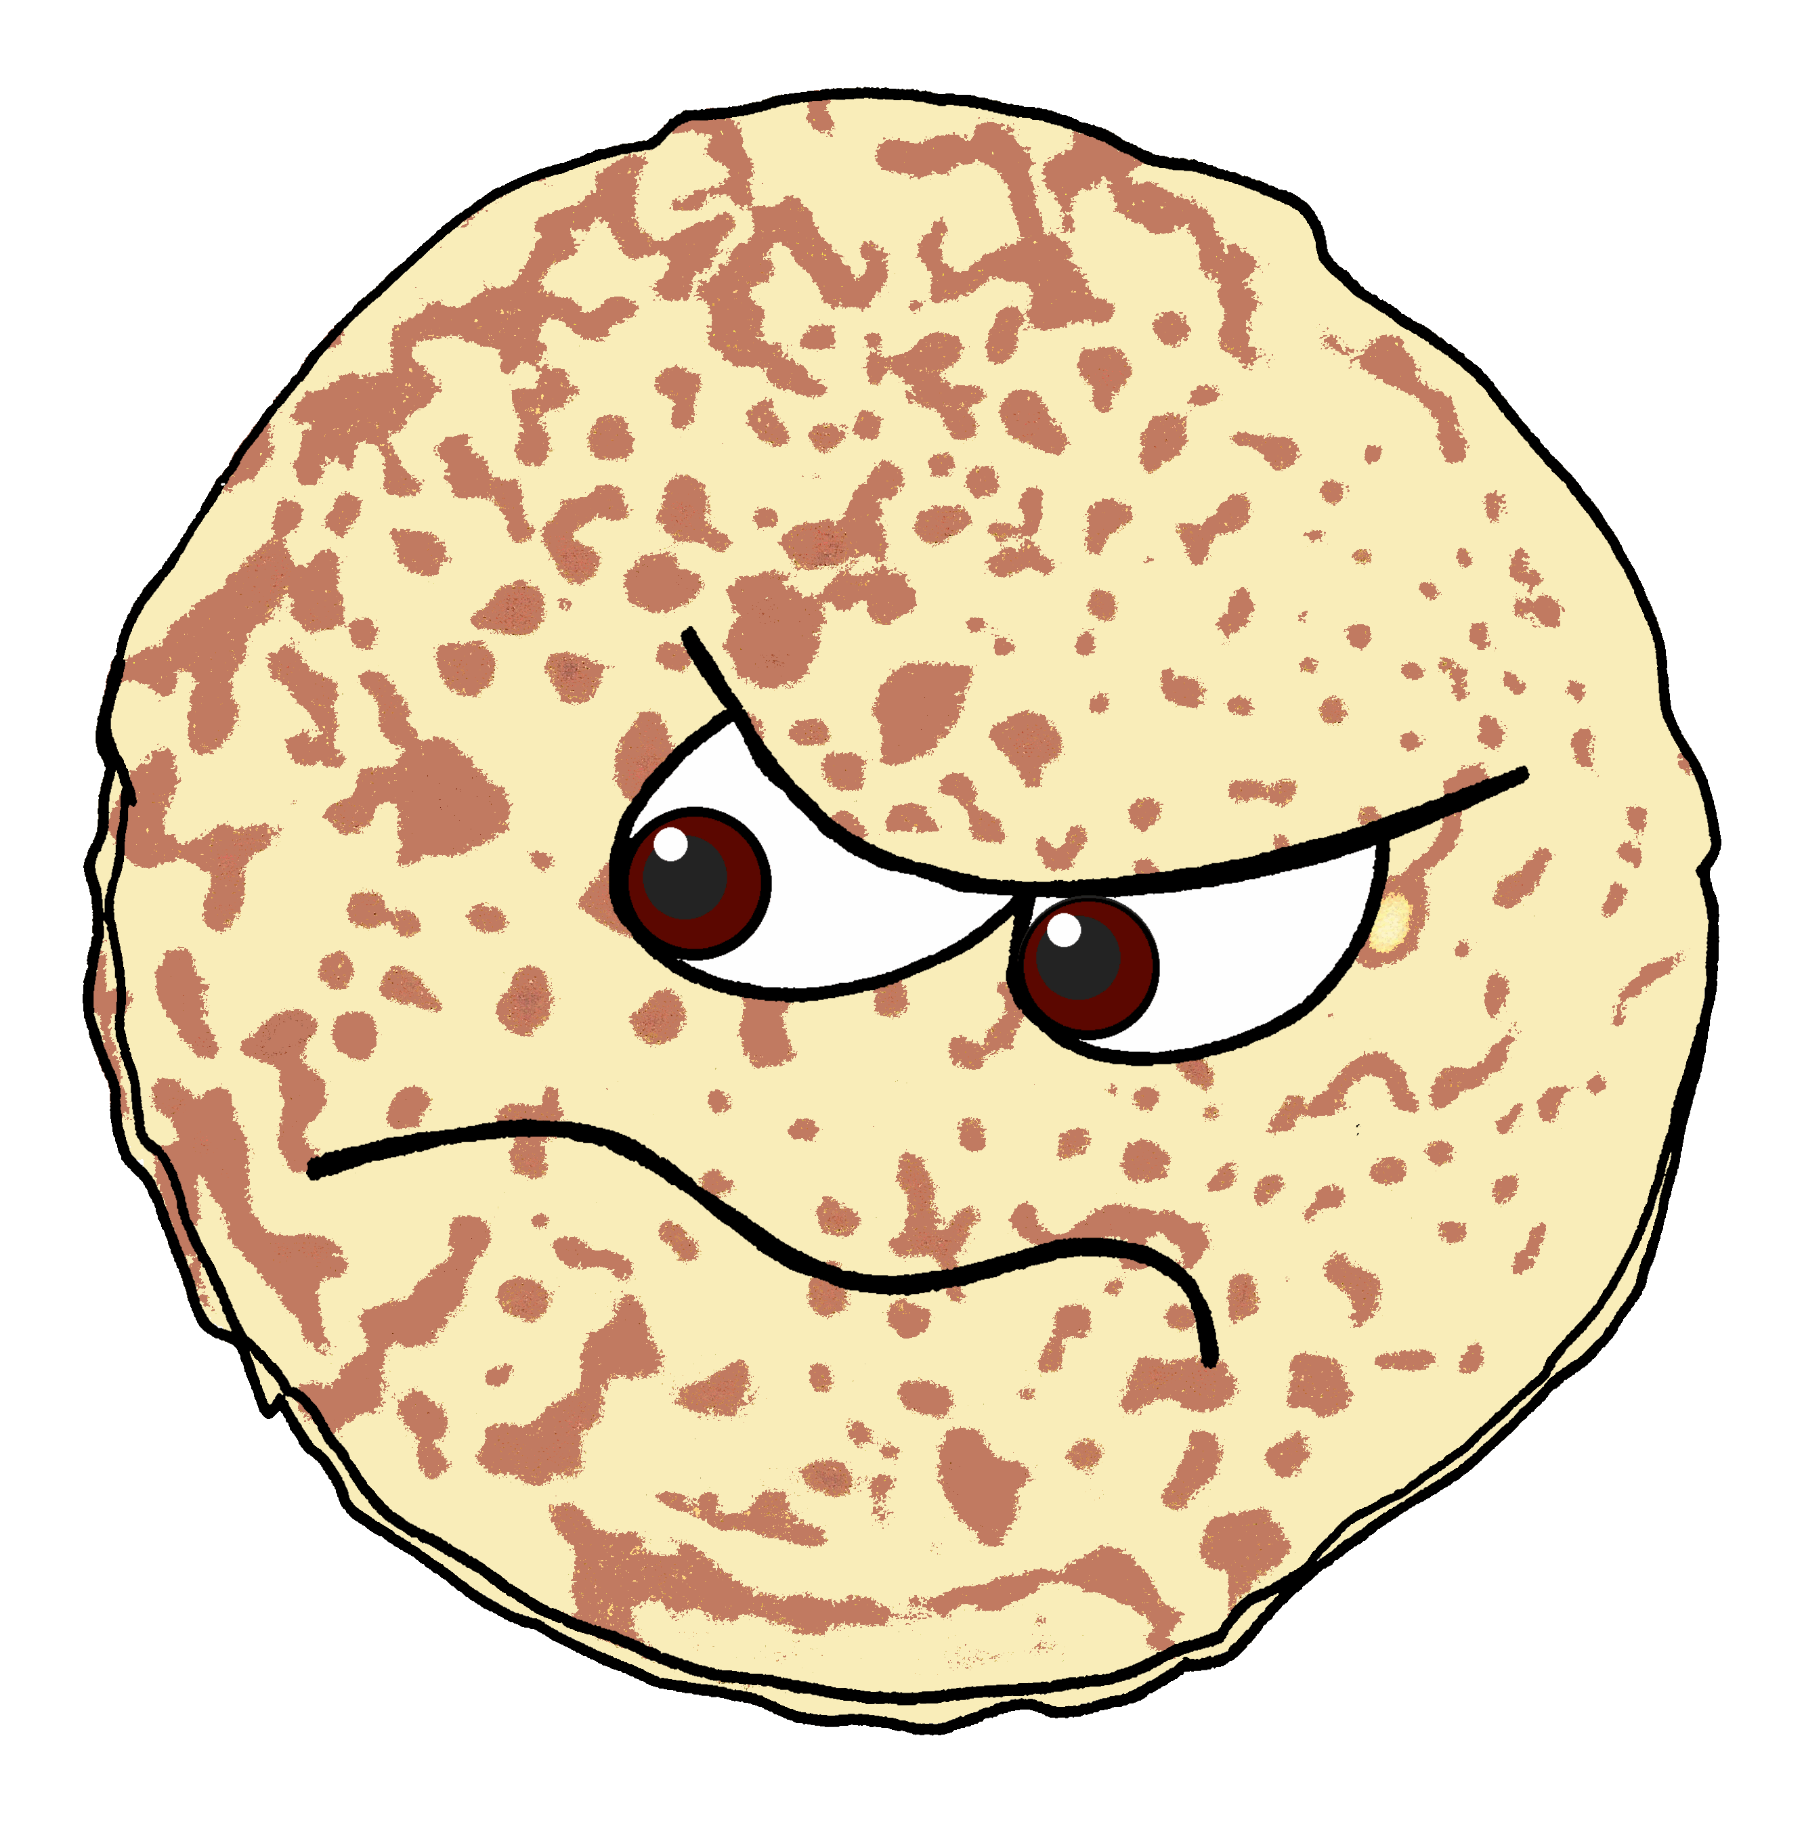
wollen
As you know, to say ‘want’ with another verb, use wollen plus an infinitive verb. The second verb is at the end of the sentence:
Sie will tanzen.
She wants to dance.
And to say doesn’t want to with verbs, use nicht before the infinitive verb:
Sie will nicht tanzen.
She doesn’t want to dance.
Notes:
Timing: 2 minutes
Aim: Grammar revision of wollen with 2 –verb structures, in preparation for the Pfannkuchen story on the next slide.
Procedure:
Click through the animations to present the information.
Elicit English translation for the German examples provided.
7

Slide 8
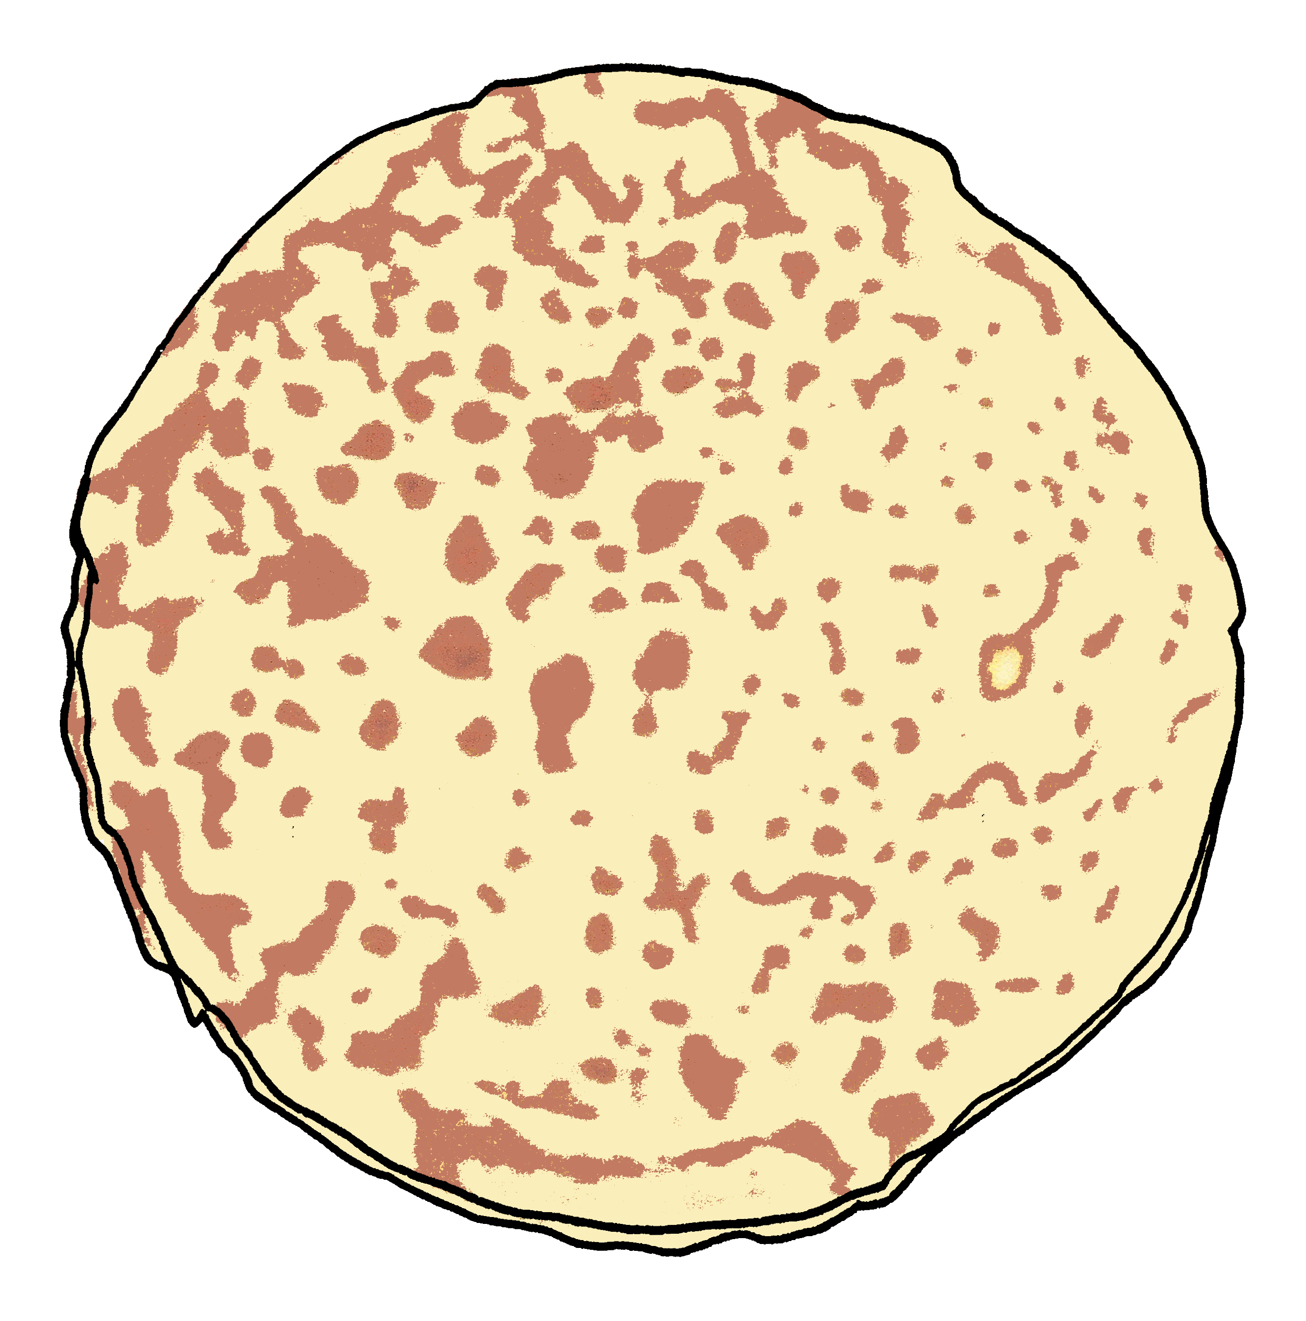
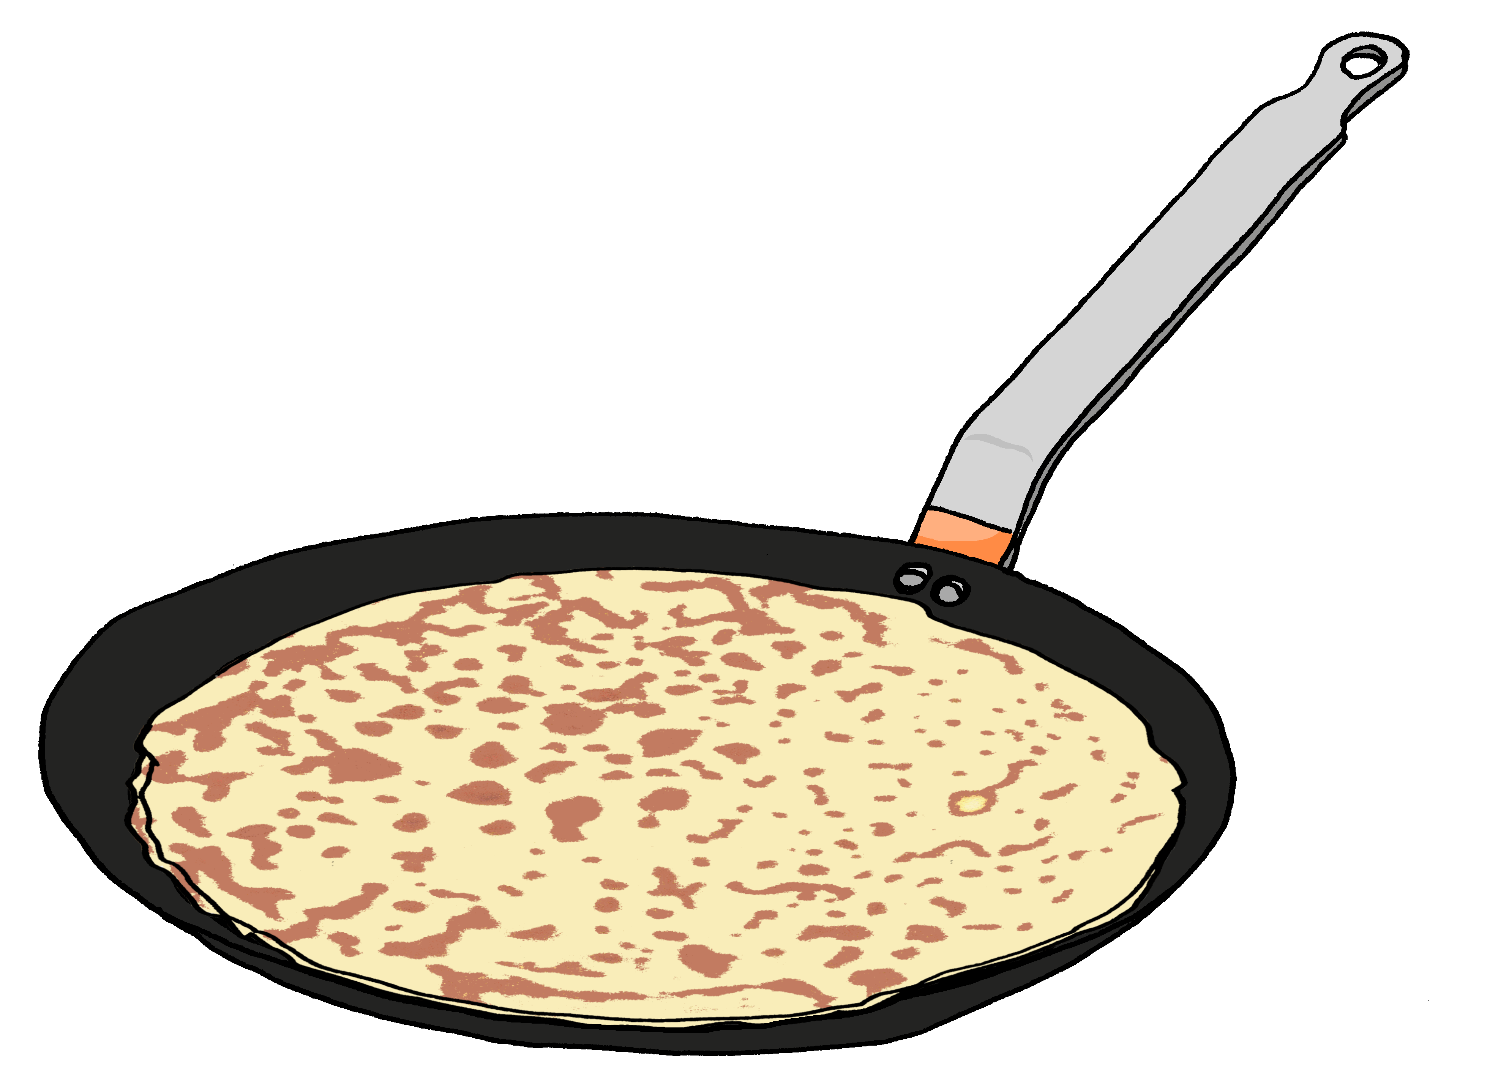
Geschichte
Der dicke fette Pfannkuchen
Es war einmal ein Pfannkuchen.
Er ist in der Pfanne und wird immer größer.
Es war einmal – it was once (once upon a time)
Notes:
Timing: 10 minutes (7 slides plus full story slide)
Aim: to practise previously taught vocabulary in the pancake story context.
Procedure:
Introduce the story by reading it out loud as each line appears or (in the audio version by clicking to bring up each audio’d line).
Ensure the meaning is clear.
On the final slide, the full story is set out. Pupils read the story in pairs.
Draw attention to the forms of wollen used in the story: Pupils find the 5 instances where ‘wollen’ is used.
Click to highlight the sentences with ‘wollen’ one by one.
Optional: Show all or part of the Youtube video – this is a longer story which can be picked up throughout weeks 12 and 13. Link to Youtube video “Der dicke fette Pfannkuchen”: https://www.youtube.com/watch?v=byn4zjvqVSo
Frequency of unknown vocabulary and cognates:
Es war einmal / once upon a time [N/A] [Pfannkuchen [>5009] Pfanne [>5009] heiß [1195] braun [2320] springen [1431] rollen [2490] frei [289] überrascht [>5009] fangen [2043] glücklich [1070] weiter
[221]
Jones, R.L & Tschirner, E. (2019). A frequency dictionary of German: Core vocabulary for learners. London: Routledge.
8

Slide 9
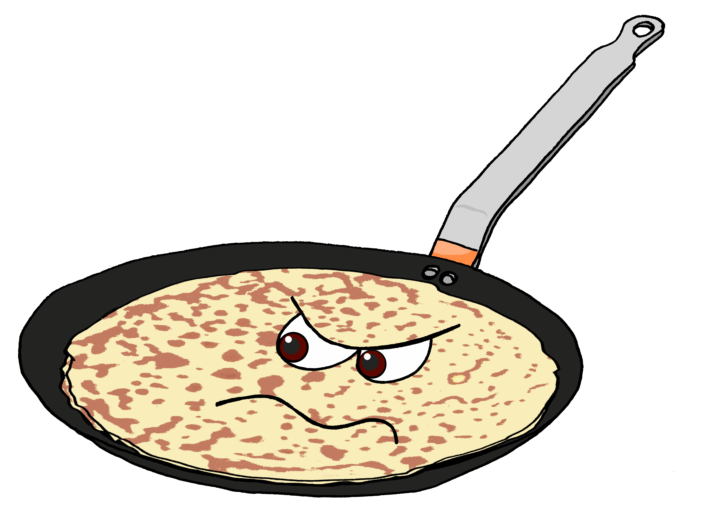
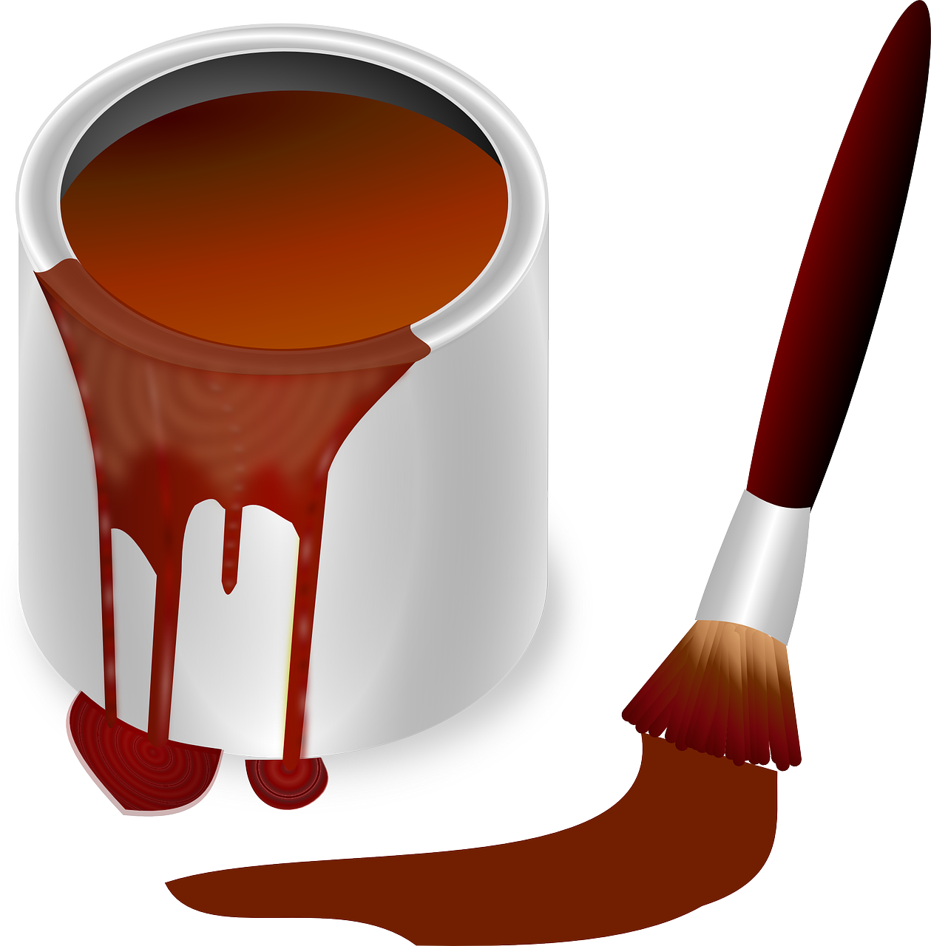
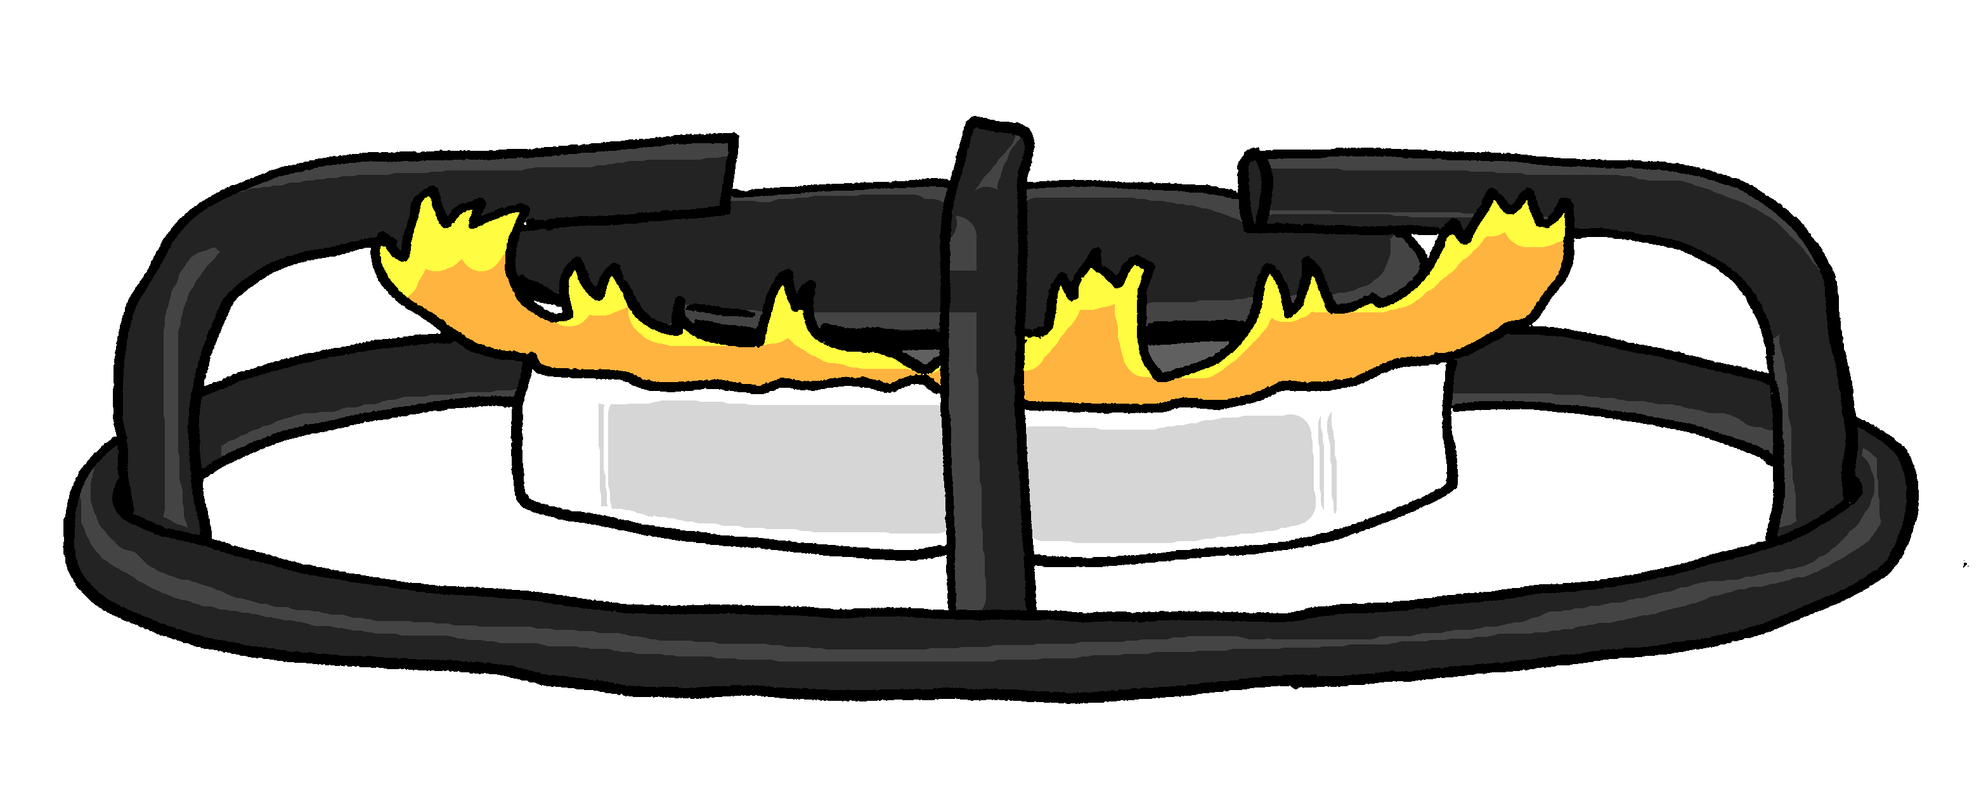
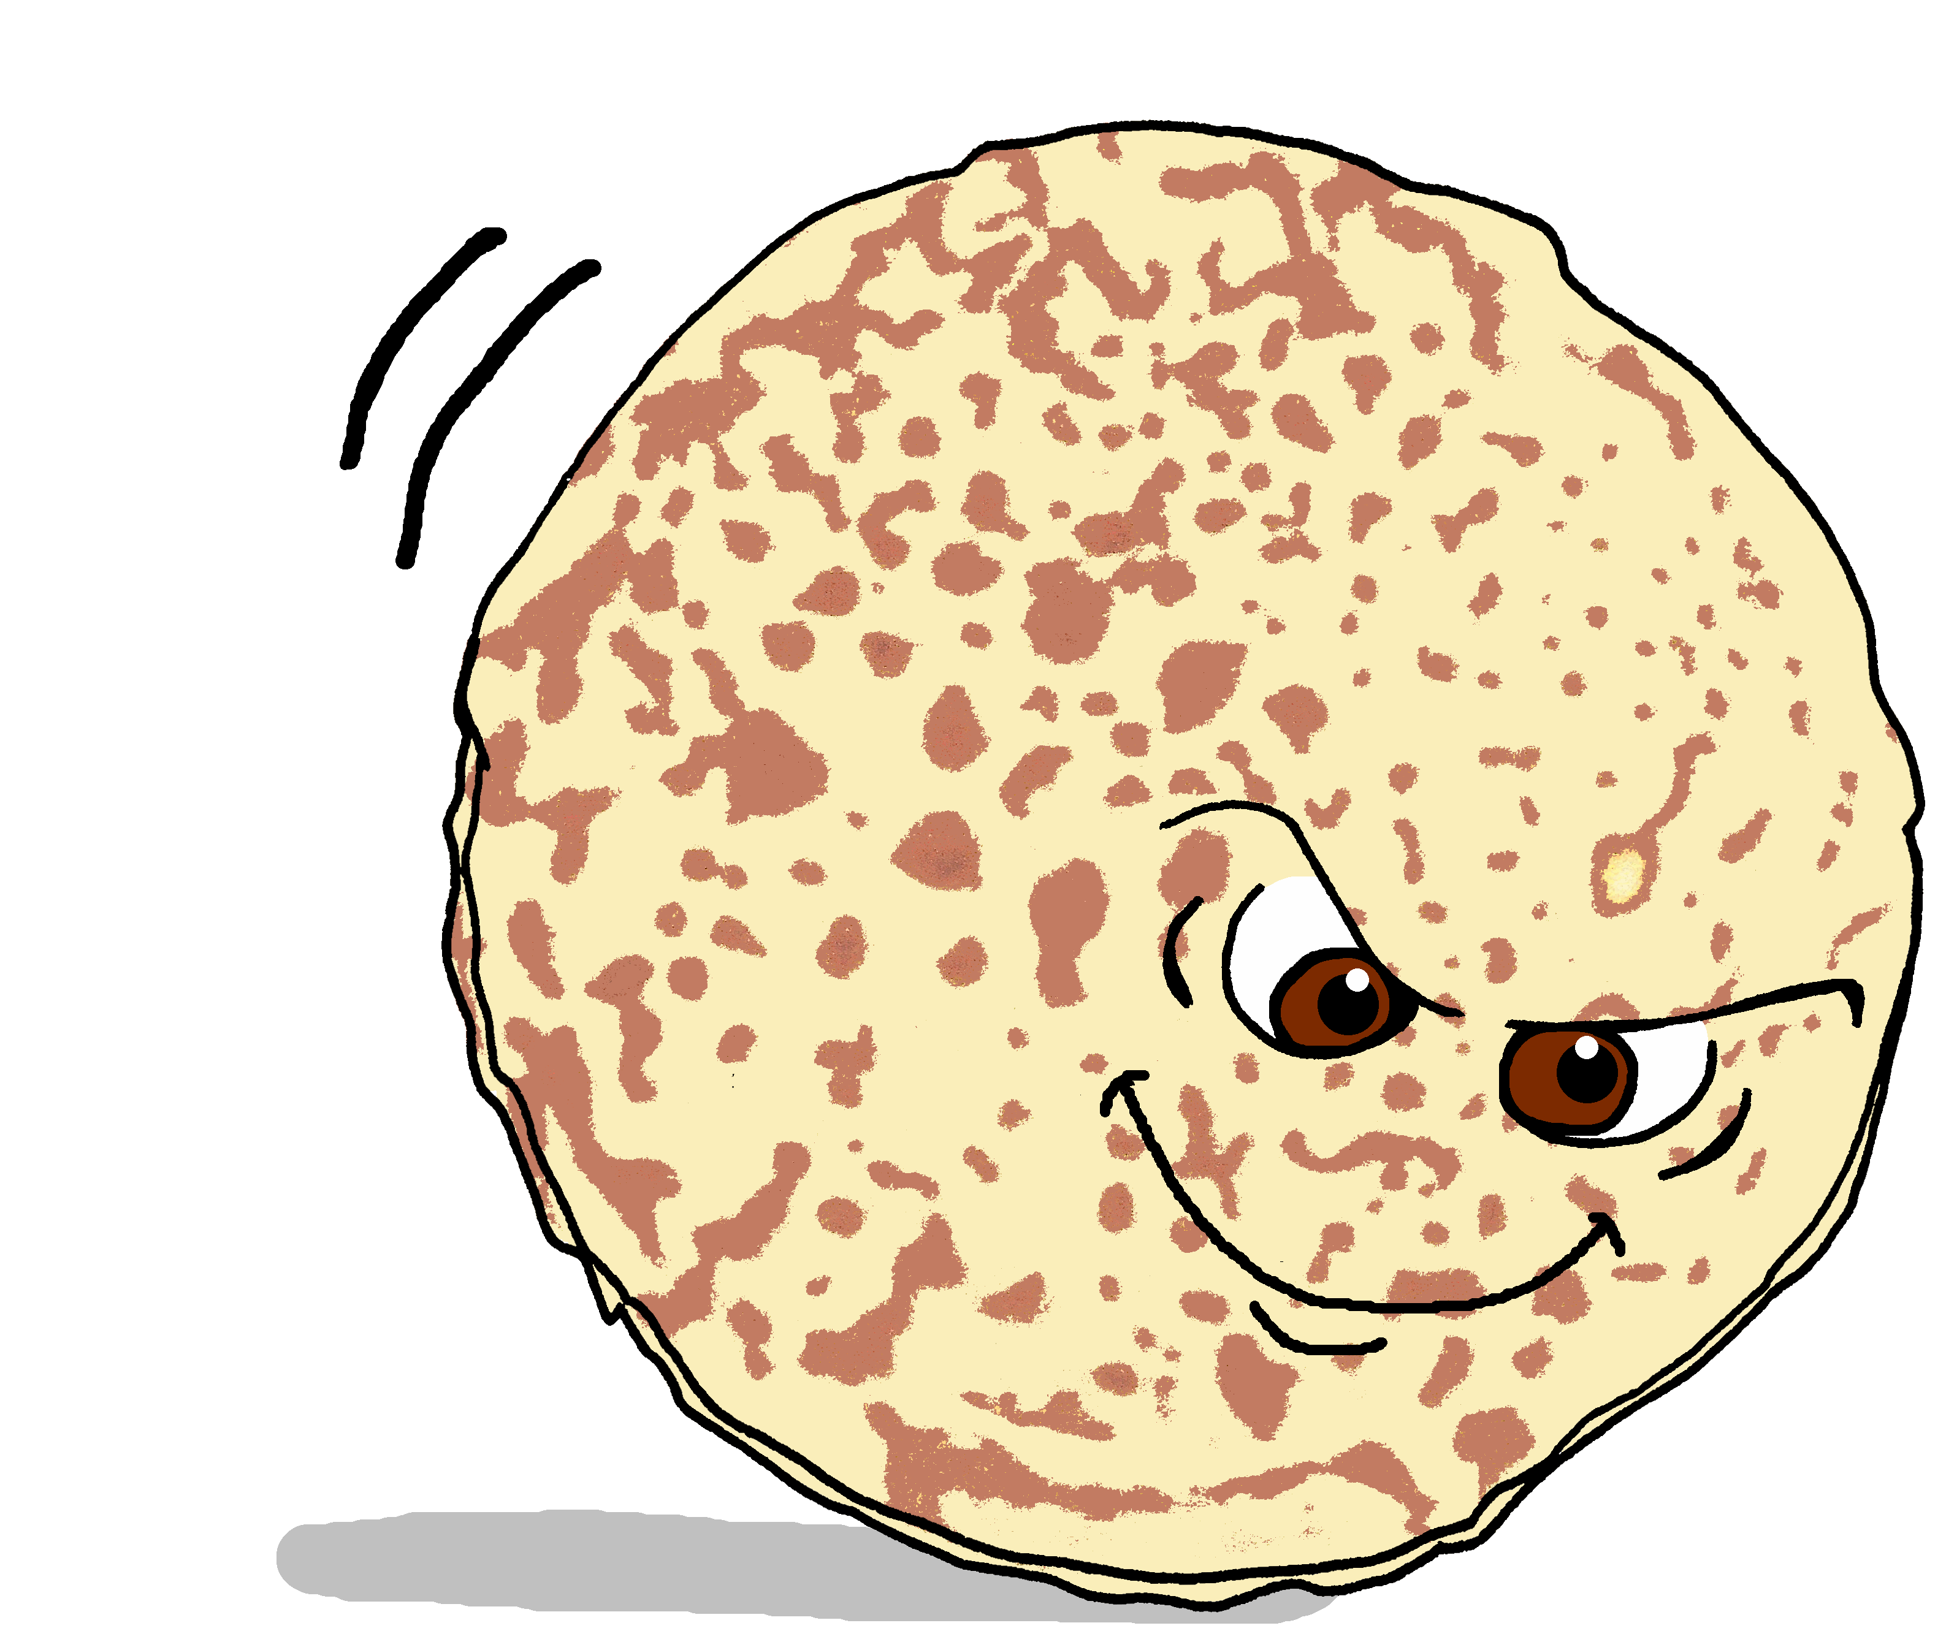
Geschichte
Der dicke fette Pfannkuchen
Die Pfanne wird heiß und der Pfannkuchen wird braun.
Dann springt der Pfannkuchen aus der Pfanne!
Notes:
[2/8]
9

Slide 10
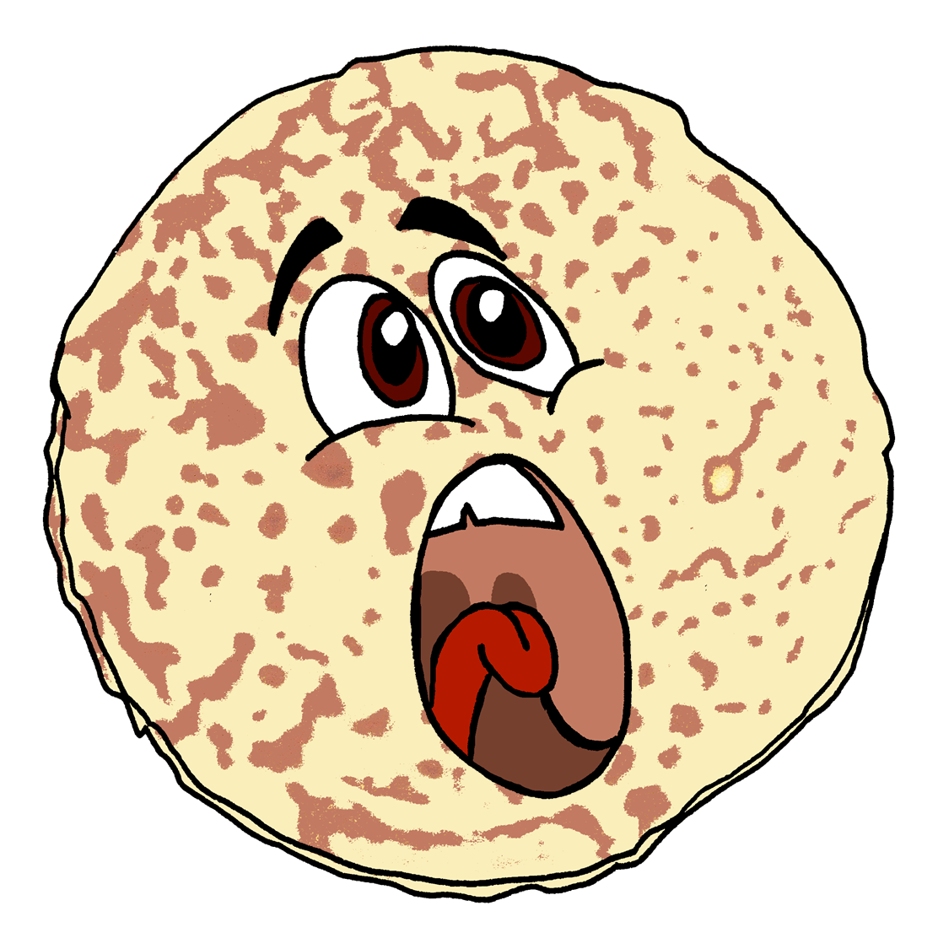
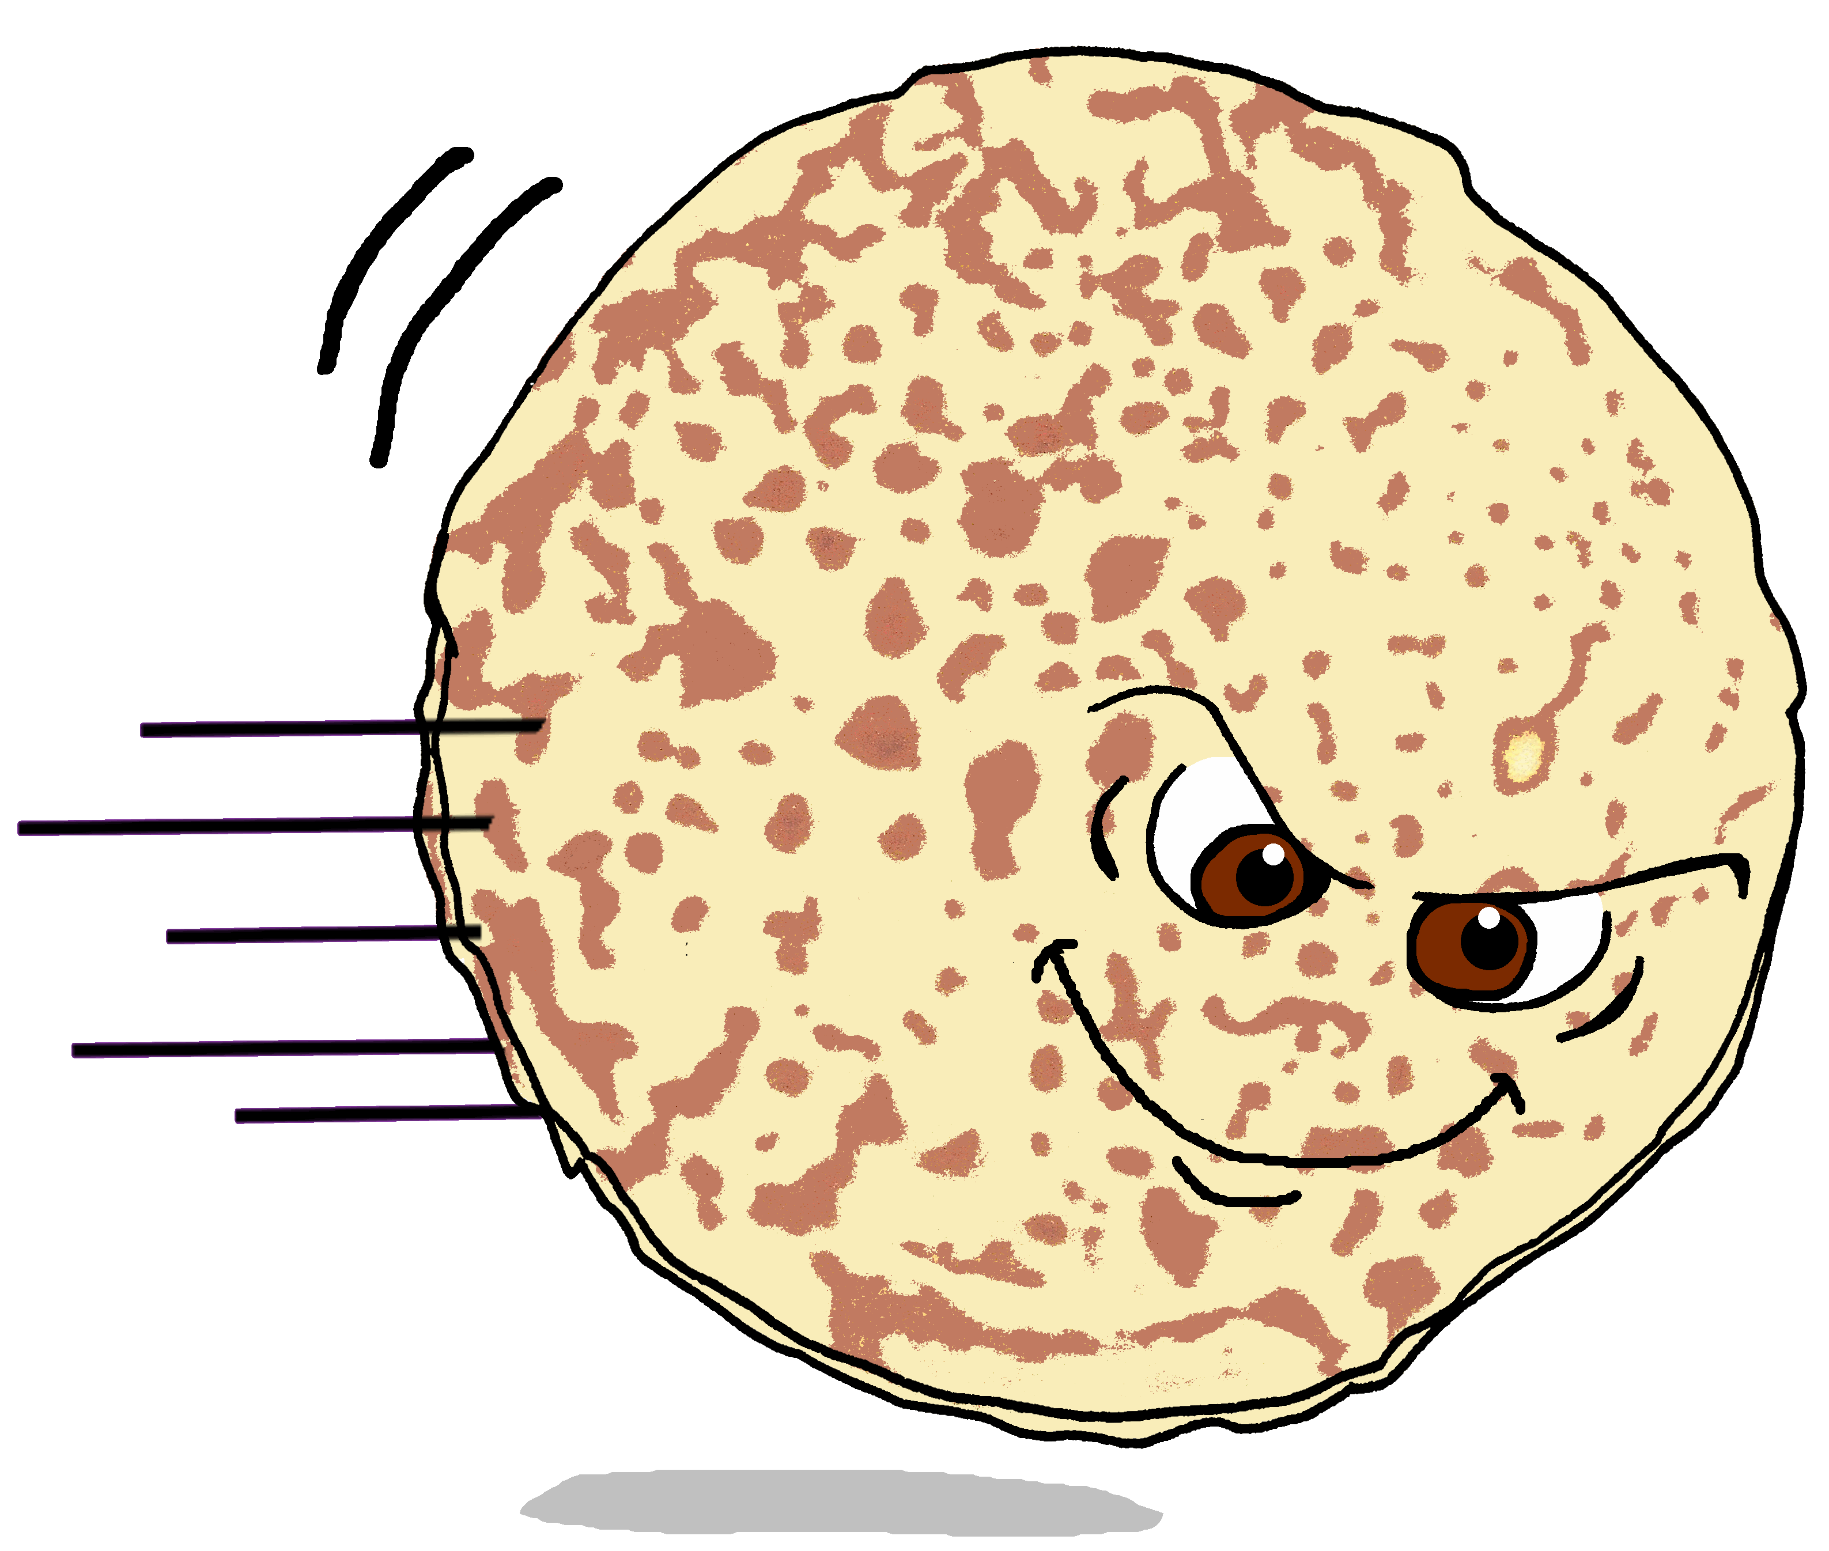
Geschichte
Der dicke fette Pfannkuchen
Er rollt durch das Zimmer wie ein Skateboard und sagt:
Hilfe! Ich will frei sein!
Notes:
[3/8]
10

Slide 11
Geschichte
Der dicke fette Pfannkuchen
überrascht - surprised
Alle Leute sind überrascht. Sie sagen:
Warum?!
Warum?!
Sie wollen den Pfannkuchen fangen, aber er ist zu schnell.
fangen – to catch
Notes:
[4/8]
11

Slide 12
Geschichte
Der dicke fette Pfannkuchen
Er will nicht in der Pfanne sein!
Er rollt aus dem Haus.
Notes:
[5/8]
12

Slide 13
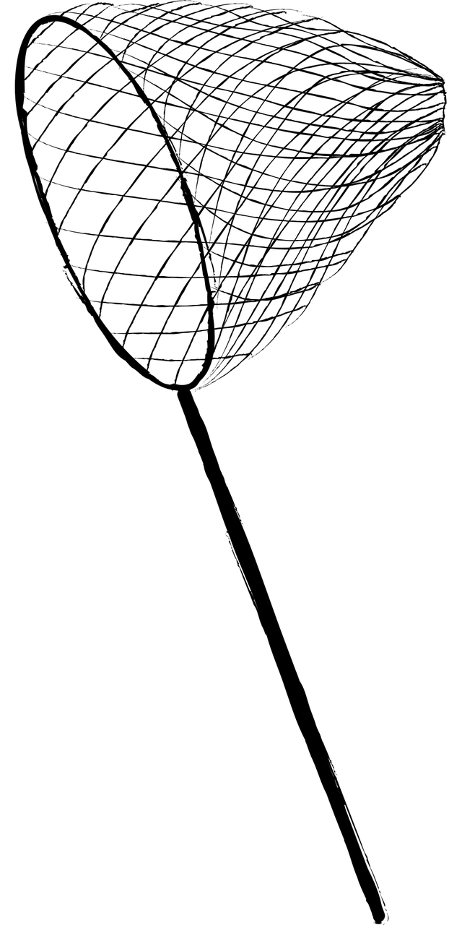
Geschichte
Der dicke fette Pfannkuchen
Die Leute wollen den Pfannkuchen fangen, aber er ist zu schnell.
Der Pfannkuchen will nicht im Haus sein. Er will frei sein.
Notes:
[6/8]
13

Slide 14
Geschichte
Der dicke fette Pfannkuchen
Er rollt und rollt, immer weiter.
Er ist glücklich.
The End
Und so endet die Geschichte vom dicken fetten Pfannkuchen.
immer weiter – on and on
Notes:
[7/8]
14

Slide 15
Geschichte
Der dicke fette Pfannkuchen
Es war einmal ein Pfannkuchen.
Er ist in der Pfanne und wird immer größer.
Die Pfanne wird heiß und der Pfannkuchen wird braun.
Dann springt der Pfannkuchen aus der Pfanne!
Er rollt durch das Zimmer wie ein Skateboard und sagt: "Hilfe! Ich will frei sein!"
Alle Leute sind überrascht. Sie sagen: „Warum?“
Sie wollen den Pfannkuchen fangen, aber er ist zu schnell.
Er will nicht in der Pfanne sein! Er rollt aus dem Haus.
Die Leute wollen den Pfannkuchen fangen, aber er ist zu schnell.
Der Pfannkuchen will nicht im Haus sein. Er will frei sein.
Er rollt und rollt, immer weiter. Er ist glücklich.
Und so endet die Geschichte vom dicken fetten Pfannkuchen.
Notes:
[8/8]
Timing: 10 minutes
Suggested activities: 1. Pupils read the text aloud in pairs, taking it in turns.
2. Pupils turn away from the board, listen to the text again (perhaps line by line) and put the 12 story cards in order.
3. Alternatively, display this slide. Pupils read the text and put the 12 story cards in order. The correct order of cards is as per the handout.
Note: the audio on this slide is attached, in three sections to the three paragraphs. If teachers want pupils to sort cards by listening to the text, they should go back through the previous 7 story slides.
15

Slide 16
Tschüss!
blau
Notes:
16

Slide 17
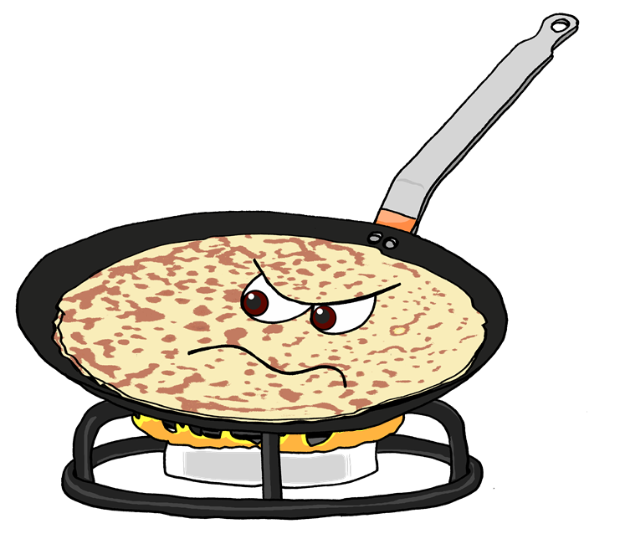
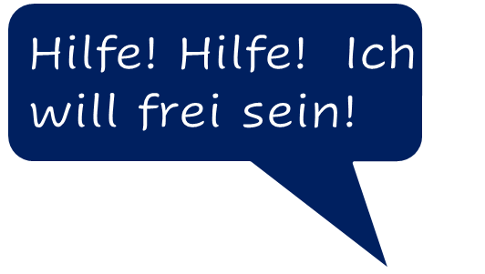
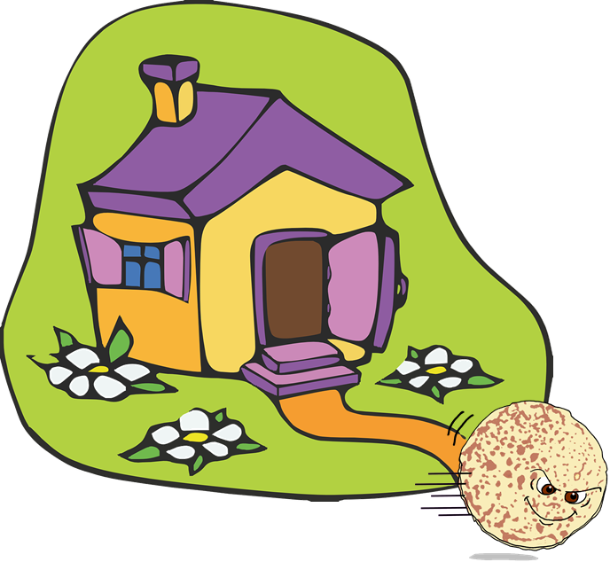
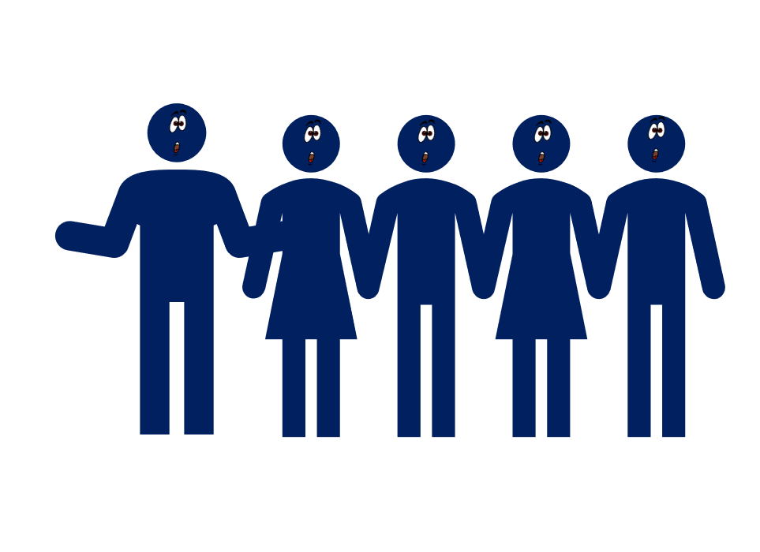
Story images
The End
Notes:
Optional story cards – to be cut up. Pupils listen to the story and put the cards in order OR read the story with a partner and put the cards in order.

