Slide 1
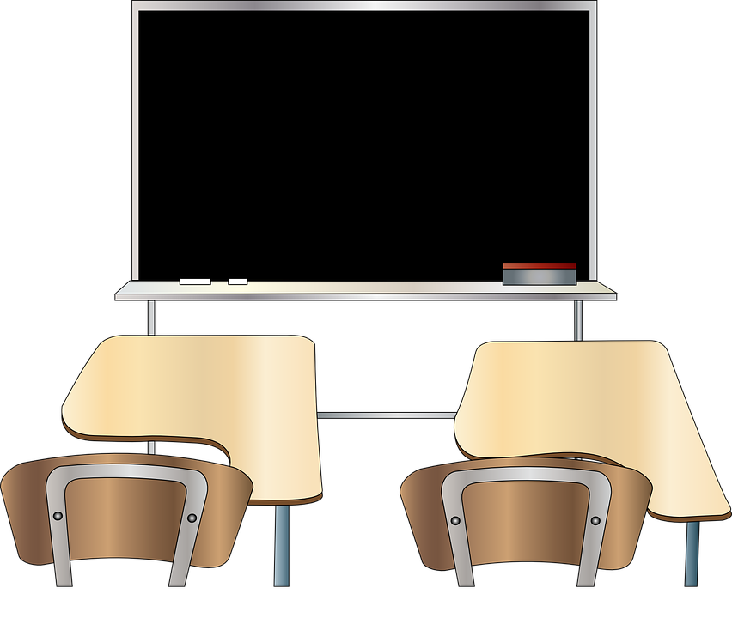
What do I know now?
Wir wiederholen! ☺
blau
Follow ups 1-5
Term 3 Week 9
Notes:
Artwork by Steve Clarke. Pronoun pictures from NCELP (www.ncelp.org). All additional pictures selected from Pixabay and are available under a Creative Commons license, no
attribution required.
Phonics:
Revisit SSC: [v] [w] [r] [er-] [-er] [-ig] [-g] [-d] [-b] [-tion] [z] [ei] [ie] [th] [pf] [kn]
Vocabulary: Revisit Term 3 vocabulary
Revisit 1: Buch [300] Fußball [1277] Handy [1693] Jacke [3287] Rucksack [3180] Spiel [328] T-Shirt [3914]
Revisit 2: Angst (vor) [392] Durst [n/a] Hunger [2097] Spaß [1045] froh [1424] müde [2000] bitte [471] danke [877]
Jones, R.L & Tschirner, E. (2019). A frequency dictionary of German: Core vocabulary for learners. London: Routledge.
The frequency rankings for words that occur in this PowerPoint which have been previously introduced in these resources are given in the SOW and in the resources that first
introduced and formally re-visited those words.
For any other words that occur incidentally in this PowerPoint, frequency rankings will be provided in the notes field wherever possible.
Remember that at the start of the course (first three lessons of Rot/Gelb) pupils learnt language (for greetings and register taking) that can still be part of the lesson routines in upper KS2 (Blau/Grün). They are not re-taught, as we anticipate that teachers have built these in from early in lower KS2.

Slide 2
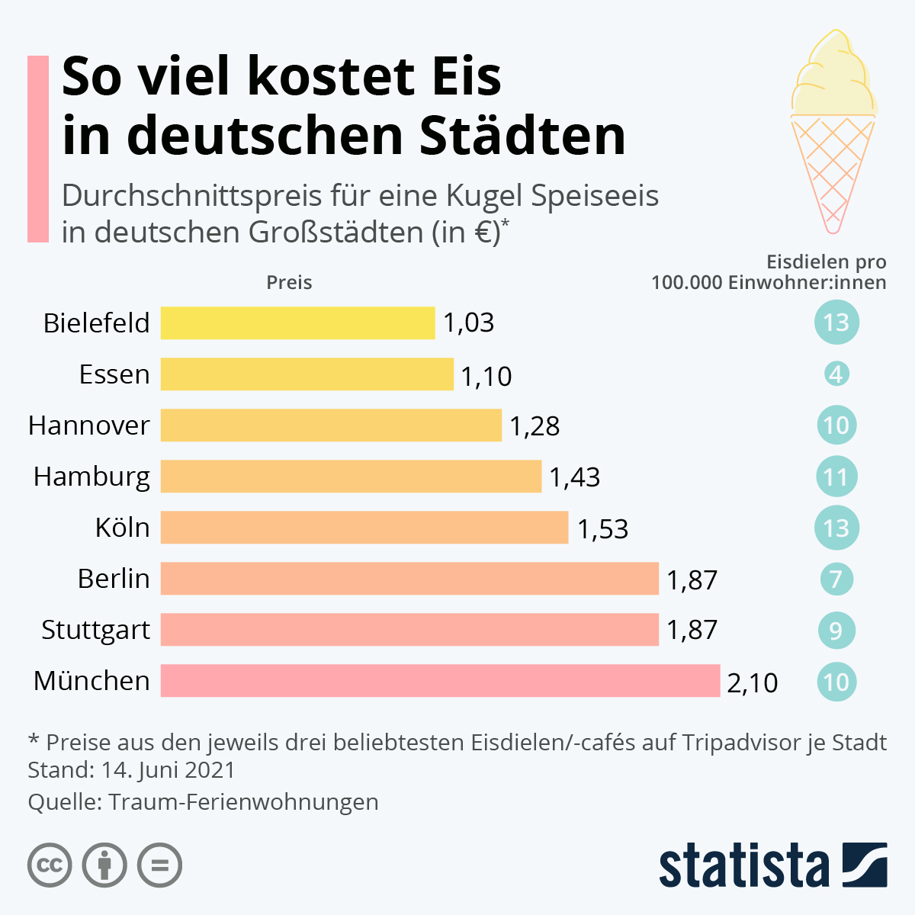
Follow up 1a
[ei]
[ie]
aussprechen
[er-]
[v]
[-er]
[-d]
[-g]
Notes:
Timing: 5 minutes (two slides)
Aim: to practise read aloud of a range of SSC with place names, some of which will be unfamiliar.
Procedure:
Click to bring up the prompt highlighting and elicit choral read aloud of each place.
Teacher says to confirm pronunciation.
Move to next slide to practise more SSC.
Note: The infographic has the average price of an ice cream in different cities in Germany. Source: https://de.statista.com/infografik/9806/preise-fuer-eine-kugel-eis-in-ausgewaehlten-staedten/
Transcript:
So viel kostet Eis in deutschen Städten Bielefeld Essen Hannover Hamburg Köln Berlin Stuttgart München

Slide 3
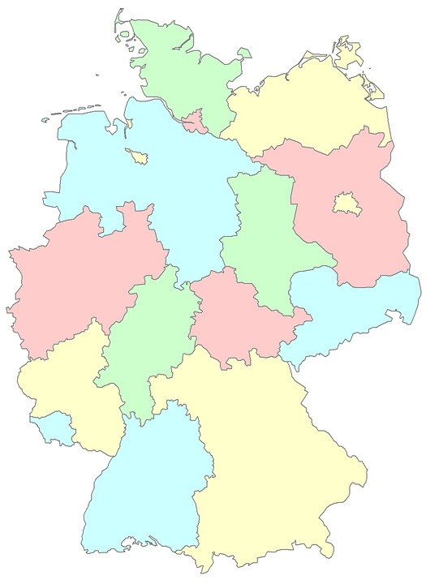
Follow up 1b
Information: Orte in Deutschland
aussprechen
[w]
Habichtswald
[-er]
[-d]
Thallwitz
Schlinzig
Oberahr
[pf]
Bad Orb
[-tion]
Arweiler
Pforzheim
[-ig]
[-b]
[-r]
[th]
Notes:
Timing: 5 minutes
Aim: to practise read aloud of a range of SSC with place names, some of which will be unfamiliar.
Note: the places on the map are approximated.
Procedure:
Click to bring up the prompt highlighting and elicit choral read aloud of each place. NB highlighting appears in order of top to bottom left hand side, then top to bottom right hand side.
Teacher says (or click to hear audio) to confirm pronunciation.
Transcript:
Habichtswald
Schlinzig
Arweiler
Pforzheim
Thalwitz
Oberahr
Bad Orb

Slide 4
lesen
Follow up 2
Lies den Text. Was sagt Inga?
Hallo!
Wie geht’s? Ich bin Inga. Ich wohne mit meiner Familie in Essen, das ist im Westen von Deutschland. Ich habe eine Katze und ich spiele Fußball. Fußball ist wunderbar!
1. What two details do we find out about where Inga lives? (2)
Lives in Essen with her family,
in the west of Germany.
2. What does Inga say about football? (2 details)
She plays football, football is wonderful.
3. What does Inga plan to do in the holidays?
In den Ferien plane ich, keine Hausaufgaben zu machen. Meine Freundin Anne wohnt in England, sie trägt im Sommer keine Uniform. Für mich ist das kein Thema – in Deutschland trägt man keine Uniform in der Schule!
no homework
4. What does Inga say about Anne? (3 details)
Inga’s friend, from England, she doesn’t wear uniform in the summer.
5. Why is that different for Inga?
Anne und ich wollen im Juli zusammen Fahrrad fahren. Wir hoffen, einen Ausflug nach Sylt zu machen. Das ist eine Insel im Norden. Wir planen, dort eine Pause von der Schule zu machen.
Was machst du im August? Wohin fährt deine Familie im Sommer?
In Germany people don’t wear school uniform.
6. What do Inga and Anne want to do in July? (2 details)
go cycling together, a trip to Sylt.
7. What three questions does Anne ask? (3)
How are you? What are you doing in August? Where does your family go in the summer?
Notes:
Timing: 8 minutes
Aim: to practise written comprehension of vocabulary and grammar from Term 3 in a longer text.
Procedure:
Pupils read what Inga has written, and then answer the questions to the right in English.
Click to reveal answers.
There are 14 points available for the task.
In the audio version, click on the three paragraphs to hear each section of text, as required.
Alternative suggestion:
For more challenge, this activity could also be done as a unimodal listening activity, if pupils turn away from the board and have a copy of the questions for each paragraph in sight, as they listen.
4

Slide 5
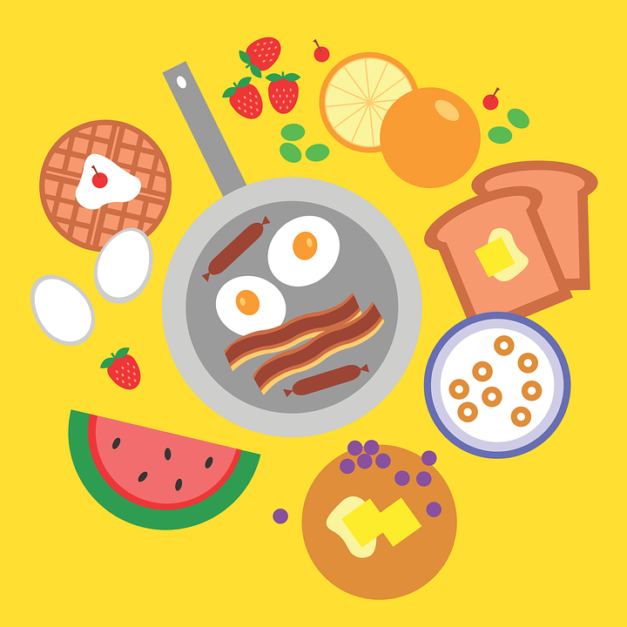
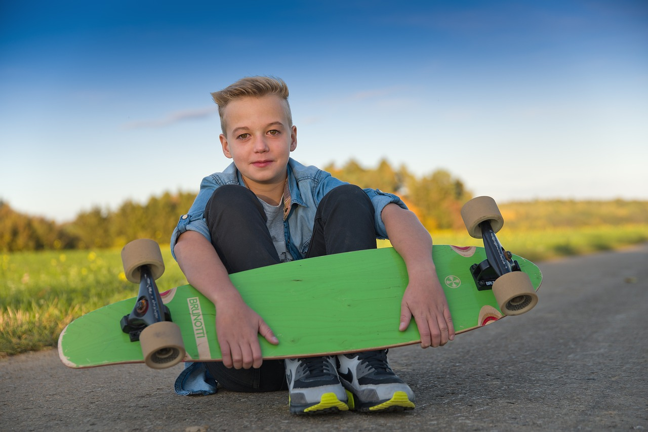
Vokabeln
Follow up 3
Lies den Text. Schreib Vokabeln auf Deutsch.
Just have a go! Write any of these English words or phrases in German. You can add different words, too.
Wörter
Hello! I am Niklas. I live in Germany! How are you?
What do you do in summer?
In summer I often go swimming or skateboarding.
In July we are driving to the North. We are staying a week. I want to swim in the river there. And you? What do you (all) do?
I hope to get your answer soon*!
Bye, Niklas
cleaning
festival, celebration
breakfast
reading
homework
*soon – bald
Notes:
Timing: 5 minutes
Aim: to practise written production of this term’s vocabulary.
Note: This is a more straightforward version of the activity, asking pupils for individual words. A more challenging version can be found on the following slide, where pupils are encouraged to write a mixture of sentences and words.
Procedure:
Pupils read the message in English from Niklas (in the middle).
Pupils use Niklas’ message and the words and pictures on the notebook to the right as inspiration. They use the lines on the left to write any words in German that they could use to reply to Niklas. They could use any of the words on the notebook, and any other words they know.
Vocabulary:
bald [503]
Jones, R.L & Tschirner, E. (2019). A frequency dictionary of German: Core vocabulary for learners. London: Routledge.
5

Slide 6
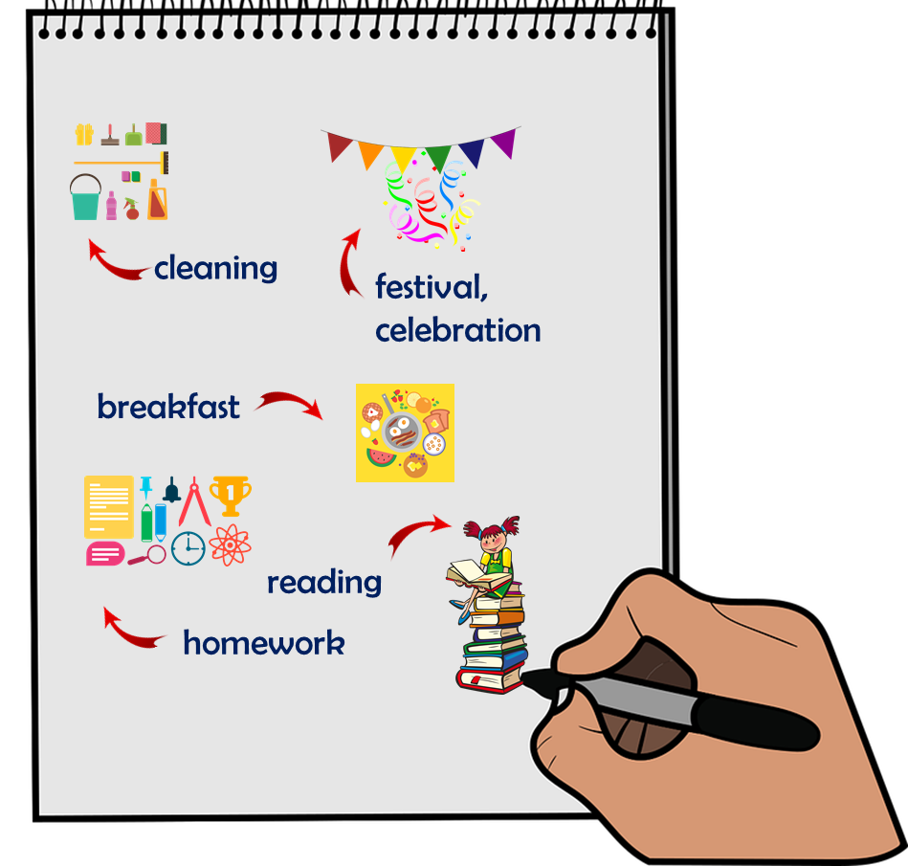
schreiben
Follow up 3
Write a message to Niklas in German. Write anything you like. You can write short sentences or words or a mixture.
Schreib auf Deutsch.
Hello! I am Niklas. I live in Germany! How are you?
What do you do in summer?
In summer I often go swimming or skateboarding.
In July we are driving to the North. We are staying a week. I want to swim in the river there. And you? What do you (all) do?
I hope to get your answer soon*!
Bye, Niklas
Notes:
Timing: 8 minutes
Aim: to practise written production of this term’s vocabulary and to practise written production of short sentences.
Note: This is a more challenging version of the activity, where pupils are encouraged to write a mixture of sentences and words. A more straightforward version of the activity can be found on the previous slide, where pupils are asked to write individual words.
Procedure:
Pupils read the message from Niklas on the left. Pupils use Niklas’ message and the words and pictures on the notebook to the right as inspiration.
6

Slide 7
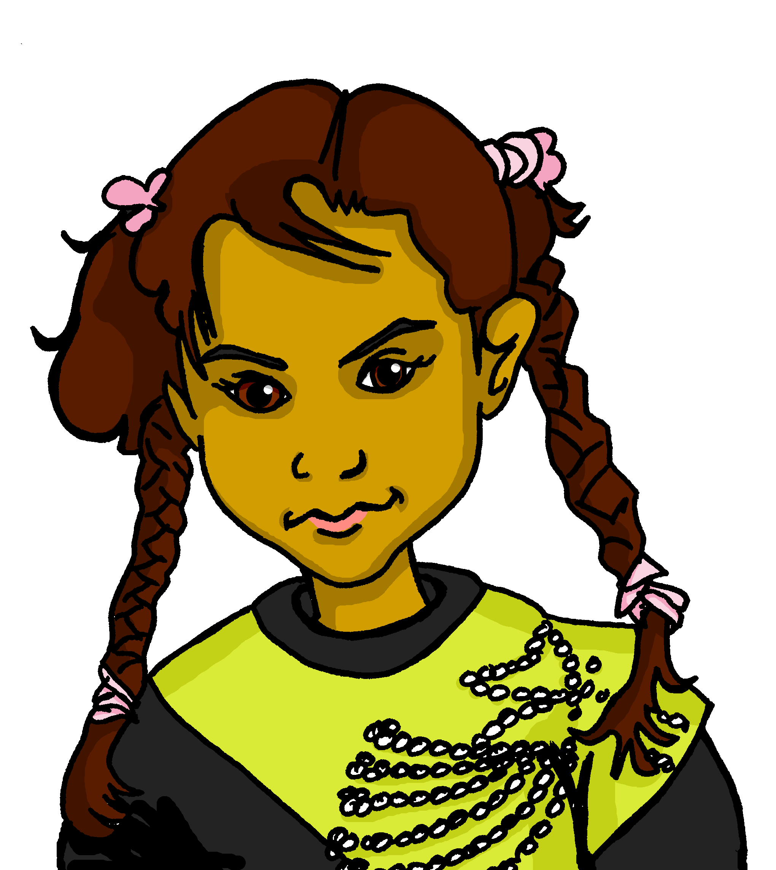
Fragen und Antworten
Follow up 4
Partnerarbeit: Auf Deutsch sprechen.
Wie heißt du?
Ich heiße Aisha.
sprechen
Sie heißt Aisha.
Was
Wo
Wann
Wie
Warum
Welcher
willst du schwimmen?
wohnst du?
Tag ist heute?
alt bist du?
fährst du Skateboard?
hast du Geburtstag?
willst du in den Ferien machen?
bleibst du heute zu Hause?
heißt du?
geht’s?
Notes:
Timing: 10 minutes
Aim: to practise building questions using a variety of question words and verbs; to practise using a variety of verbs in 1st, 2nd, 3rd persons; to practise some of this term’s vocabulary.
Procedure:
Pupils work in pairs. Partner A matches a blue question starter and with a yellow question ender and asks Partner B the question. Partner B responds in the first person.
Click to model how this would work with Aisha and Johanna.
Once partners have asked and answered all possible questions, they then write down their partner’s answers in the third person. Click to model this with Johanna.
In the audio version, audio is attached to the text boxes.

Slide 8
Follow up 5
Rede mit deinem Partner/deiner Partnerin.
Ich…
Reaktionen! 😃
sprechen
… will einen Film sehen.
… versuche, ein Buch zu lesen.
… hoffe, einen Ausflug zu machen.
… will in ein Restaurant gehen.
… besuche heute nachmittag Oma und Opa.
… kann das Haus sauber machen.
… plane, Frühstück zu machen.
… hoffe, ein Geschenk zu bekommen.
… will keine Uniform tragen.
… kann meine Freundin in England besuchen.
… will mit meinen Freunden in die Stadt gehen.
A
B
Ich will einen Film sehen.
Das macht Spaß!
😃 macht Spaß| ist toll | mag ich| kein Thema! | viel Spaß! |
Notes:
There are two versions of this activity: This is the more scaffolded one.
It would be possible to do this activity and then the next version to provide increasing challenge/progression.
Timing: 3 minutes
Aim: to practise reading comprehension of both newly introduced and revisited vocabulary & apply logic to the statements.
Procedure:
Click x2 to bring up the speech bubbles and model the conversation.
Pupils take turns to read the statements and react to them according to their own opinion.

Slide 9
Follow up 5
Rede mit deinem Partner/deiner Partnerin.
I want…
Reaktionen! 😃
sprechen
… to watch a film.
… to read a book.
… to go on a trip.
… to go to a restaurant.
… to visit Oma and Opa.
… to clean the house.
… to make breakfast.
… to get a present.
… to wear no uniform.
… to visit my friend (female) in England.
… to go into town with my friends.
A
B
Ich will einen Film sehen.
Das macht Spaß!
😃 macht Spaß| ist toll | mag ich| kein Thema! | viel Spaß! |viel Glück!
Notes:
There are two versions of this activity: This is the more challenging one.
Note that this version of the activity only uses ‘wollen – ich will’ to reduce the cognitive load and allow pupils to focus on the word order with this 2-verb structure, varying the vocabulary in each sentence.
Timing: 3 minutes
Aim: to practise spoken production of both newly introduced and revisited vocabulary.
Procedure:
Click x2 to bring up the speech bubbles and model the conversation.
Pupils take turns to speak. They can choose to use the prompts in any order.
The listening pupil reacts, according to their own opinion.

Slide 10
Extra follow up:

Schreib auf Englisch.
Can you get at least 15 points?
Wörter
 | der Durst | Angst (vor) | der Hunger
 | danke | müde | bitte
 | froh | der Spaß | das Frühstück
 | man | der Rucksack | das T-Shirt
 | diesmal | dann | werden
 | warum? | putzen | wollen
 | sauber | der Ausflug | versuchen
(the) thirst
fear (of)
(the) hunger
Vokabeln
x3
thank you
tired
please
glad, happy
(the) fun
(the) breakfast
you, one
(the) rucksack
(the) t-shirt
x2
to become, becoming
this time
then
why?
to clean, cleaning
to want (to), wanting (to)
x1
clean
the trip, excursion
to try, trying
Notes:
Timing: 5 minutes
Aim: to practise written production of vocabulary from this and revisited weeks.
Procedure: 1. Give pupils a blank grid. They fill in the English meanings of any of the words they know, trying to reach 15 points in total.
Note: The most recently learnt and practised words are pink, words from the previous week are green and those from week 1 are blue, thus more points are awarded for them, to recognise that memories fade and more effort (heavy lifting!) is needed to retrieve them.

Slide 11
Extra follow up:

Schreib auf Deutsch.
Can you get at least 15 points?
Wörter
 | please | thank you | (the) breakfast
 | (the) fun | glad, happy | tired
 | fear (of) | (the) thirst | (the) hunger
 | then | you, one | to become, becoming
 | (the) t-shirt | (the) rucksack | this time
 | to try, trying | clean | to want (to), wanting (to)
 | (the) trip, excursion | to clean, cleaning | why?
bitte
danke
das Frühstück
Vokabeln
x3
der Spaß
froh
müde
Angst (vor)
der Durst
der Hunger
dann
werden
x2
man
das T-Shirt
der Rucksack
diesmal
wollen
versuchen
sauber
x1
der Ausflug
putzen
warum?
Notes:
Timing: 5 minutes
Aim: to practise written production of vocabulary from this and revisited weeks.
Procedure: 1. Give pupils a blank grid. They fill in the German meanings of any of the words they know, trying to reach 15 points in total.
Note: The most recently learnt and practised words are pink, words from the previous week are green and those from week 1 are blue, thus more points are awarded for them, to recognise that memories fade and more effort (heavy lifting!) is needed to retrieve them.

Slide 12
Tschüss!
blau
Notes:
12

Slide 13
Extra follow up:

Schreib auf Englisch.
Can you get at least 15 points?
Wörter
 | der Durst | Angst (vor) | der Hunger
 | danke | müde | bitte
 | froh | der Spaß | das Frühstück
 | man | der Rucksack | das T-Shirt
 | diesmal | dann | werden
 | warum? | putzen | wollen
 | sauber | der Ausflug | versuchen
Vokabeln
x3
x2
x1
Notes:
HANDOUT

Slide 14
Extra follow up:

Schreib auf Deutsch.
Can you get at least 15 points?
Wörter
 | please | thank you | (the) breakfast
 | (the) fun | glad, happy | tired
 | fear (of) | (the) thirst | (the) hunger
 | then | you, one | to become, becoming
 | (the) t-shirt | (the) rucksack | this time
 | to try, trying | clean | to want (to), wanting (to)
 | (the) trip, excursion | to clean, cleaning | why?
Vokabeln
x3
x2
x1
Notes:
HANDOUT

