Slide 1
What do I know now?
Wir wiederholen!
☺
blau
Revisiting sounds, words and structures
Term 3 Week 9
Notes:
Artwork by Steve Clarke. Pronoun pictures from NCELP (www.ncelp.org). All additional pictures selected from Pixabay and are available under a Creative Commons license, no
attribution required.
Phonics:
Revisit SSC: [v] [w] [r] [er-] [-er] [-ig] [-g] [-d] [-b] [-tion] [z] [ei] [ie] [th] [pf] [kn]
Vocabulary: Revisit Term 3 vocabulary
Revisit 1: Buch [300] Fußball [1277] Handy [1693] Jacke [3287] Rucksack [3180] Spiel [328] T-Shirt [3914]
Revisit 2: Angst (vor) [392] Durst [n/a] Hunger [2097] Spaß [1045] froh [1424] müde [2000] bitte [471] danke [877]
Jones, R.L & Tschirner, E. (2019). A frequency dictionary of German: Core vocabulary for learners. London: Routledge.
The frequency rankings for words that occur in this PowerPoint which have been previously introduced in these resources are given in the SOW and in the resources that first
introduced and formally re-visited those words.
For any other words that occur incidentally in this PowerPoint, frequency rankings will be provided in the notes field wherever possible.
Remember that at the start of the course (first three lessons of Rot/Gelb) pupils learnt language (for greetings and register taking) that can still be part of the lesson routines in upper KS2 (Blau/Grün). They are not re-taught, as we anticipate that teachers have built these in from early in lower KS2.
1

Slide 2
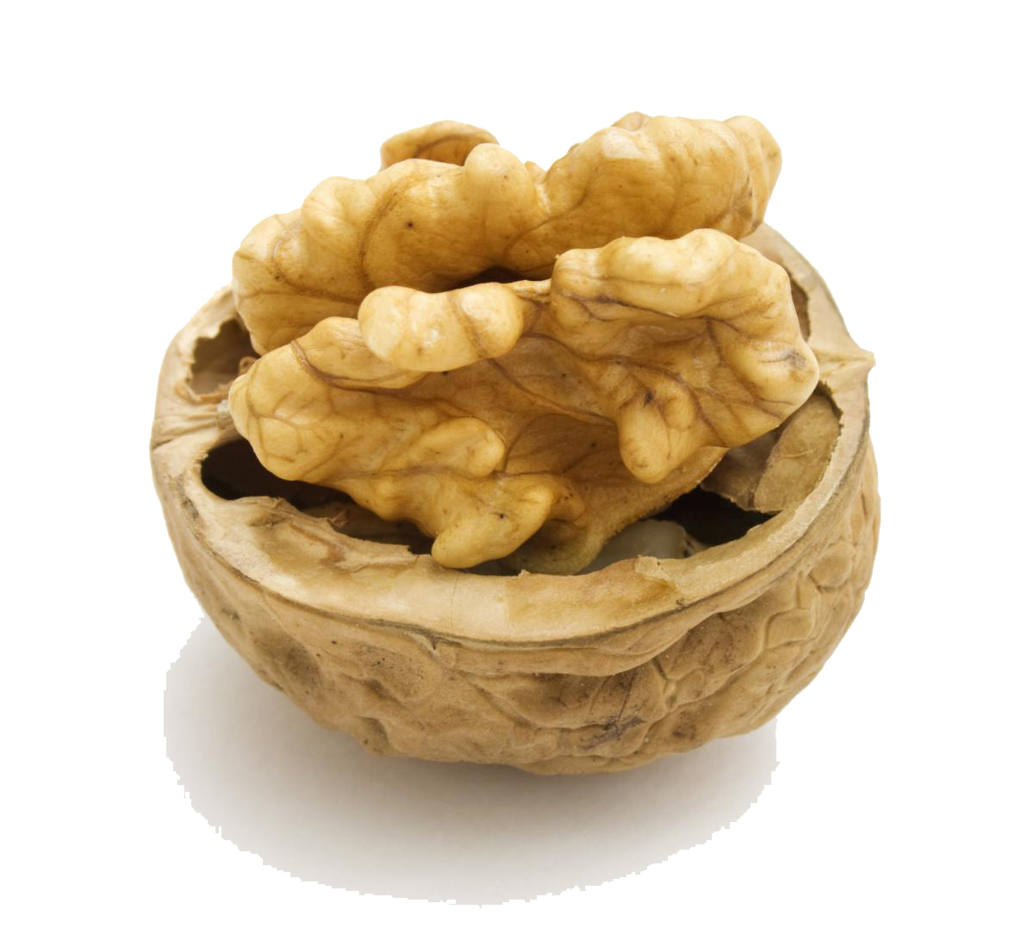
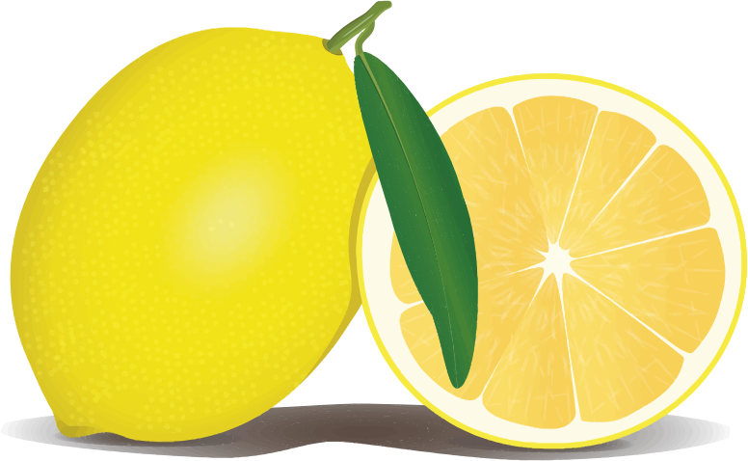
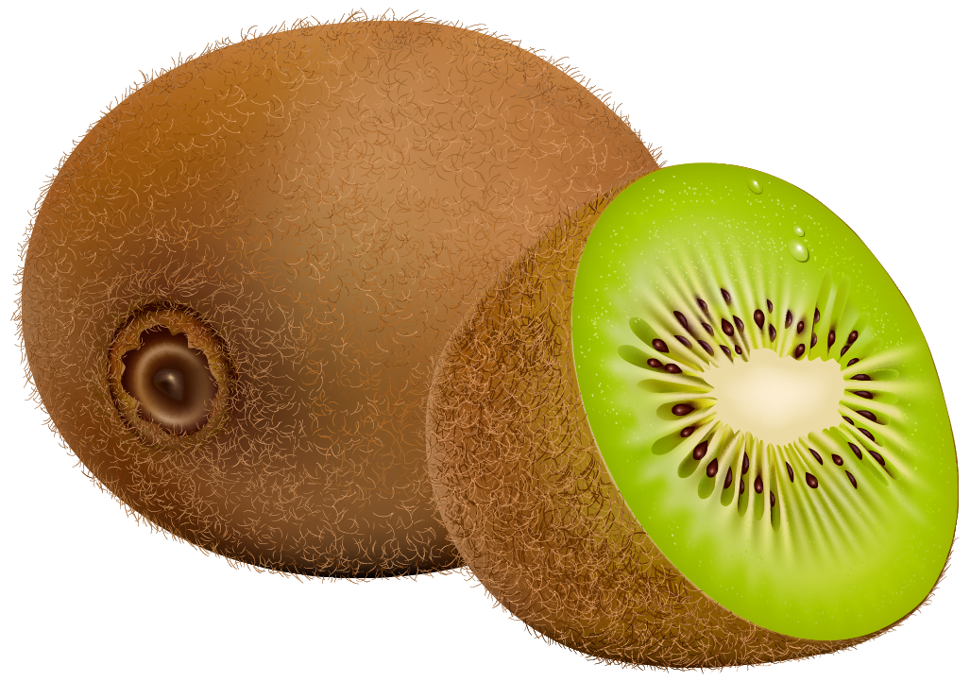
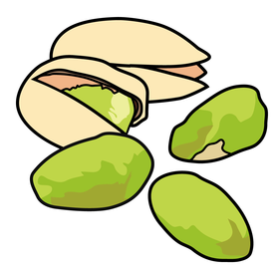
Phonetik
Erdbeer
[ei]
Walnuss
aussprechen
o
rten
Eiss
[w]
Pfefferminze
[er-]
Zitrone
[-d]
[pf]
Kiwi
4 Eisportionen
[z]
[-tion]
Schokolade
4 knusprige
Waffeln
Pistazie
[-ig]
[-b]
im Korb mit Erdbeeren mit Thermosflasche
Pfirsich
[-r]
[th]
knusprig - crispy
Notes:
Timing: 3 minutes
Aim: to practise several SSC. Most are from this term’s revisiting; a few are from Terms 1 and 2 (and previous years, as phonics are all revisited every year).
Procedure:
Read the instruction.
Allow pupils to read the menu aloud in pairs.
Click to highlight the different SSC one by one and elicit choral read aloud.
Teacher pronounces to confirm correct pronunciation of each word.

Slide 3
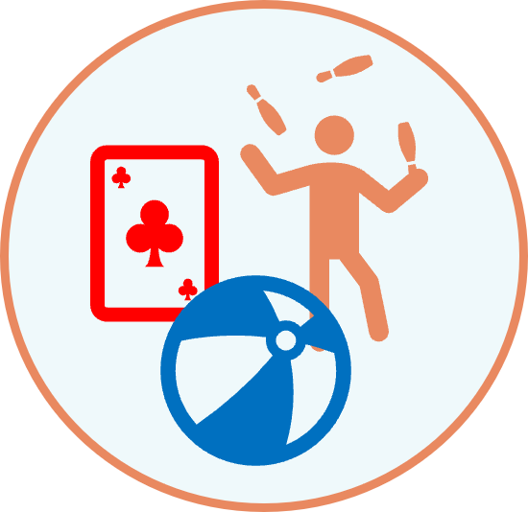
hören
Was mache ich?
Ich wiederhole Vokabeln!
Hör zu. Dann schreib das Verb auf Deutsch.
 | das Verb auf Deutsch
essen
schreiben
1
2
schlafen
in the lesson
3
spielen
an egg
4
ein Ei suchen
5
nach Hause fahren
6
im Unterricht sitzen
Notes:
Timing: 5 minutes
Aim: to practise aural comprehension of some previously taught phrases for different occasions, associating them with a relevant verb, which students then write in German, practising written production, too.
Procedure:
1. Click to listen to each phrase.
2. Pupils identify it and the associated verb/verb phrase and write those in German.
3. Click to correct.
Transcript:
essen
schlafen
spielen
ein Ei suchen
nach Hause fahren
im Unterricht sitzen
Ich wiederhole die Vokabeln!
3

Slide 4
hören
Hör zu. Schreib die Wörter.
Ich wiederhole die Vokabeln!
The 2nd verb is at the end of the sentence in German.
So you will hear these details in the middle of the sentence.
A | B | C
a place ☐ | a vehicle ☐ | clothing ☐
a time ☐ | a place ☐ | a sport ☐
a person ☐ | a day of the week ☐ | food ☐
clothing ☐ | an object ☐ | a person ☐
an animal ☐ | a place ☐ | clothing ☐
a person ☐ | a day ☐ | an object ☐
I | you | she | he _____ _______...
I | you | she | he _____ _______...
I | you | she | he _____ _______...
I | you | she | he _____ _______...
I | you | she | he _____ _______...
I | you | she | he _____ _______...
the room
B
wants to
clean
1
go
skateboarding
hopes to
2
your breakfast
want to
eat
3
her rucksack
can
look for
4
want to
find
your t-shirt
5
a friend (m)
plan to
visit
Notes:
Timing: 5 minutes
Aim: to practise aural comprehension of term 3 vocabulary and structures.
Procedure:
1. Listen once for the subject and the two verbs.
2. Click to correct this part.
3. Listen again to identify the object of the sentence – either just the category or the full details.
4. Click to provide both elements of each answer.
Transcript:
B. Ich will mein Zimmer putzen.
Er hofft, diesmal Skateboard zu fahren.
Du willst dein Frühstück essen.
Sie kann ihren Rucksack suchen.
Du willst dein T-Shirt finden.
Ich plane, einen Freund zu besuchen.
4

Slide 5
lesen
Schreib die Wörter auf Deutsch.
v
¹
e
²
h
__
__
__
__
n
⬇
1. to try, trying
4. please
6. to want (to)
7. thank you
8. why?
➡
2. to hope, hoping
3. to
5. important
6. to become, get
9. because 10. clean
o
f
f
__
__
r
Ich wiederhole Vokabeln!
__
s
z
__
³
__
u
__
b
c
⁴
w
c
g
__
__
__
i
__
__
__
h
t
__
⁵
i
t
e
__
__
⁷
w
e
__
d
n
t
r
__
⁶
__
__
e
__
__
a
__
e
w
o
__
d
__
__
__
⁸
__
__
⁹
n
n
n
a
__
__
__
l
r
__
k
__
l
__
a
b
e
r
¹⁰
S
__
__
__
__
u
__
__
e
m
__
__
n
Notes:
Timing: 5 minutes
Aim: to revisit vocabulary from previous weeks.
Procedure: 1.Teachers model the task by drawing pupils’ attention to the clues on the left-hand side of the slide.
NB. All these words have been introduced and practised before. 2. Pupils work in pairs and try to translate as many as they can.
3. Elicit meaning from pupils and click to bring up the answers in numerical order.
NB. Further rounds of learning can be facilitated by one pupil turning away from the board, and his/her partner asking him/her the meanings (‘Wie sagt man XXX auf Deutsch?’). This activity can work from L2 → L1 or L1 → L2.
5

Slide 6
lesen
Schreib 1-6 und das Wort.
Ich wiederhole Grammatik!
1. | Heute _________ ich Geburtstag. Today is my birthday. | ☐ hat ☐ ist ☐ habe
2. | ________ du Hunger? Are you hungry? | ☐ hast ☐ bist ☐ ist
3. | Wir ________ sehr müde. We are very tired. | ☐ haben ☐ sind ☐ bin
4. | _________ ihr froh? Are you all happy/glad? | ☐ seid ☐ sind ☐ habt
5. | Sie ______ Spaß dort. She is having fun there. | ☐ ist ☐ hat ☐ hast
6. | Nein! Er __________ Angst vor Elefanten. No! He is scared of elephants. | ☐ hat ☐ ist ☐ bist
1
2
3
4
5
6
Notes:
Timing: 5 minutes
Aim: to practise written recognition of the correct verb for several sentences, some of which do not have word-for-word translations, and where the meaning of ‘haben’ is, essentially ‘be’ not ‘have’.
Procedure:
Explain the task and do the first one together to model it.
Remind pupils that although we say ‘is’ in English in German we literally say ‘Today have I birthday’.
Give pupils time to complete items 2-6 and click to correct.
6

Slide 7
lesen
Schreib 1-6 und das Pronomen.
Remember there is one present tense in German, but two in English.
Dann schreib den Satz auf English.
1. | _________ spielt montags Fußball. He ____________________________. | ☐ er ☐ sie ☐ man ☐ ihr
2. |  | ☐ er ☐ sie ☐ man ☐ ihr
3. |  | ☐ er ☐ sie ☐ man ☐ ihr
4. |  | ☐ er ☐ sie ☐ man ☐ ihr
5. |  | ☐ er ☐ sie ☐ man ☐ ihr
6. |  | ☐ er ☐ sie ☐ man ☐ ihr
1
plays football on Mondays
2
_________ hat im Januar Geburtstag.
has her birthday in January
She ______________________________.
3
________ geht nach der Schule schwimmen.
go swimming after school
You (people) _________________________.
_________ kauft ein Butterbrot – kein Thema!
4
are buying a sandwich– no problem!
You (all) ____________________________________
5
_________ bekommt viele Hausaufgaben.
gets a lot of homework
She ___________________________________.
______ besucht heute Abend Oma und Opa.
6
are visiting Oma und Opa this evening
You (all) ________________________________________.
Notes:
Timing: 5 minutes
Aim: to practise written comprehension of four pronouns which share a verb ending; to practise written comprehension of short present tense sentences and their translation into one of two present tenses in English, according to the adverb.
Procedure:
Explain the task and do the first one together to model it.
Students write 1-6 and the pronoun, then write down the meaning in English.
Remind pupils that although we say ‘is’ in English in German we literally say ’Today have I birthday’.
Give pupils time to complete items 2-6 and click to correct – first the pronoun, then the meaning in English.
7

Slide 8
Tschüss!
blau
Notes:
8

