Slide 1
Describing me and others
Freundschaft - friendship
rot
Possessive adjectives mein, meine, dein, deine
SSC [z]
Term 1 Week 10
Notes:
Artwork by Steve Clarke. Pronoun pictures from NCELP (www.ncelp.org). All additional pictures selected from Pixabay and are available under a Creative Commons
license, no attribution required.
Phonics:
[z] Zug [675] sitzen [231] Platz [326] Zimmer [665] zehn [333]
Vocabulary:
New words in bold: Bild [253] Foto [633] Freund, Freundin [273] Fußball [1277] Tasche [1804] mein, meine [51] dein, deine [233]
Revisit 1: Beispiel [94] Form [307] Mensch [90] groß [67] klein [110] Auf Wiedersehen [n/a] tschüss [3766]
Revisit 2: du [54] bist [4]
Jones, R.L & Tschirner, E. (2019). A frequency dictionary of German: Core vocabulary for learners. London: Routledge.
The frequency rankings for words that occur in this PowerPoint which have been previously introduced in these resources are given in the SOW and in the resources
that first introduced and formally re-visited those words.
For any other words that occur incidentally in this PowerPoint, frequency rankings will be provided in the notes field wherever possible.
Note that the first three lessons of the year teach language that can be continuously recycled as lesson routine every lesson in Y3/4.
The idea would be that the class teacher (whether or not s/he teaches the class German can re-use the language as part of the daily routine with the class.
1

Slide 2
aussprechen
[z]
…
This is a German high-speed train called ICE, which stands for Intercity Express.
Zug
Notice that alphabet letters sound different in German. ‘C’ sounds similar to ‘Z’!
ICE
Notes:
Timing: 1 minute
Aim: to introduce the SSC [z].
Procedure:
Introduce the SSC and present the source word ‘Zug’ (with gesture, if using).
Click to bring on the picture and get pupils to repeat the word ‘Zug’ (with gesture, if using).
Click again to bring up speech bubble to explain cultural reference re ICE train.
Click again to bring up an audio button to hear I-C-E pronounced. This is how these letters are pronounced in the German alphabet. We are not learning this here, but click to bring up a callout to raise awareness that the alphabet letters ‘C’ and ‘Z’ have the same starting sound.
Note:
a gesture for ‘Zug’ might be to roll your arms like wheels of a train and make a tche-tche-thche-tche sound like a train.
Vocabulary: Zug [675]
Jones, R.L & Tschirner, E. (2019). A frequency dictionary of German: Core vocabulary for learners. London: Routledge.
2

Slide 3
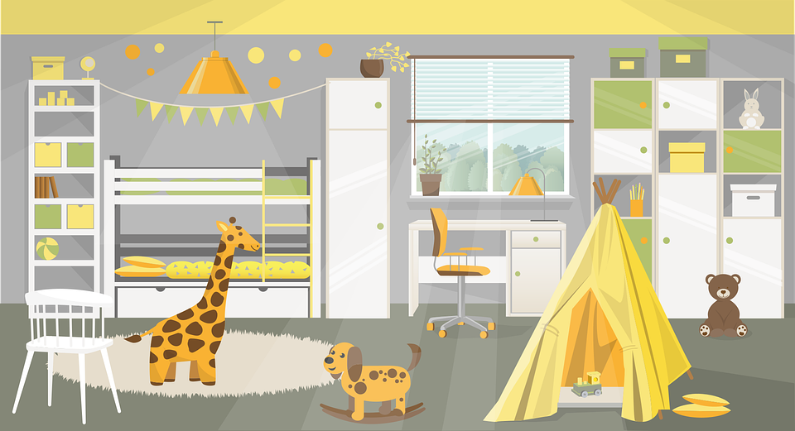
aussprechen
[z]
Which words are nouns? How do you know?
…
Zug
sitzen
Platz
zehn
Zimmer
Notes:
Timing: 1 minute
Aim: to consolidate the SSC [z].
Procedure:
Re-present the SSC and the source word ‘Zug’ (with gesture, if using).
Click to bring on the picture and get pupils to repeat the word ‘Zug’ (with gesture, if using).
Present the cluster words in the same way, bringing on the picture and getting pupils to pronounce the words.
Click to bring up call-out explaining the pronounciation of ‘z’.
Click to bring up the prompt to identify the nouns (the ones with capital letters). This is still very new knowledge for pupils, so it’s good to revisit this as often as we can. Plus, it gives an additional opportunity to pronounce the words.
Click to highlight the 3 x nouns.
Vocabulary:
sitzen [231] Platz [326] Zimmer [665] zehn [333]
Jones, R.L & Tschirner, E. (2019). A frequency dictionary of German: Core vocabulary for learners. London: Routledge.

Slide 4
aussprechen
[z]
Say the pupil names out loud.
Aliz | Zander | Franziska
Luzia | Moritz | Franz
Lorenz | Zelda | Zara
30
S
0
START
Notes:
Timing: 2 minutes
Aim: to consolidate the SSC [z] by reading out pupil names.
Procedure:
1. Pupils work in pairs reading out the pupil names.
2. Change roles.
3. Click for the timer to appear and repeat the task with a little time pressure.

Slide 5
Vokabeln
Freundschaft*
die Freundschaft - friendship
Learning languages is about making friends.
You show kindness when you learn even a few words in another language.
Let’s remember some of the friendship sentences we have learnt already!
Hallo!
Guten Tag!
_ _ _ _ _!
_ _ _ _ _ _ _’_?
_ _ _ _ _ _ _ _!
Wie geht’s?
Can you say other kind things?
Das ist gut!
Du bist toll!
That’s good!
Das ist toll!
You are great!
Du bist super!
Danke!
That’s great!
You are super!
Thank you!
Notes:
Timing: 3 minutes
Aim: to introduce the idea that learning other languages opens the door to new friendships, and that a few kind words go a long way; to revisit
some previously-taught language from this term that fits our category of ‘friendship sentences’. This is an idea we will return to now and then
during the course.
Procedure:
Click to present the information on the slide.
Elicit the German from pupils for the English greetings and friendly statements.
Allow pupils a few moments to turn to those around them and greet them and say something kind about their work or about them themselves.
Remind pupils that we all need to hear kind words every day, in whatever language!
5

Slide 6
Vokabeln
Wörter
wie?
how?
Wie
____ geht’s?
[How’s it going?]
Notes:
Timing: 2 minutes (two slides)
Aim: to recap ‘Wie geht’s’ and how to reply.
Procedure:
Click to bring up animations and elicit English and then German as appropriate to the sequence.
6

Slide 7
Vokabeln
Wörter
gut
Ja, es geht.
nicht so gut
Notes:
Procedure:
1. Click to bring up animations and elicit the German for each prompt.
2. Ensure meanings are clear.
3. Give pupils 30 seconds to turn to others around them and ask ‘how’s it going’ and reply.
7

Slide 8
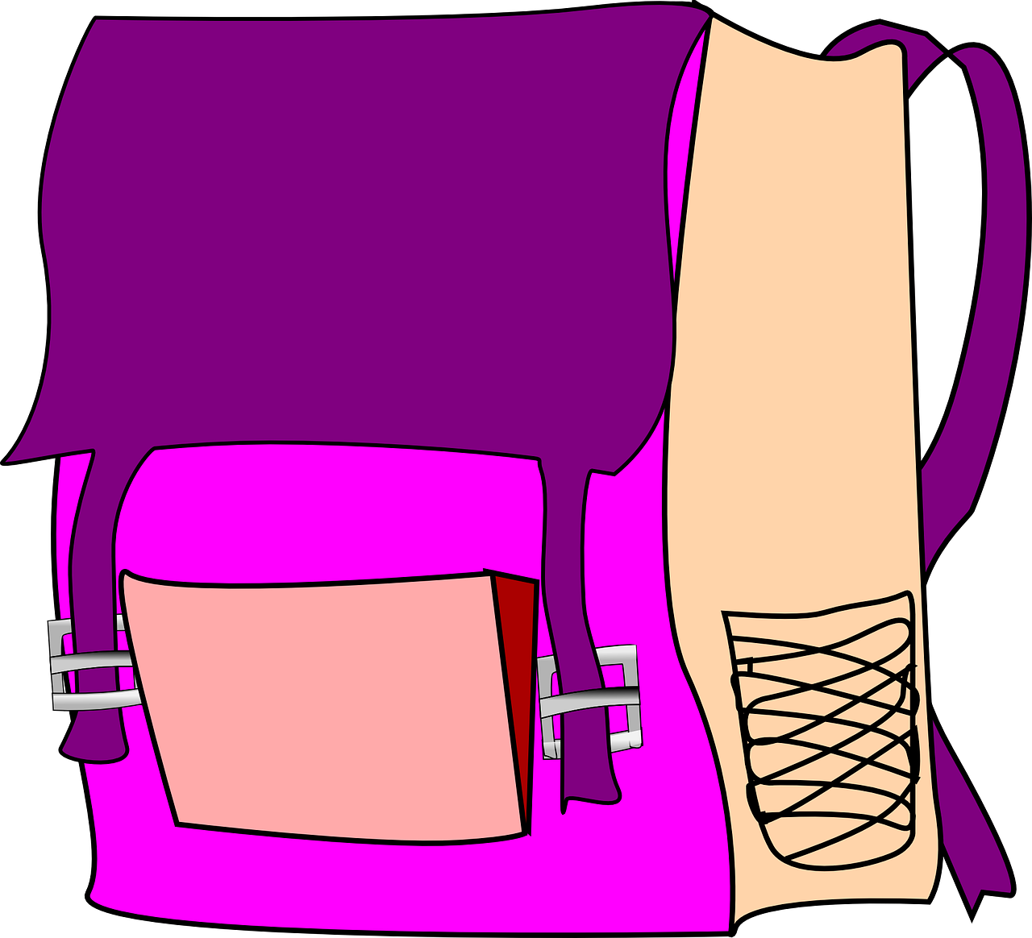
Vokabeln
Wörter
das Bild
der Freund
die Freundin
das Foto
der Fußball
die Tasche
Notes:
Timing: 5 minutes (three slides)
Aim: to present and practise new vocabulary for this week
Procedure:
Click for German word and picture to appear.
Pupils repeat the word.
Teacher elicits English meaning ‘Was ist das auf Englisch?’
8

Slide 9
Vokabeln
Wörter
picture
der Freund
die Freundin
das Bild
friend (m)
friend (f)
der Fußball
die Freundin
das Foto
das Bild
der Freund
die Tasche
football
bag
photo
die Tasche
das Foto
der Fußball
Notes:
[2/3]
Procedure:
Teachers elicits suggestions from pupils (the words are triggered to enable pupils to suggest ones in any order).
If pupils say, for example, ‘Football ist der Fußball’ the teacher clicks on the German word, which disappears and reappears over the English definition.
Pupils repeat the word.
Continue until all the words have been practised.
Move to the next slide.
9

Slide 10
Vokabeln
Wörter
picture
friend (m)
friend (f)
d_ _ B_ _ _
d_ _ F_ _ _ _ _ _ _
das Bild
d_ _ F_ _ _ _ _
die Freundin
der Freund
photo
football
bag
d_ _ F_ _ _
der Fußball
d_ _ F_ _ _ _ _ _
die Tasche
das Foto
d_ _ T_ _ _ _ _
Notes:
[3/3]
Procedure:
Pupils practise oral production of the six new words.
Again, pupils can volunteer their answers in any order (or the teacher can use English meaning to elicit the German words).
To reveal the full words, click on the blue gapped versions.
Click on the pictures to hear the audio, as required.
10

Slide 11
mein | dein (possessive adjectives)
To say ‘my’ use mein or meine:
masculine
feminine
neuter
mein Fußball
meine Tasche
mein Foto
e
my football
my bag
my photo
The word ‘mein’ must agree with the gender of the noun that follows. The feminine form is ‘meine’.
To say ‘your’ use dein or deine:
dein Fußball
deine Tasche
dein Foto
e
your football
your bag
your photo
Notes:
Timing: 2 minutes
Aim: to introduce the possessive adjectives ‘mein’ and ‘dein’.
Procedure:
Click through the animations to present the new information.
Elicit English translation for the German examples provided.
11

Slide 12
hören
Aisha
Aisha is new to Johanna’s class. She is from Syria.
Johanna is pleased to be her welcome buddy.
She helps her with her things.
Hör zu. Was ist das?
?
A | B
Heft | Flasche
Tasche | Bleistift
Freund | Freundin
Bleistift | Mini-tafel
Flasche | Foto
Ding | Tasche
Bild | Form
Ex
1
What does Johanna give to Aisha?
2
What else does Johanna mention? Schreib eine Liste auf Englisch.
3
4
an exercise book, pencil, friend (f), mini-board, bottle, bag
5
6
jetzt - now
Notes:
Timing: 8 minutes
Aim: to practise aural comprehension of ‘dein’ and ‘deine’ and relate them to the gender of previously taught nouns and nouns taught this lesson.
Procedure:
Explain the scenario.
Explain the pupils need to listen out for dein or deine and decide which thing Johanna is talking about.
Complete the listening task. Teachers click to correct.
Click to bring up the next picture/question prompts and work through them.
Transcript:
Das ist dein [Heft].
Und das ist dein [Bleistift].
Ich bin deine [Freundin].
Und das ist deine [Mini-tafel].
Ist das deine [Flasche]?
Das ist deine [Tasche], nicht wahr?
Das ist mein [Bild] aber es ist jetzt dein [Bild].
12

Slide 13
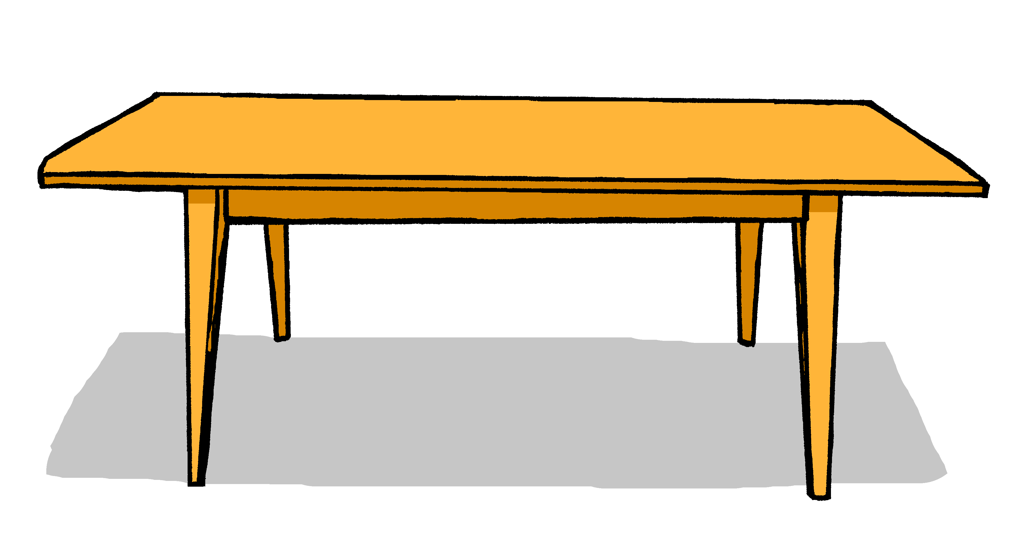
lesen
Das ist mein… Das ist meine…
Aisha is new to German, too. Johanna makes her some labels for her things but they get smudged. Help Aisha match the label to the correct item.
Meine Tasche
Mein Foto
A
B
A
B
1
4
Meine Flasche
Meine Form
2
5
Mein Bild
Mein Fußball
3
6
Notes:
Timing: 6 minutes
Aim: to practise written comprehension of the forms ‘mein’ and ‘meine’.
Procedure:
Read out the instructions.
Pupils write or say A or B for each item, based on the mein or meine.
Click to bring up answer tick for item.
Click again to reveal written form.
Continue for items 2-6.
13

Slide 14
Tschüss!
rot
Notes:
14

