Slide 1
Describing me and others
meine Schule
rot
Follow ups 1-5
Term 1 Week 11
Notes:
Artwork by Steve Clarke. Pronoun pictures from NCELP (www.ncelp.org). All additional pictures selected from Pixabay and are available under a Creative Commons license, no attribution required.
Phonics:
soft [ch] ich [10] leicht [311] sprechen [161]
hard [ch] Buch [300] Woche [219] machen [58]
Vocabulary: Buch [300] Haustier [>5009] Schule [359] Tier [614] nicht wahr? [n/a]
Jones, R.L & Tschirner, E. (2019). A frequency dictionary of German: Core vocabulary for learners. London: Routledge.
The frequency rankings for words that occur in this PowerPoint which have been previously introduced in these resources are given in the SOW and in the resources that first introduced and formally re-visited those words.
For any other words that occur incidentally in this PowerPoint, frequency rankings will be provided in the notes field wherever possible.
Note that the first three lessons of the year teach language that can be continuously recycled as lesson routine every lesson in Y3/4.
The idea would be that the class teacher (whether or not s/he teaches the class German can re-use the language as part of the daily routine with the class.

Slide 2
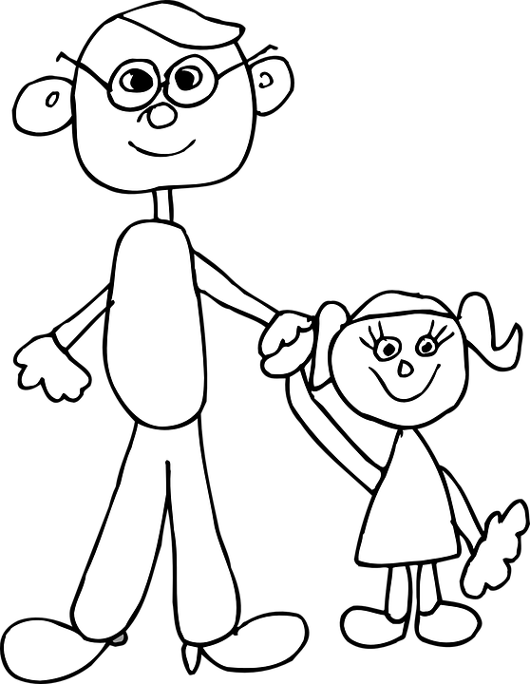
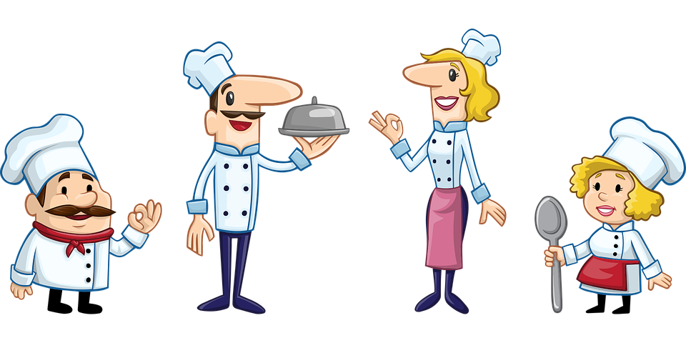
Follow up 1: Sag die Wörter.
Partnerarbeit – pair work
Partnerarbeit*
auch | lachen | acht | suchen | einfach
Tochter | Mittwoch | kochen | weiblich | Buch
nicht | Milch | Kuchen | richtig | sprechen
Eiche | rechts | sechzehn | ich | hoch
aussprechen
60
S
0
START
Notes:
Timing: 5 minutes Aim: To practise the SSC [ch] in a pairwork read aloud and listening task.
Procedure: 1. Pupils work in pairs. Pupil A picks five words from the board, jotting them down, without showing Pupil B.
2. Pupil B has to name the correct five words, by saying each one until s/he has found all five.
3. When all five words have been said students swap roles and repeat. 4. Teachers can click on each picture to check pronunciation with the class, as required.
Frequency of unknown words/cognates:
acht [645] auch [6] Buch [300] Eiche [>5009] einfach [131] hoch [118] kochen [1481] Kuchen [4381] lachen [444] Milch [2276] Mittwoch [1187] nicht [11] rechts [829] richtig [177] sechzehn [4924] sprechen [161] suchen [293] Tochter [694] weiblich [1984] Jones, R.L & Tschirner, E. (2019). A frequency dictionary of German: Core vocabulary for learners. London: Routledge.

Slide 3
Compound words
In German, you can put several words together to make one long word! This is called a compound word.
Note that he final ‘e’ in Schule is dropped. Look, no ‘e’ here!
feminine
masculine
masculine!
meine Schule
mein Freund
mein Schulfreund
my friend
my school friend
my school
The gender of a compound noun is always the gender of the last word.
Notes:
Timing: 2 minutes
Aim: to introduce the concept of compounds.
Procedure:
Click through the animations to present the new information.
Using the question mark animations, elicit English translation for the German examples provided.
3

Slide 4
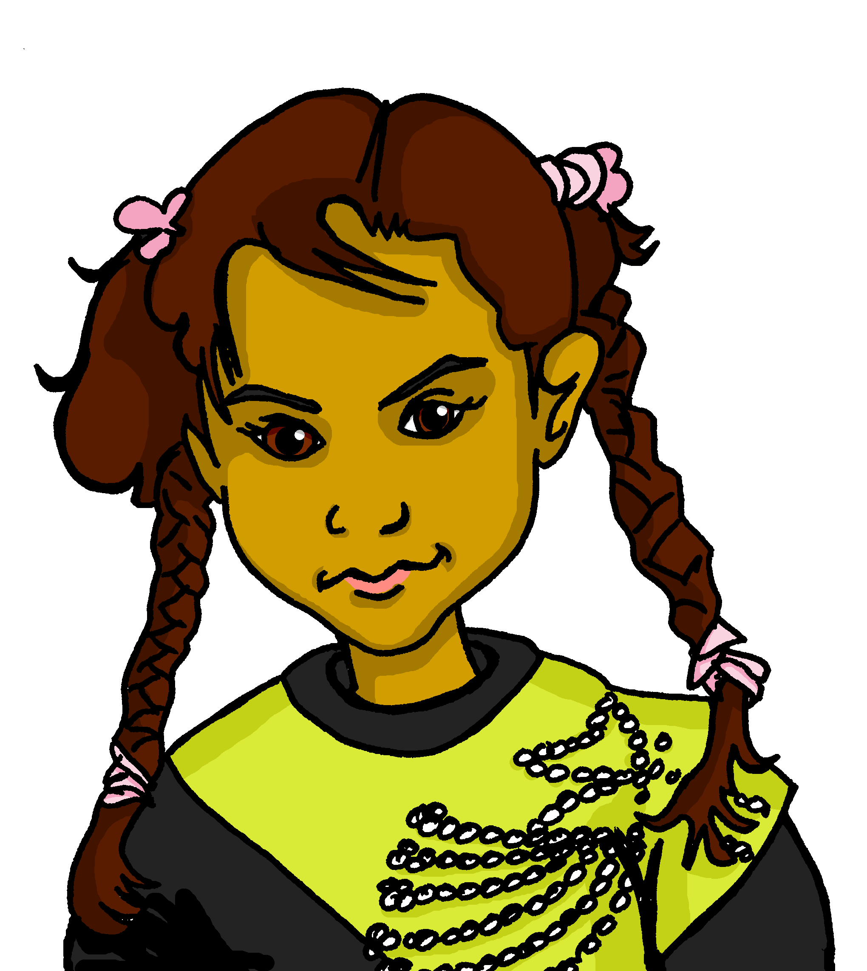
Follow up 2
Johanna ist Aishas Freundin
Johanna is helping Aisha to learn more German. Was ist das auf Deutsch?
lesen
Schulfreund
school friend (m)
Notes:
slide 1 of 7
Timing: 3 minutes
Aim: to practise written vocabulary recognition of compound words
Procedure:
Click to bring up German compound word.
Elicit meaning in English.
Click to bring up English meaning. There are 8 compound words in total.
For the last one, Fußball, football, explain that this one is a compound in English too!

Slide 5
Follow up 2
Johanna ist Aishas Freundin
Johanna is helping Aisha to learn more German. Was ist das auf Deutsch?
lesen
Schulfreundin
school friend (f)
Notes:
2/7

Slide 6
Follow up 2
Johanna ist Aishas Freundin
Johanna is helping Aisha to learn more German. Was ist das auf Deutsch?
lesen
Schulfoto
school photo
Notes:
3/7

Slide 7
Follow up 2
Johanna ist Aishas Freundin
Johanna is helping Aisha to learn more German. Was ist das auf Deutsch?
lesen
Schulbuch
school book
Notes:
4/7

Slide 8
Follow up 2
Johanna ist Aishas Freundin
Johanna is helping Aisha to learn more German. Was ist das auf Deutsch?
lesen
Schultasche
school bag
Notes:
5/7

Slide 9
Follow up 2
Johanna ist Aishas Freundin
Johanna is helping Aisha to learn more German. Was ist das auf Deutsch?
lesen
Haustier
‘house animal- = pet!
Notes:
6/7

Slide 10
Follow up 2
Johanna ist Aishas Freundin
Johanna is helping Aisha to learn more German. Was ist das auf Deutsch?
lesen
Fußball
‘foot ball’ = football!
Notes:
7/7

Slide 11
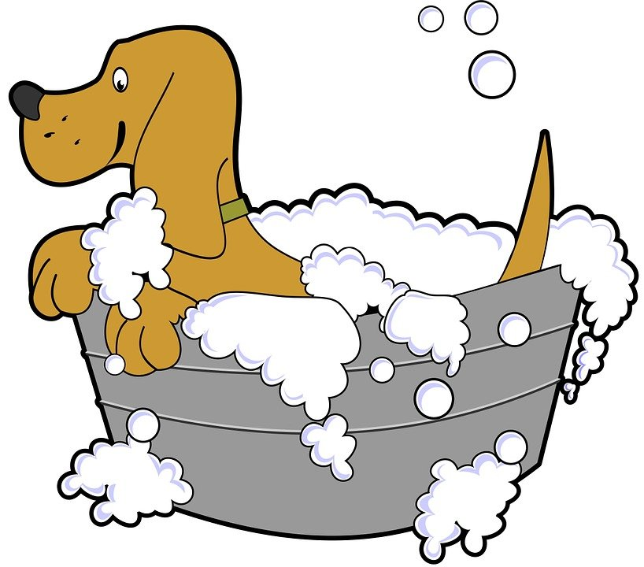
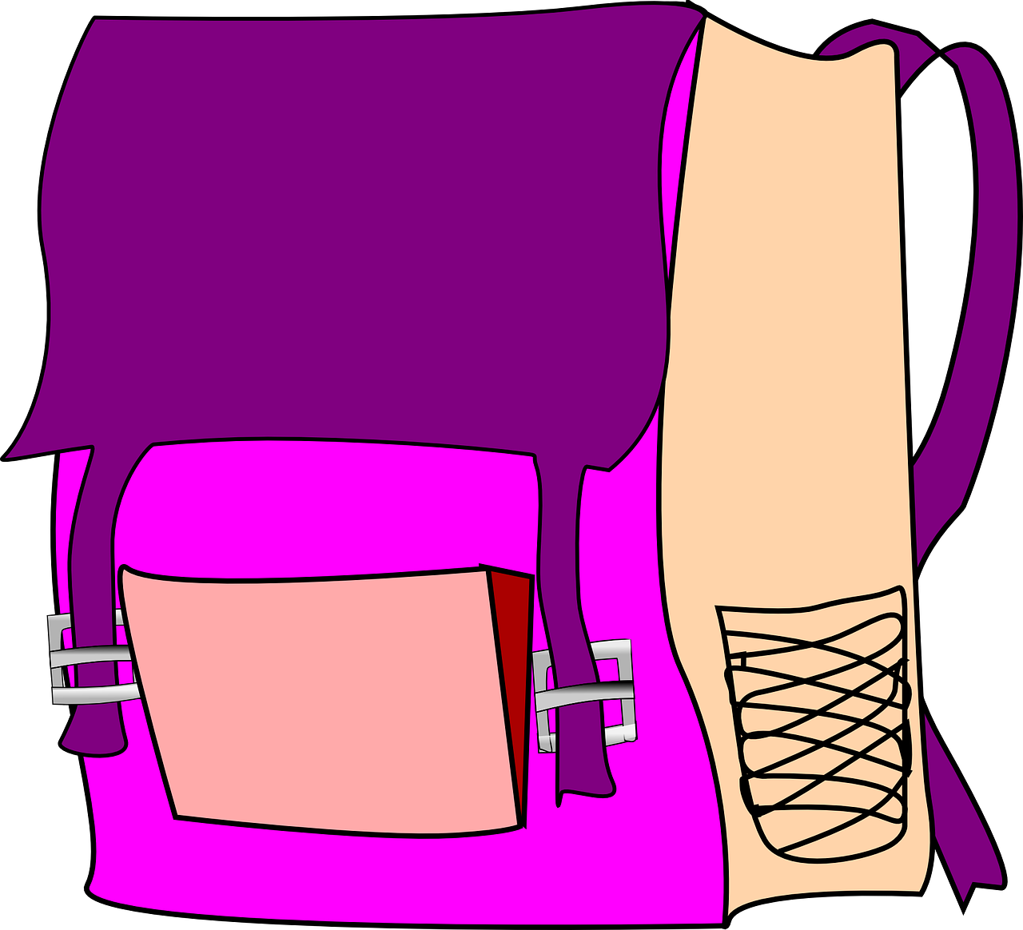
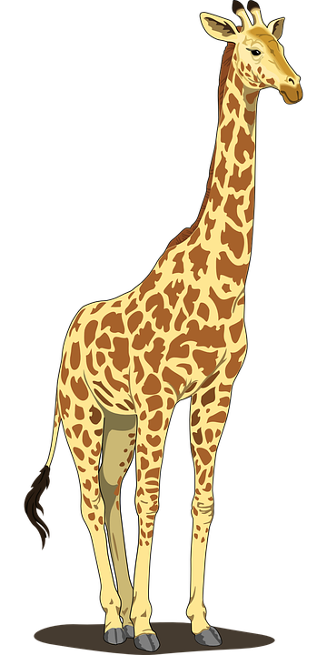
Follow up 3
Johanna und Aisha
Aisha wants to practise. Help her understand these short messages from Johanna.
hören
Schreib 1-6 und das Wort auf Englisch.
1 | my | your | ?
2 | my | your | ?
3 | my | your | ?
4 | my | your | ?
5 | my | your | ?
6 | my | your | ?
1
pet
2
book
‘nicht wahr’ works for any ‘tag’ question so here we would say: ‘isn’t he?’
3
school
4
animal
5
bag
6
friend (m)
Notes:
Timing: 5 minutes
Aim: to practise aural comprehension of this week’s vocabulary and grammar (mein/dein) in short sentences.
Procedure:
Click on the audio button to play recording.
Elicit answers – is it my or your, and what is the word Johanna is talking about? (answer in English).
Click for answer to mein/dein.
Click for word to appear in English.
Continue for items 2-5.
Transcript:
Das ist dein Haustier.
Das mein Buch.
Das ist meine Schule.
Das ist nicht dein Tier.
Ist das deine Tasche?
Er ist mein Freund, nicht wahr?

Slide 12
Follow up 4a
Johanna ist Aishas Freundin
Johanna and Aisha are asking each other about their things in German. Is there a ‘nicht wahr’ at the end of their questions, or not?
lesen
1.
Das ist dein Heft ,nicht wahr ?
2.
Ist das deine Schultasche ?
3.
Das ist dein Haustier ,nicht wahr ?
4.
Das ist ein Punkt ,nicht wahr ?
5.
Ist das deine Schule ?
6.
Ist das dein Buch ?
Notes:
Timing: 5 minutes
Aim: to identify two types of question types by syntax: Ist das…+ nicht wahr, and Das ist … .
Procedure:
Explain that pupils have to read the questions and decide, based on the syntax, whether there is a nicht wahr at the end or not.
Elicit the answers, the click to reveal.
Pupils read the dialogue in pairs to practise the pronounciation.

Slide 13
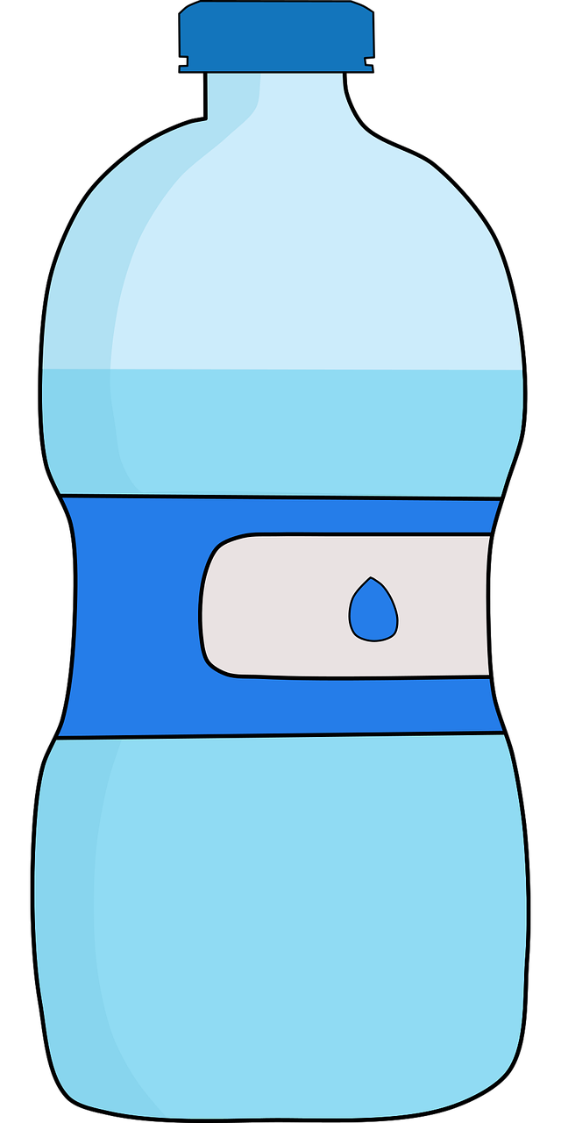
Follow up 4b. Partnerarbeit.
Are these your things, or not? Speak with a partner.
sprechen
 | ? | is it? | isn’t it?
1 | ,nicht wahr? | ja | nein
2 | ? | nein | ja
3 | ,nicht wahr? | nein | ja
4 | ,nicht wahr? | ja | nein
5 | ? | nein | ja
6 | ? | ja | nein
Das ist deine Flasche, nicht wahr?
Nein, das ist nicht meine Flasche.
Ist das dein Haustier?
Nein, das ist nicht mein Haustier.
Das ist deine Schule, nicht wahr?
Ja, das ist meine Schule.
Das ist dein Buch, nicht wahr?
Nein, das ist nicht mein Buch.
Ist das dein Tier?
Nein, das ist nicht mein Tier.
Ist das deine Tasche?
Ja, das ist meine Tasche.
Notes:
Timing: 5 minutes
Aim: Speaking task to practise answering differently depending on whether the question is an inversion or a nicht wahr question.
Procedure:
Explain the task. Pupils have to ask their partner either ‘this is your …, isn’t it?’ (nicht wahr), or ‘is this your…?’. The answer is either yes or no, depending on the type of question (answer in whole sentences. Do the first item as an example.
Elicit the question, click to bring up the written version.
Elicit the answer, click to bring up the written version.
Pupils continue in pairs for items 2-6.
Click to bring up written versions for items 2-6 in turn.

Slide 14
Follow up 5:

Schreib auf Englisch.
Can you get at least 15 points?
Wörter
 | England | und | toll
 | wo? | es | Germany
 | gut | auch | aber
 | nicht | wie geht’s? | wie?
 | die Schule | nicht wahr? | der Punkt
 | das Haustier | das Buch | das Tier
Vokabeln
England
and
great
x3
where?
it
Deutschland
good
also, too
but
x2
not
how’s it going?
how?
(the) school
isn’t/isn’t that right?
(the) dot, point, full stop
x1
(the) pet
(the) book
(the) animal
Notes:
Timing: 5 minutes
Aim: to practise written comprehension of vocabulary from this and revisited weeks.
Procedure: 1. Give pupils a blank grid. They fill in the English meanings of any of the words they know, trying to reach 15 points in total. 2. Remind pupils that adjectives can refer to male or female persons and they should note this in their translations. E.g. pleased (f), short (m).
Note: The most recently learnt and practised words are pink, words from the previous week are green and those from week 1 are blue, thus more points are awarded for them, to recognise that memories fade and more effort (heavy lifting!) is needed to retrieve them.

Slide 15
Follow up 5:

Schreib auf Deutsch.
Can you get at least 15 points?
Wörter
 | Germany | great | and
 | it | where? | England
 | not | how? | how’s it going?
 | good | but | also, too
 | (the) animal | isn’t it/isn’t that right? | (the) dot, point, full stop
 | (the) book | (the) pet | (the) school
Vokabeln
Deutschland
toll
und
x3
es
wo?
England
nicht
wie?
wie geht’s?
x2
gut
aber
auch
das Tier
nicht wahr?
der Punkt
x1
das Buch
das Haustier
die Schule
Notes:
Timing: 5 minutes
Aim: to practise written production of vocabulary from this and revisited weeks.
Procedure: 1. Give pupils a blank grid. They fill in the German meanings of any of the words they know, trying to reach 15 points in total. 2. Remind pupils that adjectives can refer to male or female persons and they should note this in their translations. E.g. pleased (f), short (m).
Note: The most recently learnt and practised words are pink, words from the previous week are green and those from week 1 are blue, thus more points are awarded for them, to recognise that memories fade and more effort (heavy lifting!) is needed to retrieve them.

Slide 16
Tschüss!
rot
Notes:
16

Slide 17
Follow up 5:

Schreib auf Englisch.
Can you get at least 15 points?
Wörter
 | England | und | toll
 | wo? | es | Germany
 | gut | auch | aber
 | nicht | wie geht’s? | wie?
 | die Schule | nicht wahr? | der Punkt
 | das Haustier | das Buch | das Tier
Vokabeln
x3
x2
x1
Notes:
Template for photcopying

Slide 18
Follow up 5:

Schreib auf Deutsch.
Can you get at least 15 points?
Wörter
 | Germany | great | and
 | it | where? | England
 | not | how? | how’s it going?
 | good | but | also, too
 | (the) animal | isn’t it/isn’t that right? | (the) dot, point, full stop
 | (the) book | (the) pet | (the) school
Vokabeln
x3
x2
x1
Notes:
Template for photocopying

