Slide 1
Describing me and others
meine Schule
rot
Nicht + mein, meine, dein, deine
SSC soft and hard [ch]
Term 1 Week 10
Notes:
Artwork by Steve Clarke. Pronoun pictures from NCELP (www.ncelp.org). All additional pictures selected from Pixabay and are available under a Creative Commons license, no
attribution required.
Phonics:
soft [ch] ich [10] leicht [311] sprechen [161]
hard [ch] Buch [300] Woche [219] machen [58]
Vocabulary: Buch [300] Haustier [>5009] Schule [359] Tier [614] nicht wahr? [n/a]
Jones, R.L & Tschirner, E. (2019). A frequency dictionary of German: Core vocabulary for learners. London: Routledge.
The frequency rankings for words that occur in this PowerPoint which have been previously introduced in these resources are given in the SOW and in the resources that first
introduced and formally re-visited those words.
For any other words that occur incidentally in this PowerPoint, frequency rankings will be provided in the notes field wherever possible.
Note that the first three lessons of the year teach language that can be continuously recycled as lesson routine every lesson in Y3/4.
The idea would be that the class teacher (whether or not s/he teaches the class German can re-use the language as part of the daily routine with the class.
1

Slide 2
aussprechen
soft [ch]
…
ich
Notes:
Timing: 1 minute
Aim: to introduce the SSC soft [ch].
Procedure:
Introduce the SSC and present the source word ‘ich’ (with gesture, if using).
Click to bring on the picture and get pupils to repeat the word ‘ich’ (with gesture, if using).
Note:
a gesture for ‘ich’ might be to point to yourself.
2

Slide 3
aussprechen
soft [ch]
…
ich
leicht
sprechen
Notes:
Timing: 1 minute
Aim: to consolidate the SSC soft [ch].
Procedure:
Re-present the SSC and the source word ‘ich’ (with gesture, if using).
Click to bring on the picture and get pupils to repeat the word ‘ich’ (with gesture, if using).
Present the cluster words in the same way, bringing on the picture and getting pupils to pronounce the words.
Vocabulary: leicht [311] sprechen [161]
Jones, R.L & Tschirner, E. (2019). A frequency dictionary of German: Core vocabulary for learners. London: Routledge.

Slide 4
aussprechen
hard [ch]
…
Buch
Notes:
Timing: 1 minute
Aim: to introduce the SSC soft [ch].
Procedure:
Introduce the SSC and present the source word ‘Buch’ (with gesture, if using).
Click to bring on the picture and get pupils to repeat the word ‘Buch’ (with gesture, if using).
Note:
a gesture for ‘Buch’ might be to fan out your hands as if opening up a book.
Vocabulary: Buch [300]
Jones, R.L & Tschirner, E. (2019). A frequency dictionary of German: Core vocabulary for learners. London: Routledge.
4

Slide 5
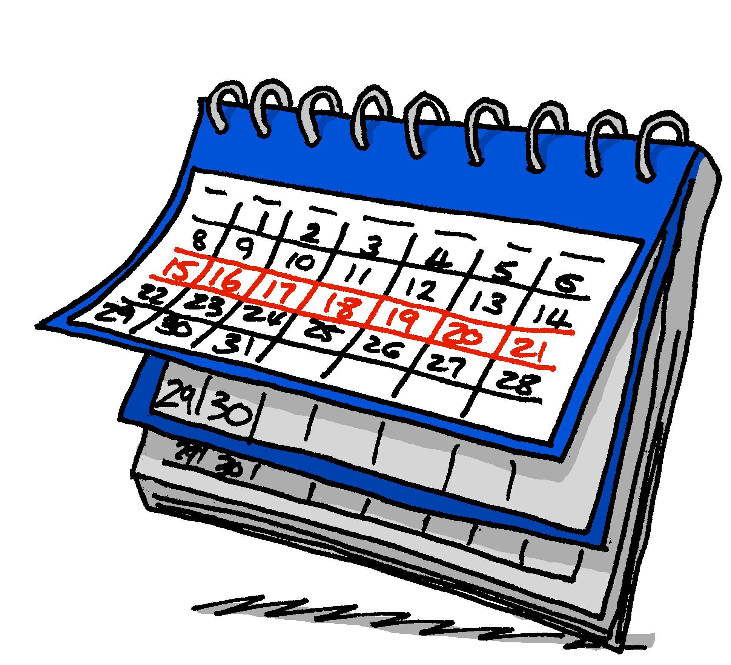
aussprechen
hard [ch]
…
Buch
Woche
machen
Notes:
Timing: 1 minute
Aim: to consolidate the SSC soft [ch].
Procedure:
Re-present the SSC and the source word ‘ich’ (with gesture, if using).
Click to bring on the picture and get pupils to repeat the word ‘ich’ (with gesture, if using).
Present the cluster words in the same way, bringing on the picture and getting pupils to pronounce the words.
Vocabulary: Woche [219] machen [58]
Jones, R.L & Tschirner, E. (2019). A frequency dictionary of German: Core vocabulary for learners. London: Routledge.

Slide 6
aussprechen
Hör zu.
Soft [ch]: ich, leicht, sprechen.
Hard [ch]: Buch, Woche, machen.
Is it soft or hard [ch]?
 | soft [ch] | hard [ch]
1 |  |  | lachen
2 |  |  | suchen
3 |  |  | Milch
4 |  |  | Eiche
5 |  |  | einfach
6 |  |  | sechzehn
Every country has a national tree. German has the ‘Eiche’ (oak) and… so does England!
Notes:
Timing: 2 minutes
Aim: to distinguish between the SSCs soft [ch] and hard [ch] in the listening modality.
Procedure:
1. Click to bring up instructions.
2. Click for reminder callout bubble about the difference between hard and soft [ch].
3. Click sound button to play recording for item 1. Pupils decide whether it is soft or hard [ch].
4. Click for answer tick, then for written version, then for picture.
5. Continue for items 2-6.
Transcript:
lachen
suchen
Milch
Eiche
einfach
sechzehn

Slide 7
Vokabeln
Was ist das auf Deutsch?
Wörter
das Bild
das Foto
der Freund
die Freundin
der Fußball
die Tasche
Notes:
1/6
Timing: 5 minutes (6 slides)
Aim: revisit previously taught vocabulary.
Procedure:
Pupils read the words and decide which word relates to the picture shown.
Teacher asks ‘Was ist das auf Deutsch?’
Click to bring up answer.
If needed, the teacher can prompt for the English meaning ‘Was ist das auf Englisch?’ but it is likely that the meaning is transparently given by the pictures on this occasion.
7

Slide 8
Vokabeln
Wörter
das Bild
das Foto
der Freund
die Freundin
der Fußball
die Tasche
Notes:
2/6
8

Slide 9
Vokabeln
Wörter
das Bild
das Foto
der Freund
die Freundin
der Fußball
die Tasche
Notes:
3/6
9

Slide 10
Vokabeln
Wörter
das Bild
das Foto
der Freund
die Freundin
der Fußball
die Tasche
Notes:
4/6
10

Slide 11
Vokabeln
Wörter
das Bild
das Foto
der Freund
die Freundin
der Fußball
die Tasche
Notes:
5/6
11

Slide 12
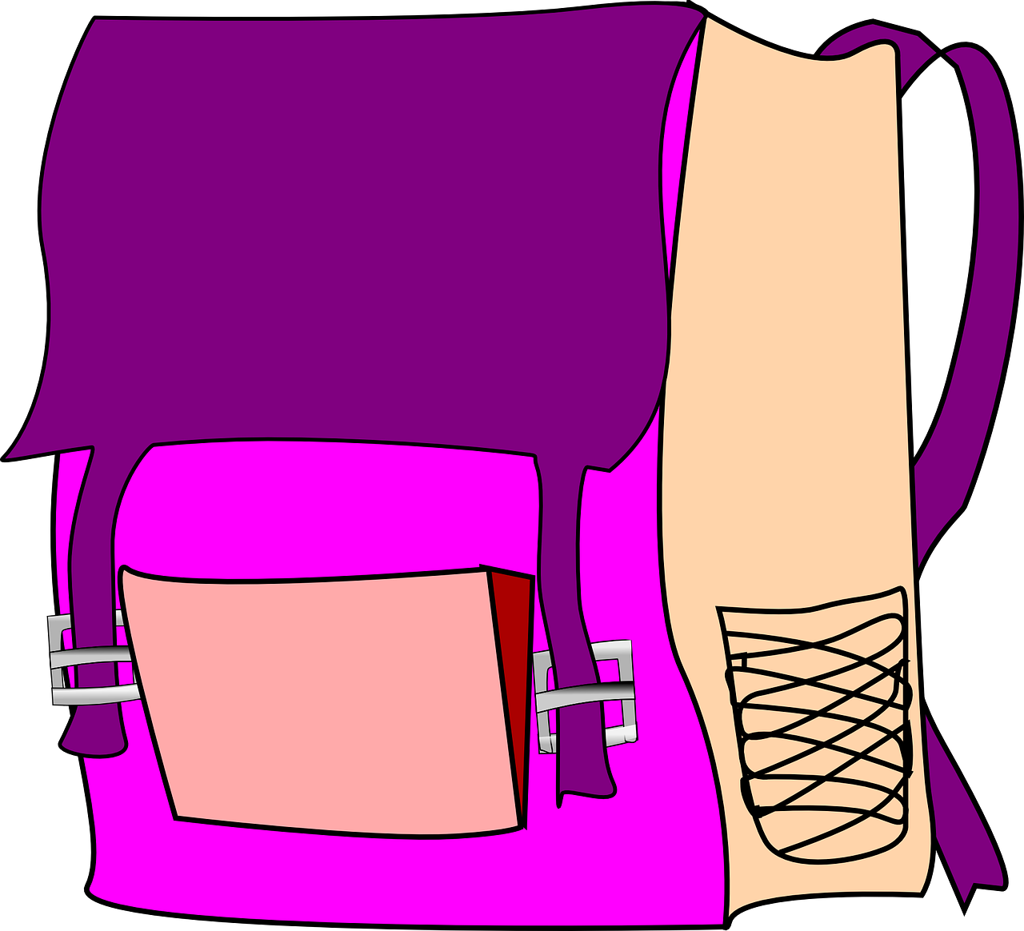
Vokabeln
Wörter
das Bild
das Foto
der Freund
die Freundin
der Fußball
die Tasche
Notes:
6/6
12

Slide 13
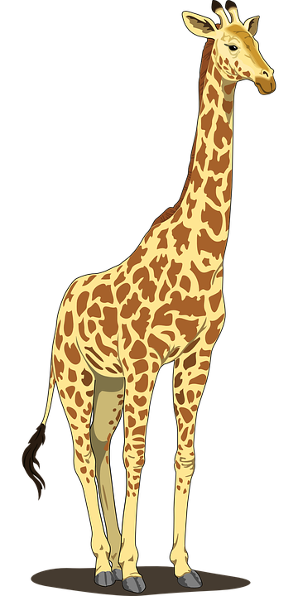
Vokabeln
Wörter
das Buch
das Tier
das Haustier
nicht wahr?
die Schule
Nicht wahr literally means ‘not true?’ and is used as a tag question.
Der Tisch ist groß, nicht wahr?
The table is big, isn’t it? (isn’t that true)?
Notes:
Timing: 5 minutes
Aim: to introduce this week’s new vocabulary.
Procedure:
Click to trigger the picture and word together. Say the German word (or play the recording) and get students to repeat.
Click again to repeat an animation of the word, to elicit students production of the word without the teacher.
Repeat with the other four items.
After the last item, click to bring up callout to explain the use of ‘nicht wahr’.
13

Slide 14
Vokabeln
Wörter
Das ist eine Schule, nicht wahr?
Notes:
1/5
Timing: 5 minutes (6 slides)
Aim: to practise this week’s new vocabulary and ‘nicht wahr’.
Procedure:
Click to bring up Frau Bahlsen’s speech bubble asking ‘This is a …, isn’t it?’
Click to bring up the picture.
Pupils say either ja or nein.
Click to bring up the answer.
Repeat for the next four slides.
14

Slide 15
Vokabeln
Wörter
Das ist ein Tier, nicht wahr?
Notes:
2/5
15

Slide 16
Vokabeln
Wörter
Das ist ein Buch, nicht wahr?
Notes:
3/5
16

Slide 17
Vokabeln
Wörter
Das ist ein Freund, nicht wahr?
Notes:
5/5
17

Slide 18
Nicht (not)
You already know how to use nicht (not):
Use nicht before an adjective or adverb to mean not:
Ich bin hier.
Ich bin nicht hier.
I am here.
I am not here.
Use nicht before ‘der, die, das’ and a noun to mean not:
Das ist das Buch.
Das ist nicht das Buch.
That is the book.
That is not the book.
Use nicht before proper nouns to mean not:
Das ist Deutschland.
Das ist nicht Deutschland.
That is Germany.
That is not Germany.
Notes:
Timing: 2 minutes
Aim: to revise the already known uses of nicht.
Procedure:
Click through the animations to recap uses of nicht.
Elicit English translation for the German examples provided.
18

Slide 19
Nicht (not)
We also use nicht to mean not before ‘my’ and ‘your’:
Das ist mein Haustier.
Das ist nicht mein Haustier.
That is my pet.
That is not my pet.
Das ist deine Schule.
Das ist nicht deine Schule.
That is your school.
That is not your school.
Notes:
Timing: 2 minutes
Aim: to introduce the use of ‘nicht’ with ‘mein’ and ‘dein’.
Procedure:
Click through the animations to present the new information.
Elicit English translation for the German examples provided.
19

Slide 20
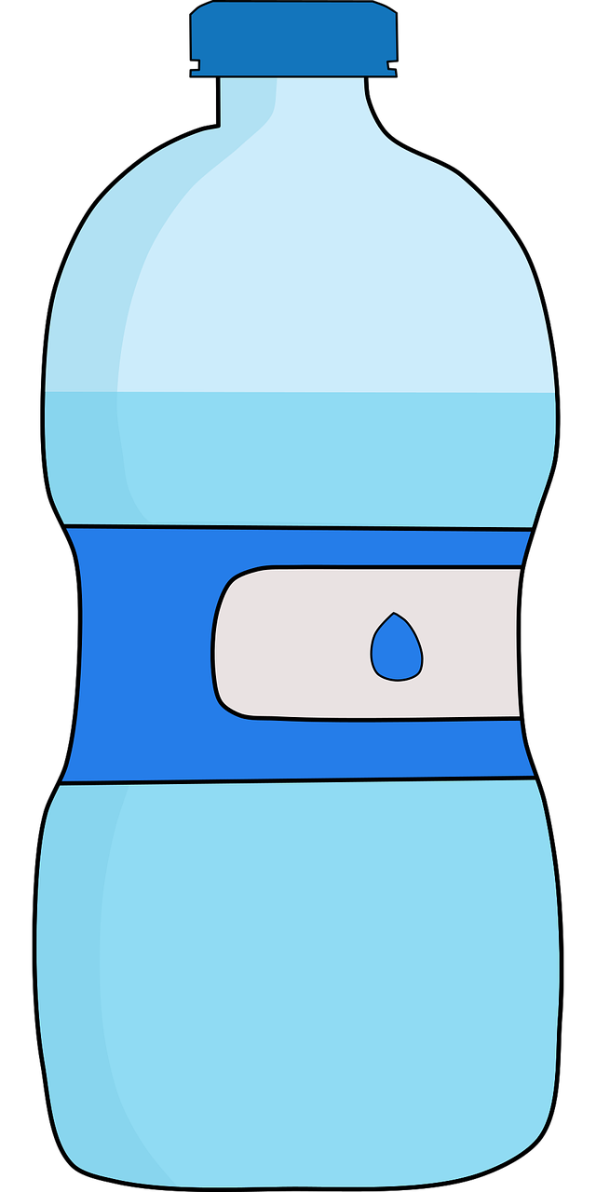
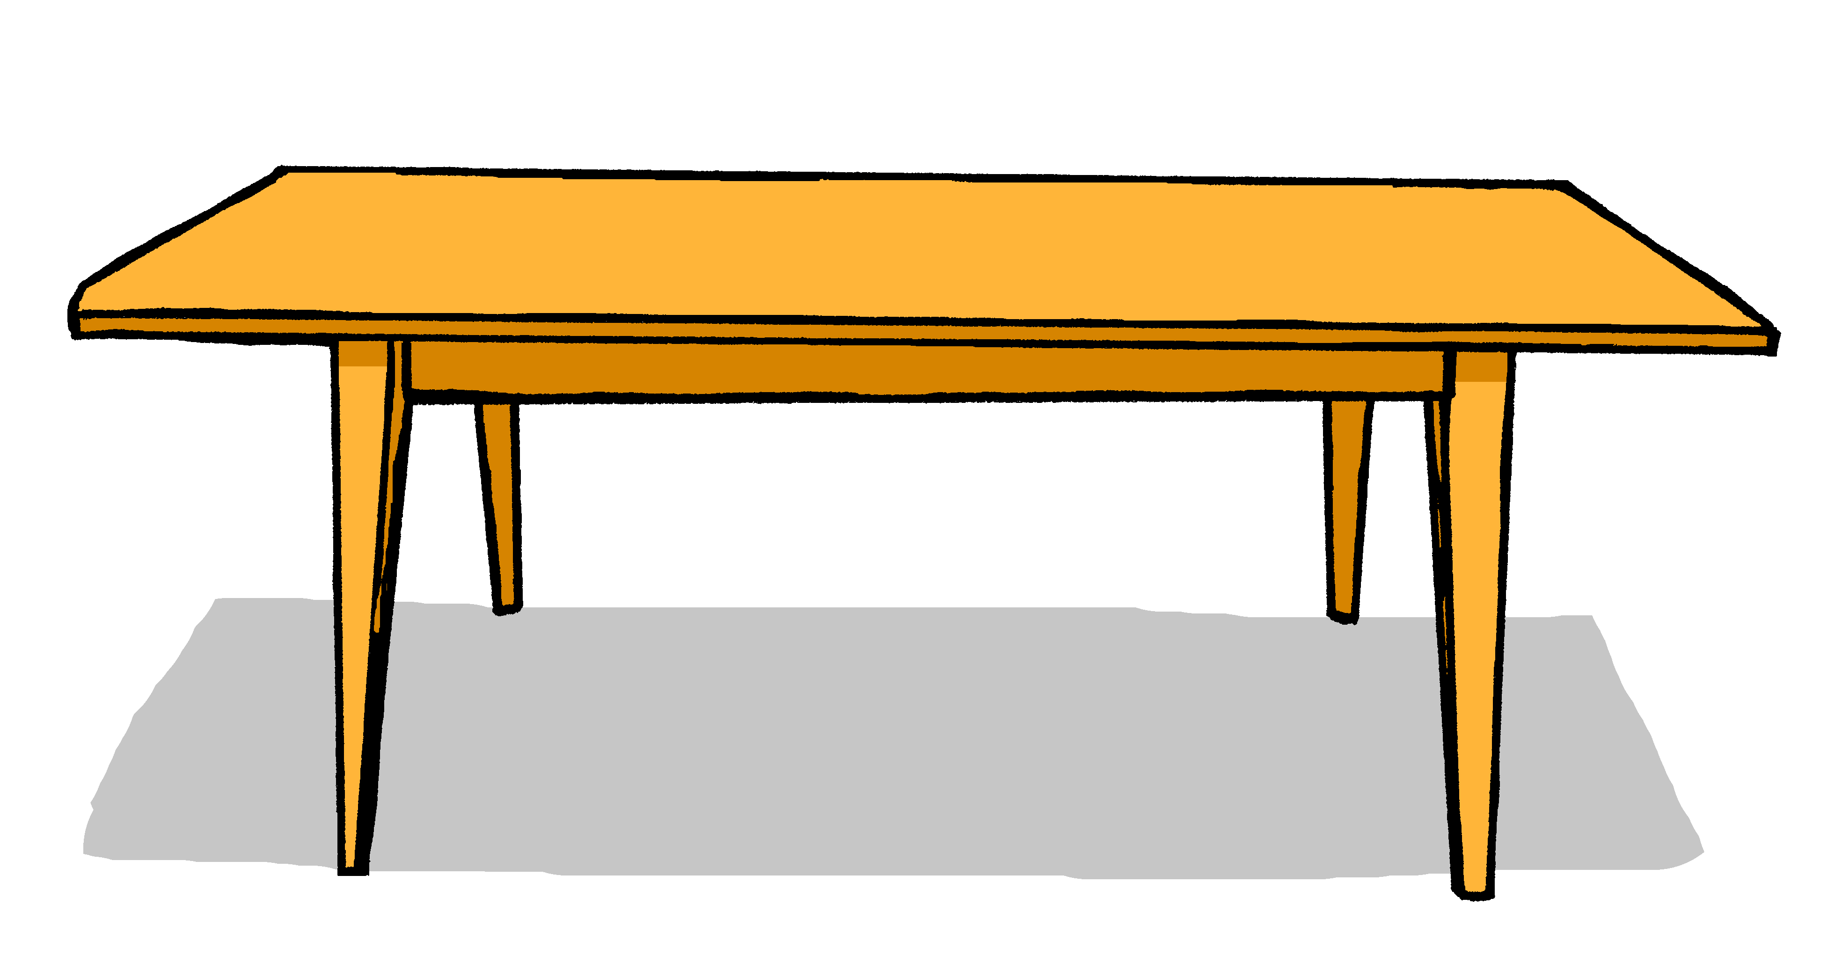
lesen
Das ist mein… Das ist nicht mein… Das ist meine… Das ist nicht meine
Johanna makes some labels for Aisha’s things but they get smudged and also she’s not sure which items are Aisha’s. Help Aisha match the label to the correct item, and say whether it’s hers or not.
Das ist nicht meine Flasche.
Das ist mein
Haustier.
A
B
A
B
1
4
Das ist nicht meine Schule.
Das ist nicht meine Tasche.
2
5
Das ist mein
Haustier.
Das ist mein Freund.
3
6
Notes:
Timing: 6 minutes
Aim: to practise distinguishing between written forms of ‘mein’ and ‘meine’, and to distinguish between positive and negative sentences.
Procedure:
Read out the instructions. Pupils read the labels and write or say A or B for each item, based on mein (m/nt) or meine (f).
Click to bring up answer tick for item.
Click again to reveal written form.
Pupils now decide whether the sentence is positive or negative – does it contain ‘nicht’? Elicit the answers
Click for answer tick.
Continue for the rest of the items.
20

Slide 21
hören
Aisha
Johanna is pleased to be Aisha’s welcome buddy.
She helps her with her things.
Hör zu. Was ist das?
A | B
Schule | Buch
Punkt | Tafel
Haustier | Freundin
Tasche | Tier
Flasche | Foto
Form | Ort
Beispiel | Farbe
Ja oder nein?
Ex
1
2
3
4
5
6
Notes:
Timing: 8 minutes
Aim: to practise aural comprehension of ‘dein’ and ‘deine’ and relate them to the gender of nouns. To listen out for negation with ‘nicht’.
Procedure:
Explain the pupils need to listen out for dein or deine and decide which thing Johanna is talking about, A or B.
Click the example audio button. Elicit answer. Click for green answer border and picture to appear.
Explain that pupils have to now listen out for whether the thing talked about is a yes or a no. Click the picture in the’ Ja oder nein’ column to play the recording.
Elicit the answer, click to bring up correct answer.
Continue for items 1-6.
Transcript:
Das ist deine [Schule].
Das ist nicht deine [Tafel].
Das ist nicht dein [Haustier].
Das ist dein [Tier].
Das ist nicht dein [Foto].
Das ist dein [Ort], nicht wahr? Nein!
Das ist dein [Beispiel], nicht wahr? Ja!
21

Slide 22
Tschüss!
rot
Notes:
22

