Slide 1
What I can do
Ich kann* das!
rot
Follow ups 1-5
Term 1 Week 12
kann – can
Notes:
Artwork by Steve Clarke. All additional pictures selected from Pixabay and are available under a Creative Commons license, no attribution required.
Phonics: revisit SSC long and short [a] [e] [i] [o] [u] (for these also write long or short); [ei] [ie] [w] [z] hard and soft [ch]
Vocabulary: revisit words from lessons 1 - 11
Jones, R.L & Tschirner, E. (2019). A frequency dictionary of German: Core vocabulary for learners. London: Routledge.
The frequency rankings for words that occur in this PowerPoint which have been previously introduced in these resources are given in the SOW and in the resources that first
introduced and formally re-visited those words.
For any other words that occur incidentally in this PowerPoint, frequency rankings will be provided in the notes field wherever possible.

Slide 2
aussprechen
Follow up 1
long
[u]
short
[u]
aussprechen
nur
um
[only]
[around, at]
Notes:
Timing: 5 minutes (eight slides)
Aim: to practise read aloud of SSC learnt so far with unknown words.
Procedure:
Tell pupils that they are going to practise the sounds of German that they have learnt this year.
Click to bring up the first ‘flashcard’.
Elicit the SSC first. (To bring all pupils in together, teachers could use a silent 3-2-1 countdown gesture with their fingers).
Elicit the word, using the same countdown procedure.
Click to bring up the 2nd flashcard and repeat steps 1-4.
Word frequency (1 is the most frequent word in German):
nur [123] um [44]
Jones, R.L & Tschirner, E. (2019). A frequency dictionary of German: Core vocabulary for learners. London: Routledge.
2

Slide 3
aussprechen
Follow up 1
long
[a]
short
[a]
aussprechen
fragen
ganz
[to ask]
[whole, all the]
Notes:
[2/8]
Word frequency (1 is the most frequent word in German):
fragen [153] ganz [69]
3

Slide 4
aussprechen
Follow up 1
long
[o]
short
[o]
aussprechen
wohl
Wort
[well]
[word]
Notes:
3/8
Word frequency (1 is the most frequent word in German):
wohl [261] Wort [194]
4

Slide 5
aussprechen
Follow up 1
[ei]
[ie]
aussprechen
drei
nie
[never]
Notes:
4/8
Word frequency (1 is the most frequent word in German):
drei [106] nie [186]
5

Slide 6
aussprechen
Follow up 1
long
[e]
short [e]
aussprechen
wegen
Geld
[because of]
Notes:
5/8
Word frequency (1 is the most frequent word in German):
wegen [243] Geld [235]
6

Slide 7
aussprechen
Follow up 1
long
[i]
short
[i]
aussprechen
ihnen
Kind
[them]
[child]
Notes:
6/8
Word frequency (1 is the most frequent word in German):
ihnen [1025] Kind [133]
7

Slide 8
aussprechen
Follow up 1
[w]
[z]
aussprechen
etwa
Prozent
[them]
[percent]
Notes:
7/8
Word frequency (1 is the most frequent word in German):
etwa [181] Prozent [172]
8

Slide 9
aussprechen
Follow up 1
soft [ch]
hard [ch]
aussprechen
wichtig
doch
[important]
[however, but]
Notes:
8/8
Word frequency (1 is the most frequent word in German):
wichtig [144] doch [73]
9

Slide 10
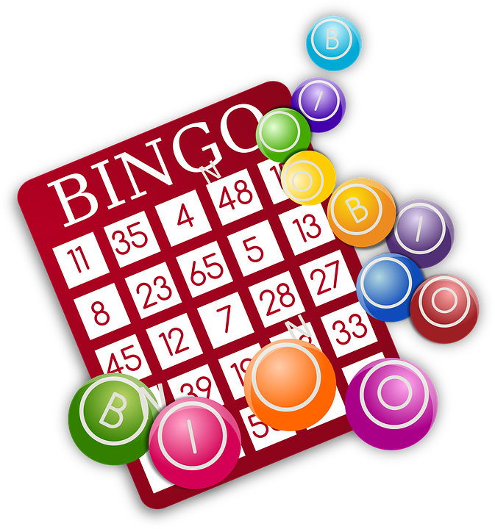
Follow up 2: Sag die Wörter.
aussprechen
Oktober
elf
Ding
Spiel
60
klar
Juli
S
Zwerg
Tasche
Antwort
acht
oder
und
0
[answer]
(hard [ch])
START
Notes:
Timing: 5 minutes
Aim: to practise applying knowledge of previously learnt SSCs to known and unknown words.
Procedure: 1. Start the timer. Pupil A tries to read aloud all of the words taking care with their pronounciation of the highlighted SSC’s, within the 60 seconds allowed.
2. Pupil B listens. If Pupil A makes a slip, Pupil B can direct him/her to start again from the beginning. 3. They swap roles and repeat the task.
Word frequency for unknown words: (1 is the most frequent word in German):
acht [144] Antwort [73] elf [ccc] Juli [1544] Oktober [1223] Spiel [328] Zwerg [4318]

Slide 11
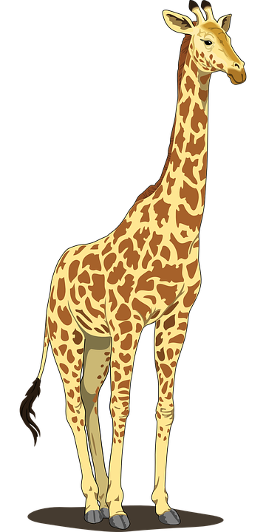
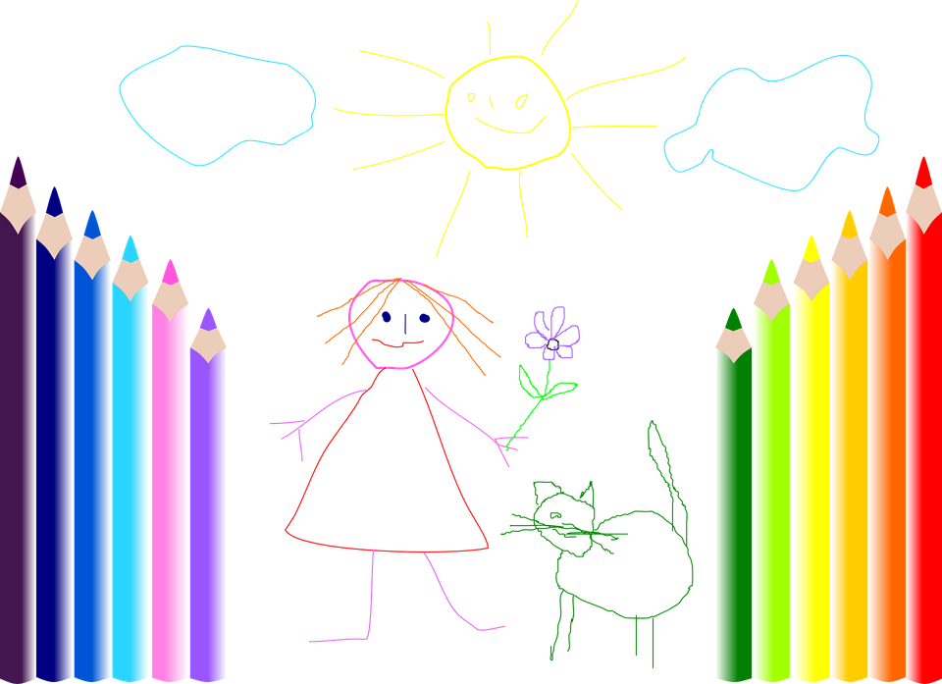
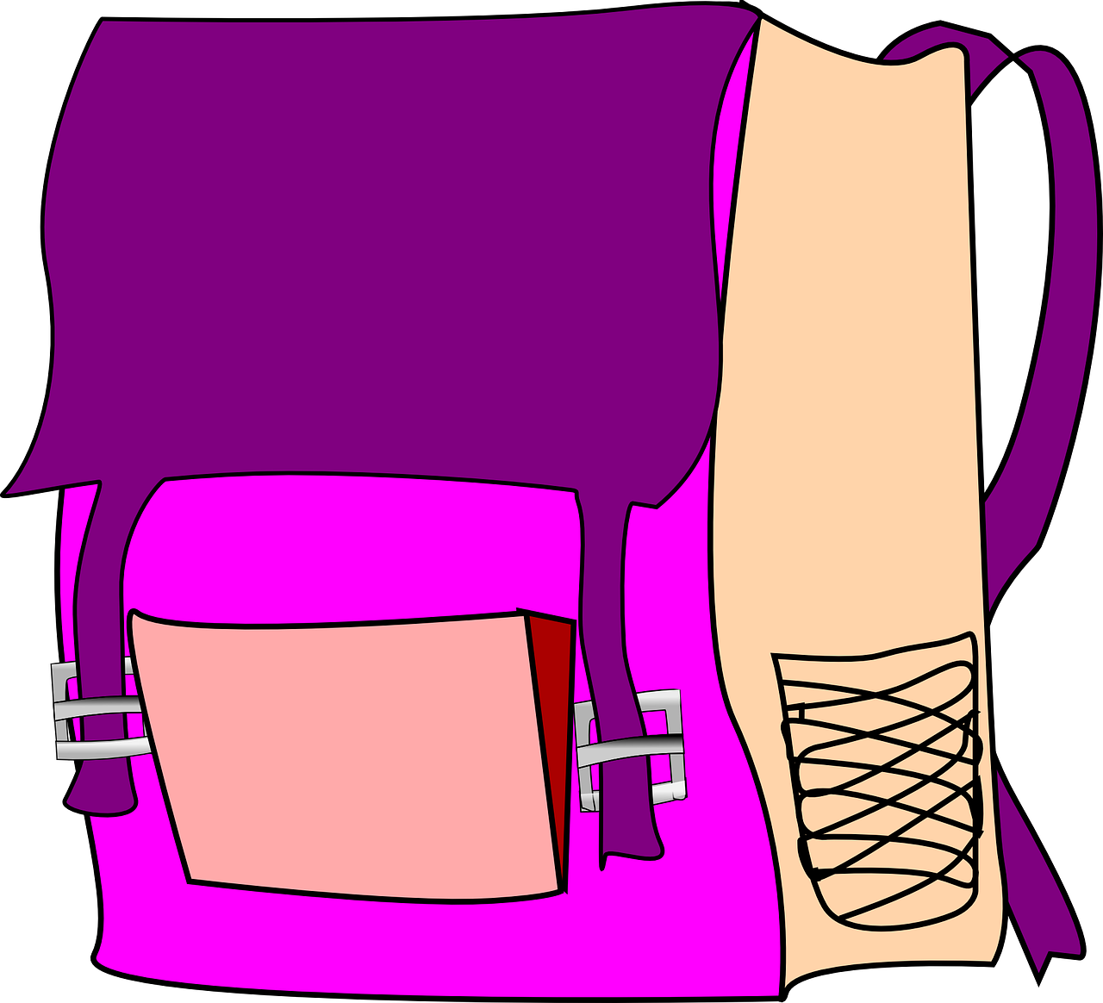
Follow up 3
Sag die Wörter.
sprechen
sprechen
der
das
die
Notes:
Timing: 5 minutes
Aim: to practise spoken production of a range of vocabulary and practise applying gendered articles
Procedure:
Click to bring up the image. Pupils say the word and say them aloud with the appropriate article.
Click again for the words to disappear into the appropriate ‘pacman’.
Continue for the rest of the items.
Items in order:
die Farbe
das Buch
die Freundin
die Schule
das Tier
die Tasche
das Ding
der Ort
der Tisch
das Heft
die Tafel
der Bleistift

Slide 12
hören
Follow up 4
Das ist ein Quiz für dich, Robbie!
For each question, put a cross (x) under the type of word you hear. You will hear each German word twice. Choose one correct answer only.
This word is a good example of …
 | A | B | C | D
1. | a country ☐ | a person ☐ | an animal ☐ | an object ☐
2. | an object ☐ | a description ☐ | a question word ☐ | a country ☐
3. | an animal ☐ | an object ☐ | a person ☐ | a question word ☐
4. | a question word ☐ | a country ☐ | a location ☐ | a greeting ☐
1
2
3
4
Notes:
Timing: 5 minutes
1/2
Procedure:
Pupils write 1-8 and write down A, B, C, or D for each word that they hear. Items 5-8 continue on the next slide.
Click to reveal answers 1-4 in turn.
Transcript:
Deutschland
Bleistift
wie
links
12

Slide 13
hören
Follow up 4
This word is a good example of …
 | A | B | C | D
1. | an object ☐ | a greeting ☐ | a person ☐ | a country ☐
2. | a greeting ☐ | an object ☐ | an animal ☐ | a person ☐
3. | a location ☐ | a country ☐ | a greeting ☐ | a question word ☐
4. | an object ☐ | an animal ☐ | a person ☐ | a description ☐
5
6
7
8
Notes:
Answers
2/2
Transcript:
Guten Tag
Haustier
wo
Freund
13

Slide 14
Follow up 5:

Schreib auf Deutsch.

schreiben
1 _____________________________
Du bist mein Freund.
You are my (male) friend.

Ich bin dein Freund.
2 _____________________________
I am your (male) friend.

3 _____________________________
Sie ist deine Freundin.
She is your (female) friend.
Notes:
Timing: 5 minutes
Aim: to revise forms of the verb sein and gender agreement of possessive adjective and nouns in R1 (nominative).
Procedure:
Pupils translate the sentences from English into German.
Click for answers.

Slide 15
Tschüss!
rot
Notes:
This slide has an audio-fied Tschüss
15

