Slide 1


Describing me and others
Hallo!
Guten Tag!
rot
Follow ups 1-5
Term 1 Week 2
Notes:
Artwork by Steve Clarke. Pronoun pictures from NCELP (www.ncelp.org). All additional pictures selected from Pixabay and are available under a Creative Commons license, no attribution required.
Phonics:
long [a] ja [45] da [239] Tag [111]
short [a] hallo [1077] danke [877] was? [38]
Vocabulary: ich [10] er [15] sie [7] sein, bin, ist [4] da [239] hier [68] Hallo [1077] Guten Tag [n/a]
Jones, R.L & Tschirner, E. (2019). A frequency dictionary of German: Core vocabulary for learners. London: Routledge.
The frequency rankings for words that occur in this PowerPoint which have been previously introduced in these resources are given in the SOW and in the resources that first
introduced and formally re-visited those words.
For any other words that occur incidentally in this PowerPoint, frequency rankings will be provided in the notes field wherever possible.

Slide 2





Follow up 1
Hör zu.
hören
A Listen. Write the word that is mentioned.
C Take turns to say the following German words out loud. Your partner will give you a point each time you remember the English translation as well.
Partner A
ich bin
Hallo
ja
er ist
hier
du bist
1
sein | bin | ich
2
er | Guten Tag | nein
Partner B
sie ist
da
sein
du bist
nein
Guten Tag
…
3
Hallo | ja | sie
sprechen
4
du | sein | hier
5
bist | bin | sie
6
da | ich | ist
B Write the number of the matching answer.
D Ping Pong translation in pairs
Round 1: Challenge each other by testing whether you can translate the new German words into English.
Round 2: Now challenge your partner by asking for the German words.
6
3
there____ 4. Hello ____
here ____ 5. yes ____
Hello - formal____ 6. no____
4
3
2
2
Notes:
Timing: 5 minutes
Aim: to practise aural comprehension of this week’s new vocabulary; written comprehension
Procedure:
Click to listen. pupils circle the correct number (if they have the sheet printed). If not, they can use numbers 1,2.3. Click for answers.
Pupils refer to their listening table, and write the corresponding words into the gaps in Section B.
Click to reveal answers.
Transcript:
1. ich
2. er
3. sie
4. sein
5. bin
6. ist

Slide 3


Follow up 2: long and short [u]
German [u] can be short or long.
aussprechen
It is short when followed by more than one consonant, e.g., Nummer (number), Punkt (dot, full stop).
It is long when it comes after a single consonant e.g. du
or, when
  followed by the letter ‘h’, e.g., Frau Kuhl
  or by a single consonant, e.g., gut (good).
Notes:
Timing: 1 minute
Aim: to explain long and short [u] sounds.
Procedure:
Click through the animations, clicking also on the audio buttons to hear each word.

Slide 4

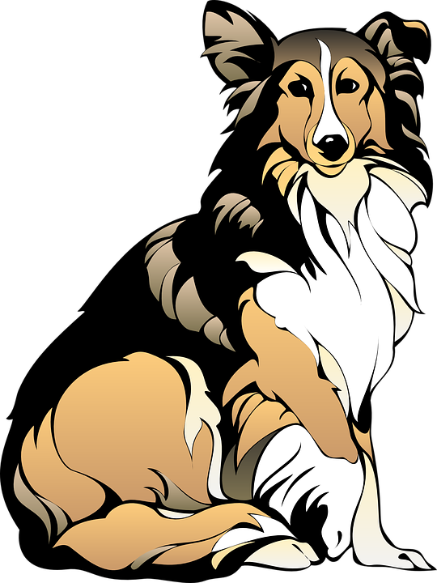







Follow up 2
Hör zu.
[a] oder* [u]?
The ‘d’ sound at the end sounds more like a ’t’
H a n d
H u n d
u n t e n
1
_
2
_
3
_
hören
‘ß’ is a letter called ‘szett’; it is sometimes used instead of double ‘s’
4
B a l l
5
B a n d
6
F u ß b a l l
_
_
_
_
b u n t
8
u n d
F a l l
7
_
_
9
_
oder – or
Notes:
Timing: 5 minutes
Aim: to practise transcribing the missing vowels in unknown words.
Procedure:
Click to listen to each word.
Listen and write the missing letter(s).
Click to reveal answers.
NB: there are callouts for 1 and 6.
Vocabulary: Ball [1782] Band [1025] bunt [1818] Fall [187] Fußball [1277] Hand [180] Hund [1825 und [2] unten [710] Jones, R.L & Tschirner, E. (2019). A frequency dictionary of German: Core vocabulary for learners. London: Routledge.

Slide 5

Follow up 3: Listen and read aloud.
auch = also
Hallo! Guten Tag!
Ist Ute da?
aussprechen
Ja, Frau Kuhl, sie ist da.
Susie
Hallo Frau Kuhl, ich bin Ursula, und ich bin auch da!
Danke Ursula,
das ist gut!
Ursula
Notes:
Timing: 5 minutes
Aim: to practise applying knowledge of long and short [u] to mostly previously taught words.
Procedure:
1. Click each speech bubble to play the audio recording of each part of the dialogue.
2. Pupils read aloud after each part, paying particular attention to short and long a-sounds.
3. Pupils could have a print out of the dialogue (see end of the PPT for b/w version) and colour the [u]s in 2 colours: one colour for long [u], one colour for short [u].

Slide 6


Follow up 4
Bin ich Uli?
Remember that in English we swap ‘I am ‘ to ‘Am I’ to make a yes/no question:
I am Uli.
Am I Uli?
In German we do the same:
Ich bin Uli.
Bin ich Uli?
Notes:
Timing: 5 minutes
Aim: lead in grammar slide in preparation for follow up 4.
Procedure:
Click through the explanation, then click to reveal the following slide.

Slide 7











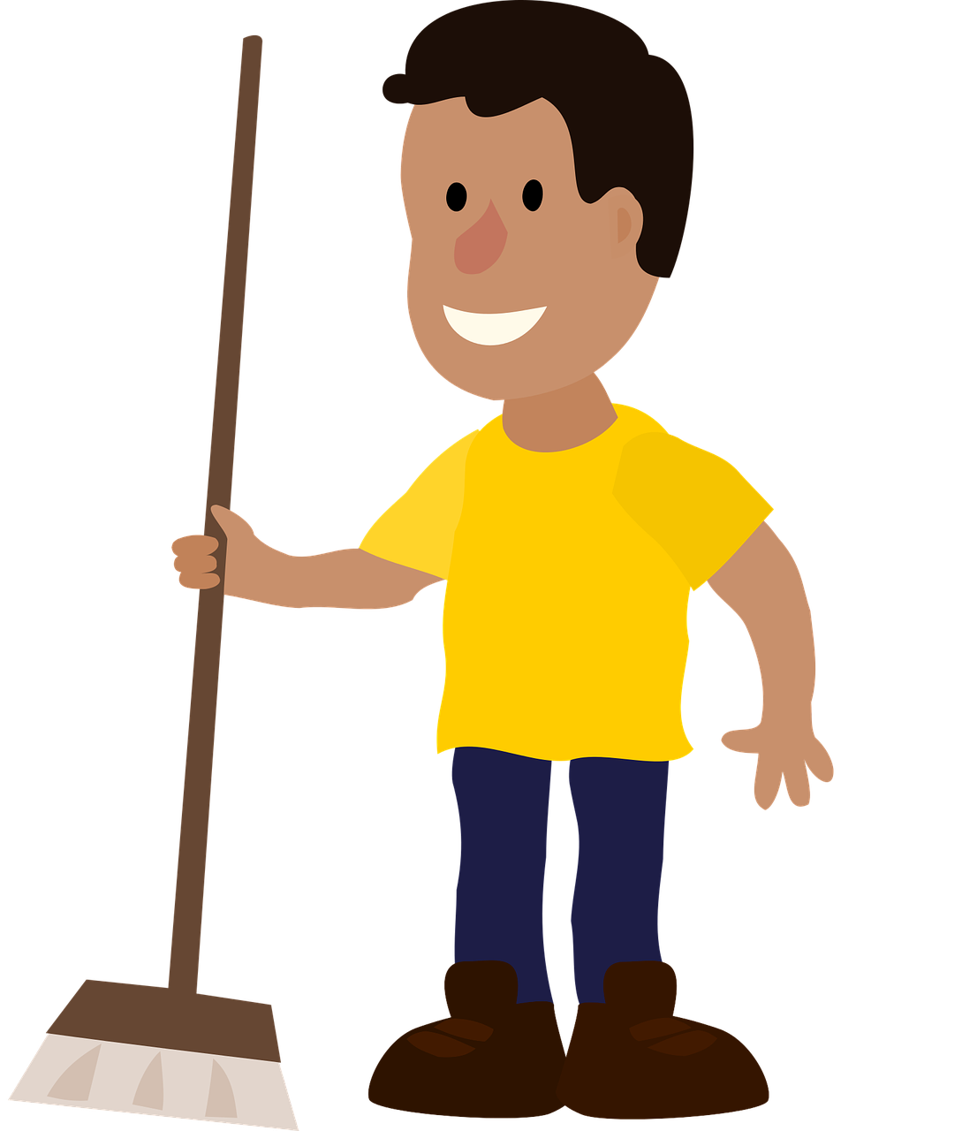
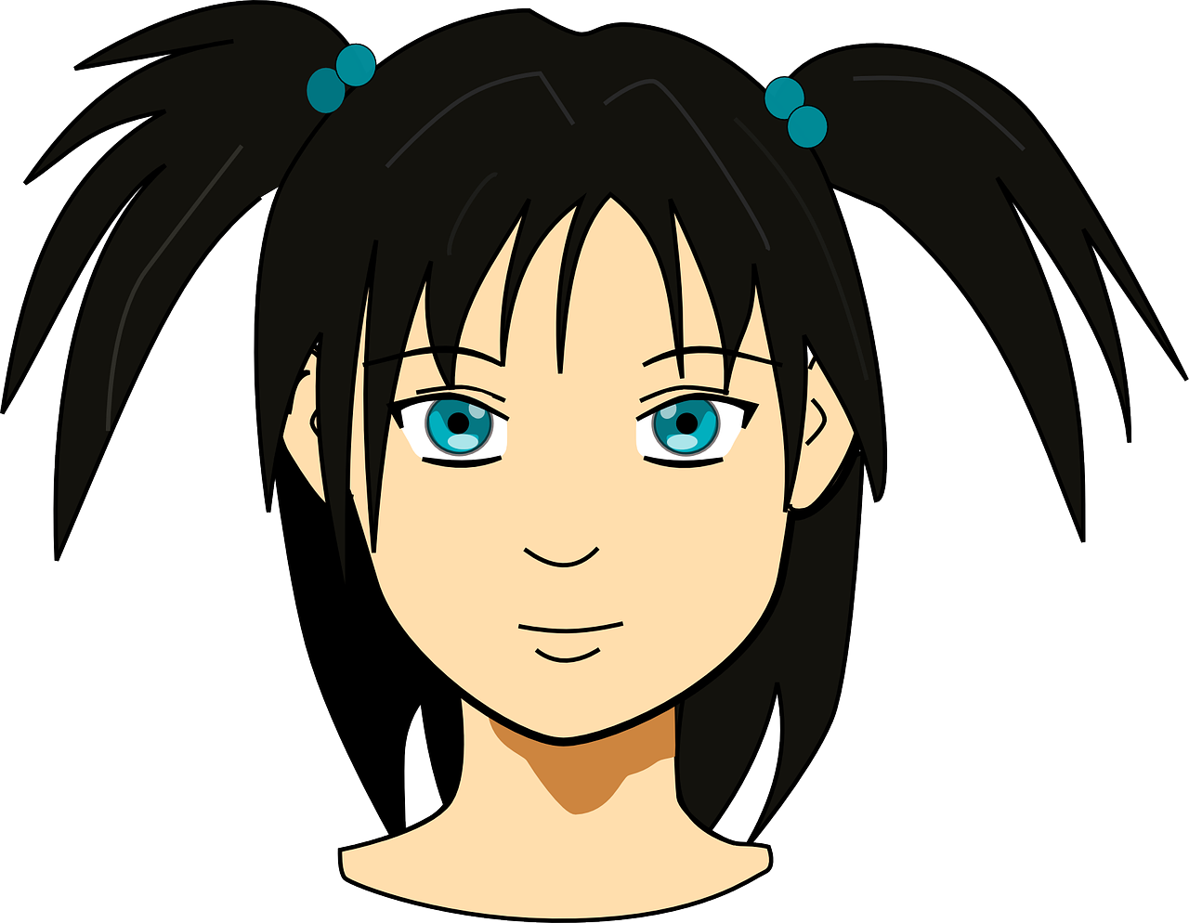
Follow up 4
Ja!
Nein!
Bin ich…?
…
Ask questions to find out who you are in less than one minute.
Uli | Udodi | Ursula | Lucie
Susie | Ulla | Kunigunde | Louisa
Urs | Munja | Uschi | Uner
Mustafa | Uta | Udo | Lukas
sprechen
60
S
0
START
Notes:
Timing: 5 minutes
Aim: to practise pronunciation of long and short [a] sounds in a short sentence; to practise pronunciation of ‘ich bin’; to practise use of ‘ja’ and ‘nein’ in a communicative context.
Procedure:
The teacher models the activity by asking a pupil to select a sticker and putting on his/her back. S/he shows the class briefly and then says ‘Ich bin XXX’ statements with all the names until the pupils say ‘Ja’. When the name is wrong they say ‘Nein’.
Teacher puts sticker or post-it with one of the names on each pupil’s back.
Pupils circulate in the room. Each pupil they meet they have one chance to guess their own identity, saying ‘Ich bin XXX’.
The listening pupil checks the sticker and says either ‘ja’ or ‘nein’.
Pupils have to try to find out their identity in less than one minute.
Swap stickers and repeat the activity.
Note: The teacher can develop the activity by eliciting naming of pupils by other pupils. E.g. Sie ist Ulla. Er ist Lukas, etc.

Slide 8

Follow up 5:

Schreibe auf Englisch.
Can you get at least 8 points?
Wörter
 | ja | nein | Hallo
 | da | hier | Guten Tag
 | sein | ich bin | ist
 | du bist | er | sie
Vokabeln
yes
no
hello / hi
there
here
hello (formal)
to be /being
I am
is
you are
he
she
Notes:
Timing: 5 minutes
Aim: to practise written comprehension of vocabulary from this week.
Procedure:
1. Give pupils a blank grid. They fill in the English meanings of any of the words they know, trying to reach at least 8 points in total.

Slide 9
Follow up 5:

Schreibe auf Deutsch.
Can you get at least 8 points?
Wörter
 | no | here | yes
 | hello/hi | hello (formal) | there
 | she | is | he
 | I am | to be, being | you are
Vokabeln
nein
hier
ja
Hallo
Guten Tag
da
sie
ist
er
ich bin
sein
du bist
Notes:
Timing: 5 minutes
Aim: to practise written production of vocabulary from this week.
Procedure:
1. Give pupils a blank grid. They fill in the German meanings of any of the words they know, trying to reach at least 8 points in total.

Slide 10
Tschüss!
rot
Notes:
10

Slide 11
Follow up 3: Listen and read aloud.
auch = also
Hallo! Guten Tag!
Ist Ute da?
aussprechen
Ja, Frau Wuhl, sie ist da.
Susie
Hallo Frau Wuhl, ich bin Ursula, und ich bin auch da!
Danke Ursula,
das ist gut!
Ursula
Notes:
HANDOUT

Slide 12
Follow up 5:

Schreibe auf Englisch.
Can you get at least 8 points?
Wörter
 | ja | nein | Hallo
 | da | hier | Guten Tag
 | sein | ich bin | ist
 | du bist | er | sie
Vokabeln
Notes:
HANDOUT

Slide 13
Follow up 5:

Schreibe auf Deutsch.
Can you get at least 8 points?
Wörter
 | no | here | yes
 | hello/hi | hello (formal) | there
 | she | is | he
 | I am | to be, being | you are
Vokabeln
Notes:
HANDOUT

