Slide 1
Describing me and others
Wo ist Deutschland?
Wo ist er/sie? Wo bist du?
Wo ist das?
long and short [o]
rot
Term 1 Week 3
Notes:
Artwork by Steve Clarke. Pronoun pictures from NCELP (www.ncelp.org). All additional pictures selected from Pixabay and are available under a Creative Commons license, no attribution required.
Phonics:
long [o] wo? [94] wohnen [380] Million [206] short [o] Kopf [279] offen [382] kommen [61]
Vocabulary:
es [12] wo [94] England [1762] Deutschland [140] toll [972] und [2]
Jones, R.L & Tschirner, E. (2019). A frequency dictionary of German: Core vocabulary for learners. London: Routledge.
The frequency rankings for words that occur in this PowerPoint which have been previously introduced in these resources are given in the SOW and in the resources that first introduced and formally re-visited those words.
For any other words that occur incidentally in this PowerPoint, frequency rankings will be provided in the notes field wherever possible.
Note that the first three lessons of the year teach language that can be continuously recycled as lesson routine every lesson in Y3/4.
The idea would be that the class teacher (whether or not s/he teaches the class German) can re-use the language as part of the daily routine with the class.
1

Slide 2
aussprechen
long [o]
…
wo
Notes:
Timing: 1 minute
Aim: to introduce the SSC long [o].
Procedure:
Introduce the SSC and present the source word ‘wo’ (with gesture, if using).
Click to bring on the picture and get pupils to repeat the word ‘wo’ (with gesture, if using).
Note:
a gesture for ‘wo’ might be to put your hand on your forehead and look into the distance as if to spot something on the horizon
Word frequency (1 is the most frequent word in German): wo? [94]
Jones, R.L & Tschirner, E. (2019). A frequency dictionary of German: Core vocabulary for learners. London: Routledge.
2

Slide 3
aussprechen
long [o]
…
wohnen
wo
Million
Notes:
Timing: 1 minute
Aim: to consolidate the SSC long [o].
Procedure:
Re-present the SSC and the source word ‘wo’ (with gesture, if using).
Click to bring on the picture and get pupils to repeat the word ‘wo’ (with gesture, if using).
Present the cluster words in the same way, bringing on the picture and getting pupils to pronounce the words.
Word frequency (1 is the most frequent word in German): Million [206]] ohne [119] wo? [94] wohnen [380]
Jones, R.L & Tschirner, E. (2019). A frequency dictionary of German: Core vocabulary for learners. London: Routledge.

Slide 4
aussprechen
short [o]
…
Kopf
Notes:
Timing: 1 minute
Aim: to introduce the SSC short [o].
Procedure:
Introduce the SSC and present the source word ‘Kopf’ (with gesture, if using).
Click to bring on the picture and get pupils to repeat the word ‘Kopf’ (with gesture, if using).
Note:
a gesture for ‘Kopf’ might be to point to your head.
Word frequency (1 is the most frequent word in German): Kopf [279]
Jones, R.L & Tschirner, E. (2019). A frequency dictionary of German: Core vocabulary for learners. London: Routledge.
4

Slide 5
aussprechen
short [o]
…
kommen
Kopf
offen
kommen – to come
Notes:
Timing: 1 minute
Aim: to consolidate the SSC short [o].
Procedure:
Re-present the SSC and the source word ‘Kopf’ (with gesture, if using).
Click to bring on the picture and get pupils to repeat the word ‘Kopf’ (with gesture, if using).
Present the cluster words in the same way, bringing on the picture and getting pupils to pronounce the words.
Word frequency (1 is the most frequent word in German): kommen [61] Kopf [279] offen [382]
Jones, R.L & Tschirner, E. (2019). A frequency dictionary of German: Core vocabulary for learners. London: Routledge.
5

Slide 6
aussprechen
[o]
long and short [o]
Hör zu.
hören
 | L: long [o] | S: short [o] | word
1 |  |  | offen
2 |  |  | wohnen
3 |  |  | wo
4 |  |  | Kopf
5 |  |  | Million
6 |  |  | kommen
Notes:
Timing: 5 minutes
Aim: to consolidate the SSC long [a] and short [a] by practising listening to the different pronunciations.
Procedure:
1. Click audio button 1 to play the recording for item 1. Pupils need to decide is it long [o] or short [o] and write list of S for short and L for long
2. Elicit the answer; encourage pupils to pay particular attention to short [o] or long [o].
3. Click to bring up the answer tick for item 1.
4. Elicit the whole word; if necessary click the audio button again to play recording again.
5. Click to bring up the written version of the German word, together with picture.
6. Continue for items 2-6.
Transcript: offen
wohnen
wo?
Kopf Million kommen

Slide 7
Vokabeln
Hör zu und sag das Wort.
Wörter
und
wo?
where?
and
Notice that final ‘d’ in German sounds like English ‘t’!
England
Deutschland
Germany
great
toll
es
Notes:
Timing: 5 minutes
Aim: to present and practise written comprehension and read aloud of the new vocabulary for this week.
Procedure: 1. Click for a German word. Elicit pronunciation from pupils.
2. Click for the English meaning and picture prompt. Elicit the German word again.
3. Present all five words like this, in order.
4. Click for one English meaning to disappear. Elicit the English meaning from pupils. Continue with the remaining items.
5. Click for the German word to disappear. Elicit the German from pupils. Continue with the remaining items.
Vocabulary:
es [12] wo [94] England [1762] Deutschland [140] toll [972] und [2]
Jones, R.L & Tschirner, E. (2019). A frequency dictionary of German: Core vocabulary for learners. London: Routledge.
7

Slide 8
Asking questions
ist
Remember, to mean ‘is’ we say ______ .
wo ist
To ask ‘where is’, say ________ ?
Wo ist Berlin?
Where is Berlin?
Es ist in Deutschland.
It is in Germany.
Notes:
Timing: 2 minutes
Procedure:
Click through the animations to present the new information.
Elicit English translation for the German examples provided.
8

Slide 9
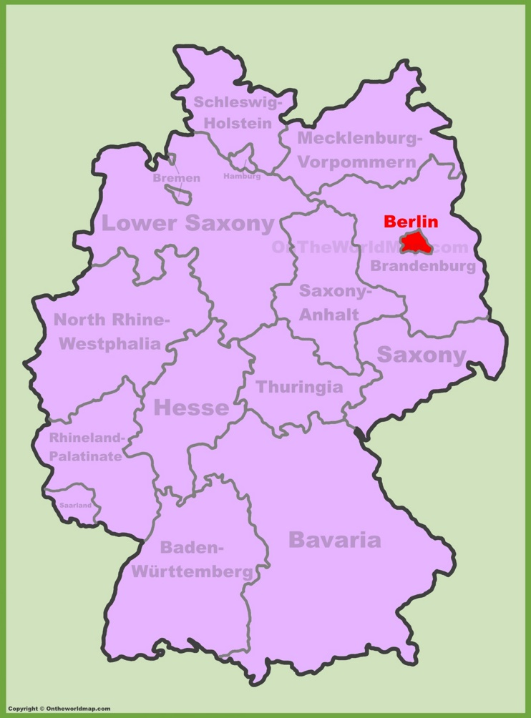
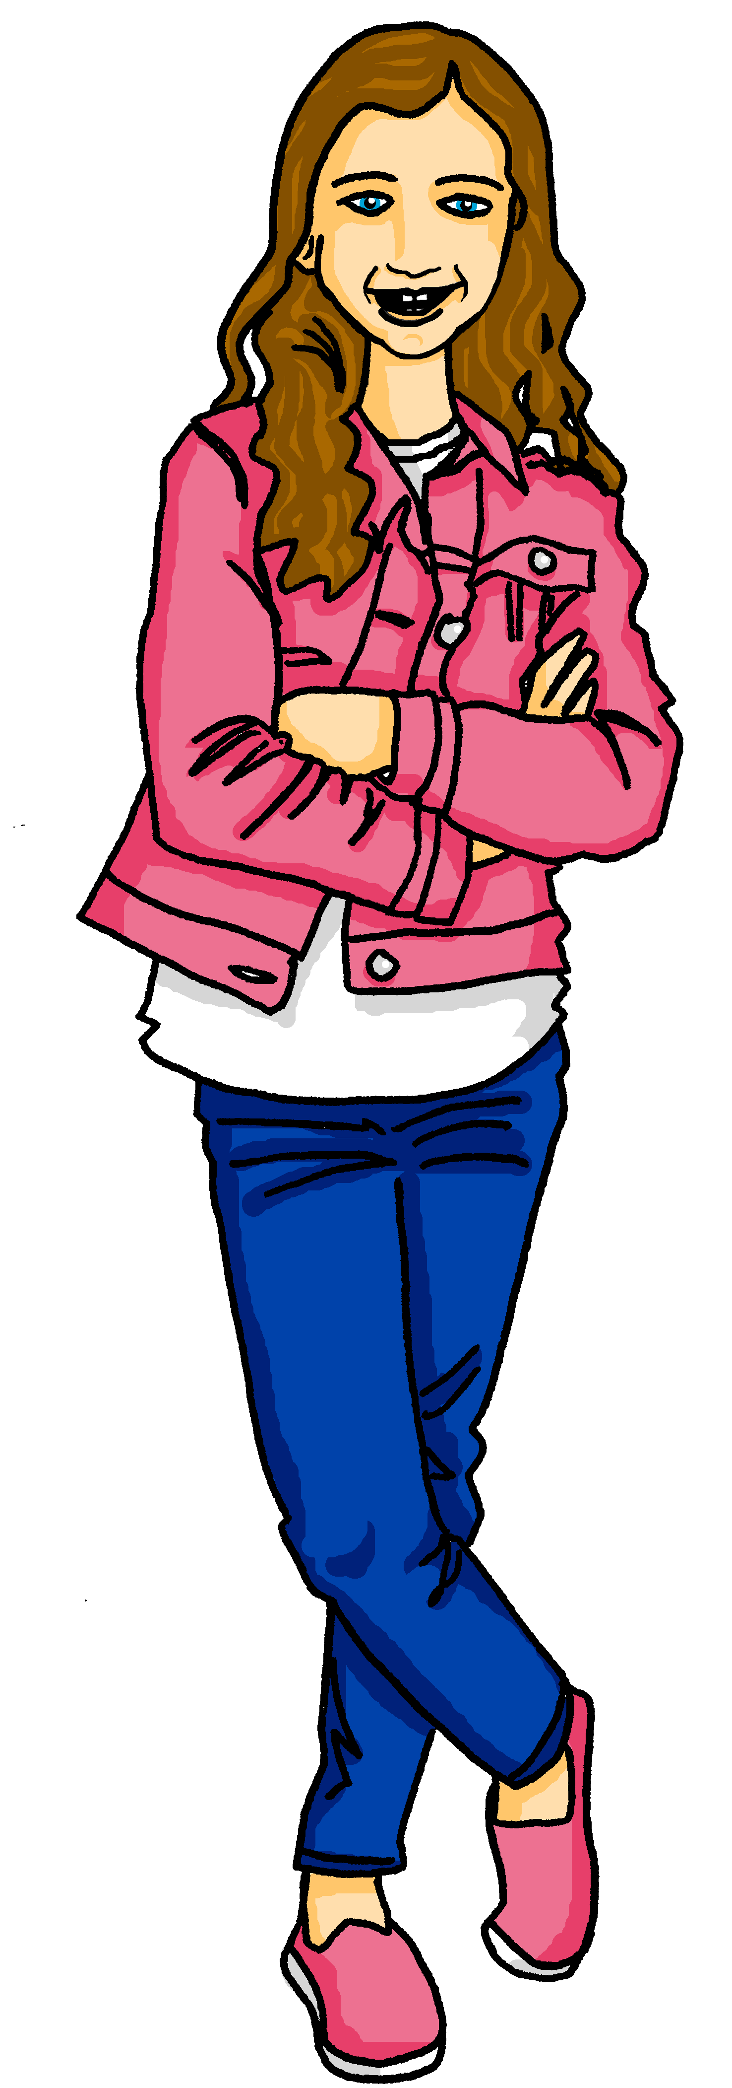
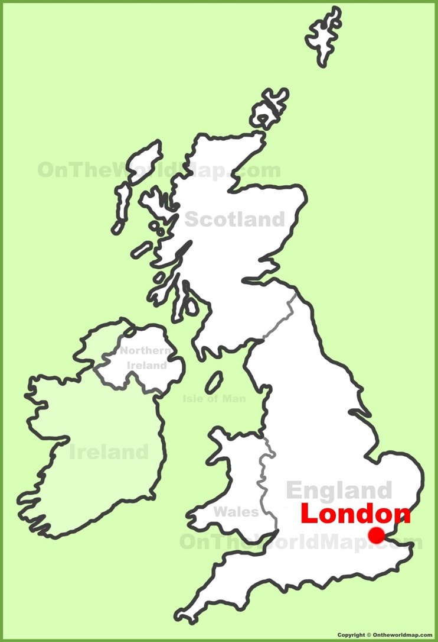
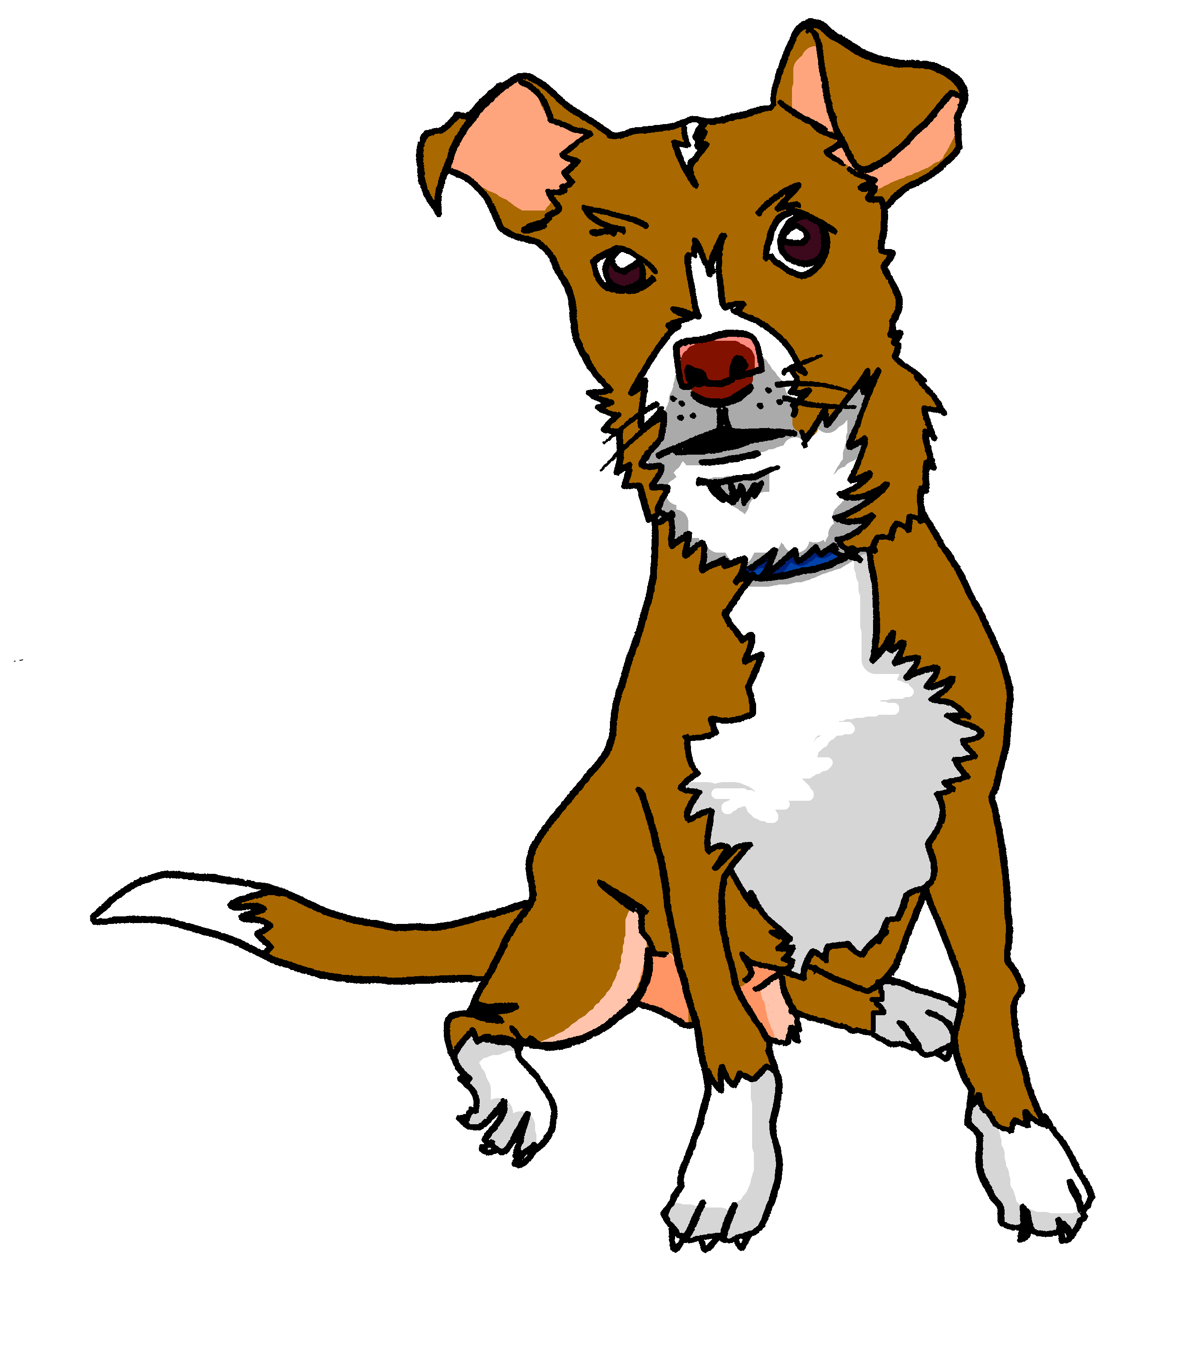
Kultur
Kultur
Wo ist…?
Berlin ist in Deutschland. Es ist die Hauptstadt*.
Berlin ist toll!
London ist in England. Es ist die Hauptstadt.
London ist super!
Hauptstadt – capital city
Notes:
Timing: 5 minutes
image of Germany map: https://ontheworldmap.com/germany/city/berlin/berlin-location-on-the-germany-map.html
image of UK/England map: https://ontheworldmap.com/uk/city/london/london-location-on-the-uk-map.html
Aim: to present and practise new vocabulary for this week
Procedure:
Click to bring up the first text box about Berlin. Click again to bring up the map.
Click to bring up the nest text box about London. Click again to bring up the map.
Click to bring up speech bubble about Berlin.
Click to bring up speech bubble about London.
9

Slide 10
schreiben
Writing Deutschland and England
Let’s practise some writing!
I’m sure you know how to spell England!
Now let’s practise writing it on your sleeve with your finger!
In German, the ‘E’ in England is a different sound, and you don’t hear the ‘g’.
England
Now let’s try the word for Germany! The second part is the same!
Deutschland
Now practice writing Deutschland on your sleeve.
Notes:
Timing: 2 minutes
Aim: to prepare for the written production of England and Deutschland
Procedure:
Introduction to writing in German – pupils practise by writing on their sleeve with their finger.
Click through the animations.
Click on the words England and Deutschland to bring up the sound, if you wish.
Help pupils break down the words into syllables: Deut-tsch-land, Eng-land. After each word on the next click a line will appear to indicate where the word can be separated.
10

Slide 11
hören
Hör zu. Wo ist es?
Write the correct country name in German.
 | Deutschland
 | England
 | Deutschland
 | Deutschland
 | Deutschland
 | England
 | Deutschland
 | England
Oranienburg
1
2
3
Newcastle
Bonn
4
Olsdorf
5
6
Birmingham
7
Oxford
Osterberg
Oberding
8
Notes:
Timing: 5 minutes
Aim: to practise aural comprehension of place names, matching sound to print, and to practise writing Deutschland and England.
Procedure:
1. Click to play the recording of the first question and answer. The answer will be beeped out.
2. Remind pupils to break down the words into syllables like on the last slide: Deu-tsch-land, Eng-land. Pupils may write the words on their sleeves with their fingers for practice just the once.
3. Now pupils write 1-8 and the words Deutschland or England as appropriate for each item.
4. Click in turn to bring up the answer.
3. Ask: Wo ist…? Pupils repeat chorally – es ist in England, etc.
Transcript:
Wo ist Olsdorf? Es ist in [Deutschland].
Wo ist Birmingham? Es ist in [England].
Wo ist Bonn? Es ist in [Deutschland].
Wo ist Oranienburg? Es ist in [Deutschland].
Wo ist Oberding? Es ist in [Deutschland].
Wo ist Newcastle? Es ist in [England].
Wo ist Osterberg? Es ist in [Deutschland].
Wo ist Oxford? Es ist in [England].
11

Slide 12
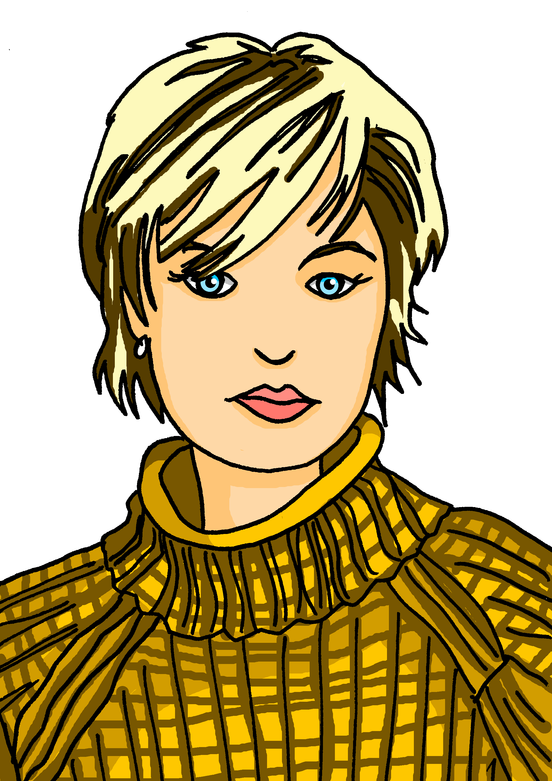
sprechen
Maike und Steffen
…
Ich bin Steffen.
Ich bin Maike.
Er ist Steffen.
Sie ist Maike.
Maike
Steffen
Johanna
Moritz
Ich bin Moritz.
Er ist Moritz.
Ich bin Johanna.
Sie ist Johanna.
Notes:
Timing: 8 minutes
Aim: to introduce two new characters – the parents Maike and Steffen. To practise spoken production of Ich bin and er/sie ist.
Procedure:
Click to bring up pictures of the new character Maike. Click to bring up speech bubble Ich bin Maike. Pupils repeat chorally.
Elicit a presentation of Maike in the 3rd person – Sie ist Maike. (Click to bring up the icon of another person with an empty speech bubble and then model ‘Sie ist Maike’.
Continue for the other characters.
Practise once again with all of the sentences – two of the names are new and will need some practice.
12

Slide 13
lesen
Maike and Steffen are travelling for work but they are never in the same place.
Maike messages Steffen. Steffen’s phone screen is dirty! Who is where?
Maike (I am in…)
 | ______
 | ______
 | ______
 | _____
 | _____
 | _____
1 | Ich bin in Frankfurt. Du bist in Oxford.
2 | Du bist jetzt in London und ich bin in Birmingham.
3 | Hallo! Du bist in Newcastle und ich bin in Olsdorf.
4 | Ich bin jetzt in Bonn, und du ?
5 | Du bist in Osterberg! Oh, ich bin in Kassel.
6 | Du bist in Oranienburg? Ich bin in Berlin!
Frankfurt
1
1
2
Birmingham
2
3
Olsdorf
3
4
Bonn
Steffen (you are in…)
 | ______
 | ______
 | ______
 | _____
 | _____
Kassel
4
5
6
Berlin
5
1
Oxford
2
London
6
3
Newcastle
5
Osterberg
6
Oranienburg
Notes:
Timing: 8 minutes
Aim: to practise written comprehension of the learnt vocab and placenames, and to distinguish between first and second person singular.
Procedure:
Pupils write: Maike, and Steffen. They need to work out six places where Maike and Steffen are right now. NB Maike is writing the messages, so ich bin = Maike, du bist = Steffen.
Click to bring up the answers (the place names) in the Maike and Steffen tables, in the order in which they appear in the text.
Click again to remove the splodges from Steffen’s phone screen.
Continue for items 2-6. NB there is no place for Steffen for number 4.
Click to play the recording of the sentences if you wish.
Transcript:
1. Ich bin in Frankfurt. Du bist in Oxford. 2. Du bist jetzt in London und ich bin in Birmingham.
3. Hallo! Du bist in Newcastle und ich bin in Olsdorf.
4. Ich bin jetzt in Bonn… und du?
5. Du bist in Osterberg! Oh, ich bin in Kassel.
5. Du bist in Oranienburg? Oh, ich bin in Berlin!
13

Slide 14
Tschüss!
rot
Notes:
14

