Slide 1
Describing me and others
Schule ist cool!
rot
Follow ups 1-5
Term 1 Week 4
Notes:
Artwork by Steve Clarke. Pronoun pictures from NCELP (www.ncelp.org). All additional pictures selected from Pixabay and are available under a Creative Commons license, no attribution required.
Phonics:
long [a] ja [45] da [239] Tag [111]
short [a] hallo [1077] danke [877] was? [38]
Vocabulary: ich [10] er [15] sie [7] sein, bin, ist [4] da [239] hier [68] Hallo [1077] Guten Tag [n/a]
Jones, R.L & Tschirner, E. (2019). A frequency dictionary of German: Core vocabulary for learners. London: Routledge.
The frequency rankings for words that occur in this PowerPoint which have been previously introduced in these resources are given in the SOW and in the resources that first
introduced and formally re-visited those words.
For any other words that occur incidentally in this PowerPoint, frequency rankings will be provided in the notes field wherever possible.

Slide 2
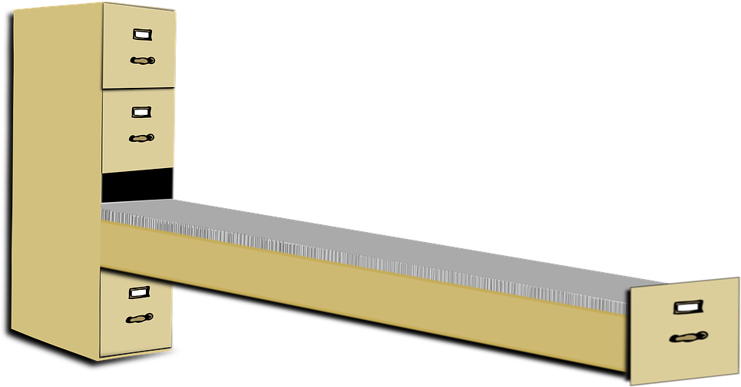
Follow up 1
Hör zu. [ei] oder* [a]?
T a g
k ei n
J a h r
1
_
2
_
3
_
hören
4
ei n s
5
s a g e n
l a n g
_
_
6
_
7
z w ei
8
M a n n
d r ei
_
_
9
_
oder – or
Notes:
Timing: 5 minutes
Aim: to practise transcribing the missing vowels in unknown words.
Procedure:
Click to listen to each word.
Listen and write the missing letter(s).
Click to reveal answers.
Vocabulary: eins [774] drei [106] Jahr [53] kein [46] lang [97] Mann [121] sagen [40] Tag [111] zwei [70]
Jones, R.L & Tschirner, E. (2019). A frequency dictionary of German: Core vocabulary for learners. London: Routledge.

Slide 3
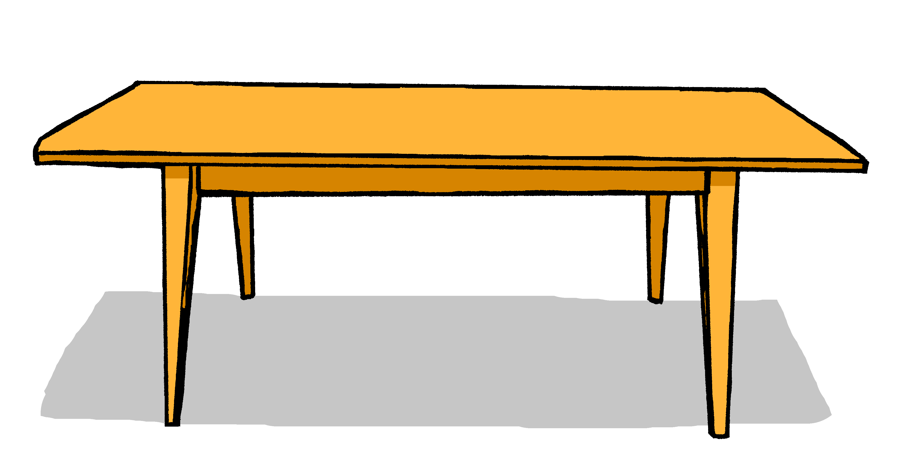
Follow up 2
Was ist das auf Deutsch?
Wörter
d__ T____h
der Tisch
Vokabeln
d__ T___l
…
die Tafel
sprechen
die Flasche
d__ F_____e
d__ F_____r
das Fenster
das Heft
d__ H__t
d__ B_____t
der Bleistift
Notes:
Timing: 3 minutes
Aim: to practise the new vocabulary further and to establish the knowledge of gender for the six nouns learnt this week. Procedure: 1. Read the teacher instruction for the activity in German. Elicit the meaning from pupils or tell them what it means. They do not know all the words yet but they do know (was, ist, and Deutsch from Deutschland)
2. Bring up gapped version of the word. Allow pupils to recall the word and its article. 3. Reveal the full version of the word. Repeat for other nouns. 4. Bring up the pictures and ask pupils to say the nouns and their articles.
5. Ask pupils which is their favourite German word so far, and to think about why. Is it the sound, the meaning, the fact it is easy (or difficult) to remember?

Slide 4
Follow up 3a
Ist es der, die oder das?
…
sprechen
___ Bleistift
___ Flasche
___ Heft
___ Tafel
___ Tisch
m
___ Fenster
nt
f
Notes:
Timing: 5 minutes (two slides)
Aim: to revise gender and word knowledge. Procedure: 1. The six nouns appear as pictures with word (without article) on separate mouse clicks. Say the word (chorally) with its definite article. 2. On second click, the noun moves into the ‘appropriately gendered’ mouth.

Slide 5
Follow up 3b
Was ist das auf Deutsch?
…
sprechen
m
m
nt
nt
f
f
Notes:
Procedure: 1. This time, only the images for the six nous appear on separate mouse clicks. Say the word (chorally) with its definite article. 2. On second click, the noun moves into the ‘appropriately gendered’ mouth.

Slide 6
Follow up 4:

Schreib auf Deutsch.
A
B
schreiben
1. Wo ist die Tafel ?
2. Wo ist der Tisch ?
Notes:
Timing: 5 minutes (3 slides)
Aim: to practise gender knowledge and written recall of the new vocabulary
Procedure: 1. Pupils write 1-6 in their books (or on whiteboards). 2. Identify which noun is ‘hidden’ from the definite article. Write A or B. 3. If pupils can also try to write the full missing word in German. Note: Reassure pupils that they are not expected to know these spellings 100% yet, but that trying to write them from memory, trying to remember, is a key part of learning.

Slide 7
Follow up 4:

A
B
schreiben
3. Wo ist das Heft ?
4. Wo ist die Flasche ?
Notes:
[2/3]

Slide 8
Follow up 4:

A
B
schreiben
5. Wo ist das Fenster ?
6. Wo ist der Bleistift ?
Notes:
[3/3]

Slide 9
Follow up 5:

Schreibe auf Englisch.
Can you get at least 15 points?
Wörter
 | Guten Tag | sein | ich
 | er | bin | sie
 | ist | Hallo | da
 | hier | ja | nein
 | der Bleistift | die Tafel | das Fenster
 | der Tisch | die Flasche | das Heft
 | der | die | das
Hello (formal)
to be, being
I
Vokabeln
x3
he
am
she
is
hello
there
x2
here
yes
no
pencil
board
window
table
bottle
exercise book
x1
the (m)
the (f)
the (nt)
Notes:
Timing: 5 minutes
Aim: to practise written comprehension of vocabulary from this and revisited weeks.
Procedure: 1. Give pupils a blank grid. They fill in the English meanings of any of the words they know, trying to reach 15 points in total. 2. Remind pupils that adjectives can refer to male or female persons and they should note this in their translations. E.g. pleased (f), short (m).
Note: The most recently learnt and practised words are pink, words from the previous week are green and those from week 1 are blue, thus more points are awarded for them, to recognise that memories fade and more effort (heavy lifting!) is needed to retrieve them.

Slide 10
Follow up 5:

Schreibe auf Deutsch.
Can you get at least 15 points?
Wörter
 | Hello (formal) | to be, being | I
 | he | am | she
 | is | hello | there
 | here | yes | no
 | pencil | board | window
 | table | bottle | exercise book
 | the (m) | the (f) | the (nt)
Guten Tag
sein
ich
Vokabeln
x3
er
bin
sie
ist
Hallo
da
x2
hier
ja
nein
der Bleistift
die Tafel
das Fenster
der Tisch
die Flasche
das Heft
x1
der
die
das
Notes:
Timing: 5 minutes
Aim: to practise written comprehension of vocabulary from this and revisited weeks.
Procedure: 1. Give pupils a blank grid. They fill in the English meanings of any of the words they know, trying to reach 15 points in total. 2. Remind pupils that adjectives can refer to male or female persons and they should note this in their translations. E.g. pleased (f), short (m).
Note: The most recently learnt and practised words are pink, words from the previous week are green and those from week 1 are blue, thus more points are awarded for them, to recognise that memories fade and more effort (heavy lifting!) is needed to retrieve them.

Slide 11
Tschüss!
rot
Notes:
11

Slide 12
Follow up 5:

Schreibe auf Englisch.
Can you get at least 15 points?
Wörter
 | Guten Tag | sein | ich
 | er | bin | sie
 | ist | Hallo | da
 | hier | ja | nein
 | der Bleistift | die Tafel | das Fenster
 | der Tisch | die Flasche | das Heft
 | der | die | das
Vokabeln
x3
x2
x1
Notes:
Template for printing

Slide 13
Follow up 5:

Schreibe auf Deutsch.
Can you get at least 15 points?
Wörter
 | Good day | to be, being | I
 | he | am | she
 | is | hello | there
 | here | yes | no
 | pencil | board | window
 | table | bottle | exercise book
 | the (m) | the (f) | the (nt)
Vokabeln
x3
x2
x1
Notes:
Template for printing

