Slide 1
Describing me and others
Schule ist cool!
rot
German nouns
Words for ‘the’
SSC [ei]
Term 1 Week 4
Notes:
Artwork by Steve Clarke. Pronoun pictures from NCELP (www.ncelp.org). All additional pictures selected from Pixabay and are available under a Creative Commons license, no
attribution required.
Phonics:
[ei] frei [318] ein [5] klein [114] sein [3] allein [258]
Vocabulary (new): Fenster [674] Flasche [1602] Heft [3862] Bleistift [>5009] Tafel [3855] Tisch [529] der, die, das [1]
Revisit 1: ich [10] er [15] sie [7] sein, bin, ist [4] da [239] hier [68] Guten Tag [n/a] Hallo [1077] ja [45] nein [148]
Jones, R.L & Tschirner, E. (2019). A frequency dictionary of German: Core vocabulary for learners. London: Routledge.
The frequency rankings for words that occur in this PowerPoint which have been previously introduced in these resources are given in the SOW and in the resources that first introduced and formally re-visited those words.
For any other words that occur incidentally in this PowerPoint, frequency rankings will be provided in the notes field wherever possible.
Note that the first three lessons of the year teach language that can be continuously recycled as lesson routine every lesson in Y3/4.
The idea would be that the class teacher (whether or not s/he teaches the class German can re-use the language as part of the daily routine with the class.
1

Slide 2
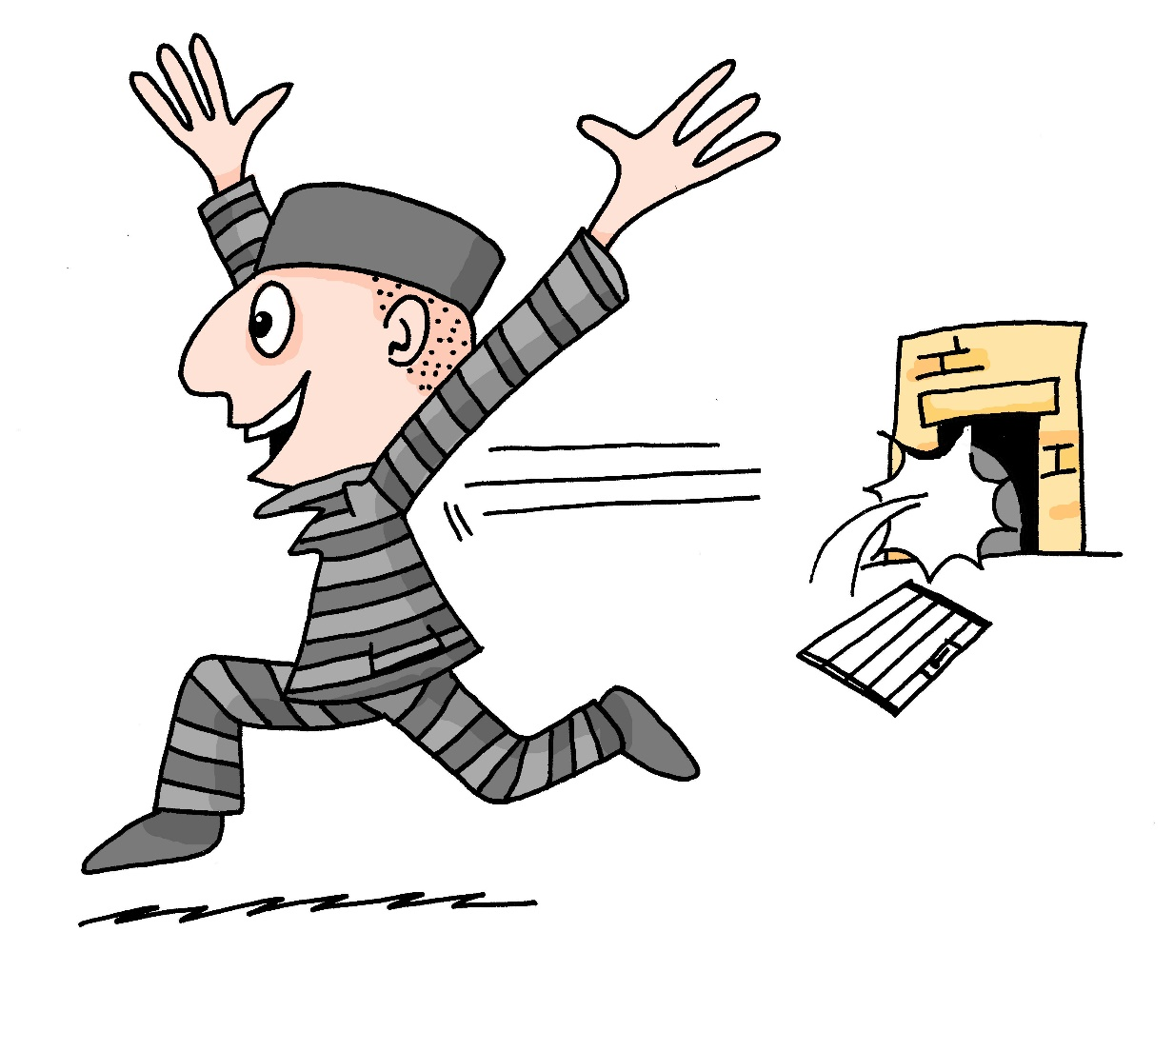
aussprechen
[ei]
…
free
frei
Notes:
Timing: 1 minute
Aim: to introduce the SSC [ei].
Procedure:
Introduce the SSC and present the source word ‘frei’ (with gesture, if using).
Click to bring on the picture and get pupils to repeat the word ‘frei’ (with gesture, if using).
Note:
a gesture for frei’ might be to throw you hands up in the air and pretend to run away.
Vocabulary: frei [318
Jones, R.L & Tschirner, E. (2019). A frequency dictionary of German: Core vocabulary for learners. London: Routledge.
2

Slide 3
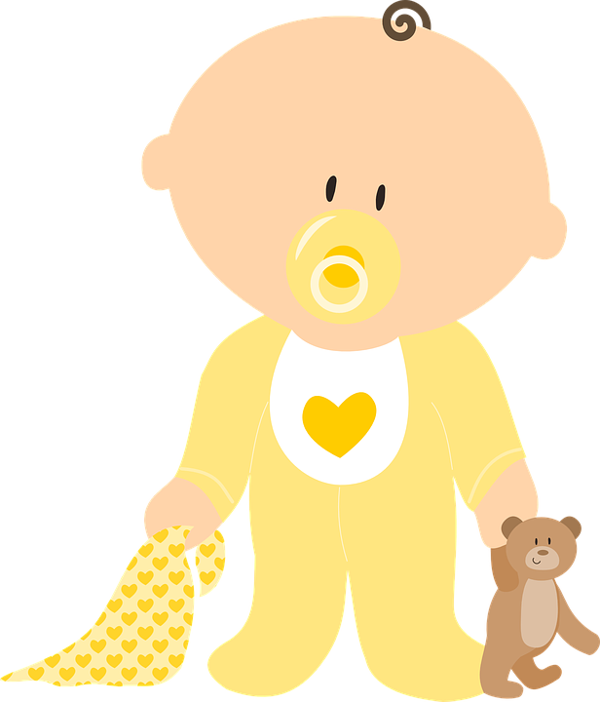
aussprechen
[ei]
…
frei
/a
sein
ein
alone
klein
allein
Notes:
Timing: 1 minute
Aim: to consolidate the SSC [ei].
Procedure:
Re-present the SSC and the source word ‘frei’ (with gesture, if using).
Click to bring on the picture and get pupils to repeat the word ‘frei’ (with gesture, if using).
Present the cluster words in the same way, bringing on the picture and getting pupils to pronounce the words.
Vocabulary: frei [318] ein [5] klein [114] sein [3] allein [258]

Slide 4
aussprechen
[ei]
Say the pairs out loud.
…
shine
scheinen
weiß
mine
most
white
wide
light
by
side
frei
mein
meist
Seite
price
weit
allein
free
Freitag
Friday
bei
leicht
alone
Preis
START
Notes:
Timing: 1 minute
Aim: to consolidate the SSC [ei].
Procedure:
Explain that pupils have to find German/ English pairs and say them out loud in under one minute (use the timer).
Demonstrate using the word ‘frei’ which is known, and also ‘allein’.
Vocabulary: (new)
bei [29] mein [51] Seite [197] weit [230] scheinen [275] Preis [334] meist [379] weiß [472
Jones, R.L & Tschirner, E. (2019). A frequency dictionary of German: Core vocabulary for learners. London: Routledge.

Slide 5
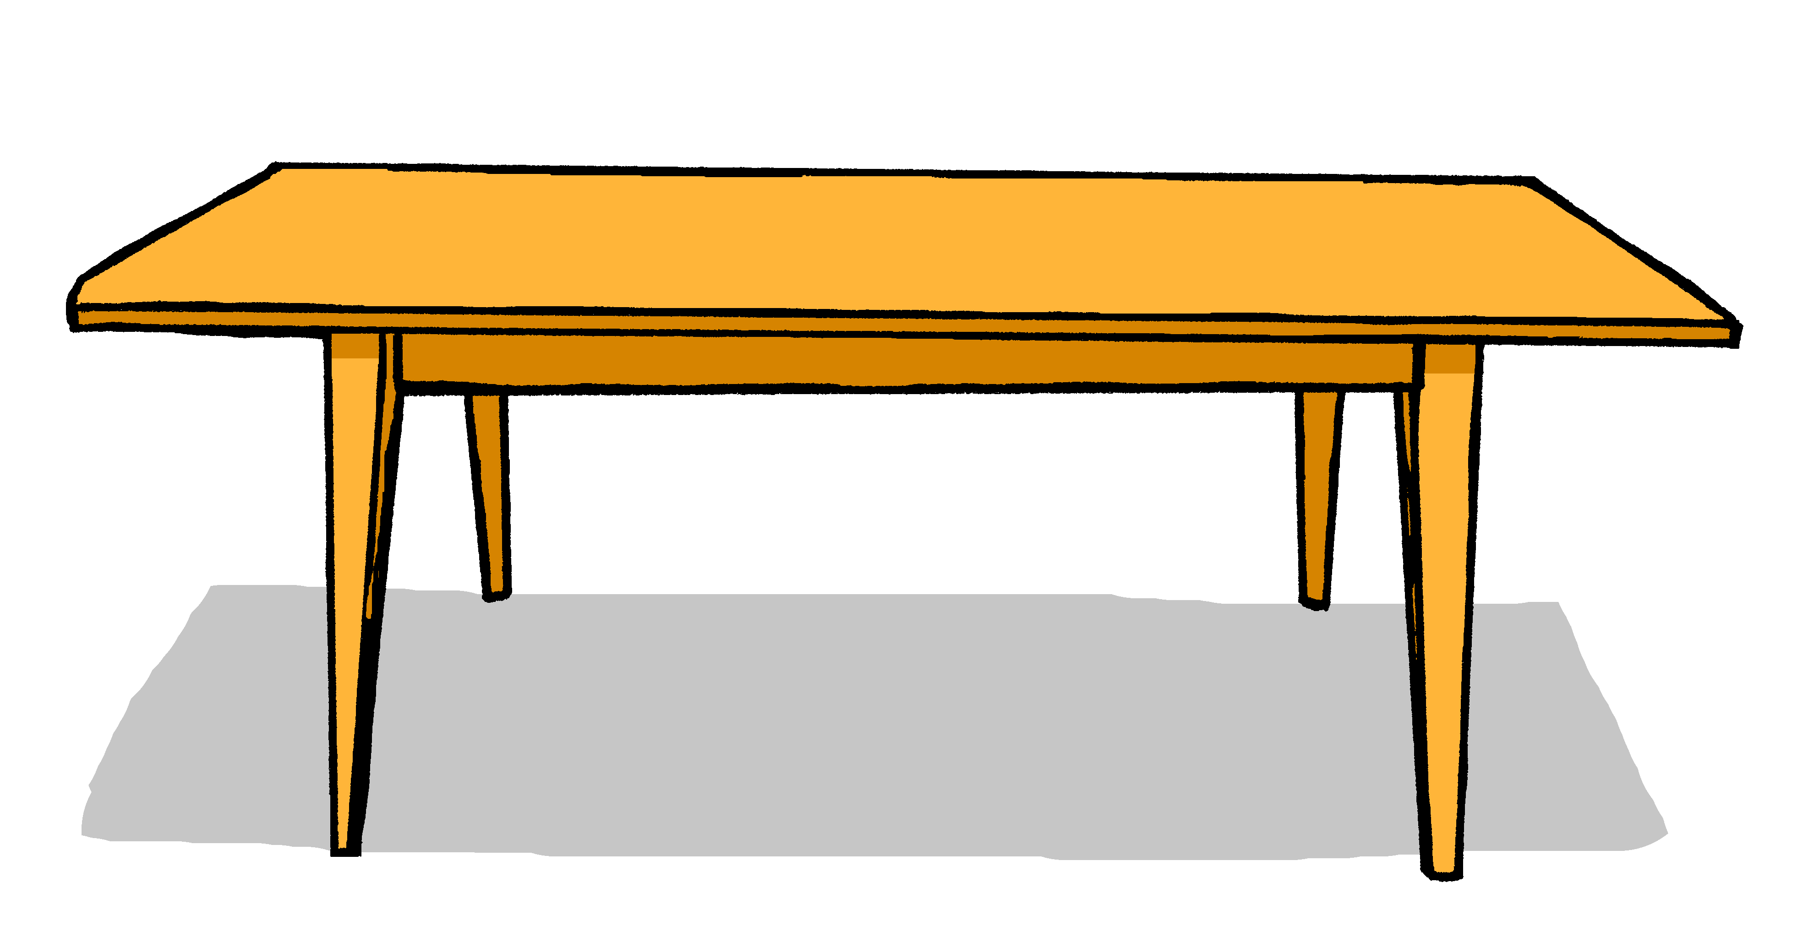
Nouns
All German nouns start with a capital letter, wherever they are in the sentence:
Der Tisch ist da.
The table is there.
Which nouns do this in English?
Proper nouns, e.g. London, September, Monday, Emily.
German proper nouns do this as well.
Notes:
Timing: 2 minutes
Aim: to present information about capitalisation of German nouns.
Procedure:
Click through the animations to present the new information.
Elicit English translation for the German example provided.
5

Slide 6
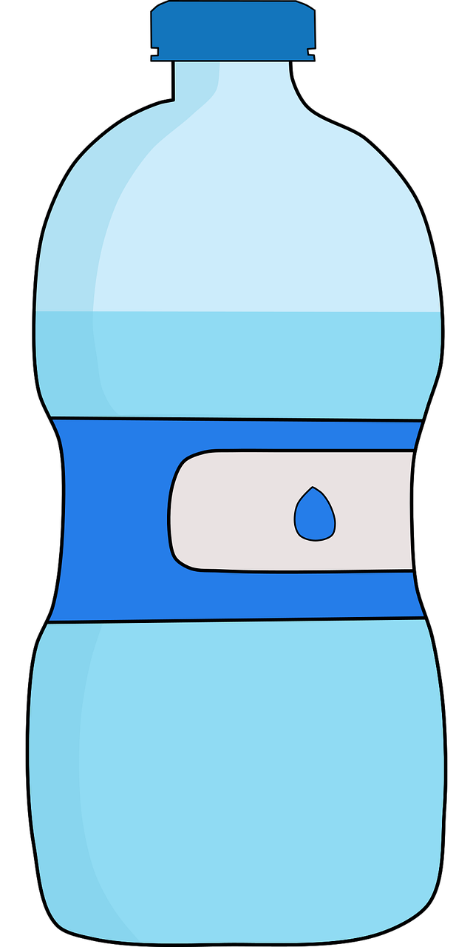
der, die, das (the)
German has three words for the:
masculine
feminine
neuter
der
das Heft
der Tisch
die Flasche
das
die
English speakers might find this tricky because English only uses the.
Every noun has a gender, but grammatical gender is not the same as biological gender.
Notes:
Timing: 3 minutes Aim: To introduce the concept of noun gender and the three singular definite articles (words for ‘the’) in German. Procedure: 1. Bring up the text and read it carefully, with helpful intonation.
2. Try to elicit the nouns from students before revealing them. Students have learnt two possible nouns for ‘die’ and ‘das’.
Note: It’s important for teachers to draw out the importance of learning gender. One point of interest is native speaker prediction based on gender. Depending on the class, it might be interesting for students to know that native speakers of languages with gender begin to predict what is going to be talked about as soon as the gender word is said – i.e. if there are two objects in view and just the word for ‘the’ is said, it is already clear what is being talked about. This classification of nouns by gender serves to speed up identification (fractions of a second, but still interesting and important!)
The key point for teachers to emphasise is that students need to learn nouns with their gender from the first encounter and practise recalling them frequently.
Vocabulary:
der, die, das [1] Flasche [1602] Heft [3862] Tisch [529]
Jones, R.L & Tschirner, E. (2019). A frequency dictionary of German: Core vocabulary for learners. London: Routledge.
6

Slide 7
Vokabeln
Let’s learn six nouns in German.
Wörter
der Tisch
die Tafel
das Fenster
der Bleistift
die Flasche
das Heft
Notes:
Timing: 5 minutes
Aim: to present and practise written comprehension and read aloud of the new vocabulary for this week.
Procedure: 1. Click for a German word. Elicit pronunciation from pupils.
2. Click for the English meaning and picture prompt. Elicit the German word again.
3. Present all six words like this, in order.
4. Click for one English meaning to disappear. Elicit the English meaning from pupils. Continue with the remaining items.
5. Click for the German word to disappear. Elicit the German from pupils. Continue with the remaining items.
Vocabulary:
der, die, das [1] Bleistift [>5009] Fenster [674] Flasche [1602] Heft [3862] Tafel [3855] Tisch [529]
Jones, R.L & Tschirner, E. (2019). A frequency dictionary of German: Core vocabulary for learners. London: Routledge.
7

Slide 8
Nouns
Which words need a capital letter in German?
1
The
table
is
there.
1. Der Tisch ist da.
2
Where
is
the
bottle?
2. Wo ist die Flasche?
3
The
exercise book
is
here.
3. Das Heft is hier.
4
Where
is
Johanna?
4. Wo ist Johanna?
5
Johanna
is
in
Berlin.
5. Johanna ist in Berlin.
Notes:
Timing: 3 minutes Aim: To practise the concept of capital letters on German nouns. Procedure: 1. Bring up each question.
2. Students identify the words that need capitals. Point out that both German and English always start sentences with a capital letter. 3. Elicit and/or present the German sentence.
Note that pupils have only just been introduced to these words so may remember some of them, but it is fine to just present the German sentences.
8

Slide 9
hören
Wo ist…?
Notes:
slide 1 of 6
Timing: 2 minutes (6 slides) Aim: To practise knowledge of noun gender and the three singular definite articles (words for ‘the’) in German. Procedure: 1. Click to bring up both pictures at once. 2. Say the gender of either one and students have to respond by either turning their heads to the left or right or pointing at the correct picture, whichever is clearer. The teacher can frame this as the partially completed question ‘Wo ist die…? OR ‘Wo ist das…?
Transcript:
Wo ist die…?
9

Slide 10
hören
Wo ist…?
Notes:
[2/6]
Transcript:
Wo ist das…?
10

Slide 11
hören
Wo ist…?
Notes:
[3/6]
Transcript:
Wo ist der…?
11

Slide 12
hören
Wo ist…?
Notes:
[4/6]
Transcript:
Wo ist das…?
12

Slide 13
hören
Wo ist…?
Notes:
[5/6]
Transcript:
Wo ist die…?
13

Slide 14
hören
Wo ist…?
Notes:
[6/6]
Transcript:
Wo ist der…?
14

Slide 15
Kultur
Schule in Deutschland
In Germany, children start school at 6 years old. In most of the country, primary school takes four years. School finishes around lunchtime, and there is no school uniform!
Schule is cool!
Notes:
Timing: 5 minutes
Aim: to present an introduction to school in Germany.
Procedure:
Read the text about school in Germany. Pupils can discuss if they like the sound of school in Germany, why/why not.
Click to bring up the speech bubble: Schule ist cool!
Pupils have a go at reading out the speech bubble to each other: Schule ist cool!
15

Slide 16
Tschüss!
rot
Notes:
16

