Slide 1
Describing me and others
rot
Follow ups 1-5
Term 1 Week 5
Notes:
Artwork by Steve Clarke. Pronoun pictures from NCELP (www.ncelp.org). All additional pictures selected from Pixabay and are available under a Creative Commons license, no attribution required.
Phonics:
long [e] geben [49] Idee [451] mehr [52]
short [e] denken [128] Bett [659] helfen [338]
Vocabulary (new): was [38] blau [948] falsch [524] gelb [1446] rot [477] richtig [177] das² [1]
Jones, R.L & Tschirner, E. (2019). A frequency dictionary of German: Core vocabulary for learners. London: Routledge.
The frequency rankings for words that occur in this PowerPoint which have been previously introduced in these resources are given in the SOW and in the resources that first
introduced and formally re-visited those words.
For any other words that occur incidentally in this PowerPoint, frequency rankings will be provided in the notes field wherever possible.

Slide 2
aussprechen
Follow up 1
…
long [e]
geben
to give
more
Idee
mehr
Notes:
Timing: 1 minute
Aim: to remind pupils of the SSC long [e].
Procedure:
Re-present the SSC and the source word ‘geben’ (with gesture, if using).
Click to bring on the picture and get pupils to repeat the word ‘geben’ (with gesture, if using).
Present the cluster words in the same way, bringing on the picture and getting pupils to pronounce the words.
Vocabulary:
Idee [451] mehr [52]
2

Slide 3
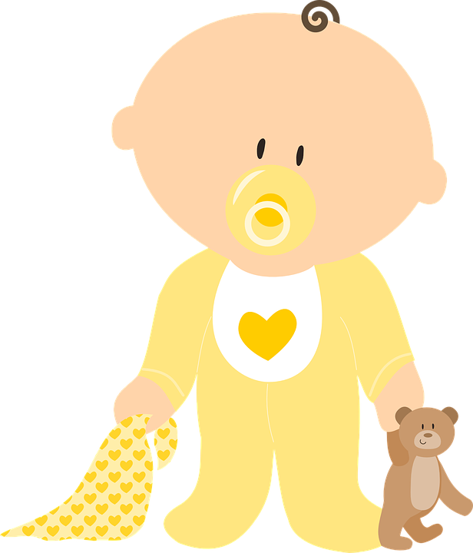
aussprechen
[ei]
Follow up 1
…
frei
/a
sein
ein
alone
klein
allein
Notes:
Timing: 1 minute
Aim: to revise the SSC [ei].
Procedure:
Re-present the SSC and the source word ‘frei’ (with gesture, if using).
Click to bring on the picture and get pupils to repeat the word ‘frei’ (with gesture, if using).
Present the cluster words in the same way, bringing on the picture and getting pupils to pronounce the words.
Vocabulary: frei [318] ein [5] klein [114] sein [3] allein [258]

Slide 4
Follow up 1
Hör zu. Langes [e] oder* [ei]?
Moritz is dreaming. What is he dreaming about? Hör zu. Schreib A oder B.
hören
1
A
B
soul
Seele
Seile
oder – or
Notes:
slide 1 of 6
Timing: 5 minutes
Aim: to practise aural distinction between SSC long [e] and [ei].
Procedure:
Click to listen to each word.
Pupils write A or B.
Click to reveal answer.
Elicit the pronunciation of both words to give pupils additional read aloud practice.
Frequency of unknown words and cognates:
Seil [4925] Seele [1927]
Jones, R.L & Tschirner, E. (2019). A frequency dictionary of German: Core vocabulary for learners. London: Routledge.

Slide 5
Follow up 1
Hör zu. Langes [e] oder* [ei]?
hören
2
A
B
fein
Feen
oder – or
Notes:
[2/6]
Frequency of unknown words and cognates:
Feen [>5009] fein [1676]
Jones, R.L & Tschirner, E. (2019). A frequency dictionary of German: Core vocabulary for learners. London: Routledge.

Slide 6
Follow up 1
Hör zu. Langes [e] oder* [ei]?
hören
3
A
B
Frau Meier
Meier
Meer
oder – or
Notes:
[3/6]
Frequency of unknown words and cognates:
Meer [852] Meier N/A
Jones, R.L & Tschirner, E. (2019). A frequency dictionary of German: Core vocabulary for learners. London: Routledge.

Slide 7
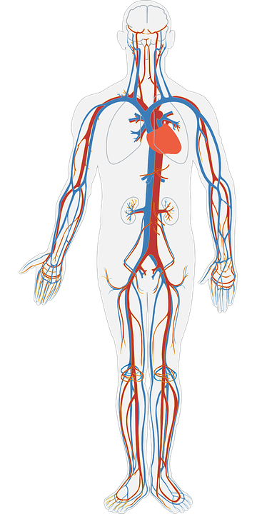
Follow up 1
Hör zu. Langes [e] oder* [ei]?
hören
4
A
B
Venen
weinen
oder – or
Notes:
[4/6]
Frequency of unknown words and cognates:
weinen [1556] Vene [3465]
Jones, R.L & Tschirner, E. (2019). A frequency dictionary of German: Core vocabulary for learners. London: Routledge.

Slide 8
Follow up 1
Hör zu. Langes [e] oder* [ei]?
hören
5
A
B
sehen
sein
oder – or
Notes:
[5/6]
Frequency of unknown words and cognates:
sehen [79]
Jones, R.L & Tschirner, E. (2019). A frequency dictionary of German: Core vocabulary for learners. London: Routledge.

Slide 9
Follow up 1
Hör zu. Langes [e] oder* [ei]?
hören
6
A
B
nee
nein
Nee means the same as nein, like ‘nah’ in English.
oder – or
Notes:
[6/6]
Frequency of unknown words and cognates:
nee (148, variation of nein)
Jones, R.L & Tschirner, E. (2019). A frequency dictionary of German: Core vocabulary for learners. London: Routledge.

Slide 10
Follow up 2
Was ist das auf Englisch*?
auf Englisch – in English
Schreib auf Englisch.
hören
1
Hello! I am here in England.
2
Are you in Germany?
3
Yes, that’s right.
4
The pencil is red.
5
No, that’s false/wrong!
6
The pencil is yellow and blue.
Notes:
Timing: 5 minutes
Aim: to practise aural comprehension of a range of the new language learnt so far in the course in short, simple sentences.
Procedure: 1. Read the teacher instruction for the activity in German. Elicit the meaning from pupils.
2. Click to listen to the first sentence.
3. Pupils write down the meaning in English.
4. Click to reveal the meaning.
5. Complete items 2-6 and click to correct.
6. Extension: teachers can elicit the German from the English answers on the slide. It does not matter if pupils can only offer some of the words from memory in German. They should be encouraged to say what they do know. Teachers can re-play the audio for an additional listen and check step.
Transcript: Ich bin hier in England!
Bist du in Deutschland?
Ja, das ist richtig!
Der Bleistift ist rot.
Nein, das ist falsch!
Der Bleistift ist gelb und blau.

Slide 11
Follow up 3
Was ist das auf Englisch?
…
Choose 5 words. Say them to your partner in German. S/he will tell you what they mean in English.
sprechen
Person A:
wo?, der Bleistift, toll, ist, und
where?, the pencil, great, is, and
sein | die Flasche | blau | gelb | das²
das Fenster | wo? | was? | der Bleistift | und
das Heft | hier | du | richtig | ja
der Tisch | da | rot | falsch | nein
die Tafel | der, die, das | toll | ist | ich
Notes:
Timing: 5 minutes
Aim: to practise oral comprehension (listening pupils) and read aloud (speaking pupil) of previously taught words. Procedure:
Pupil A chooses 5 words and say to them to their partner in German.
Pupil B says the meaning in English.
Swap roles.

Slide 12
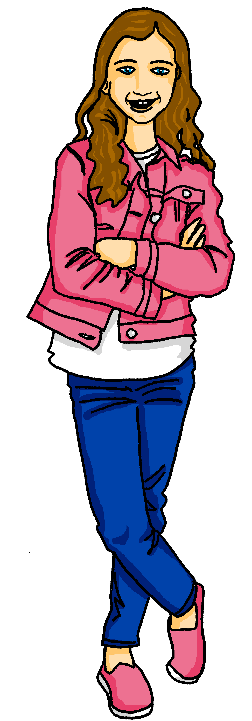
Follow up 4:

Hör zu. Dann sing mit!
singen
Hallo! Hallo! Guten Tag! Hallo! Hallo! Guten Tag!
Hallo! Ich bin hier,
Hallo! Du bist da, Hallo! Hallo! Guten Tag!
Notes:
Timing: 5 minutes
Aim: to practise some previously learnt vocabulary in a simple song (to the tune of ‘If you’re happy and you know it’).
Procedure: 1. Click to play the audio of the song.
2. Repeat the words of each line to practise saying them clearly (borrow the rhythm of the song so that this is a rehearsal stage before singing).
3. Click to play the audio again and this time, pupils join in.
Note: Teachers might like to re-use this song as part of their lesson starting routine in future lessons. Soon pupils will not need to see the words to recall it.

Slide 13
Follow up 5:

Schreib auf Englisch.
Can you get at least 15 points?
Wörter
 | ja | ist | Guten Tag
 | sie | da | er
 | die Tafel | der Bleistift | der Tisch
 | die Flasche | das Fenster | du bist
 | das² | richtig | was
 | falsch | gelb | rot
yes
is
hello (formal)
Vokabeln
x3
she
there
he
(the) board
(the) pencil
(the) table
x2
(the) bottle
(the) window)
you are
that
right
what
x1
false
yellow
red
Notes:
Timing: 5 minutes
Aim: to practise written comprehension of vocabulary from this and revisited weeks.
Procedure: 1. Give pupils a blank grid. They fill in the English meanings of any of the words they know, trying to reach 15 points in total. 2. Remind pupils that adjectives can refer to male or female persons and they should note this in their translations. E.g. pleased (f), short (m).
Note: The most recently learnt and practised words are pink, words from the previous week are green and those from week 1 are blue, thus more points are awarded for them, to recognise that memories fade and more effort (heavy lifting!) is needed to retrieve them.

Slide 14
Follow up 5:

Schreib auf Deutsch.
Can you get at least 15 points?
Wörter
 | there | he | is
 | Hello (formal) | she | yes
 | (the) window | (the) bottle | (the) table
 | you are | (the) pencil | board
 | red | yellow | what
 | blue | right | that
da
er
ist
Vokabeln
x3
Guten Tag
sie
ja
das Fenster
die Flasche
der Tisch
x2
du bist
der Bleistift
die Tafel
rot
gelb
was
x1
blau
richtig
das²
Notes:
Timing: 5 minutes
Aim: to practise written comprehension of vocabulary from this and revisited weeks.
Procedure: 1. Give pupils a blank grid. They fill in the English meanings of any of the words they know, trying to reach 15 points in total. 2. Remind pupils that adjectives can refer to male or female persons and they should note this in their translations. E.g. pleased (f), short (m).
Note: The most recently learnt and practised words are pink, words from the previous week are green and those from week 1 are blue, thus more points are awarded for them, to recognise that memories fade and more effort (heavy lifting!) is needed to retrieve them.

Slide 15
Tschüss!
rot
Notes:
15

Slide 16
Follow up 5:

Schreib auf Englisch.
Can you get at least 15 points?
Wörter
 | ja | ist | Guten Tag
 | sie | da | er
 | die Tafel | der Bleistift | der Tisch
 | die Flasche | das Fenster | du bist
 | das² | richtig | was
 | falsch | gelb | rot
Vokabeln
x3
he
x2
x1
Notes:
Timing: 5 minutes
Aim: to practise written comprehension of vocabulary from this and revisited weeks.
Procedure: 1. Give pupils a blank grid. They fill in the English meanings of any of the words they know, trying to reach 15 points in total. 2. Remind pupils that adjectives can refer to male or female persons and they should note this in their translations. E.g. pleased (f), short (m).
Note: The most recently learnt and practised words are pink, words from the previous week are green and those from week 1 are blue, thus more points are awarded for them, to recognise that memories fade and more effort (heavy lifting!) is needed to retrieve them.

Slide 17
Follow up 5:

Schreib auf Deutsch.
Can you get at least 15 points?
Wörter
 | there | he | is
 | Hello (formal) | she | yes
 | (the) window | (the) bottle | (the) table
 | you are | (the) pencil | (the) board
 | red | yellow | what
 | blue | right | that
Vokabeln
x3
x2
x1
Notes:
Template for printing

