Slide 1

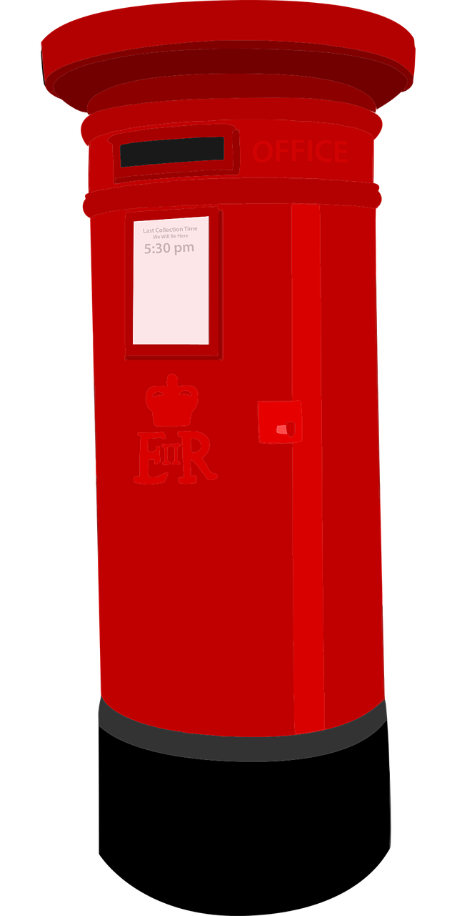
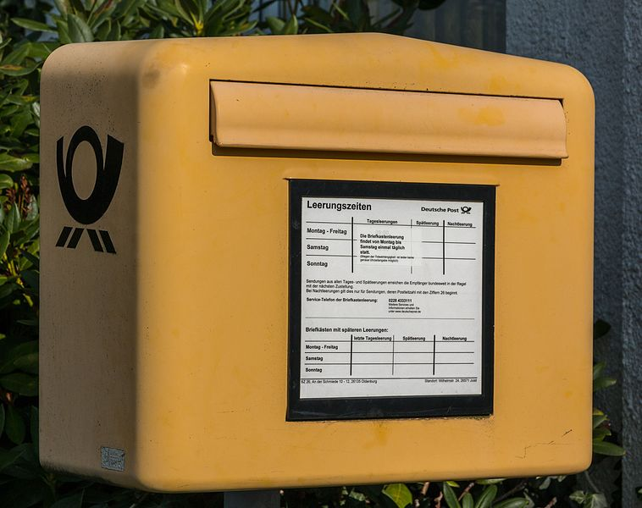
Describing me and others
rot
Describing nouns
SSC long and short [e]
Term 1 Week 5
Notes:
Artwork by Steve Clarke. Pronoun pictures from NCELP (www.ncelp.org). All additional pictures selected from Pixabay and are available under a Creative Commons license, no
attribution required.
Phonics:
long [e] geben [49] Idee [451] mehr [52]
short [e] denken [128] Bett [659] helfen [338]
Vocabulary (new): was [38] blau [948] falsch [524] gelb [1446] rot [477] richtig [177] das² [1]
Revisit 1: du [54] bist [4]
Jones, R.L & Tschirner, E. (2019). A frequency dictionary of German: Core vocabulary for learners. London: Routledge.
The frequency rankings for words that occur in this PowerPoint which have been previously introduced in these resources are given in the SOW and in the resources that first introduced and formally re-visited those words.
For any other words that occur incidentally in this PowerPoint, frequency rankings will be provided in the notes field wherever possible.
Note that the first three lessons of the year teach language that can be continuously recycled as lesson routine every lesson in Y3/4.
The idea would be that the class teacher (whether or not s/he teaches the class German can re-use the language as part of the daily routine with the class.
1

Slide 2


aussprechen
long [e]
…
Notice that the 2nd ‘e’ sounds like the ‘a’ in ‘ago’.
to give
geben
Notes:
Timing: 1 minute
Aim: to introduce the SSC long [e].
Procedure:
Introduce the SSC and present the source word ‘geben’ (with gesture, if using).
Click to bring on the picture and get pupils to repeat the word ‘geben’ (with gesture, if using).
Note: a gesture for ‘geben’ might be to pretend to give someone on object.
geben [49]
2

Slide 3


aussprechen
long [e]
…
geben
to give
more
Idee
mehr
Notes:
Timing: 1 minute
Aim: to introduce the SSC long [e].
Procedure:
Re-present the SSC and the source word ‘geben’ (with gesture, if using).
Click to bring on the picture and get pupils to repeat the word ‘geben’ (with gesture, if using).
Present the cluster words in the same way, bringing on the picture and getting pupils to pronounce the words.
Idee [451] mehr [52]
3

Slide 4

aussprechen
short [e]
…
Notice that the 2nd ‘e’ sounds like the ‘a’ in ‘ago’.
to think
denken
Notes:
Timing: 1 minute
Aim: to consolidate the SSC short [e].
Procedure:
Introduce the SSC and present the source word ‘denken’ (with gesture, if using).
Click to bring on the picture and get pupils to repeat the word ‘denken’ (with gesture, if using).
Note: a gesture for ‘denken’ might be to pretend to to put your finger to your temple as though you are pondering something.
denken [128]

Slide 5


aussprechen
short [e]
…
denken
to think
to help
Bett
helfen
Notes:
Timing: 1 minute
Aim: to consolidate the SSC short [e].
Procedure:
Re-present the SSC and the source word ‘denken’ (with gesture, if using).
Click to bring on the picture and get pupils to repeat the word ‘denken’ (with gesture, if using).
Present the cluster words in the same way, bringing on the picture and getting pupils to pronounce the words.
Note: a gesture for ‘denken’ might be to pretend to to put your finger to your mouth and as if you’re concentrating and thinking about something.
Bett [659] helfen [338]

Slide 6






hören
long and short [e]
Hör zu. Ist das (long)[e] oder )short [e]?
hören
 | long [e] | short [e] | word
1 |  |  | Bett
2 |  |  | Problem
3 |  |  | Idee
4 |  |  | gelb
5 |  |  | mehr
6 |  |  | Ende
Notes:
Timing: 5 minutes
Aim: to consolidate the SSC long [e] and short [e] by practising listening to the different pronunciations.
Procedure:
1. Click audio button 1 to play the recording for item 1. Pupils need to decide is it long [e] or short [e] and write list of S for short and L for long.
2. Elicit the answer; encourage pupils to pay particular attention to short [e] or long [e].
3. Click to bring up the answer tick for item 1.
4. Elicit the whole word; if necessary click the audio button again to play recording again.
5. Click to bring up the written version of the German word, together with picture.
6. Continue for items 2-6.
Transcript:
Bett
Problem
Idee
gelb
mehr
Ende
Vocabulary:
Ende [183] gelb [1446] Problem [210]

Slide 7








Vokabeln
Vokabeln lernen
You already know that ‘das’ means ‘the’, but it also means ‘that’! E.g. Was ist das?
What is that?
Wörter
das
richtig
falsch
Was
Listen carefully to this word. You know how to say ‘ich’; the ‘ig’ here sounds the same as ‘ich’!
Remember that in German, final –d sounds like –t (e.g. ‘und’). In the same way, final –b sounds like –p!
gelb
rot
blau
Notes:
Aim: to present and practise written comprehension and read aloud of the new vocabulary for this week.
Procedure:
1. Click for a German word. Elicit pronunciation from pupils.
2. Click for the English meaning and picture prompt. Elicit the German word again.
3. Present all six words like this, in order.
4. Click for one English meaning to disappear. Elicit the English meaning from pupils. Continue with the remaining items.
5. Click for the German word to disappear. Elicit the German from pupils. Continue with the remaining items.
7

Slide 8



sprechen
Was ist rot?
…
sprechen
Notes:
slide 1 of 6
Timing: 2 minutes (6 slides)
Aim: To elicit vocabulary using the three news colours.
Procedure:
1. Click to bring up both pictures at once.
2. Ask: was ist rot? Pupils say: Das Heft ist rot. Continue for 6 slides.
8

Slide 9
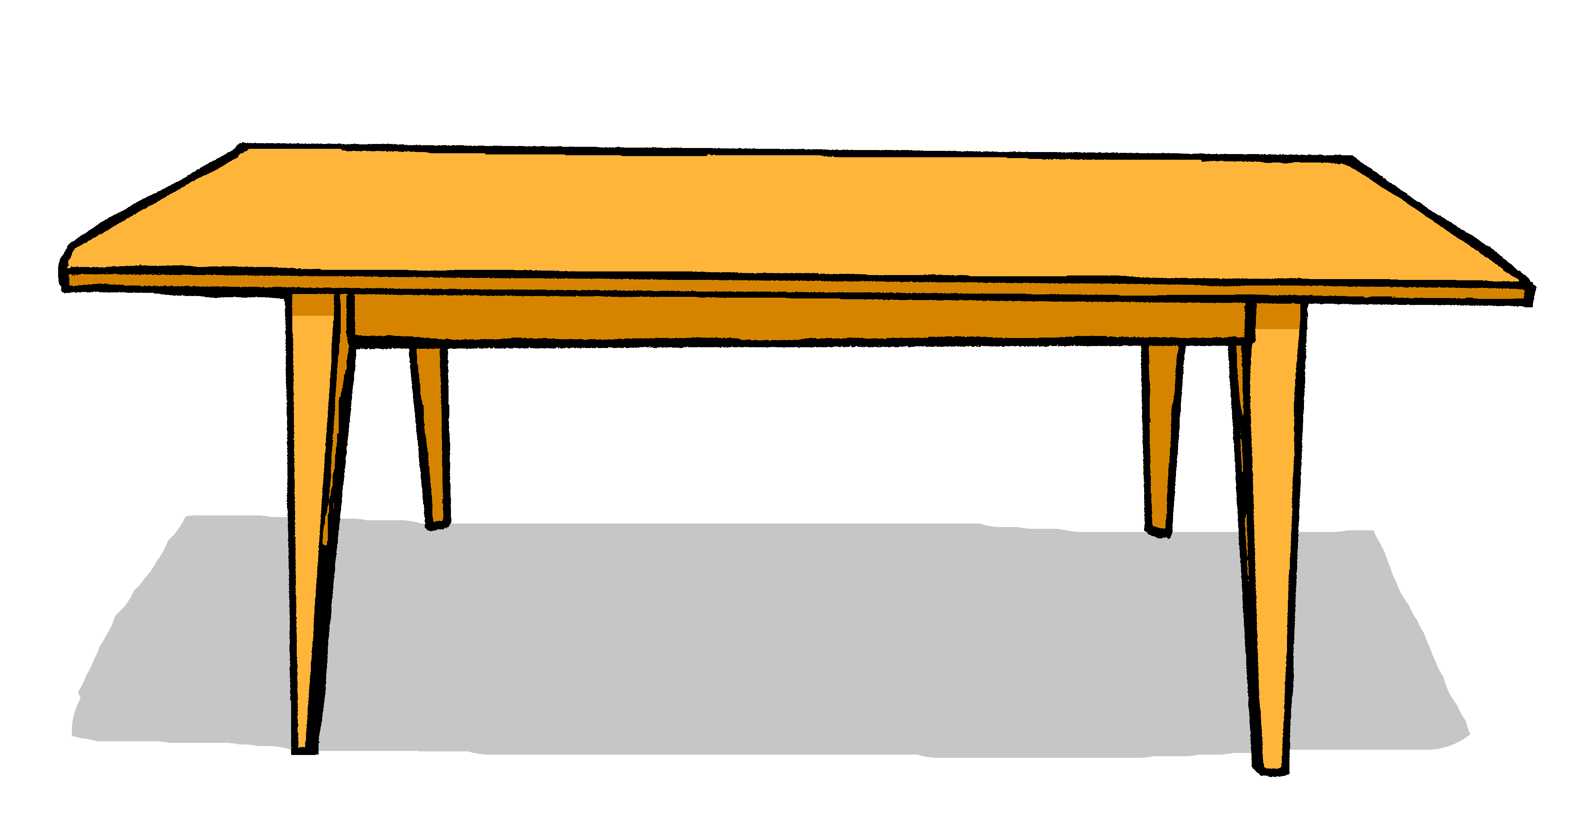
sprechen
Was ist gelb?
…
sprechen
Notes:
slide 2 of 6
Timing: 2 minutes (6 slides)
Procedure:
1. Click to bring up both pictures at once.
2. Ask: was ist gelb?
3. Pupils say: Der Tisch ist gelb.
9

Slide 10
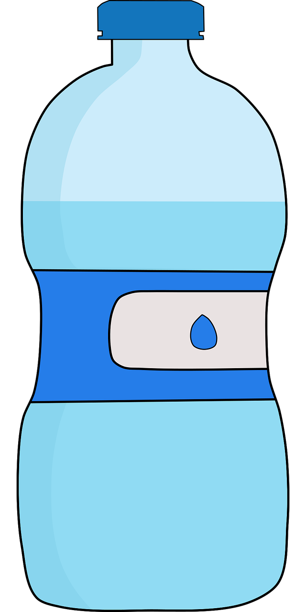
sprechen
Was ist blau?
…
sprechen
Notes:
slide 3 of 6
Timing: 2 minutes (6 slides)
Procedure:
1. Click to bring up both pictures at once.
2. Ask: was ist blau?
3. Pupils say: Die Flasche ist blau.
10

Slide 11
sprechen
Was ist gelb?
…
sprechen
Notes:
slide 4 of 6
Timing: 2 minutes (6 slides)
Procedure:
1. Click to bring up both pictures at once.
2. Ask: was ist gelb?
3. Pupils say: Die Tafel ist gelb.
11

Slide 12


sprechen
Was ist blau?
…
sprechen
Notes:
slide 5 of 6
Timing: 2 minutes (6 slides)
Procedure:
1. Click to bring up both pictures at once.
2. Ask: was ist blau?
3. Pupils say: Das Fenster ist blau.
12

Slide 13
sprechen
Was ist gelb?
…
sprechen
Notes:
slide 6 of 6
Timing: 2 minutes (6 slides)
Procedure:
1. Click to bring up both pictures at once.
2. Ask: was ist gelb?
3. Pupils say: Der Bleistift ist gelb.
13

Slide 14

Kultur
Farben* in Deutschland und England
*die Farbe - colour
Countries have different colours for some things.
Look at the pictures:
Wo ist das?
Wo ist das?
Richtig! Das ist in England.
Ja, das ist in Deutschland.
Notes:
Timing: 5 minutes (5 x slides)
Aim: to raise intercultural awareness of different uses of colours for different things in Germany and England.
Procedure:
Read the short explanation about colours in Germany and England.
Click to present the example of the post boxes, asking Wo ist das? and eliciting Das ist in England/Deutschland from the whole class.
Click to reveal the correct answers.
Follow up by making true or false statements about each post box, to elicit Nein, das ist falsch or Ja, das ist richtig. Click to model these answers from Johanna and Moritz.
Then repeat steps 2-4 with the next 4 slides.
Picture attribution: German post box
Dietmar Rabich / Wikimedia Commons / “Juist, Briefkasten -- 2014 -- 3622” / CC BY-SA 4.0
14

Slide 15
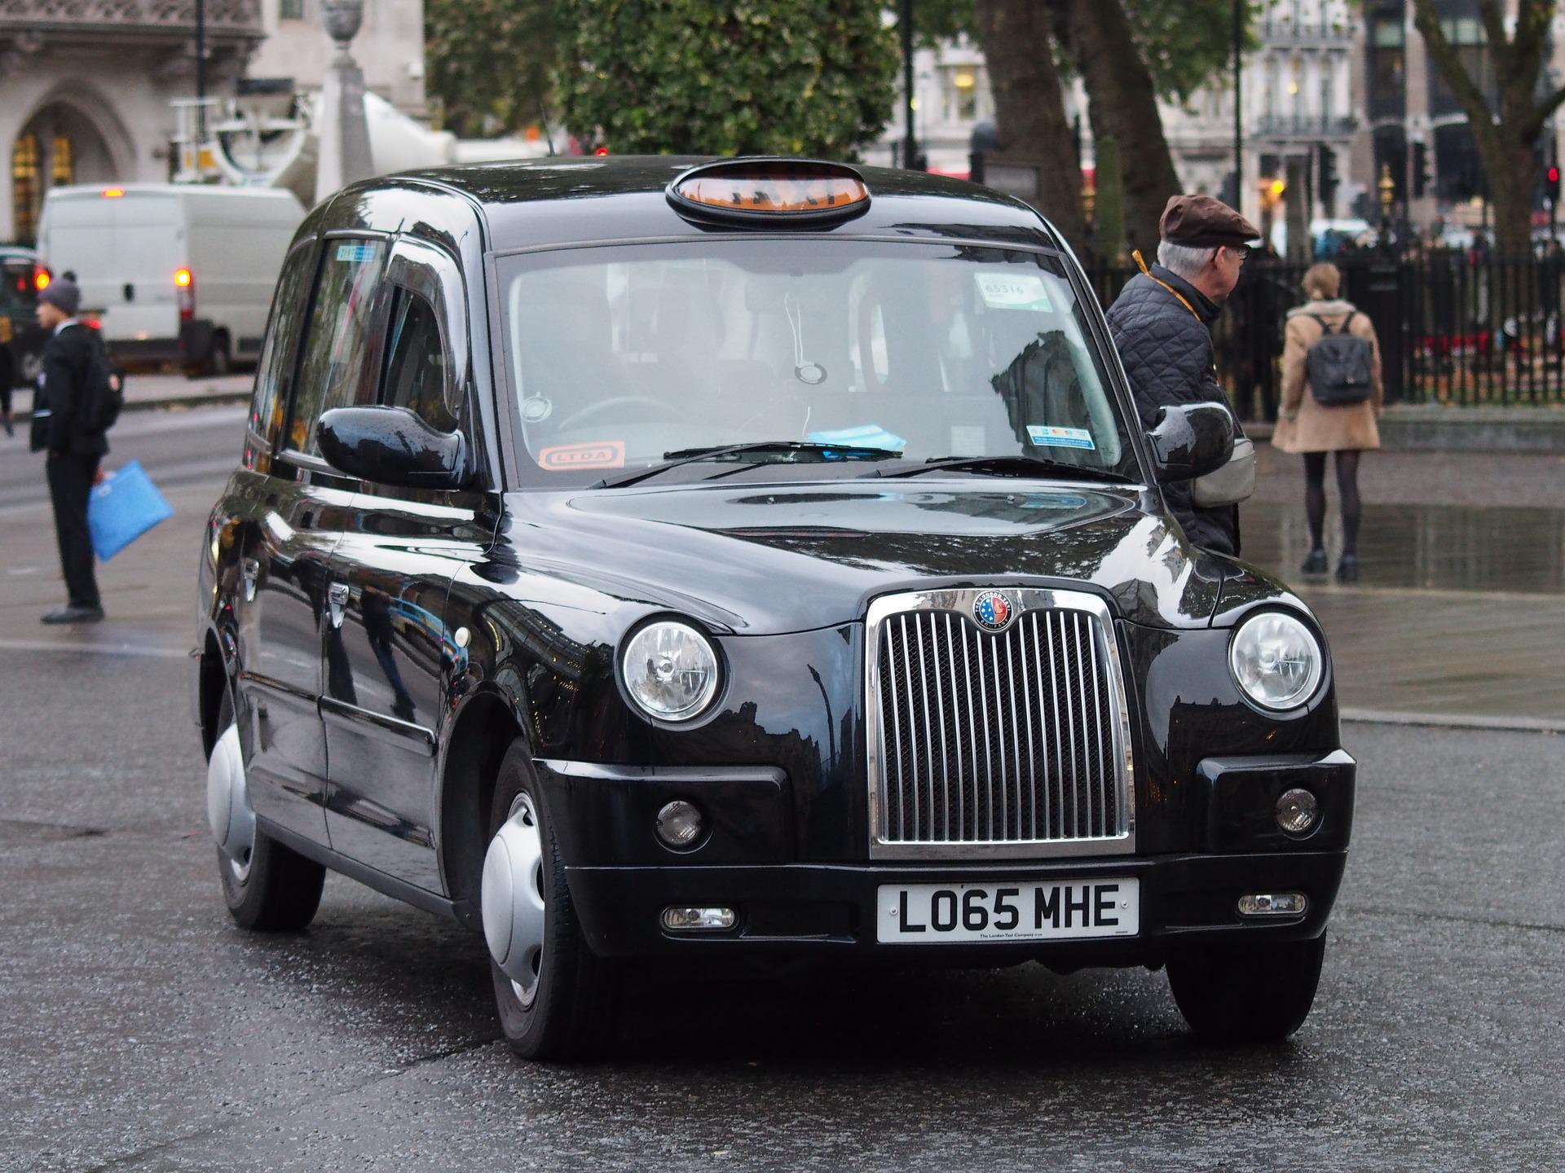
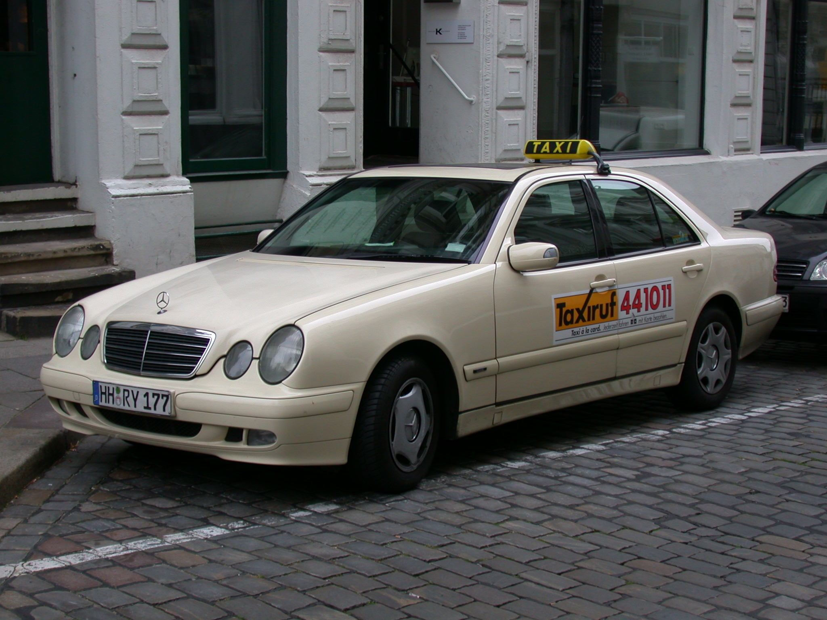
Kultur
Farben* in Deutschland und England
Wo ist das?
Wo ist das?
Richtig! Das ist in Deutschland.
Ja, das ist in England.
Notes:
[2/5]
Attribution: German taxi
User: (WT-shared) Riggwelter at wts wikivoyage, CC BY-SA 4.0, via Wikimedia Commons
15

Slide 16
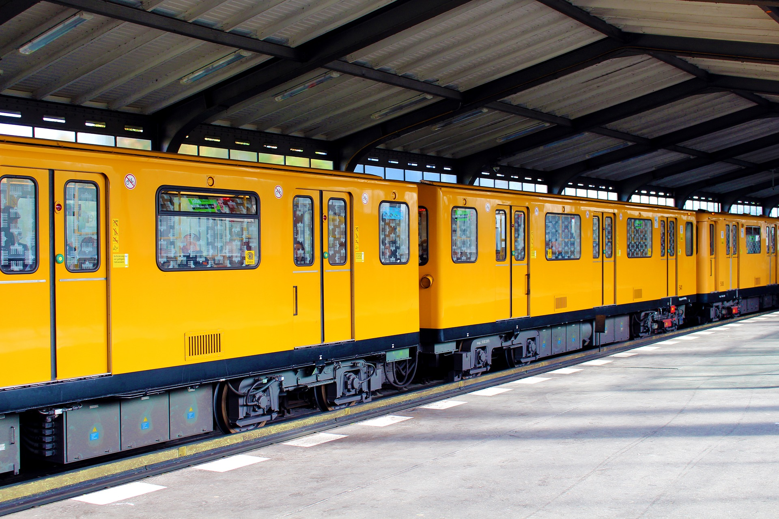
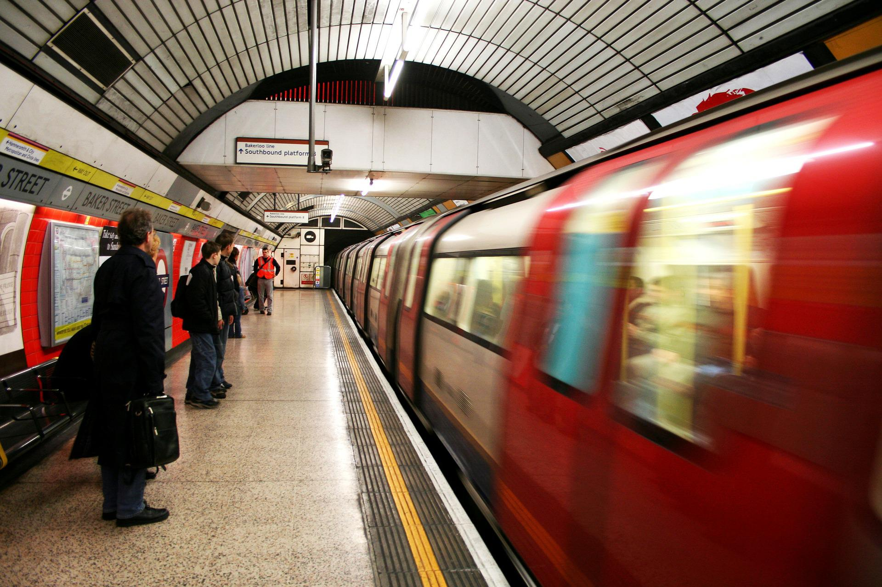
Kultur
Farben* in Deutschland und England
Wo ist das?
Wo ist das?
Richtig! Das ist in England.
Ja, das ist in Deutschland.
Notes:
[3/5]
16

Slide 17
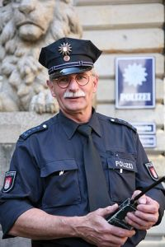
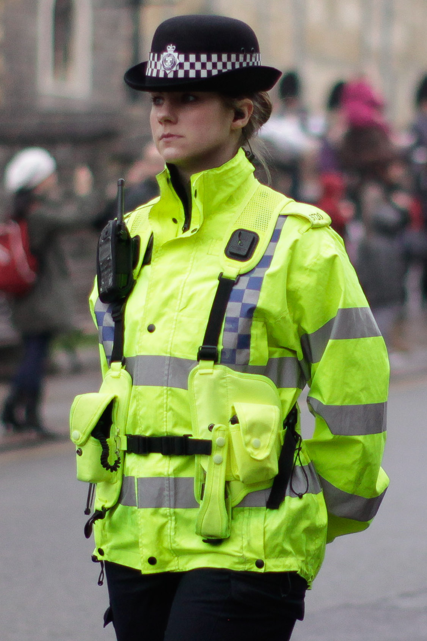
Kultur
Farben* in Deutschland und England
Wo ist das?
Wo ist das?
Richtig! Das ist in England.
Ja, das ist in Deutschland.
Notes:
[4/5]
Attribution: German police officer
Daniel Schwen via Wikimedia Commons
British Police officer
Ollie Harding via Wikimedia Commons https://commons.wikimedia.org/wiki/File:Policewoman_in_the_UK_%285304887200%29.jpg
17

Slide 18
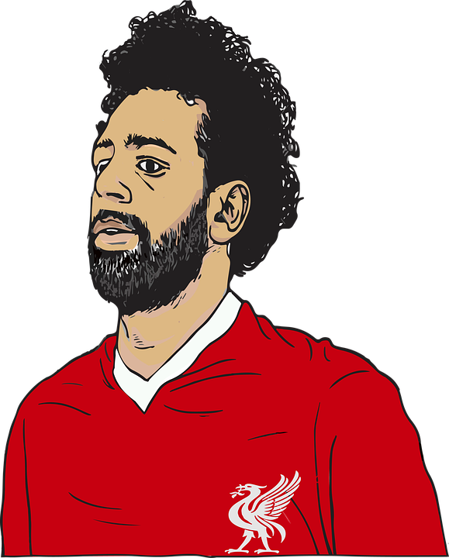
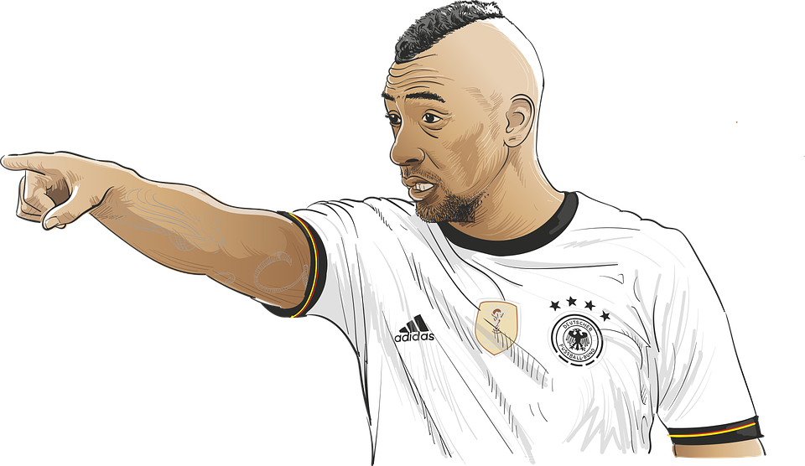
Kultur
Farben* in Deutschland und England
Wo ist das?
Wo ist das?
Richtig! Das ist in Deutschland.
Ja, das ist in England.
Notes:
[5/5]
18

Slide 19



Nouns
Remember that all German nouns start with a capital letter, wherever they are in the sentence:
Der Tisch ist da.
The table is there.
All German proper nouns also start with capital letters, just like in English:
And don’t forget that all sentences start with a capital letter in both German and English!
e.g. Berlin, Moritz.
Notes:
Timing: 2 minutes
Aim: to recap information about capitalisation of German (and English) nouns.
Procedure:
Click through the animations to present the new information.
Elicit English translation for the German example provided.
19

Slide 20
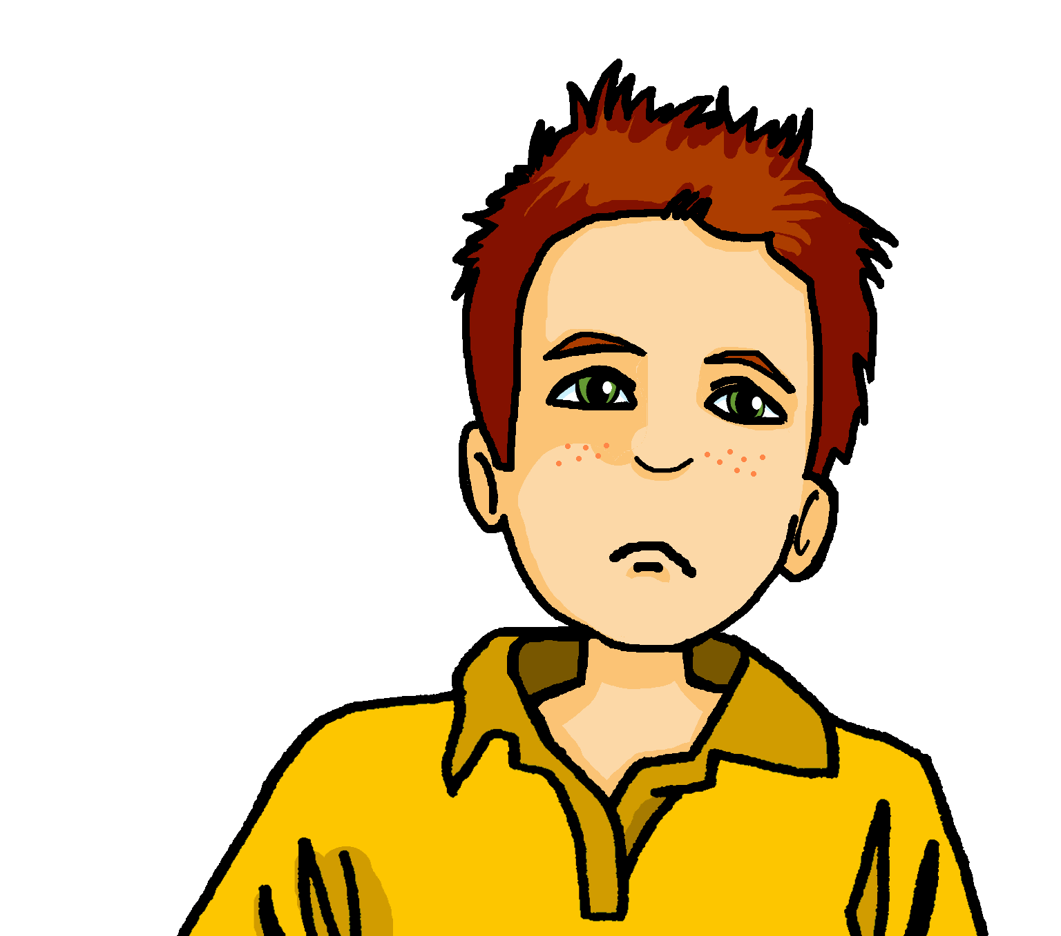

schreiben
Schreib das richtig.
Moritz’s computer screen isn’t working. All his sentences have lost their punctuation. Can you help put them right?
1
der
1. Der Bus ist rot.
bus
ist
rot
2. Das ist in England.
2
das
ist
in
england
3. Johanna ist in Berlin.
3
johanna
ist
in
berlin
4
die
flasche
ist
blau
4. Die Flasche ist blau.
5
die
banane
ist
gelb
5. Die Banane ist gelb.
6
ich
bin
in
deutschland
6. Ich bin in Deutschland.
Notes:
Timing: 6 minutes
Aim: To practise applying the rules about capitalisation to simple German sentences.
Procedure:
1. Ensure that pupils are clear about the scenario and the task.
2. Do the first item to model the activity with pupils.
3. Pupils write each sentence.
4. Click to bring up the written answers.
Frequency of unknown words and cognates:
Bus [1562] Banane [>5009]
Jones, R.L & Tschirner, E. (2019). A frequency dictionary of German: Core vocabulary for learners. London: Routledge.
20

Slide 21
Tschüss!
rot
Notes:
21

